Slide 1

Spherical Inward Propagation Flame
of Type Ia Supernova
Xingyu Su
Department of Energy and Power Engineering, Tsinghua University
suxy15tsinghua@gmail.com
2019.01.17

Slide 2
Contents
Type Ia Supernova
Curvature effect
Equations and Dimensionless
Case study

Slide 3
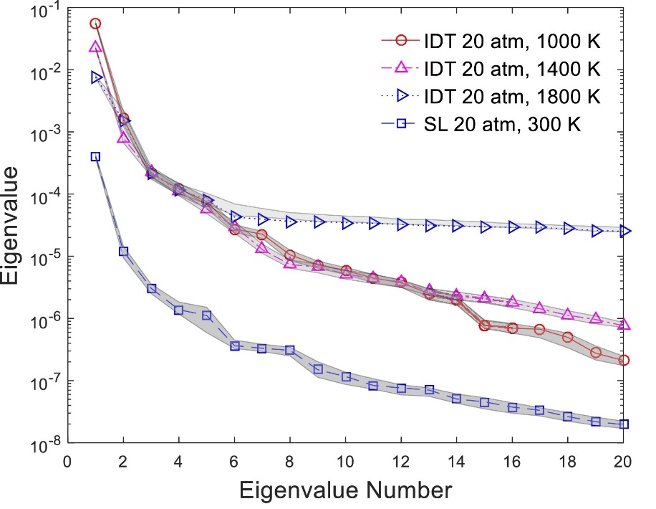
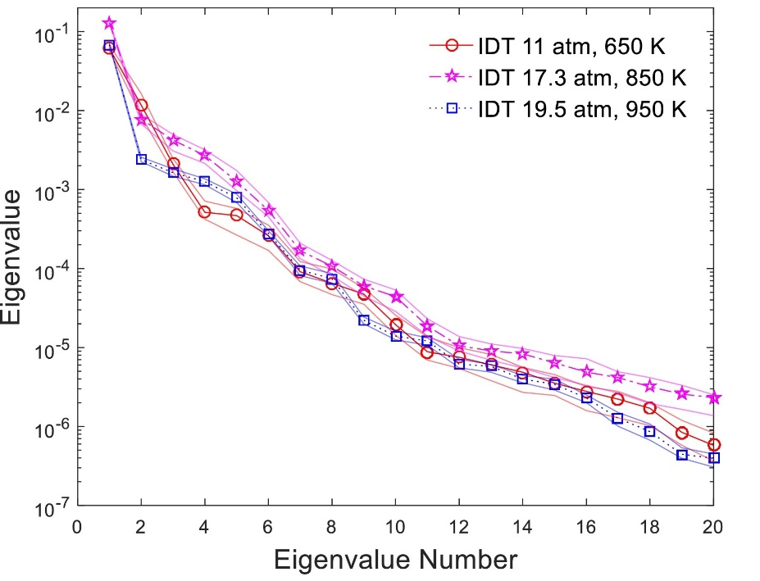
Applications of Active Subspaces (I)
Ignition delay time and laminar flame speed
One-dimensional active subspace for most of cases
Hydrogen (33-dim.) /Methane (217-dim.) /DME (169-dim.)
Pressure 1-20 atm, Temperature 600–1800 K, Equivalence ratio 0.5-1
CH₄
DME
W. Ji et al. 2018
W. Ji, J. Wang, O. Zahm, Y.M. Marzouk, B. Yang, Z. Ren, C.K. Law, Combust. Flame, 190 (2018) 146-157.
Notes:
Describe the uncertainty source

Slide 13
Thanks

