Slide 1



Self-adaptive Update Lower Bound in
Evolutionary Algorithms
11812714 张柯远
2021/03/12

Slide 2
Outline
Introduction
Algorithm Design
Experimental Results

Slide 3
Introduction
The self-adaptive parameter η is applied to CEP, FEP, IFEP[1] in terms of controlling the mutation steps.
The loss of step size control happens inevitably in normal lognormal self-adaptation in EP[2].
Fixed lower bound can be a possible solution. However, it is highly problem dependent.

Slide 4
Introduction
In [2], an algorithm (IFEP_DLB2) based on IFEP[2], which changes the lower bound of η in every α¹ generations, is proposed.
when I tried to reproduce this algorithm, α is still problem dependent. If α is too large, the loss of step size happens; If α is too small, step size explodes.
The main task of my experiment is to find a way to change α dynamically.
1. In the paper, α = 5.

Slide 5
Outline
Introduction
Algorithm Design
Experimental Results

Slide 6

Algorithm Design
δ(i) = median{avg[δ(i, j)], j = 1, 2, … , n} [2, eq.5]
avg[δ(i, j)] = $\frac{1}{m}\sum_{1}^{m}{\text{δ}\text{v}\text{(}\text{i}\text{, }\text{j}\text{),}}$ j = 1, 2, …, n [2]
η_bound(i+1) = 0.875*η_bound(i) + 0.125*δ(i)
i is the i-th generation, n is dimension of solution and m is the number of the accepted offspring.
After α_{t} generations since last update:
α_{t+1} = $\left\{\begin{aligned}\text{α}\text{t}+10, when \text{δ}\text{(}\text{i}\text{) }>\text{η}\text{_}\text{bound}\text{(}\text{i}\text{+1)} \\ \frac{\text{α}\text{t}}{2}, when \text{δ}\text{(}\text{i}\text{) }≤\text{η}\text{_}\text{bound}\text{(}\text{i}\text{+1)}\end{aligned}\right.$

Slide 7
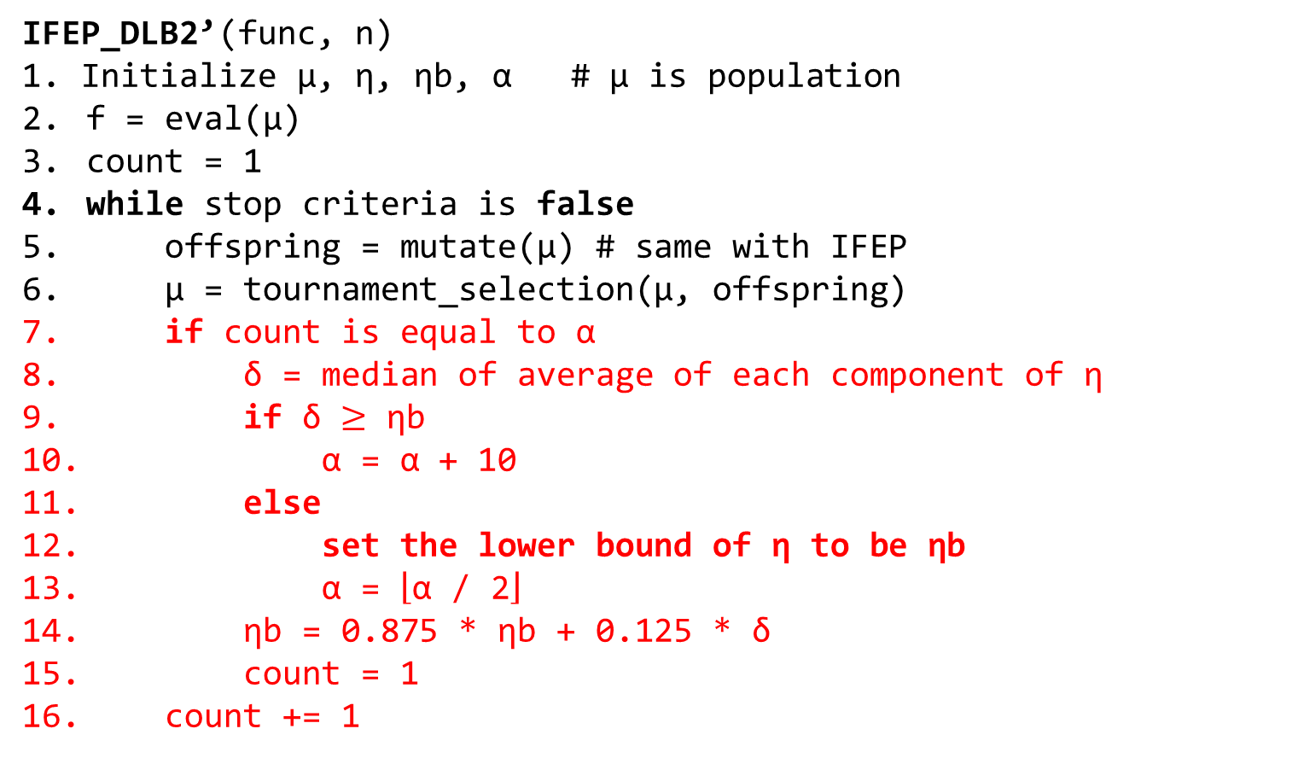
Pseudo-code
IFEP_DLB2’(func, n)
1. Initialize μ, η, ηb, α # μ is population
f = eval(μ)
count = 1
while stop criteria is false
offspring = mutate(μ) # same with IFEP
μ = tournament_selection(μ, offspring)
if count is equal to α
δ = median of average of each component of η
if δ $≥$ ηb
α = α + 10
else
set the lower bound of η to be ηb
α = $\left\lfloor \text{α}\text{ / 2}\right\rfloor$
ηb = 0.875 * ηb + 0.125 * δ
count = 1
count += 1
adapted from [1]
change α dynamically

Slide 8
Outline
Introduction
Algorithm Design
Experimental Results

Slide 9
Experimental Setup
FEP_FLB:
# of population = 100
fixed lower bound = 0.0001
initial value of η = 3
tournament size q = 10
FEP_DLB2’:
# of population = 10
fixed lower bound = None initial value of η = 3
tournament size q = 10
minimum α = 5
initial value of ηb = 6

Slide 10
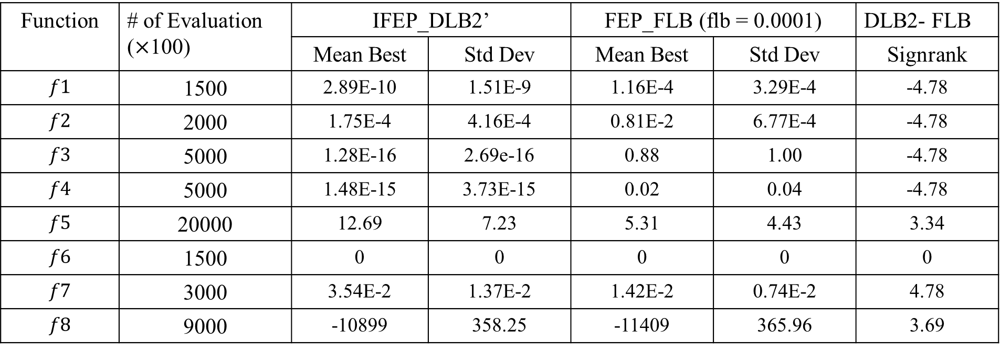
Experimental Results
Table1: Comparing IFEP_DLB2’ with FEP_FLB on $f1−f11, f13$
Function | # of Evaluation ($×$100) | IFEP_DLB2’ |  | FEP_FLB (flb = 0.0001) |  | DLB2- FLB
 |  | Mean Best | Std Dev | Mean Best | Std Dev | Signrank
$$f1$$ | 1500 | 2.89E-10 | 1.51E-9 | 1.16E-4 | 3.29E-4 | -4.78
$$f2$$ | 2000 | 1.75E-4 | 4.16E-4 | 0.81E-2 | 6.77E-4 | -4.78
$$f3$$ | 5000 | 1.28E-16 | 2.69e-16 | 0.88 | 1.00 | -4.78
$$f4$$ | 5000 | 1.48E-15 | 3.73E-15 | 0.02 | 0.04 | -4.78
$$f5$$ | 20000 | 12.69 | 7.23 | 5.31 | 4.43 | 3.34
$$f6$$ | 1500 | 0 | 0 | 0 | 0 | 0
$$f7$$ | 3000 | 3.54E-2 | 1.37E-2 | 1.42E-2 | 0.74E-2 | 4.78
$$f8$$ | 9000 | -10899 | 358.25 | -11409 | 365.96 | 3.69

Slide 11
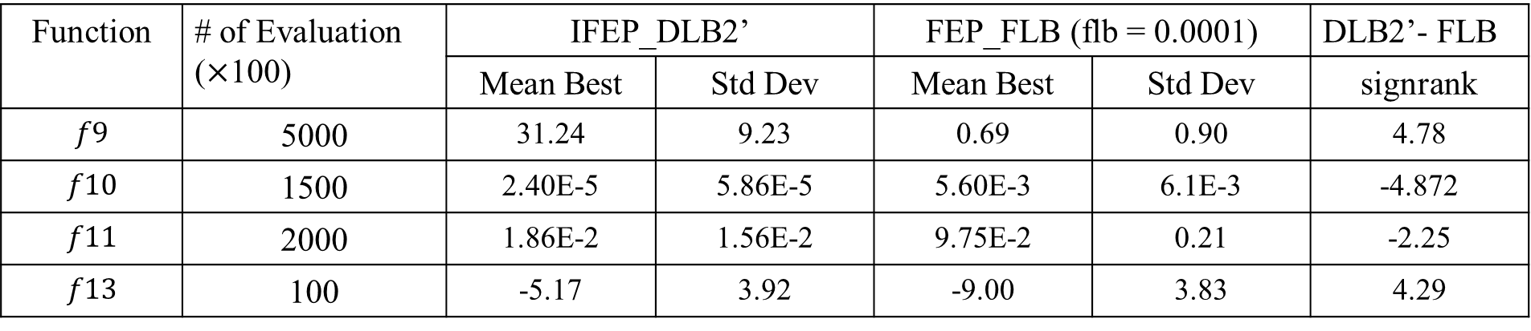
Experimental Results
Function | # of Evaluation ($×$100) | IFEP_DLB2’ |  | FEP_FLB (flb = 0.0001) |  | DLB2’- FLB
 |  | Mean Best | Std Dev | Mean Best | Std Dev | signrank
$$f9$$ | 5000 | 31.24 | 9.23 | 0.69 | 0.90 | 4.78
$$f10$$ | 1500 | 2.40E-5 | 5.86E-5 | 5.60E-3 | 6.1E-3 | -4.872
$$f11$$ | 2000 | 1.86E-2 | 1.56E-2 | 9.75E-2 | 0.21 | -2.25
$$f13$$ | 100 | -5.17 | 3.92 | -9.00 | 3.83 | 4.29
The results are over 30 runs. “Mean Best” indicates the average final best function value and “Std Dev” means the standard deviation. “Signrank” stands for the zval in the Wilcoxon Signed Rank Test.

Slide 12
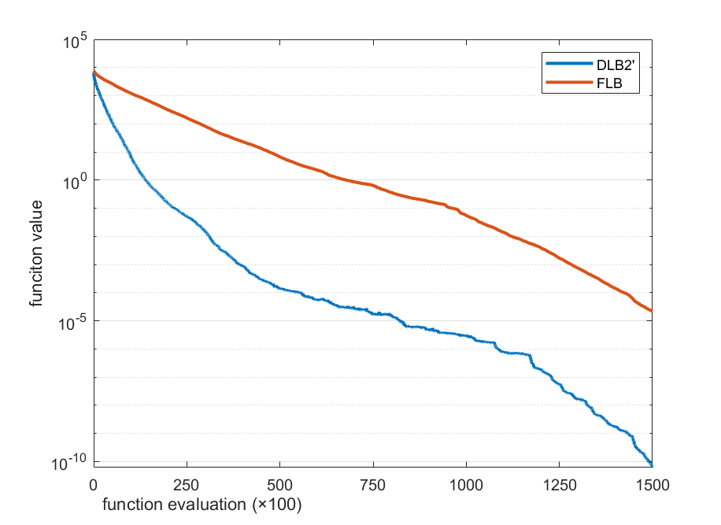
ANALYSIS
Figure 1: Comparison IEFP_DLB2’ with EFP_FLB in $f1$

Slide 13
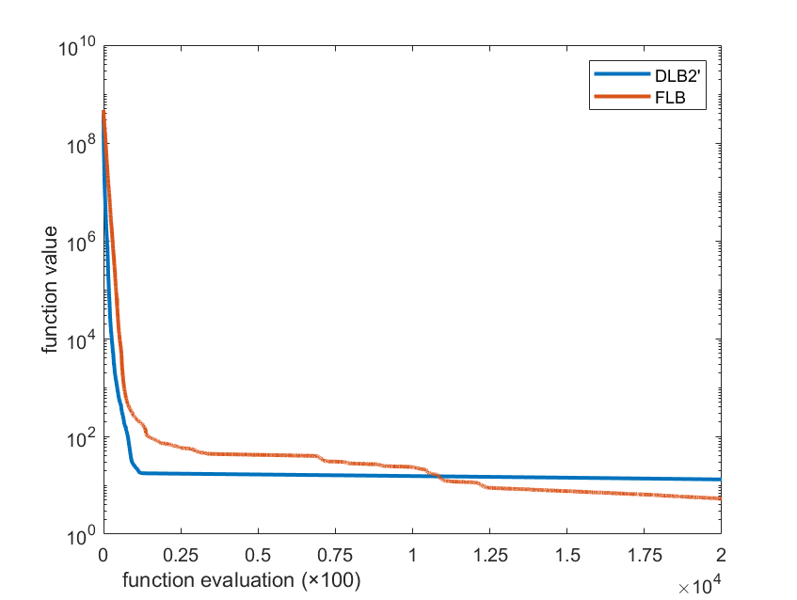
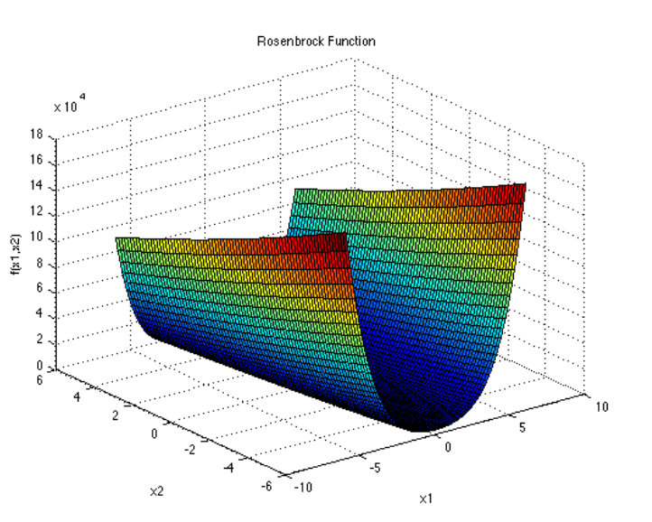
ANALYSIS
Figure 3: screenshot from http://www.sfu.ca/~ssurjano/rosen.html
Figure 2: Comparison IEFP_DLB2’ with EFP_FLB in $f5$

Slide 14
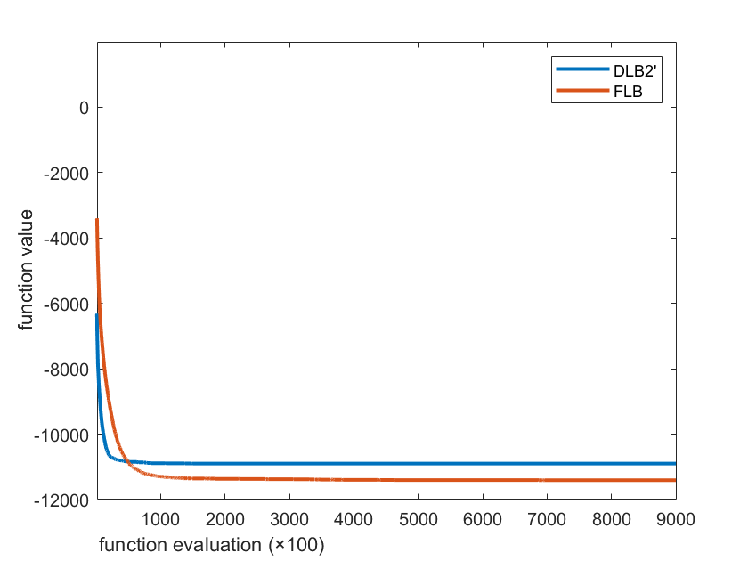
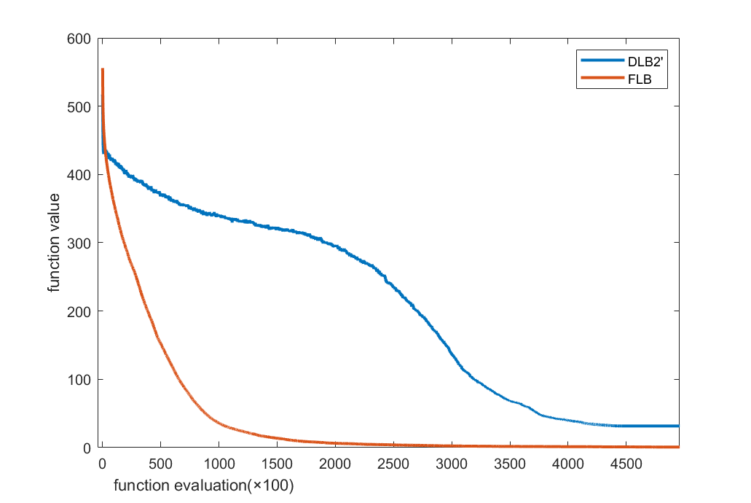
ANALYSIS
Figure 4: Comparison IEFP_DLB2’ with EFP_FLB in $f8$
Figure 5: Comparison IEFP_DLB2’ with EFP_FLB in $f$9

Slide 15
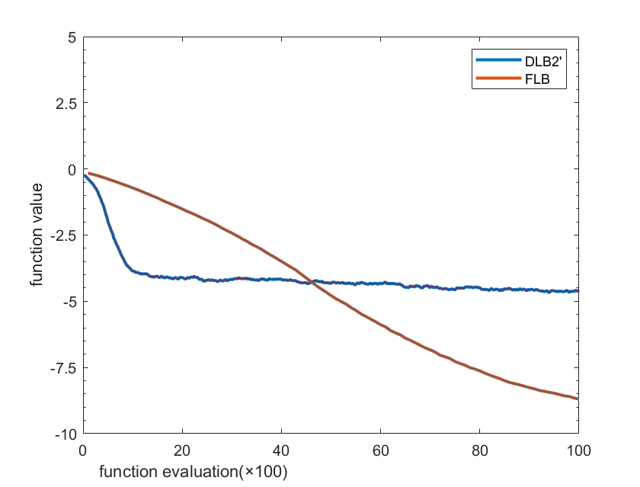
ANALYSIS
haven’t converged
Figure 6: Comparison IEFP_DLB2’ with EFP_FLB in $f$13

Slide 16
Conclusion
Advantage of IEFP_DLB2’:
Change the time to set η bound dynamically.
Disadvantages of IEFP_DLB2’:
Some components of η may be negatively influenced by other component.
The pace of mutation step is not stable: too fast, stagnate in local optimum; too slow, cost a long time to converge.

Slide 17
References
1. X. Yao, Y. Liu and G. Lin, “Evolutionary programming made faster,” IEEE Transactions on Evolutionary Computation, 3(2):82-102, July 1999.
2. K. H. Liang, X. Yao and C. S. Newton, “Adapting self-adaptive parameters in evolutionary algorithms,” Applied Intelligence, 15(3):171-180, November/December 2001.

Slide 18
THANK YOU
Q & A

