Slide 1





Gallery D.C.: Design Search and Knowledge Discovery through Auto-created GUI Component Gallery
Chunyang Chen, Sidong Feng, Zhenchang Xing, Linda Liu, Shengdong Zhao, Jinshui Wang
Notes:
Hello everyone, I am Sidong from ANU.
Today I will present my work on Gallery D.C, design search and knowledge discovery through auto-created GUI component gallery.
CHEN:are you sure that you can finish 18 slides in 15 mins (or <15min)?

Slide 2
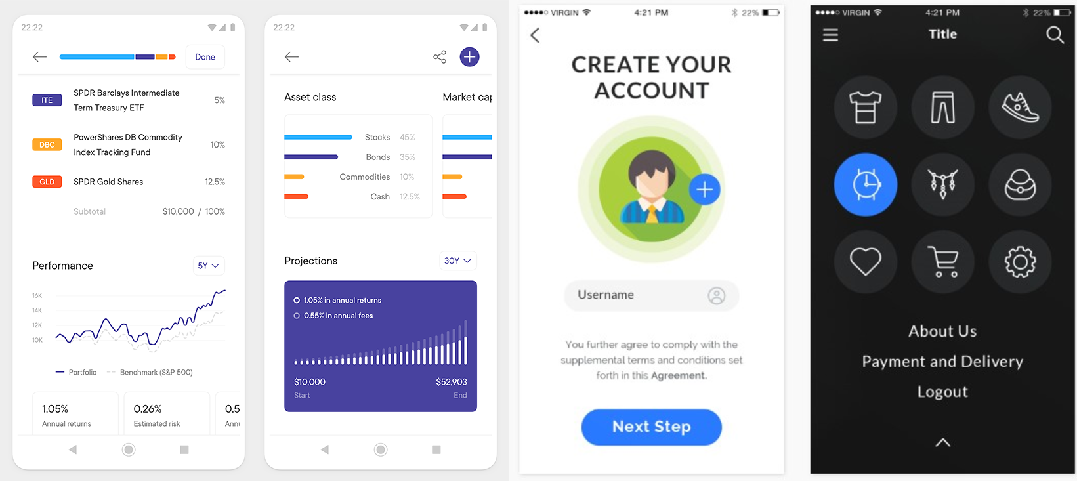
What is Design Sharing?
Design sharing is a routine activity through which design knowledge and creativity is exchanged among designers.
Notes:
Design sharing is a routine activity through which design knowledge, creativity and aesthetics is exchanged among designers. Through design sharing, the designers can gain feedback from the community and boost their portfolio.
Meanwhile, the repository of the shared designs provides an opportunity to learn about GUI designs, gain design inspiration and understand design trends.

Slide 3
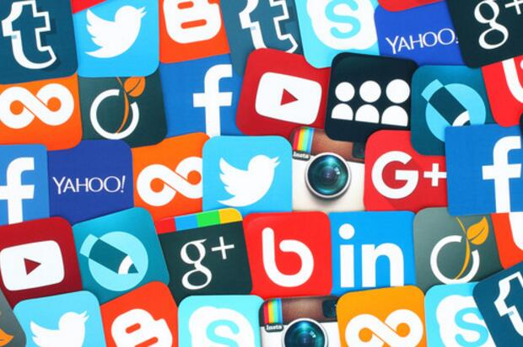
What is Invisible Crowdsourcing?
Invisible crowdsourcing is one of the emerging Web 2.0 based phenomena and enables a broader collaboration indirectly with thousands of designers who craft the design of the world-wide popular mobile apps.
Notes:
Invisible crowdsourcing is one of the emerging Web 2.0 based phenomena and enables a boarder collaboration indirectly with thousands of designers who craft the design of the world-wide popular mobile apps. Existing design sharing platforms have three fundamental limitations.
Chen: Can you please add some app icons and screenshots below to show the examples.

Slide 4
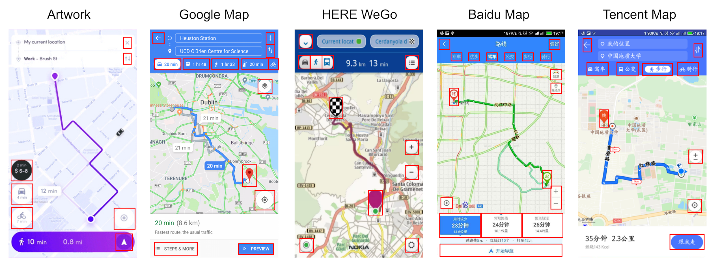
Motivation: Design Practicality
Designers need to see the practical use of certain GUI designs in real applications, rather than just artworks.
Notes:
First, existing design sharing platforms showcase creative design artworks, but GUI designers also need to see the practical use of certain design ideas in real applications.
GUI design artwork and real application GUIs may have substantial differences.
Here we show an example of map application GUIs. We can see that the map-GUI artwork does include the core GUI components of a map application, but it is much simpler than the GUIs of real world map applications. On the contrary, the complexity of the four real-world map applications GUIs is roughly the same. This suggests that the information needs of map users in the real world go beyond those core needs supported in a simple design artwork. It is fine to ignore these additional information needs in the design work. However, if the real-world applications leave these needs unattended, they risk losing valuable users to their competitors.
CHEN: Mention that the current design sharing is not enough due to: 1)artswork is far from the real application 2)never components based

Slide 5
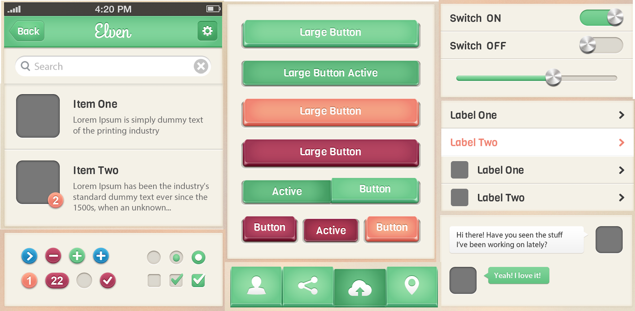
Motivation: Design Granularity
Designers want to see not only the overall designs but also the detailed design of the GUI components.
Notes:
Second, existing design sharing platforms tend to support the sharing of the overall design of the GUI only.
Although there are some GUI component design kits, however, these component design kits do not provide the GUI context in which certain components can be practically composed.
In the design work, designers need to drill down specific GUI components and at the same time still need to see the composition of GUI components as a whole.

Slide 6
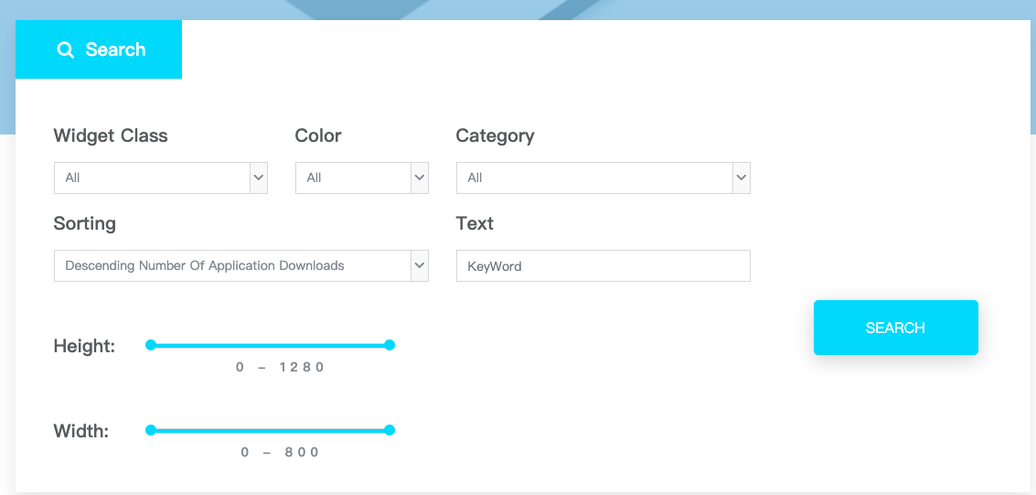
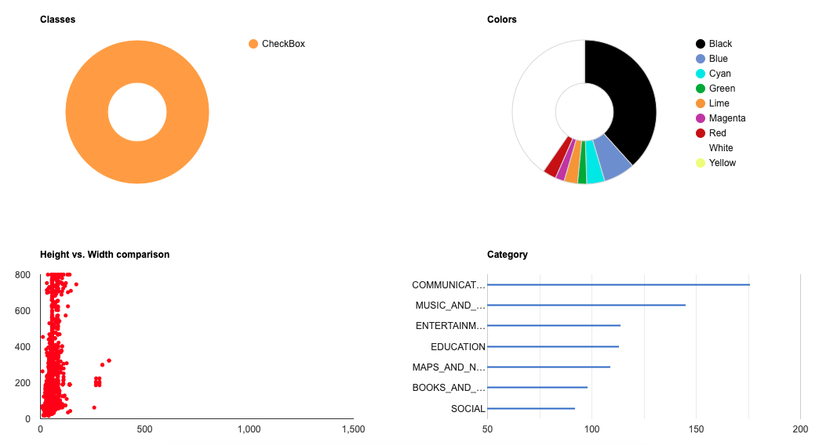
Motivation: Design Knowledge Discovery
Designers need advanced GUI design search abilities and knowledge discovery support.
Gallery D.C.: http://mui-collection.herokuapp.com/
Notes:
Third, existing design sharing platforms support only tagging-based search for the GUI designs.
However, designers also need advanced search abilities, for example, multi-faceted design search such as by component types, application categories, color, size, displayed text and etc.
And also designers need summarization of design demographics such as color and size distribution. In addition design comparison across competitors is required to facilitate their designs system.
We have built an interesting website for our gallery system.
CHEN: Add the URL to our site, and when presenting, please stay in this slides for 20 seconds and encourage audience to try our site.

Slide 7
TALK OUTLINE
Problem Definition
Data Collection
Component Wirification
Gallery D.C.
Informal Feedbacks from Designers
‹#›
Notes:
To address the information needs of designers beyond simple content sharing and search, we design innovative ways to collect, analyze, search, summarize and compare GUI designs of real-world applications on a truly massive scale.
We introduce our problem definition and give an overview of main steps of our approach. Then, we annotate some mechanism in our website. And finally, we talk about the feedbacks from 7 professional designers.

Slide 8
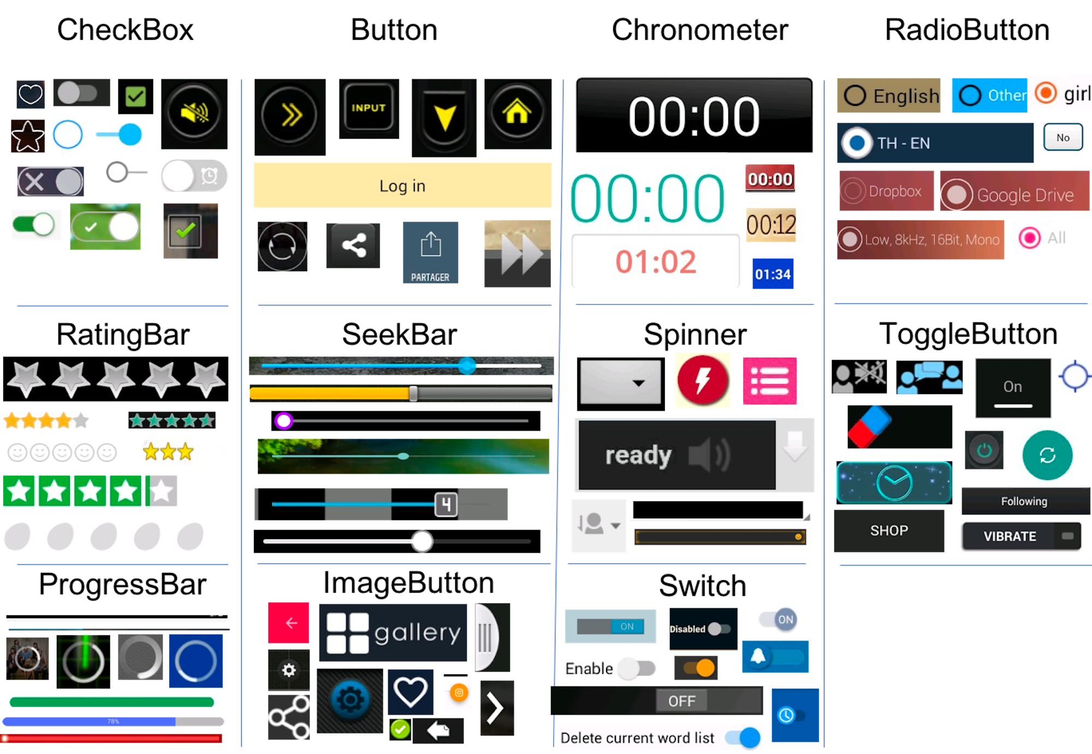
01
Problem Definition
A large-scale gallery of 11 types of GUI components for Android GUI design
Notes:
A mobile platform, such as Android or iOS, supports a wide range of GUI components for building the GUI of mobile apps. In this work, we explain and evaluate our approach using Android apps, but our approach is not limited to just Android apps. Our goal is to build a large-scale gallery of 11 types of GUI components for Android GUI design to assist designers in component leveI.
These 11 types of UI components can be divided into two general categories for easy reference: button (including button, image button, check box, radio button, switch, and toggle button), and information bar (progress bar, rating bar, seek bar, spinner, and chronometer).
Being able to easily access the design of a type of GUI components from thousands of Android apps would help designers and developers understand the landscape and practicality of GUI designs for their own design tasks.
Time limitation talk:
Note that we do not consider content-centric UI components such as text view and image view, because these component is highly content dependent without much consideration of component design itself.

Slide 9
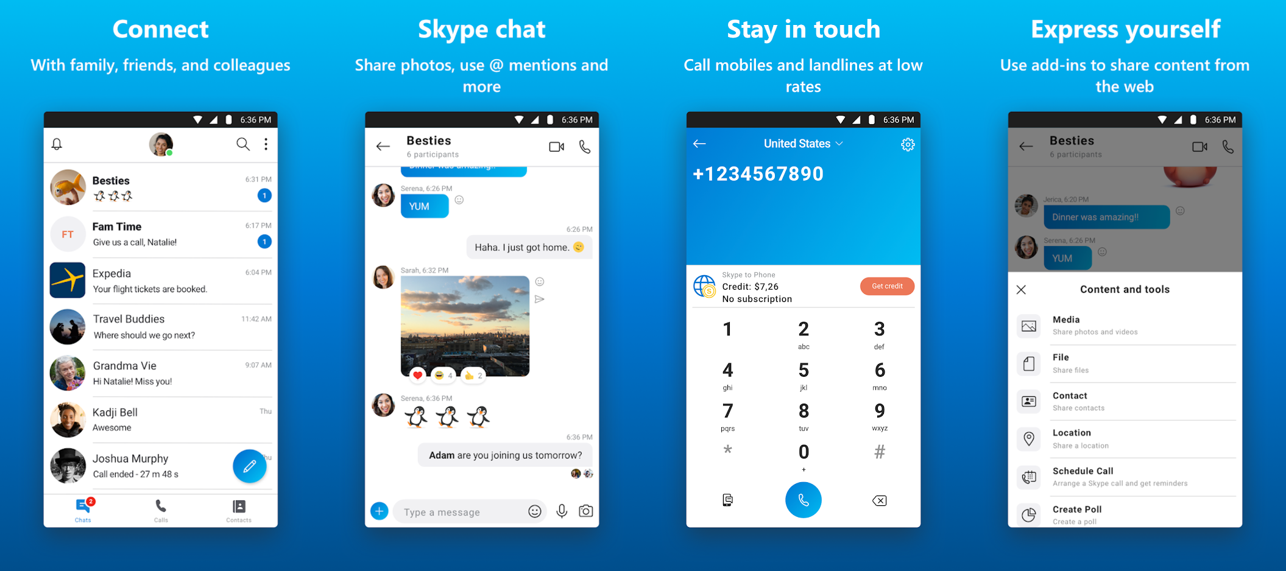
01
Problem Definition
Application introduction screenshots in market usually illustrates the most important features and the best-designed GUIs of an application
Notes:
CHEN: As we already have some introduction images in next slide, do we still need this one?
However, collecting and inspecting real-application GUIs in an ad-hoc fashion cannot effectively exploit this gold mine of GUI design resources.
We found that the application introduction screenshot in market usually illustrates the most important features and the best-designed GUIs of an application which enables us to efficiently boost our gallery database.
However, the hierarchy in introduction screenshot is unable to collect, so that it motivates us to train a deep-learning object detection model to automatically wirify (i.e., decompose) the screenshot into a set of GUI components.

Slide 10
02
Data Collection
 | Method | Data Size
Real-app screenshots | Automated GUI Exploration | 68,702
App Introduction screenshots | Crawling | 469,177
Notes:
We collect two kinds of app GUI screenshots for the whole work. To collect the first dataset, real application screenshots, we develop an automated UI exploration method to automatically execute an app, explore the app’s GUIs, take the runtime GUI screenshot and also dump the UI components and their metadata in the screenshot, which is time consuming.
The second dataset contains 469,177 app introduction GUI screenshots crawled from Google Play. Despite app introduction screenshots achieve high quality design, but also crawling can be easily done to obtain efficiency compare to the first dataset collection.
CHEN: Also add a screenshot of introduction page of one app.

Slide 11
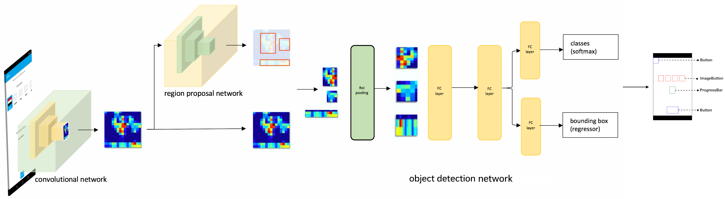
03
Component Wirification
We use the real-app screenshots to train a component detection model using Faster RCNN.
The trained model is then used to wirifiy (i.e., decompose) components from the app introduction screenshots.
Notes:
We use the first dataset, the real-app screenshots to train the GUI component detection model using Faster RCNN.
The trained model is then used to wirify (i.e., decompose) the app introduction screenshots in the second dataset into the GUI components (with component metadata) in these screenshots.
CHEN: The image is too blurred to see clearly.

Slide 12
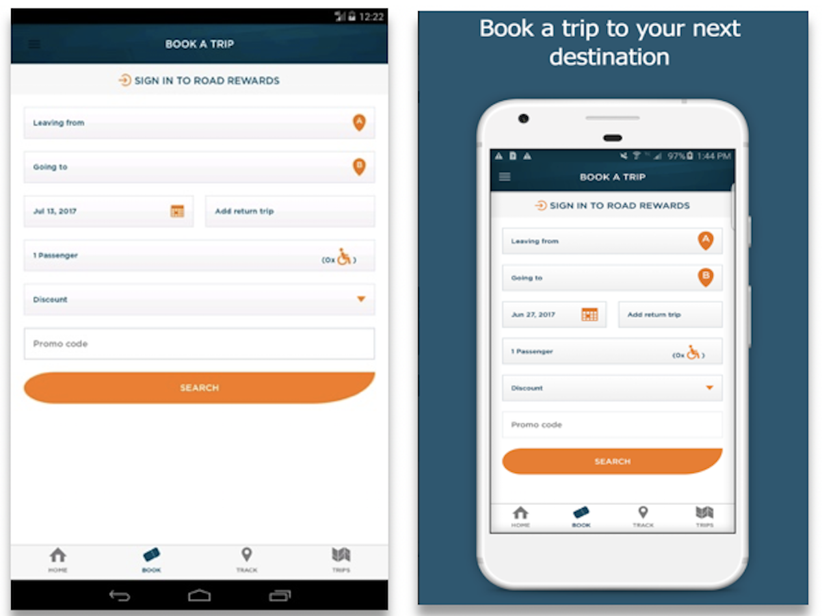
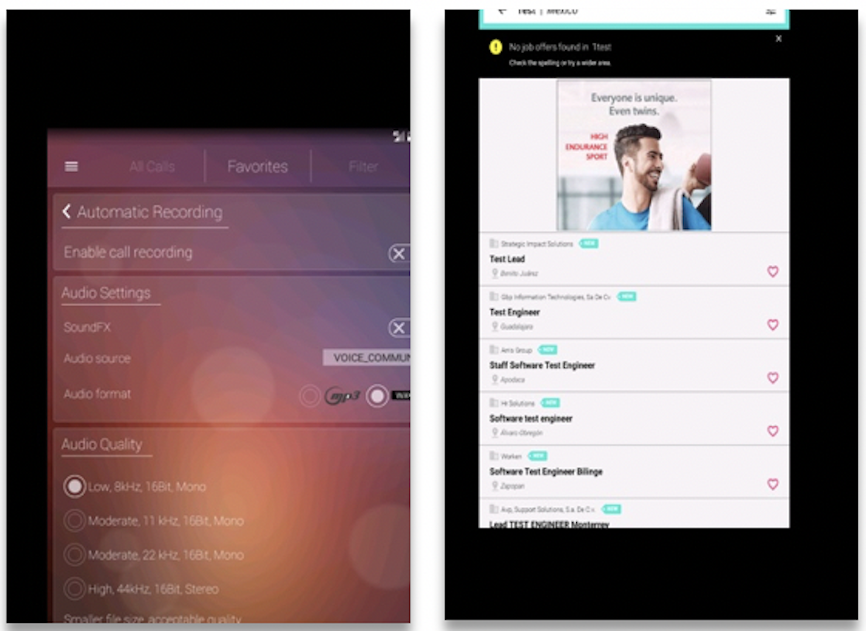
03
Component Wirification
We develop a GUI-specific image augmentation method to transform the real application screenshots into similar style of introduction screenshots.
Problem
Solution
Notes:
Introduction screenshots are different from the real-app screenshot. The introduction screenshots are more like posters which contain not only the app GUI screenshots, but also much other information.
Such image differences between the training data and the testing data may lead to poor performance of the trained model.
To bridge the gap between the GUI screenshots from the two resources, we apply the image augmentation method to transform the training screenshots to simulate testing data such as randomly resizing the app runtime GUI screenshots, and randomly moving it into four directions (e.g., left, right, up, down) around the center of the image.

Slide 13
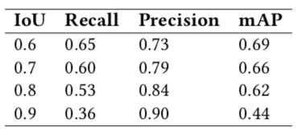
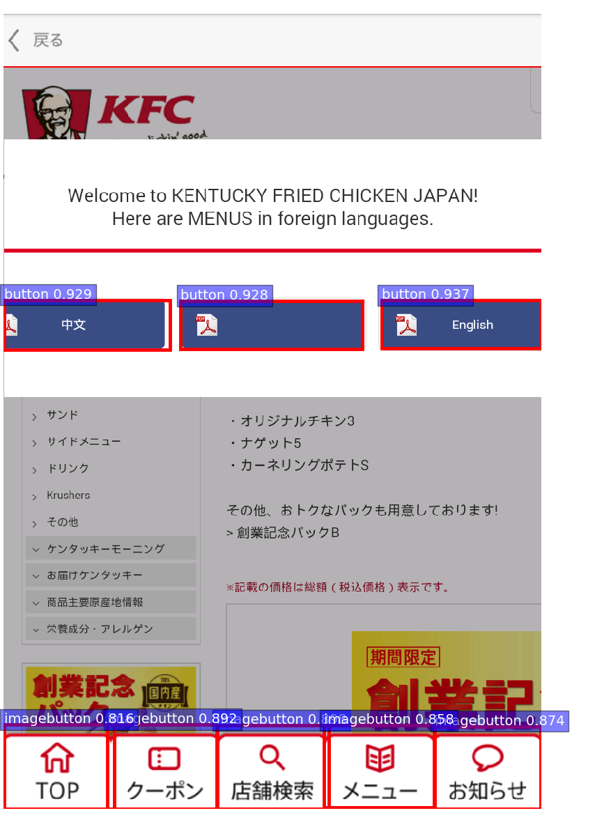
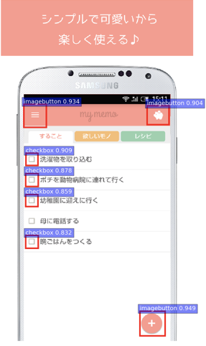
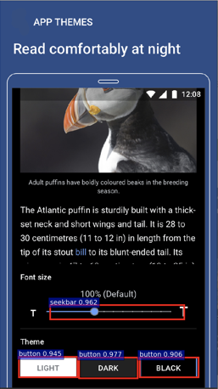
03
Component Wirification
Performance of model:
Recall: 0.62, Precision: 0.76, mAP: 0.51
Notes:
The three principal metrics used for evaluating and comparing the performance are precision, recall and mean Average Precision.
The overall performance of our model is 0.76 for precision, 0.62 for recall and 0.51 for mAP. The images below show some examples of our GUI component wirification.
First image demonstrate that our model performs well on the training dataset, which is the real-app screenshots. Next two images emphasizes our model trained with image augmentation can reliably detects the majority of the GUI components within the app introduction screenshots.

Slide 14
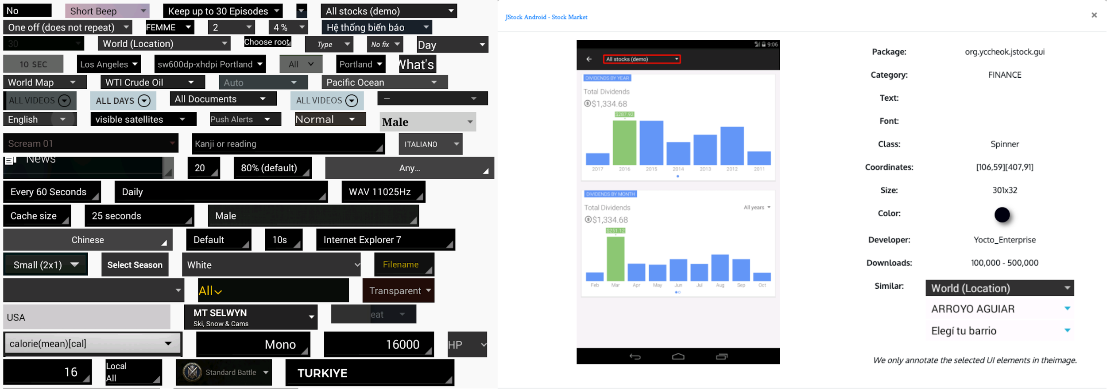
03
Gallery D.C. (http://mui-collection.herokuapp.com/)
Give designers direct access to GUI components and at the same time allow them to view actual use of the components in the whole designs.
Notes:
With only the component level information, designers do not see the whole GUI context where the components can be used and composed with other components. To satisfy designers’ information needs holistically, we need to automatically detect GUI components in the whole GUI designs so that the two levels of design information can be conveniently connected.
We devised to give designers direct access to GUI components and at the same time allow them to view actual use of the components in the whole designs.
CHEN: for the example on the right-hand side, audience may not see the GUI screenshot very clearly.

Slide 15
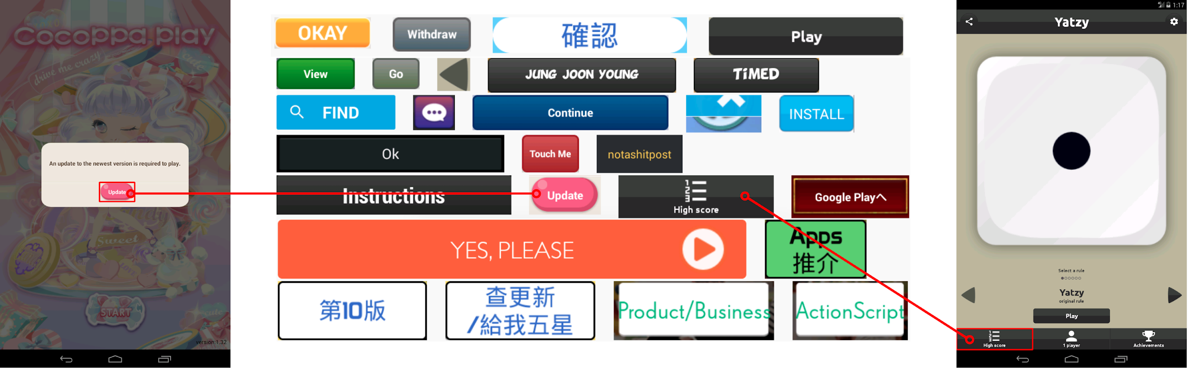
04
Informal Feedbacks from Designers
Inspirational Search
Game application scenario
Pink reflective bubble attract young girls
ranking-list icon ranking mechanism
Notes:
CHEN: YOU may consider the animation to tell this story, i.e., adding the content piece by piece.
To understand how the Gallery D.C. would be useful in a real design context, we conducted informal interviews with 7 professional designers. Overall they praised our gallery and they have emphasized three important features in their real design context
One interaction designer from Google described a particular use case in which our website can be helpful. In her last job of designing a game app, she needs to decide on style of the buttons that can fit the game she wants to design. She found the component search function particularly useful for looking for inspirations. Using our website, she searched and selected the button component type and set up the app category as game_casual in the filter. Within the different buttons, she found two of them attractive. One button is of pink color with reflective bubble which deemed to attract young girls. Since the target audience of the game app is for young girls, she selected this design and put into her design notebook for reference.
She also find the other button with the ranking-list icon interesting. It is not only straightforward to show the button semantic, but also reminds her to add the ranking mechanism into the game.
After further checking the whole screenshots and even other screenshots within this app, she also understands the position of this button in the current screen, and other functionality which can also be embedded into her own app. She found this process of initially using bottom-up search with components, and then gradually identify and expand the design style and concept by checking the design of apps that contains interesting components a promising alternative strategy she would like to adopt into her design practices.

Slide 16
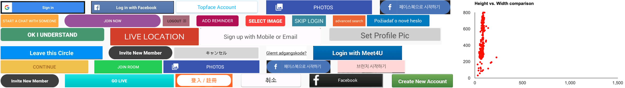
04
Informal Feedbacks from Designers
Design Demographics
Social media application scenario
flat and wide catch attention
Notes:
Another designer from Google provides an example of how to use our website to help the design of a social media app.
In Gallery D.C., she searched the GUI components by social application category. Apart from the buttons, it also showed the color demographics and size distribution. She discovered that most buttons within the social-medial apps are rather flat and wide as compared with other categories.
After recalling her own experience in using social apps and searching the web, she further validated this assumption that the wide and big buttons can easily catch audience’s attention, especially for young users who extensively use that kind of app.
The summarization of design features of GUI components is a powerful approach for him to understand the design trend and practices.

Slide 17
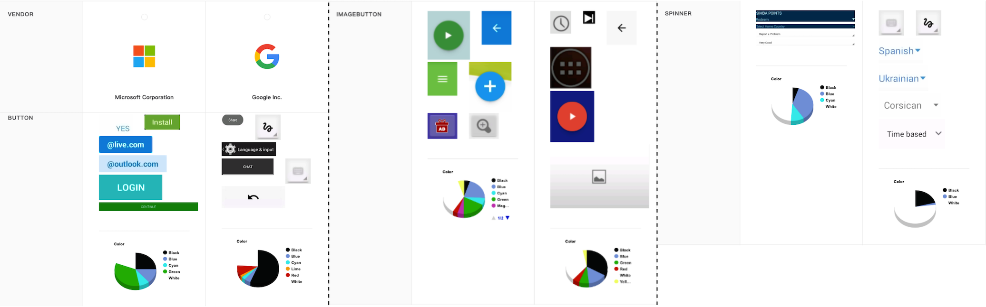
04
Informal Feedbacks from Designers
Comparison Shopping
Distinguished design system scenario
Microsoft right angle rectangle
Google white, black, gray, shadowing effects
Notes:
Another designer was working on creating the UI component design system which is a set of standards for design and code along with components. Such UI component design system enforces visual and interaction consistency of different products within the company for delivering better and familiar user experiences. To get an understanding of the design style of different companies, he adopted the comparison functionality provided in our Gallery D.C.. He selects two big companies (Google and Microsoft) for detailed comparison.
Our tool returns a list of different components from these two companies. By contrasting these components, he clearly discovered that most components in Microsoft are of the right-angle rectangle. Instead, Google prefers to use white, black and gray color, and Google also embed the shadowing effects to their components. With those features displayed, he further thought about how to distinguish his design system from the current ones.

Slide 18
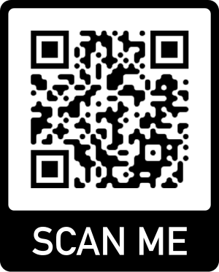
Summary of contributions
Invisible crowdsourcing GUI design resources in the application market
Complement existing design sharing platforms
Design Practicality
Design Granularity
Design Knowledge Discovery
Qualitative study showing the usefulness of Gallery D.C.
http://mui-collection.herokuapp.com/
Video: https://www.youtube.com/watch?v=Co5ydBLH9JA
Paper: https://chunyang-chen.github.io/publication/designGallery_CSCW19.pdf
Chunyang Chen, Sidong Feng, Zhenchang Xing, Linda Liu, Shengdong Zhao, Jinshui Wang. 2019. Gallery D.C.: Design Search and Knowledge Discovery through Auto-created GUI Component Gallery. Proc. ACM Hum.-Comput. Interact. 3, CSCW, Article 180 (November 2019), 22 pages.
75
Notes:
CHEN: It is a good idea to add the scan code, but can you put it on each page (maybe top right?)
We present a deep-learning based approach for harvesting invisible crowdsourcing GUI design resources in the application market. Those invisible design resources are made explicit in our design gallery, they complement existing design sharing platforms by exposing designer to not only design creativity and aesthetics but also design practicality. Furthermore, our design gallery contains both whole GUI designs and GUI components which give designers more flexibility to access design knowledge at different granularities. Last but not least, our design gallery supports multi-faceted design search, design demographics summarization, and design comparison shopping. These design applications can be incorporated into existing design sharing platforms to extend them beyond content sharing and curation.

