Slide 1
RoomStay
UI / UX design — renter, partner, and admin screens
Condo and Apartment Rental Management System

Slide 2
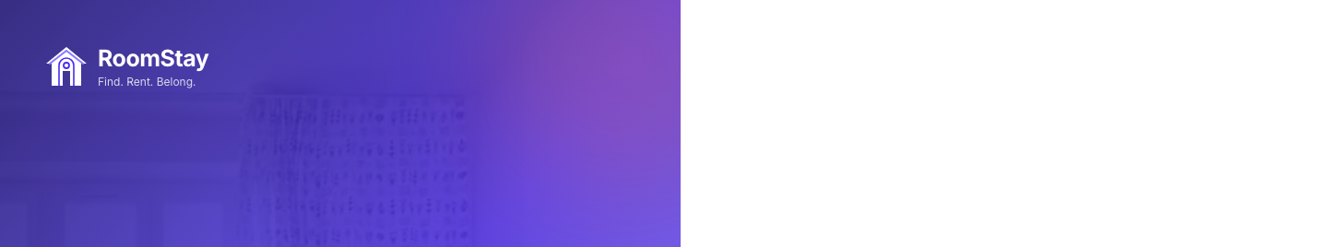
WHO USES IT
Three roles, one login
Every account starts as a renter. Partner access comes from an approved application. Admin reviews everything.
Renter
Partner
Admin
Search rooms, request a booking, pay the deposit at the bank, upload the slip photo.
Publish listings, approve requests, check the slip, confirm the booking, start the rental.
Review partner applications, listings, users, and deposit chats. RoomStay never moves the money.

Slide 3
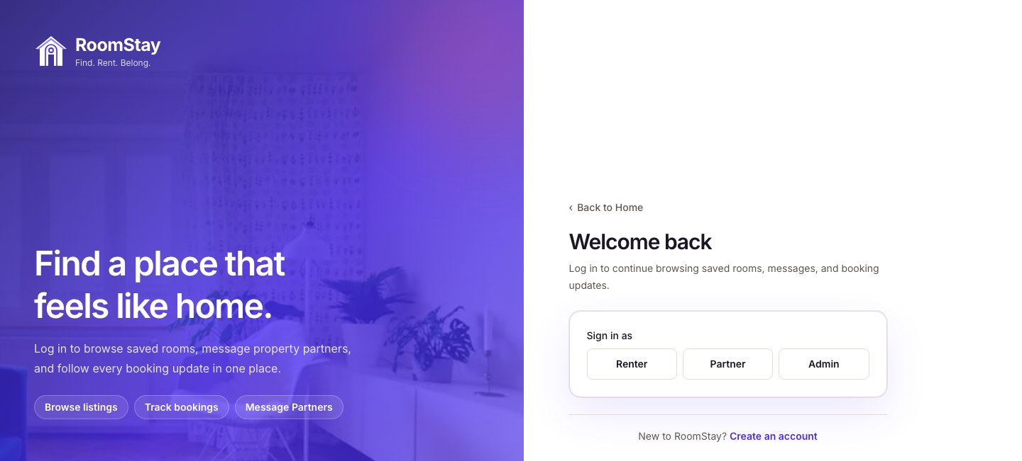
SIGN IN
Role-first login
The person chooses Renter, Partner, or Admin before typing the email and password.

Slide 4
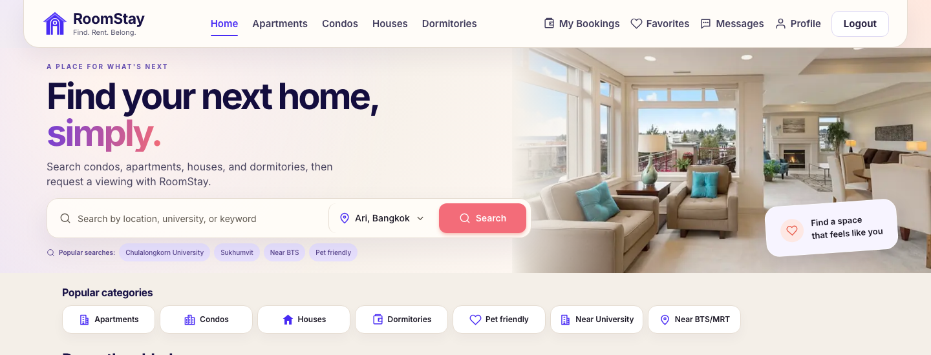
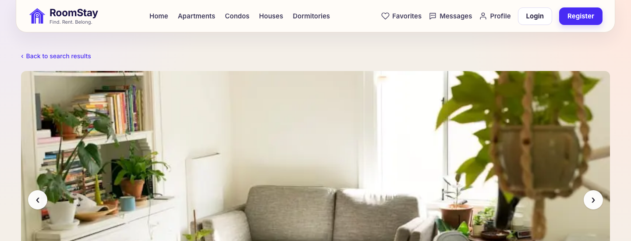
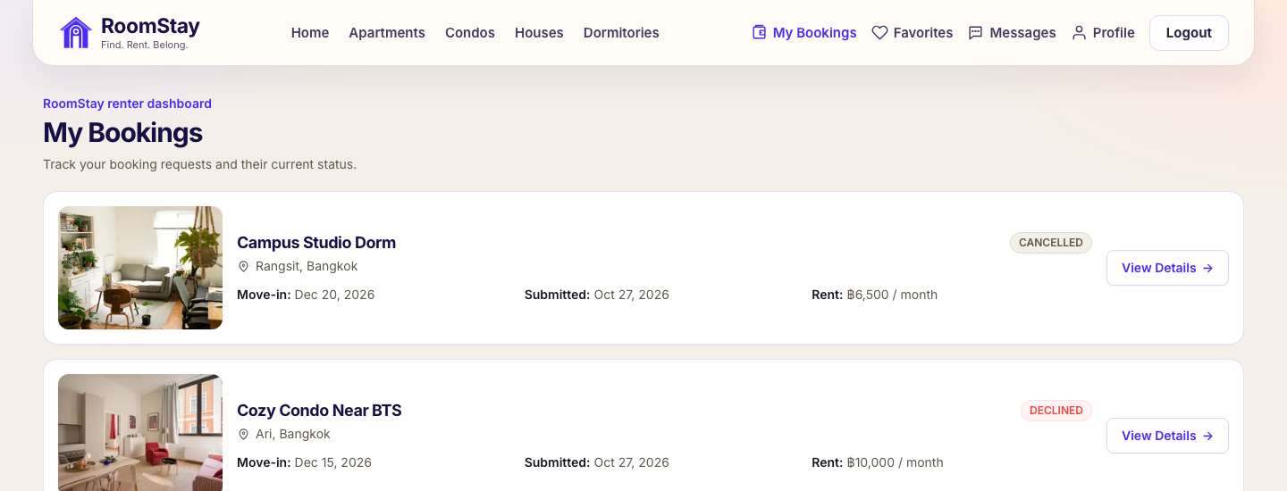
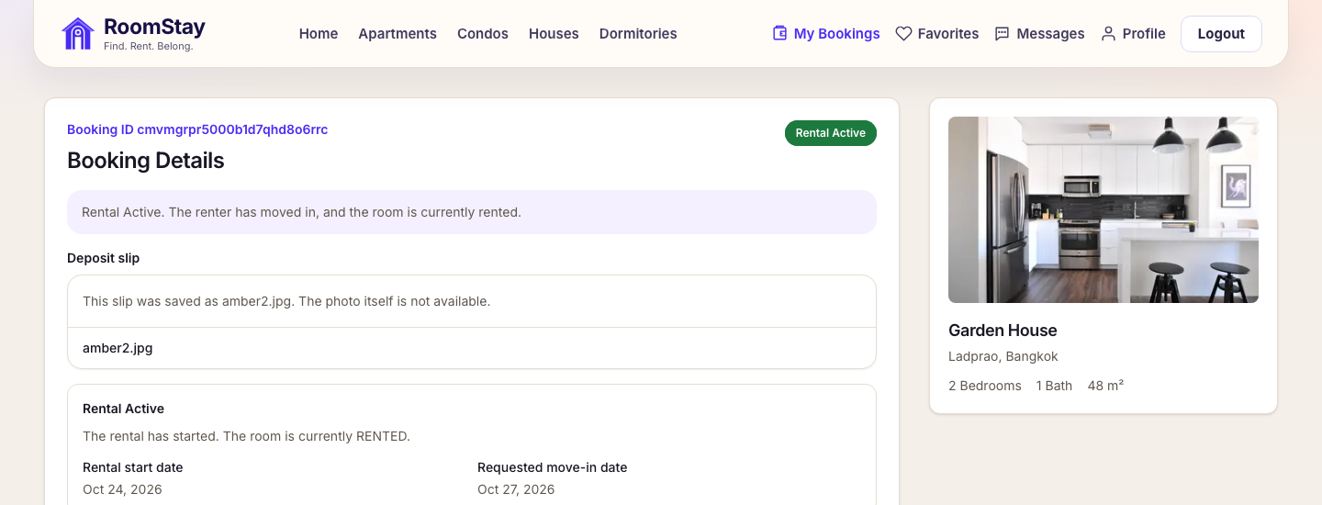
RENTER
Renter screens
Search a room, send a request, then follow the booking and the deposit slip.
Home
Room details
My bookings
Booking and deposit slip

Slide 5
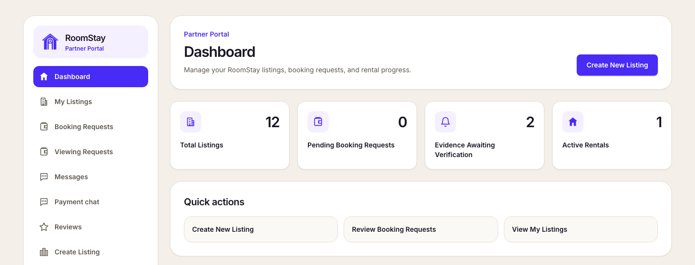
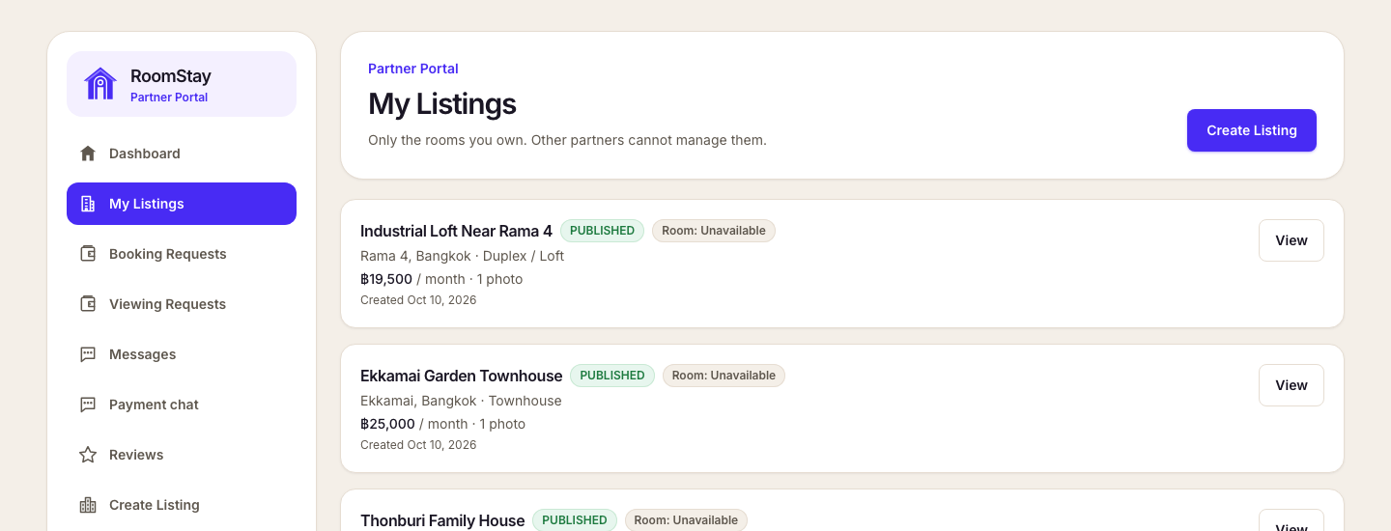
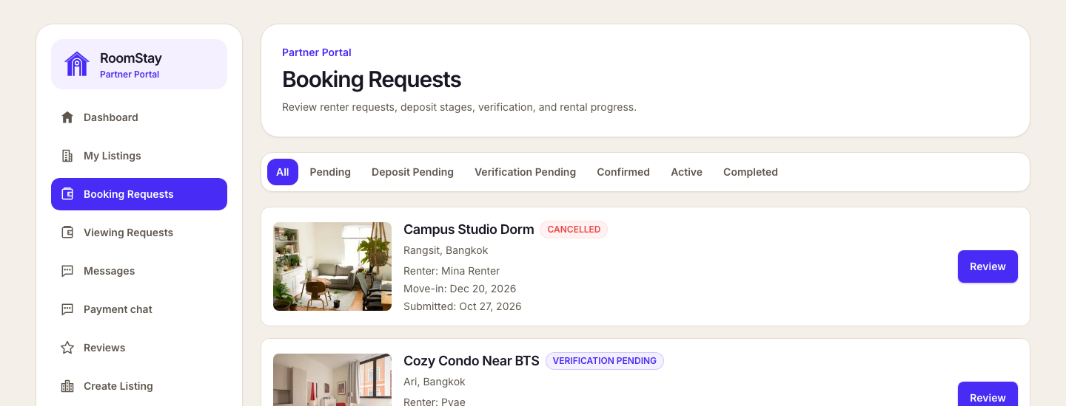
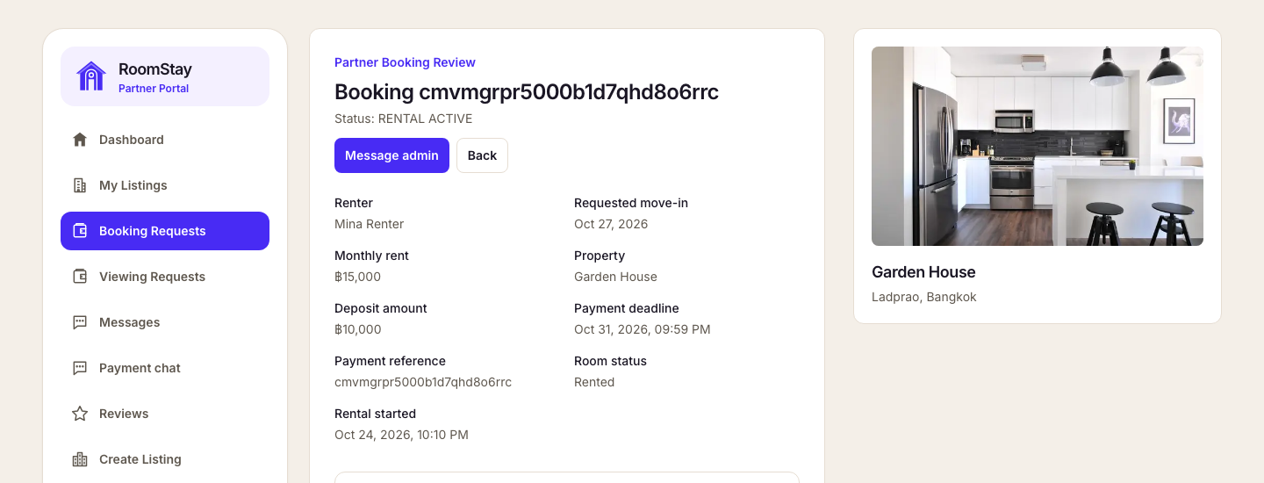
PARTNER
Partner screens
An approved partner manages listings and reviews each booking request.
Dashboard
My listings
Booking requests
Booking review

Slide 6
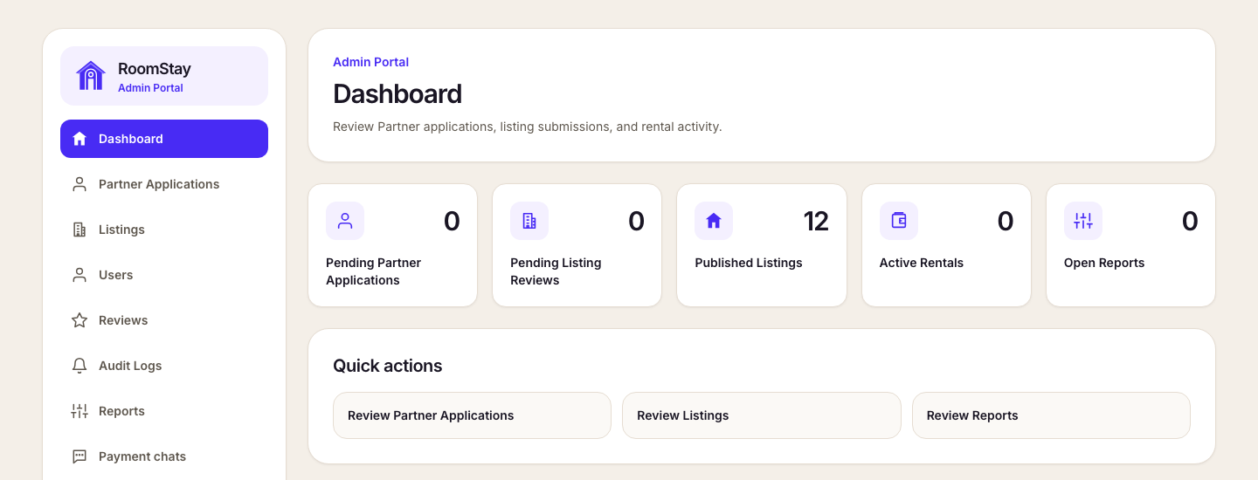
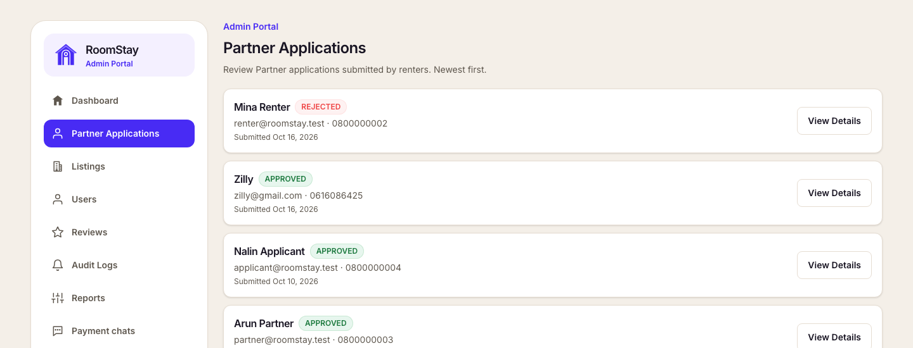
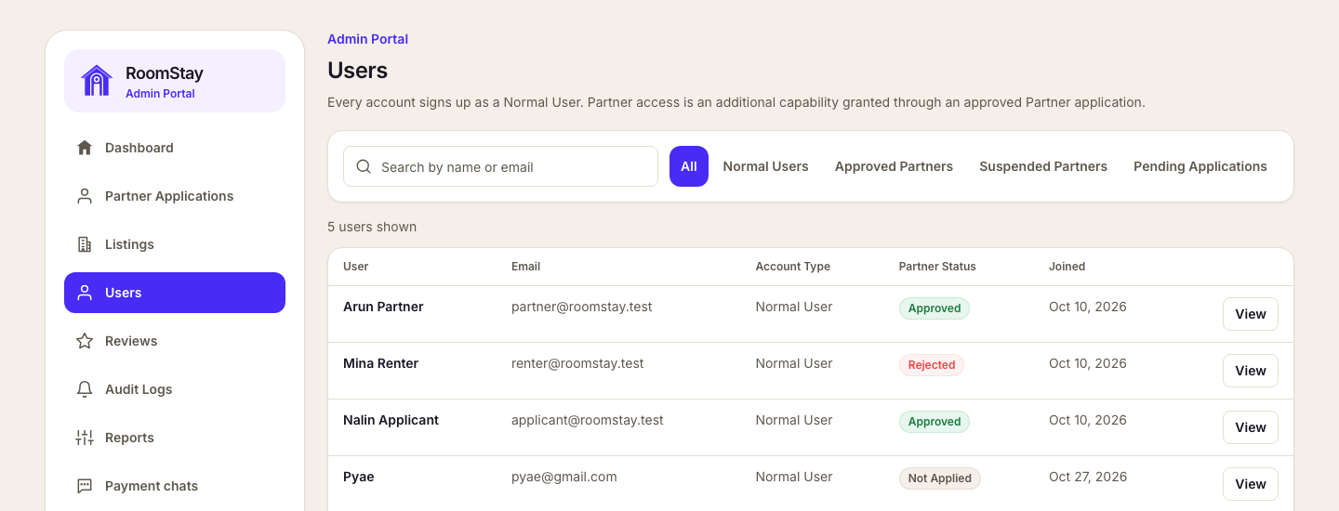
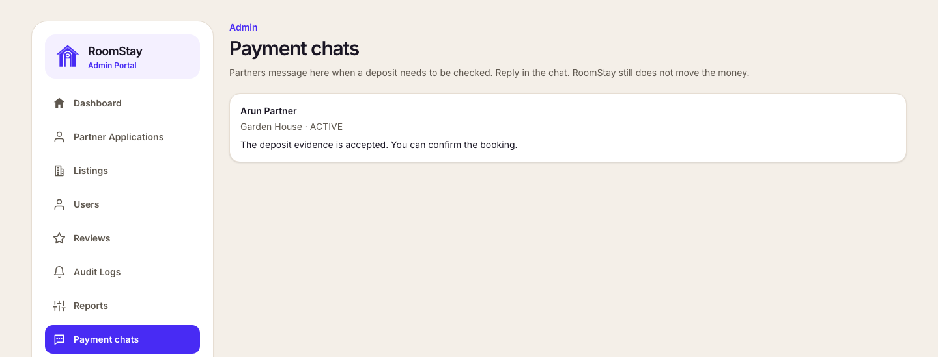
ADMIN
Admin screens
Admin reviews partner applications, users, and deposit chats. RoomStay does not move the money.
Dashboard
Partner applications
Users
Payment chats

Slide 7
FLOW
From search to move-in
Viewing is optional. Nothing is held until the partner approves the request.
1
2
3
4
Find a room
Send a request
Upload the slip
Move in
Renter searches by location, university, or keyword.
Room stays open until the partner approves.
Renter pays the deposit at the bank and uploads the photo.
Partner checks the slip, confirms, then starts the rental.

