Slide 1
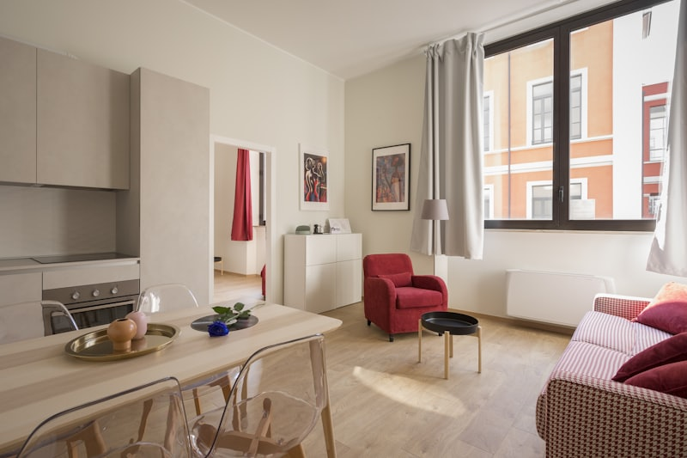
ROOMSTAY
Find a room.
Book it.
Show the slip.
Database design and GUI walkthrough

Slide 2
ROOMSTAY
What is RoomStay?
01
02
03
Search
Request
Prove payment
Condos, apartments, houses, and dormitories in one catalog.
A renter asks to book. A viewing is optional and does not reserve the room.
The renter pays at the bank, then uploads a photo of the transfer slip.
2 / 9

Slide 3
ROOMSTAY
Who uses it?
Renter
Searches rooms, sends a booking request, and uploads the deposit slip.
Partner
An approved user. Lists rooms, approves requests, and checks the slip.
Admin
Reviews partner applications and listings, and replies in the payment chat.
3 / 9

Slide 4
ROOMSTAY
How is the database designed?
People and rooms
Booking records
User — renter, partner, or admin
PartnerApplication — who may list rooms
Property — the room, including facilities
PropertyPhoto, Favorite, Viewing
Booking — the request and its status
ReservationDeposit — amount, deadline, and the slip
Conversation and Message
Review, Report, Notification, AuditLog
4 / 9

Slide 5
ROOMSTAY
Facilities stay on Property
facilities: string[]
Wi-Fi, Air conditioner, Furnished, Parking, and the rest are one list on the property row.
One table
Shown in the GUI
No extra tables
The ERD and the database use the same Property table.
Room page chips and the partner listing form read that list.
Facility and PropertyFacility are not in this database.
5 / 9

Slide 6
ROOMSTAY
How the ERD connects to the GUI
Property
Home, search, and the room page
Booking
Request booking and My bookings
ReservationDeposit
Bank details and the uploaded slip
User + PartnerApplication
Login role and the partner portal
Report, Notification, AuditLog
Admin pages
6 / 9

Slide 7
ROOMSTAY
What the GUI looks like
1 Home
2 Room
3 Booking request
4 My bookings
5 Deposit and slip
6 Partner checks the slip
7 Payment chat
8 Admin
Live site localhost:3000 Prototype localhost:3000/gui-prototype.html
7 / 9

Slide 8
ROOMSTAY
How the system flows
1
Request
2
Approve
3
Pay
Pending. The room stays available.
Deposit pending. The room is reserved.
The renter pays at the bank.
4
Upload
5
Check
6
Move in
The slip photo is saved on the booking.
The partner accepts the slip. Booking confirmed.
The room is rented, then available again when the rental ends.
8 / 9

Slide 9
ROOMSTAY
What we do next
Open the website and walk the same path as the diagram.
1
Show a room and send a booking request.
2
Approve it as the partner and show the bank details.
3
Upload a slip and open it on the partner review.
4
Open the payment chat, then the admin pages.
9 / 9

