Slide 1




UPI Fraudulent Transaction Operation Recognition
using
Machine Learning Model
Paper Code : PGIT(DS)194B
Prepared by,
Subarna Paul 11561723008
B. P. PODDAR INSTITUTE OF MANAGEMENT & TECHNOLOGY Approved by AICTE, New Delhi and Affiliated to MAKAUT, W.B.

Slide 2

CONTENTS
Introduction
UPI Fraudulent Types
Machine Learning Models
Program Flow
Fraud Detection Model
Predictive Model Flow
Machine Learning Models Used
Machine Learning Models & Comparative Study
Summary of Results
Conclusion
References

Slide 3
Introduction
Bank/UPI transactions fall into two categories: Genuine and Fraudulent transactions.
Our project focused on using machine learning models to identify –
Fraudulent UPI transactions
Developed several machine learning models using various methodologies and strategies.
Compared and assessed the models from the previous stage using both quantitative and visual criteria.
Analyzed the results obtained and drew a conclusion about the research objective

Slide 4

UPI Fraudulent Types
Phishing
Malware
Social Engineering
Money Mules

Slide 5
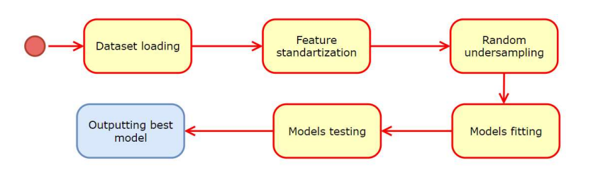
Program Flow

Slide 6
Fraud Detection Model
Supervised Learning model, they map input variables (x) to discrete output functions (y) that represent categories rather than numerical values.
Dataset
Train: 80%, Test: 20%
Training Set
Test Set
x_train
y_train
x
y
x_test
y_test

Slide 7
Predictive Model Flow
sklearn models
Set random state
fit x_train, y_train
Predict accuracy score using y_test, y_pred
sklearn metrics
Predict y_pred using x_test

Slide 8

Machine Learning Models
Logistic Regression (LR)
K-Nearest Neighbours (KNN)
Support Vector Machine (SVM)
Naive Bayes (NB)
Decision Tree (DT)
Random Forest (RF)

Slide 9
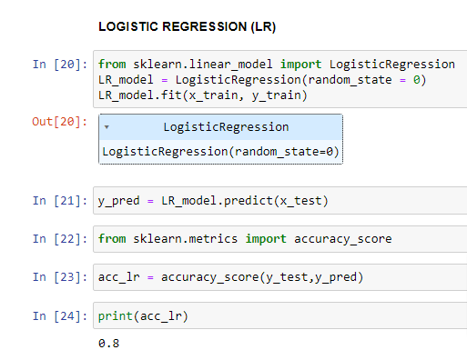
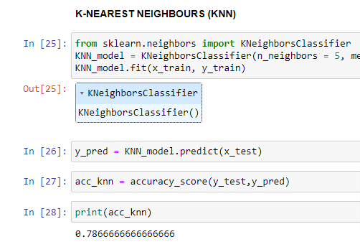
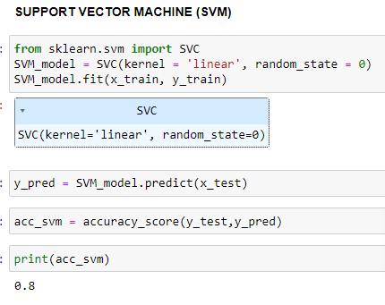
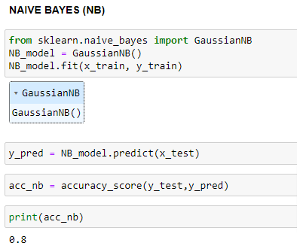
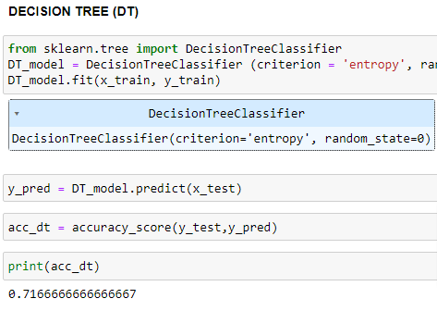
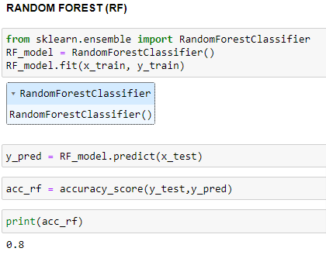
Machine Learning Models Used
Accuracy : 84%
Accuracy : 82%
Accuracy : 84%
Accuracy : 84%
Accuracy : 67%
Accuracy : 83%

Slide 10
Machine Learning Models & Comparative Study
Logistic Regression (LR)
Performs well in handling high-dimensional data with complex relationships, missing values, and outliers
Computationally expensive for massive datasets and challenging to interpret.
K-Nearest Neighbors (KNN)
Easy to implement and works well on small datasets, handling nonlinear relationships.
Computationally expensive for large datasets sensitive to irrelevant features and distance metrics
Support Vector Machine (SVM)
Performs well on many problems, including nonlinear data, and handles high-dimensional data.
Computationally expensive for large datasets. Sensitive to choice of kernel function and hyper-parameters.

Slide 11
Machine Learning Models & Comparative Study
Naive Bayes (NB)
Fast and straightforward, performing well in handling categorical features.
Assumes independence between features. may not perform well on highly nonlinear data.
Decision Tree (DT)
Easy to interpret and handles nonlinear relationships. Good performance on small to medium datasets.
Easily overfits the data and is
sensitive to small changes in data.
Random Forest (RF)
Performs well in handling high-dimensional data with complex relationships, missing
values, and outliers.
Computationally expensive for massive datasets and challenging to interpret.

Slide 12
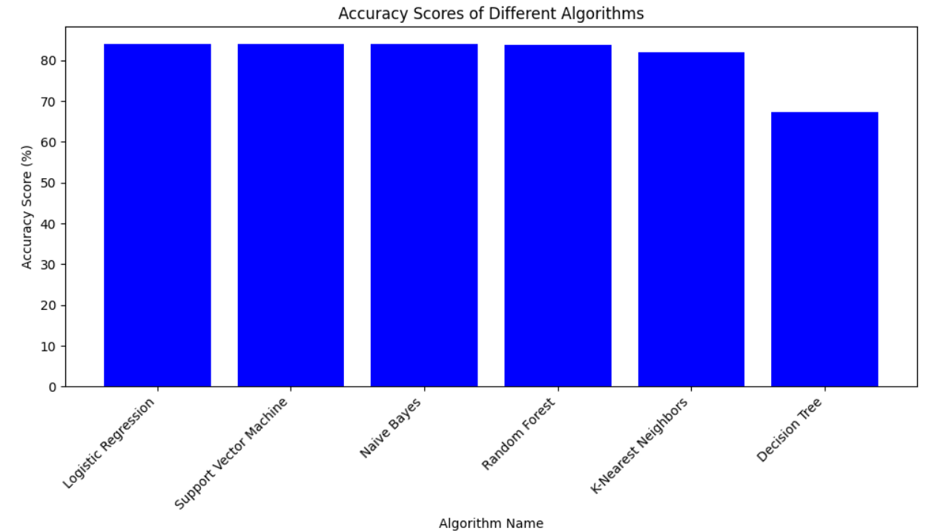
Summary of Results

Slide 13
Conclusion
This report underscores the significance of employing artificial intelligence for the detection of fraudulent UPI transactions. We put forth several classification algorithms capable of categorizing transactions based on specific features.
References
Nitu Kumari, S. Kannan and A. Muthukumaravel - “Credit Card Fraud Detection Using Genetic-A Survey” published by MiddleEast Journal of Scientific Research, IDOSI Publications, 2014
V. N. Dornadula and S. Geetha ―Credit Card Fraud Detection using Machine Learning Algorithms, Procedia Comput. Sci., vol. 165, pp. 631–641, 2019, doi: 10.1016/j.procs.2020.01.057.
The python standard library (https://docs.python.org/3/library/index.html#the-pythonstandard-library)

Slide 14
THANK YOU !

