Slide 1
SPECTRUM ONLINE INTERNSHIP 2020 TASK 1
DESIGN OF BODY MASS INDEX CALCULATOR USING GRAPHICAL USER INTERFACE DEVELOPMENT ENVIRONMENT IN MATLAB

Slide 2
TASK 1
SUBMITTED BY: SUBHAM KEDIA
REGD. NO.: 1701106111
BRANCH: ELECTRICAL ENGINEERING
SECTION A
6TH SEMESTER
COLLEGE OF ENGINEERING AND TECHNOLOGY

Slide 3
DESIGN OF BODY MASS INDEX CALCULATOR USING GRAPHICAL USER INTERFACE DEVELOPMENT ENVIRONMENT IN MATLAB (USE MENU FUNCTION)
The MATLABs inbuilt Graphical User Interface Development Environment was used to create a BMI calculator.
As mentioned in the task 1 instruction document, menu function was used to ask the user a choice between two metric systems, namely, Imperial System and SI System.
The following pages contain some snippets and observations in order to provide the respected mentor a clear picture.
The .m files used for the following pages are “Welcome.m”, “Measurements.m” and “Condition.m”.

Slide 4
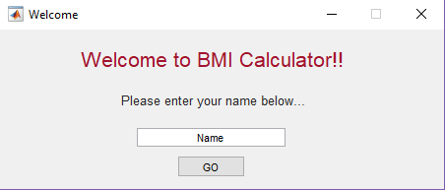
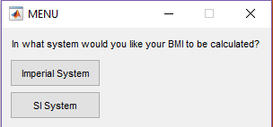
When “Welcome.m” is run, or “Welcome” is entered in the command window, such a GUI window opens up.
This window asks for the user’s name.
Enter a name and press the “GO” button to proceed.
A MENU window opens, asking the choice of metric system to the user.

Slide 5
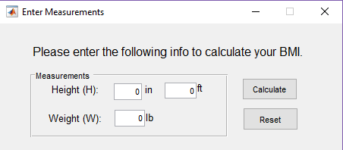
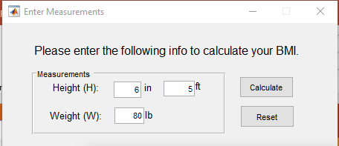
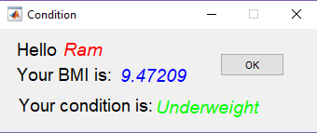
When option “Imperial System” is selected the window appears as such. Enter some values.
When clicked on “Calculate” a window shows the health condition of the user, on basis of body weight.

Slide 6
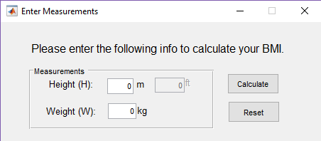
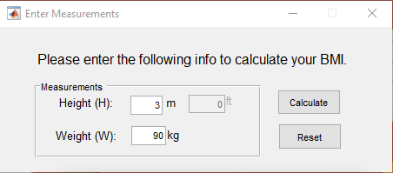
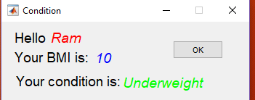
When option “SI System” is selected the window appears as such. Enter some values.

Slide 7
DESIGN OF BODY MASS INDEX CALCULATOR USING GRAPHICAL USER INTERFACE DEVELOPMENT ENVIRONMENT IN MATLAB (NOT USING MENU FUNCTION)
The use of MENU function makes the flow a little bit tedious.
So the following pages shall show GUI for BMI calculation without a menu function.
The files “BMICalculator.m” and “Condition.m” are used foor the following GUI windows.

Slide 8
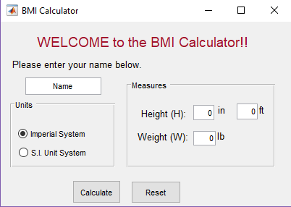
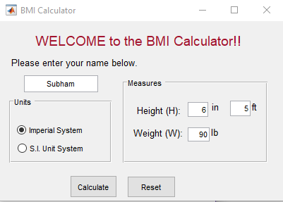
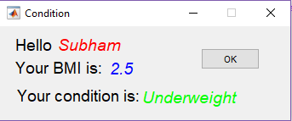
When the file “BMICalculator.m” is run or “BMICalculator” is entered in the command window, such a GUI window appears.

Slide 9
CONCLUSIONS:
The use of menu() function was studied.
title='In what system would you like your BMI to be calculated?’;
k=menu(title,'Imperial System', 'SI System’);
The title is the message that is displayed. The other two arguments are the options that appear on tabs.
The choice of option returns a value equal to the position where that particular option appears from the top starting from 1.
The principle elements of a GUI are Components, Containers and Callbacks. They were studied briefly too.
Components are elements for example, text boxes, graphical controls, menus, axes and toolbars. Containers are panels in which one or more components or containers can be added. Example of components are panels and button groups. Callbacks are the functions which are written for the GUI to act in an event of a mouse click or keyboard entry on some components.
The callback functions can be found in the code submitted in the format tagname_Callback(hObject,eventdata,handles). Where the tag name is the tag of a component.

Slide 10
THANK YOU.

