Slide 1
SPECTRUM ONLINE INTERNSHIP 2020 TASK 2
Create a GUI to show graphs for number of patients and deaths due to COVID-19 with respect to days .

Slide 2
TASK 2
SUBMITTED BY: SUBHAM KEDIA
REGD. NO.: 1701106111
BRANCH: ELECTRICAL ENGINEERING
SECTION A
6TH SEMESTER
COLLEGE OF ENGINEERING AND TECHNOLOGY

Slide 3
Create a GUI to show graphs for number of patients and deaths due to COVID-19 with respect to days .
The Graphical User Interface submitted hereby consists of a uicontrol GUI menu to select from countries in a list and return the total number of confirmed cases and deaths due to global pandemic COVID-19 virus.
The deaths and confirmed cases are plotted on a axes plot in bar representation.
The total number of confirmed cases and total deaths are displayed in a text box.
The data is obtained from a excel file ‘data.xlsx’ and imported in form of a function in MATLAB. This function is used to select the range of columns for a country.

Slide 4
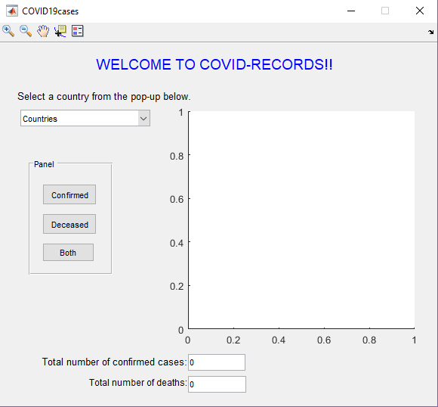
After saving the files ‘countriestab.m’ and ‘COVID19cases.m’ in your MATLAB, run the command ‘COVID19cases’ in the command window. A GUI window will show up.
From the dropdown select a country of the available 5 choices.
Then click on any of the buttons.
The button confirmed shows a plot of number of confirmed cases against days.
The button ‘Deceased’ shows a plot of number of deaths against days.
The button ‘Both’ will show both the above plots in same window.

Slide 5
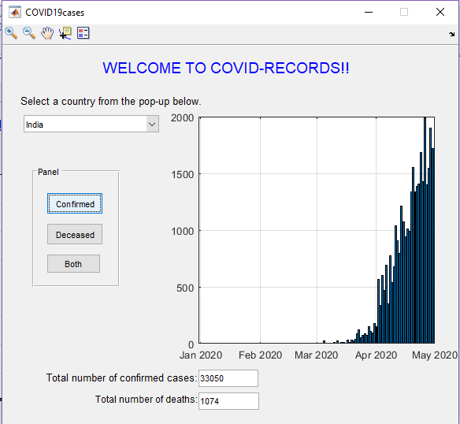
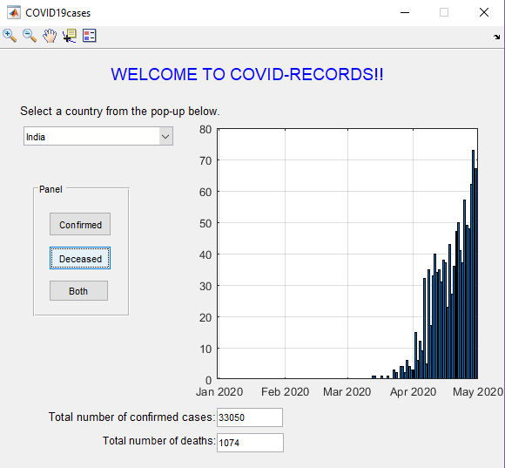


Slide 6
The toolbar on the window helps to study the plot properly.
CONCLUSION:
The COVID-19 data plotting GUI was successfully designed.
The process of uploading data and plotting from an excel sheet was also studied carefully.

