Slide 1
SPECTRUM ONLINE INTERNSHIP 2020 TASK 3
MATLAB PROGRAM TO MODULATE AND DEMODULATE AN AUDIO SIGNAL AND PLOT IT ACCORDINGLY.

Slide 2
TASK 3
SUBMITTED BY: SUBHAM KEDIA
REGD. NO.: 1701106111
BRANCH: ELECTRICAL ENGINEERING
SECTION A
6TH SEMESTER
COLLEGE OF ENGINEERING AND TECHNOLOGY

Slide 3
MATLAB PROGRAM TO MODULATE AND DEMODULATE AN AUDIO SIGNAL AND PLOT IT ACCORDINGLY.
A MATLAB Script file ‘mod_demod.m’ is the solution submitted.
First the user is asked, if MATLAB can start recording his voice for 10 seconds.
The recorded audio is saved to the user desired folder with user desired filename on the computer. Command ‘uigetdir’ is used to allow the user to select his desired location or directory.
From the Signal Processing Toolbox, “modulate(x,fc,fs,’method’)” function is used. This function modulates the message signal ‘x’ with a carrier wave ‘cos(2πfc*t)’, by the mentioned method ‘am’ or ‘fm’ meant for ‘Amplitude Modulation’ or ‘Frequency Modulation’ respectively, and returns a modulated wave. The choice between AM or FM is asked to the user by use of ‘menu( )’ function.
The modulated signal is then demodulated to get the same input signal.
In two figure windows, the plots of input audio signal, carrier signal, modulated signal and demodulated signal are plotted on the figure window.
After a pause of 5 seconds, the demodulated signal is played in the background.

Slide 4
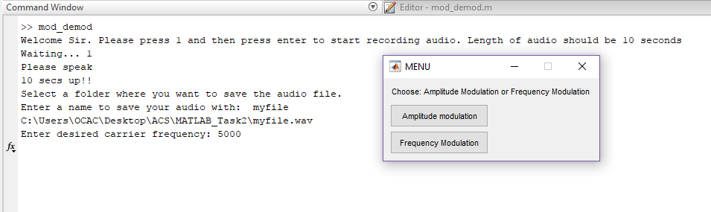
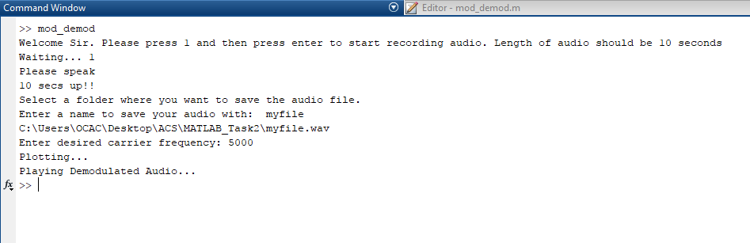
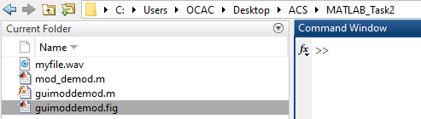

Slide 5
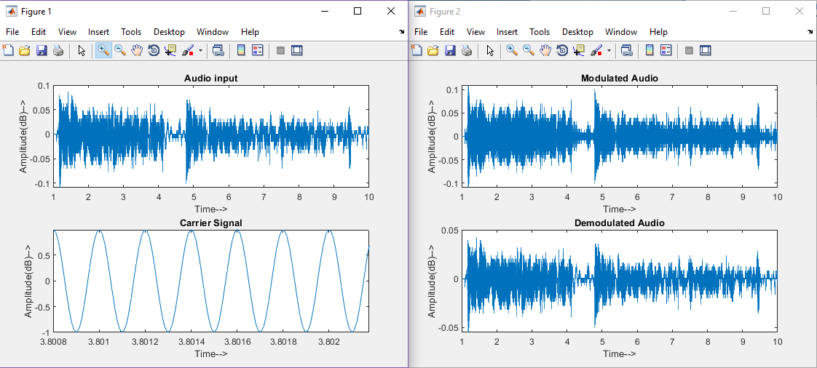
The functions modulate( ) and demod( ) belong to signal processing toolbox. These were used to modulate and demodulate the audio message, respectively.
The carrier signal generated when modulate function is used is “cos(2*pi*fc*t)”. This function was created within the code for purpose of displaying.

Slide 6
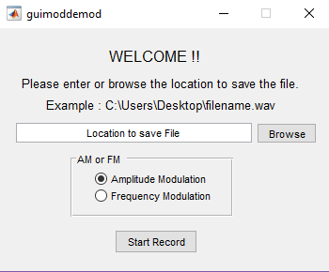
Using gui
The file ‘guimoddemod.m’ is the .m file for a GUI designed interface.
One can directly enter the location for the file to be saved along with the name or click on the ‘Browse’ button to select a directory and a default name ‘newfile.wave’ is created.
Then select between ‘Amplitude modulation’ or ‘Frequency Modulation’.
When ‘Start Record’ button is pressed the audio recording starts and after 10 seconds it stops.

Slide 7
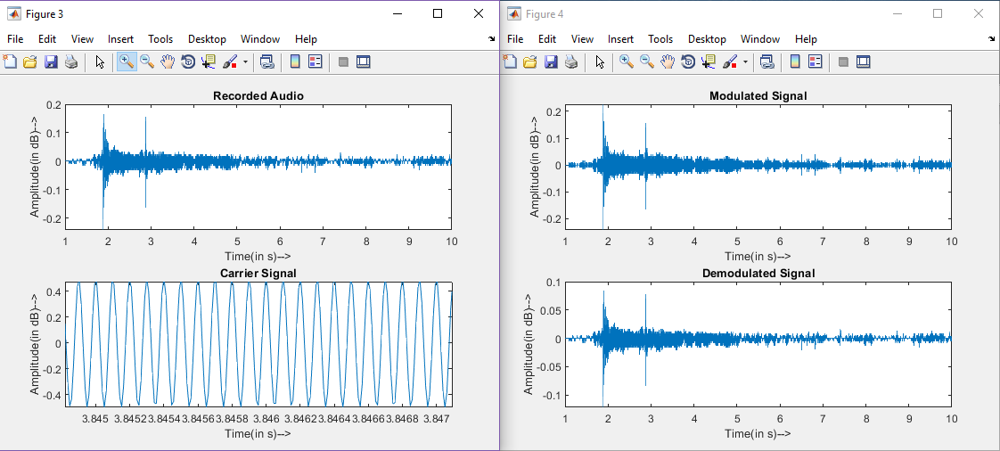

Slide 8
conclusion
In MATLAB the recorded audio is saved as a column matrix. This column matrix has a number of cells determined by the sampling frequency and time of recording. The number of cells is always less than or equal to the product of sampling frequency fs, and time of recording t.
To increase the volume of the demodulated audio, the output of demod function is multiplied by a whole number, and is now used as a input to audioplayer( ).

