Slide 1
WeatherWatch
Capstone Architecture Deep-Dive
S06B01 · Deep-tier track: Networking
Serverless weather poller on AWS — public entry point, external API call, secret at runtime, on-demand storage — reviewed against the Well-Architected Framework and extended into a VPC.
Subahan Talamarla · July 2026
Notes:
30-sec intro: WeatherWatch is a serverless poller. Today's deep-dive: what's built and working, then the networking deep-tier — how it moves into a VPC with public/private subnets — mapped to Well-Architected. ~4 minutes, review-round.

Slide 2
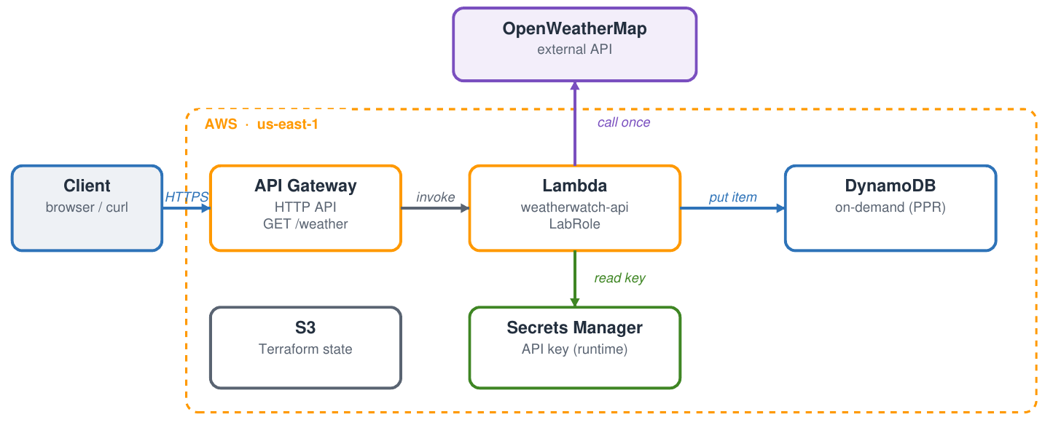
1
What's built
Terraform-managed, us-east-1 — all three phases apply cleanly
Public front door
API Gateway HTTP API → Lambda (LabRole).
One real API call
Handler reads the OpenWeatherMap key from Secrets Manager at runtime and calls the API once.
Something real with it
Transforms the response and writes it to an on-demand DynamoDB table.
All as code
Phase 0 table + state, Phase 1 Lambda + secret, Phase 2 front door — nothing hard-coded.
Notes:
What's built: a Terraform-managed serverless pipeline. Client hits API Gateway, which invokes the Lambda under LabRole. The Lambda reads its key from Secrets Manager, calls OpenWeatherMap once, transforms, and stores in the on-demand DynamoDB table. Three Terraform phases, all in us-east-1.

Slide 3
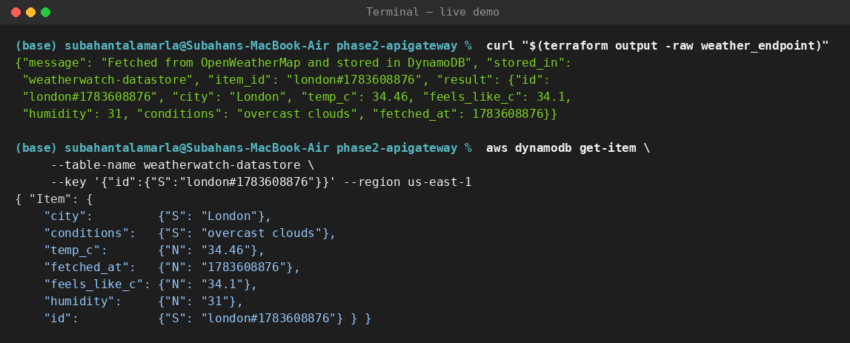
2
What works — shown running
One public request → live weather → persisted in DynamoDB
Live demo — run it
terraform output -raw weather_endpoint
curl "$(…weather_endpoint)"
→ JSON weather, HTTP 200
aws dynamodb get-item …
→ item persisted
Proven end-to-end
front door · Secrets Manager read · external call · DynamoDB write — all in one request.
Notes:
Rather than describe it — here it is running. I curl the public endpoint; it returns live London weather with HTTP 200 and the item id. Then get-item shows the same record persisted in DynamoDB. That exercises the whole chain in one request. (If the lab is up I run this live; the panel is my backup.)

Slide 4
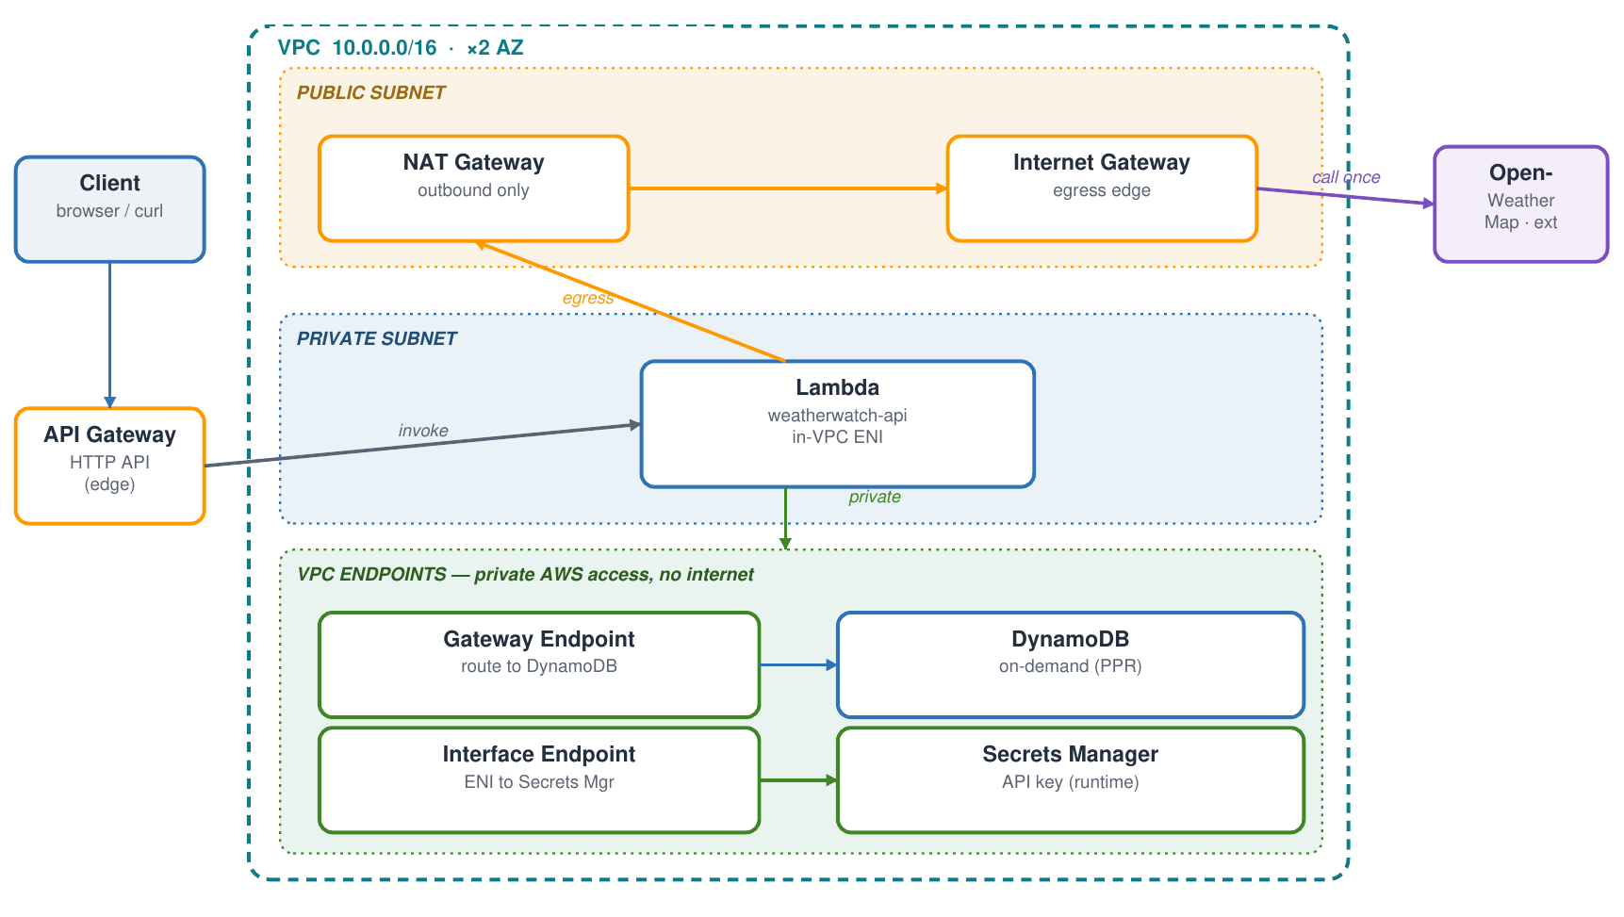
3
Deep-tier: Networking
Target design — Lambda in private subnets, data plane off the public internet
Private compute
Lambda runs in private subnets across 2 AZs — no inbound from the internet.
Private AWS access
VPC endpoints keep DynamoDB (gateway) and Secrets Manager (interface) traffic on the AWS network.
Controlled egress
Only outbound to OpenWeatherMap, via NAT + Internet Gateway.
Pillar: Security
Least exposure — the sensitive paths never touch the public internet.
Notes:
The networking deep-tier. Today the services are all managed with no VPC. The target: put the Lambda in private subnets across two AZs. Its calls to DynamoDB and Secrets Manager go through VPC endpoints, so that traffic never leaves the AWS network. The only egress is outbound to OpenWeatherMap through a NAT and Internet Gateway. This is the Security pillar — minimize exposure.

Slide 5
4
Decisions × Well-Architected
Every choice named a rejected option and a pillar (6-pillar framework)
COST
OPERATIONAL EXCELLENCE
SECURITY
On-demand DynamoDB
over RDS
Zero idle cost for a bursty, mostly-idle poller; RDS wins on ad-hoc SQL but bills 24×7.
API Gateway HTTP API
over Function URL (IAM)
Clean public, browser-testable door; a signed Function URL can't open in a browser.
Secrets Manager
over env var / hard-code
Key stays out of code and state, read at runtime, rotatable.
Reviewed against all six pillars — Operational Excellence, Security, Reliability, Performance Efficiency, Cost Optimization, Sustainability.
Notes:
Each decision names what I chose, what I rejected, and the pillar. On-demand DynamoDB over RDS for cost. HTTP API over a signed Function URL for operational excellence — it's browser-testable. Secrets Manager over an env var for security. All reviewed against the six Well-Architected pillars.

Slide 6
5
What's left · the one risk
Standup close — the honest gaps and what I'm watching
What's left
• Apply the throttling fix live (it's committed in main.tf).
• Stand up the VPC: private subnets + endpoints + NAT.
• Observability: CloudWatch log retention + X-Ray tracing.
• Least-privilege role in place of shared LabRole (real account).
• Document manual key rotation.
The one risk I'm watching
The public GET /weather route is unauthenticated — every hit spends compute and a paid OpenWeatherMap call, so a burst could run up cost.
Mitigation in flight:
• Stage throttling (10 req/s, burst 5) — committed, returns HTTP 429 past the limit.
• Networking target moves the data plane to private VPC endpoints — off the internet entirely.
Notes:
What's left: apply the throttle live, build out the VPC, add observability, swap LabRole for a least-privilege role, document rotation. The one risk I'm watching: the public unauthenticated endpoint driving compute and a paid API call — a burst runs up cost. Mitigation is in flight: throttling is committed, and the networking target pulls the data plane onto private endpoints.

Slide 7
Sources
Course references used for this deep-dive — review-round format
›
AWS Well-Architected Framework (whitepaper, Nov 6 2024)
docs.aws.amazon.com/wellarchitected/latest/framework/welcome.html
›
Terraform AWS provider — aws_lambda_function, aws_dynamodb_table, aws_vpc / subnet, aws_vpc_endpoint
registry.terraform.io/providers/hashicorp/aws/latest/docs
›
AWS Lambda Developer Guide — configuring a function to access a VPC
docs.aws.amazon.com/lambda/latest/dg/configuration-vpc.html
›
Amazon DynamoDB Developer Guide — on-demand capacity mode
docs.aws.amazon.com/amazondynamodb/latest/developerguide/
Notes:
Sources: the Well-Architected whitepaper, the Terraform AWS provider docs for each resource, the Lambda VPC configuration guide, and the DynamoDB on-demand guide. Happy to take review-round questions.

