Slide 1
Week 6: Machine Learning

Slide 2
Last Lecture..
Gradient Descent
Batch Gradient Descent
Stochastic Gradient Descent
Mini-Batch Gradient Descent

Slide 3
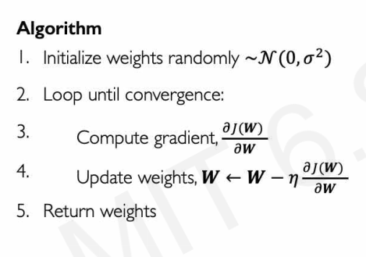
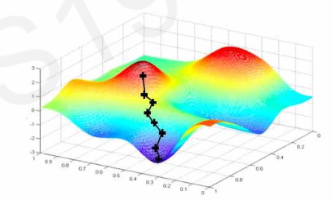
Batch Gradient Descent

Slide 4
Learning Rate
The parameter η, which we called the Learning Rate/step size
Its value is very important for Gradient Descent
It determine the speed of learning
Fix Value or entire learning : We can try Small, Large and medium values
Adaptive Value:

Slide 5
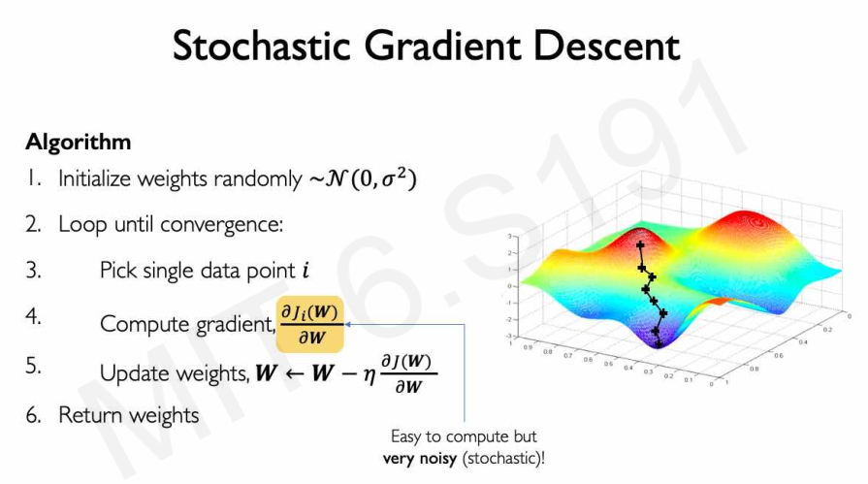

Slide 6
Mini-batch Gradient Descent
At each step, instead of computing the gradients based on the full training set (as in Batch GD) or based on just one instance (as in Stochastic GD), Mini batch GD computes the gradients on small random sets of instances called minibatches.
The main advantage of Mini-batch GD over Stochastic GD is that you can get a performance boost from hardware optimization of matrix operations, especially when using GPUs.
The algorithm’s progress in parameter space is less erratic than with SGD, especially with fairly large mini-batches.

Slide 7
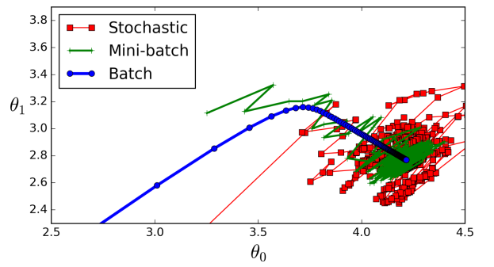
Mini-batch Gradient Descent

Slide 8
Simulated Annealing
Therefore randomness is good to escape from local optima, but bad because it means that the algorithm can never settle at the minimum.
One solution to this dilemma is to gradually reduce the learning rate.
The steps start out large (which helps make quick progress and escape local minima), then get smaller and smaller, allowing the algorithm to settle at the global minimum.

Slide 9
Simulated Annealing
This process is called simulated annealing, because it resembles the process of annealing in metallurgy where molten metal is slowly cooled down
The function that determines the learning rate at each iteration is called the learning schedule

Slide 10
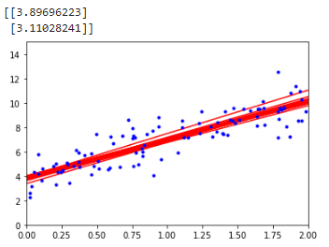
Stochastic GD
X_new = np.array([[0], [2]])
X_new_b = np.c_[np.ones((2, 1)), X_new] # add x0 = 1 to each instance
n_epochs = 500
t0, t1 = 5, 50 # learning schedule hyperparameters
def learning_schedule(t):
return t0 / (t + t1)
theta = np.random.randn(2,1) # random initialization
for epoch in range(n_epochs):
for i in range(m):
random_index = np.random.randint(m)
xi = X_b[random_index:random_index+1]
yi = y[random_index:random_index+1]
gradients = 2 * xi.T.dot(xi.dot(theta) - yi)
eta = learning_schedule(epoch * m + i)
theta = theta - eta * gradients
y_predict = X_new_b.dot(theta)
plt.plot(X_new, y_predict, "r")
print(theta)
plt.plot(X, y, "b.")
plt.axis([0, 2, 0, 15])
plt.show()

Slide 11
Polynomial Regression

Slide 12
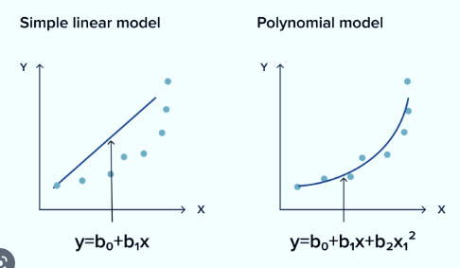
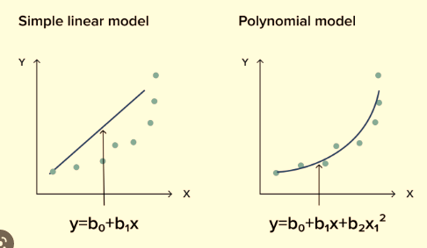
Polynomial Regression
If the relationship between the inputs and output is not linear, we can use a polynomial to model the relationship.
We will formulate the polynomial regression model for single feature regression problem.
Polynomial Regression is often termed as Non-linear Regression or Linear in Parameter Regression.

Slide 13
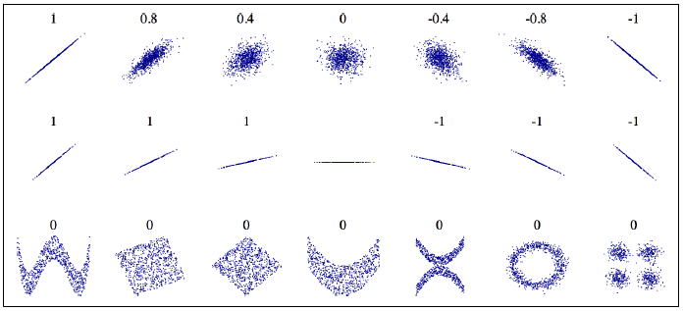
Correlation Coefficient

Slide 14
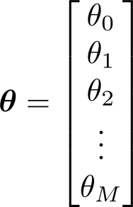
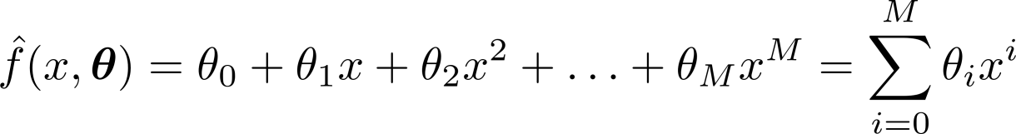

Single Feature Regression: Formulation:

Slide 15

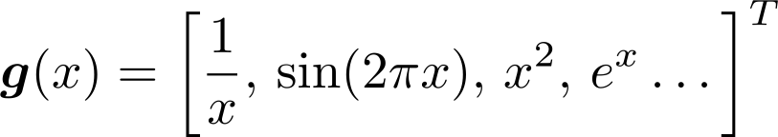
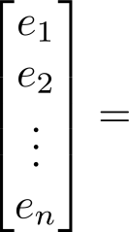
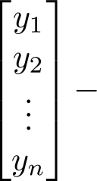
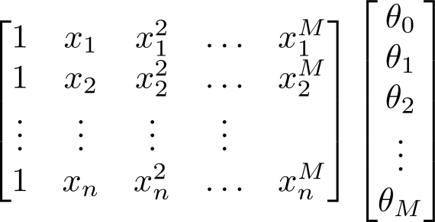






Single Feature Regression: Formulation:
Residual Error, We have seen this before.

Slide 16





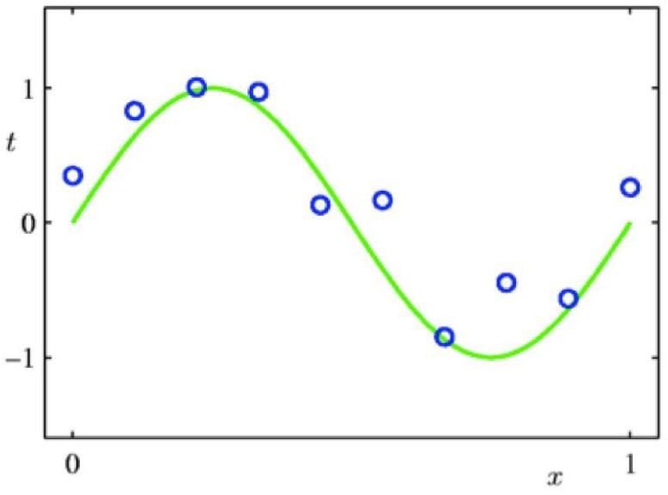

Single Feature Regression: Example

Slide 17

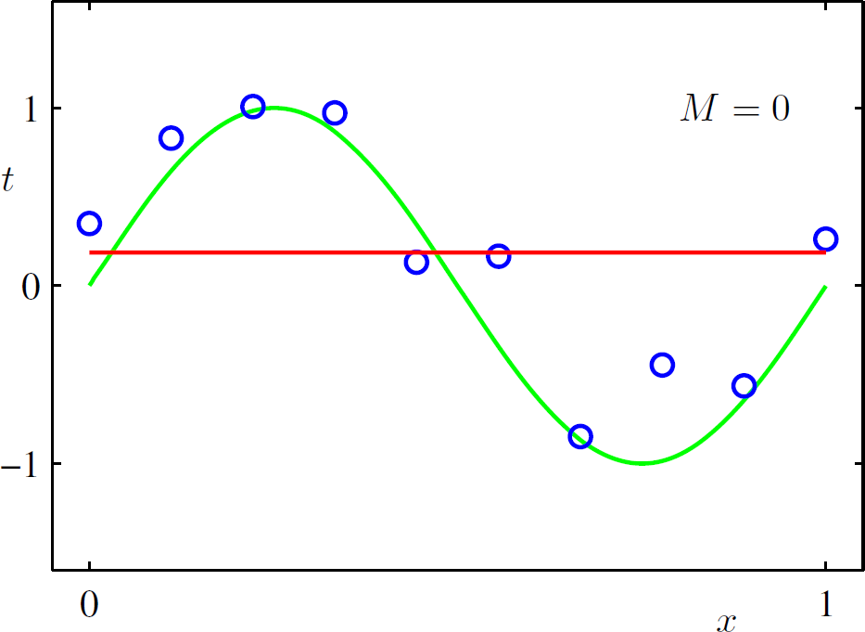
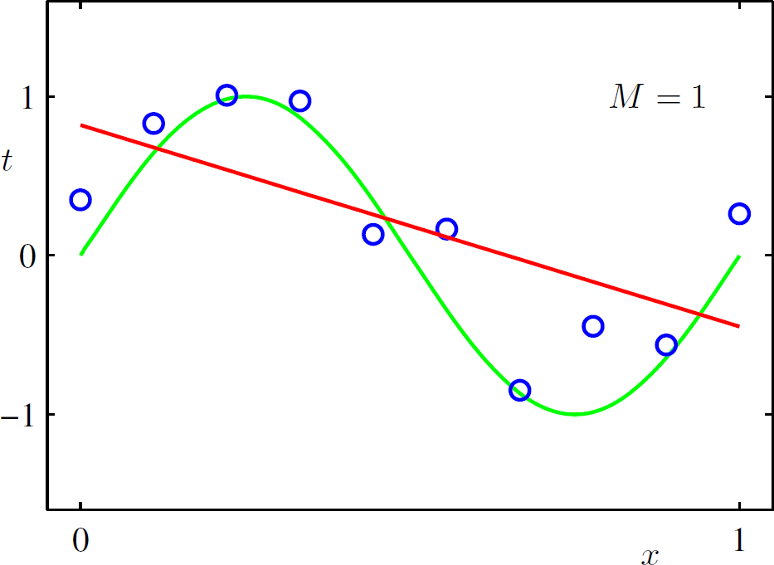



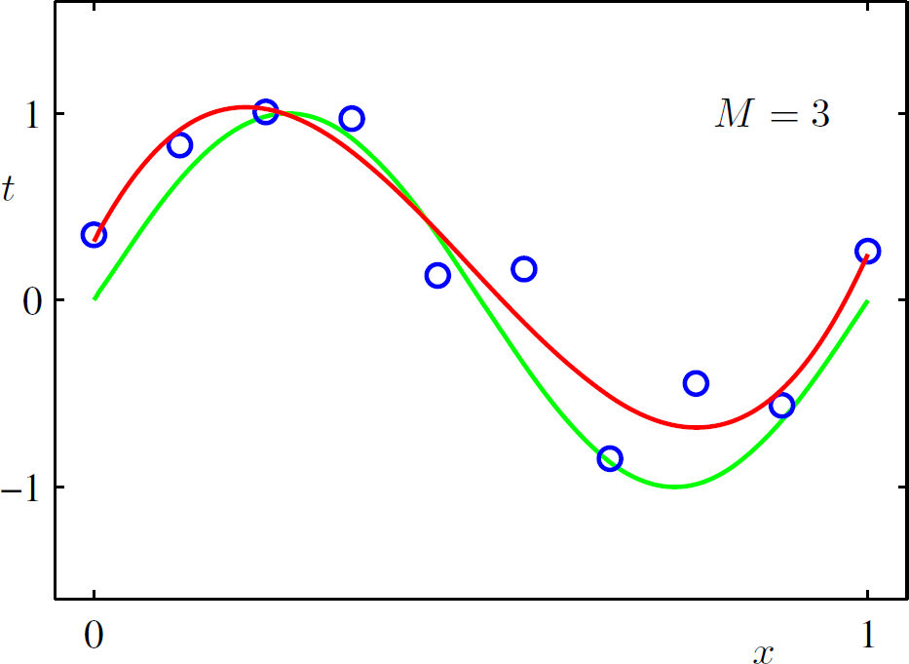
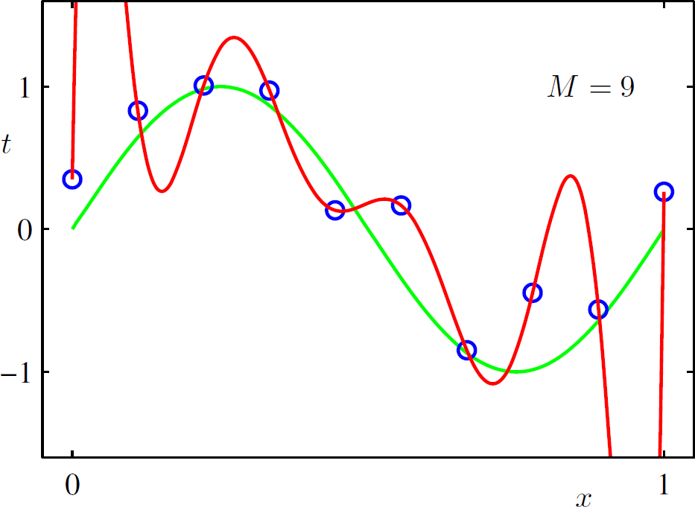
Single Feature Regression: Example
Underfitting: Model is too simple
Overfitting: Model is too complex

Slide 18
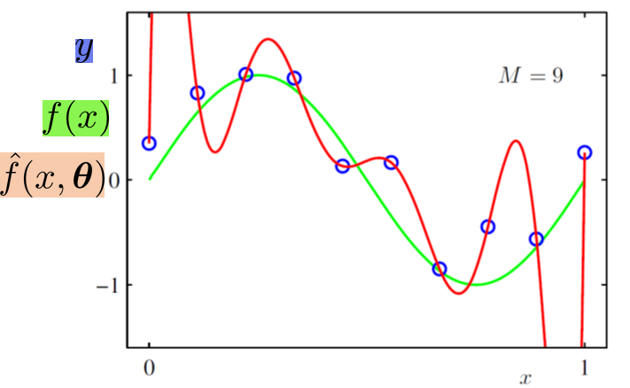
Polynomial Regression (Overfitting)
Overfitting

Slide 19
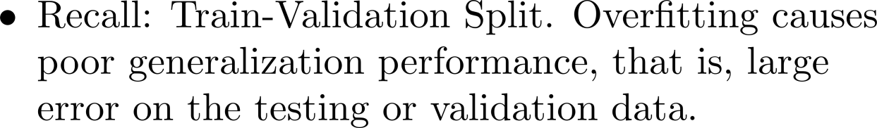
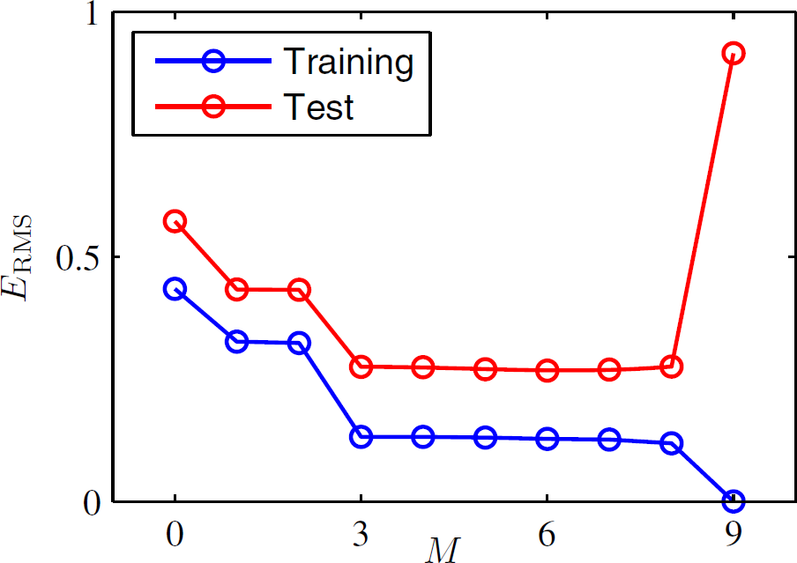
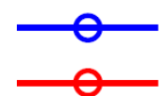

Polynomial Regression (Overfitting)
We can decide M=9 is overfitting because in this example we know true function. Mostly we do not know true function of training data. What should we do?
Solution 1:
Good choice of M

Slide 20
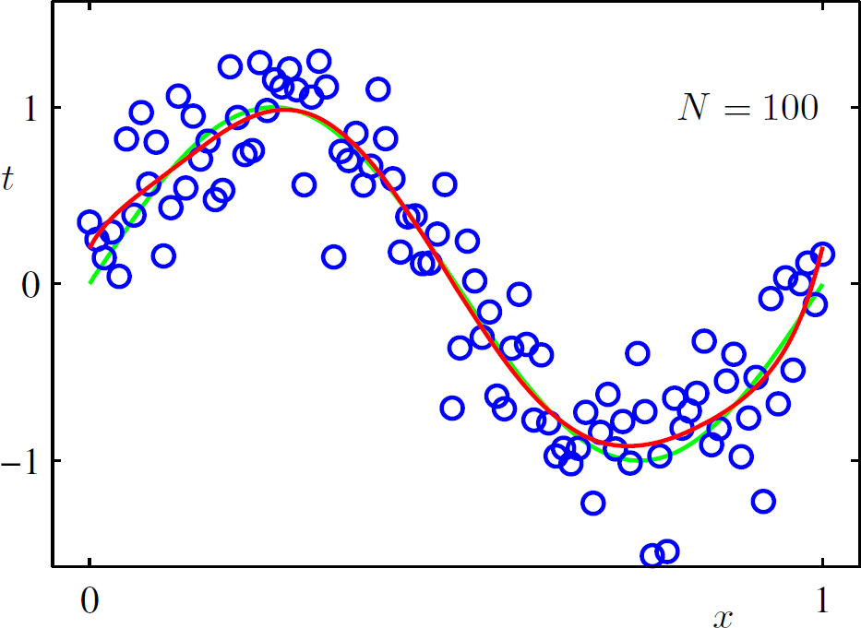




Polynomial Regression (Overfitting)
The polynomial degree M is the hyper-parameter of our model (k in kNN),controls the complexity of the model.
If we stick with M=3 model, this is the restriction on the number of parameters.
We encounter overfitting for M=9 because we do not have sufficient data.
Solution 2: Take more data points to avoid over-fitting.

Slide 21
Polynomial Regression (Overfitting)
Solution 3: Regularization

Slide 22

Regularization
With univariate linear regression we didn’t have to worry about overfitting
Thus, it is common to use regularization on multivariate linear functions to avoid overfitting.
Recall that with regularization we minimize the total cost of a hypothesis, counting both the empirical loss and the complexity of the hypothesis:
Cost (h) = EmpLoss(h) + λ Complexity (h)

Slide 23
Regularization
For linear functions the complexity can be specified as a function of the weights. We can consider a family of regularization functions:
As with loss functions with q =1 we have L1 regularization, which minimizes the sum of the absolute values;
With q =2, L2 regularization minimizes the sum of squares.
Which regularization function should you pick? That depends on the specific problem, but L1 regular is SPARSE

Slide 24
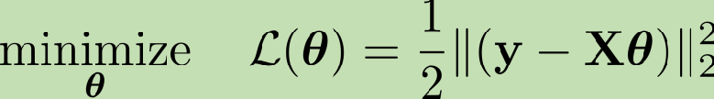
Regularization
Encourages the model coefficients to be small by adding a penalty term to the error.
We had the loss function of the following form that we minimize to find the coefficients:
We add a ‘penalty term’, known as regularizer, in the loss function as
Regularized Loss function
Regularizer

Slide 25
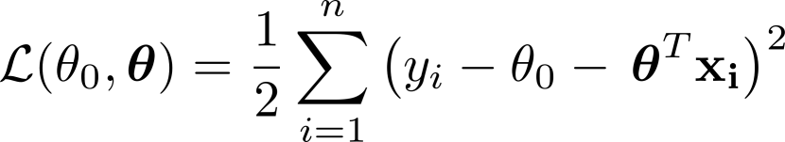
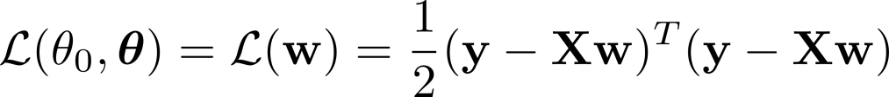
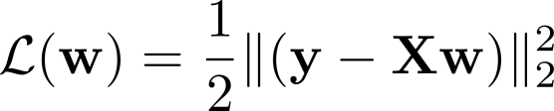
L² Least-squares Regularization

Slide 26
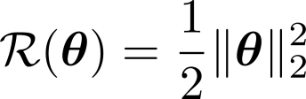
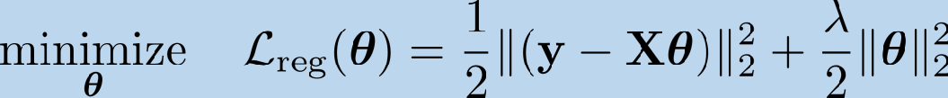
Regularization
L² Least-squares Regularization – Ridge Regression:
- Since we require to discourage the model coefficients from reaching large values; we can use the following simple regularizer:
- For this choice, regularized loss function becomes

Slide 27
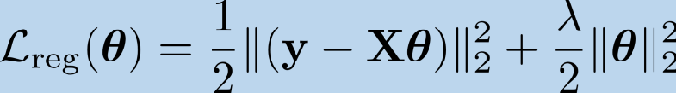
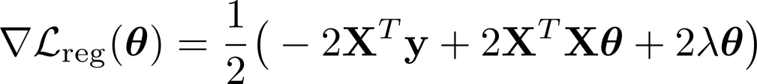




L² Least-squares Regularization – Ridge Regression:
- Regularized loss function is still quadratic, and we can find closed form solution.

Slide 28
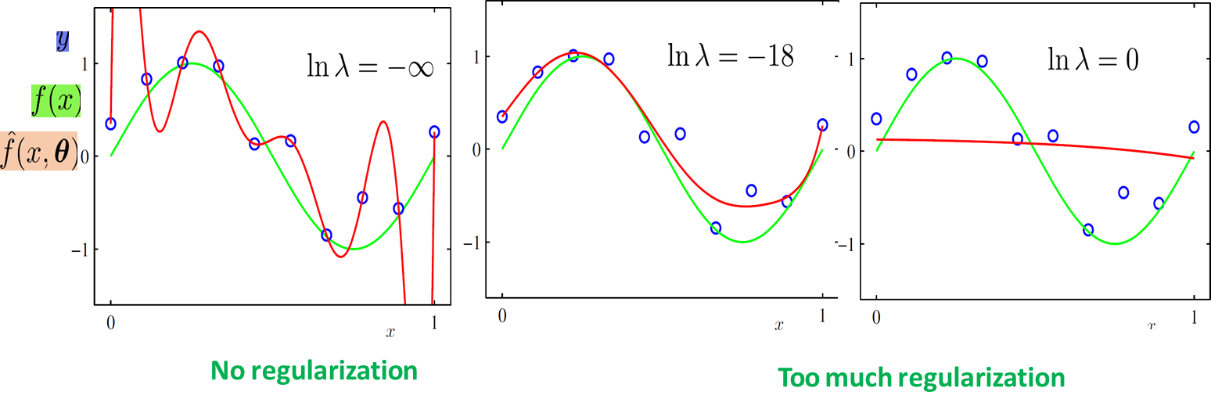
L² Least-squares Regularization – Ridge Regression:

Slide 29



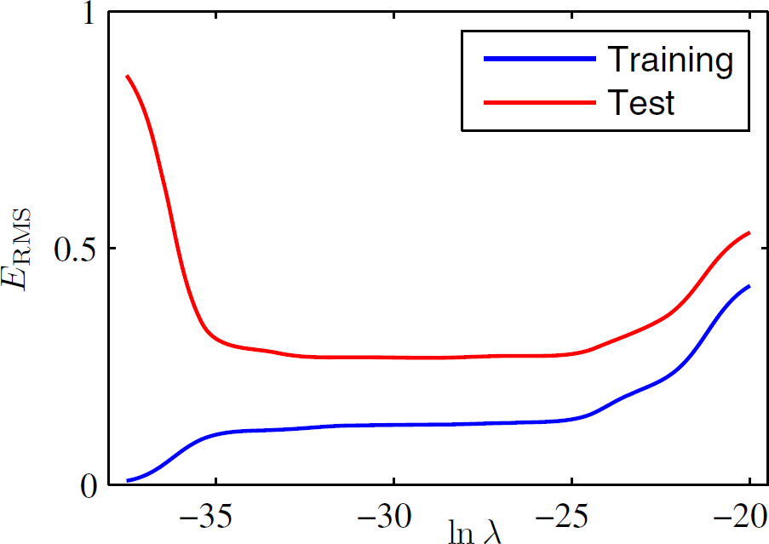
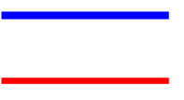
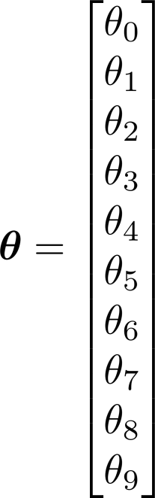
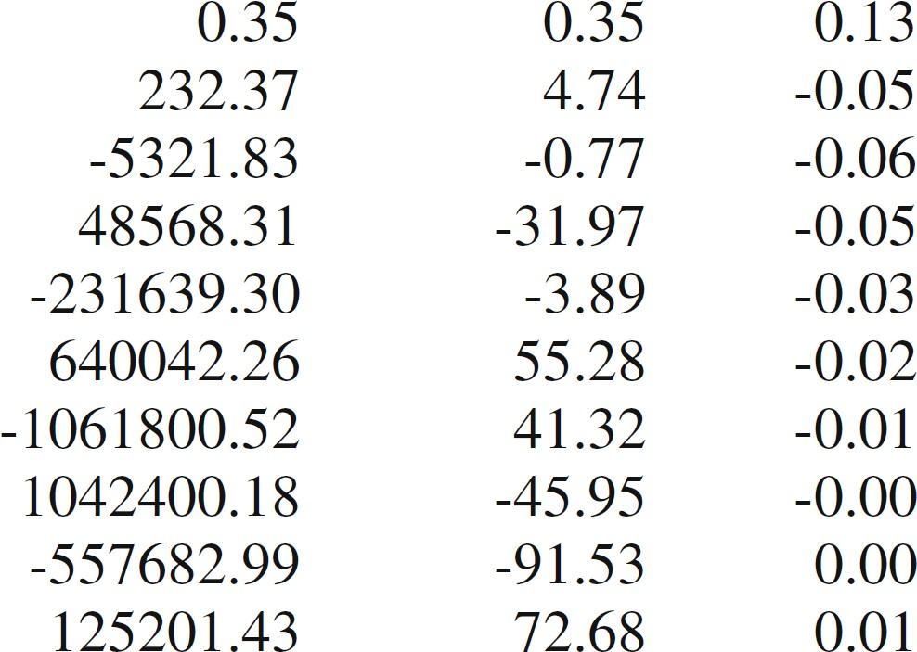
L² Least-squares Regularization – Ridge Regression

Slide 30
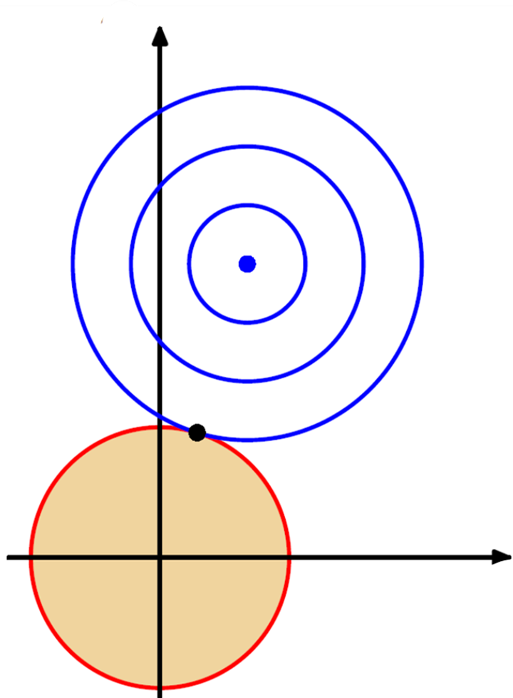

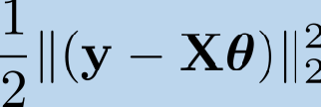
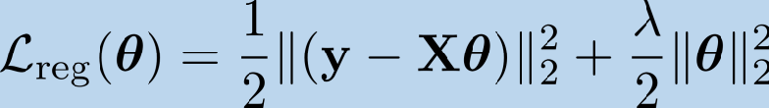

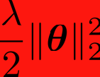

L² Least-squares Regularization – Ridge Regression: Graphical Visualization:

Slide 31
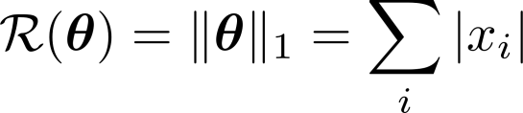
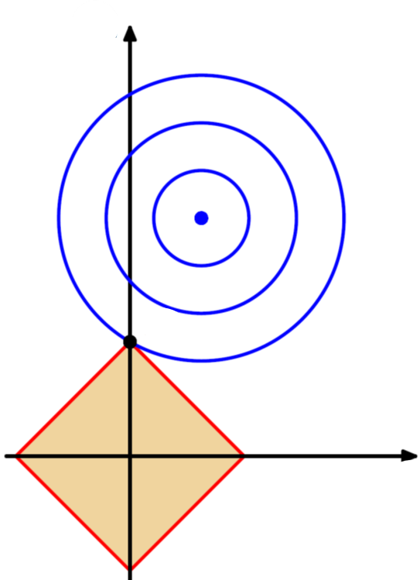
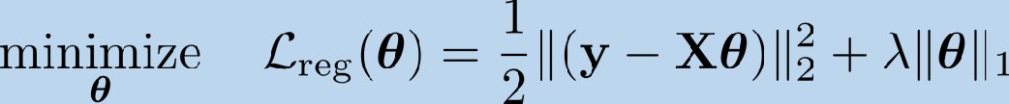

L¹ – LASSO Regression: Graphical Visualization:

