Slide 1
Week 1: Machine Learning

Slide 2
Course Information
Title of Course: Machine Learning
Theory Credits: 2
Lab Credits: 1

Slide 3
Theory Assessment
Mid Exam (30%)
Final Exam (40%)
Sessional (30%)
4 Quizzes
2 Assignments
1 Project

Slide 4
Theory Assessment
7 Lab Assessment(70%)
Submission
Attendance
Assessment
Final Project

Slide 5
Objectives of Course
The aim of this course is to:
a) Present the basic machine learning concepts;
b) Present a range of machine learning algorithms along with their strengths and weaknesses;
c) Apply machine learning algorithms to solve problems of moderate complexity

Slide 6
Course Learning Outcomes
CLO-1: Describe basic machine learning concepts, theories and applications. C1 (Knowledge)
CLO-2: Apply supervised learning techniques to solve classification problems of moderate complexity. C3 (Apply)
CLO-3: Apply unsupervised learning techniques to solve clustering problems of moderate complexity C3 (Apply)
CLO-4: Apply reinforcement learning algorithms to environments with complex dynamics. C3 (Apply)
CLO-5: Develop a reasonable size project using suitable machine learning technique C6 (Create)

Slide 7
Weekly Agenda…
Machine learning Defined
Types of Machine Learning
Dataset Types
Machine Learning Challenges

Slide 8
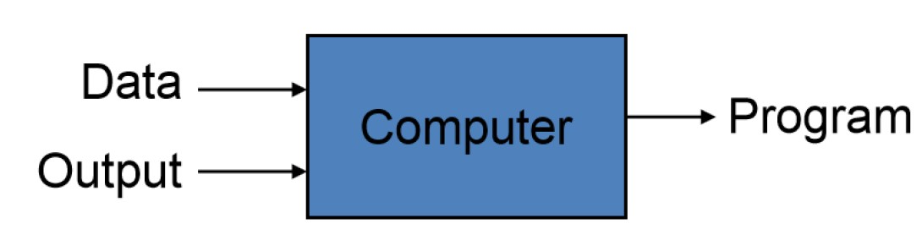
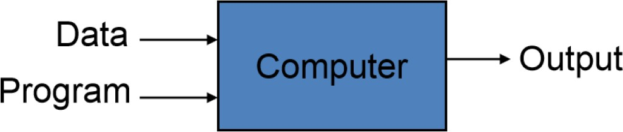
Machine Learning Overview
What is Machine Learning?
Automating the process of automation
Getting computers to program themselves
Traditional Programming
Machine Learning
Given examples (training data), make a machine learn system behavior or discover patterns

Slide 9
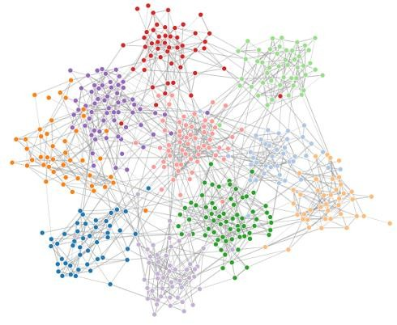
Machine Learning: Overview
What is Machine Learning?
- Study, Design and Analysis of algorithms that improve their performance at some task
Model
f (x)
Algorithm
Data

Slide 10
Learning From Examples
Factored representation (Examples)
a vector of features/attributes values (input)
and outputs that can be either a continuous numerical value or a discrete value. (output)
INDUCTIVE LEARNING :a general function or rule from specific examples (input–output) pairs is called inductive learning.

Slide 11
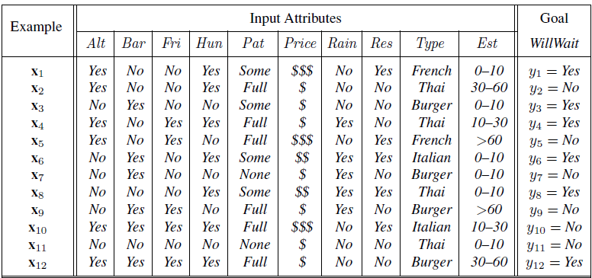
Inductive Learning (Learning From Examples)

Slide 12
Machine Learning Types
Supervised learning:
Classification
Numeric Prediction
Unsupervised learning:
Clustering
Principle Component Analysis
Semi-supervised learning:
Reinforcement learning:
Machine Learning

Slide 13

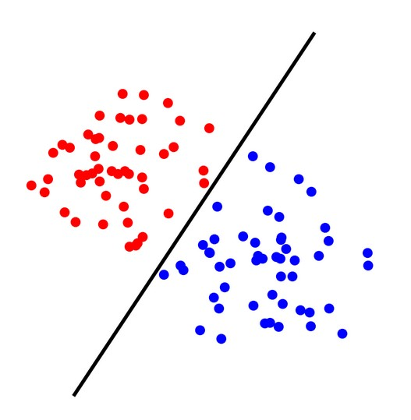
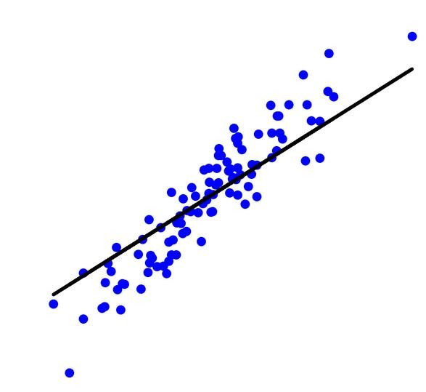
Nature of ML Problems
Supervised Learning: The learning algorithm would receive a set of inputs along with the corresponding correct outputs to train a model
Training Data
All labeled data
Model
Prediction
Classification: Discrete Prediction
Regression: Quantitative Prediction on a continuous scale
Given a data sample, predict its class
Given a data sample, predict a numerical value

Slide 14

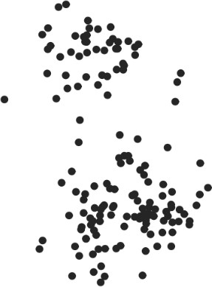
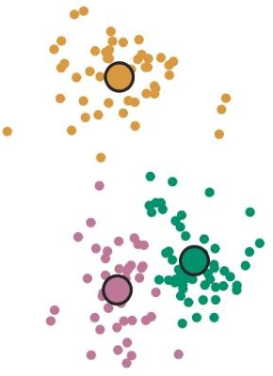
Nature of ML Problems
Unsupervised Learning: The learning algorithm would receive unlabeled raw data to train a model and to find patterns in the data
Training Data
All unlabeled data
Model
Clustering

Slide 15

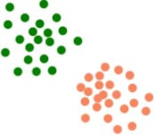
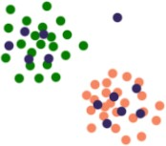
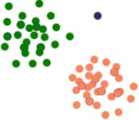
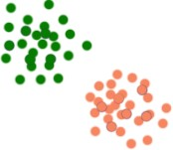
Nature of ML Problems
Semi-supervised Learning: The learning algorithm receives labeled and unlabeled raw data to train a model Main objective is to efficiently accommodate the unlabeled data
Training Data
Labeled
+
unlabeled Data
Data Modeling and Augmentation
Model
Anomaly
-> ignore it
Use labeled data to build a model
Place unlabeled data with model
Use the model to label the unlabeled data
Fit the model again with the combined data

Slide 16
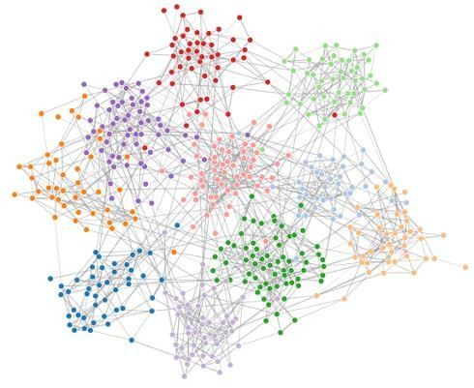
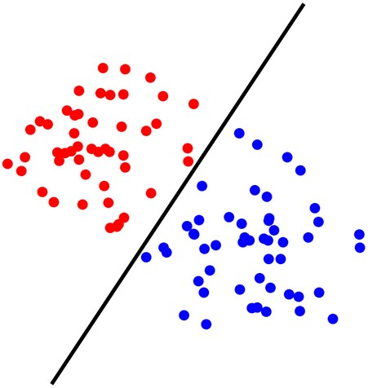
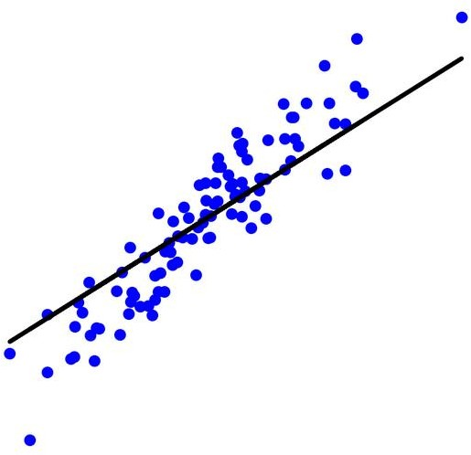


Machine Learning: Overview
Typical Flow
Problem Nature Identification
Training Data Collection
f (x)
Model Training
Model Deployment
Model Validation

Slide 17
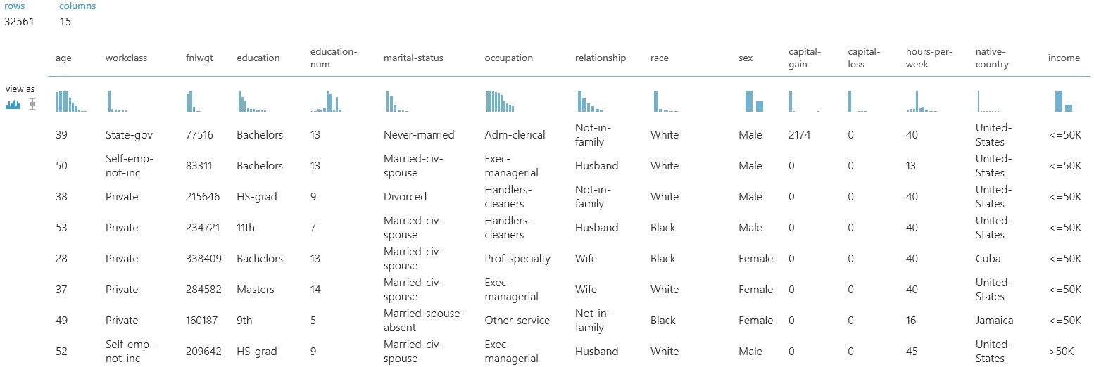
Machine Learning: Overview
Dataset Types
Tabulated Data
Each column is a feature and adds one dimension to the data
Number of columns define total number of features and hence data dimensionality
Ideally, these columns should contain different information -> uncorrelated

Slide 18
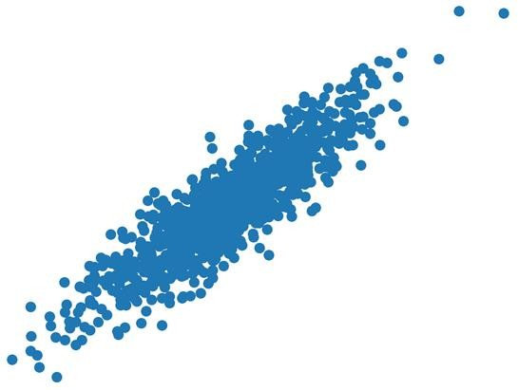
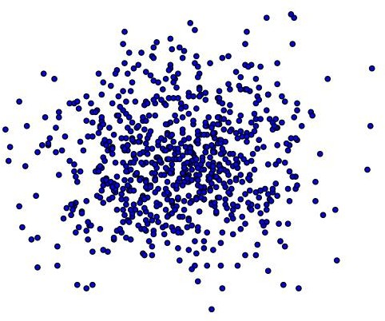


Machine Learning: Overview
Dataset Types
Feature 2
Feature 2
Feature 1
Features are correlated
Feature 1
Features are uncorrelated
Dimensionality Reduction: Find all those dimensions (features) which carry very less information and discard them

Slide 19
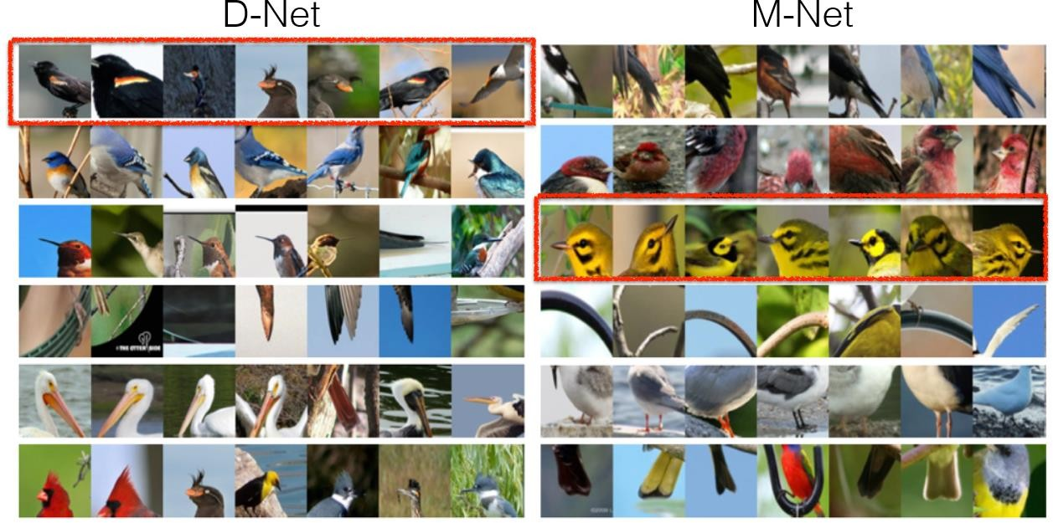
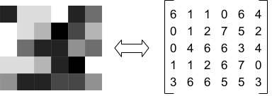
Machine Learning: Overview
Dataset Types
Images
Each image (greyscale) is a 2D data which can be represented as a matrix

Slide 20
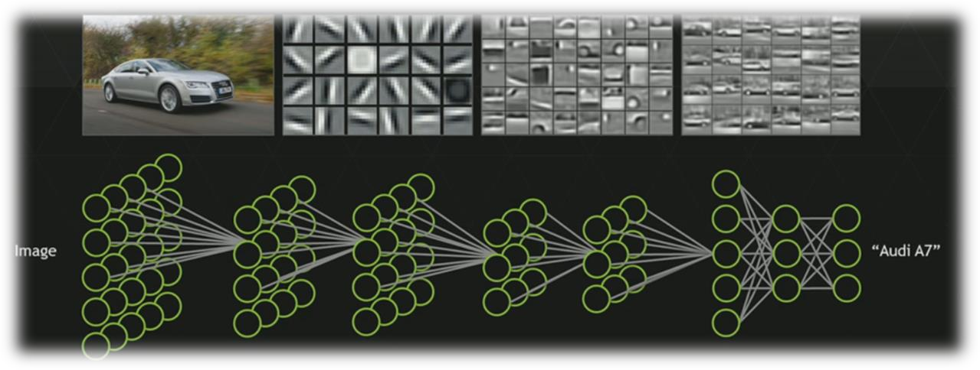
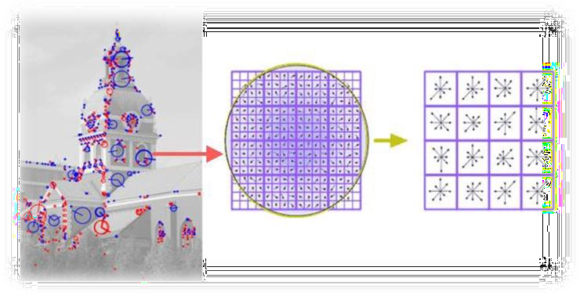
Image Descriptors:
Manually extract features
Deep Learning:
Let machine learning extract most important features
Speeded-Up Robust Features (SURF)
Binary Robust Independent Elementary Features (BRIEF)
Oriented FAST and Rotated BRIEF (ORB)
Scale-Invariant Feature Transform (SIFT)
Histogram of Oriented Gradients (HOG)
HAAR features
etc.
Neural Networks such as Convolutional Neural Networks (CNN) take raw images as input and first process it inside multiple layers to get best features called intrinsic dimension of the data

Slide 21
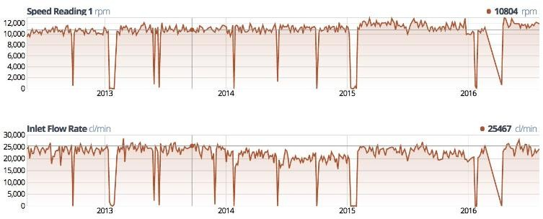
Machine Learning: Overview
Data Types
Time Series
Much difficult to deal with
Enormous Size
Cumbersome Labeling
Not so standard feature extraction strategies as in case of images. (Direct modeling of time series is preferred)

Slide 22
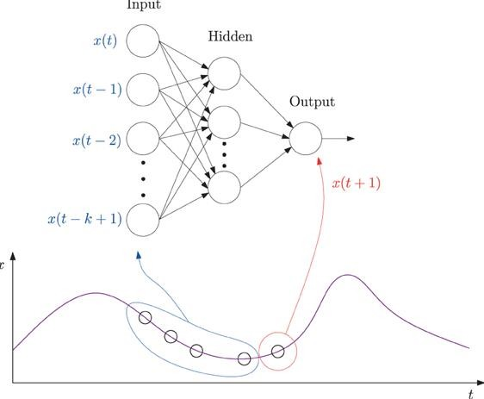
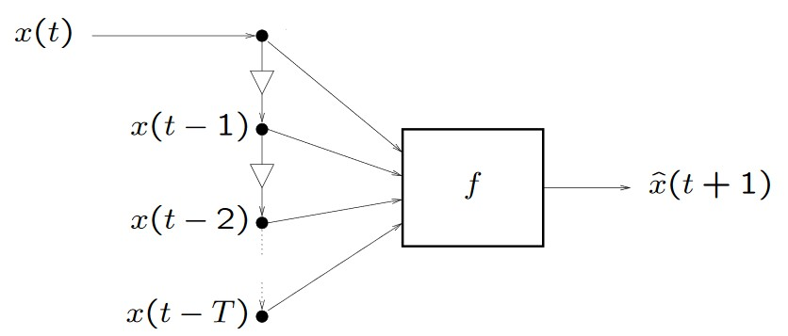
Machine Learning:Let machine learning handle the task !
Time series Models:Manually model it !
Exponential Smoothing (ETS)
Autoregressive Integrated Moving Average (ARIMA) models
Linear regression
Generalized Autoregressive Conditional Heteroskedasticity (GARCH)
Bayesian Models
Vector auto-regression (VAR) models
etc.
Neural Networks such as Convolutional Neural Networks (CNN) take raw waveforms as input and first process it inside multiple layers to get best predictive model for it

Slide 23
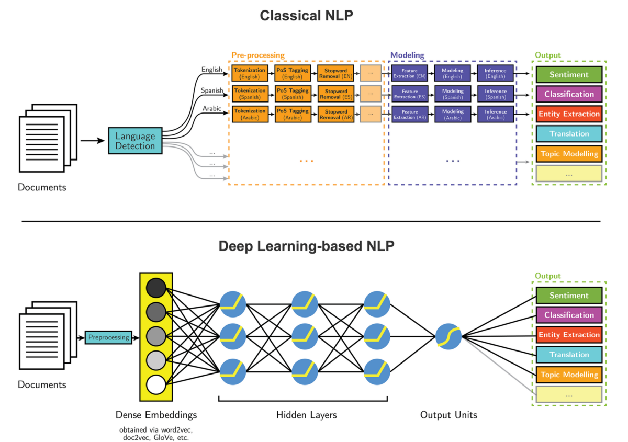

Slide 24
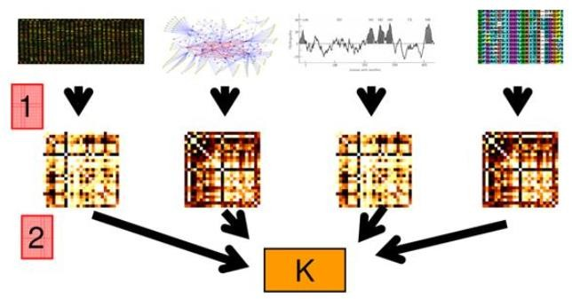
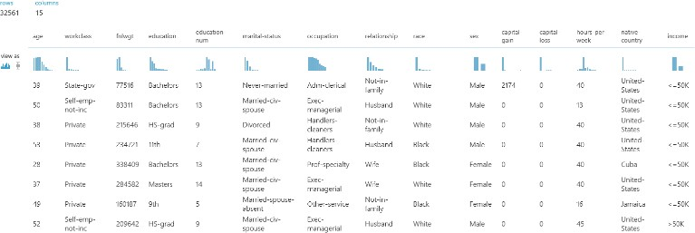
Machine Learning: Overview
Data Types
Heterogeneous data
Multimodal Machine Learning !
+
+

Slide 25
Inductive Learning Process

Slide 26
Inductive Machine Learning Process …
Preparation of Training Data
Learning Scheme OR
Learning Algorithm
Trained Model
Testing and Evaluation
Test Data
Deploy Trained & Tested Model in Domain

Slide 27
Deployed Model…
New/ Unknown Instance
ML Model
Result/ Prediction

Slide 28
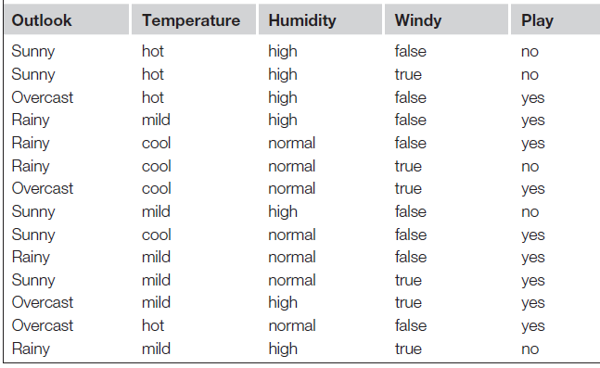
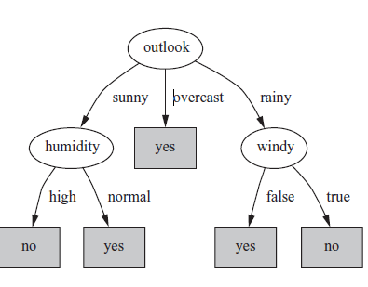
Machine Learning Process
Learning Scheme OR
Learning Algorithm

Slide 29
Attributes
Attribute (or dimensions, features, variables): a data field, representing a characteristic or feature of a data object.
E.g., customer _ID, name, address
Types:
Nominal
Binary
Numeric: (Discrete, Continuous)
Interval-scaled
Ratio-scaled

Slide 30
Attribute Types
Nominal: categories, states, or “names of things”
Hair_color = {auburn, black, blond, brown, grey, red, white}
marital status, occupation, ID numbers, zip codes
Binary
Nominal attribute with only 2 states (0 and 1)
Symmetric binary: both outcomes equally important
e.g., gender
Asymmetric binary: outcomes not equally important.
e.g., medical test (positive vs. negative)
Convention: assign 1 to most important outcome (e.g., HIV positive)
Ordinal
Values have a meaningful order (ranking) but magnitude between successive values is not known.
Size = {small, medium, large}, grades, army rankings

Slide 31
Numeric Attribute Types
Quantity (integer or real-valued)
Interval
Measured on a scale of equal-sized units
Values have order
E.g., temperature in C˚or F˚, calendar dates
No true zero-point
Intangible
We can add and subtract, but we cannot multiply, divide or calculate ratios.
Ratio
Inherent zero-point
tangible
We can speak of values as being an order of magnitude larger than the unit of measurement (10 K˚ is twice as high as 5 K˚).
e.g., temperature in Kelvin, length, counts, monetary quantities

Slide 32
General Characteristics of Data Sets
Dimensionality
The dimensionality of a data set is the number of attributes that the objects in the data set have.
In a particular data set if there are high number of attributes, then it can become difficult to analyze such a data set. This problem is referred as Curse of Dimensionality.
Sparsity
For some data sets, most attributes of an object have values of 0; in many cases fewer than 1% of the entries are non-zero. Such a data is called sparse data or it can be said that the data set has Sparsity.
Resolution
Resolution is the smallest change that can be measured.
Finer resolution reduces rounding errors. However, resolution that is too coarse may add rounding errors.

Slide 33
Supervised Machine Learning

Slide 34
Supervised Machine Learning Types
Types Supervised Machine Learning
Classification
Association
Regression \ Numeric Prediction
Also Known as Predictive Learning

Slide 35
Classification Learning
Supervised Learning
Prediction Belongs to one of distinct\Discrete class
If Prediction Consists of two Classes also known as Binary Prediction
Measure success on fresh data for which class labels are known (test data)

Slide 36
Classification Learning
Classification
Association
Regression \ Numeric Prediction
Class Attribute

Slide 37
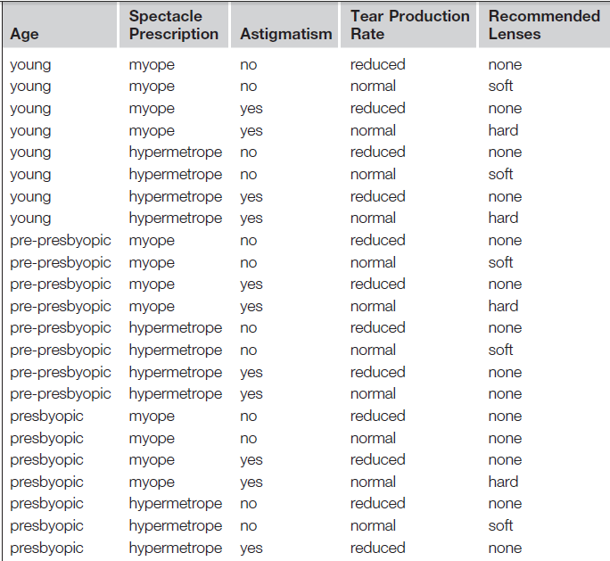
Contact Lens Problem (Classification )
Class Attribute

Slide 38
Classification Algorithms
There are many algorithms for classification. Some of the famous are following:
Decision trees
Naive Bayes classifier
Linear Regression
Logistic regression
Neural networks
Perceptron
Multi Layer Neural Networks
Support vector machines (SVM)
Quadratic classifiers
Instance Based Learning
k-nearest neighbor

Slide 39
Regression \ Numeric Prediction
Variant of classification learning where “class” is numeric (also called “regression”)
Learning is supervised
Scheme is being provided with target value
Measure success on test data
Classification
Association
Regression \ Numeric Prediction

Slide 40
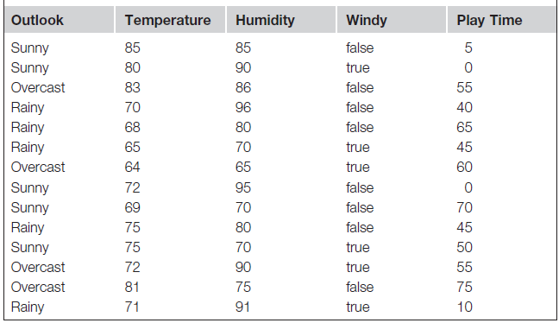
Numeric Prediction

Slide 41
Association Learning
Can be applied if no class is specified and any kind of structure is considered “interesting”
Difference to classification learning:
Can predict any attribute’s value, not just the class, and more than one attribute’s value at a time
Hence: far more association rules than classification rules
Association rules usually involve only nonnumeric attributes

Slide 42
Contact Lens Problem (Association )

Slide 43
Preparation of Training Data…
Preparation of Training Data
Learning Scheme OR
Learning Algorithm
Machine Learning OR Trained Model
Testing and Evaluation

Slide 44
Preparation of Training Data

Slide 45
Components Training Data
Instances/Examples
Individual, independent examples of a concept
Attributes/Features
measuring aspects of an instance
We will focus on nominal and numeric ones

Slide 46
Training Data

Slide 47
Input in form of table
Set of instances/dataset
Represented as a single relation/flat file
Rather restricted form of input
No relationships between objects
Most common form in practical Machine Learning

Slide 48
Attributes OR Features
Each example/Instance is characterized on the basis of fixed, predefined set of features/attributes
Instances may have more features?
Features may depends on each other
Selection of features
Contribution of a feature

Slide 49
Feature Types
Features can be classified on the basis of their values
Nominal
Values are distinct Symbols
Numeric
Either real or integer valued

Slide 50
Feature Types

