Slide 1
Week 10: Machine Learning

Slide 2
Last Lecture..
Classification Evaluation

Slide 3
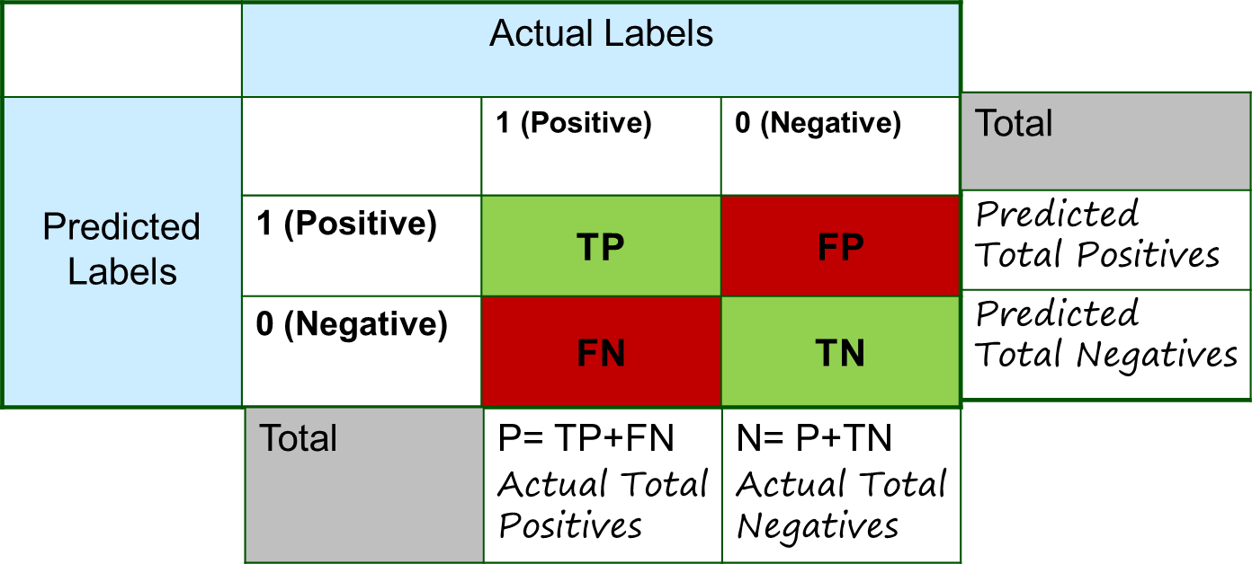
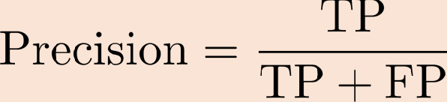
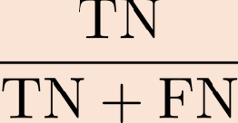
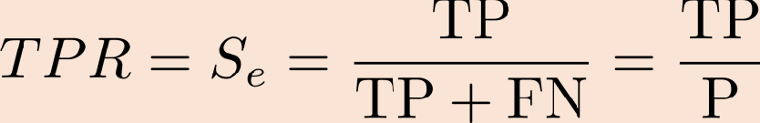
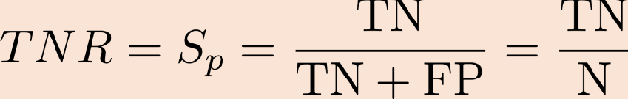
Evaluation of Classification Performance
Confusion Matrix Metrics:
Negative Predicted Value

Slide 4
Trade-offs
Precision and Sensitivity (Recall) Trade-off
Sensitivity and Specificity Trade-off

Slide 5
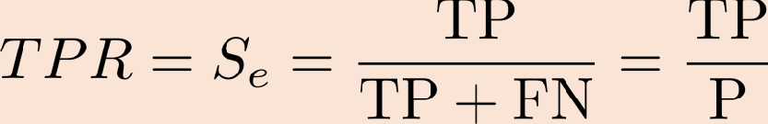
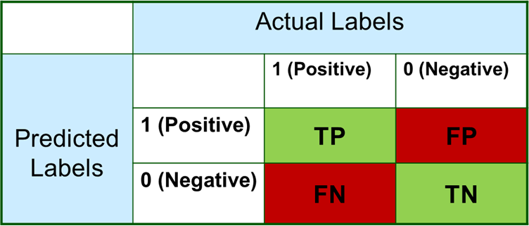

Evaluation of Classification Performance
Confusion Matrix: Precision and Sensitivity (Recall) Trade-off:
- Disease Detection:
Sensitivity or Recall Precision
We want high Precision and high S_{e} (=1, Ideally).
We should combine precision and sensitivity to evaluate the performance of classifier.
- F1-Score
Classifier only get a high F1 score if both recall and precision are high.

Slide 6


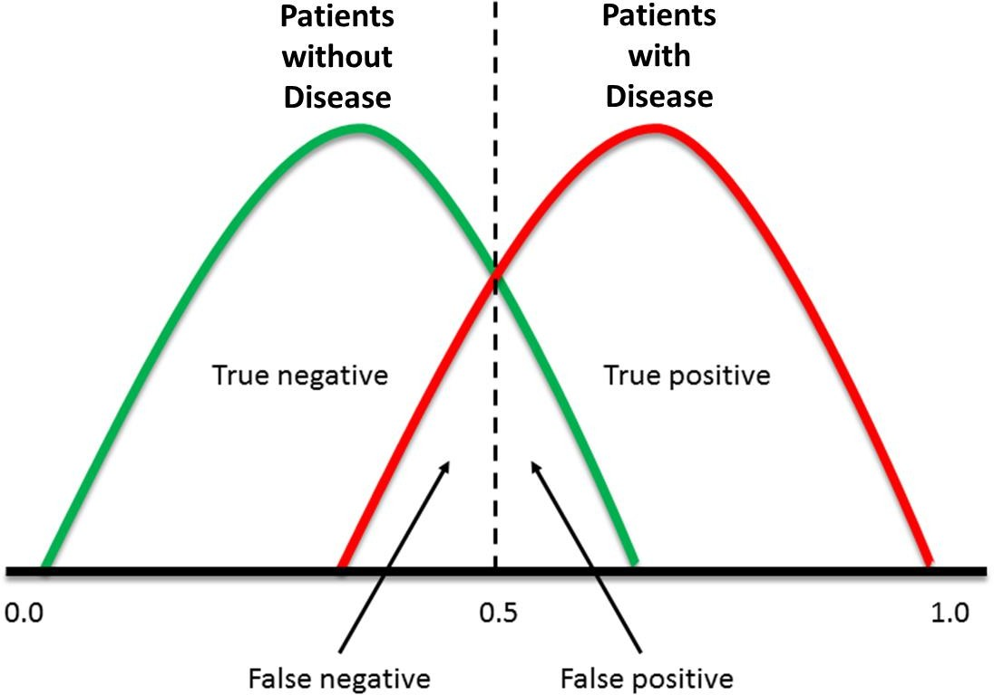
Evaluation of Classification Performance
Confusion Matrix: Sensitivity and Specificity Trade-off:
How optimal a pair of sensitivity, specificity values is?
- Is S_{p}= 0.8, S_{e}= 0.7 better than S_{p}= 0.7, S_{e}= 0.8?
The answer depends on the application.
In disease diagnosis;
- happy to reduce S_{p} in order to increase S_{e}.
In other applications, we may have different requirements.
Trade-off is better explained by ROC curve and AUC.
Threshold
S_{e}= 1 S_{p}= 1

Slide 7
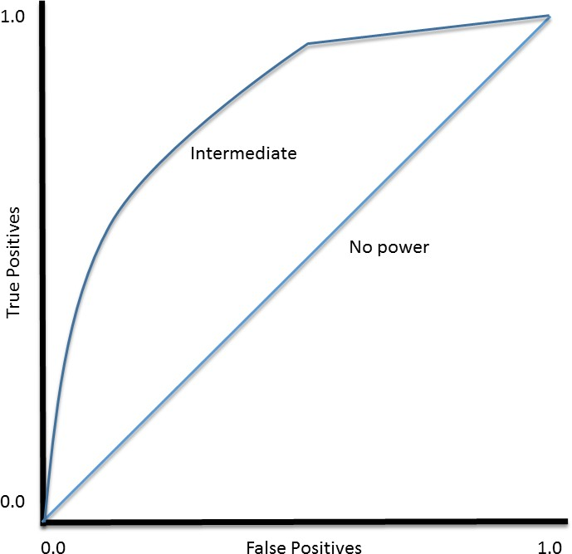
Evaluation of Classification Performance
Confusion Matrix:
ROC Curve and AUC:
TPR (Sensitivity): how many correct positive results occur among all positive samples.
FPR (1 – Specificity): how many incorrect positive results occur among all negative samples.
The best possible prediction method
- S_{e} = S_{p} = 1 (Upper left corner of ROC space)
ROC Curve

Slide 8
Multinomial Evaluations

Slide 9
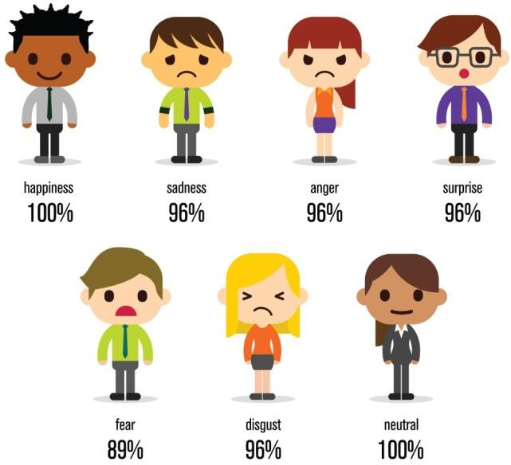
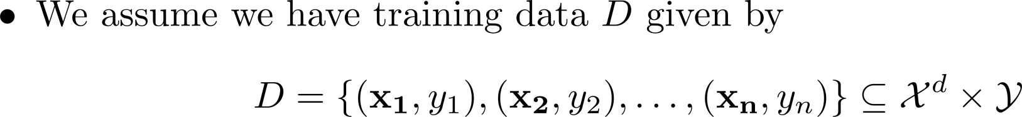

Multi-Class Classification
Formulation:
Examples:
Emotion Detection.
Vehicle Type, Make, model, color of the vehicle from the images streamed by safe city camera.
Speaker Identification from Speech Signal.
State (rest, ramp-up, normal, ramp-down) of the process machine in the plant.
Sentiment Analysis (Categories: Positive, Negative, Neutral), Text Analysis.
Take an image of the sky and determine the pollution level (healthy, moderate, hazard).
Record Home WiFi signals and identify the type of appliance being operated.

Slide 10
Evaluation of Classification Performance
Multiclass Classification:
How do we define the measures for the evaluation of the performance of multi-class classifier?
Macro-averaging: We compute performance for each class and then average.
Micro-averaging: Compute confusion matrix after collecting decisions for all classes and then evaluate.

Slide 11






Evaluation of Classification Performance
Multiclass Classification: Confusion Matrix
Predict if a bowler will bowl a no-ball, wide bowl, regular bowl?
15 no-balls, 20 wide-balls in an inning (Total balls: 335)
Model Predictions:
Actual
Wide-ball Regular ball
No-ball
Precision
8 | 5 | 20
2 | 10 | 10
5 | 5 | 270
No-ball
Classifier Output
Wide-ball
Regular ball
Recall

Slide 12
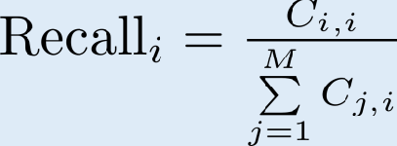
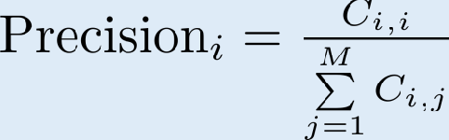
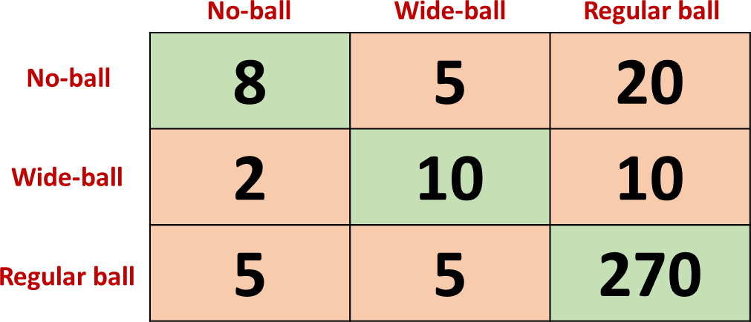
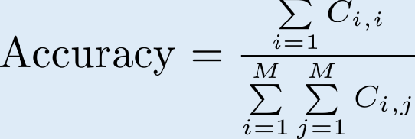
Evaluation of Classification Performance
Multiclass Classification: Confusion Matrix – Recall and Precision:
Recall
For i-th class, recall represents the fraction of data-points classified correctly, that is,
Precision
For i-th class, precision represents the fraction of data-points
predicted to be in class i are actually in the i-th class, that is,
Accuracy
Fraction of data points classified correctly, that is,

Slide 13
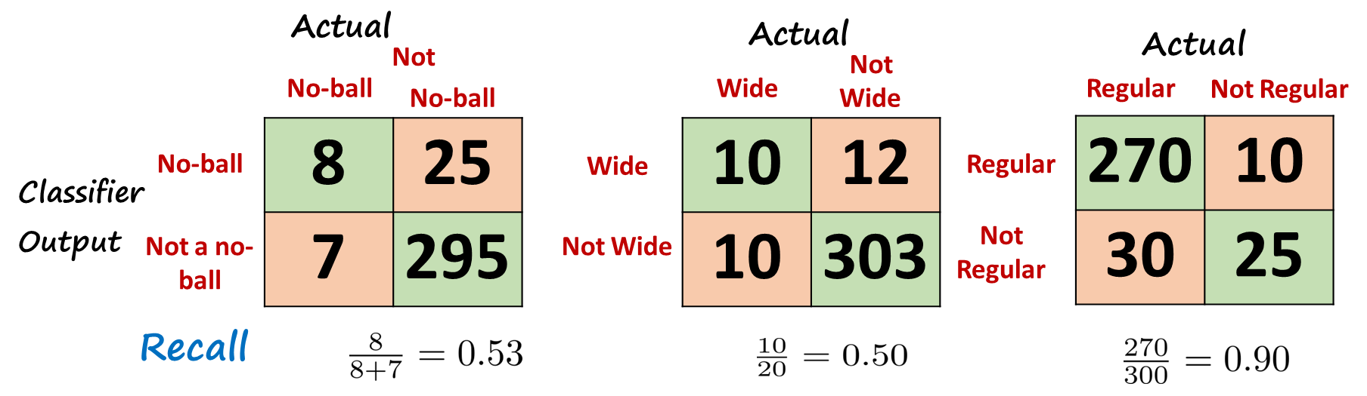

Evaluation of Classification Performance
Multiclass Classification:Confusion Matrix – Macro-Averaging:
- We compute performance for each class and then average.
Confusion Matrix – Each Class:
Macro-average Recall:

Slide 14
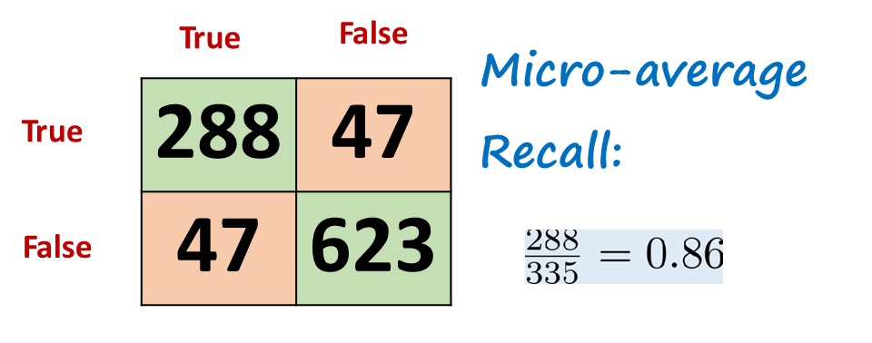
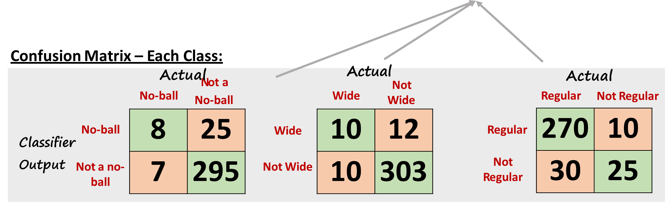
Multiclass Classification Evaluation
Confusion Matrix – Micro-Averaging:
- Compute confusion matrix after collecting decisions for all classes and then evaluate.

Slide 15
Micro-Averaging vs Macro Averaging:
Micro-average is termed as a global metric.
Consequently, it is not a good measure when classes are not balanced.
Macro-average is relatively a better as we can see a zoomed-in picture before averaging.
Note Macro-averaging does not take class imbalance into account.

Slide 16
Artificial Neural Networks (ANN)

Slide 17
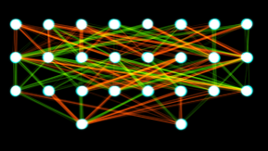
Neural Networks
Inspired by the networks of brain cells called neurons.
Other names the field include connectionism, parallel distributed processing, and neural computation.
The neuron devised by McCulloch and Pitts (1943). Roughly speaking, it “fires” when a linear combination of its inputs exceeds some (hard or soft) threshold
A neural network is just a collection of units connected together;

Slide 18
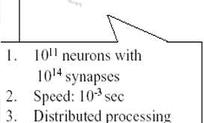
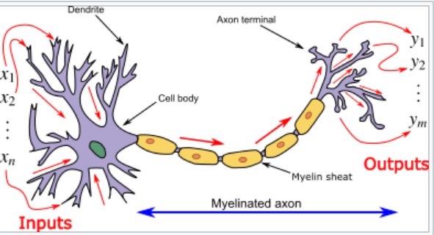
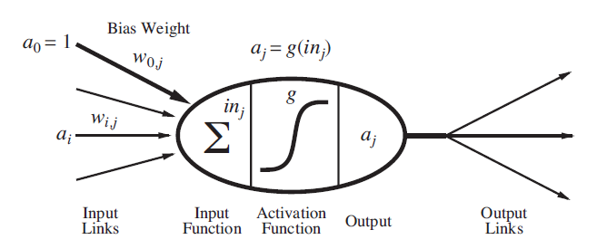
Biological Neuron Vrs. Artificial Neuran

Slide 19
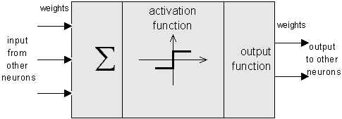
Artificial Neuron Architecture
Input Signal, x_{i}:
Features of Training Data
Also included a Bias input which is 1
Set of real valued weights, w_{i}:
The weight describe the connection strength
Aggregation of input signals, Σx_{i}w_{i}:
Sum of weighted inputs
Activation Function: h_{w}(x)
This function determine the output of neuron
Options are Hard limiter OR Sigmoid

Slide 20
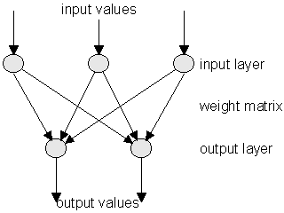
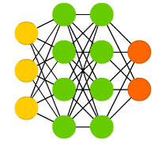
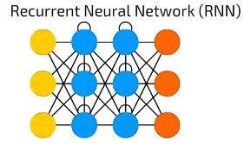
Network Architecture
The network topology: pattern of connection between the individual neuron
A feed-forward network has connections only in one direction
Feed-forward networks are usually arranged in layers,
Perceptron: 1 Input Layer , 1 Output Layer
Multi Layer Peceptron:1 Input Layer, 1 or More Hidden Layers, 1 Output Layer
RECURRENT network, on the other hand, feeds its outputs back into its own inputs.

Slide 21
Artificial Neuron Architecture

Slide 22
Network Architecture
Perceptron: 1 Input Layer , 1 Output Layer

Slide 23
Before Discussing Multilayer Perceptron (MLP) Lest first Discuss Activation Function and Loss Function
Activation Function
Activation Function decides Output of Neuron
Objective/Loss Function

Slide 24
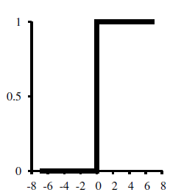
Activation Function (Hard)
Hard Limiter/Step Function: The hard threshold function Threshold (z) with 0/1 output.
Issues
hypothesis hw(x) is not differentiable this makes learning with the perceptron rule a very unpredictable adventure.
The linear classifier always announces a completely confident prediction of 1 or 0,even for examples
Cannot be used with gradient descent

Slide 25


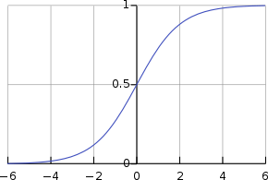

Activation Function (Soft)
Logistic Function known as Sigmoid function has very good mathematical properties it always produces a value between 0 to 1
The output, can be interpreted as a probability of belonging to the class labeled 1 OR 0

Slide 26





Neural Networks
Sigmoid:
Issues:

Slide 27
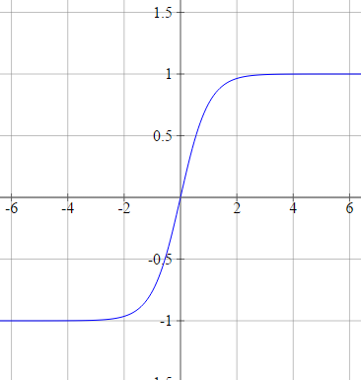




Neural Networks
tanh (Hyperbolic tangent):
Issues:

Slide 28
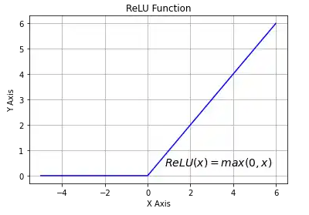
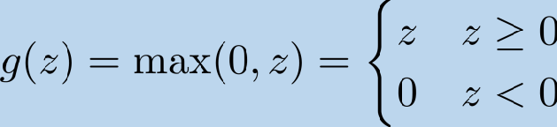


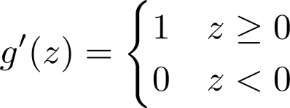
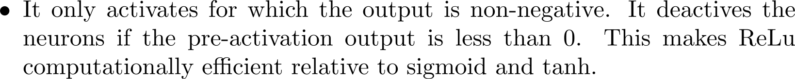
Neural Networks
Rectifier – Rectified Linear Unit (ReLu):
Why?
Issues:
Different variants of ReLu have been proposed to overcome these issues.

Slide 29
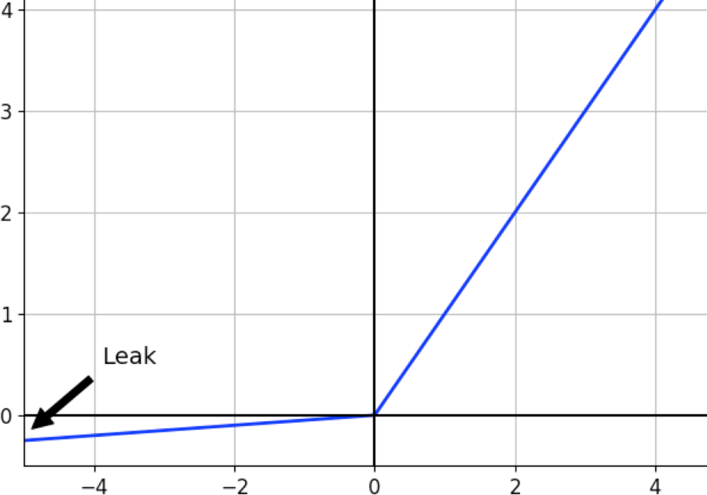

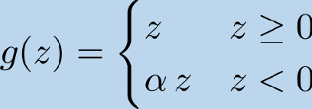
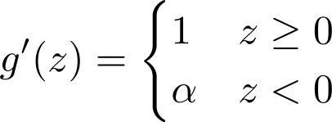
Neural Networks
Leaky Rectified Linear Unit (Leaky ReLu):
We use rectified linear, leaky rectified linear sigmoid and tanh for hidden layer.

Slide 30
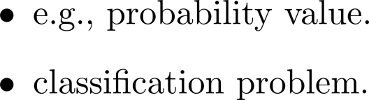
Neural Networks
Activation Function for output layer:

Slide 31
Neural Networks
Choice of the Activation Function:
For classification tasks;
we prefer to use sigmoid, tanh functions and their combinations.
Due to the saturation problem, sigmoids and tanh functions are sometimes avoided.
As indicated earlier, ReLU function is mostly used (computationally fast).
ReLu variants are used to resolve a dead neuron issue (e.g., Leaky ReLu).
It must be noted that ReLU function is only used in the hidden layers.
Start with ReLu or leaky/randomized Relu and if the results are not satisfactory, you may try other activation functions.

Slide 32
Multi-Layer Perceptron (MLP)

Slide 33
Multi-Layer Perceptron
The Multi-Layer-Perceptron was first introduced by M. Minsky and S. Papert in 1969.
It is an extended Perceptron and has one or more hidden neuron layers between its input and output layers.
Due to its extended structure, a Multi-Layer-Perceptron is able to solve every logical operation, including the XOR problem

Slide 34
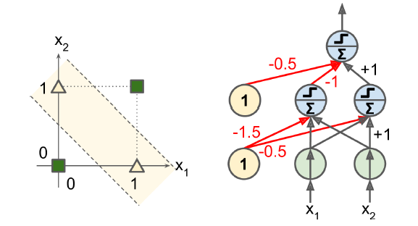
Multi-Layer Perceptron

Slide 35
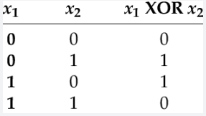
XOR Problem
1.5
(1*1.5)+(1*-1)+(1*-1)=-0.5
so output is 0
-1
1
1
-1
(1*.5)+(1*1)+(1*-1)=-0.5
Output is 0
-1
-1
1
-1
-0.5
(1*0.5)+(1*-1)+(1*-1)=-1.5
so output is 0
0.5
Activation function we use:
1 if net is >0
h(net)=
0 if net is <0
This architecture is known as
Multilayer Perceptron/Network

Slide 36
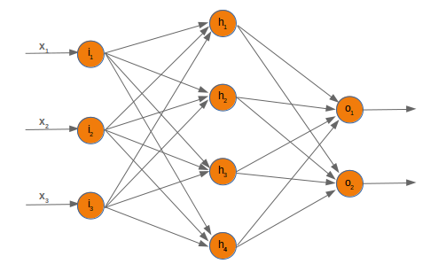
Multi-Layer Perceptron
Type | Feed Forward
Neuron Layer | 1 input layer , 1 output layer 1 or more hidden layers
Input Values types | Binary
Activation Function | Hard Limiter /Sigmoid
Learning Methods | Supervised
Learning Algorithm | Delta Learning rules, Back Propagation
Mainly Used in | Complex logical operations pattern classification

Slide 37



Neural Networks
Neural Networks:
Example: 3-layer network, 2 hidden layers
Feedforward Neural Network:
Output from one layer is an input to the next layer.

Slide 38














Neural Networks
Neural Networks – Notation:
Example: 3-layer network, 2 hidden layers

