Slide 1
Week 5: Machine Learning

Slide 2
Last Lecture..
Linear Regression

Slide 3
Model Based Approach
Different from KNN: Linear regression adopts a modular approach which we will use most of the times in the course.
Select a model
Defining a loss function
Formulate an optimization problem to find the model parameters such that a loss function is minimized.
Employ different techniques to solve optimization problem or minimize loss function

Slide 4
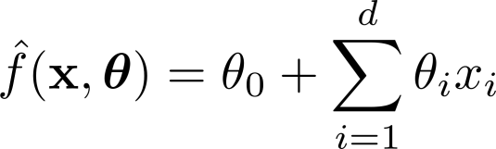

Linear Regression
Model:
h_{w}(x)=w₁x + w₀

Slide 5
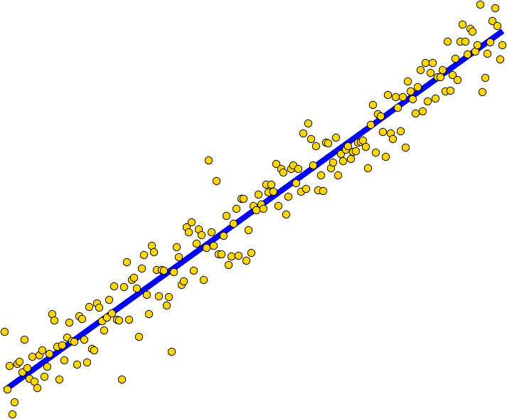


Linear Regression
Model:
What is Linear?
𝐨𝐫 𝒚
𝐨𝐫 𝒚

Slide 6
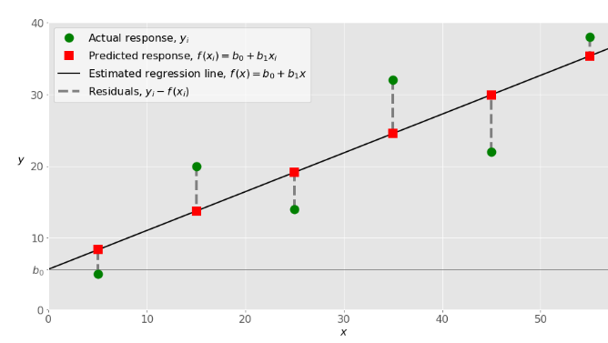
Loss Function

Slide 7
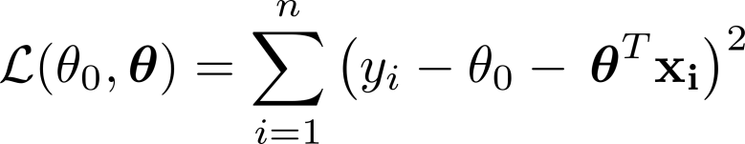
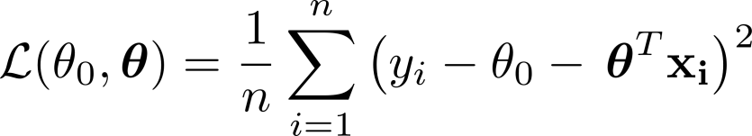
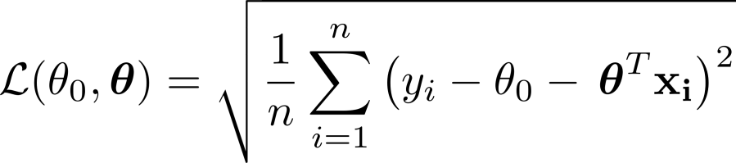
Define Loss Function:

Slide 8

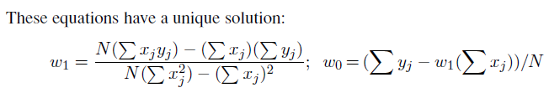
Closed Form

Slide 9
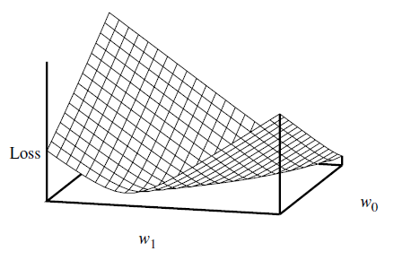
WEIGHT SPACE
Many forms of learning involve adjusting weights to minimize a loss,
So it helps to have a mental picture of what’s going on in weight space—the space defined by all possible settings of the weights.
For univariate linear regression, the weight space defined by w₀ and w₁ is two-dimensional, so we can graph the loss as a function of w0 and w1

Slide 10
WEIGHT SPACE
We see that the loss function is convex, this is true for every linear regression problem with an L2 loss function,
This implies that there are no local minima.
In some sense that’s the end of the story for linear models; if we need to fit lines to data, we apply Closed form equations

Slide 11
Gradient Descent
To go beyond linear models, we will need to face the fact that the equations defining minimum loss will often have no closed-form solution. Instead, we will face a general optimization search problem in a continuous weight space
Such problems can be addressed by a hill-climbing algorithm that follows the gradient of the function to be optimized.
In this case, because we are trying to minimize the loss, we will use gradient descent.
We choose any starting point in weight space a point in the (w0, w1) plane—and then move to a neighboring point that is downhill, repeating until we converge on the minimum possible loss:

Slide 12
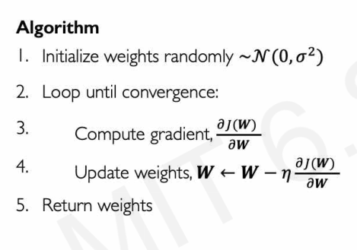
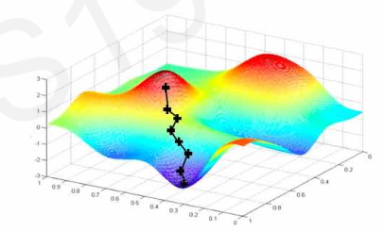
Gradient Descent

Slide 13
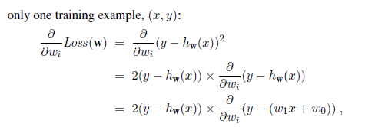

Gradient Descent

Slide 14

Gradient Descent
The preceding equations cover one training example. For N training examples, we want to minimize the sum of the individual losses for each example
These updates constitute the batch gradient descent learning rule for univariate linear regression.

Slide 15
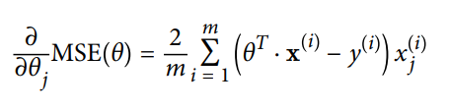
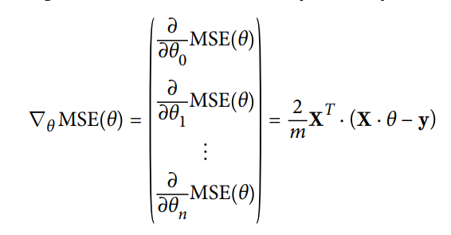


Slide 16
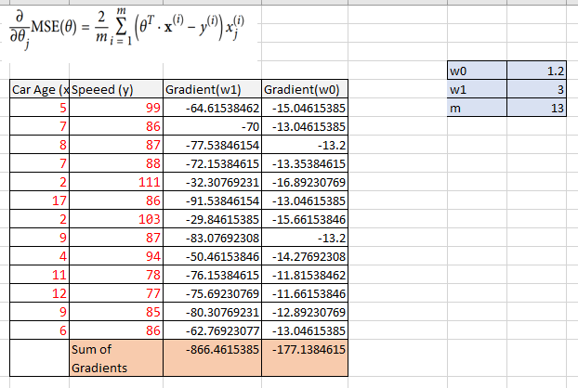
Gradient

Slide 17

Gradient Descent
import matplotlib.pyplot as plt
from scipy import stats
import numpy as np
X = np.array([5,7,8,7,2,17,2,9,4,11,12,9,6])
y = np.array([99,86,87,88,111,86,103,87,94,78,77,85,86])
y=y.reshape(13,1)
eta = 0.1
n=len(X)
X_b = np.c_[np.ones((n, 1)), X] # add x0 = 1 to each instance
theta = np.random.randn(2,1) # random initialization
print("Before=",theta)
gradients = 2/n * X_b.T.dot(X_b.dot(theta) - y)
theta = theta - eta * gradients
print("After=",theta)

Slide 18
Gradient Descent Implementation
eta = 0.1 # learning rate
n_iterations = 100
m = 100
theta = np.random.randn(2,1) # random initialization
for iteration in range(n_iterations):
gradients = 2/m * X_b.T.dot(X_b.dot(theta) - y)
theta = theta - eta * gradients
X_new = np.array([[0], [2]])
X_new_b = np.c_[np.ones((2, 1)), X_new]
y_predict = X_new_b.dot(theta)
plt.plot(X_new, y_predict, "r")
print(theta)
plt.plot(X, y, "b.")
plt.axis([0, 2, 0, 15])
plt.show()

Slide 19
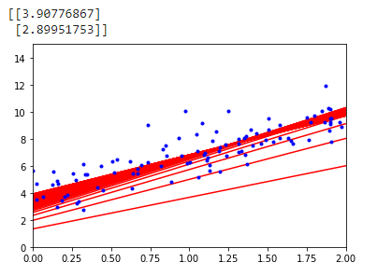
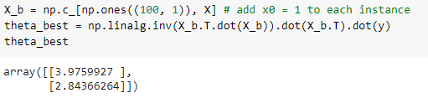
Gradient Descent Implementation

Slide 20
Gradient Descent

Slide 21
Batch Gradient Descent
Notice that this Algorithm involves calculations over the full training set X, at each Gradient Descent step! This is why the algorithm is called Batch Gradient Descent:
It uses the whole batch of training whole data at every step. As a result it is terribly slow on very large training sets

Slide 22
Learning Rate
The parameter η, which we called the Learning Rate/step size
Its value is very important for Gradient Descent
It determine the speed of learning
Fix Value or entire learning : We can try Small, Large and medium values
Adaptive Value:

Slide 23
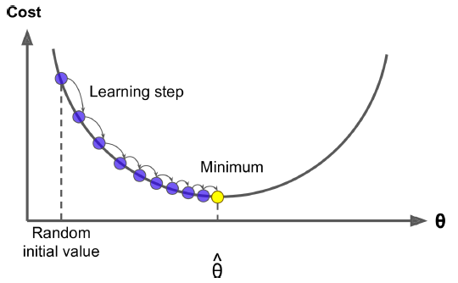
Gradient Descent Algorithm
The parameter η, which we called the step size

Slide 24
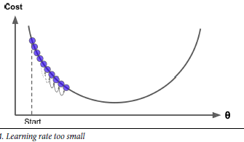
Gradient Descent

Slide 25
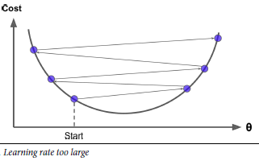
Gradient Descent

Slide 26
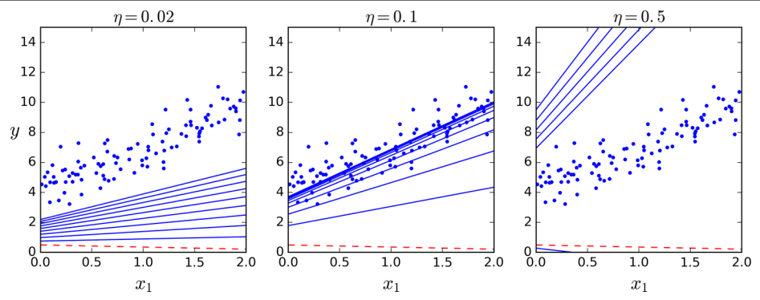
Learning Rate Effects

Slide 27
Stochastic Gradient Descent
At the opposite extreme, Stochastic Gradient Descent just picks a random instance in the training set at every step and computes the gradients based only on that single instance.
Obviously this makes the algorithm much faster since it has very little data to manipulate at every iteration.
It also makes it possible to train on huge training sets, since only one instance needs to be in memory at each iteration (SGD can be implemented as an out-of-core algorithm

Slide 28
Stochastic Gradient Descent
On the other hand, due to its stochastic (i.e., random) nature, this algorithm is much less regular than Batch Gradient Descent: instead of gently decreasing until it reaches the minimum, the cost function will bounce up and down, decreasing only on aver‐ age. Over time it will end up very close to the minimum, but once it gets there it will continue to bounce around, never settling down
So once the algorithm stops, the final parameter values are good, but not optimal

Slide 29
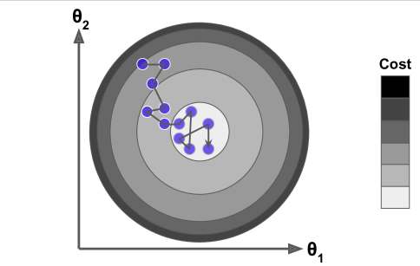
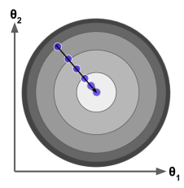
Stochastic & Batch GD

Slide 30
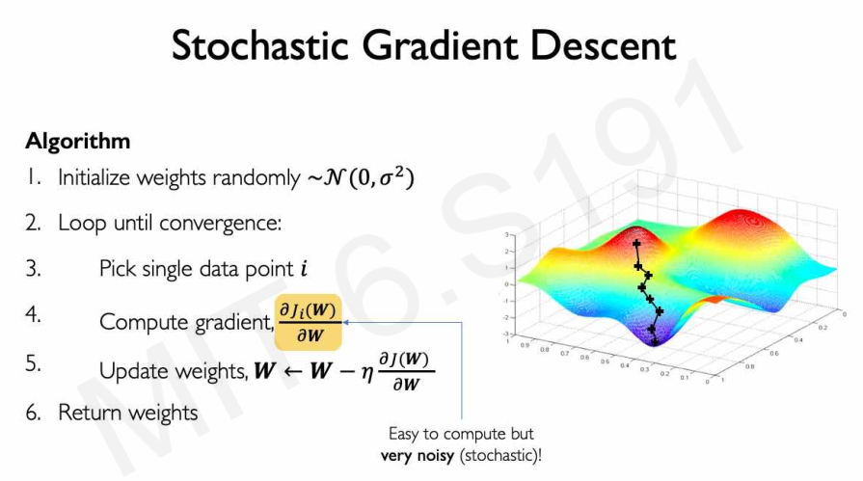

Slide 31
Mini-batch Gradient Descent
At each step, instead of computing the gradients based on the full training set (as in Batch GD) or based on just one instance (as in Stochastic GD), Mini batch GD computes the gradients on small random sets of instances called minibatches.
The main advantage of Mini-batch GD over Stochastic GD is that you can get a performance boost from hardware optimization of matrix operations, especially when using GPUs.
The algorithm’s progress in parameter space is less erratic than with SGD, especially with fairly large mini-batches.

Slide 32
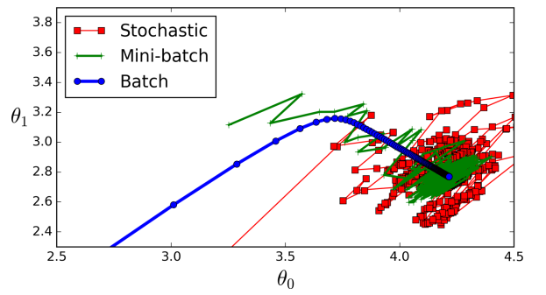
Mini-batch Gradient Descent

Slide 33
Simulated Annealing
Therefore randomness is good to escape from local optima, but bad because it means that the algorithm can never settle at the minimum.
One solution to this dilemma is to gradually reduce the learning rate.
The steps start out large (which helps make quick progress and escape local minima), then get smaller and smaller, allowing the algorithm to settle at the global minimum.

Slide 34
Simulated Annealing
This process is called simulated annealing, because it resembles the process of annealing in metallurgy where molten metal is slowly cooled down
The function that determines the learning rate at each iteration
is called the learning schedule

Slide 35
LINEAR REGRESSION
A univariate linear function (a straight line) with input x and output y
h_{w}(x)=w₁x + w₀ .
The task of finding the h_{w} that best fits these data is called linear regression.
To fit a line to the data, all we have to do is find the values of the weights [w₀,w₁] that minimize the empirical loss.

Slide 36
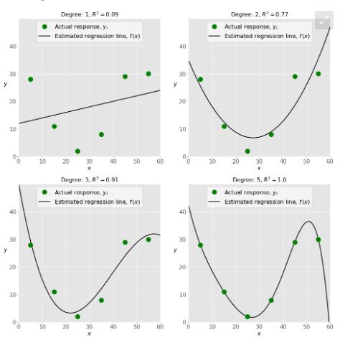

Slide 37
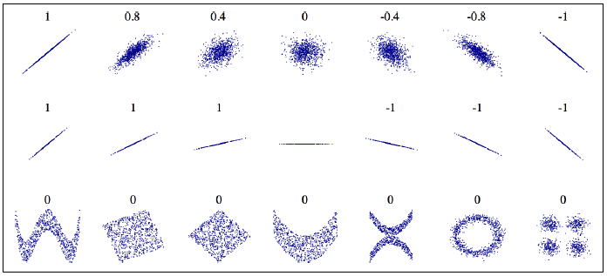
Correlation Coefficient

Slide 38

MULTIVARIATE LINEAR REGRESSION
We can easily extend to multivariate linear regression problems, in which each example x_{j} is an n-element vector.
Our hypothesis space is the set of functions of the form

