Slide 1
Week 7: Machine Learning

Slide 2
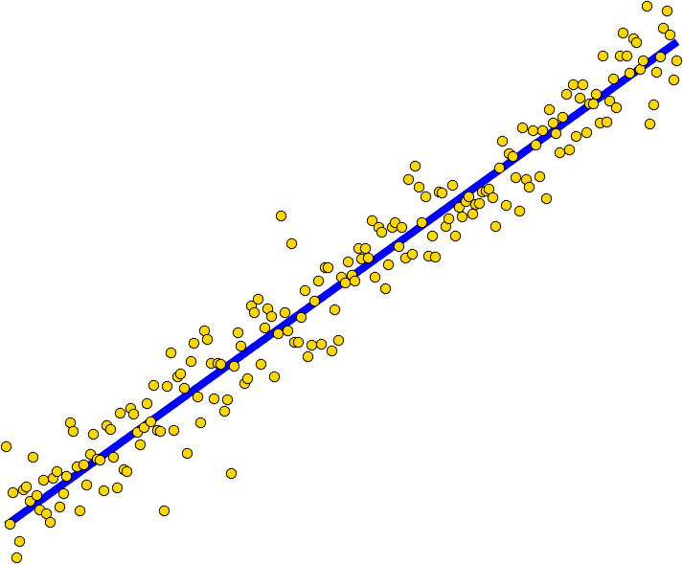

Last Lecture..
𝒚
Polynomial Regression
Regularization
How to Learn?
Closed Form
Gradient Descent
Learning→
Prediction→
Parametric Learning: No need to keep data, once you have learned Weights/Parameter

Slide 3
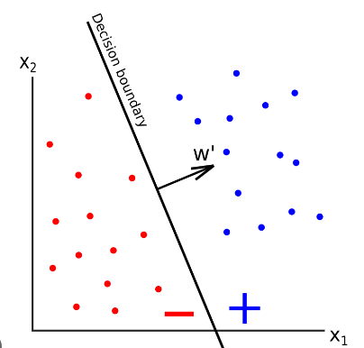
Linear Classification
𝒚

Slide 4
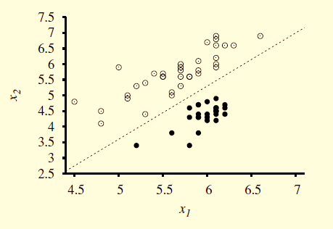
Decision Boundary
A decision boundary is a line (or a surface, in higher dimensions) that separates the two classes.
If decision boundary is a straight line is call Linear Separator
− 4.9 + 1.7x₁ − x₂ = 0
decision boundary
body wave magnitude: x1 and surface wave magnitude x2, earthquakes (white circles) and nuclear explosions (black circles)

Slide 5
Model Based Approach
Select a model
Defining a loss function
Formulate an optimization problem to find the model parameters such that a loss function is minimized.
Employ different techniques to solve optimization problem or minimize loss function

Slide 6
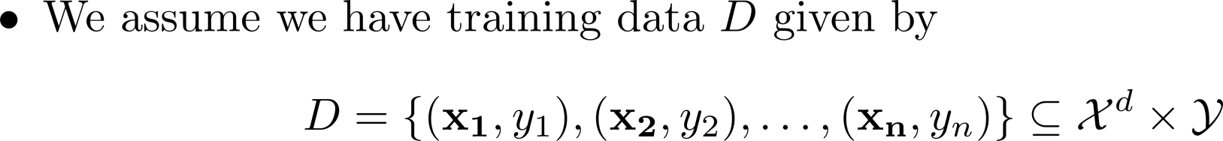
Classification
Binary or Binomial Classification:
- Disease detection, spam email detection, fraudulent transaction, win/loss prediction, etc.
Multi-class (Multinomial) Classification:
Emotion Detection, Vehicle Type, Make, model, of the vehicle from the images streamed by road cameras. Speaker Identification from Speech Signal. Sentiment Analysis (Categories: Positive, Negative, Neutral), Text Analysis.
Take an image of the sky and determine the pollution level (healthy, moderate, hazard).

Slide 7
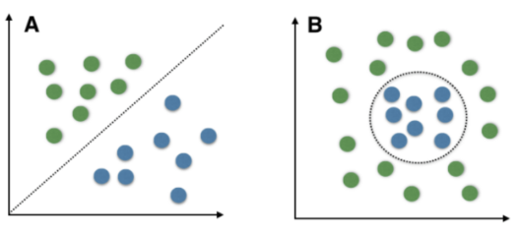
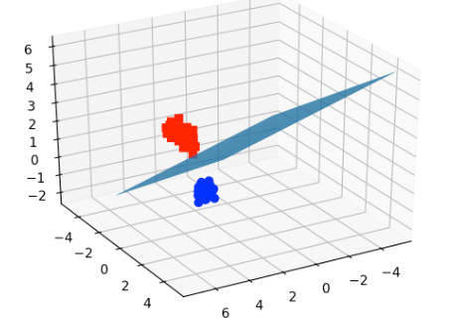
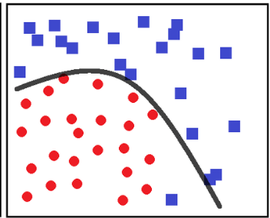
Decision Boundaries

Slide 8
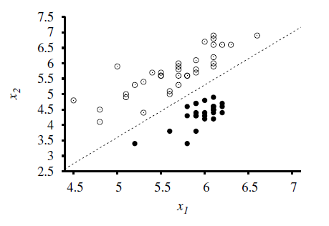
Linear Separability (Decision Making)
The data that admit such a separator are called linearly separable.
The linear separator in this case is defined by − 4.9 + 1.7x₁ − x₂ = 0

Slide 9
Linear Separability (Decision Making)
Threshold function
Class 1 (explosions), are to the right of this line with higher values of x₁ and lower values of x₂, so they are points for which −4.9 + 1.7x₁ − x₂ > 0,
Class 2 (earthquakes) have −4.9 + 1.7x₁ − x₂ < 0.
h_{w}(x) = 1 if w ・ x ≥ 0 and 0 otherwise.
Class 2 (earthquakes)
Class 1 (explosions),

Slide 10
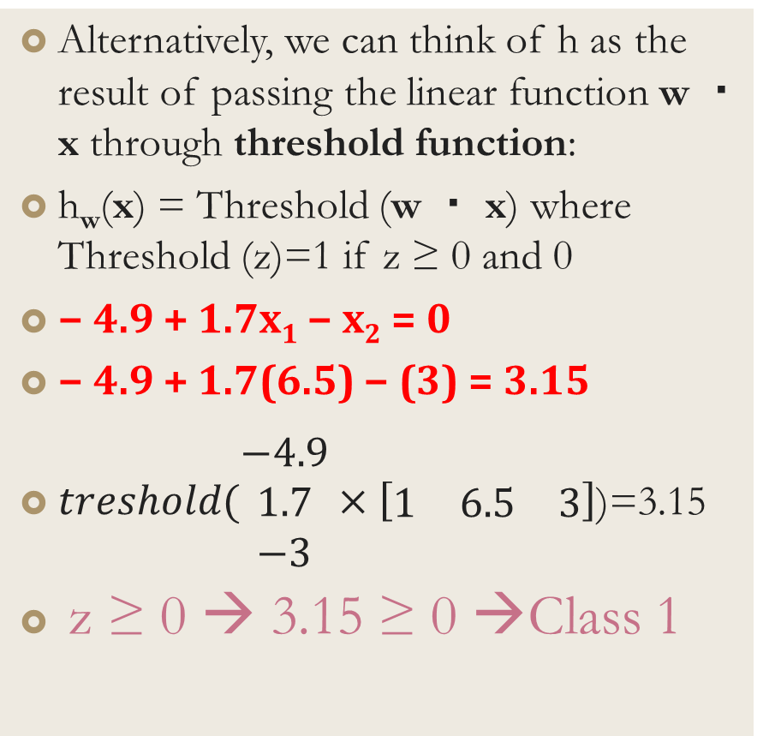
Threshold function
Alternatively, we can think of h as the result of passing the linear function w ・ x through threshold function:
h_{w}(x) = Threshold (w ・ x) where Threshold (z)=1 if z ≥ 0 and 0
− 4.9 + 1.7x₁ − x₂ = 0
− 4.9 + 1.7(6.5) − (3) = 3.15
$treshold(\begin{matrix}−4.9 \\ 1.7 \\ −3\end{matrix}×\left[\begin{matrix}1 & 6.5 & 3\end{matrix}\right]$)=3.15
z ≥ 0 → 3.15 ≥ 0 →Class 1
Class 2 (earthquakes)
Class 1 (explosions),

Slide 11
Hard Limiter Threshold function
z ≥ 0 → 3.15 ≥ 0 →Class 1
If function predict only two values (0,1)…(1,-1) etc.
Class 2 (earthquakes)
Example:
If we set θ = 0.5, then:
f(0.7)=1, (since 0.7 ≥ 0.5)
f(0.3)=0, (since 0.3 < 0.5)
Class 1 (explosions),

Slide 12
How to Learn Weights (Parameters) ?
Perceptron Learning Rule
Logistic Regression
Support Vector Machines (SVM)

Slide 13
Perceptron Learning
Perceptron uses a simple form of supervised learning
If the result is incorrect, the perceptron changes its weights, in order to reduce the error w_{i} ← w_{i} + α (y − h_{w}(x))×x_{i}

Slide 14
Perceptron Learning
w_{i} ← w_{i} + α (y − h_{w}(x))×x_{i}
Both the true value y and the hypothesis output hw(x) are either 0 or 1, so there are three possibilities:
If the output is correct, i.e., y =h_{w(}x), then the weights are not changed.
If y is 1 but h_{w}(x) is 0, then w_{i} is increased when the corresponding input xi is positive and decreased when x_{i} is negative.
• If y is 0 but h_{w}(x) is 1, then w_{i} is decreased when the corresponding input xi is positive and increased when xi is negative.

Slide 15
Classification Example
x₁ | x₂ | output
1.0 | 1.0 | 1
9.4 | 6.4 | -1
2.5 | 2.1 | 1
8.0 | 7.7 | -1
0.5 | 2.2 | 1
7.9 | 8.4 | -1
7.0 | 7.0 | -1
2.8 | 0.8 | 1
1.2 | 3.0 | 1
7.8 | 6.1 | -1
Activation Function: h_{w}(x)= h_{w}(w₁*x₁+ w₂*x₂ +w₃*1)
x₁
w₁
x₂
w₂
h_{w}(x)
bias
w₃

Slide 16
Activation Function
Activation Function of perceptron is either –1 or 1
It uses a simple hard limiting function
Activation above threshold results in an output value of 1 and –1 otherwise
1 if Σx_{i}w_{i} >= 0
-1 if Σx_{i}w_{i} < 0

Slide 17
Classification Example
x₁ | x₂ | output
1.0 | 1.0 | 1
9.4 | 6.4 | -1
2.5 | 2.1 | 1
8.0 | 7.7 | -1
0.5 | 2.2 | 1
7.9 | 8.4 | -1
7.0 | 7.0 | -1
2.8 | 0.8 | 1
1.2 | 3.0 | 1
7.8 | 6.1 | -1
h_{w}(x)=h_{w}(w₁*x₁+ w₂*x₂ +w₃*1)
x₁
w₁
1 if Σx_{i}w_{i} >= 0
-1 if Σx_{i}w_{i} < 0
x₂
w₂
h(x)
bias
w₃
Random weights=[.75,.5,-.6]
Iteration1:h_{w}(x)¹=h(.75*1+.5*1-.6*1)=h(.65)=1
Iteration2: h_{w}(x)²=h(.75*9.4+.5*6.4-.6*1)=h(9.65)=1

Slide 18
Classification Example
x₁ | x₂ | output
1.0 | 1.0 | 1
9.4 | 6.4 | -1
2.5 | 2.1 | 1
8.0 | 7.7 | -1
0.5 | 2.2 | 1
7.9 | 8.4 | -1
7.0 | 7.0 | -1
2.8 | 0.8 | 1
1.2 | 3.0 | 1
7.8 | 6.1 | -1
w^{t}= w_{i} ← w_{i-1} + α (y − h_{w}(x))×x_{i-1}
w³=w²+0.2(-1-1))x²
h(x)³=h(-3.01*2.5-2.06*2.1-1.0*1)
=h(-12.84)=-1
after 500 iterations accuracy is 90%:
Weight vector converges to: [-1.3,-1.1,10.9]

Slide 19
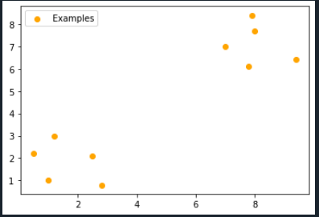
Classification Example
x₁ | x₂ | output
1.0 | 1.0 | 1
9.4 | 6.4 | -1
2.5 | 2.1 | 1
8.0 | 7.7 | -1
0.5 | 2.2 | 1
7.9 | 8.4 | -1
7.0 | 7.0 | -1
2.8 | 0.8 | 1
1.2 | 3.0 | 1
7.8 | 6.1 | -1
w^{t}= w_{i} ← w_{i-1} + α (y − h_{w}(x))×x_{i-1}
import matplotlib.pyplot as plt
x1 = [1.0,9.4,2.5,8.0,0.5,7.9,7.0,2.8,1.2,7.8]
x2 = [1.0,6.4,2.1,7.7,2.2,8.4,7.0,0.8,3.0,6.1]
plt.scatter(x1,x2,c="orange",label="Examples")
plt.legend()
plt.show()

Slide 20
Neural Network
Earliest example of neural computing is the McCulloch-Pitts neuron
Input to the this neuron is either excitatory(+1) or inhibitory(-1)
The activation function multiplies each input with its corresponding weight and sums the results
If the sum is greater than or equal to zero, the neuron return 1,otherwise,-1

Slide 21
Neural Network (AND)
x
+1
h(x)=
x+y-2
y
+1
x^y
1
-2
Activation Function
1 if Σx_{i}w_{i} >= 0
-1 if Σx_{i}w_{i} < 0
Constant or bias
x | y | x+y-2 | Output
1 | 1 | 0 | 1
1 | 0 | -1 | -1
0 | 1 | -1 | -1
0 | 0 | -2 | -1

Slide 22
Neural Network (OR)
x
+1
h(x)=
x+y-1
y
+1
x ν y
1
-1
Activation Function
1 if Σx_{i}w_{i} >= 0
-1 if Σx_{i}w_{i} < 0
x | y | x+y-1 | Output
1 | 1 | 1 | 1
1 | 0 | 0 | 1
0 | 1 | 0 | 1
0 | 0 | -1 | -1

Slide 23
Neural Network (OR) Linear Separable
y
(0,1)
(1,1)
(0,0)
(1,0)
x

Slide 24
Limitation
We cannot apply perceptron on the data which is not linearly separable
y
x | y | Output
1 | 1 | 0
1 | 0 | 1
0 | 1 | 1
0 | 0 | 0
(0,1)
(1,1)
(0,0)
(1,0)
x

Slide 25
Logistic Regression

Slide 26
Logistic Regression
Logistic Regression: Discriminative Classifier
Estimate P(y|x) directly from the data
‘Logistic regression’ is an algorithm to carry out classification.
Name is misleading; the word ‘regression’ is due to the fact that the method attempts
to fit a linear model in the feature space.
Instead of predicting class, we compute the probability of instance being that class.
A simple form of a neural network

Slide 27



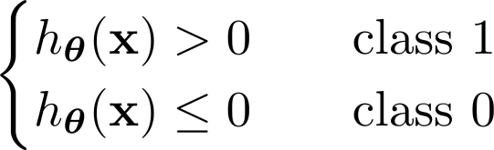








Logistic Regression
Consider a binary classification problem.
We have a multi-dimensional feature space (d features).
Features can be categorical (e.g., gender, ethnicity) or continuous (e.g., height, temperature).
Regression/Perceptron model:
Real-valued output here!

Slide 28

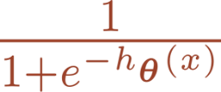

Logistic Regression
Model:
Real-valued output here!
We want probability; between 0 and 1!
Logistic regression model:
Sigmoid function
Activation function
Regression

Slide 29
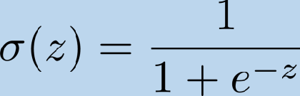
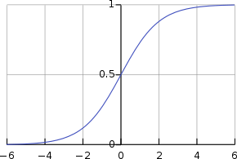

Logistic (Sigmoid) Function

Slide 30
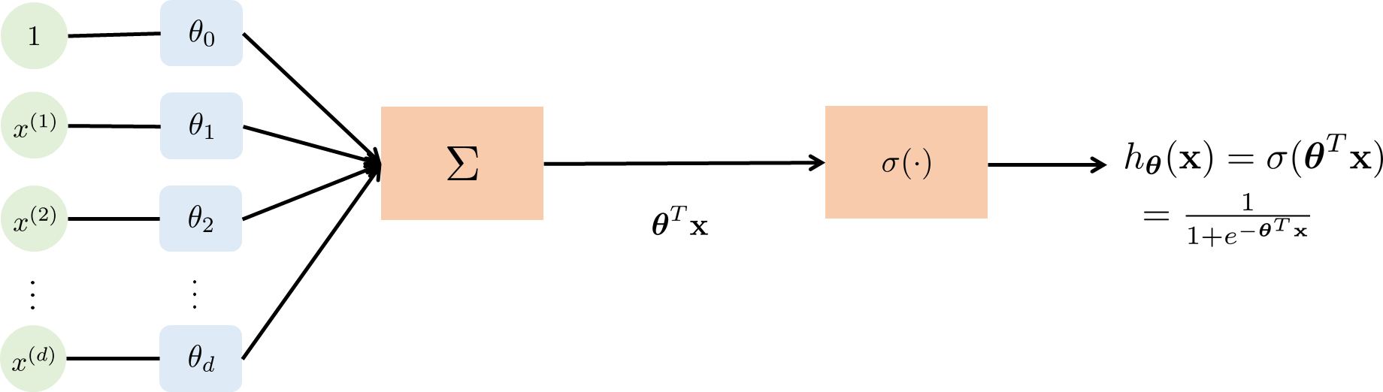
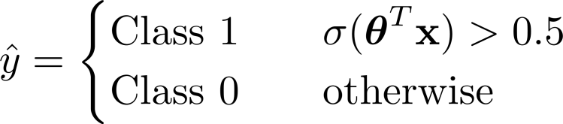
Logistic Regression
Classification:

Slide 31




Logistic Regression
- Disease prediction: Diagnose cancer given size of the tumor.

Slide 32
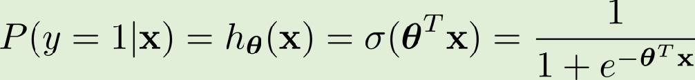

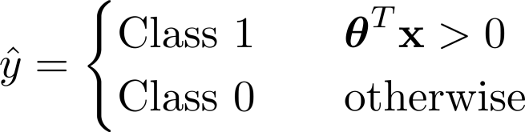

Decision Boundary:

Slide 33
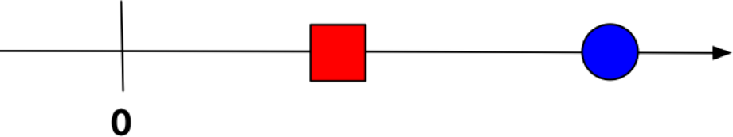

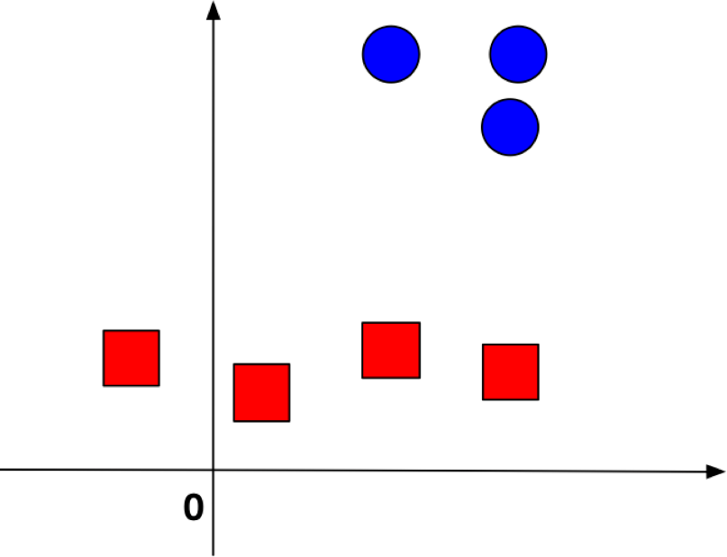



Logistic Regression
Hyper-Plane:

Slide 34

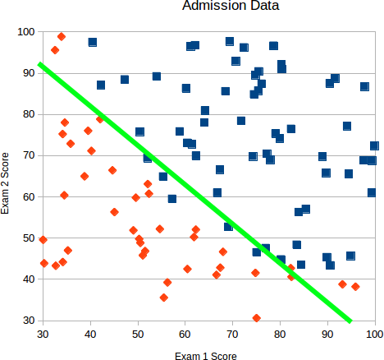


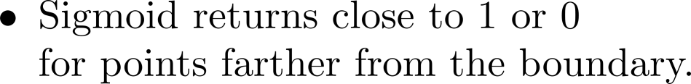
Logistic Regression
Decision Boundary - Example:

Slide 35
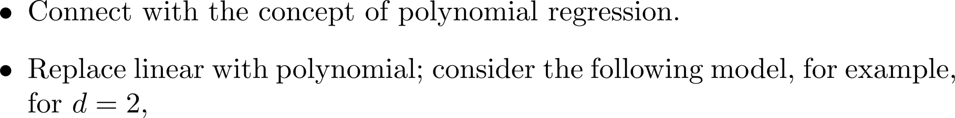
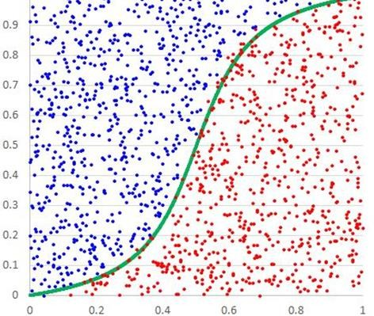
Non-linear Decision Boundary:

Slide 36
Multi-Class Classification/Multinomial Classification

Slide 37
Multiclass Classifiers
Binary classifiers distinguish between two classes
Multiclass classifiers (also called multinomial classifiers) can distinguish between more than two classes
Some algorithms (such as Random Forest classifiers or naive Bayes classifiers) are capable of handling multiple classes directly.
Others (such as Support Vector Machine classifiers or Linear classifiers) are strictly binary classifiers.
However, there are various strategies that you can use to perform multiclass classification using multiple binary classifiers.

Slide 38
Multiclass Classifiers
For example, one way to create a system that can classify the digit images into 10 classes (from 0 to 9) is to train 10 binary classifiers, one for each digit (a 0-detector, a 1-detector, a 2-detector, and so on)
Then when you want to classify an image, you get the decision score from each classifier for that image and you select the class whose classifier outputs the highest score
This is called the one-versus-all (OvA) strategy (also called one-versus-the-rest)..

Slide 39
Logistic Regression
Multi-Class (Multinomial) Classification:
Option 1: Build a one-vs-all (OvA) one-vs-rest (OvR) classifier:

Slide 40
one-versus-one (OvO)
Another strategy is to train a binary classifier for every pair of digits: one to distinguish
0s and 1s, another to distinguish 0s and 2s, another for 1s and 2s, and so on.
This is called the one-versus-one (OvO) strategy.

Slide 41
Multi-Class (Multinomial) Classification:
Option 2: Build an all-vs-all classifier (commonly known as one-vs-one classifier):

Slide 42







Multi-Class (Multinomial) Classification:
Option 2: Build an all-vs-all classifier (commonly known as one-vs-one classifier):
Classifier 1 A vs B
Classifier 2 B vs C
Classifier 3 A vs C
Select label for which the sum is maximum

Slide 43
Comparison
Some algorithms (such as Support Vector Machine classifiers) scale poorly with the size of the training set
So for these algorithms OvO is preferred since it is faster to train many classifiers on small training sets than training few classifiers on large training sets.
For most binary classification algorithms, however, OvA is preferred.

