Slide 1
Week 3: Machine Learning

Slide 2
Last Lecture..
Categories of Data Sets
Batch Learning / Online Learning
Component of Training Data (TD)
Characteristics of TD
Dimensionality
Sparsity
Resolution
Main Challenges of ML
Insufficient Quantity of Data
Non-Representative Data
Poor Quality of Data
Overfitting of Training Data
Under-fitting of Training Data

Slide 3
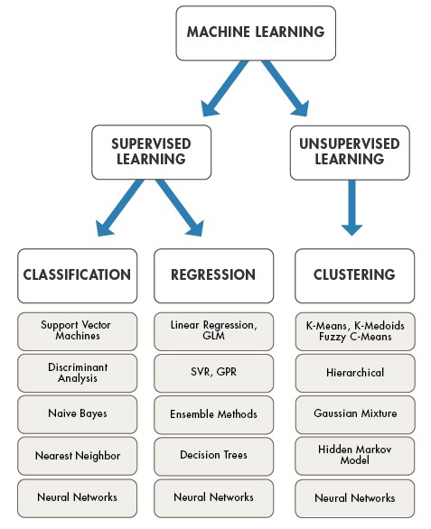
Classification Algorithms

Slide 4
K-Nearest Neighbor Algorithm (K-NN)
"Show me who your friends are and I’ll tell you who you are?"

Slide 5

What is KNN?
KNN – K Nearest Neighbors, is one of the simplest Supervised Machine Learning algorithm mostly used for:
Classification
Regression
It classifies a data point based on how its neighbors are classified
It returns numeric value based on the values of its neighbors

Slide 6
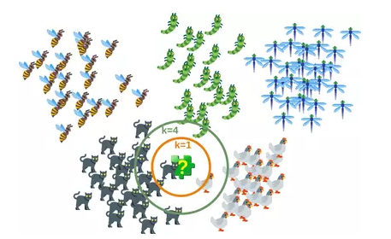
What is KNN?
KNN stores all available instances and classifies new cases based on a similarity measure which makes it Instance Based Learning

Slide 7
Instance-Based Versus Model-Based Learning
Model Based Learning
Active Learners / Create Model
Need to retrain periodically
Only need model, no need of training data for generalization (Decision Making)
Not easy to adapt new instances
Examples: Naïve Bayes, Decision Tree
Instance Based Learning
Lazy Learning /Rote Learning
Do Nothing simply Save training data
Only use training data for generalization

Slide 8
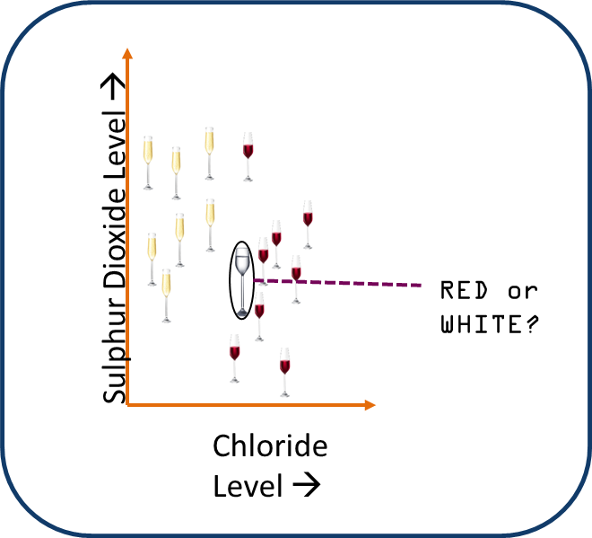
KNN Algorithm
Choose K?
Decide Distance Metric
k in KNN is a parameter that refers to the number of nearest neighbors to include in the majority voting process

Slide 9
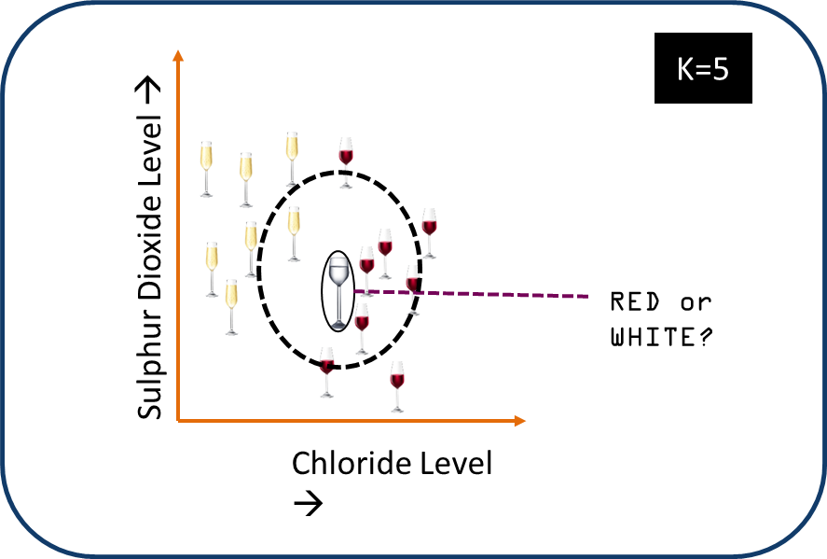
KNN Algorithm
1-Calculate distance between new and every example in data set
2-Sort Data in ascending order
3-Return majority class of top 5

Slide 10

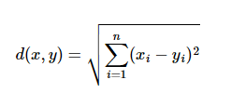
KNN Algorithm
Consider a dataset having two variables: height (cm) & weight (kg) and each point is classified as Normal or Underweight
57 kg | 170 cm | ?
Weight(x2) | Height(x2) | Class
51 | 167 | Underweight
62 | 182 | Normal
69 | 176 | Normal
64 | 173 | Normal
65 | 172 | Normal
56 | 174 | Underweight
58 | 169 | Normal
57 | 173 | Normal
55 | 170 | Normal
Use Euclidean distance for similarity?

Slide 11
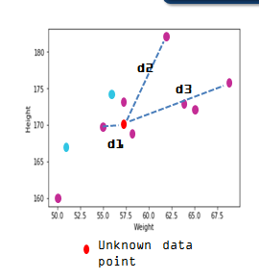
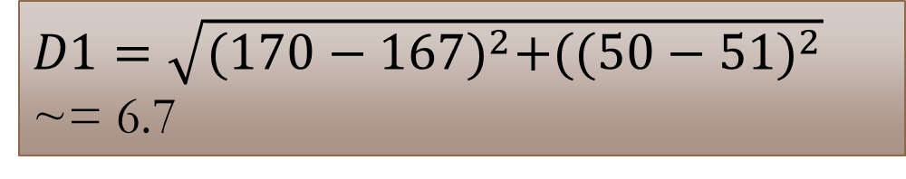
KNN Algorithm
Similarly, we will calculate Euclidean distance of unknown data point from all the points in the dataset
$D1=\sqrt{{(170−167)}^{2}+({(50−51)}^{2}}$ ~= 6.7

Slide 12
KNN Algorithm -Consider K=3
Weight(x2) | Height(x2) | Class | Euclidean Distance
51 | 167 | Underweight | 6.7
62 | 182 | Normal | 13
69 | 176 | Normal | 13.4
64 | 173 | Normal | 7.6
65 | 172 | Normal | 8.2
56 | 174 | Underweight | 4.1
58 | 169 | Normal | 1.4
57 | 173 | Normal | 3
55 | 170 | Normal | 2
57 kg | 170 cm | ?
Prediction: Normal

Slide 13
Euclidean Distance
The Euclidean distance between two points x and y in either the plane or 3-dimensional space measures the length of a line segment connecting these two points.
Calculated from the Cartesian coordinates of the points using the Pythagorean theorem
Pythagorean distance

Slide 14

Manhattan Distance
It is defined as the sum of the absolute values of the differences between the coordinates of x and y:

Slide 15
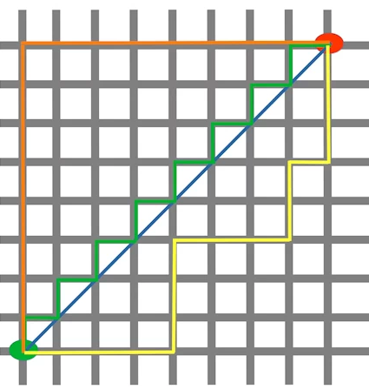
Distance
Distance Metrics
The blue line illustrates the Eucliden distance between the green and red dot. Otherwise you can also move over the orange, green or yellow line from the green point to the red point. The lines correspond to the manhatten distance. The length is equal.

Slide 16

Minkowski Distance
The Minkowski distance generalizes the Euclidean and the Manhatten distance in one distance metric.
If we set the parameter p in the following formula to 1 we get the manhattan distance an using the value 2 gives us the euclidean distance:

Slide 17
Distance on Numeric Data: Minkowski Distance
Minkowski distance: A popular distance measure
where i = (x_{i1}, x_{i2}, …, x_{ip}) and j = (x_{j1}, x_{j2}, …, x_{jp}) are two p-dimensional data objects, and h is the order (the distance so defined is also called L-h norm)

Slide 18
Special Cases of Minkowski Distance
h = 1: Manhattan (city block, L₁ norm) distance
E.g., the Hamming distance: the number of bits that are different between two binary vectors
h = 2: (L₂ norm) Euclidean distance
h → ∞. “supremum” (L_{max} norm, L∞ norm) distance.
This is the maximum difference between any component (attribute) of the vectors

Slide 19
Properties of Distance Metric
Properties
d(i, j) > 0 if i ≠ j, and d(i, i) = 0 (Positive definiteness)
d(i, j) = d(j, i) (Symmetry)
d(i, j) ≤ d(i, k) + d(k, j) (Triangle Inequality)
A distance that satisfies these properties is a metric

Slide 20
Characteristics of kNN:
No assumptions about the distribution of the data
Non-parametric algorithm
No parameters
Hyper-Parameters
k (number of neighbors)
Distance metric (to quantify similarity)

Slide 21
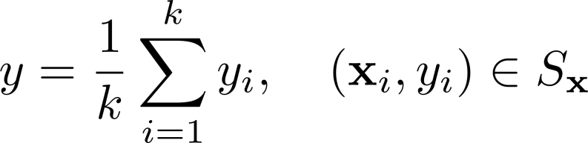
Characteristics of kNN:
- Complexity (both time and storage) of prediction increases with the size of training data.
- Can also be used for regression (average or inverse distance weighted average)
- For example,

Slide 22
Choice of k:
- k=1
Sensitive to noise
High variance
Increasing k makes algorithm less sensitive to noise
- k=n
Decreasing k enables capturing finer structure of space
Idea: Pick k not too large, but not too small (depends on data) How?

Slide 23
Choice of k:
Learn the best hyper-parameter, k using the data.
Split data into training and validation.
Start from k=1 and keep iterating by carrying out (5 or 10, for example) cross-validation and computing the loss on the validation data using the training data.
Choose the value for k that minimizes validation loss.
This is the only learning required for kNN.

Slide 24
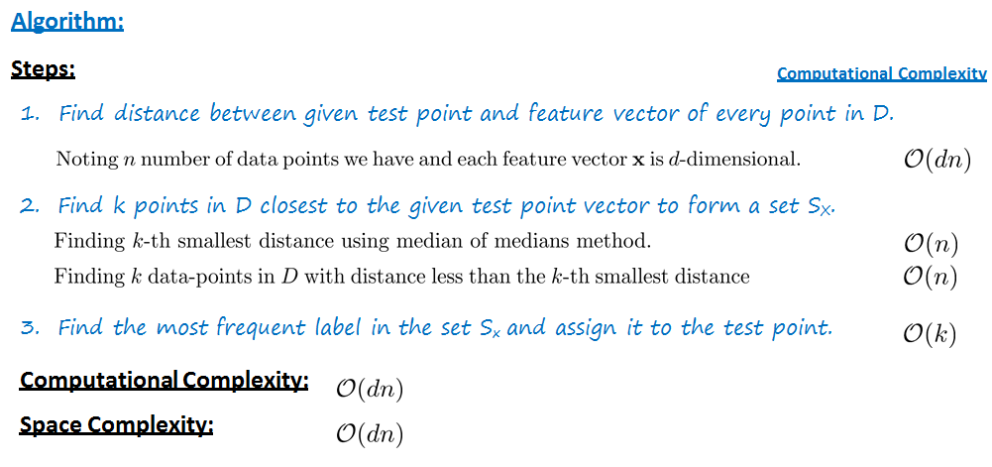
KNN Complexity

Slide 25
Fast kNN:
kNN Computational complexity: O(nd)
How to make it faster?
Dimensionality Reduction
Feature Selection (to be covered later)
PCA (to be covered)
Use efficient method to find nearest neighbors
KD Tree

Slide 26
K-D Tree:
k-Dimensional tree
Extended version of binary search tree in higher dimension
Pick the splitting dimension
Randomly
Large variance dimension
Pick the middle value of the feature along the selected dimension after sorting along that dimension.
Use this value as the root node and construct a binary tree and keep going.

Slide 27
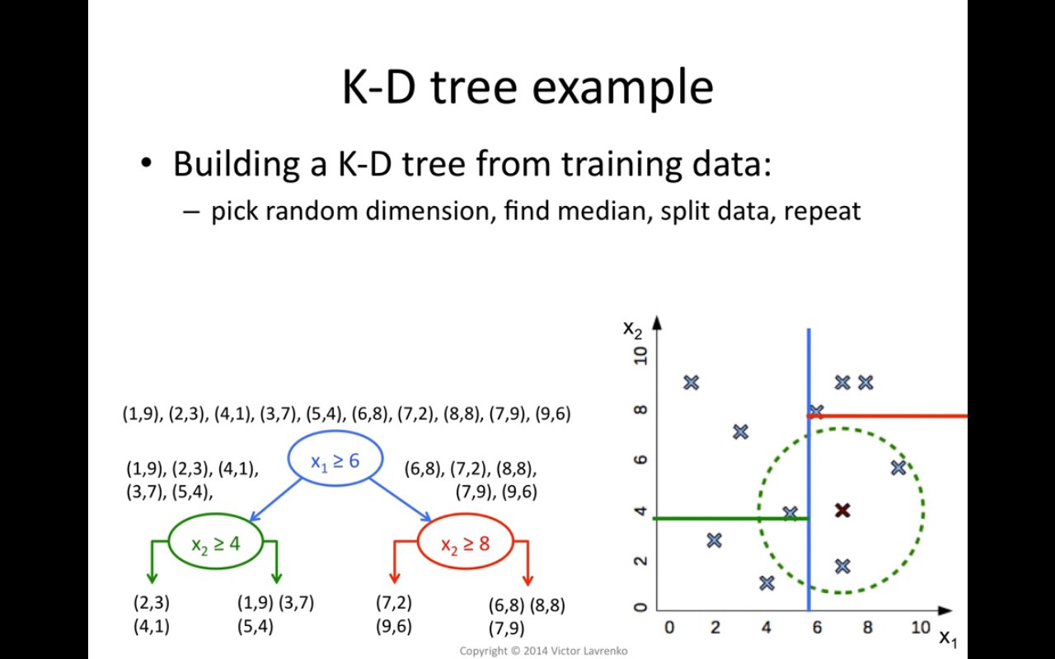

Slide 28
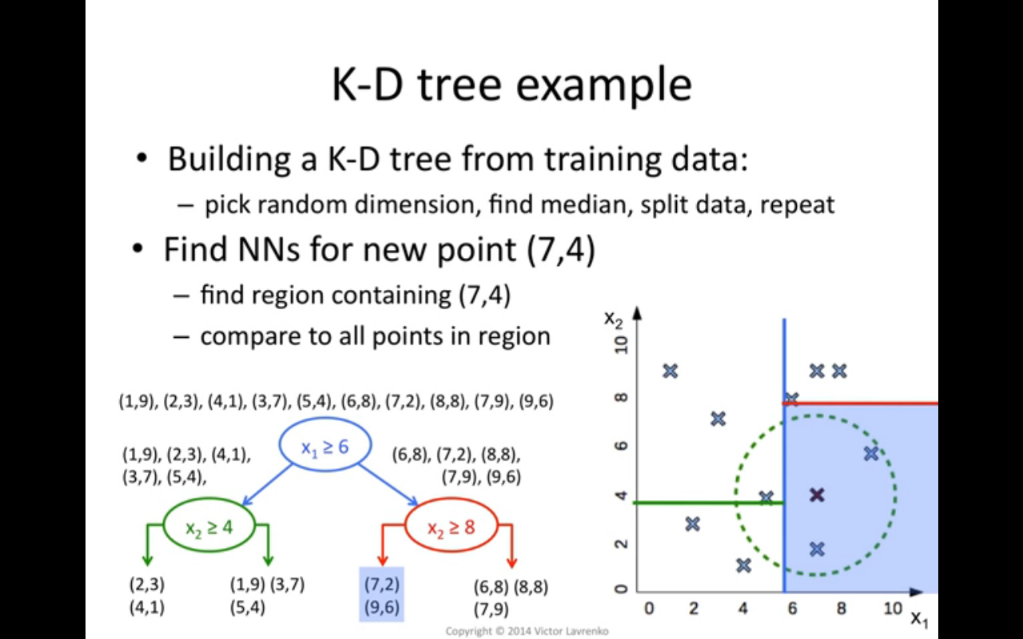

Slide 29

Example

Slide 30
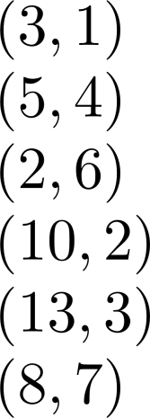








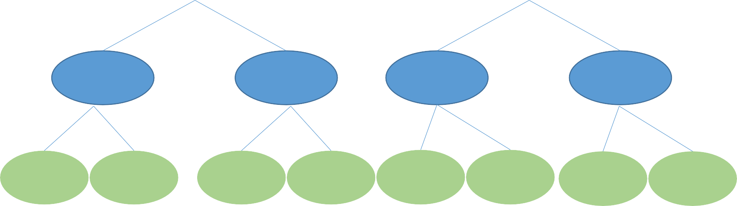
K-D Tree:
Example:
Splitting dimension

Slide 31
K-D Tree - Summary:
Enables significant reduction in the time to support nearest neighbor algorithm.
Search to O(logn).
Trade-offs:
Computational overhead to construct a tree O(n logn).
Space complexity: O(n).
May miss neighbors.
Performance is degraded with the increase in the dimension of future space (Curse of Dimensionality).

Slide 32



When do we use KNN Algorithm?
Data is labeled
We can use KNN when
Dog
Dataset is small
Data is noise free
Weight(x2) | Height(y2) | Class
51 | 167 | Underweight
62 | 182 | one-fourty
69 | 176 | 23
64 | 173 | hello kitty
65 | 172 | Normal
Because KNN is a ‘lazy learner’ i.e. doesn’t learn a discriminative function from the training set
Noise

Slide 33
Regression Numerical Prediction

Slide 34
Regression/Numeric Prediction
Type of Supervised Learning
Class attribute could be any value
Variety of Techniques Used
Statistical (Univariate Regression, Multi-Variate Regress etc.)
Decision Tree (CART)
KNN
etc.

Slide 35
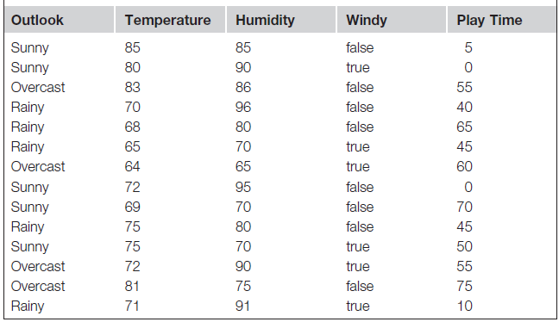
Numeric Prediction

Slide 36
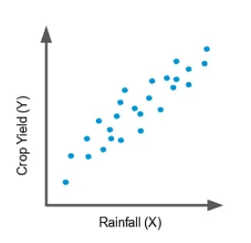
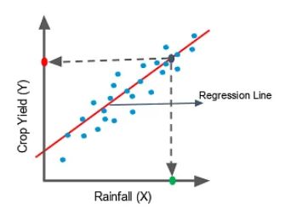

LINEAR REGRESSION

Slide 37


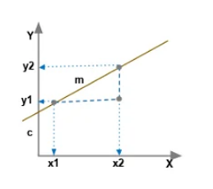
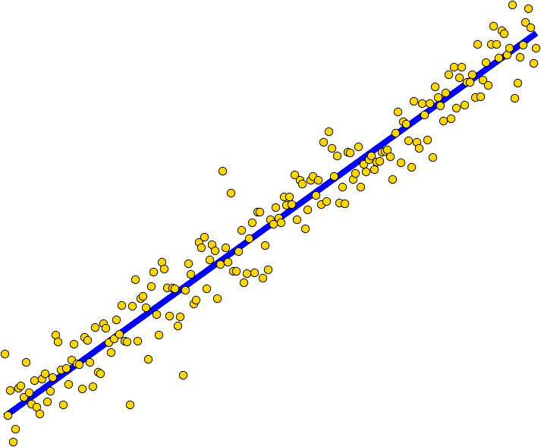
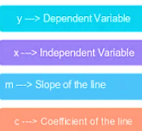
LINEAR REGRESSION

Slide 38
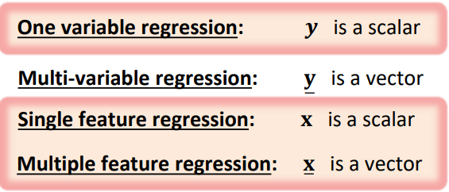
LINEAR REGRESSION

Slide 39
Examples:
Single Feature:
Predict score in the course given the number of hours of effort per week.
Establish the relationship between the monthly e-commerce sales and the advertising costs.
Multiple Feature:
Studying operational efficiency of machine given sensors (temperature, vibration) data.
Predicting remaining useful life (RUL) of the battery from charging and discharging information.
Estimate sales volume given population demographics, GDP indicators, climate data, etc.
Predict crop yield using remote sensing (satellite images, gravity information).
Dynamic Pricing or Surge Pricing by ride sharing applications (Uber).
Rate the condition (fatigue or distraction) of the driver given the video.
Rate the quality of driving given the data from sensors installed on car or driving patterns.

Slide 40
Model Based Approach
Different from KNN: Linear regression adopts a modular approach which we will use most of the times in the course.
Select a model
Defining a loss function
Formulate an optimization problem to find the model parameters such that a loss function is minimized.
Employ different techniques to solve optimization problem or minimize loss function

