Slide 1
Week 4: Machine Learning

Slide 2
Last Lecture..
Linear Regression

Slide 3


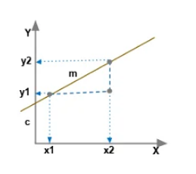
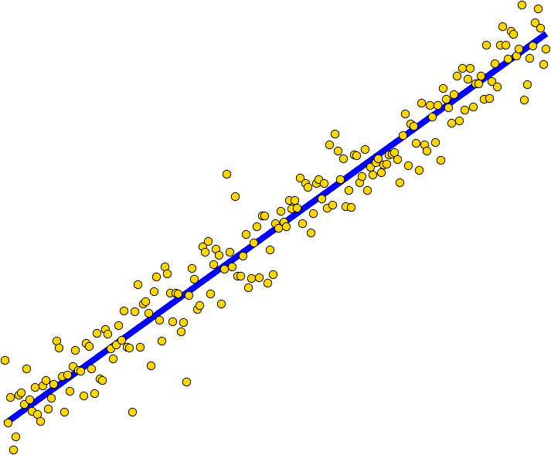
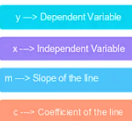
LINEAR REGRESSION

Slide 4
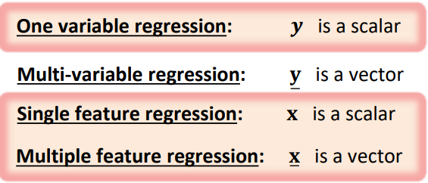
LINEAR REGRESSION

Slide 5
Model Based Approach
Different from KNN: Linear regression adopts a modular approach which we will use most of the times in the course.
Select a model
Defining a loss function
Formulate an optimization problem to find the model parameters such that a loss function is minimized.
Employ different techniques to solve optimization problem or minimize loss function

Slide 6
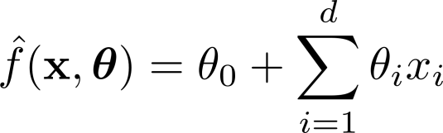

Linear Regression
Model:
h_{w}(x)=w₁x + w₀

Slide 7







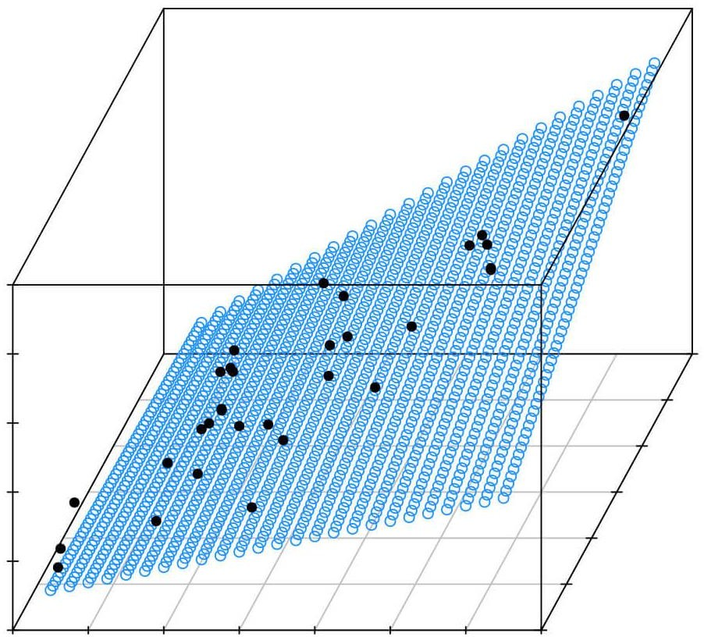





Linear Regression
Model:
What is Linear?
h_{w}(x)=w₁x + w₀
𝐨𝐫 𝒚
𝐨𝐫 𝒚

Slide 8


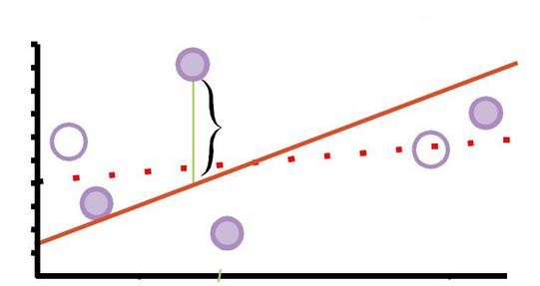

Define Loss Function:
Loss function should be a function of model parameters.
Observed values
𝒚
Residual error
True unknown function:
𝐱

Slide 9
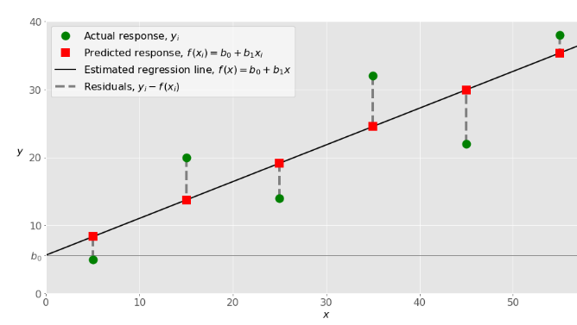
Loss Function

Slide 10
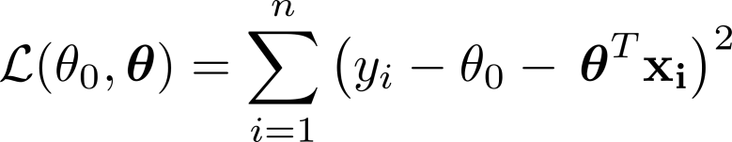
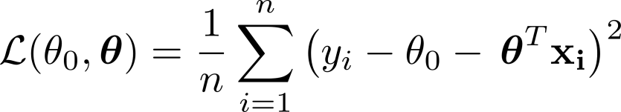
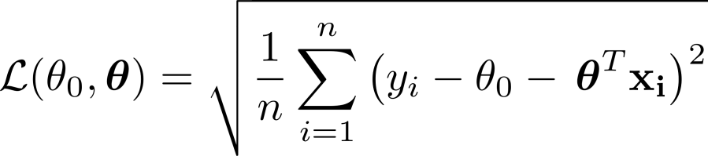
Define Loss Function:

Slide 11
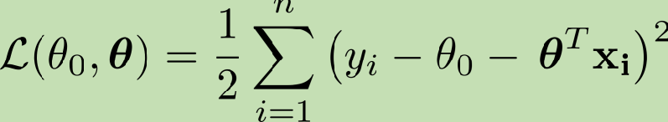
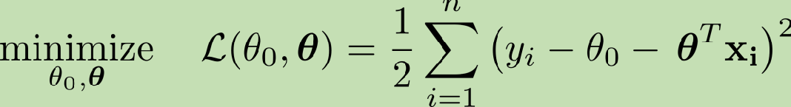
Define Loss Function:

Slide 12


Closed Form Solution
h_{w}(x)=w₁x + w₀
We would like to find w∗ = argmin_{w} Loss (h_{w}). Loss (h_{w}) is
minimized when its partial derivatives with respect to w0 and w1 are zero:

Slide 13
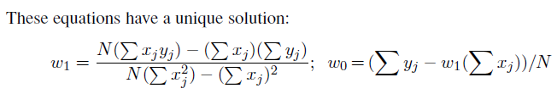
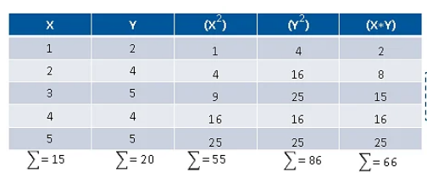
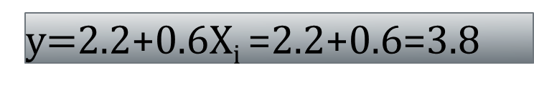
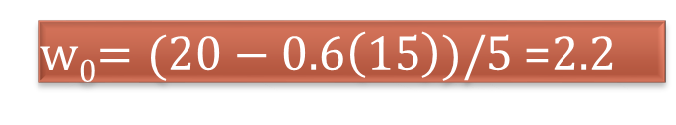

Closed Form Solution
w₁$=\frac{\left(5∗66\right)−(15∗20) }{5∗55−\left(15\right)2}$ =0.6
w₀$=(20−0.6\left(15\right))/5$ =2.2
y$=$2.2+0.6X_{i} =2.2+0.6=3.8

Slide 14

Closed Form (Normal Equation)

Slide 15
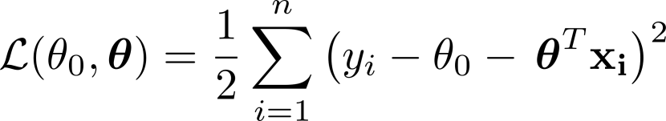
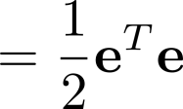
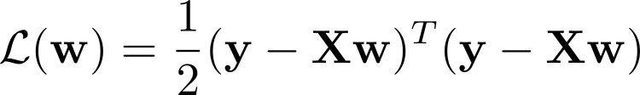
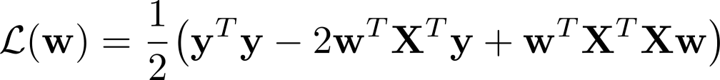
Closed Form (Normal Equation)

Slide 16
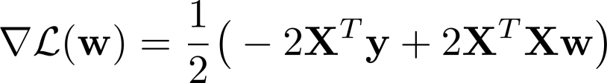


Closed Form (Normal Equation)

Slide 17
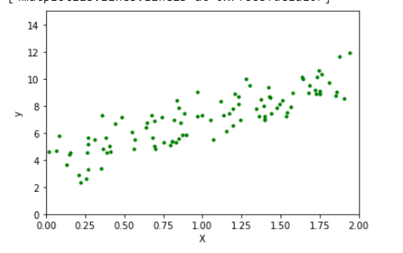
Data for Regression
import matplotlib.pyplot as plt
import numpy as np
X = 2 * np.random.rand(100, 1)
y = 4 + 3 * X + np.random.randn(100, 1)
fig, ax = plt.subplots()
ax.set_xlabel('X')
ax.set_ylabel('y')
ax.plot(X, y,"g.")
plt.axis([0, 2, 0, 15])

Slide 18

Closed Form (Normal Equation)
X_b = np.c_[np.ones((100, 1)), X] # add x₀ = 1 to each instance
theta_best = np.linalg.inv(X_b.T.dot(X_b)).dot(X_b.T).dot(y)
theta_best

Slide 19
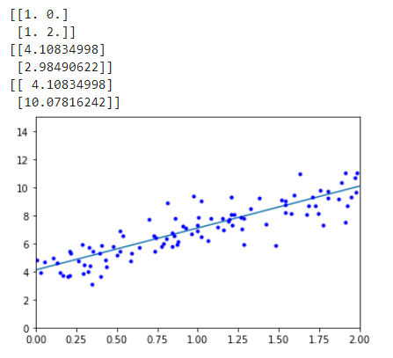
Prediction
X_new = np.array([[0], [2]])
X_new_b = np.c_[np.ones((2, 1)), X_new] # add x0 = 1 to each instance
print(X_new_b)
print(theta_best)
y_predict = X_new_b.dot(theta_best)
print(y_predict)
#Let’s plot this model’s predictions:
plt.plot(X_new, y_predict, "r")
plt.plot(X, y, "b.")
plt.axis([0, 2, 0, 15])
plt.show()

