Slide 1



Machine Learning LAB
Week 04

Slide 2
Regression implementation
Load Data of Regression
Drop Sr# column
Split X,y
Train test split of 20%
Regression
Scale the data
Again Apply Regression and return RMSE

Slide 3
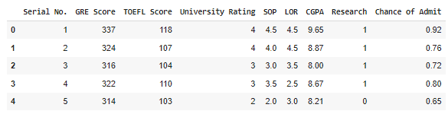
Load Data & Drop Sr
import pandas as pd
df=pd.read_csv("/content/drive/My Drive/ML_Labs/DataSets/Admission_Predict_Ver1.1.csv")
coulumns=df.columns
df.head()
df.drop("Serial No.",axis=1,inplace=True)
y = df['Chance of Admit ']
df.drop("Chance of Admit ",axis=1,inplace=True)

Slide 4
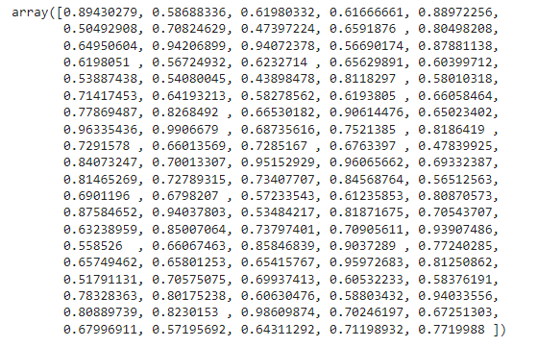
Split X,y Train Test Split 20%
from sklearn.model_selection import train_test_split
x_train,x_test,y_train,y_test = train_test_split(df,y,test_size=0.2)
from sklearn.linear_model import LinearRegression
lr = LinearRegression()
lr.fit(x_train,y_train)
pred = lr.predict(x_test)
pred

Slide 5

Regression
from sklearn import metrics
import numpy as np
rmse = np.sqrt(metrics.mean_squared_error(y_test,pred))
rmse

Slide 6
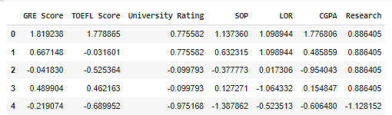
Scale the data
from sklearn.preprocessing import StandardScaler
sc = StandardScaler()
sc.fit(df)
df = sc.transform(df)
df1=pd.DataFrame(df,columns=coulumns[1:8])
x_train,x_test,y_train,y_test = train_test_split(df,y,test_size=0.2)
df1.head()

Slide 7

Again Apply Linear Regression
from sklearn.linear_model import LinearRegression
lr = LinearRegression()
lr.fit(x_train,y_train)
pred = lr.predict(x_test)
rmse = np.sqrt(metrics.mean_squared_error(y_test,pred))
rmse

Slide 8
Activity 2 (Submission)
Download Data of Regression of your choice from library, Kaggle etc.
Drop irrelevant columns
Split X,y
Train test split of 30%
Regression
Scale the data (Standarization/min-max scaler)
Again Apply Regression and return RMSE

Slide 9
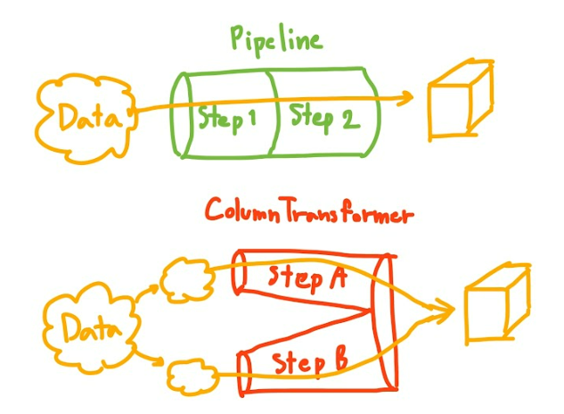
Preprocessing Pipeline

Slide 10
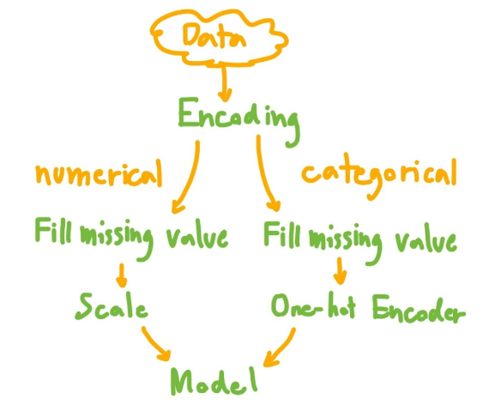
Preprocessing Pipeline

Slide 11
Preprocessing Pipeline
import pandas as pd
from sklearn.datasets import load_iris
from sklearn.model_selection import train_test_split
from sklearn.preprocessing import StandardScaler
from sklearn.pipeline import Pipeline
from sklearn.neighbors import KNeighborsClassifier
from sklearn.tree import DecisionTreeClassifier
from sklearn.metrics import accuracy_score

Slide 12
Preprocessing Pipeline
# Load the dataset
iris = load_iris()
X = iris.data
y = iris.target

Slide 13
Preprocessing Pipeline
# Split the data into training and testing sets
X_train, X_test, y_train, y_test = train_test_split(X, y, test_size=0.2, random_state=42)
# Define the preprocessing steps
preprocessor = Pipeline([
('scaler', StandardScaler()) # Standardize the features
])
# Define the classifiers
knn = KNeighborsClassifier()
decision_tree = DecisionTreeClassifier()
# Build the pipelines
knn_pipeline = Pipeline([
('preprocessor', preprocessor),
('classifier', knn)
])

Slide 14
Preprocessing Pipeline
decision_tree_pipeline = Pipeline([
('preprocessor', preprocessor),
('classifier', decision_tree)
])
# Fit the pipelines
knn_pipeline.fit(X_train, y_train)
decision_tree_pipeline.fit(X_train, y_train)
# Make predictions
knn_predictions = knn_pipeline.predict(X_test)
decision_tree_predictions = decision_tree_pipeline.predict(X_test)

Slide 15

Preprocessing Pipeline
# Compare the results
knn_accuracy = accuracy_score(y_test, knn_predictions)
decision_tree_accuracy = accuracy_score(y_test, decision_tree_predictions)
print("K-Nearest Neighbors Accuracy:", knn_accuracy)
print("Decision Tree Accuracy:", decision_tree_accuracy)

Slide 16
Activity 3 (Submission)
Apply the Preprocessing pipe on some classification data
Attach KNN and Decision Tree algorithms with the pipeline
Compare the results of these algorithms

Slide 17
KNN Implementation
Load Iris Dataset
Plot its 3 dimensions
Split in train and test
Write function which finds Euclidean Distance
Function which return K=3 neighbors
Function which do voting and calculate accuracy

Slide 18

Loading & Showing data
import numpy as np
from sklearn import datasets
iris = datasets.load_iris()
data = iris.data
labels = iris.target
for i in [0, 79, 99, 121]:
print(f"index: {i}, features: {data[i]}, label: {labels[i]}")

Slide 19
Splitting the data
indices = np.random.permutation(len(data))
n_test_samples = 12 # number of test samples
learn_data = data[indices[:-n_test_samples]]
learn_labels = labels[indices[:-n_test_samples]]
test_data = data[indices[-n_test_samples:]]
test_labels = labels[indices[-n_test_samples:]]

Slide 20
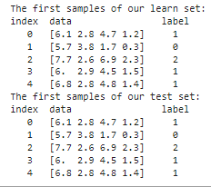
Splitting the data
print("The first samples of our learn set:")
print(f"{'index'}{'data'}{'label'}")
for i in range(5):
print(f"{i} {learn_data[i]} {learn_labels[i]}")
print("The first samples of our test set:")
print(f"{'index'}{'data'}{'label'}")
for i in range(5):
print(f"{i} {test_data[i]} {test_labels[i]}")

Slide 21
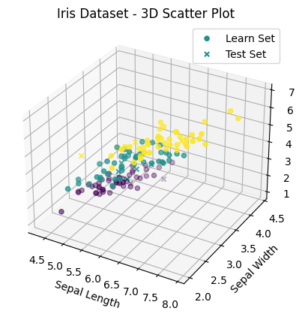
Loading & Showing data
import matplotlib.pyplot as plt fig = plt.figure()
ax = fig.add_subplot( projection='3d') # Plotting the learn set
ax.scatter(learn_data[:, 0], learn_data[:, 1], learn_data[:, 2], c=learn_labels, cmap='viridis', label='Learn Set') # Plotting the test set
ax.scatter(test_data[:, 0], test_data[:, 1], test_data[:, 2], c=test_labels, cmap='viridis', marker='x', label='Test Set') # Set labels for each axis
ax.set_xlabel('Sepal Length')
ax.set_ylabel('Sepal Width') # Set the title of the plot
ax.set_title('Iris Dataset - 3D Scatter Plot') # Add a legend
ax.legend() # Display the plot
plt.show()

Slide 22

Calculate Distance
import numpy as np def distance(instance1, instance2):
instance1 = np.array(instance1)
instance2 = np.array(instance2)
return np.linalg.norm(instance1 - instance2) print(distance([3, 5], [1, 1]))
print(distance(learn_data[3], learn_data[44]))

Slide 23
Getting Neighbors
def get_neighbors(training_set, labels, test_instance, k, distance):
distances = []
for train, label in zip(training_set, labels):
dist = distance(test_instance, train)
distances.append((train, dist, label))
distances.sort(key=lambda x: x[1])
return distances[:k]
for i in range(5):
neighbors = get_neighbors(learn_data, learn_labels, test_data[i], 3, distance=distance)
print(f"Index: {i}\nTestset Data: {test_data[i]}\nTestset Label: {test_labels[i]}\nNeighbors: {neighbors}\n")

Slide 24
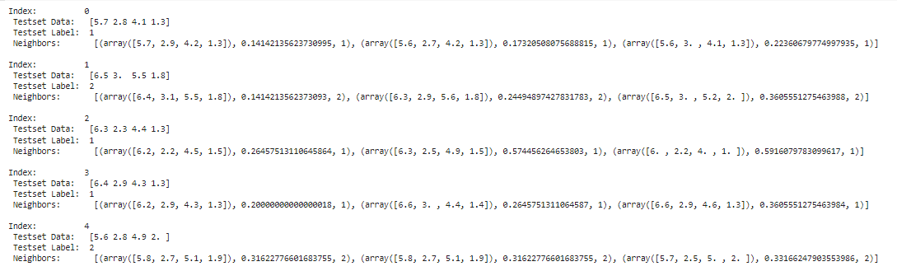
Getting Neighbors

Slide 25
Voting
from collections import Counter
def vote(neighbors):
class_counter = Counter(neighbor[2] for neighbor in neighbors)
return class_counter.most_common(1)[0][0]
count = 0
for i in range(n_test_samples):
neighbors = get_neighbors(learn_data, learn_labels, test_data[i], 1, distance=distance)
if test_labels[i] == vote(neighbors):
count += 1
print("Index:", i, ", Result of Vote:", vote(neighbors), ", Label:", test_labels[i], ", Data:", test_data[i])
accuracy = count / n_test_samples
print("Accuracy:", accuracy)

Slide 26
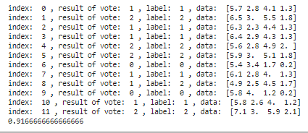
Voting

Slide 27
Activity-4 Submission
Load Wine Dataset
Plot its 3 dimensions
Split in train and test (Using built in function)
Write function which finds Euclidean Distance
Function which return K=5 neighbors
Function which do voting and calculate accuracy

