Slide 1

Histogram equalization & specification
Dr. P. Vijayalakshmi Professor, Department of ECE SSNCE
Reference : Digital Image processing – Rafael Gonzalez, Richard E. Woods

Slide 2
Histogram processing
Histogram: of a digital image with gray levels 0 to L-1 is a
discrete function of h(r_{k}) = n_{k}
r_{k} – k^{th} gray level
n_{k} – number of pixels having gray levels r_{k}
Normalized histogram p(r_{k}) = n_{k}/n
n – total number of pixels in the image
Normalized histogram gives an estimate of probability of occurrence of each gray level. Sum of all the components in an normalized histogram is 1.
Useful in compression, segmentation

Slide 3
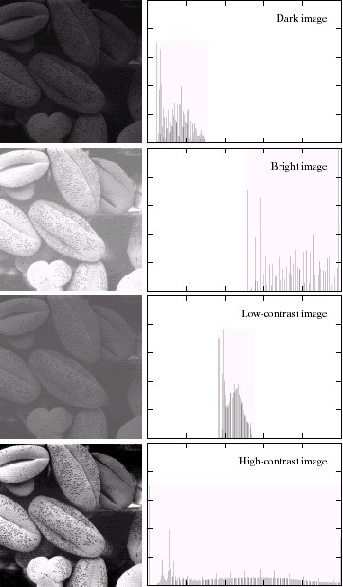
Image and histogram
Courtesy: Gonzalez & woods, Digital image processing

Slide 4
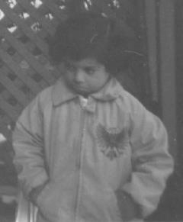
Image and histogram
1600
1400
1200
1000
800
600
400
200
0
0
50
100
150
200
250
Histogram equalization
Histogram matching or histogram specification

Slide 5
Histogram equalization
Histogram equalization:
To transform the gray levels of the image so that the histogram of the resultant image has histogram equalized or uniformly distributed.
Used for modifying the contrast
To equally make use of all the available gray levels in the dynamic range
To further process it for histogram matching or specification

Slide 6
Assuming the pixel values are continuous functions
p(s) ds = p(r) dr
That is probability density of the transformed variable ‘s’
is determined by the gray level distribution of the input
image and by the chosen transformation function s = T(r)

Slide 7
Histogram equalization
Steps involved:
Find the number of pixels in each gray level and total number
of pixels
Find the probability mass function of all the pixels in the image
Find the cumulative distribution function
Multiply the cumulative distribution function by L-1, L being the maximum gray level, to obtain new gray levels
Map the new gray level values to the pixels with old gray levels.

Slide 8
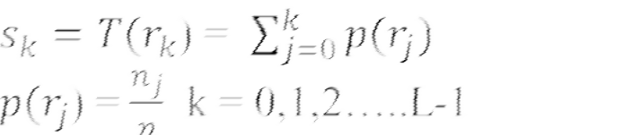
Histogram equalization
Mapping each pixel with level r_{k} in the input image into
the corresponding pixel with level s_{k} in the output image
Gray level values | Number of pixels | Probability mass function | Cumulative distribution function
0 | 790 | 0.19 | 0.19
1 | 1023 | 0.25 | 0.44
2 | 850 | 0.21 | 0.65
3 | 656 | 0.16 | 0.81
4 | 329 | 0.08 | 0.89
5 | 245 | 0.06 | 0.95
6 | 122 | 0.03 | 0.98
7 | 81 | 0.02 | 1.00

Slide 9
Histogram equalization
Gray level values | Number of pixels | Probability mass function | Cumulative distribution function | CDF * L-1
0 | 790 | 0.19 | 0.19 | 1.33 = 1
1 | 1023 | 0.25 | 0.44 | 3.08 = 3
2 | 850 | 0.21 | 0.65 | 4.55 = 5
3 | 656 | 0.16 | 0.81 | 5.67 = 6
4 | 329 | 0.08 | 0.89 | 6.23 = 6
5 | 245 | 0.06 | 0.95 | 6.65 = 7
6 | 122 | 0.03 | 0.98 | 6.86 = 7
7 | 81 | 0.02 | 1.00 | 7 = 7

Slide 10
Distributions (PMF, CDF)
0.4
0.2
0
0
2
4
6
8
1
0.5
0
0
2
4
6
8
1
0.5
0
0
2
4
6
8

Slide 11
Mapping
Mapping:
Old gray level values | New gray level values | Frequency of occurrence
0 | 1 | 790
1 | 3 | 1023
2 | 5 | 850
3 | 6 | 656
4 | 6 | 329
5 | 7 | 245
6 | 7 | 122
7 | 7 | 81

Slide 12
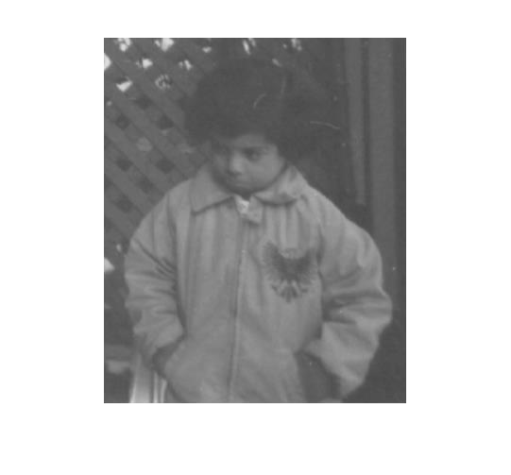
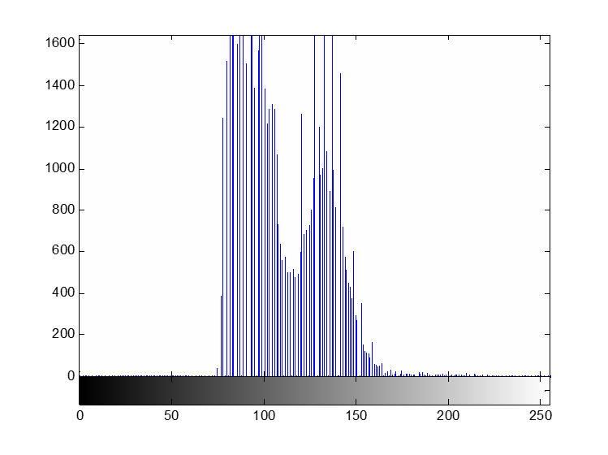
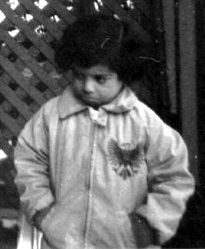
Histogram equalization
1600
1400
1200
1000
800
600
400
200
0
0
50
100
150
200
250

Slide 13
Histogram matching or specification
Specify the shape of the histogram we wish the processed
image should have
The method used to generate a processed image that has a specified histogram is called histogram matching or histogram specification
Steps involved:
Equalize the histogram of the input image
Equalize the specified histogram
Relate the two equalized histograms

Slide 14
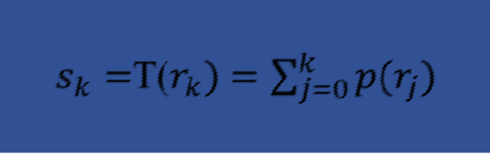

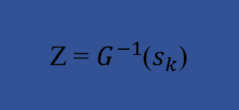
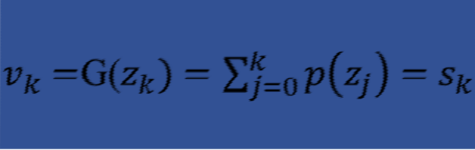
Histogram matching

Slide 15
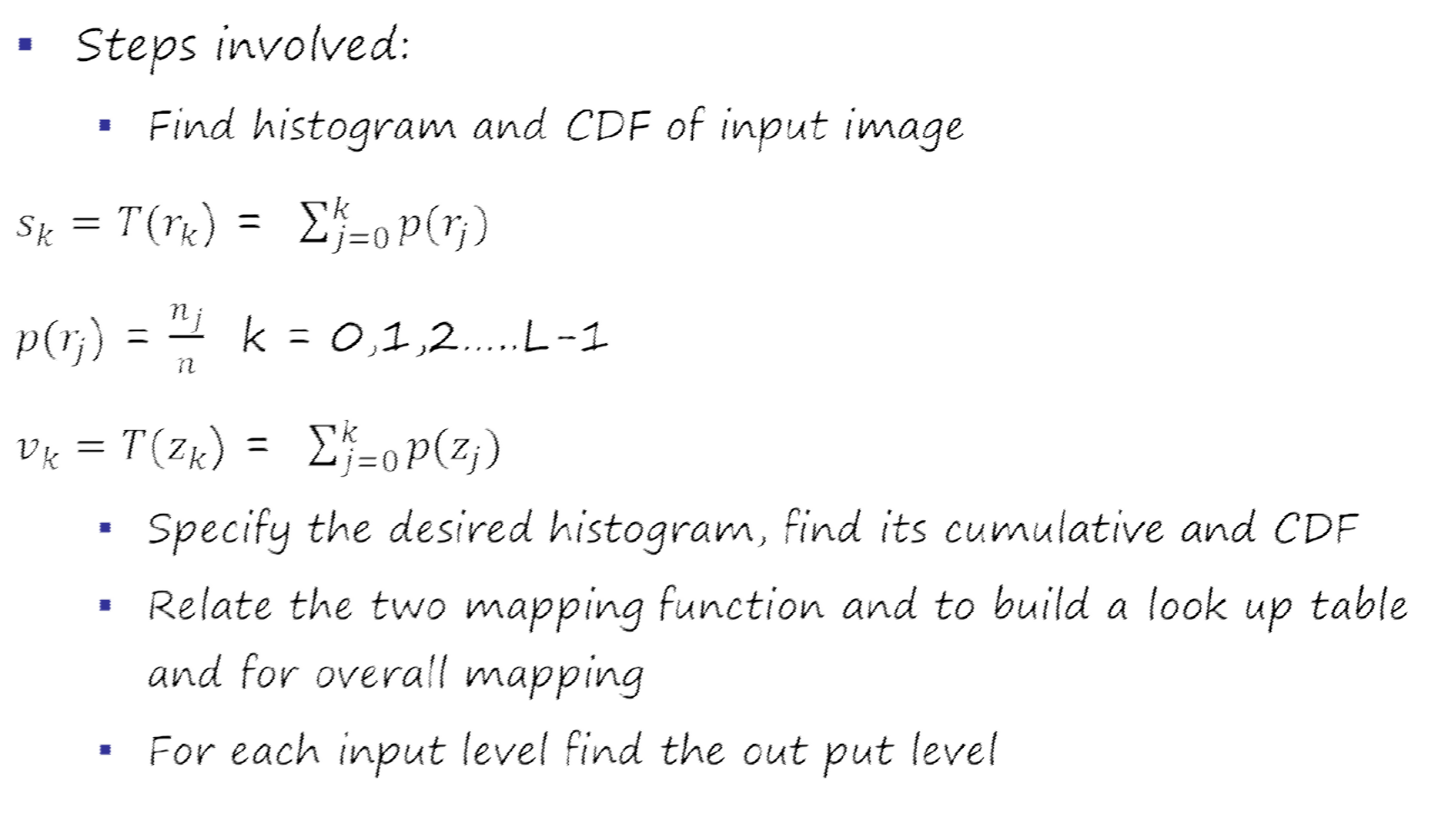
Matching
▪

Slide 16
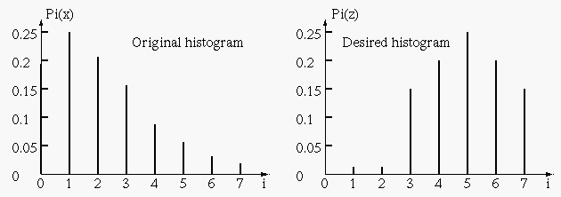
Example

Slide 17
Example
Gray level values | Number of pixels | Probability mass function | Cumulative distribution function
0 | 790 | 0.19 | 0.19
1 | 1023 | 0.25 | 0.44
2 | 850 | 0.21 | 0.65
3 | 656 | 0.16 | 0.81
4 | 329 | 0.08 | 0.89
5 | 245 | 0.06 | 0.95
6 | 122 | 0.03 | 0.98
7 | 81 | 0.02 | 1.00
Gray level values | Probability mass function | Cumulative distribution function
0 | 0 | 0
1 | 0 | 0
2 | 0 | 0
3 | 0.15 | 0.15
4 | 0.2 | 0.35
5 | 0.3 | 0.65
6 | 0.2 | 0.85
7 | 0.15 | 1.0

Slide 18
Example
Input gray level | Cumulative distribution function | Cumulative distribution function | Output gray level
0 | 0.19 | 0.0 | 3
1 | 0.44 | 0.0 | 4
2 | 0.65 | 0.0 | 5
3 | 0.81 | 0.15 | 6
4 | 0.89 | 0.35 | 6
5 | 0.95 | 0.65 | 7
6 | 0.98 | 0.85 | 7
7 | 1.0 | 1.0 | 7
i | 0 | 1 | 2 | 3 | 4 | 5 | 6 | 7
j | 3 | 4 | 5 | 6 | 6 | 7 | 7 | 7

