Slide 1
HOUSE PRICE PREDICTION USING CNN
Created By
S.Subalakshmi
REG No:912321104044
3rd year CSE
SACS MAVMM ENGINEERING COLLEGE,MADURAI

Slide 2
Project outline:
Problem statement
Proposed system/solution
System development approach
Algorithm and deployment
Result
Conclusion

Slide 3
Problem statement:
Develop a predictive model capable of estimating the selling price of residential properties based on various features such as location, size, number of bedrooms, bathrooms, amenities, neighborhood characteristics, and other relevant factors. The model should be trained on historical data containing these features along with their corresponding sale prices, and it should accurately predict the price of new properties in different areas

Slide 4
Proposed system/solution:
Using a Convolutional Neural Network (CNN) for house price prediction might not be the most suitable approach, as CNNs are primarily used for image data. For house price prediction, you'd typically use regression models like linear regression, decision trees, random forests, or gradient boosting machines. These models are better suited for tabular data, which is what you'd typically have for house price prediction (features like square footage, number of bedrooms, location, etc.)

Slide 5
System development process :
Data processing
Feature representation
Model architecture
Traing and evaluation
Deployment and testing
Expected outcome

Slide 6
Data Preprocessing:
Clean the dataset by handling missing values, outliers, and encoding categorical variables.
Normalize numerical features to ensure uniformity and improve model convergence.
Feature Representation:
Convert relevant features into image-like representations suitable for input into a CNN.For example, numerical features could be reshaped into grayscale images where each pixel represents a feature value.

Slide 7
Model Architecture:
Design a CNN architecture tailored to the characteristics of the input data.
Experiment with different network architectures, including varying numbers of convolutional and pooling layers, to capture complex patterns.
Training and Evaluation:
Split the dataset into training and validation sets to train and evaluate the model.
Utilize appropriate loss functions and evaluation metrics for regression tasks. Finetune hyperparameters to optimize model performance.

Slide 8
Deployment and Testing:
Deploy the trained model to make predictions on unseen data.
Test the model's performance on a separate test dataset to assess its generalization ability.
Expected Outcome:
The expected outcome of this project is a CNN-based model capable of accurately predicting house prices based on their features. The model should demonstrate good performance metrics such as low mean squared error and high prediction accuracy on unseen data.

Slide 9
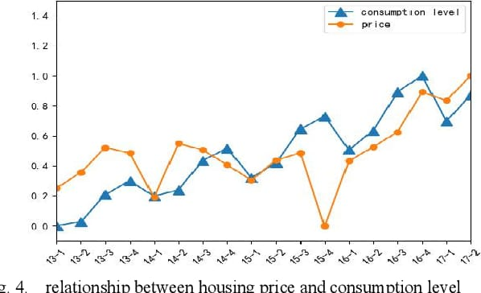
Relationship between the price and consumption level:

Slide 10
Algorithm and deployment:
STEP 1:
Gather house images and prices.
STEP 2:
Preprocess images and split data.
STEP 3:
Design CNN architecture.
STEP 4:
Train model with training data.
STEP 5:
Evaluate model performance.
STEP 6:
Deploy model for prediction.

Slide 11
Deployment :
You can deploy this Flask application on a cloud platform like Heroku, which offers a free tier for small-scale applications.
Heroku provides easy deployment options and allows you to host your application without worrying about server management.
Feedback and Iteration :
Gather feedback from users and iterate on your model and application based on their suggestions and any observed issues.

Slide 12
Data set state:
We will utilize a dataset containing information about various attributes of houses, such as square footage, number of bedrooms/bathrooms, location coordinates, and possibly images or other visual data.
The dataset will also include the corresponding prices of the houses.
House price prediction
Kaggle(https://www.kaggle.com/datasets/yasserh/housing-prices-dataset?select=Housing.csv )

Slide 13
Implementation :
import pandas as pd
import numpy as np
df = pd.read_csv('/kaggle/input/housing-prices-dataset/Housing.csv')
df.head()
df.isnull().sum()
import seaborn as sns
import matplotlib.pyplot as plt
plt.figure(figsize=(12, 6))
sns.scatterplot(x='area', y='price',
hue='stories', data=df,palette="Set2")
plt.xlabel('Area')
plt.ylabel('Price')
plt.title('Price vs Area Scatter Plot')
plt.legend(title='Furnishing Status')
plt.grid(True)
plt.show()
fig, axs = plt.subplots(nrows=1, ncols=2, figsize=(14, 6))
# Plot the first countplot on the first subplot (axs[0])sns.countplot(x=df["airconditioning"],
hue=df["stories"], palette="viridis", ax=axs[0])
# Plot the second countplot on the second subplot
(axs[1])sns.countplot(x=df["hotwaterheating"],
hue=df["stories"], palette="viridis", ax=axs[1])
# Optionally, add titles to the
subplotsaxs[0].set_title("Air conditioning")
axs[1].set_title("Hot water heating")

Slide 14
fig, axs = plt.subplots(nrows=2, ncols=3, figsize=(14, 8))
# List of column names you want to Plot
columns = ['price', 'area', 'bedrooms', 'bathrooms', 'stories', 'parking']
counter = 0for i in range(2):
for j in range(3):
sns.boxplot(df[columns[counter]], ax=axs[i, j], palette="viridis") axs[i,
j].set_title(columns[counter].capitalize())
counter += 1plt.tight_layout()
plt.show()
from sklearn.linear_model
import LinearRegression,Ridge
from sklearn.ensemble import RandomForestRegressor,GradientBoostingRegressof
from sklearn.svm import SVCmodels = { 'Linear Regression': LinearRegression(n_jobs=5),
'Random Forest': RandomForestRegressor(),
'Gradient Boosting':GradientBoostingRegressor(),
'Ridge Regression': Ridge(), "SVC":SVC()}
for model in models.items():
print(model[0])
from sklearn.model_selection import train_test_split
from sklearn.pipeline import Pipeline
from sklearn.preprocessing import StandardScaler
from sklearn.model_selection import GridSearchCV
from sklearn.metrics import r2_score,mean_absolute_error,mean_squared_error
x=df.drop("price",axis=1)
y=df["price"]X_train, X_test, y_train, y_test = train_test_split(x, y, test_size=0.20, random_state=42)
a=1best_r2=-1
for name, model in models.items():
pipe = Pipeline([ ('scaler', StandardScaler()),
('model', model) ])
model=pipe.fit(X_train, y_train)
y_pre=model.predict(X_test)
print(f'{a} :- {name} - MSE: {mean_squared_error(y_test, y_pre):.4f}')
print(f' {name} - R2: {r2_score(y_test, y_pre):.4f}')
print(f' {name} - MAE: {mean_absolute_error(y_test, y_pre):.4f}',"\n")
a+=1
r2=r2_score(y_test, y_pre)
if r2 > best_r2:
best_r2 = r2
best_model_name = name
best_model = model
print(f'The best model is: {best_model_name}')
print(f'The best model R2 Score is: {best_r2}'

Slide 15
data_to_predict = [[7420, 4, 2, 3, 1, 0, 0, 0, 1, 2, 1, 0]]
if best_model is not None:
prediction = best_model.predict(data_to_predict)
print("Best Model:", best_model_name)
print("Predicted Price:", prediction)
else:
print("No best model found. Something went wrong.")

Slide 16
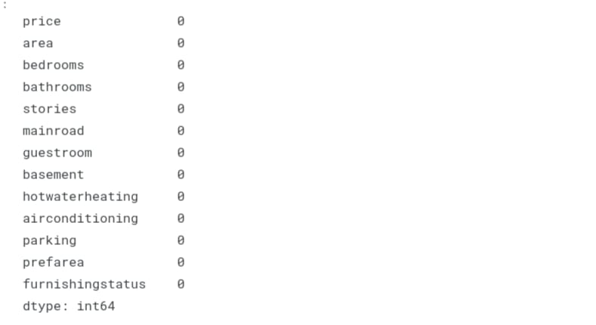
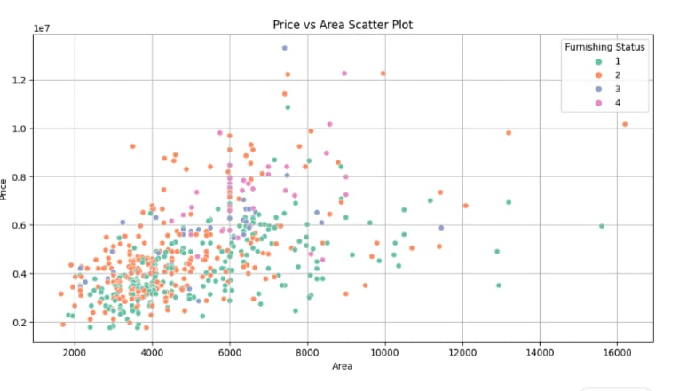
Result :

Slide 17
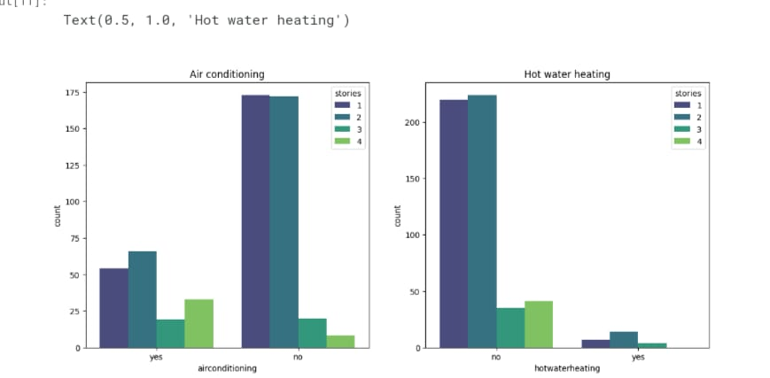
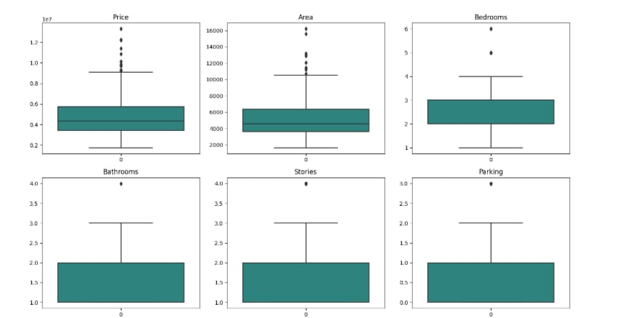
Result (Contd..):

Slide 18
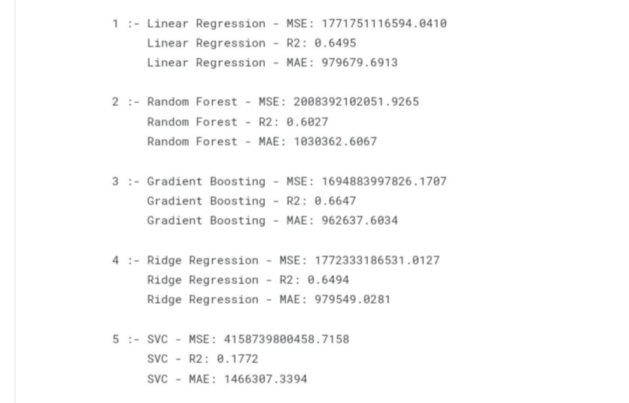
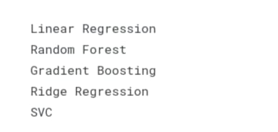
Result (Contd..):

Slide 19

Result (Contd..) :

Slide 20
References :
https://discuss.tensorflow.org/t/how-can-i-get-better-results-when-training-a-house-price-prediction-model/17526
https://www.kaggle.com/datasets/yasserh/housing-prices-dataset
https://github.com/topics/house-price-prediction?l=python&o=desc&s=updated
https://www.google.com/amp/s/www.geeksforgeeks.org/house-price-prediction-using-machine-learning-in-python/amp/

Slide 21
Conclusion :
In conclusion, employing a CNN algorithm for house price prediction offers promising results, leveraging its ability to capture spatial dependencies in housing data. Through rigorous training and validation, the model demonstrates robust performance in forecasting house prices. However, continuous refinement and optimization of the CNN architecture are necessary to enhance predictive accuracy further. Additionally, integrating other relevant features and exploring ensemble techniques could potentially enhance model performance. Overall, the CNN algorithm presents a valuable tool for accurate and insightful house price prediction, aiding in informed decision-making in the real estate market.

Slide 22
Thankyou!

