Slide 1
FoodSquare

Slide 2
Data
Flow
Diagram

Slide 3
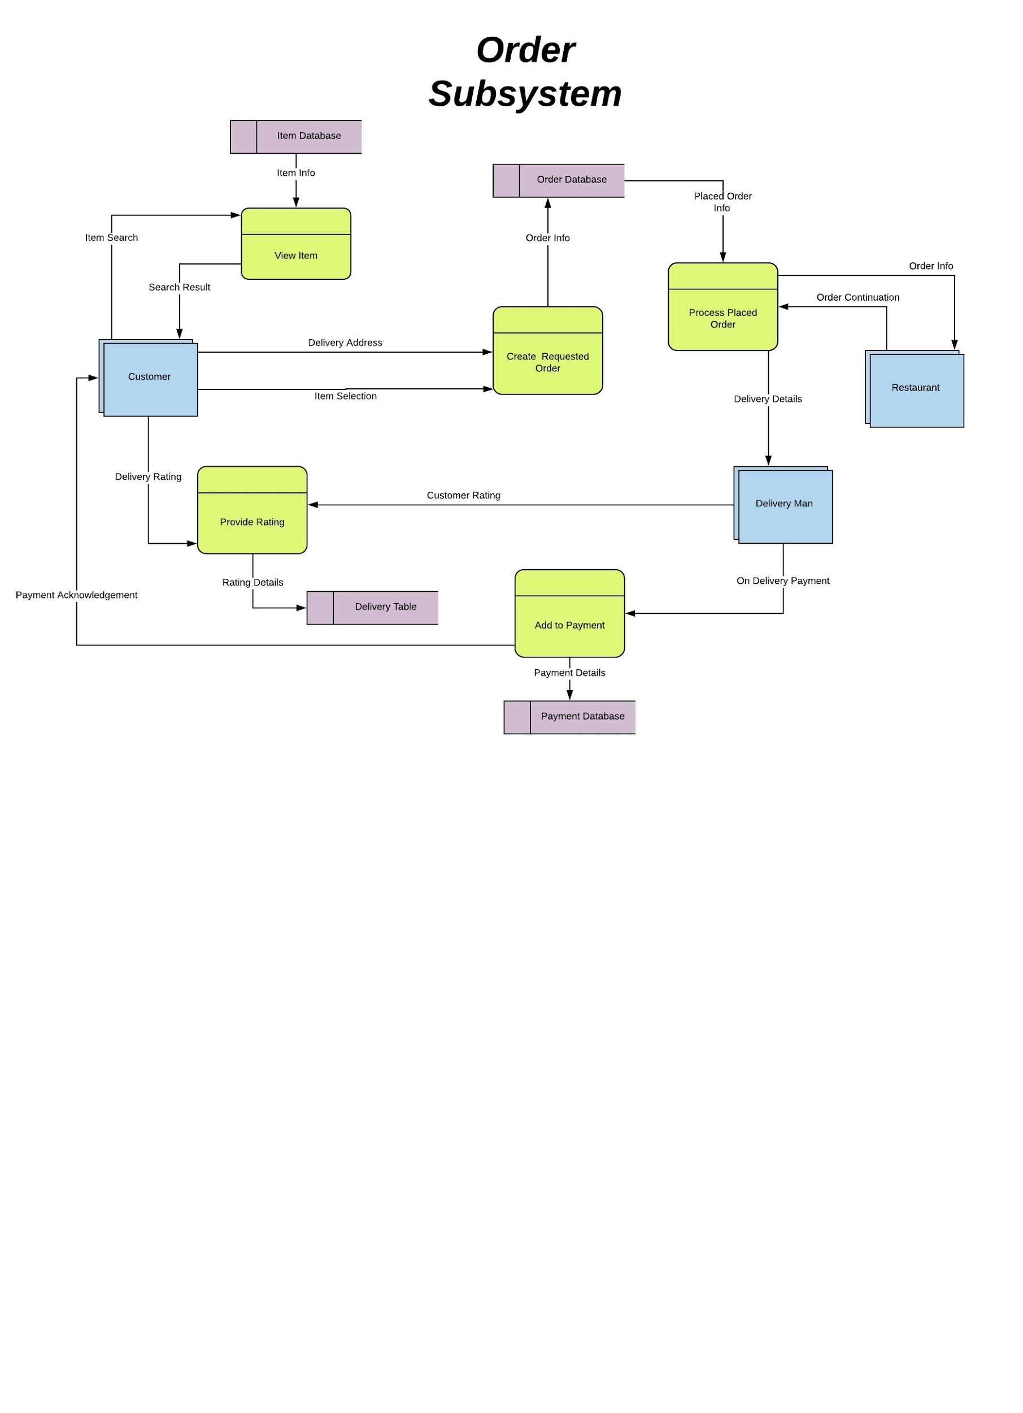

Slide 4
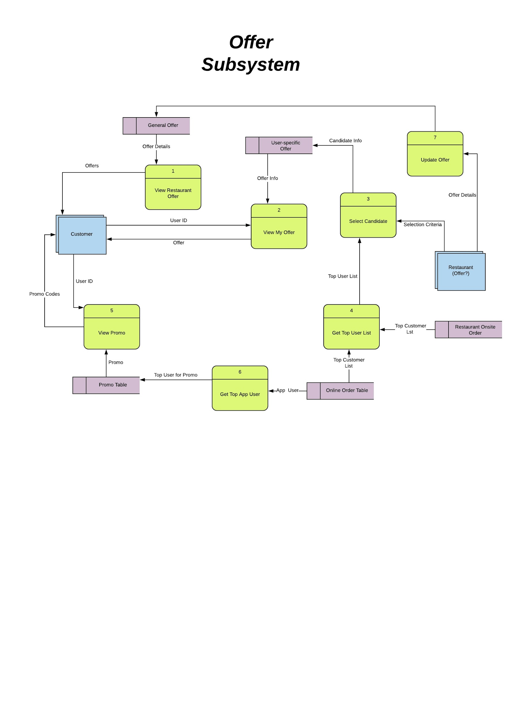

Slide 5
Sequence
Diagram

Slide 6
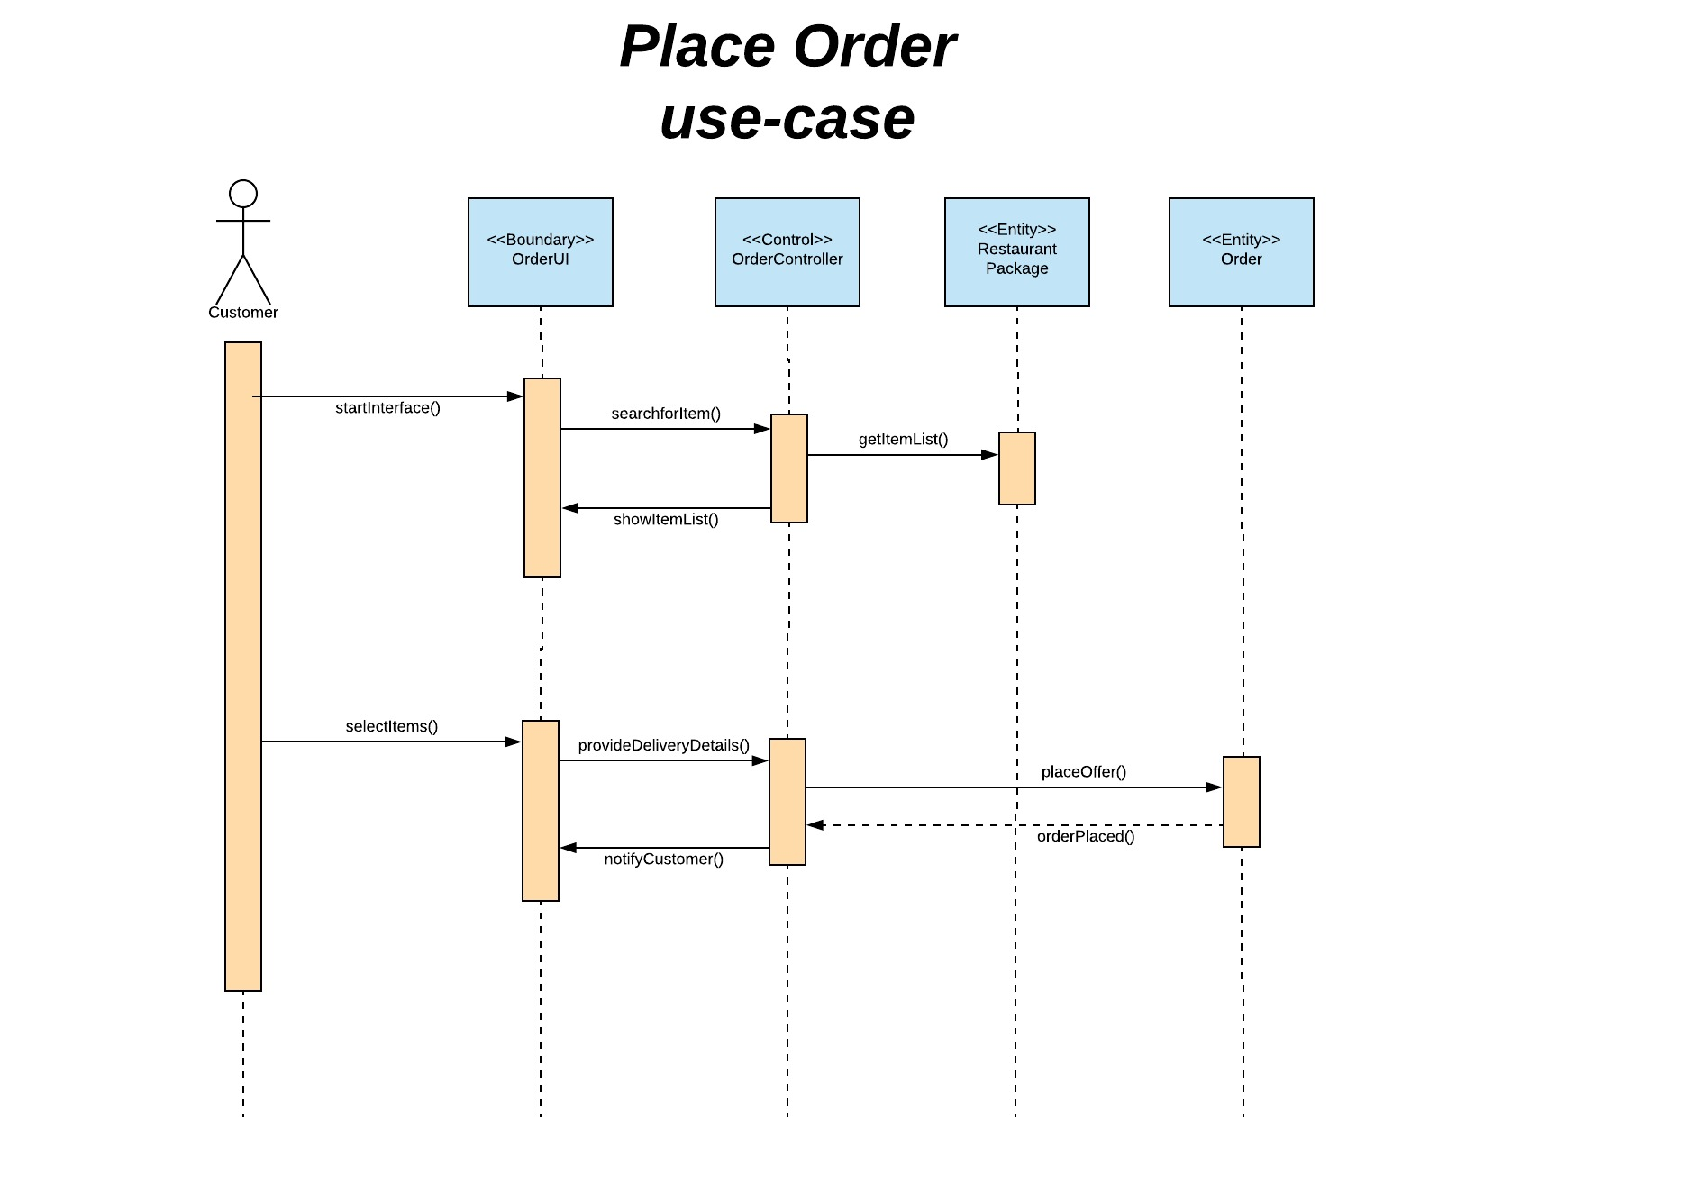

Slide 7
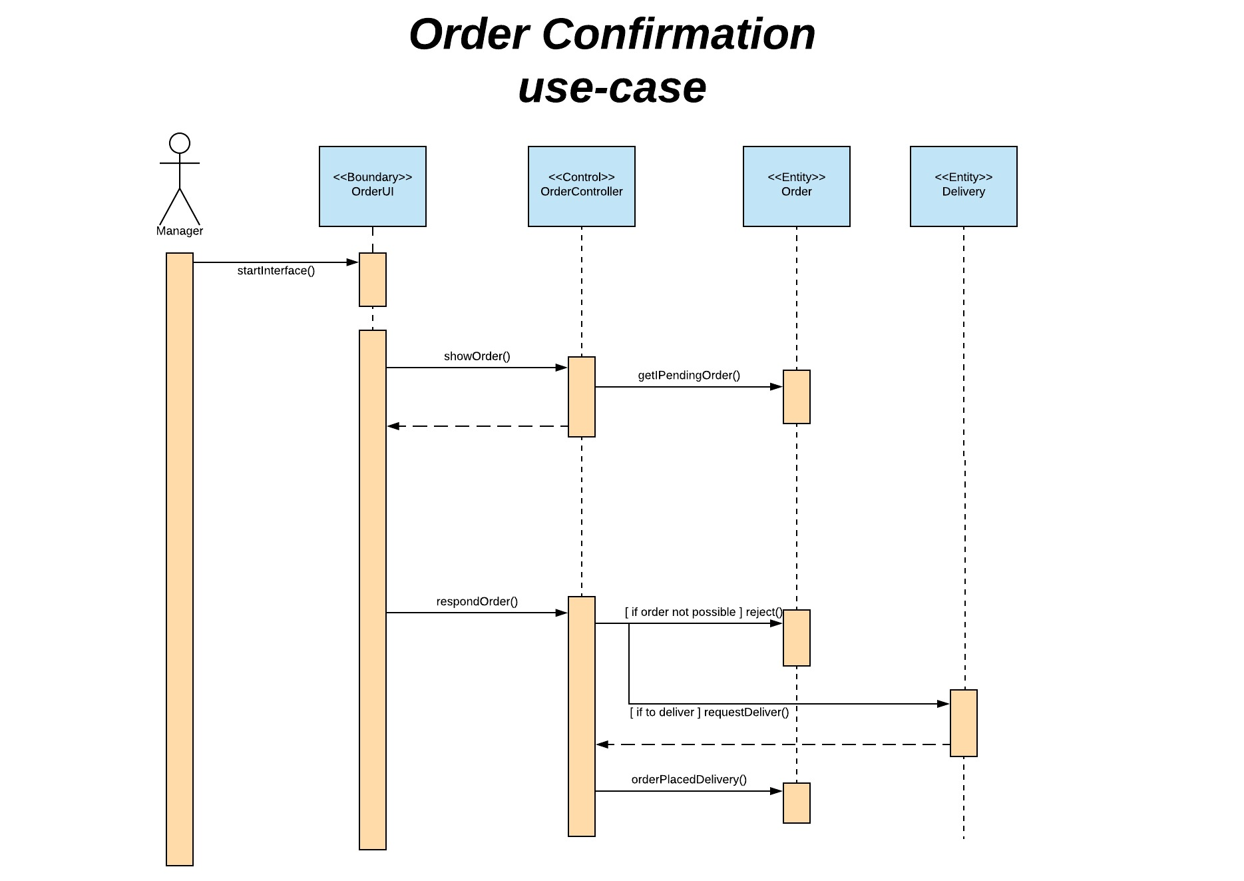

Slide 8
Thank you!

