Slide 1
aviewgui.py
Quick Start
2016/01/05

Slide 2
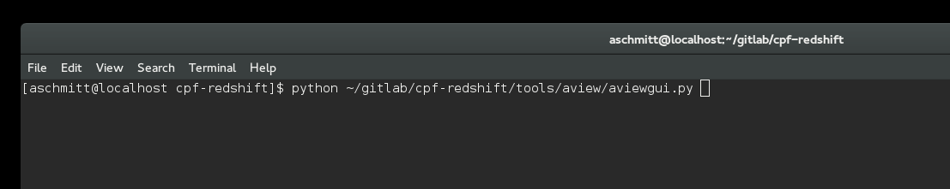
Start the script

Slide 3
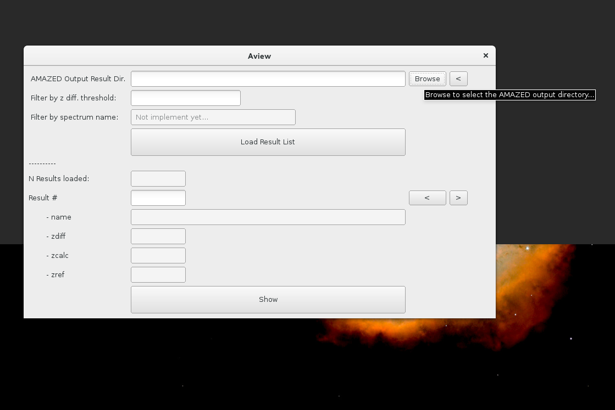
Browse to the AMAZED output directory

Slide 4
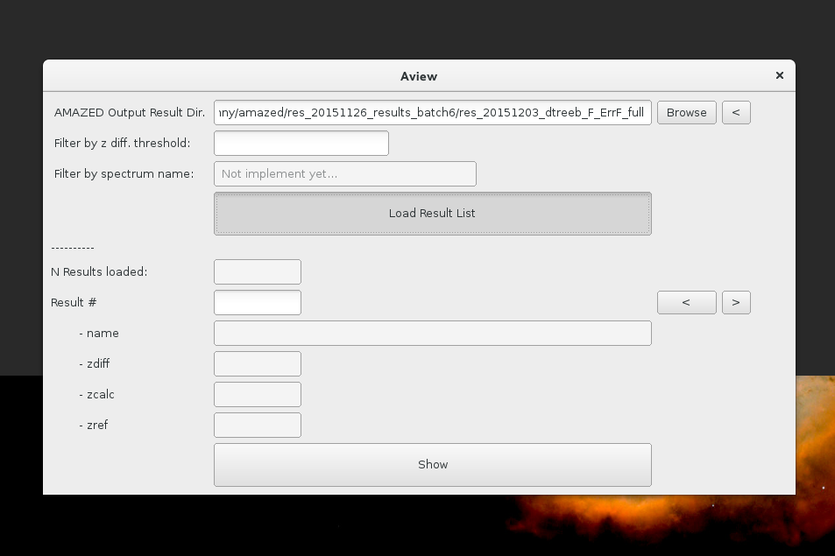
Load the result list

Slide 5
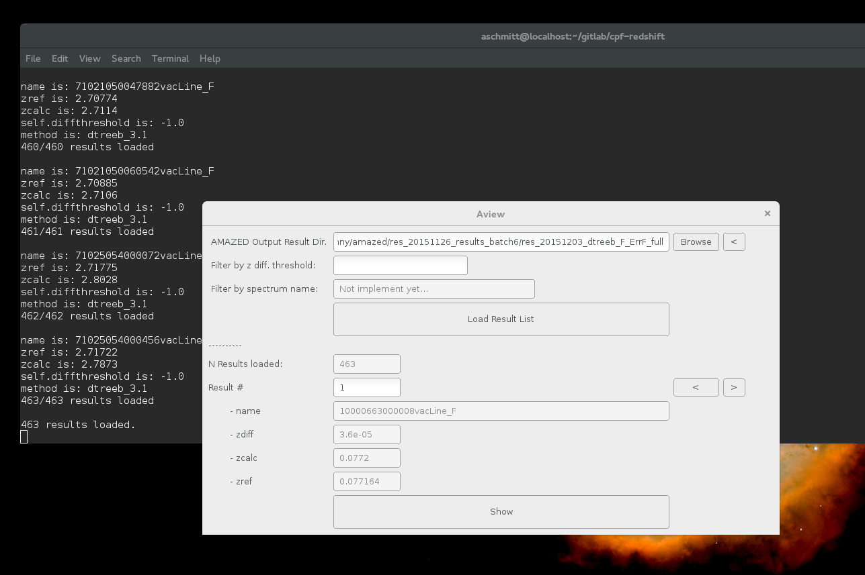
See the loaded results...

Slide 6
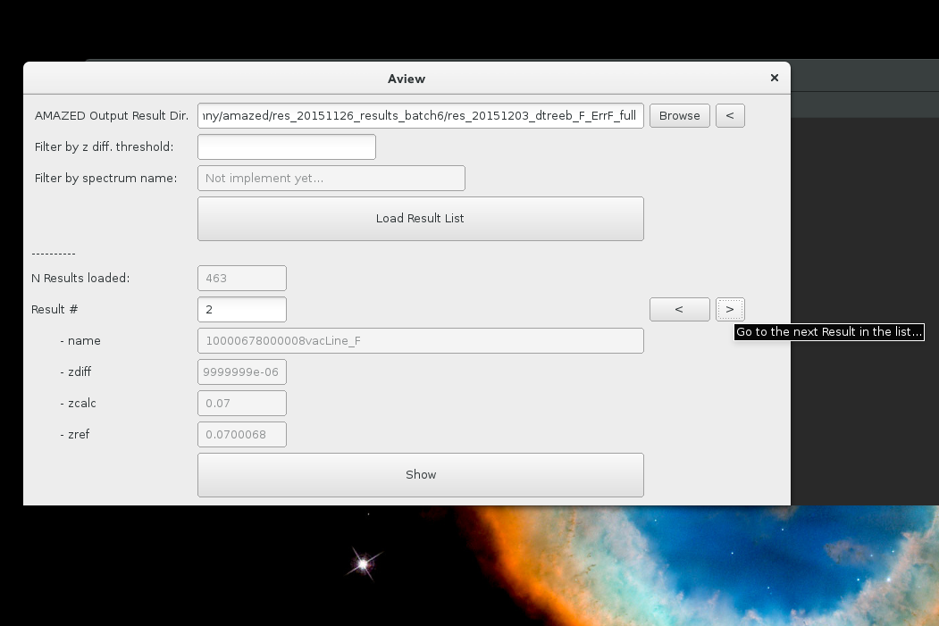
Navigate between the individual spectrum results...

Slide 7
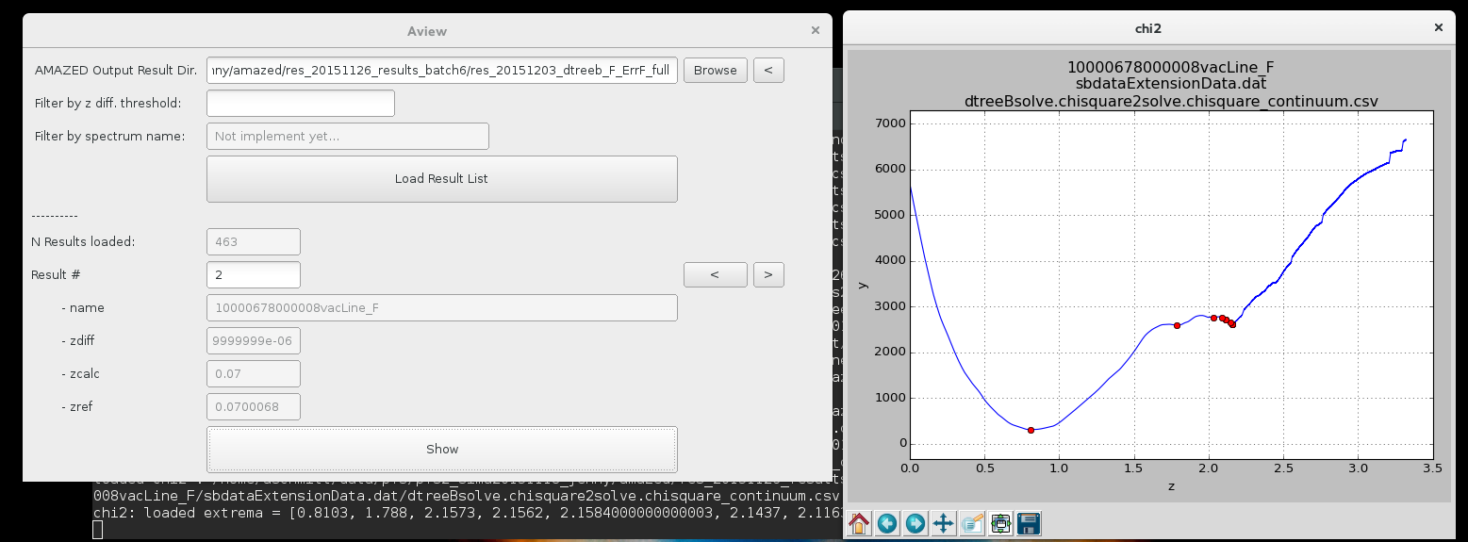
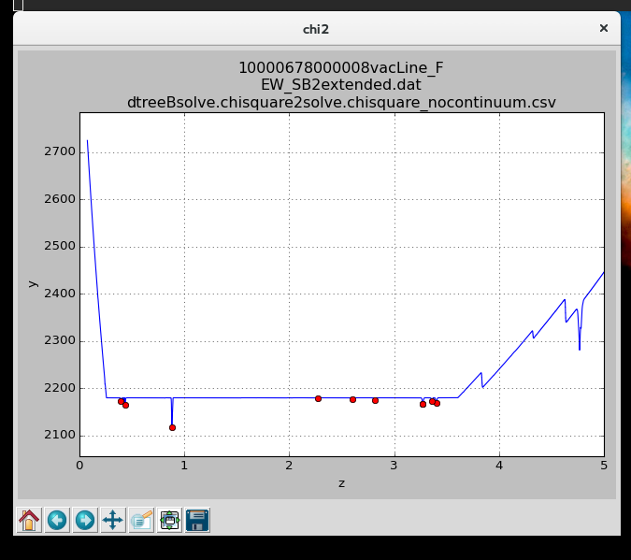
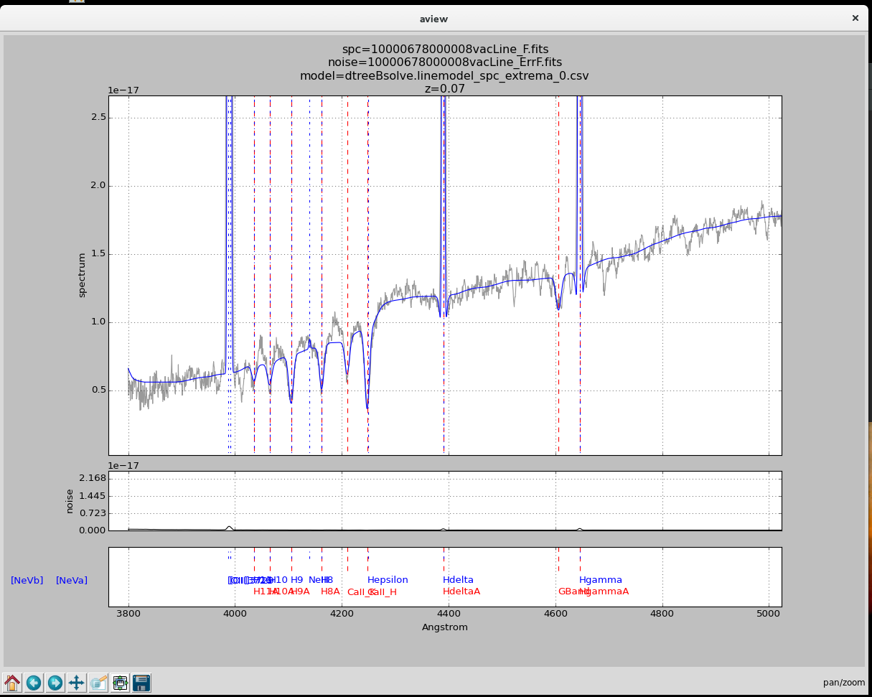
Plot some results for the selected spectrum ...

Slide 8
NB:
You can use aview.py for a command line version of the display script. It allows to override the redshift value (default is the zcalc value) used for plotting the spectrum overlaid with the template or the linemodel…
The chisquare results are only displayed if the AMAZED pipeline has been run with the parameter :
"SaveIntermediateResults": "all"
Tested methods are : dtree7, dtreeB, chisquare, linemodel, ...
This is an early prototype version that is intended to provide a quick and easy display. Your feedback is very welcome

