Slide 1
collision analysis with ETS and simFun

Slide 2
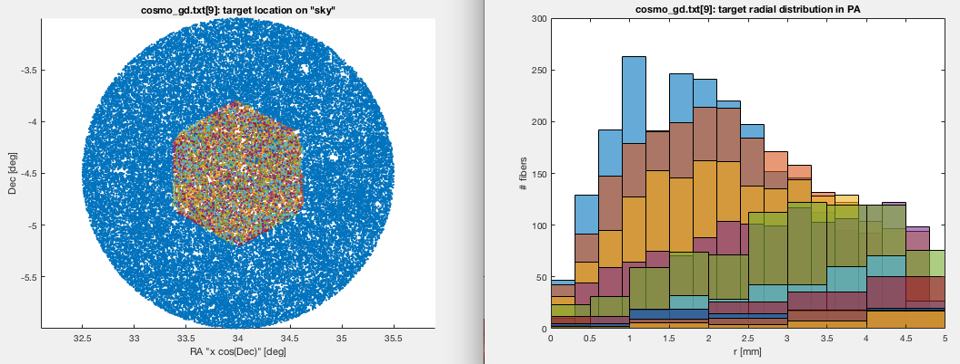
ETS
Move to the target data directory and run ETS
$ cd $LOCALPATH/ics_cobraOps/matlab/Target_Lists/pfs_target_test_data_set/data
$ ets_demo assigner=draining_closest input=pfs_preliminary_target_cosmology.dat n_exposures=10 output=cosmo_gd.txt time=2016-04-03T08:00:00Z
Generate figure(2) , plot the field targets and then the assigned targets and radial histograms.
>> figure(2); hold on;
>> load_dat( 'pfs_preliminary_target_cosmology.dat');
>> for kk=0:9, loadtgt('cosmo_gd.txt',kk,nan); end;

Slide 3
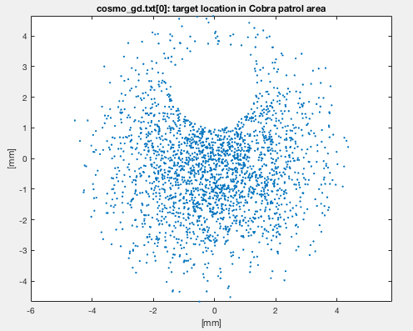
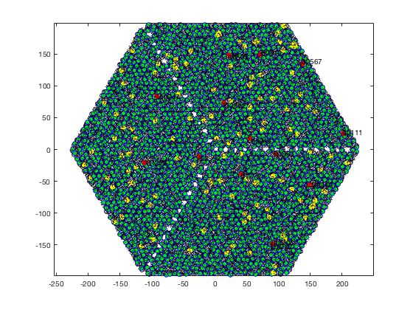
ETS→ simFun
example to show a sigle exposure (figure 1 from loadtgt)
>> loadtgt('cosmo_gd.txt',0,nan);
suppress plotting and just pull the target list for exposure 0
>> cosmo_gd_exp0 = loadtgt('cosmo_gd.txt',0);
switch to “matlab/collisions” directory and run simFun using these targets, with motor maps drawn from real cobras but ideal arm lengths (2.375 mm)
>> cd ../../../collisions/
>> q = simFun(cosmo_gd_exp0,'full',1,0)
Using updatedMotorMapsFromThisRun2.xml...
intractable collision on 1779: use+: 1 deltaT: 61
intractable collision on 2210: use+: 1 deltaT: 7
intractable collision on 1779: use+: 1 deltaT: 61
intractable collision on 2210: use+: 1 deltaT: 7
q =
struct with fields:
targets: [2394◊1 double]
Traj: [1◊1 struct]
Coll: [1◊1 struct]
bench: [1◊1 struct]
minDist: [13782◊1 double]
caats: [26◊1 double]
assignments: [1◊1 struct]

Slide 4
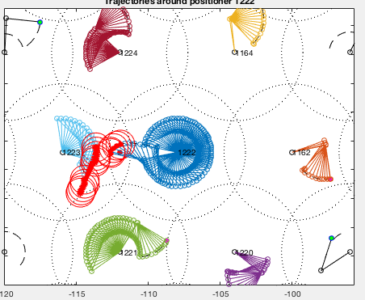
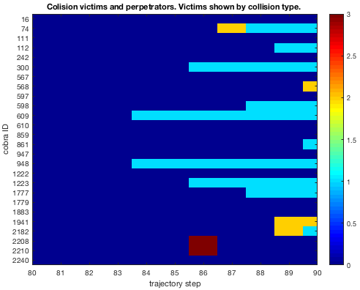
simFun analysis
To inspect a collision, zoom in on a red dot and take note of the identifying number. Hold the figure to plot over the existing map.
>> hold on; showMovementAfterSim(q,1222)
The top figure shows fiber-elbow collisions on this trajectory. The extent of the fiber and elbow are shown for the victim, while for the perpetrator, only the fiber extent is shown.
Indices (1-2394) of cobras involved in collisions:
>> colliders = find(q.Coll.V > 0);
Nearest-neighbor indices (1-13782) of colliders
>> collidersNN = nonzeros(q.Coll.rcindx(colliders,colliders));
collidersNN can be used to pull data from Coll.detected and Coll.type
>> imagesc(q.Coll.type(collidersNN,:))
Collision type indicates where the victim was contacted. 1=elbow, 2=arm, 3=fiber. Following lines of matlab code label the Y axis with cobra ID’s
>> set(gca,'YTick',1:length(colliders))
>> set(gca,'YTickLabel',... cellstr(num2str(colliders)))
Large numbers of type 1 collisions indicate lack of fiber-elbow constraint.

