Slide 1
PFS ICS infrastructure
Atsushi Shimono (PFS Project Office)
2017/03/09

Slide 2
Agenda
PFS ICS infrastructure design review
Overview of targets in this review
Brief overview of PFS ICS design
Network
Link over fiber on telescope
Storage and image data handling
VM infrastructure
Database server and its replication/backup
ICS infrastructure status monitoring and defect detection
Procedure on instrument exchange
Hardware delivery to Subaru
Discussions on interfaces between Subaru and PFS
Network connection to Subaru (data flow, V-LAN)
Access control to/from PFS network
System alert handling (items to STS)
Engineering data archive (during on-site AIT, independent unit test)

Slide 3
Overview of targets in this review
Network
Link over fiber on telescope
Storage and image data handling
VM infrastructure
Database server and its replication/backup
ICS infrastructure status monitoring and defect detection
Procedure on instrument exchange

Slide 4
Items for review shown in ICS architecture diagram
Pure-software
Subsystem actor
Sequence (SpS/PFI)
Integrated control
Message Hub System (MHS)
Log/Status archive
Status viewer GUI
ICS Storage
Virtual Machine Infrastructure
Backup infrastructure
TARGET AREA
PFS Network (PFS-LAN)
Hardware
Individual
Integrated

Slide 5
ENU1
2
3
4
Subaru
B/R/NCU1
2
3
4
g2t
IIC
STARS
Gen2
g2cam
m2t
MPS
MLP1
MAC
FPS
Hilo
On-site DRP
MHS
AGCC
STS
SAS
MCS
DB
Storage
TARGET AREA
etc. …
jsonp provider
SHM
Status archiver
MHS
Operational status viewer (browser)
jsonp or CORS
HTML
DB to json
SQL
database
MHS
Status archive
summit
Hilo storage?
(ICS)
db server
DB
backup
operation
Daily backup
replication
Daily backup
operation
DB
db server
(on-site DRP)
backup
hilo
TARGET AREA
Summit master iSCSI storage
External access
Survey database
(On-site database backup/replication proposal)
hilo outside-DMZ
Survey cluster?

Slide 6
Brief overview of PFS ICS design

Slide 7
Network
PFS has four IR detectors which make continuous data flow from devices to storage server(s), and its own camera system for auto guide. PFS instrument network shall be capable to handle these data flow with some burst-liked additions considered, and also is better to have capability for future upgrades of the instrument.
PFS plans to have its own network subnet with servers for DNS, DHCP, NTP. Network switches are planned to be managed under CDM (for modification of configuration, monitoring and alert handling), and also are monitored by PFS for instrument health checks during observation (e.g. to check network data flow for image data) and a data flow optimization.
This section is organized as follows:
Requirements
L1 design
Performance verification is in next section – “Link over fiber on telescope”
Handling on instrument exchange is in the last section – “Procedure on instrument exchange”
L3 design
Monitoring

Slide 8
Requirements – Network
Requirements from Subaru point of view:
Subaru standard recommendation of network switches
Cisco 2960X-24TD-L or 2960CG-8TC-L is the standard (to keep management and spare handling simple)
If other(s) is desired, Cisco 2960X, 2960CG or 3650 are possible selection
Network switch management
Network switch shall be managed by and monitored from Subaru CDM
Their configuration shall follow standard configuration (e.g. VLAN, remote access) of CDM.
One VLAN ID will be assigned for PFS-LAN
Seemless access from Subaru network (incl Hilo, VPN) to PFS LAN for remote maintenance and operation are required, although security of instrument operation need to be secured in a required level.
All connections to the Subaru dome are in fiber connection.
Static IP address assignment is desired.
Requirements from PFS instrument point of view:
Required data flow rate
CB2F – TUE-IR (SpS): (assuming) min 200Mbps for all IR detectors (one stream), currently on TCP but alternative is on UDP
CB2F – Cs (MCS): not assuming real time data transfer, but raw stream in ~900Mbps
PFS to Gen2 at CB2F: not well defined but as large as possible (item in discussion session)
Special requirements on numbers of fibers:
PF or TUE-Opt – CB2F: two pairs of Ethernet, and two pairs of single mode fiber for PCIe bus extender

Slide 9
L1 design – Network

Slide 10
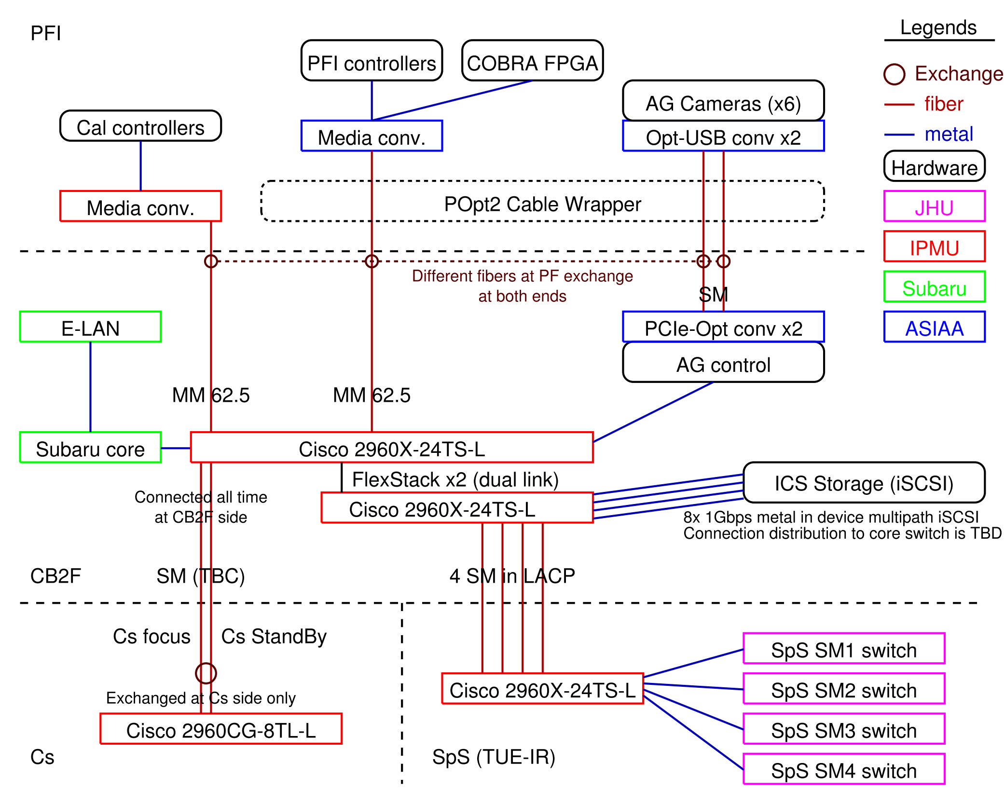

Slide 11
L3 design – Network

Slide 12
Monitoring – Network

Slide 13
Link over fiber on telescope

Slide 14
Storage and image data handling

Slide 15
Requirements from ICS actors’ point of view
4 continuous stream from IR detector control computer
Assuming 4k sq. image per 3-4sec, 60-90Mbps for one up-the-ramp
Could be double, depends on reference pixel : TBC
2.4TB/night for 90Mbps x 4 with 15hours operation per night, 36TB/run for 15day run
No need to read up-the-ramp raw data
Also saved on memory, used for final (summed?) FITS image output
VM host images
Data rate could be small for normal operation
NFS or iSCSI on virtio – need study from DR or backup point of view
30GB per VM could be enough, 0.6TB for 20 VMs; 2TB with 3 generation back-up
NFS host for CCD and IR (final) FITS images
Not high data rate – e.g. 512MB in ~40sec
Both write and read
Read from FTP server for sending to Gen2 (archiver)
50 – 100 GB per night, up to 2TB for 15day run
Survey with shortest exposure will be 7.5min (cosmology), ~100 times per night for 12 hour observation
NFS host for AG images
1 or 2 x 2MB image per a second, both read (TBD) and write
Focusing image will be one order smaller (e.g. one exposure per 10 sec)
Will PFS save locally or not is a question, but ~200GB per night, ~3TB per 15day rurn
PostgreSQL data store
Could not be on NFS, need to be direct iSCSI mount at host
Tron log archive will be < ~1TB (SDSS 15 years in 500GB or so)
Survey and exposure execution database will be smaller
Backup storage
Mostly at daytime job

Slide 16
Requirements from ICS actors’ point of view – Summary
Storage performance requirement summary
Read/Write performance
800Mbps (90Mbps x 4SM x 2 for reference pixel + buffer) write performance at least
Write mostly in sequence write (FITS data), ~10k IOPS is fine (or already over-spec)
Capacity – ~100TB
10TB for operational storage (e.g. VM, DB)
90TB for FITS-liked data; 40TB for 15day run
Mostly raw up-the-ramp data
Could be compressed after run -> 1/3 or 1/4
Seeking possibility to compress at the first moment
If compressed, 15TB for 15day run, 90TB for half year
Will be moved to external storage in such periods
10TB for backup of DB

Slide 17
Hardware implementation plan
120TB (or 108TB) iSCSI RAID6 4U storage server
20D+2P+2H x 6TB NLSAS HDD, or 2x(9D+2P)+2H NLSAS HDD
8x 1Gbps metal interface for data, 2x metal for console interface
device-multipath or independent at initiator
See next for details
2 core switches for PFS network at control building
Connected by FlexStack, might no issue on data exchange
FlexStack has 40Gbps in total with dual link
Connect all 10 metal to one switch could be better for management?
Need to develop plan further on connections
Connecting high-bandwidth lines to storage side could be possible
Each switch has 24 metals and 4 SFPs
All IR detector control could be connected with 4 metals and 4 SFPs
Link to Subaru core switch could be 1 (or 2?) metals
With them all, 16 metals and 4 SFPs in total

Slide 18
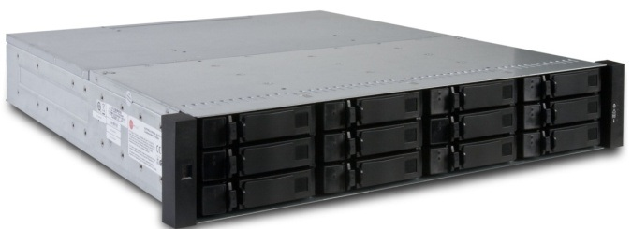
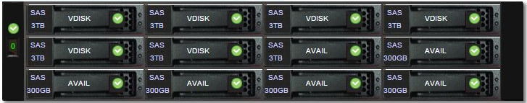
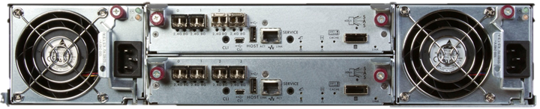
Hardware implementation plan – CDS4004
Performance
100K Read IOPS, 650K IOPS from cache
6.4Gbps read, 5.3Gbps write
Host interface
2U12 3.5in as one host or JBOD, up to 3 JBODs (+ 1 host)
Using 1host + 1JBOD with fully populated disk (24 HDDs in total)
Could add another 2 JBOD, if necessary during operation
Two host controllers in redundant
No battery backed-up cache, write from memory to flash by capacitor backed-up
Max 8 SFP+, compatible with FC, iSCSI (hybrid) or SAS
Certifications
NEBS 3 compliant for telecommunication
ML-STD-810F/G
Already procured, under test at IPMU

Slide 19
Storage coordination plan as storage server
6 LUNs for 108 or 120TB
4LUNs for IR detector controller storage, 20TB each
Capable to store 30day’s run
Or 90-120 day’s if compressed
1LUN for NFS, 25TB+
Data, VM image storage, backup
1LUN for PostgreSQL database, 3TB
1 NFS server will supply all required NFS/FTP storage
If virtio IOPS requirement appears huge, might be divided into two
If all in linux with certain version, no issue found on testing environment.
FTP for transferring data to Gen2
Assuming g2t can specify external FTP server by configuration
Even we need FTP service on each, all are read only and no issue on locking.

Slide 20
Storage coordination plan per a service
IR detector
Direct iSCSI storage LUN mount to each control host for raw up-the-ramp FITS images
4 iSCSI targets (LUNs) in total for this
NFS mount for final FITS images
1Gbps up/down full link is enough for all data I/O
Nearly same in and out (90 or 180 Mbps) for up-the-ramp, even if no compression
VM host storage
TBD, but assuming on NFS (qcow2?)
Online backup is possible with qcow2 disk image
If some writable area required, mount NFS storage at OS level (not mounting additional virtio)
Most of hardware connected actors will run on physical machine, not VM
General NFS
1Gbps up/down full link is enough?
One dedicated hardware is required for NFS service
Services with special care required
Database (PostgreSQL) storage
iSCSI mount storage area or large volume in VM disk image (No NFS mount as filesystem!)
Backup operation will be on pgsql layer – no special care required on storage connection
iSCSI mount storage is better?
Storage for backup
Will be mostly used at daytime – daily cron job liked
No serious performance requirement will be applicable, rely on general NFS service should be fine

Slide 21
Plan before deployment at on-site
No special care is required, except for IR detector control
Neither volume nor bandwidth is high
AIT local area NFS service is enough… Or even local fs.
From application level, nothing will differ for this use b/w iSCSI or NFS/local
e.g. lock, bandwidth
Volume size for storage of IR detector control
Bandwidth per one camera is not so high (~100Mbps)
Simple NFS server can supply ~600Mbps
Continuous up-the-ramp outputs large size data is an iusse
100Mbps over 1day is ~1TB
Compression will make this 250 – 350 GB/day
But can be done with recent HDDs, without considering about backup
No need to backup these software stability test data
Need to be studied once PFS get an IR detector
e.g. how much we need to save/check/analyze up-the-ramp data
Better to study how existing instrument at Subaru doing?

Slide 22
Emergency recovery plan
(to be studied following failure modes)

Slide 23
VM infrastructure

Slide 24
Database server and its replication/backup

Slide 25
Status monitoring and defect detection

Slide 26
Procedure on instrument exchange

Slide 27
Hardware delivery to Subaru

Slide 28
Items and assigned delivery
Followings are hardware items which the project (or Subaru) need to prepare or deliver to the summit, and subsystems use these items.
CB2F (Control Building 2F)
Rack to host items (Subaru): before all of followings
Assumed deepest unit is ~760mm (MPS), ~650mm (DB host)
Network switch (IPMU; already in hand): (at least) 1 at MCS, 2nd at SCR
ICS RAID6 storage (IPMU; already in hand): SM1
MCS backup could be done with small storage?
VM host computers (IPMU; some already in hand)
(at least) 1 at MCS (any subsystem delivered to summit) – to run MHS
Others depends on system load
Serial communication (MLP1; IPMU) host: PFI
KVM, PDU etc. (IPMU; some already in hand): MCS?
DB host (IPMU; spec TBD): SM1??
SpS (both IR3 and TUE-IR)
5th rack (from JHU): SCR
Network switch to connect CB2F (IPMU; already in hand): SCR
UPS and power supply (Subaru): SCR
1U host computer @ 5th rack (IPMU; spec TBD): SCR
Telemetry devices/system (TBD): SCR (or SM1)

Slide 29
Setup to accept MCS
MCS will be installed as Cs instrument. We need to have minimum operation hardware at CB2F, including PFS network.
19inch Rack (Subaru)
PFS network switch (at least 1; IPMU; already in hand)
Also connection to subaru’s core switch
VM host (IPMU; 1 already in hand)
Hosting administrative VM, e.g. dnsmasq
KVM, PDU (IPMU; already in hand)
At this stage, no special care for power distribution is required, only like connecting things to PDU at CB2F. Also network is simple, we need two fiber connection to Cs and its standby (one active, one backup), one connection to subaru core switch with routing.

Slide 30
Setup to accept SCR
In parallel to build SCR (Spectrograph Clean Room) at TUE-IR (IR4), we need to have control hardware for SCR.
2nd network switch at CB2F (IPMU; already in hand)
might only need 1 SFP to SpS, but better to have and check working at this moment
Network switch at SpS (IPMU; already in hand)
5th rack (from JHU)
UPS at IR3, with power distribution/panel (Subaru)
1U host computer (also for SCR control) (IPMU)
Telemetry devices (TBD)
e.g. Lakeshore temperature monitor and sensors
At this point, we need full power distribution system to supply spectrograph, both UPS and power panel w/ cables. Environment active control subsystem for SCR shall be considered as a part of SCR, so not listed here.
For network and storage, we only need “connected” at this point, so performance evaluation on network in parallel to SCR preparation (or validation) is fine.

Slide 31
Setup to accept SM1,2
Before we have SM1,2 at summit, we need almost all of hardware.
ICS RAID6 storage (IPMU)
DB host (IPMU)
Not as full operation (e.g. interaction with ETS or survey coordination), but to store MHS status archive or telemetry etc.
Before this point, PFS network and storage need to be fully prepared and validated on performance point of view (for NCU1,2 operation).

Slide 32
Setup to accept PFI
Most of computing and power resources need to be active well before delivery of PFI to the summit.
Serial communication (IPMU)
This communication will be validated at factory of melco (Mitsubishi; at Amagasaki) in test setup.

Slide 33
Discussions on interfaces between Subaru and PFS
Network connection to Subaru (data flow, V-LAN)
Access control to/from PFS network
System alert handling (items to STS)
Engineering data archive (during on-site AIT, independent unit test)

Slide 34
Backup or copied materials to be used

Slide 35
Updates/Progresses – shared infrastructure
Communication fibers at Subaru have tested and passed
Mostly by real data flow, except for 1Gbps SM fibers (OTDR)
ICS storage performance have verified with simulated 4 H4RG data streams
Simulation configuration: Storage – NFS server – 4x data generator
Achieved ~2.3Gbps file write, enough for 4 H4RG data streams
ToDo
Need some consideration on network configuration
More realistic test (e.g. having both read/write) could be better
PFS-LAN network host stage for configuration and stability passed
Using real hardware to be used on-site
Some management configuration will be modified by Subaru (CDM) after delivery
ToDo
Connection between PFS-LAN and Subaru network is not fixed yet
Data backup procedures (e.g. DB) are in production at pfs servers
Virtual machine servers for ICS components are under host stage at IPMU
Dell R710 (2U Xeon E5506) x2, R410 (1U Xeon E5640x2) x3, R310 x1+ backup (2U x2)
4 port Gbps NIC

Slide 36
PFS Network Physical Wiring Diagram
Inst Exchange
PFI
fiber
PFI Controllers
AG Cam (x6)
metal
Cal Controllers
COBRA
JHU
Media Conv.
USB-Opt Conv. (x2)
Media Conv.
IPMU
POpt2 Cable Wrapper
Subaru
Different fibers at PF exchange
MM 50
ASIAA
E-LAN
USB-Opt Conv. (x2)
MM 62.5
MPS
MM 62.5
1 or 2 TBC??
TBD
AG Ctrl
Subaru core
Cisco 2960X-24TS-L
FlexStack x2 (dual link)
8x 1Gbps metal in device multipath iSCSI
Connected
all time @CB2F
Cisco 2960X-24TS-L
ICS Storage (iSCSI or NFS)
CB2F
MM 50
4SM in LACP
Cs focus
Cs Stand-by
SpS SM1 switch
Cisco 2960X-24TS-L
SpS SM2 switch
Exchanged at Cs only
2960CG-8TL-L
SpS SM3 switch
Cs
SpS (TUE-IR)
SpS SM4 switch

Slide 37
Network connection ToDo
Connection to Summit core (E-LAN, V-LAN)
To send up-the-ramp smoothly, we may need more than 1Gbps. Need LACP configuration.
PFS side for up-the-ramp to Gen2 is one g2cam host (TBC), need some care on LACP balancing.
V-LAN is also through Summit core, could connect through trunk port configuration on Summit core and PFS core.
Even if we select this, I want to keep separate connection for V-LAN and PFS-LAN to the host (in PFS network).
Connection between PFS core and SpS (ICS #579)
There is a way to go on configuration to pass 4x300-400Mbps stream, but need to be cared in configuration both BEE and iSCSI storage.

Slide 38
Host cluster at CB2F
Most of services are planned to run on VMs, such as MHS, logger, support infrastructure. Also PFI related actors are in consideration.
Some services (esp. DB) is planned as bare system, but could be on VM if performance is verified.
Host configuration (still in development):
iSCSI storage (108TB RAID6 w/2sp, 2x2U) x1
Dell R710 Xeon E5506 (2xAC, 2U) x2
Dell R410 Xeon E5640 (1xAC, 1U) x3
Dell R310 Xeon E3-? (1xAC +1 vacant, 1U) x1 (for DB?)

Slide 39
Host cluster ToDo
Verify iSCSI storage performance with more realistic configuration
Currently only write from 4xH4RG simulator – NFS server – iSCSI storage.
Better to verify with running VMs, DB connections, with some data read/write (incl. sending up-the-ramp to Gen2)
IR data handling
Original plan was host control computer at CB2F with large memory, which will do all for data management
Read directly from SAM over 1Gbps network
Save up-the-ramp FITS (single 2D HDU) to storage, and on memory
Build final FITS file from data on memory (no read stream from storage for this)
Currently, BEE reads data from SAM via USB, and saves to storage
Something other need to care of building final FITS file etc.
Verify VM operation performance
Mostly tested using PFS server cluster at IPMU for pfs.ipmu.jp
Integration of PFI control into VM cluster
Need to check PCI passthrough performance and capability for PCIe extender.
Or USB mount could work?
Check network bandwidth requirement (for shared interface)
Host maintenance operation
Health check with iDRAC etc.

