Slide 1
Presentation for PFS ICS infrastructure design review
Atsushi Shimono (PFS Project Office)
2017/03/09 0800-1200 JST
draft
pages as filled draft are marked with left up corner marks, but 1st draft status

Slide 2
Agenda
PFS ICS infrastructure design review
Overview of targets in this review
Brief overview of PFS ICS design
Network
Link over fiber on telescope
Storage and image data handling
VM infrastructure
ICS infrastructure support hardware
Database server and its replication/backup
ICS infrastructure status monitoring and defect detection
Procedure on instrument exchange
Procedures for power failure detection and handling
Hardware delivery to Subaru
Discussions on interfaces between Subaru and PFS
Network connection to Subaru (data flow, V-LAN)
Access control to/from PFS network
System alert handling (items to STS)
Engineering data archive (during on-site AIT, independent unit test)

Slide 3
Overview of targets in this review
Network
Link over fiber on telescope
Storage and image data handling
VM infrastructure
ICS infrastructure support hardware
Database server and its replication/backup
ICS infrastructure status monitoring and defect detection
Procedure on instrument exchange
Procedures for power failure detection and handling
Hardware delivery to Subaru

Slide 4
Items for review shown in ICS architecture diagram
Pure-software
Subsystem actor
Sequence (SpS/PFI)
Integrated control
Message Hub System (MHS)
Log/Status archive
Status viewer GUI
ICS Storage
Virtual Machine Infrastructure
Backup infrastructure
TARGET AREA
PFS Network (PFS-LAN)
Hardware
Individual
Integrated

Slide 5
ENU1
2
3
4
Subaru
B/R/NCU1
2
3
4
g2t
IIC
STARS
Gen2
g2cam
m2t
MPS
MLP1
MAC
FPS
Hilo
On-site DRP
MHS
AGCC
STS
SAS
MCS
DB
Storage
TARGET AREA
etc. …
jsonp provider
SHM
Status archiver
MHS
Operational status viewer (browser)
jsonp or CORS
HTML
DB to json
SQL
database
MHS
Status archive
summit
Hilo storage?
(ICS)
db server
DB
backup
operation
Daily backup
replication
Daily backup
operation
DB
db server
(on-site DRP)
backup
hilo
TARGET AREA
Summit master iSCSI storage
External access
Survey database
(On-site database backup/replication proposal)
hilo outside-DMZ
Survey cluster?

Slide 6
Overview of targets in this review
Network
Design and its trade study
Hardware had (almost) fixed, but some configurations are in discussion session
Link over fiber on telescope
Design and on-site verification results
Storage and image data handling
Design, item selection, performance verification
VM infrastructure
ICS infrastructure support hardware
Database server and its replication/backup
ICS infrastructure status monitoring and defect detection
Procedure on instrument exchange
Procedures for power failure detection and handling
Hardware delivery to Subaru
Delivery schedule for preparation to accept each instrument component
Note: title pages are colorized for ease of seeking.

Slide 7
Brief overview of PFS ICS design

Slide 8
Network
PFS has four IR detectors which make continuous data flow from devices to storage server(s), and its own camera system for auto guide. PFS instrument network shall be capable to handle these data flow with some burst-liked additions considered, and also is better to have capability for future upgrades of the instrument.
PFS plans to have its own network subnet with servers for DNS, DHCP, NTP. Network switches are planned to be managed under CDM (for modification of configuration, monitoring and alert handling), and also are monitored by PFS for instrument health checks during observation (e.g. to check network data flow for image data) and a data flow optimization.
This section is organized as follows:
L1-2 requirements and design
This part includes cable or structure parts (so called L0)
Performance verification is in next section – “Link over fiber on telescope”
Handling on instrument exchange is in the last section – “Procedure on instrument exchange”
L3 requirements and design
Monitoring

Slide 9
L1-2 Requirements – Network
Requirements from Subaru point of view:
Subaru standard recommendation of network switches
Cisco 2960X-24TD-L or 2960CG-8TC-L is the standard (to keep management and spare handling simple)
If other(s) is desired, Cisco 2960X, 2960CG or 3650 are possible selection
Network switch management
Network switch shall be managed by and monitored from Subaru CDM
Their configuration shall follow standard configuration (e.g. VLAN, remote access) of CDM.
One VLAN ID will be assigned for PFS-LAN
Seemless access from Subaru network (incl Hilo, VPN) to PFS LAN for remote maintenance and operation are required, although security of instrument operation need to be secured in a required level.
All connections to the Subaru dome are in fiber connection.
Static IP address assignment is desired.
Requirements from PFS instrument point of view:
Required data flow rate
CB2F – TUE-IR (SpS): (assuming) min 200Mbps for all IR detectors (one stream), currently on TCP but alternative is on UDP
CB2F – Cs (MCS): not assuming real time data transfer, but raw stream in ~900Mbps
PFS to Gen2 at CB2F: not well defined but as large as possible (item in discussion session)
Special requirements on numbers of fibers:
PF or TUE-Opt – CB2F: two pairs of Ethernet, and two pairs of single mode fiber for PCIe bus extender

Slide 10
L1 design – Network
Network switch selection
PFS uses three places in the dome for its instrument. All connections between CB2F and three places are by fiber (as requirement), and no fiber connection is used for other parts – internal connection in one place. Considering required number of network fiber connections from CB2F, Cisco 2960X-24TD-L (24 metal, 2 SFP+) is not a good selection, and PFS will use 2960X-24TS-L (24 metal, 4 SFP) for CB2F and SpS network switches.
A number of fiber connections at CB2F is at least 5 (or 7; depends on how much slack PFS will assume for detector data transfer), so PFS will use two Cisco 2960X-24TS-L at CB2F with dual FlexStack link – this is not for redundancy of network connections but just for capacity of network ports.
Numbers of connections with large network data flow are limited, but most of them are originated from fiber connection. Also bandwidth capacity of FlexStack link is similar to backplane bandwidth (80G of FlexStack; 108G of switch with LAN Base). PFS will not set special assignments on port configuration.
Network connection
Type of fibers for Ethernet connections is not one, but is a mix of SM and MM (62.5). Also distance between CB2F patch panel to three places are around 300m.
PFS has selected 1000BASE-LX for fiber Ethernet links, to be capable of distances over fiber connections, and to make variety of SFP modules as small as possible.
PFS will not use fiber connection within one physical place (as noted before), and all connections are by Cat5e or Cat6 metal lines.
No port is configured as “shutdown”. Ports for VLANs other than PFS-LAN (e.g. Subaru management or V-LAN) are statistically connected, so all ports without media connection will be used only by PFS-LAN. To prevent confusion at on-demand connection, e.g. service ports on walls of SCR (spectrograph clean room), configure all temporary connection ports as PFS-LAN access ports.
External connection (to Subaru)
External connection will use metal connection (1000Base-T). Connection for V-LAN is TBD.
Currently PFS assumes one connection. (to be discussed in discussion session)

Slide 11
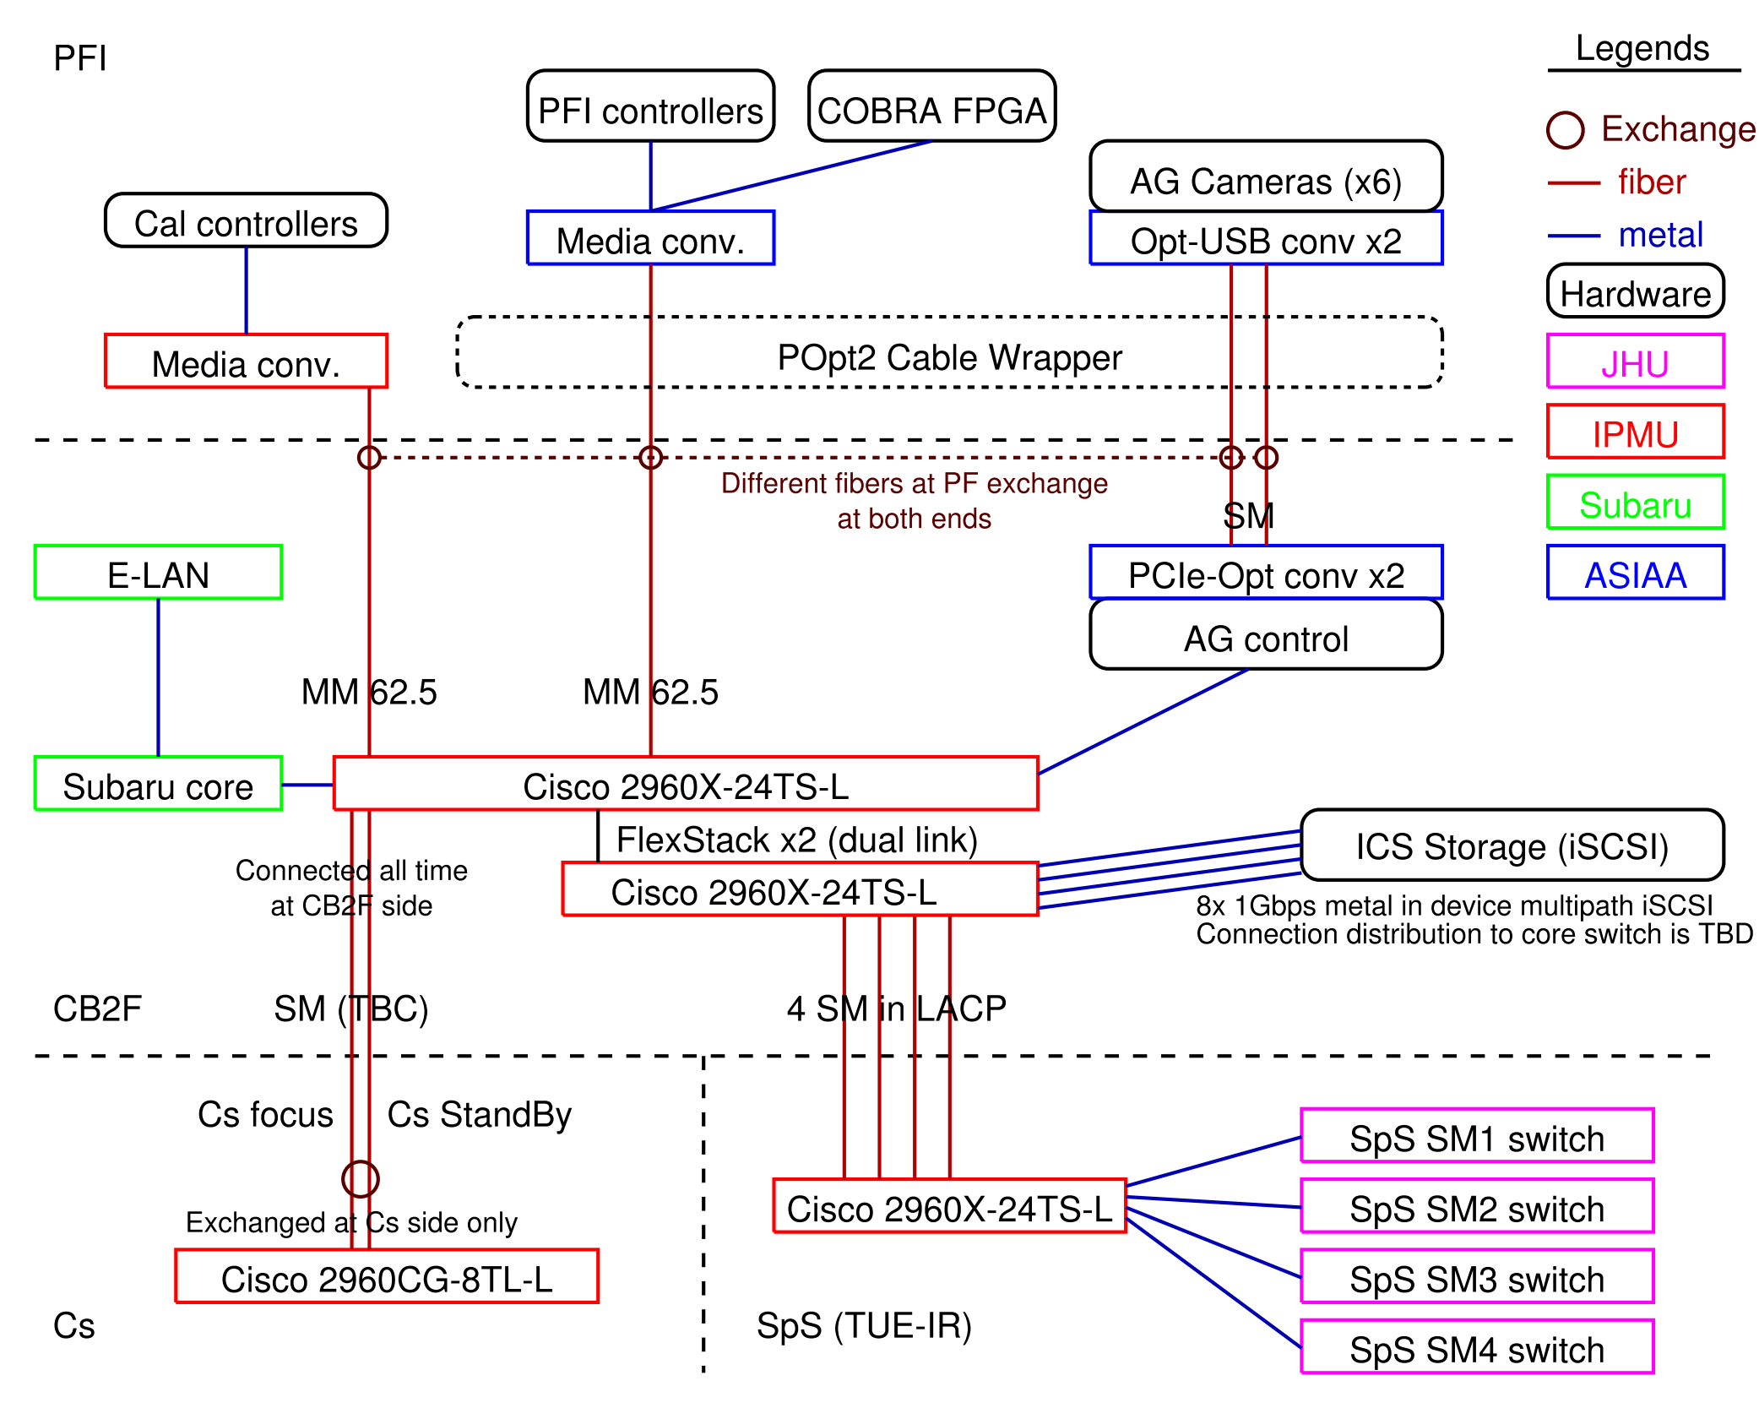
Connection diagram / L1 design – Network
Notes:
This diagram does not show all connections, but just picks inter-place links and major devices.
Fibers marked as TBC are not yet at a stage of final assignment by Subaru.
Connection for iSCSI storage is under discussion (between iSCSI and FC).

Slide 12
L3 requirements – Network
Requirements and conditions:
PFS LAN has assigned IP address range of 133.40.164/23 from Subaru.
Some of PFS ICS software modules and their configurations depend on hostname assignment from DHCP
IP address is to be fixed to functions like BCU1-BEE but not to each device (handled by MAC address), and software configuration are selected using assigned hostname.
Some of PFS ICS hardware rely on BOOTP, and PFS wants to use DHCP option section for their configuration.
Some of PFS ICS hosts will be by virtual machines, MAC address assignment scheme is required.

Slide 13
L3 design – Network
Design in PFS ICS:
PFS ICS will host dnsmasq server (DHCP + DNS)
Network configurations are hosted in this server
Two set of configurations are registered in git: MAC address and hostname, hostname and IP address
On hardware replacement (broken or maintenance), only a set of MAC address and hostname will be replaced
Hardware configuration is tracked by git hash, but this hash is not planned to be included in FITS header
PFS will consider possibility to have some, if required (by PFS data reduction or by Subaru)
(ToDo) Network block assignment need to be defined for ease of management (e.g. address block of 133.40.164.0/28 is for network switches)
DHCP assignment for non registered MAC addresses will be enabled for temporary tools like maintenance or AIT
Critical boxes are by static configuration, e.g. network switch, VM host server
“dnsmasq” server itself will be a VM client, its host shall be statically configured
Even for static configured hosts, sets of configurations are registered into git
All ports except for up-/down- links are configured as access port
PFS network is defined as one VLAN, but management network (or V-LAN) is also required
Only up-/down- link ports to Subaru or between two PFS network switches are configured as trunk port
If some host requires more than two networks (e.g. PFS-LAN and V-LAN), these shall have connections for each network

Slide 14
Monitoring – Network
Requirements
Capable to monitor network connection and flow status both on demand and history
Capable to monitor switch health statistics
No special line or authentication for monitoring, use Ethernet connection
Design and implementation
Configure SNMP public read as “snmp-server community public ro” from all VLANs
Configure each port with name of peer
Just for clarify, but name will appear on SNMP also, and status service does not need to have copied configuration
Traffic monitoring is recommended to be more than per a few tens seconds
High frequency monitoring, e.g. per several seconds, is useful to detect spike/peak of network load
1Hz SNMP readout worked on real hardware (ref: link over fiber on telescope section), but such high rate is not required
Considering data store (or say, data volume to archive), statistics from high frequency monitoring is an option
This is an option especially for status posted over MHS
Visualization is a key for historical data, way is not defined yet. Could be done by STS, of course.
Weathermap could be a best option for display during operation, but not yet included in the plan
Display in Gen2 might not be a good idea on data supply point of view.

Slide 15
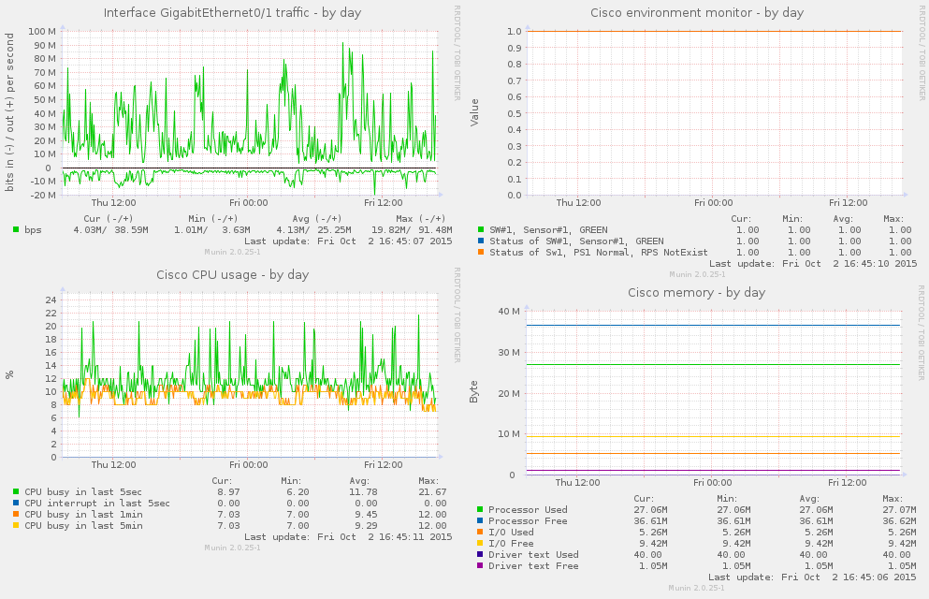
Monitoring – Network
Sample of network switch monitoring drawn by munin.
All panels are based on data acquired via SNMP. Traffic is by general IF-MIB plugin, others are by custom plugins. Statistics other than traffic are not changed frequently (CPU usage has some spike,,,) and frequent monitoring is not important.

Slide 16
Link over fiber on telescope
PFS will use two types of signal for communication over fiber on the telescope between CB2F and places in the dome. One is Ethernet connection by 1000BASE-LX (1Gbps) over SM or MM fiber, and another is an optical PCIe bus extender with a USB host controller over SM fiber (4.25 or 8.5GBaud?). 1000BASE-LX is planned to be used to all three places, but an optical PCIe bus extender is only used between POpt2 (PFI in PFS) and CB2F for connection of USB devices to host computer at CB2F.
This section is to present a detail of technical requirements and limitations for each connections, trades and selection criterias, and performance verification.
This section is organized as follows:
Technical requirements and limitations
Trades and selection
Selection of an optical PCIe bus extender was performed as a part of PFI, taking limitations on PFI side into account
Performance verification using real fibers
Test procedure and verification results for 1000BASE-LX on TUE-Opt fibers
Test procedure and verification results for PCIe bus extender on TUE-Opt fibers

Slide 17
Requirements – Link over fiber on telescope
Ethernet connection
Better to be the same component for both SM and MM fiber
Fiber lengths are not short, and fibers itself are somehow old
MM fiber will be used only for PFI connections
High data flow rate is not required for this connection, ~100Mbps could be fine
The highest bandwidth will be by COBRA FPGA communication, but low (or no) error rate is a key for COBRA FPGA operation
Test and verify whether MCP is required or not for MM fiber connections
Connection of CB2F – SpS will host continuous high data rate, but SM fibers are assignable for this line
Optical PCIe bus extender
Space is quite limited at PFI side, selection is mainly limited by PFI design
Need to be lined up between CB2F and PFI via real fiber
Fiber assignment is possible for all SM, 50MM, 62.5MM
Bus speed minimum requirement could be USB 2.0, but better to have more (e.g. USB 3.0) for slack
Devices connected at PFI are six AG cameras, fiber back illumination system, monitoring camera and microphone, etc.
Interface of PFS AG camera (FLI ML4720 MB) is USB 2.0, we will have six of them.
Data rate from devices will not be large as ~1Gbps
AG camera has ~3MB for full image, ~100Mbit for all but will not read as 10Hz
PFS decided to divide these connections into two bus extenders, and to use bus extender with USB 3.0
PFS PFI may not have enough space to have MCP along its cabling route

Slide 18
Technical backgrounds – Link over fiber on telescope
Fiber cables on Subaru telescope have not replaced from its built (TBC). Run-length from CB2F patch panels are: (ref: OTDR measurement etc.)
CB2F – TUE-Opt IDF (PF Stand-by; so-called Route E): ~300m
CB2F – Ns-Opt IDF (route to TUE-IR/SpS; so-called Route F/G) : ~220m
We will have additional b/w Ns-Opt IDF to TUE-Opt, but new fiber cable
CB2F – PF panel (so-called Route M): ~250m
Also we will need to attach fibers to switches on both sides, around 10m but with “new” fibers. PFS might not use Route E, and length of additional fiber to TUE-Opt on Route F/G will be shorter than 80m, we might be fine with assuming 225m + 50 (40+10)m fiber length between two SFPs.
Specific part # is unknown for fibers, but measured attenuation values are around 4dB (~3.8dB for GI62.5, ~4.3dB for GI50).
Messia III/IV system used SBus SIF card, and its specification seems like 1000-SX, but used around 300Mbps data flow max.

Slide 19
Technical backgrounds – Link over fiber on telescope
Multimode (MM) fibers are categorized into several categories by minimum modal bandwidth defined at 850nm and 1300nm. Also per each category maximum link(-able) length for each application are defined, summarized as table below. FDDI and OM1 is for 62.5um, OM2-4 is for 50um MM fiber. Modal bandwidth is defined as -3db bandwidth on frequency spectrum of output light for impulse after passing specified length fiber.
As shown in table below, fiber with wider modal bandwidth can link longer length between transmitters. (Note; some max link length is limited per specification of communication protocol.)
category | MB (MHz*km) (850 / 1300 nm) | 1000-SX | 1000-LX (w/o MCP) | 1000-LX (w/ MCP) | 10G-SR | FC 1G | FC4G
 | (wavelength) | 850nm | 1300nm | 1300nm | 850nm | 850nm | 850nm
FDDI | 160 / 500 | 220m | n/a | 550m | 26m
OM1 | 200 / 500 | 275m | n/a | 550m | 33m | 300m | 70m
OM2 | 500 / 500 | 550m | n/a | 550m | 82m | 500m | 150m
OM3 | 1500 / 2000 | 970m | 550m | 550m | 300m | 860m | 380m
OM4 | 3500 / 4700 | 1040m | 550m | 550m | 550m | (n/a) | 400m

Slide 20
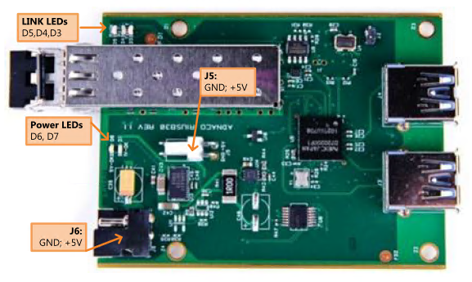
Trades and selection – Link over fiber on telescope
1Gbps Ethernet
PFS has selected 1000BASE-LX for its optical network
USB connection
PFS has identified several items and performed on-site test
Selected PCIe bus extender with USB host controller after on-site test
Adnaco-H1A (photo below)

Slide 21
Performance verification – Link over fiber on telescope
Performance verification was performed using real fiber at the prime focus of the telescope, for both Ethernet and USB extension. Since availability of real fibers at the prime focus is limited by day time works in the dome – the telescope need to be at the zenith for human access to fiber outlets, we also used TUE-Opt or Ns-Opt fiber patch panels for alternative test ports, whose fibers are also used by PFS for works at the standby (off telescope).
Performance test is performed by checking real data rate for full load supplied to each bus. Plans of measurements are developed for each bus, SNMP data transfer counter for network switches and dummy data read/write software for USB connection. For both buses, measurement plans are verified using short fiber cable connections, and system are verified with full load.
Connections are as follows:
CB2F
(OCB21)
PF or TUE-Opt
MCP
MCP
Test PC
Cisco SW
SFP
SFP
Media Conv
Test PC
Metal RJ45
LC-LC
LC-LC
Metal RJ45
Configuration for ethernet network test
MCP; if required
MCP; if required
Test PC
PCIe-USB
PCIe extender
USB Storage
LC-LC
Configuration for PCIe extender (USB) test
LC-LC

Slide 22
Performance verification plan for Ethernet
Packet transfer error rate on switches could be gathered via SNMP (or other administrative methods) like 1.3.6.1.2.1.2.2.1.14 or .20 (also other values included transmitted packets, bps).
Using such switches and connects small computer(s) at both side, we can transfer large data flow and check network stability.
Reading status via SNMP in high frequency could make some load on switches, but not an issue for monitoring by 1-0.1Hz (already over requirement for our purpose).
Fiber communications are not affected with what kind of data is flowing, so we do not need special software for making data transfer, but we can just use netcat (nc). Use of “dd” or “rsync” (with –bwlimit?) was effected by short time performance degradation of storage, and was rejected.
Procedure is:
Place switches on both PF and CB2F, connect one or two PCs on both side
We might not need full 1Gbps data flow, but better to check nearly conjection, so flow as much as possible without any limit
Network is full duplex with two fiber cables, we don’t need to test two directions at one time
Check stability by monitoring status counters for full load (1Gbps)
Pair of “nc –l –p XXXXX > /dev/null” and “cat /dev/null | nc X.X.X.X XXX”
Gather data over ~100sec to check stability

Slide 23
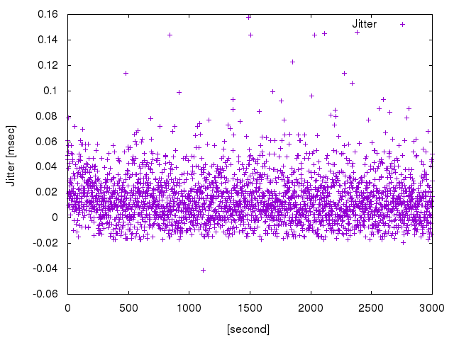
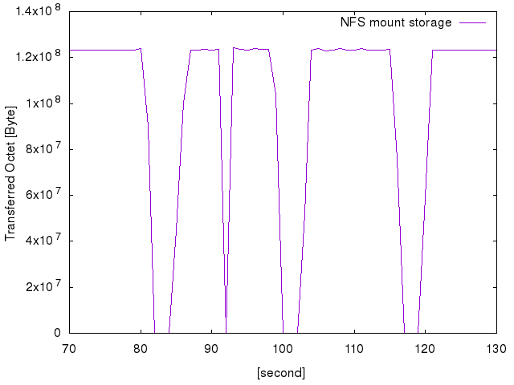
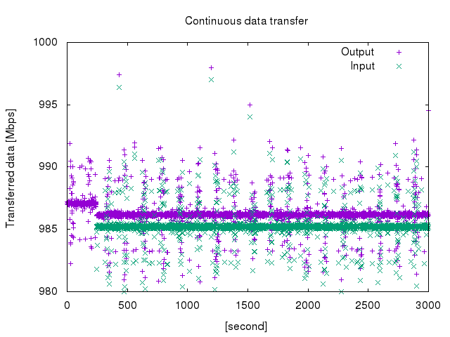
Plan verification – Performance verification plan for Ethernet
Used script to gather switch packet count
https://github.com/himorin/scripts/blob/master/network/ifmib_rate.pl
Output status, flowed octets, error packets, discarded packets for in/out in specified second interval
Jitter of output period is measured as < 1msec with real cisco switch. (left below)
Real measurement over 3000 points (in 1Hz) is shown
Jitter in time domain seems random, so should not be serious issue on measurement
Data flow generation verification
Data writing to NFS mount storage showed some sudden drop during test (middle below)
Used SSD storage to gain write performance. No issue was found when write locally.
Netcat data generation was succeeded as right below, first ~300sec is one direction, later is bi-direction
Reason of periodical jitter (up and down in short time) is not clear but ~5Mbps for ~985Mbps.

Slide 24
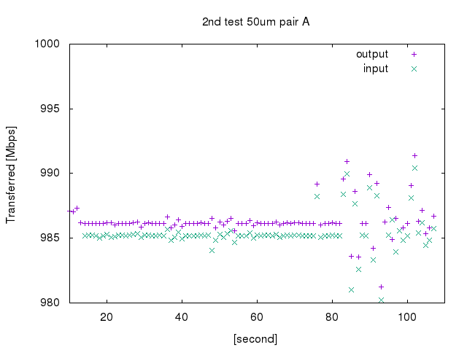
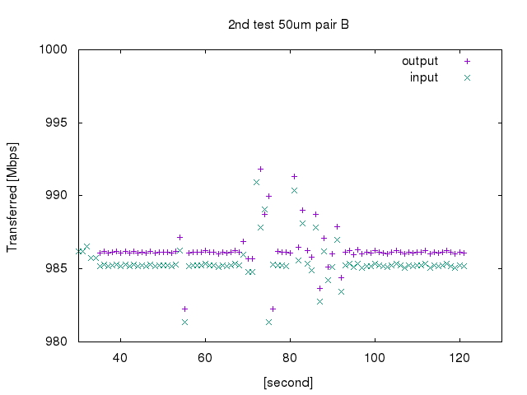
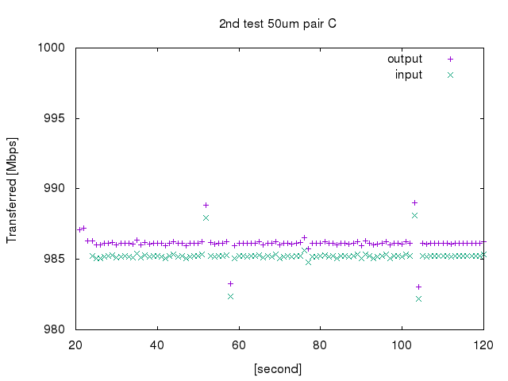
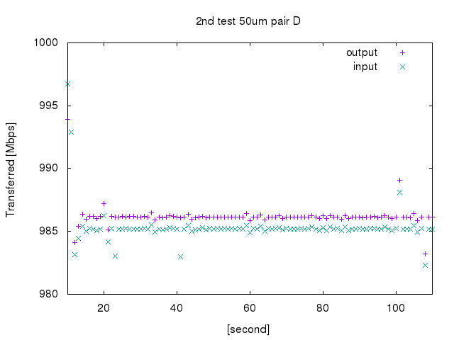
Results – Performance verification plan for Ethernet
Test passed for all configurations with/without MCP. Bottom panels are samples of measurements.
1st: tested both with and without MCP on 62.5um MMF b/w CB2F and PF
No change detected between with and without
Checked laser dBm by cisco status (just to check difference between TX and RX)
4.5dBm changed in average (-6.1/-1.7, -6.6/-1.9, -6.6/-2.7, -6.8/-1.6) = loss by fibers and connections
2nd: tested without MCP for all pairs b/w CB2F and PF on 50/62.5um MMF
All pairs worked fine
3rd: tested without MCP for all pairs b/w CB2F and TUE-Opt (connector rack) on 50/62.5um MMF
All pairs worked fine
PFS has decided:
Use 1000BASE-LX for all Ethernet connections over fiber
Changed MCP to be not a default plan

Slide 25
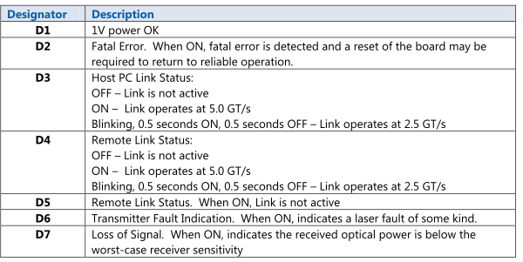
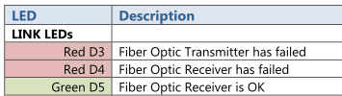
Performance verification plan for bus extender (I)
Finally selected device has limited capability for checking status of fiber link (as shown in figures below). If we find a way to check internal status of PCI Express bus, we could use these status to check communication failure rate, but it seemed difficult (or at least need to do some technical study).
Therefore, we planned just to check possible data flow rate, once we confirmed connection over a pair of fiber cables (TX/RX) by both LEDs and host computer operating system, and planned to compare with assumed maximum data flow rate – since its maximum communication data flow is kept as 2.5GT/s.
The PCIe extender had already tested with newly purchased 270m MM fiber at ASIAA and worked without MCP, prior to on-site test at the telescope.

Slide 26
Performance verification plan for bus extender (II)
Procedure is:
Attach USB memories to USB hub at target.
USB memory was tested at off-site prior to on-site test
Two USB 3.0 memories were used to fill data flow
USB SSD was not considered for this performance verification.
Run two tests, with short (~1m) fiber (local) and real
Compare two results to check degradation by the real fiber
Checked > 5min for stability
Host operating system was Windows
Used GUI storage performance measurement software for writing to and reading from USB memory
Data rate and stability was checked using saved log file from software
See next page for details
At least one pair from assigned fibers are tested
Fibers are validated by OTDR already

Slide 27
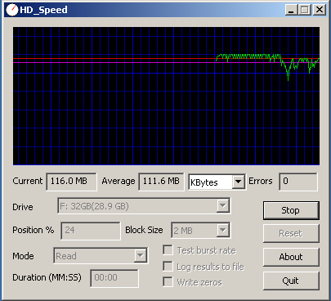
Performance verification plan for bus extender (III)
Software used for test can output log into file. Format was as follows (sample cutout):
--------
[Test Start 4/28/2016 7:11:23 AM] drive: \\.\D: start_offset: 0 mode: Read blocksize: Auto type: sequential parallel: 1
blocksize: 64KB
result: 16000KB/s offset: 0% 8000KB
blocksize: 32KB
result: 13312KB/s offset: 0% 14656KB
: : : : :
result: 15872KB/s offset: 89% 27581120KB
[Test Stop 4/28/2016 7:40:59 AM] errors: 0 average: 15.3 MB
--------
First and last lines are start and end of execution, we take these lines to separate among tests. “errors” in the last line seems no unit, just take “0” as success (or graph go 0kB/s during error). Per each 0.5 sec one “result” line is written, kB/s is performance in the last 0.5 sec, and last kB is cumulative size of data tested. Blocksize seems size of block read/write, but haven’t checked its effect since size is well larger than packet size of USB protocol.
On USB 3.0 test, log file is only from one software, so we just memo (and get screen shot) their total data rate. And used this log file for checking long term stability and short-term degradation.

Slide 28
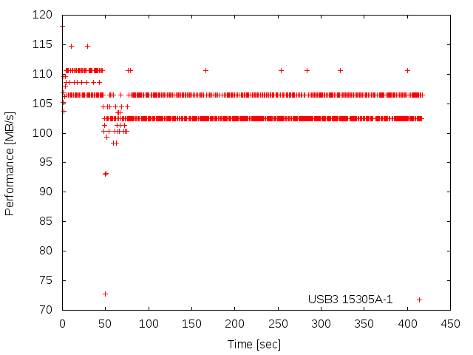
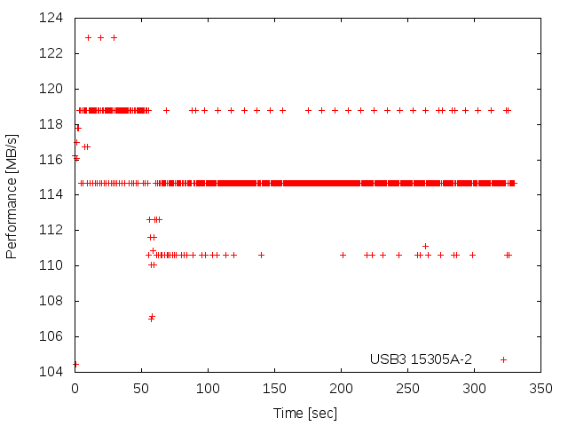
Results – Performance verification plan for bus extender
For MM 50um fibers, connection itself had failed.
For SM fibers:
Achieved performance:
Short length: ~180MB/s (~1.4Gbps)
NsOpt (HDS): ~150MB/s (~1.2Gbps)
Both are in total of two USB memories.
Communication was stable
Although some load rebalance was observed over 5min test between two USB memories.

Slide 29
Storage and image data handling

Slide 30
Requirements from ICS actors’ point of view
4 continuous stream from IR detector control computer
Assuming 4k sq. image per 3-4sec, 60-90Mbps for one up-the-ramp
Could be double, depends on reference pixel : TBC
2.4TB/night for 90Mbps x 4 with 15hours operation per night, 36TB/run for 15day run
No need to read up-the-ramp raw data
Also saved on memory, used for final (summed?) FITS image output
VM host images
Data rate could be small for normal operation
NFS or iSCSI on virtio – need study from DR or backup point of view
30GB per VM could be enough, 0.6TB for 20 VMs; 2TB with 3 generation back-up
NFS host for CCD and IR (final) FITS images
Not high data rate – e.g. 512MB in ~40sec
Both write and read
Read from FTP server for sending to Gen2 (archiver)
50 – 100 GB per night, up to 2TB for 15day run
Survey with shortest exposure will be 7.5min (cosmology), ~100 times per night for 12 hour observation
NFS host for AG images
1 or 2 x 2MB image per a second, both read (TBD) and write
Focusing image will be one order smaller (e.g. one exposure per 10 sec)
Will PFS save locally or not is a question, but ~200GB per night, ~3TB per 15day rurn
PostgreSQL data store
Could not be on NFS, need to be direct iSCSI mount at host
Tron log archive will be < ~1TB (SDSS 15 years in 500GB or so)
Survey and exposure execution database will be smaller
Backup storage
Mostly at daytime job

Slide 31
Requirements from ICS actors’ point of view – Summary
Storage performance requirement summary
Read/Write performance
800Mbps (90Mbps x 4SM x 2 for reference pixel + buffer) write performance at least
Write mostly in sequence write (FITS data), ~10k IOPS is fine (or already over-spec)
Capacity – ~100TB
10TB for operational storage (e.g. VM, DB)
90TB for FITS-liked data; 40TB for 15day run
Mostly raw up-the-ramp data
Could be compressed after run -> 1/3 or 1/4
Seeking possibility to compress at the first moment
If compressed, 15TB for 15day run, 90TB for half year
Will be moved to external storage in such periods
10TB for backup of DB

Slide 32
Hardware implementation plan
120TB (or 108TB) iSCSI RAID6 4U storage server
20D+2P+2H x 6TB NLSAS HDD, or 2x(9D+2P)+2H NLSAS HDD
8x 1Gbps metal interface for data, 2x metal for console interface
device-multipath or independent at initiator
See next for details
2 core switches for PFS network at control building
Connected by FlexStack, might no issue on data exchange
FlexStack has 40Gbps in total with dual link
Connect all 10 metal to one switch could be better for management?
Need to develop plan further on connections
Connecting high-bandwidth lines to storage side could be possible
Each switch has 24 metals and 4 SFPs
All IR detector control could be connected with 4 metals and 4 SFPs
Link to Subaru core switch could be 1 (or 2?) metals
With them all, 16 metals and 4 SFPs in total

Slide 33
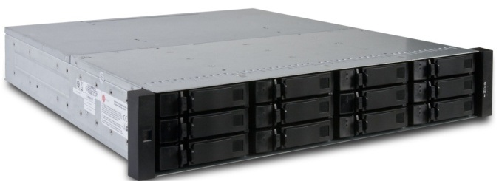
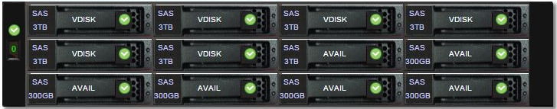
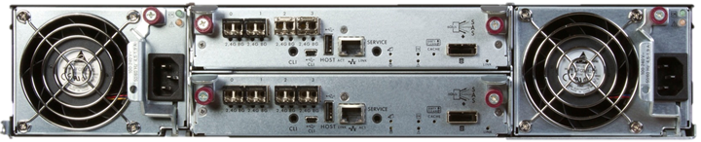
Hardware implementation plan – CDS4004
Performance
100K Read IOPS, 650K IOPS from cache
6.4Gbps read, 5.3Gbps write
Host interface
2U12 3.5in as one host or JBOD, up to 3 JBODs (+ 1 host)
Using 1host + 1JBOD with fully populated disk (24 HDDs in total)
Could add another 2 JBOD, if necessary during operation
Two host controllers in redundant
No battery backed-up cache, write from memory to flash by capacitor backed-up
Max 8 SFP+, compatible with FC, iSCSI (hybrid) or SAS
Certifications
NEBS 3 compliant for telecommunication
ML-STD-810F/G
Already procured, under test at IPMU

Slide 34
Storage coordination plan as storage server
6 LUNs for 108 or 120TB
4LUNs for IR detector controller storage, 20TB each
Capable to store 30day’s run
Or 90-120 day’s if compressed
1LUN for NFS, 25TB+
Data, VM image storage, backup
1LUN for PostgreSQL database, 3TB
1 NFS server will supply all required NFS/FTP storage
If virtio IOPS requirement appears huge, might be divided into two
If all in linux with certain version, no issue found on testing environment.
FTP for transferring data to Gen2
Assuming g2t can specify external FTP server by configuration
Even we need FTP service on each, all are read only and no issue on locking.

Slide 35
Storage coordination plan per a service
IR detector
Direct iSCSI storage LUN mount to each control host for raw up-the-ramp FITS images
4 iSCSI targets (LUNs) in total for this
NFS mount for final FITS images
1Gbps up/down full link is enough for all data I/O
Nearly same in and out (90 or 180 Mbps) for up-the-ramp, even if no compression
VM host storage
TBD, but assuming on NFS (qcow2?)
Online backup is possible with qcow2 disk image
If some writable area required, mount NFS storage at OS level (not mounting additional virtio)
Most of hardware connected actors will run on physical machine, not VM
General NFS
1Gbps up/down full link is enough?
One dedicated hardware is required for NFS service
Services with special care required
Database (PostgreSQL) storage
iSCSI mount storage area or large volume in VM disk image (No NFS mount as filesystem!)
Backup operation will be on pgsql layer – no special care required on storage connection
iSCSI mount storage is better?
Storage for backup
Will be mostly used at daytime – daily cron job liked
No serious performance requirement will be applicable, rely on general NFS service should be fine

Slide 36
Plan before deployment at on-site
No special care is required, except for IR detector control
Neither volume nor bandwidth is high
AIT local area NFS service is enough… Or even local fs.
From application level, nothing will differ for this use b/w iSCSI or NFS/local
e.g. lock, bandwidth
Volume size for storage of IR detector control
Bandwidth per one camera is not so high (~100Mbps)
Simple NFS server can supply ~600Mbps
Continuous up-the-ramp outputs large size data is an iusse
100Mbps over 1day is ~1TB
Compression will make this 250 – 350 GB/day
But can be done with recent HDDs, without considering about backup
No need to backup these software stability test data
Need to be studied once PFS get an IR detector
e.g. how much we need to save/check/analyze up-the-ramp data
Better to study how existing instrument at Subaru doing?

Slide 37
Emergency recovery plan
(to be studied following failure modes)

Slide 38
VM infrastructure

Slide 39
ICS infrastructure support hardware

Slide 40
Space condition of PFS CB2F rack
Functional requirement from PFS
Can mount 30” (~760mm) depth computer
PFI/MPS control computer (Dell Precision R5500) is ~30” depth 2U
Can mount 0U PDU at rear side
Want to have 42U
Power input by NEMA L5-30P
Subaru standard
External cabling will be from floor hole
No forced cooling (TBC)
Assumption
No redundant power supply

Slide 41
Unit registration – overview
(TBC) U in total
Management and service resources
0U PDU
1U KVM
System wide infrastructure
2x 1U Cisco network switch (rear side??)
1U patch panel
UPS is TBD (will not?)
IIC computing resource
2x 2U iSCSI storage
3x 1U computer (TBC)
PFI control
?U AGCC host computer (extender fiber connection to PFI)
2U MPS host computer
SpS control
Originally assumed to have 2-4U computer for IR readout, but will not (TBC)
No need for Cs (MCS)

Slide 42
Management and service resources
PDU
0U vertical mount type / ATEN PN7320
20 port outlet, 2 line breakers
2 sensors (1 temperature, 1 temperature + humidity)
Vendor manual
https://pfs.ipmu.jp/docsrv/doc/Software/ICS/ATEN%20PN7212-7320%20PDU%20user%20manual
KVM
1U 16port KVM / ATEN KN2116A
Vendor manual
https://pfs.ipmu.jp/docsrv/doc/Software/ICS/ATEN%20KN2116A%20KVM%20user%20manual

Slide 43
System wide infrastructure
PFS-LAN core switch
2x 1U Cisco 2960G connected by FlexStack
Not separable on mount
Mount toward rear??
1U patch panel
With cable feed through from front to rear?
AUX metal ethernet at front (TBC)
Fiber patch panel at rear?
Connection exchange of PFI fibers
UPS
TBD
2-3kVA in 2U could be enough?

Slide 44
Database server and its replication/backup

Slide 45
Status monitoring and defect detection

Slide 46
Procedure on instrument exchange

Slide 47
Procedures for power failure detection and handling

Slide 48
Power failure mode I - glitch
“glitch” is actually not a power failure, voltage will not fall down to 0V, but will be effectively low voltage (normally to 80% level in Japan) for short time up to ten cycles.
This mode will not happen UPS-ed power line, like PF (POpt2) and Cs
TUE-Opt stand-by backed up by UPS-2 (+DG)
UPS-2 (+DG) and DG (w/o UPS) on SpS (IR4 = TUE-IR), FMOS is on UPS-2 (TBC)
(TBD/TBC) PFS would bring backup-UPS for SpS placed at IR3
Ctrl. Bldg. 2F is backed up by UPS-3 (w/o DG) (or we also bring our own, as others)
Situations / fatal events will be happen
No impact on observation – telescope will continue working
Need to continue instrument operation – regardless modes (exposure, configuration)
Actions / considerations required
Check power line quality (glitch) - underway

Slide 49
Power failure mode II – several minutes
As for telescope operation, power failure of several minutes level will be covered by dome-UPS (UPS-1 and UPS-2; CVCF), but dome rotation and tracking will stop. Instrument need to be operated without failure, but “active” operation like exposure or moving parts need to be finished or suspended as soon as possible after power failure detected.
Situations / fatal events will be happen
Dome co-rotation and telescope tracking will stop
Dome-chiller will down until diesel come up
Actions / considerations required
(Bring PFS-UPS for SpS)
When to give up this mode, and to switch mode III (next slide; start shutdown)
Operations to be taken
Stop exposure – close shutter, read detector
Turn off illuminators – fiber back illuminator (science, fiducial), calib. lamp etc.
Stop fiber configuration procedure
Keep PFS backend (infrastructure) functionality until FITS finalized if under exposure
Stop AG camera for thermal protection (no glycol flow to HEX)

Slide 50
Power failure mode III – ten-odd min to several tens of hours
After diesel generator (DG) came up and stabilized, MDB-2 will run with DG power. Dome chillers (in operation after DG supplied) and some part of telescope (drives on) will remain in operation, others like dome air compressor will be off to reduce load on DG.
Situations / fatal events will be happen
Instrument control computers (CB2F) had gone
No control on PFI
Dome chillers return on diesel came up (hopefully)
Operations to be taken
PFS ICS infrastructure at ctrl. bldg. 2F need to be down before this mode
PFS-LAN, shared storage, database server, heartbeat system will down
MHS VM (+ e.g. telemetry archive) need to start running on SpS infrastructure
Subsystems are operated in stand-alone mode
shutdown non-emergency items
Turn off outlets of PDU – for required by control box, e.g. ENU control box
Monitor dome chiller glycol supply temperature at SpS chiller

Slide 51
Power failure mode IV – more than several tens of hours
Diesel backup will go away after several tens of hours from power failure. PFS need to shutdown all subsystems before it.
Situations / fatal events will be happen
All power will down
Actions / considerations required
Emergency telemetry logging system required??
IR detector warm up heater
Telemetry logging into writable storage on PC108, but need to be reliable on rw
Lifetime of SD card is not so large w/ massive write
Who (system) to decide to shutdown? – need control at SpS floor
No way to get diesel status? e.g. remaining time. DG down will be detected w/power.
PFS-UPS at IR3 will be for shutdown, batteries in racks for keep heaters and PC108 on.
Operations to be taken
Shutdown control computing resources
Stop cryo-cooler, warm-up detectors by heater (TBC)

Slide 52
Subsystem shutdown procedures and remarks
Before listing shutdown procedure, conditions are follows.
PFI
No UPS within PFI, rely on system power supply through cable wrapper
PDU exists but only several ports
Cs/MCS
No UPS, PDU within Cs/MCS
Ctrl. Bldg. 2F
Rack mounted UPS (TBD) and 0U network-PDU for PFS ICS rack
SpS
Two operational conditions
Dewar not cooled down or cooling down to operational temperature
Dewar cooled down at operational temperature
Rack sized UPS to cover SpS power until diesel coming up
Network-PDU for infrastructural computing/network resources

Slide 53
Subsystem shutdown procedures and remarks I - PFI
No battery within PFI, PDU is not for shutdown procedure but mainly for trouble shooting.
AG camera + USB-Opt converter could be down w/o command
(TBC) AG camera will be heated up without cooling by glycol (stops until DG up)
COBRA system at not queued could be down w/o command
Note, check FPGA condition on power on/off
COBRA system under queued need to be finished
e.g., do not issue next queue from MPS to FPGA
Back illumination, camera could be down w/o command
But still need to be down for thermal issue
Possible procedure
Stop cameras and illuminators, if required (TBC)
Wait to finish executed queue to COBRA system
and shutdown (or wait for power to disappear)

Slide 54
Subsystem shutdown procedures and remarks II – Cs/MCS
No buttery nor PDU at Cs/MCS, excl. diesel and UPS-2
Control computer need to be shutdown by OS
CMOS camera and controller could be down w/o command
Mirror motor could be down w/o command (need to be confirmed)
Possible procedure
Shutdown control computer, on moving to stand-alone mode

Slide 55
Subsystem shutdown procedures and remarks III – CB2F
Control building 2F (CB2F) is backed up by UPS-3 but without diesel. PFS will bring PDU, UPS of PFS dedicated need to be considered depending on timing, since we will have key infrastructural modules for operation at CB2F and need to care on procedure. (5min to finish, is short??)
Key modules
Network switch : if down, we cannot reach to subsystem
Storage server, database server, heartbeat system, VM server, MHS server
Operational modules
Subsystem controllers : IR SAM control, AGC, PFICS, MPS
System modules : IIC (master sequencer), logging system, Gen2 connection system
Possible procedure
(decided to move mode-III, and to start shutdown procedure)
Wait to finish subsystem commands – FITS finalization, COBRA operation, lights off
Shutdown operational subsystem modules AND send “standalone” signal to subsystems
(after hardware operation finished; but shall be finished within “decision” period)
IR SAM / CCD-BEE control : readout, finalize up-ramp to FITS files + sending to Gen2
PFICS, MPS : stop by commanded COBRA move finished
Shutdown system modules : IIC, logging system, Gen2 connection system, MHS server
Live migrate MHS and logging system to SpS control box
Shutdown infrastructural computing resources (servers) : VM, database, storage
(TBD) Make network switch remain operation, until UPS power down

Slide 56
Subsystem shutdown procedures and remarks IV – SpS (I)
Procedure for SpS will depend on status of dewar cooled down. If dewar is in operational temperature (e.g. 88K for IR detector), we shall keep cryo-cooler as much as possible. Items other than dewar, spectrograph need to stop its operation on power failure detected.
(TBC; issue resolved or not) For whole shutter system (incl. computing), we need to keep power backed-up by UPS during detector readout, since it will automatically open/close on power-on.
If SMx/yCU is not in operational temperature
any operation on the dewar will be stopped – vacuum, cooling.
Vaccum to dewar will be closed by emergency stop valve?
(TBC) will we cool down dewar while turbo pumps on? (the last bulb to dewar open)
If SMx/yCU is in operational temperature
need to maintain their temperature as long as possible.
(TBC) need to keep xCU/BEE and PCM (VCCS) on to monitor telemetry
PFS-chiller is better to be operated while cryo-coolers are on. – even dome chiller down by trouble? (TBD)
better to have an emergency heartbeat system at SpS floor (after “standalone”)
After (final) shutdown commanded, dewars (detectors) are possible to go environment temperature, but heaters are required (not only for H4RGs but also on CCDs).
Considerations required
PFS-chiller could be backed up by PFS-UPS before diesel up? Also could be backed up by diesel?
No. Need to down PFS-chiller, since dome-chiller downs. Reserver will work during this period.
Heartbeat system dedicated to SpS is required during “standalone” period?
Need consideration on storage for BEE (PC104 in readonly storage)

Slide 57
Subsystem shutdown procedures and remarks IV – SpS (II)
Possible procedure
Right after power failure detected, IIC shall command to subsystems
Stop exposure, close shutter and readout detectors
Stop illumination sources – back illumination, internal illumination, fiber monitoring
Stop non-operational dewars – vacuum, cryo-cooler
Shift to “standalone” mode
Shutdown non-emergency computers
ENU controllers (LAM), fiber monitoring system (LNA)
IR H4RG SAM – if we cannot just power disconnection
(TBD) shutdown SCR environment control
Start SpS emergency heartbeat system and MHS+ run on SpS computers
“shutdown” mode
Shutdown cryocooler, (ion-pump : at when??)
Shutdown xCU/BEE PC108, xCU VCCS (PCM)
Network core switch will down at diesel down
Make xCU/BEE PC108 standalone, turn on heater.

Slide 58
Subsystem startup/recovery procedures
Once PFS started sequences for power failure, control systems will be in irregular state than normal power on/off procedure. Also power supply may be back suddenly before instrument checked by operator, we need to be care of hardware safety conditions with disabling power supply before power cut procedure and so on.
Detailed studies are required for all subsystems, following are examples.
SpS xCU ion pumps and cryo-coolers
Should not be operated before vacuumed and glycol temperature in normal
PFI AG cameras
Should not be operated before glycol temperature in normal

Slide 59
Operational flow on each power failure mode
Power failure detection
Will follow “official” procedure of Subaru, also we have some mechanism via UPS etc.
Immediately after power failure detected
Stop operational commands in execution
Close shutter and readout detectors, finalize data (CCD/IR)
Decision to switch to subsystem-level stand-alone mode
After operational commands finished
CB2F controllers need to be successfully shutdown before UPS out
Staged switch could be possible – depends on timeline
First, shutdown subsystem controllers , whose start-up time is short
Telescope may not be recovered immediately after power recovered, we have time
Subsystem-level stand-alone mode
PFI have no controller, Cs/MCS could be down right after stand-alone mode
SpS need to change operational mode (shutdown un-emergency items)
System shutdown (final)
SpS subsystems will be the one

Slide 60
Operational flow on each power failure mode - timeline
Power outage
Event + 5-10min
Event + 1-3days
UPS-3 active
UPS active @ CB2F (UPS-3 or PFS-UPS)
UPS-1,2 active
diesel active
dome chiller down
Stop AG
PFS-LAN down
Finish COBRA operation
Finish detector operation
Stop illuminators
Shutdown MCS computers
Shutdown subsystem controllers @ CB2F
Shutdown system modules
Shutdown CB2F physical servers
SpS-chiller non-backup by dome-chiller
SpS cooling active
Stop turbo pumps
Detectors warm up
Stop exposure, exec readout
Shutdown ENU, FMS
Shutdown cryocooler
Start SpS emm heartbeat?
Shutdown SCR
Standalone xCU PC108
Decide to standalone
Subsystem @ standalone
Decide to shutdown (SpS)

Slide 61
Hardware delivery to Subaru

Slide 62
Items and assigned delivery
Followings are hardware items which the project (or Subaru) need to prepare or deliver to the summit, and subsystems use these items.
CB2F (Control Building 2F)
Rack to host items (Subaru): before all of followings
Assumed deepest unit is ~760mm (MPS), ~650mm (DB host)
Network switch (IPMU; already in hand): (at least) 1 at MCS, 2nd at SCR
ICS RAID6 storage (IPMU; already in hand): SM1
MCS backup could be done with small storage?
VM host computers (IPMU; some already in hand)
(at least) 1 at MCS (any subsystem delivered to summit) – to run MHS
Others depends on system load
Serial communication (MLP1; IPMU) host: PFI
KVM, PDU etc. (IPMU; some already in hand): MCS?
DB host (IPMU; spec TBD): SM1??
SpS (both IR3 and TUE-IR)
5th rack (from JHU): SCR
Network switch to connect CB2F (IPMU; already in hand): SCR
UPS and power supply (Subaru): SCR
1U host computer @ 5th rack (IPMU; spec TBD): SCR
Telemetry devices/system (TBD): SCR (or SM1)

Slide 63
Setup to accept MCS
MCS will be installed as Cs instrument. We need to have minimum operation hardware at CB2F, including PFS network.
19inch Rack (Subaru)
PFS network switch (at least 1; IPMU; already in hand)
Also connection to subaru’s core switch
VM host (IPMU; 1 already in hand)
Hosting administrative VM, e.g. dnsmasq
KVM, PDU (IPMU; already in hand)
At this stage, no special care for power distribution is required, only like connecting things to PDU at CB2F. Also network is simple, we need two fiber connection to Cs and its standby (one active, one backup), one connection to subaru core switch with routing.

Slide 64
Setup to accept SCR
In parallel to build SCR (Spectrograph Clean Room) at TUE-IR (IR4), we need to have control hardware for SCR.
2nd network switch at CB2F (IPMU; already in hand)
might only need 1 SFP to SpS, but better to have and check working at this moment
Network switch at SpS (IPMU; already in hand)
5th rack (from JHU)
UPS at IR3, with power distribution/panel (Subaru)
1U host computer (also for SCR control) (IPMU)
Telemetry devices (TBD)
e.g. Lakeshore temperature monitor and sensors
At this point, we need full power distribution system to supply spectrograph, both UPS and power panel w/ cables. Environment active control subsystem for SCR shall be considered as a part of SCR, so not listed here.
For network and storage, we only need “connected” at this point, so performance evaluation on network in parallel to SCR preparation (or validation) is fine.

Slide 65
Setup to accept SM1,2
Before we have SM1,2 at summit, we need almost all of hardware.
ICS RAID6 storage (IPMU)
DB host (IPMU)
Not as full operation (e.g. interaction with ETS or survey coordination), but to store MHS status archive or telemetry etc.
Before this point, PFS network and storage need to be fully prepared and validated on performance point of view (for NCU1,2 operation).

Slide 66
Setup to accept PFI
Most of computing and power resources need to be active well before delivery of PFI to the summit.
Serial communication (IPMU)
This communication will be validated at factory of melco (Mitsubishi; at Amagasaki) in test setup.

Slide 67
Discussions on interfaces between Subaru and PFS
Network connection to Subaru (data flow, V-LAN)
Access control to/from PFS network
System alert handling (items to STS)
Engineering data archive (during on-site AIT, independent unit test)

Slide 68
Discussions I – Network connection to Subaru

Slide 69
Discussions II – Access control to/from PFS network

Slide 70
Discussions III – System alert handling

Slide 71
Discussions IV – Engineering data archive

Slide 72
Backup or copied materials to be used

Slide 73
Updates/Progresses – shared infrastructure
Communication fibers at Subaru have tested and passed
Mostly by real data flow, except for 1Gbps SM fibers (OTDR)
ICS storage performance have verified with simulated 4 H4RG data streams
Simulation configuration: Storage – NFS server – 4x data generator
Achieved ~2.3Gbps file write, enough for 4 H4RG data streams
ToDo
Need some consideration on network configuration
More realistic test (e.g. having both read/write) could be better
PFS-LAN network host stage for configuration and stability passed
Using real hardware to be used on-site
Some management configuration will be modified by Subaru (CDM) after delivery
ToDo
Connection between PFS-LAN and Subaru network is not fixed yet
Data backup procedures (e.g. DB) are in production at pfs servers
Virtual machine servers for ICS components are under host stage at IPMU
Dell R710 (2U Xeon E5506) x2, R410 (1U Xeon E5640x2) x3, R310 x1+ backup (2U x2)
4 port Gbps NIC

Slide 74
Network connection ToDo
Connection to Summit core (E-LAN, V-LAN)
To send up-the-ramp smoothly, we may need more than 1Gbps. Need LACP configuration.
PFS side for up-the-ramp to Gen2 is one g2cam host (TBC), need some care on LACP balancing.
V-LAN is also through Summit core, could connect through trunk port configuration on Summit core and PFS core.
Even if we select this, I want to keep separate connection for V-LAN and PFS-LAN to the host (in PFS network).
Connection between PFS core and SpS (ICS #579)
There is a way to go on configuration to pass 4x300-400Mbps stream, but need to be cared in configuration both BEE and iSCSI storage.

Slide 75
Host cluster at CB2F
Most of services are planned to run on VMs, such as MHS, logger, support infrastructure. Also PFI related actors are in consideration.
Some services (esp. DB) is planned as bare system, but could be on VM if performance is verified.
Host configuration (still in development):
iSCSI storage (108TB RAID6 w/2sp, 2x2U) x1
Dell R710 Xeon E5506 (2xAC, 2U) x2
Dell R410 Xeon E5640 (1xAC, 1U) x3
Dell R310 Xeon E3-? (1xAC +1 vacant, 1U) x1 (for DB?)

Slide 76
Host cluster ToDo
Verify iSCSI storage performance with more realistic configuration
Currently only write from 4xH4RG simulator – NFS server – iSCSI storage.
Better to verify with running VMs, DB connections, with some data read/write (incl. sending up-the-ramp to Gen2)
IR data handling
Original plan was host control computer at CB2F with large memory, which will do all for data management
Read directly from SAM over 1Gbps network
Save up-the-ramp FITS (single 2D HDU) to storage, and on memory
Build final FITS file from data on memory (no read stream from storage for this)
Currently, BEE reads data from SAM via USB, and saves to storage
Something other need to care of building final FITS file etc.
Verify VM operation performance
Mostly tested using PFS server cluster at IPMU for pfs.ipmu.jp
Integration of PFI control into VM cluster
Need to check PCI passthrough performance and capability for PCIe extender.
Or USB mount could work?
Check network bandwidth requirement (for shared interface)
Host maintenance operation
Health check with iDRAC etc.

Slide 77
Status gathering
Most all of PFS ICS control modules (called as “actor”) are connected to the MHS, Messaging Hub Service/Server, and communicates to other modules only through the MHS. Status of each module are pushed from each actor itself, using normal message exchange way or its subset dedicated to status, and distributed to other modules by the MHS.
Status archive service is connected to the MHS as one actor, gathers all updates from every actors, and saves to a system database.
BCU2 …
RCU2 …
NCU2 …
BCU1
RCU1
NCU1
g2t
IIC
Gen2
g2cam
MLP1
MAC
MHS
FPS
MPS
STS
SAS
AGC

Slide 78
Status viewer
PFS status viewer will be mainly used at the summit during night operation, but will also be used for engineering operation and monitoring, remote observation monitoring (e.g. Mitaka remote), or helping trouble shooting from remote. Therefore, at least multiple instance should be possible, and it is better to support wide variety of remote hosts even like mobile devices.
Using recent web technology, interactive GUI is quite easy to build as multi-platform including mobile devices using the same code. Also to access over network domain (or from different network domain, in other word), such method is more flexible than GUI window sharing. Although we might not use, it is easy to build 3D interactive status viewer using elements directly converted from 3D CAD file, and also we can provide URI based (or using fragment) snapshot to share status for later use.
SHM or in same process
jsonp provider
Status archiver
MHS
jsonp or CORS
Browser
Web server
SQL
DB to json
database
Static HTML

Slide 79
Instrument control system (ICS) overview
ICS is based on loosely coupled system design using MHS as message exchange server
Every hardware control software module connects to the MHS (called as ‘Actor’), schematic diagram as below
MHS provides client library for network communication and various message analysis and information handling
External connections to telescope are managed by each dedicated module as Actor
IIC – Instrument Interface and Controller Actor will handle entire system sequencing
From Subaru point of view, Gen2 is an integrated observation operation system to interface to telescope and instruments
‘g2cam’ library is provided for network communication handling
‘g2t’ will proxy between g2cam and MHS, but just as a bridge not as a sequencer
Details in SSN-00016
Also, PFS need to have two more external connection to Subaru
MLP1 – telescope control; PFS will receive and send error signal for Auto Guide (AG), details in SSN-00023
STS – Subaru Telemetry System; official archive for telemetry and status
Subaru
ENU1
2
3
4
NCU1
2
3
4
g2t
IIC
Gen2
g2cam
RCU1
2
3
4
BCU1
2
3
4
MLP1
MAC
MHS
FPS
MPS
STS
SAS
AGC
DB
Storage
etc. …

Slide 80
Instrument control system (ICS) data flow
Subaru
ENU1
2
3
4
NCU1
2
3
4
g2t
IIC
STARS
Gen2
g2cam
RCU1
2
3
4
BCU1
2
3
4
MLP1
MAC
MHS
Hilo
On-site DRP
FPS
MPS
STS
SAS
AGC
DB
Storage
etc. …
Subsystems with camera generate FITS image file, these files are handled through storage
Host (computer/VM) of actor mounts NFS shared storage, actor directly writs FITS files into NFS storage
NCU up-the-ramp files (raw) are assumed into dedicated iSCSI LUN (direct mounted)
Once actor finishes writing FITS file into NFS storage, actor push its filename as status
FITS file transfer actor get event of status update with filename, actor push it to Gen2 via g2cam
For auto guide, MAC will make special format image to be sent to V-LAN etc.
Some subsystems could use database server for saving/sharing configuration and/or status
Assuming for Cobra related configuration and/or status
Not planning to use for command/response of Cobra configuration itself
But performance to handle several sets of 2500 points over MHS need to be tested (both server and client)
In theory, these command/response/status will be distributed to all actors

Slide 81
Instrument control system (ICS) status flow
Subaru
ENU1
2
3
4
NCU1
2
3
4
g2t
IIC
Gen2
g2cam
RCU1
2
3
4
BCU1
2
3
4
MLP1
MAC
MHS
FPS
MPS
STS
SAS
AGC
DB
Storage
etc. …
In addition to command and response over MHS, MHS supports handling of status
Once each ‘actor’ pushes its status to MHS, MHS distributes it to all ‘actor’s
MHS has a special repository for definitions of these status, each ‘actor’ need to register all of them as python dictionary
On status distributed to ‘actor’, MHS client library analyzes status message, stores at local, and invoke event
ICS has a service actor (SAS) to archive and analyze status
Archive all distributed status into ICS database, and send summarized status to Subaru telemetry server (STS)
Invoke warning message to engineer/operator based on pre-defined threshold
jsonp provider
SHM
Status archiver
MHS
jsonp or CORS
Browser (UI)
SQL
database
HTML
DB to json

Slide 82
Observation flow and its sequence
Basic concepts are
SPT+ETS coordinates exposure sequence and configuration well before observation (or run)
SPT+ETS outputs a list of exposure configurations
Set of targets with stars for field acquisition, focus check and auto guide
Details in a following presentation by Kiyoto
Queue dispatcher in Gen2 picks next exposure configuration
Or, by survey sequencer (or survey operator at summit)
Once exposure finished and FITS generated, FITSs are transferred to on-site DRP at Hilo for QA processing
QA results will be presented to operator at Summit for feedback
Gen2 commands next exposure configuration to IIC, and IIC handles instrument sequence
Telescope pointing at the end of exposure (esp. InR angle) will be calculated in Gen2 and passed to IIC
For FoV rotation by mod 60 degree (details in PFS-SE-IPMU-00007)
(assuming) IIC to be main sequencer in between two exposures
Except for moving to distant field (= slewing telescope largely)?
Using Gen2 status and command as callback procedure

Slide 83
Entire night operation sequence
Conditions and considerations for entire night operation sequence are:
Night operation starts from evening with checking instrument status. Some telescope related check will be performed by DayCrew2 called as “pre-check” for weekdays, and some instrument status will be checked during “pre-check” for PFS which directly relates to the telescope. Also health check of POpt2/PFI and Cs after each exchange will be required during instrument exchange work (refer other document/note on instrument exchange procedures).
Sequence need include pre-check function – e.g. capable to operate AG camera
Operational sequence for instrument exchange will be defined separated to this
Sequence need include instrument health check before starting night operation
PFS plans to get calibration frames for all configurations executed at night, both flat (halogen lamp) and arc (three composited lamps). Since telescope need to point zenith to take these calibration frames using flat screen, also entire number of configurations will be around 50 (15min exposure for 10-14 hours) with 2-3min each required to complete, this operation is assumed to be performed after night operation – before starting daytime work keeping dome well dark.
Measuring and moving telescope focus position is normally performed two or three times per night (before observation, midnight and after observation), using object size scanning z direction of M2 or POpt(2). How PFS will do on this is unclear, but also PFS will check PF focus during exposure using focusing AG camera. If PFS need to take this kind of scanning data using AG camera, special mode need to be implemented.
Next slide shows flow diagram of “set of operations”, most of which will run in serial – like “pre-check” or “get calibration frames”.

Slide 84
Entire night operation – diagram
End of daytime operation / work
“pre-check”
“Instrument health check prior to observations”
Health check on PFS subsystems
Start of night operation
Telescope focus (initial) check
(TBD)
Go to next field
“Exposure operation”
Execute exposure
“Calibration frames”
Take calibration frames
End of night operation

Slide 85
Exposure operation
Concepts:
Coordination of procedure between two exposures as shorter as possible is a key to make observation more efficient.
Run instrument configuration sequence in parallel as possible, especially for items takes long time.
Instrument integration and test over entire PFS will only be on telescope, verify as much as possible in each stage.
Coordinate exposure configuration sequence into subsequences with simple interlocks.
Plan to verify subsequences on subsystem AIT.

Slide 86
PFS Basic Operation Sequence for Single Exposure as of 2016/08
Shutter Close
Shutter open
CCD readout
CCD data transfer
CCD wipe
IR up-ramp
IR data compose / transfer
IR up-ramp
A
IR detector reset
SpS/BIA
Turn on
(BIA ON)
Turn off
B
Turn on
(PFI Fixed fiducial ON)
Turn off
PFI/FFI
FPS / MCS configuration
Move home
Move
Move
Move
Move
Move
C
MPS
interlock
FPS
Exec sequence
MCS
background?
Continuous measurement
Check at home
MCS final data
Az
EL
Tel Slew
InR
E
ADC
D
Hexapod
AutoGuide
Field Acquisition
AG Acquisition
AutoGuide
E
On-site DRP processing / Target selection by ETS
On-site DRP processing
Exposure end
F
Exposure start

Slide 87
System verification and integration
If design follows concepts well, PFS ICS software verification and integration flow will be hierarchic, continue validation at each level and to go next level of integration. Thanks to loosely coupled module based design using MHS, validation of each actor or combination of actors within one (sub-)sequence could be done without any other software module.
These subsystem or module(s) verification are written as sequences and developed as special actor – spsait or pfiait. Using them, software integration and test flow will be 1) per module (actor), 2) per subsystem, whose hardware are at one place before shipping to Subaru (A-E in a last slide), 3) full operational sequence at Subaru.
pre-ship verification on subsequence and AIT sequence
ENU
Subaru
SpS/SM
NCU
xxxait
RCU
PFS
BCU
PFI
operation
FPS
g2t
AGC
MAC
Verification of connection between PFS module and Subaru during pre-integration connectability test
MPS
pre-ship verification on API of each actor

Slide 88
System verification and integration (at Subaru)
Last slide was mainly for software modules to control hardware, PFS also need to verify non-hardware control subsystems. This activity need to be done at Subaru using simulator and/or real controller, before point of delivery of hardware to Subaru, such as:
g2t (to Gen2)
PFS shares g2t with CHARIS, so basic function will be validated by CHARIS commissioning
Some new functions need to be validated before or during PFS commissioning
Push AG image (before start of commissioning), InR feed back (during first stage of PFI)
Sequencing between IIC and Gen2 need to be tested also
Callback for InR rotation, focusing, field acquisition, etc.
MAC (to MLP1, V-LAN, etc.)
Off-site communication test will be validated at melco factory
Error signal conversion need to be tested during first stage of full commissioning
SAS (Status)
Can be tested well before commissioning (using dummy status generation)
GUI for operator
Plan not defined yet, but assuming Web interface, server side will be validated before commissioning, client side will be updated to the last stage of commissioning

Slide 89
Current plan – connection configuration
Gen2 (storage)
Subaru core switch
1x 1Gbps metal
PFS core switch
2x C2960X w/flexstack
8x 1Gbps metal
4x 1Gbps metal
4x 1Gbps fiber, for SpS
1Gbps fiber
PFS iSCSI Storage
PFS NFS server
PFS SpS distribution switch
PFS MCS
PFS NCU
PFS [BR]CU

Slide 90
Current plan – data flow during exposure
Gen2 (storage)
Subaru core switch
PFS core switch
PFS iSCSI Storage
PFS NFS server
PFS SpS distribution switch
PFS MCS
PFS NCU
PFS [BR]CU

Slide 91
Current plan – data flow on CCD readout
Gen2 (storage)
H4RG
CCD
Subaru core switch
PFS core switch
PFS iSCSI Storage
PFS NFS server
PFS SpS distribution switch
PFS MCS
PFS NCU
PFS [BR]CU

Slide 92
Plan second? – connection configuration
Gen2 (storage)
Subaru core switch
1x 10Gbps fiber
C2960-TD
flexstack
C2960-TS
10Gbps metal/fiber
4x 1Gbps fiber, for SpS
1Gbps fiber
PFS iSCSI Storage
PFS NFS server
PFS SpS distribution switch
PFS MCS
iSCSI FC
PFS NCU
PFS [BR]CU

Slide 93
Plan second? – during exposure
Gen2 (storage)
Subaru core switch
1x 10Gbps fiber
C2960-TD
flexstack
C2960-TS
10Gbps metal/fiber
4x 1Gbps fiber, for SpS
1Gbps fiber
PFS iSCSI Storage
PFS NFS server
PFS SpS distribution switch
PFS MCS
iSCSI FC
PFS NCU
PFS [BR]CU

Slide 94
Plan second? – on CCD readout
Gen2 (storage)
H4RG
CCD
Subaru core switch
1x 10Gbps fiber
C2960-TD
flexstack
C2960-TS
10Gbps metal/fiber
4x 1Gbps fiber, for SpS
1Gbps fiber
PFS iSCSI Storage
PFS NFS server
PFS SpS distribution switch
PFS MCS
iSCSI FC
PFS NCU
PFS [BR]CU

