Slide 1
Presentation for PFS ICS infrastructure design review
Atsushi Shimono (PFS Project Office)
2017/03/09 0800-1200 JST
draft

Slide 2
Overview of PFS ICS infrastructure design review
Overview part (~20min)
Overview of targets in this review
Brief overview of PFS ICS design
Network part (~45min)
Network
Link over fiber on telescope
Network connection to Subaru (data flow, V-LAN)
Access control to/from PFS network
Closed subnet in SpS/ENU for subcomponent control
PFS ICS hardware part (~45min)
Storage and image data handling
VM infrastructure
ICS infrastructure support hardware
PFS ICS Operation part (~30min)
Database server and its replication/backup
ICS infrastructure status monitoring and defect detection
Procedure on instrument exchange
System alert handling (items to STS)
Maintenance part (~20min)
Procedures for power failure detection and handling
Redundant power supply with DG backedup at CB2F
Hardware delivery to Subaru (~5min)
General discussions (~15min+)
Green colored lines are open discussions on interfaces between Subaru and PFS

Slide 3
Overview of PFS ICS and review targets
Overview of review targets and PFS ICS is shown in this part.
PFS ICS infrastructure is to host PFS ICS and is designed to provide required functionality and performance of PFS ICS. Requirements are mostly not performance requirements but non-functional requirements, and also there are many items whose required performance are not yet determined in software design of ICS.
This part is organized as:
Overview of review targets and items in each part
Also includes brief overviews for each part.
Overview of PFS ICS design
This contains operational sequences, data flow, and real operation during observation. PFS has many subsystems and many subsystems run in parallel in between two exposures. It is a key to understand performance requirements on PFS ICS infrastructure, and specifically shown in this section.
Requirements on performance are not shown in this section, since there shall be different numbers to be allocated as requirements on different layers – such as network, computing resource, and storage.

Slide 4
Items for review shown in ICS architecture diagram
Pure-software
Subsystem actor
Sequence (SpS/PFI)
Integrated control
Message Hub System (MHS)
Log/Status archive
Status viewer GUI
ICS Storage
Virtual Machine Infrastructure
Backup infrastructure
TARGET AREA
PFS Network (PFS-LAN)
Hardware
Individual
Integrated

Slide 5
ENU1
2
3
4
Subaru
B/R/NCU1
2
3
4
g2t
IIC
STARS
Gen2
g2cam
m2t
MPS
MLP1
MAC
FPS
Hilo
On-site DRP
MHS
AGCC
STS
SAS
MCS
DB
Storage
TARGET AREA
etc. …
jsonp provider
SHM
Status archiver
MHS
Operational status viewer (browser)
jsonp or CORS
HTML
DB to json
SQL
database
MHS
Status archive
summit
Hilo storage?
(ICS)
db server
DB
backup
operation
Daily backup
replication
Daily backup
operation
DB
db server
(on-site DRP)
backup
hilo
TARGET AREA
Summit master iSCSI storage
External access
Survey database
(On-site database backup/replication proposal)
hilo outside-DMZ
Survey cluster?

Slide 6
Overview of targets in this review
For these area of review target, this presentation is organized into several parts:
Network part (~45min)
Requirements on network data flow and fiber connection over the telescope of PFS ICS had changed many times, but mostly fixed for now. This part includes requirements from performance and external restriction, design, trade study, and on-site verification.
Hardware configuration had almost fixed, but some configurations are need to be fixed between Subaru and PFS. These items are listed in a discussion session
PFS ICS hardware part (~45min)
This is a main body of hardware part of PFS ICS infrastructure, which includes computing resources, storage, and support hardware to be delivered to CB2F.
Requirements, design with trade studies if exist, and selected hardware are presented in this part. Also configuration or operation plans, and performance verifications are presented.
PFS ICS Operation part (~30min)
This is a main body of software support part of PFS ICS infrastructure, which includes operational configuration, system operation and monitoring.
Requirements on performance are not yet fixed nor evaluated yet, PFS will show possibility to expand to cover evolving requirement and possible verification plans as ICS infrastructure part.
Maintenance part (~20min)
Emergency handling and recovery plans on power failure are presented.

Slide 7
Brief overview of PFS ICS design
Hardware design for PFS ICS is somehow optimized to support requirements from PFS ICS software design. Before presenting hardware design, we present software design and requirement briefly in this section.
Instrument control system overview
Control command flow overview
Data flow from instrument to archive
Status flow for monitoring and analysis
Operation sequence overview
For entire night
For one exposure
Staged system verification, at AIT and at Subaru

Slide 8
Instrument control system (ICS) overview
ICS is based on loosely coupled system design using MHS as message exchange server
Every hardware control software module connects to the MHS (called as ‘Actor’), schematic diagram as below
MHS provides client library for network communication and various message analysis and information handling
External connections to telescope are managed by each dedicated module as Actor
IIC – Instrument Interface and Controller Actor will handle entire system sequencing
From Subaru point of view, Gen2 is an integrated observation operation system to interface to telescope and instruments
‘g2cam’ library is provided for network communication handling
‘g2t’ will proxy between g2cam and MHS, but just as a bridge not as a sequencer
Details in SSN-00016
Also, PFS need to have two more external connection to Subaru
MLP1 – telescope control; PFS will receive and send error signal for Auto Guide (AG), details in SSN-00023
STS – Subaru Telemetry System; official archive for telemetry and status
Subaru
ENU1
2
3
4
NCU1
2
3
4
g2t
IIC
Gen2
g2cam
RCU1
2
3
4
BCU1
2
3
4
MLP1
MAC
MHS
FPS
MPS
STS
SAS
AGC
DB
Storage
etc. …

Slide 9
Instrument control system (ICS) data flow
Subaru
ENU1
2
3
4
NCU1
2
3
4
g2t
IIC
STARS
Gen2
g2cam
RCU1
2
3
4
BCU1
2
3
4
MLP1
MAC
MHS
Hilo
On-site DRP
FPS
MPS
STS
SAS
AGC
DB
Storage
etc. …
Subsystems with camera generate FITS image file, these files are handled through storage
Host (computer/VM) of actor mounts NFS shared storage, actor directly writs FITS files into NFS storage
NCU up-the-ramp files (raw) are assumed into dedicated iSCSI LUN (direct mounted)
Once actor finishes writing FITS file into NFS storage, actor push its filename as status
FITS file transfer actor get event of status update with filename, actor push it to Gen2 via g2cam
For auto guide, MAC will make special format image to be sent to V-LAN etc.
Some subsystems could use database server for saving/sharing configuration and/or status
Assuming for Cobra related configuration and/or status
Not planning to use for command/response of Cobra configuration itself
But performance to handle several sets of 2500 points over MHS need to be tested (both server and client)
In theory, these command/response/status will be distributed to all actors

Slide 10
Instrument control system (ICS) status flow
Subaru
ENU1
2
3
4
NCU1
2
3
4
g2t
IIC
Gen2
g2cam
RCU1
2
3
4
BCU1
2
3
4
MLP1
MAC
MHS
FPS
MPS
STS
SAS
AGC
DB
Storage
etc. …
In addition to command and response over MHS, MHS supports handling of status
Once each ‘actor’ pushes its status to MHS, MHS distributes it to all ‘actor’s
MHS has a special repository for definitions of these status, each ‘actor’ need to register all of them as python dictionary
On status distributed to ‘actor’, MHS client library analyzes status message, stores at local, and invoke event
ICS has a service actor (SAS) to archive and analyze status
Archive all distributed status into ICS database, and send summarized status to Subaru telemetry server (STS)
Invoke warning message to engineer/operator based on pre-defined threshold
Status viewer for operators is planned as integration in Gen2, by default
PFS will deliver AIT tools and GUIs, which also could be used on maintenance
Something other could be planned, like next slide, but not a default plan now.

Slide 11
Status viewer (old plan; replaced by Gen2 plan)
PFS status viewer will be mainly used at the summit during night operation, but will also be used for engineering operation and monitoring, remote observation monitoring (e.g. Mitaka remote), or helping trouble shooting from remote. Therefore, at least multiple instance should be possible, and it is better to support wide variety of remote hosts even like mobile devices.
Using recent web technology, interactive GUI is quite easy to build as multi-platform including mobile devices using the same code. Also to access over network domain (or from different network domain, in other word), such method is more flexible than GUI window sharing. Although we might not use, it is easy to build 3D interactive status viewer using elements directly converted from 3D CAD file, and also we can provide URI based (or using fragment) snapshot to share status for later use.
SHM or in same process
jsonp provider
Status archiver
MHS
jsonp or CORS
Browser
Web server
SQL
DB to json
database
Static HTML

Slide 12
Entire night operation sequence
Conditions and considerations for entire night operation sequence are:
Night operation starts from evening with checking instrument status. Some telescope related check will be performed by DayCrew2 called as “pre-check” for weekdays, and some instrument status will be checked during “pre-check” for PFS which directly relates to the telescope. Also health check of POpt2/PFI and Cs after each exchange will be required during instrument exchange work (refer other document/note on instrument exchange procedures).
Sequence need include pre-check function – e.g. capable to operate AG camera
Operational sequence for instrument exchange will be defined separated to this
Sequence need include instrument health check before starting night operation
PFS plans to get calibration frames for all configurations executed at night, both flat (halogen lamp) and arc (three composited lamps). Since telescope need to point zenith to take these calibration frames using flat screen, also entire number of configurations will be around 50 (15min exposure for 10-14 hours) with 2-3min each required to complete, this operation is assumed to be performed after night operation – before starting daytime work keeping dome well dark.
Measuring and moving telescope focus position is normally performed two or three times per night (before observation, midnight and after observation), using object size scanning z direction of M2 or POpt(2). How PFS will do on this is unclear, but also PFS will check PF focus during exposure using focusing AG camera. If PFS need to take this kind of scanning data using AG camera, special mode need to be implemented.
Next slide shows flow diagram of “set of operations”, most of which will run in serial – like “pre-check” or “get calibration frames”.

Slide 13
Entire night operation – diagram
End of daytime operation / work
“pre-check”
“Instrument health check prior to observations”
Health check on PFS subsystems
Start of night operation
Telescope focus (initial) check
(TBD)
Go to next field
“Exposure operation”
Execute exposure
“Calibration frames”
Take calibration frames
End of night operation

Slide 14
Exposure operation
Concepts:
Coordination of procedure between two exposures as shorter as possible is a key to make observation more efficient.
Run instrument configuration sequence in parallel as possible, especially for items takes long time.
Transfer science data to Gen2 in parallel to configuration sequence, even for next exposure.
Instrument integration and test over entire PFS will only be on telescope, make operation sequences to be verified (or verifiable) as much as possible in each stage.
Coordinate exposure configuration sequence into subsequences with simple interlocks.
Plan to verify subsequences on subsystem AIT.

Slide 15
PFS Basic Operation Sequence for Single Exposure as of 2016/08
Shutter Close
Shutter open
CCD readout
CCD data transfer
CCD wipe
IR up-ramp
IR data compose / transfer
IR up-ramp
A
IR detector reset
SpS/BIA
Turn on
(BIA ON)
Turn off
B
Turn on
(PFI Fixed fiducial ON)
Turn off
PFI/FFI
FPS / MCS configuration
Move home
Move
Move
Move
Move
Move
C
MPS
interlock
FPS
Exec sequence
MCS
background?
Continuous measurement
Check at home
MCS final data
Az
EL
Tel Slew
InR
E
ADC
D
Hexapod
AutoGuide
Field Acquisition
AG Acquisition
AutoGuide
E
On-site DRP processing / Target selection by ETS
On-site DRP processing
Exposure end
F
Exposure start

Slide 16
System verification and integration
If design follows concepts well, PFS ICS software verification and integration flow will be hierarchic, continue validation at each level and to go next level of integration. Thanks to loosely coupled module based design using MHS, validation of each actor or combination of actors within one (sub-)sequence could be done without any other software module.
These subsystem or module(s) verification are written as sequences and developed as special actor – spsait or pfiait. Using them, software integration and test flow will be 1) per module (actor), 2) per subsystem, whose hardware are at one place before shipping to Subaru, 3) full operational sequence at Subaru.
pre-ship verification on subsequence and AIT sequence
ENU
Subaru
SpS/SM
NCU
xxxait
RCU
PFS
BCU
PFI
operation
FPS
g2t
AGC
MAC
Verification of connection between PFS module and Subaru during pre-integration connectability test
MPS
pre-ship verification on API of each actor

Slide 17
System verification and integration (at Subaru)
Last slide was mainly for software modules to control hardware, PFS also need to verify non-hardware control subsystems. This activity need to be done at Subaru using simulator and/or real controller, before point of delivery of hardware to Subaru, such as:
g2t (to Gen2)
PFS shares g2t with CHARIS, so basic function will be validated by CHARIS commissioning
Some new functions need to be validated before or during PFS commissioning
Push AG image (before start of commissioning), InR feed back (during first stage of PFI)
Sequencing between IIC and Gen2 need to be tested also
Callback for InR rotation, focusing, field acquisition, etc.
MAC (to MLP1, V-LAN, etc.)
Off-site communication test will be validated at melco factory
Error signal conversion need to be tested during first stage of full commissioning
SAS (Status)
Can be tested well before commissioning (using dummy status generation)
Also as in this presentation, PFS need to verify performance of delivered hardware to the Summit with real configurations.

Slide 18
Network part
In this part:
Requirements on network data flow and fiber connection over the telescope of PFS ICS had changed many times, but mostly fixed for now. This part includes requirements from performance and external restriction, design, trade study, and on-site verification.
Hardware configuration had almost fixed, but some configurations are need to be fixed between Subaru and PFS. These items are listed in a discussion session.
And is organized as:
Review items
Network
Link over fiber on telescope
Discussion (open issue) items
Network connection to Subaru (data flow, V-LAN)
Access control to/from PFS network
Closed subnet in SpS/ENU for subcomponent control

Slide 19
Network
PFS has four IR detectors which make continuous data flow from devices to storage server(s), and its own camera system for auto guide. PFS instrument network shall be capable to handle these data flow with some burst-liked additions considered, and also is better to have capability for future upgrades of the instrument.
PFS plans to have its own network subnet with servers for DNS, DHCP, NTP. Network switches are planned to be managed under CDM (for modification of configuration, monitoring and alert handling), and also are monitored by PFS for instrument health checks during observation (e.g. to check network data flow for image data) and a data flow optimization.
This section is organized as follows:
L1-2 requirements and design
This part includes cable or structure parts (so called L0)
Performance verification is in next section – “Link over fiber on telescope”
Handling on instrument exchange is in the last section – “Procedure on instrument exchange”
L3 requirements and design
Monitoring

Slide 20
L1-2 Requirements – Network
Requirements from Subaru point of view:
Subaru standard recommendation of network switches
Cisco 2960X-24TD-L or 2960CG-8TC-L is the standard (to keep management and spare handling simple)
If other(s) is desired, Cisco 2960X, 2960CG or 3650 are possible selection
Network switch management
Network switch shall be managed by and monitored from Subaru CDM
Their configuration shall follow standard configuration (e.g. VLAN, remote access) of CDM.
One VLAN ID will be assigned for PFS-LAN
Seemless access from Subaru network (incl Hilo, VPN) to PFS LAN for remote maintenance and operation are required, although security of instrument operation need to be secured in a required level.
All connections to the Subaru dome are in fiber connection.
Static IP address assignment is desired.
Requirements from PFS instrument point of view:
Required data flow rate
CB2F – TUE-IR (SpS): (assuming) min 200Mbps for all IR detectors (one stream), currently on TCP but alternative is on UDP
CB2F – Cs (MCS): not assuming real time data transfer, but raw stream in ~900Mbps
PFS to Gen2 at CB2F: not well defined but as large as possible (item in discussion session)
Special requirements on numbers of fibers:
PF or TUE-Opt – CB2F: two pairs of Ethernet, and two pairs of single mode fiber for PCIe bus extender

Slide 21
L1 design – Network
Network switch selection
PFS uses three places in the dome for its instrument. All connections between CB2F and three places are by fiber (as requirement), and no fiber connection is used for other parts – internal connection in one place. Considering required number of network fiber connections from CB2F, Cisco 2960X-24TD-L (24 metal, 2 SFP+) is not a good selection, and PFS will use 2960X-24TS-L (24 metal, 4 SFP) for CB2F and SpS network switches.
A number of fiber connections at CB2F is at least 5 (or 7; depends on how much slack PFS will assume for detector data transfer), so PFS will use two Cisco 2960X-24TS-L at CB2F with dual FlexStack link – this is not for redundancy of network connections but just for capacity of network ports.
Numbers of connections with large network data flow are limited, but most of them are originated from fiber connection. Also bandwidth capacity of FlexStack link is similar to backplane bandwidth (80G of FlexStack; 108G of switch with LAN Base). PFS will not set special assignments on port configuration.
Network connection
Type of fibers for Ethernet connections is not one, but is a mix of SM and MM (62.5). Also distance between CB2F patch panel to three places are around 300m.
PFS has selected 1000BASE-LX for fiber Ethernet links, to be capable of distances over fiber connections, and to make variety of SFP modules as small as possible.
PFS will not use fiber connection within one physical place (as noted before), and all connections are by Cat5e or Cat6 metal lines.
No port is configured as “shutdown”. Ports for VLANs other than PFS-LAN (e.g. Subaru management or V-LAN) are statistically connected, so all ports without media connection will be used only by PFS-LAN. To prevent confusion at on-demand connection, e.g. service ports on walls of SCR (spectrograph clean room), configure all temporary connection ports as PFS-LAN access ports.
External connection (to Subaru)
External connection will use metal connection (1000Base-T). Connection for V-LAN is TBD.
Currently PFS assumes one connection. (to be discussed in discussion session)

Slide 22
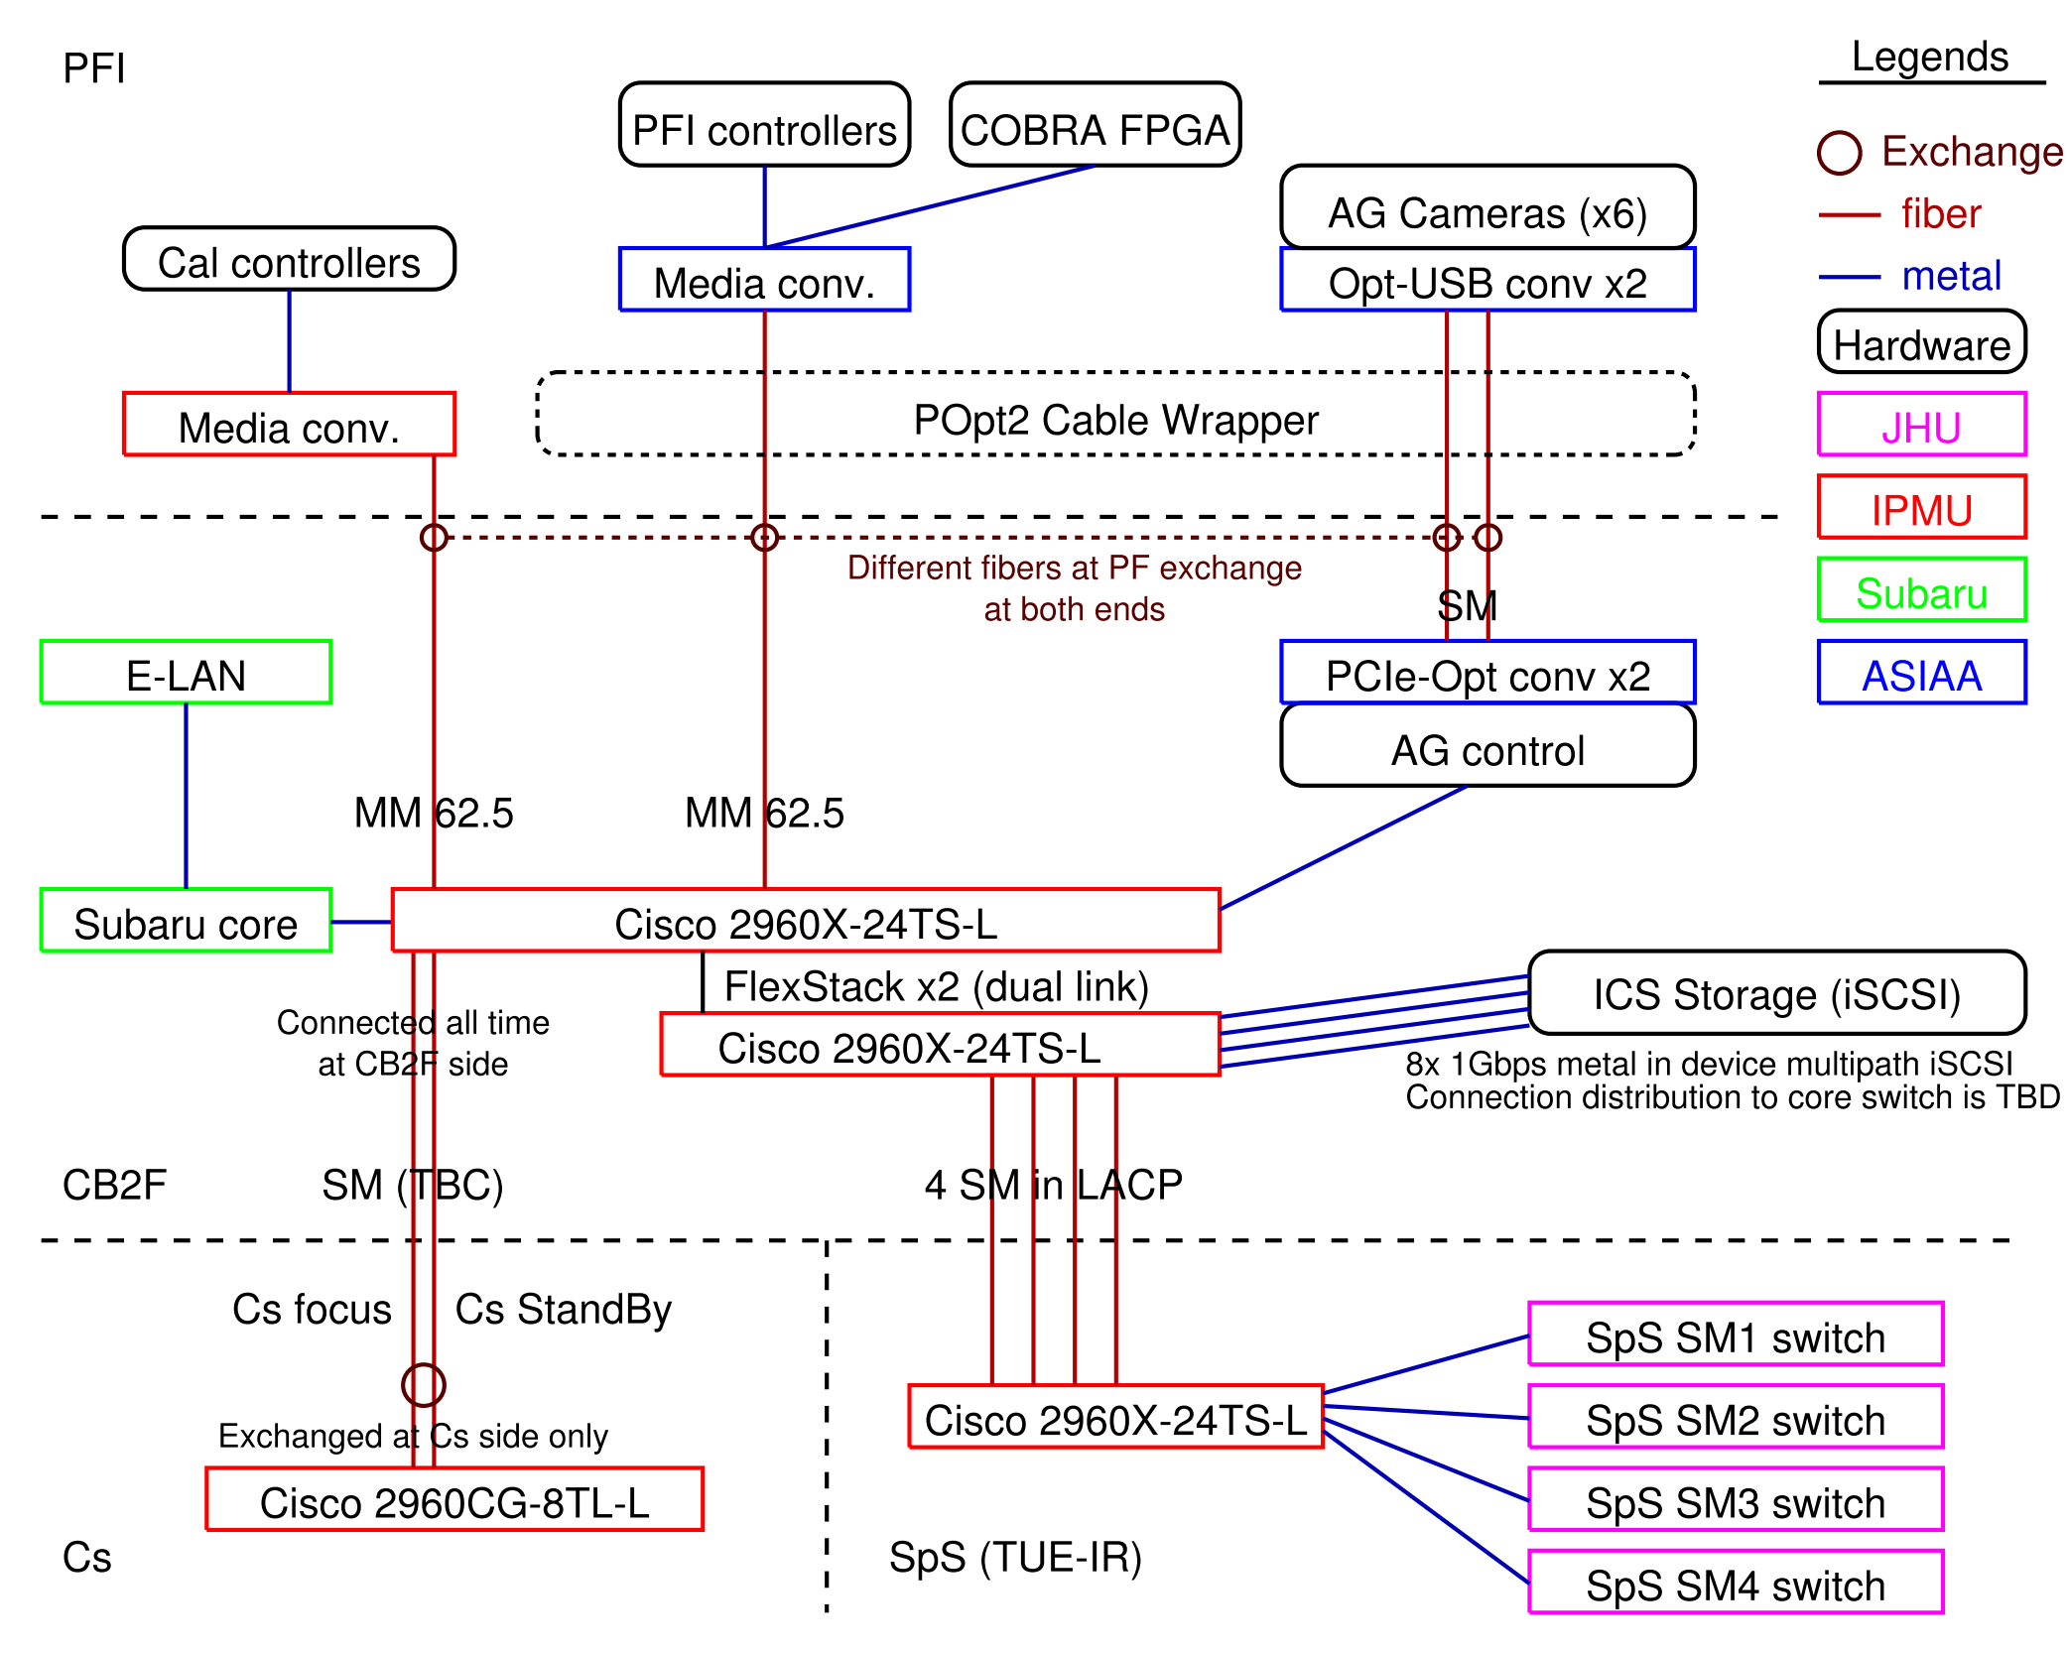
Connection diagram / L1 design – Network
Notes:
This diagram does not show all connections, but just picks inter-place links and major devices.
Fibers marked as TBC are not yet at a stage of final assignment by Subaru.
Connection for iSCSI storage is under discussion (between iSCSI and FC).

Slide 23
L3 requirements – Network
Requirements and conditions:
PFS LAN has assigned IP address range of 133.40.164/23 from Subaru.
Some of PFS ICS software modules and their configurations depend on hostname assignment from DHCP
IP address is to be fixed to functions like BCU1-BEE but not to each device (handled by MAC address), and software configuration are selected using assigned hostname.
Some of PFS ICS hardware rely on BOOTP, and PFS wants to use DHCP option section for their configuration.
Some of PFS ICS hosts will be by virtual machines, MAC address assignment scheme is required.

Slide 24
L3 design – Network
Design in PFS ICS:
PFS ICS will host dnsmasq server (DHCP + DNS)
Network configurations are hosted in this server
Two set of configurations are registered in git: MAC address and hostname, hostname and IP address
On hardware replacement (broken or maintenance), only a set of MAC address and hostname will be replaced
Hardware configuration is tracked by git hash, but this hash is not planned to be included in FITS header
PFS will consider possibility to have some, if required (by PFS data reduction or by Subaru)
(ToDo) Network block assignment need to be defined for ease of management (e.g. address block of 133.40.164.0/28 is for network switches)
DHCP assignment for non registered MAC addresses will be enabled for temporary tools like maintenance or AIT
Critical boxes are by static configuration, e.g. network switch, VM host server
“dnsmasq” server itself will be a VM client, its host shall be statically configured
Even for static configured hosts, sets of configurations are registered into git
All ports except for up-/down- links are configured as access port
PFS network is defined as one VLAN, but management network (or V-LAN) is also required
Only up-/down- link ports to Subaru or between two PFS network switches are configured as trunk port
If some host requires more than two networks (e.g. PFS-LAN and V-LAN), these shall have connections for each network

Slide 25
Monitoring – Network
Requirements
Capable to monitor network connection and flow status both on demand and history
Capable to monitor switch health statistics
No special line or authentication for monitoring, use Ethernet connection
Design and implementation
Configure SNMP public read as “snmp-server community public ro” from all VLANs
Configure each port with name of peer
Just for clarify, but name will appear on SNMP also, and status service does not need to have copied configuration
Traffic monitoring is recommended to be more than per a few tens seconds
High frequency monitoring, e.g. per several seconds, is useful to detect spike/peak of network load
1Hz SNMP readout worked on real hardware (ref: link over fiber on telescope section), but such high rate is not required
Considering data store (or say, data volume to archive), statistics from high frequency monitoring is an option
This is an option especially for status posted over MHS
Visualization is a key for historical data, way is not defined yet. Could be done by STS, of course.
Weathermap could be a best option for display during operation, but not yet included in the plan
Display in Gen2 might not be a good idea on data supply point of view.

Slide 26
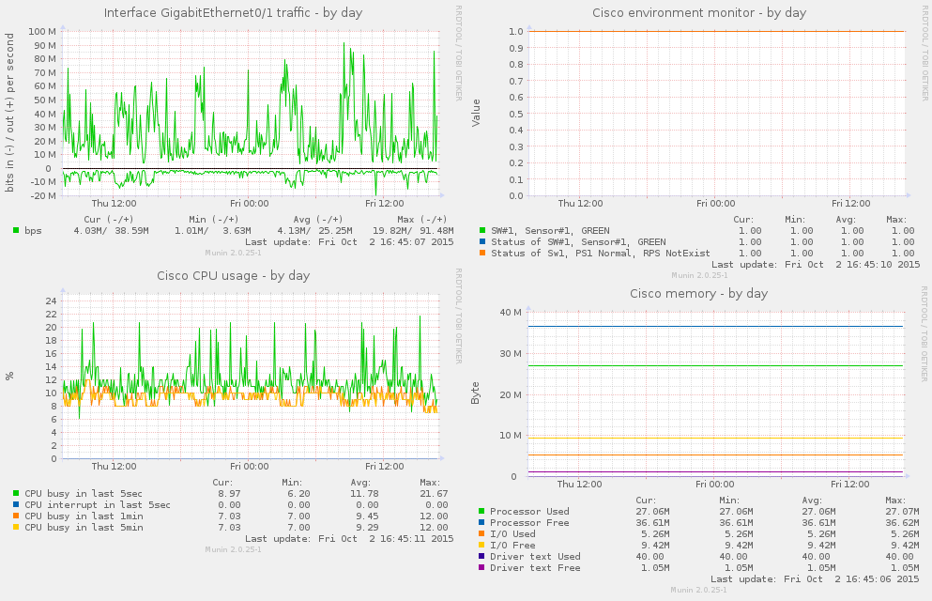
Monitoring – Network
Sample of network switch monitoring drawn by munin.
All panels are based on data acquired via SNMP. Traffic is by general IF-MIB plugin, others are by custom plugins. Statistics other than traffic are not changed frequently (CPU usage has some spike,,,) and frequent monitoring is not important.

Slide 27
Link over fiber on telescope
PFS will use two types of signal for communication over fiber on the telescope between CB2F and places in the dome. One is Ethernet connection by 1000BASE-LX (1Gbps) over SM or MM fiber, and another is an optical PCIe bus extender with a USB host controller over SM fiber (4.25 or 8.5GBaud?). 1000BASE-LX is planned to be used to all three places, but an optical PCIe bus extender is only used between POpt2 (PFI in PFS) and CB2F for connection of USB devices to host computer at CB2F.
This section is to present a detail of technical requirements and limitations for each connections, trades and selection criterias, and performance verification.
This section is organized as follows:
Technical requirements and limitations
Trades and selection
Selection of an optical PCIe bus extender was performed as a part of PFI, taking limitations on PFI side into account
Performance verification using real fibers
Test procedure and verification results for 1000BASE-LX on TUE-Opt fibers
Test procedure and verification results for PCIe bus extender on TUE-Opt fibers

Slide 28
Requirements – Link over fiber on telescope
Ethernet connection
Better to be the same component for both SM and MM fiber
Fiber lengths are not short, and fibers itself are somehow old
MM fiber will be used only for PFI connections
High data flow rate is not required for this connection, ~100Mbps could be fine
The highest bandwidth will be by COBRA FPGA communication, but low (or no) error rate is a key for COBRA FPGA operation
Test and verify whether MCP is required or not for MM fiber connections
Connection of CB2F – SpS will host continuous high data rate, but SM fibers are assignable for this line
Optical PCIe bus extender
Space is quite limited at PFI side, selection is mainly limited by PFI design
Need to be lined up between CB2F and PFI via real fiber
Fiber assignment is possible for all SM, 50MM, 62.5MM
Bus speed minimum requirement could be USB 2.0, but better to have more (e.g. USB 3.0) for slack
Devices connected at PFI are six AG cameras, fiber back illumination system, monitoring camera and microphone, etc.
Interface of PFS AG camera (FLI ML4720 MB) is USB 2.0, we will have six of them.
Data rate from devices will not be large as ~1Gbps
AG camera has ~3MB for full image, ~100Mbit for all but will not read as 10Hz
PFS decided to divide these connections into two bus extenders, and to use bus extender with USB 3.0
PFS PFI may not have enough space to have MCP along its cabling route

Slide 29
Technical backgrounds – Link over fiber on telescope
Fiber cables on Subaru telescope have not replaced from its built (TBC). Run-length from CB2F patch panels are: (ref: OTDR measurement etc.)
CB2F – TUE-Opt IDF (PF Stand-by; so-called Route E): ~300m
CB2F – Ns-Opt IDF (route to TUE-IR/SpS; so-called Route F/G) : ~220m
We will have additional b/w Ns-Opt IDF to TUE-Opt, but new fiber cable
CB2F – PF panel (so-called Route M): ~250m
Also we will need to attach fibers to switches on both sides, around 10m but with “new” fibers. PFS might not use Route E, and length of additional fiber to TUE-Opt on Route F/G will be shorter than 80m, we might be fine with assuming 225m + 50 (40+10)m fiber length between two SFPs.
Specific part # is unknown for fibers, but measured attenuation values are around 4dB (~3.8dB for GI62.5, ~4.3dB for GI50).
Messia III/IV system used SBus SIF card, and its specification seems like 1000-SX, but used around 300Mbps data flow max.

Slide 30
Technical backgrounds – Link over fiber on telescope
Multimode (MM) fibers are categorized into several categories by minimum modal bandwidth defined at 850nm and 1300nm. Also per each category maximum link(-able) length for each application are defined, summarized as table below. FDDI and OM1 is for 62.5um, OM2-4 is for 50um MM fiber. Modal bandwidth is defined as -3db bandwidth on frequency spectrum of output light for impulse after passing specified length fiber.
As shown in table below, fiber with wider modal bandwidth can link longer length between transmitters. (Note; some max link length is limited per specification of communication protocol.)
category | MB (MHz*km) (850 / 1300 nm) | 1000-SX | 1000-LX (w/o MCP) | 1000-LX (w/ MCP) | 10G-SR | FC 1G | FC4G
 | (wavelength) | 850nm | 1300nm | 1300nm | 850nm | 850nm | 850nm
FDDI | 160 / 500 | 220m | n/a | 550m | 26m
OM1 | 200 / 500 | 275m | n/a | 550m | 33m | 300m | 70m
OM2 | 500 / 500 | 550m | n/a | 550m | 82m | 500m | 150m
OM3 | 1500 / 2000 | 970m | 550m | 550m | 300m | 860m | 380m
OM4 | 3500 / 4700 | 1040m | 550m | 550m | 550m | (n/a) | 400m

Slide 31
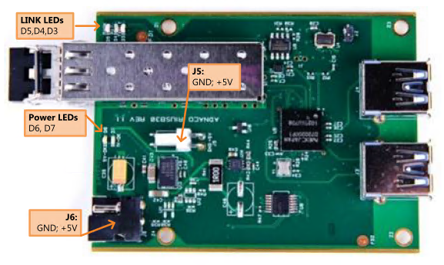
Trades and selection – Link over fiber on telescope
1Gbps Ethernet
PFS has selected 1000BASE-LX for its optical network
USB connection
PFS has identified several items and performed on-site test
Selected PCIe bus extender with USB host controller after on-site test
Adnaco-H1A (photo below)

Slide 32
Performance verification – Link over fiber on telescope
Performance verification was performed using real fiber at the prime focus of the telescope, for both Ethernet and USB extension. Since availability of real fibers at the prime focus is limited by day time works in the dome – the telescope need to be at the zenith for human access to fiber outlets, we also used TUE-Opt or Ns-Opt fiber patch panels for alternative test ports, whose fibers are also used by PFS for works at the standby (off telescope).
Performance test is performed by checking real data rate for full load supplied to each bus. Plans of measurements are developed for each bus, SNMP data transfer counter for network switches and dummy data read/write software for USB connection. For both buses, measurement plans are verified using short fiber cable connections, and system are verified with full load.
Connections are as follows:
CB2F
(OCB21)
PF or TUE-Opt
MCP
MCP
Test PC
Cisco SW
SFP
SFP
Media Conv
Test PC
Metal RJ45
LC-LC
LC-LC
Metal RJ45
Configuration for ethernet network test
MCP; if required
MCP; if required
Test PC
PCIe-USB
PCIe extender
USB Storage
LC-LC
Configuration for PCIe extender (USB) test
LC-LC

Slide 33
Performance verification plan for Ethernet
Packet transfer error rate on switches could be gathered via SNMP (or other administrative methods) like 1.3.6.1.2.1.2.2.1.14 or .20 (also other values included transmitted packets, bps).
Using such switches and connects small computer(s) at both side, we can transfer large data flow and check network stability.
Reading status via SNMP in high frequency could make some load on switches, but not an issue for monitoring by 1-0.1Hz (already over requirement for our purpose).
Fiber communications are not affected with what kind of data is flowing, so we do not need special software for making data transfer, but we can just use netcat (nc). Use of “dd” or “rsync” (with –bwlimit?) was effected by short time performance degradation of storage, and was rejected.
Procedure is:
Place switches on both PF and CB2F, connect one or two PCs on both side
We might not need full 1Gbps data flow, but better to check nearly conjection, so flow as much as possible without any limit
Network is full duplex with two fiber cables, we don’t need to test two directions at one time
Check stability by monitoring status counters for full load (1Gbps)
Pair of “nc –l –p XXXXX > /dev/null” and “cat /dev/null | nc X.X.X.X XXX”
Gather data over ~100sec to check stability

Slide 34
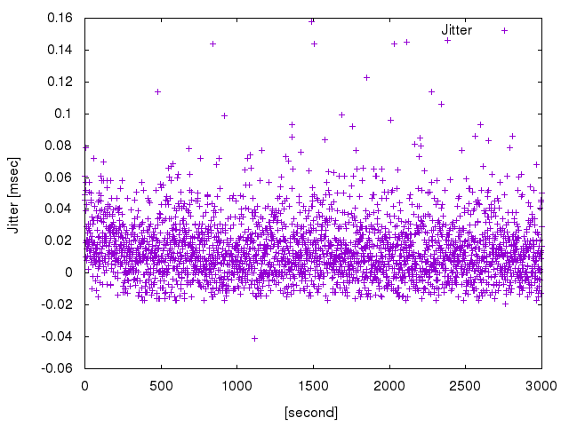
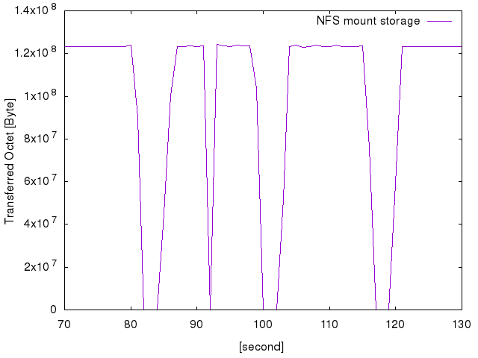
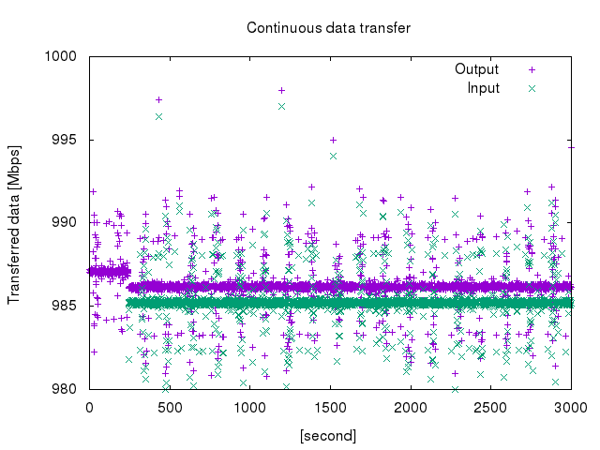
Plan verification – Performance verification plan for Ethernet
Used script to gather switch packet count
https://github.com/himorin/scripts/blob/master/network/ifmib_rate.pl
Output status, flowed octets, error packets, discarded packets for in/out in specified second interval
Jitter of output period is measured as < 1msec with real cisco switch. (left below)
Real measurement over 3000 points (in 1Hz) is shown
Jitter in time domain seems random, so should not be serious issue on measurement
Data flow generation verification
Data writing to NFS mount storage showed some sudden drop during test (middle below)
Used SSD storage to gain write performance. No issue was found when write locally.
Netcat data generation was succeeded as right below, first ~300sec is one direction, later is bi-direction
Reason of periodical jitter (up and down in short time) is not clear but ~5Mbps for ~985Mbps.

Slide 35
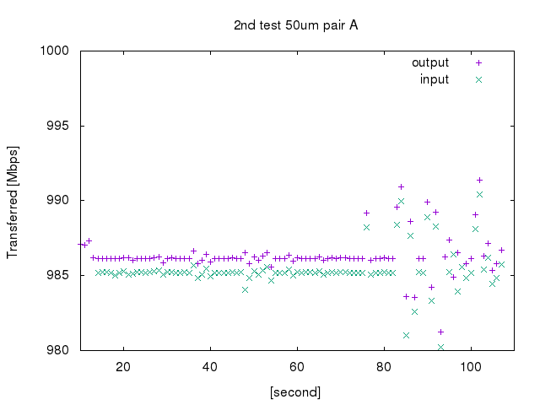
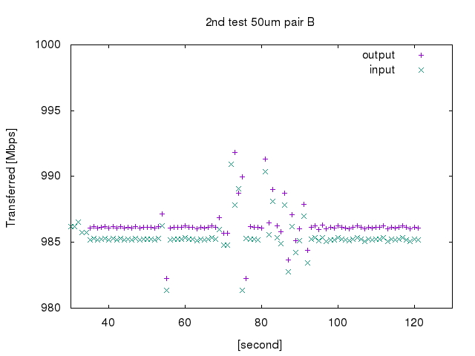
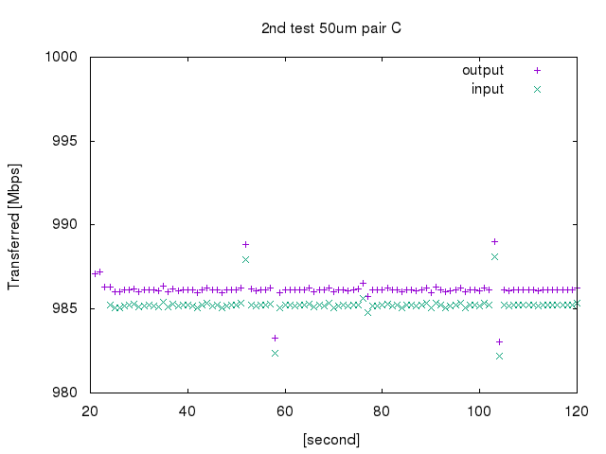
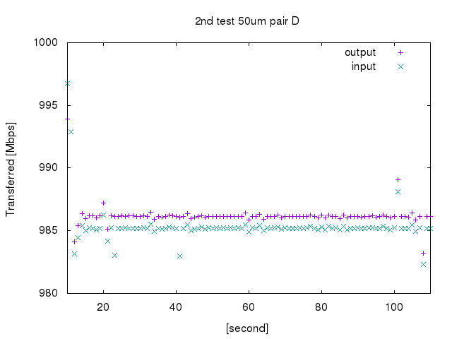
Results – Performance verification plan for Ethernet
Test passed for all configurations with/without MCP. Bottom panels are samples of measurements.
1st: tested both with and without MCP on 62.5um MMF b/w CB2F and PF
No change detected between with and without
Checked laser dBm by cisco status (just to check difference between TX and RX)
4.5dBm changed in average (-6.1/-1.7, -6.6/-1.9, -6.6/-2.7, -6.8/-1.6) = loss by fibers and connections
2nd: tested without MCP for all pairs b/w CB2F and PF on 50/62.5um MMF
All pairs worked fine
3rd: tested without MCP for all pairs b/w CB2F and TUE-Opt (connector rack) on 50/62.5um MMF
All pairs worked fine
PFS has decided:
Use 1000BASE-LX for all Ethernet connections over fiber
Changed MCP to be not a default plan

Slide 36
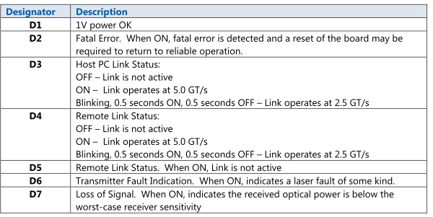
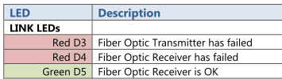
Performance verification plan for bus extender (I)
Finally selected device has limited capability for checking status of fiber link (as shown in figures below). If we find a way to check internal status of PCI Express bus, we could use these status to check communication failure rate, but it seemed difficult (or at least need to do some technical study).
Therefore, we planned just to check possible data flow rate, once we confirmed connection over a pair of fiber cables (TX/RX) by both LEDs and host computer operating system, and planned to compare with assumed maximum data flow rate – since its maximum communication data flow is kept as 2.5GT/s.
The PCIe extender had already tested with newly purchased 270m MM fiber at ASIAA and worked without MCP, prior to on-site test at the telescope.

Slide 37
Performance verification plan for bus extender (II)
Procedure is:
Attach USB memories to USB hub at target.
USB memory was tested at off-site prior to on-site test
Two USB 3.0 memories were used to fill data flow
USB SSD was not considered for this performance verification.
Run two tests, with short (~1m) fiber (local) and real
Compare two results to check degradation by the real fiber
Checked > 5min for stability
Host operating system was Windows
Used GUI storage performance measurement software for writing to and reading from USB memory
Data rate and stability was checked using saved log file from software
See next page for details
At least one pair from assigned fibers are tested
Fibers are validated by OTDR already

Slide 38
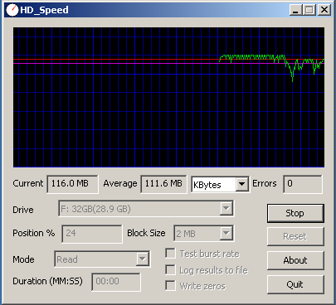
Performance verification plan for bus extender (III)
Software used for test can output log into file. Format was as follows (sample cutout):
--------
[Test Start 4/28/2016 7:11:23 AM] drive: \\.\D: start_offset: 0 mode: Read blocksize: Auto type: sequential parallel: 1
blocksize: 64KB
result: 16000KB/s offset: 0% 8000KB
blocksize: 32KB
result: 13312KB/s offset: 0% 14656KB
: : : : :
result: 15872KB/s offset: 89% 27581120KB
[Test Stop 4/28/2016 7:40:59 AM] errors: 0 average: 15.3 MB
--------
First and last lines are start and end of execution, we take these lines to separate among tests. “errors” in the last line seems no unit, just take “0” as success (or graph go 0kB/s during error). Per each 0.5 sec one “result” line is written, kB/s is performance in the last 0.5 sec, and last kB is cumulative size of data tested. Blocksize seems size of block read/write, but haven’t checked its effect since size is well larger than packet size of USB protocol.
On USB 3.0 test, log file is only from one software, so we just memo (and get screen shot) their total data rate. And used this log file for checking long term stability and short-term degradation.

Slide 39
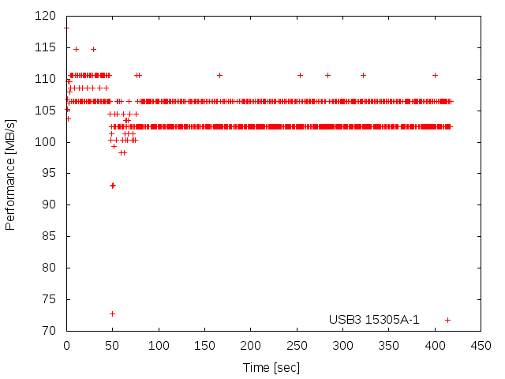
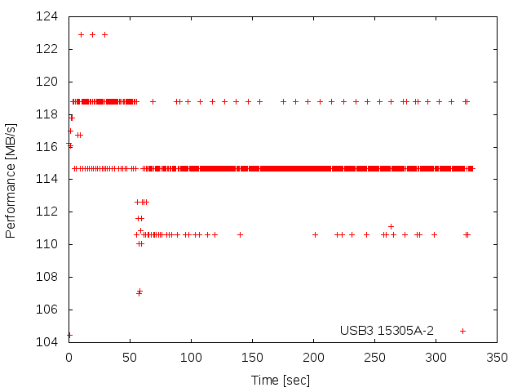
Results – Performance verification plan for bus extender
For MM 50um fibers, connection itself had failed.
For SM fibers:
Achieved performance:
Short length: ~180MB/s (~1.4Gbps)
NsOpt (HDS): ~150MB/s (~1.2Gbps)
Both are in total of two USB memories.
Right graphs are for one of USB memory measurements (to show stability)
Communication was stable
Although some load rebalance was observed over 5min test between two USB memories.

Slide 40
Discussions I – Network connection to Subaru
PFS-LAN is planned to connect to CDM managed network switch at CB2F by metal 1Gbps connection, but details have not fixed yet. Current assumptions are:
To manage network switches in PFS, management VLAN need to be passed into all network switches in PFS.
Although PFS need to have some trunk ports for uplink, PFS want to keep all other ports as access ports.
Connection between Subaru summit core (TBC) switch and PFS network switch is one link of 1Gbps metal.
Monitoring access to network switch in PFS (SNMP v2c ro) is enabled for PFS-LAN.
No remote configuration access (vty login or enable) is required from PFS-LAN for instrument operation.
In this section, PFS would like to fix and to have agreements on these points of assumptions, also want to seek some additional options from operation point of view as followings:
Handling of multiple VLANs to PFS network switch, and management
Possible VLANs are: PFS-LAN, V-LAN, CDM management LAN
Port management of network switches – trunk/access, shutdown
Uplink connection of PFS-LAN CB2F network switch
Having larger bandwidth for data transfer of up-the-ramp data
Like, multiple 1Gbps metal connection in LACP, or 10Gbps fiber connection
Faster data transfer if we archive composed up-the-ramp data, whose transfer starts after end of exposure
PFS does not assume to configure CoS (802.1p/Q).
Also possibility of such data transfer are largely depends on target host configuration of g2cam

Slide 41
Handling of multiple VLANs – Discussion I
At the moment of introducing PFS-LAN for dedicated subnet over the entire PFS instrument control at the summit, single VLAN was assumed to be used at network switches in PFS-LAN (or what PFS will bring). Following detail design study on PFS ICS, we found we need to have also:
CDM management LAN for remote manage and monitoring
This VLAN need to flow over the entire PFS network switches
V-LAN for sending AG image by RPC
V-LAN is configured as one VLAN but not by independent 100Mbps network switch(es), we can integrate V-LAN as VLAN into network switches of PFS-LAN.
PFS only need V-LAN at CB2F switches, no configuration is required for others (at SpS or Cs).
Network need to be limited as 100Mbps.
Taking ease of PFS operation, such as service ports in SCR, PFS want to make following configurations as a baseline:
Configure up/down link ports as trunk, all others as access. All ports as “no shutdown”.
Even if one VM host need to have PFS-LAN and V-LAN, two connections are required. It is easier for host operation especially on data flow rate point of view.
VM host computers have at least two network ports, and this regulation shall be fine.
SFP ports to Cs will be disconnected depends on Cs instrument position (Cs or standby), but we just let a port disconnected but not configure as shutdown. (TBD: PFS shall follow if CDM has strict restriction)
Many ports at SpS are not up even cable is connected to the switch as AUX ports in SCR, these ports are in closed room (within SCR), and let them kept “no shutdown”.
Assign static IP address for PFS-LAN VLAN at network switches
Not from DHCP, configured as static. No gateway configuration for PFS-LAN
DNS and NTP remote point to PFS one.
No tty/vty login for PFS, but enable SNMP public ro for the entire PFS-LAN
PFS plans to monitor status/statistics of connections and data flow, including LACP balancing status.

Slide 42
Uplink connections (I) – Discussion I
Normal operation of PFS does not require high bandwidth connection between Gen2 and PFS, but for data transfer of IR detector up-the-ramp images require to transfer large volume of data in parallel to other command, status or data flow, we need to consider of uplink connection bandwidth carefully.
If we transfer up-the-ramp FITS image files one frame by one frame, and do not transfer composed multi-HDU FITS files, bandwidth from PFS to Gen2 is averaged. For now we assume to archive composed multi-HDU FITS files, data flow will start after exposure ended (a bit after – to build composed FITS file from multiple up-the-ramp files, or may have faster way), and could continue after next exposure starts depends on its transfer speed. For 900sec exposure, total up-the-ramp file size for all four IR cameras are 22.5GB, and it takes 180sec with full 1Gbps upload.
On the other hand, LACP for small number of peers need to be planned and configured with much care as in performance verification of PFS storage.

Slide 43
Uplink connections (II) – Discussion I
Items need to be consider of on connection to Summit core switches are:
Currently we don’t assume to have QoS, but we need to have capacity of control flow between Gen2 and g2t.
Also data transfer for CCD image readout is important but it is within PFS and quite small data rate than secured balancing.
V-LAN is also have data transfer, but it happens only during guiding and will stop during Cobra reconfiguration.
Baseline is to transfer data from FTP server on NFS server. If no, such as using g2cam, need to consider more.
Need to care of data flow between NFS server and g2cam host.
To extend data transfer rate from PFS NFS server to Gen2:
Possible options are: having multiple 1Gbps metal connections for uplink, or 10Gbps fiber connection for uplink
Configuration with multiple 1Gbps metal connections is possible without any modification of hardware.
To have 10Gbps fiber connection, we need to add or replace two stacked network switch at CB2F
Replace SpS network switch and one of CB2F network switch and have 10Gbps connections to Subaru and SpS
Need to check connectability over SM fiber between CB2F and SpS, but could be possible
Add one network switch into FlexStack stack at CB2F
Load balancing within PFS-LAN
Connection between PFS storage and NFS server is well balanced by device-multipath iSCSI or by high speed FC (8Gbps), and no issue.
If connection between PFS NFS server and Gen2 is one, balancing by LACP from PFS NFS server to Subaru network switch is not possible.
If we can finish data transfer in 90sec (>2Gbps), no overlap happens between data transfer to Gen2 and IR readout for normal operation
For shorter exposure, we may exposure without Cobra reconfiguration, but we still have 40sec interval for CCD readout.
V-LAN data transfer continues between two exposures for this configuration, we need to be care of.
For intermediate IR arm reset, to have different exposure time among arms, we may have overlap, but could transfer after all exposures.
For these possible extensions, configurations and data flow diagrams are listed from next slide:
Alternative configuration I – connection by multiple 1Gbps metal
Alternative configuration II – connection by 10Gbps fiber
Alternative configuration III – have direct access from NFS server to Gen2

Slide 44
Current configuration plan – I
Gen2 (storage)
Subaru core switch
1x 1Gbps metal
PFS core switch
2x C2960X w/flexstack
8x 1Gbps metal
4x 1Gbps metal
4x 1Gbps fiber, for SpS
1Gbps fiber
PFS iSCSI Storage
PFS NFS server
PFS SpS distribution switch
PFS MCS
PFS NCU
PFS [BR]CU

Slide 45
Current configuration plan – II
Gen2 (storage)
Subaru core switch
PFS core switch
4x 1Gbps metal
4x 1Gbps fiber, for SpS
1Gbps fiber
PFS iSCSI Storage
PFS NFS server
PFS SpS distribution switch
PFS MCS
iSCSI FC
PFS NCU
PFS [BR]CU

Slide 46
Alternate plan I – connection configuration
Gen2 (storage)
???
Subaru core switch
Balancing configuration required
2-4x 1Gbps metal
PFS core switch
2x C2960X w/flexstack
8x 1Gbps metal
4x 1Gbps metal
4x 1Gbps fiber, for SpS
1Gbps fiber
PFS iSCSI Storage
PFS NFS server
PFS SpS distribution switch
PFS MCS
PFS NCU
PFS [BR]CU

Slide 47
Alternate plan I – during CCD readout
Gen2 (storage)
H4RG
CCD
???
Subaru core switch
Could be replaced by FC
2-4x 1Gbps metal
PFS core switch
2x C2960X w/flexstack
8x 1Gbps metal
4x 1Gbps metal
4x 1Gbps fiber, for SpS
1Gbps fiber
PFS iSCSI Storage
PFS NFS server
PFS SpS distribution switch
PFS MCS
PFS NCU
PFS [BR]CU

Slide 48
Alternate plan II – connection configuration
Gen2 (storage)
Subaru core switch
1x 10Gbps fiber
C2960-TD
flexstack
C2960-TS
10Gbps metal/fiber
4x 1Gbps fiber, for SpS
1Gbps fiber
PFS iSCSI Storage
PFS NFS server
PFS SpS distribution switch
PFS MCS
iSCSI FC
PFS NCU
PFS [BR]CU

Slide 49
Alternate plan II – during CCD readout
Gen2 (storage)
H4RG
CCD
Subaru core switch
1x 10Gbps fiber
C2960-TD
flexstack
C2960-TS
10Gbps metal/fiber
4x 1Gbps fiber, for SpS
1Gbps fiber
PFS iSCSI Storage
PFS NFS server
PFS SpS distribution switch
PFS MCS
iSCSI FC
PFS NCU
PFS [BR]CU

Slide 50
Alternate plan III – connection configuration
Gen2 (storage)
No redundancy assumed.
Replace on switching NFS server
Subaru core switch
10Gbps metal/fiber
1Gbps metal
PFS core switch
2x C2960X w/flexstack
4x 1Gbps metal
4x 1Gbps fiber, for SpS
1Gbps fiber
PFS iSCSI Storage
PFS NFS server
PFS SpS distribution switch
PFS MCS
iSCSI FC
PFS NCU
PFS [BR]CU

Slide 51
Alternate plan III – during CCD readout
Gen2 (storage)
No redundancy assumed.
Replace on switching NFS server
Subaru core switch
H4RG
CCD
10Gbps metal/fiber
1Gbps metal
PFS core switch
2x C2960X w/flexstack
4x 1Gbps metal
4x 1Gbps fiber, for SpS
1Gbps fiber
PFS iSCSI Storage
PFS NFS server
PFS SpS distribution switch
PFS MCS
iSCSI FC
PFS NCU
PFS [BR]CU

Slide 52
Discussions II – Access control to/from PFS network
Within PFS-LAN, PFS does not plan to have extensive access control or even some components does not have access restriction, such as:
L3 switching is by CDM network switch, assuming simple routing (access limitation) configuration
PFS plans to have ssh box for remote connection
Connection to MHS server does not require authentication as for now
Have possibility of authentication, but just plain authentication
No IP address based limitation in MHS, although can add at OS level (iptables etc.)
To have access control to PFS instrument control hardware and components, PFS want to have
Deny access from outside of PFS-LAN to hardware control devices (incl. PC104) completely
White list could be better for operation by PFS point of view?
Like, only to operation support devices (KVM) and remote connection boxes
PFS KVM has two network connections, can configure to be connected to network for summit normal operation, and restrict access to PFS-LAN side.
Restrict access from some external source like unsecure subnets to PFS-LAN
For security point of view, PFS would like to keep direct remote access as minimum as possible.
Staged restriction for categories of external source range could be an option
like: completely denied, authenticated remote access IP address only, direct access allowed to all normal operation hosts, and full access (without any restriction to all hosts?)
Also, from maintenance and operation at Subaru point of view, followings may be requested:
Access to MHS from remote shell client (so-called hubclient) or PFS specialized GUI client (e.g. AIT GUI)
Direct VM operation using libvirt
This has client authentication based on private PKI – need issued certificate to access, so strong authentication mechanism exists
Also this operation can be done using remote access host via shell.

Slide 53
Possible implementation plan – Discussion II
One possible implementation of access restriction based on staged restriction is to categorize PFS IP hosts by remote connection level and assign subnets for each level. For such configuration, we need to consider of:
Need to have some slack for scale out (like VM host subnet)
Number of levels could be an issue for configuration… (better to keep as minimum as possible)
A possible list of connection levels are:
Full access: hosts for remote connection (ssh etc.)
Limited access: VM hosts, support devices (KVM, PDU etc.), ICS non-hardware modules (MHS, DB server etc.)
Exclude VPN, ssh access hosts from external
Completely denied: all others
Or possible to access from the entire summit network, including observation room?
In any case, direct access to hardware control computers or devices need to be denied from outside of PFS-LAN

Slide 54
Discussions V – Closed subnet in SpS/ENU
The entrance unit (ENU; LAM part) of SpS controls mechanical parts except for camera/cryostats on the spectrograph module. For several reasons, there is some advantage (or reduction of complexity or possible trouble) to have closed local network (hidden also from PFS-LAN) for these components:
4 ENUs are required for PFS/SpS in total, can have the same IP configuration for all four sets of components
Possibility of some configurations to be written into firmware (TBC)
Operational interlock is implemented over network communication within a set of components, it is safer to remove possibility of remote injection.
Interlock is for light beam control into cameras (illuminator, shutter, etc.), and is important for safety of exposure operation and detector.
Next page shows a connection diagram for ENU.

Slide 55
19” unit in ENU rack
SM (in cover)
FCB-SRB
IR3F
2 Fiber bundle (φ TBC mm)
FIA
FCA
FMS
Fiber bundle (φ TBC mm)
IIS 19” 4U
Arudino
And Interlock /Synchro
BOARD
controller
(<10m)
Shutter (B)
1 Cable :RS 232/422 Communication with Internal source PLC (Omron φ TBC mm)
5 wire Shielded wire (φ 5mm)
controller
(<10m)
Shutter (R)
Core switch
LED driver
BIA
10cm local network
Access switch
RasPi
Possible local network
Green boxes by
IPMU+Subaru
Brown by LNA
Blue by LAM
Sensors (TBD)
PC104
Motor controller
(<10m)
RedEx
(TBD)
Env monitor
Conditioning
Sensors
Thermal (PT100)
local ethernet
Hexapod
19” 4U
Hexapod
6X motors
6X MOTOR CABLES / SUD25 (6x φ 10mm)
Ethernet (metal)
Restriction
Metal wire
fiber
TBD items
RS232C
USB
LCU controller rack under bench backup option

Slide 56
PFS ICS hardware part
In this part:
This is a main body of hardware part of PFS ICS infrastructure, which includes computing resources, storage, and support hardware to be delivered to CB2F.
Requirements, design with trade studies if exist, and selected hardware are presented in this part. Also configuration or operation plans, and performance verifications are presented.
And is organized as:
Review items
Storage and image data handling
VM infrastructure
ICS infrastructure support hardware

Slide 57
Storage and image data handling
PFS ICS plans to have one central storage to cover all requirements over (most of) the entire instrument for both active and backup. Several exceptions exist such as local storage for MCS and MPS, MCS keeps intermediate image files at its local for operation and transfers them to shared storage on non-active phase, MPS has local data store (non database but binary typed file format; not tracked nor checked-out from git repository) for its operational configuration.
Also PFS has IR detector and plans to operate them in continuous readout mode, performance of storage and its connection (including storage server/services in ICS infrastructure) needs to be cared to match with required value.
This section is organized as follows:
Requirements
Performance of storage
Size of storage
Storage selection
Configuration plan
Network connection
iSCSI LUN organization
NFS configuration and account
Performance verification
Includes possible extensions
Monitoring and recovery plan

Slide 58
Requirements (I) Performance – Storage
Requirements on storage performance is dominated by two client – detector data host, and database server.
Instrument detector data rates
4 continuous stream from IR detector control computer
Assuming 4k sq. image per 3-4sec, 60-90Mbps for one up-the-ramp
Currently, changed to “per 5-6sec”, and ~50Mbps per one detector
2.4TB/night for 90Mbps x 4 with 15hours operation per night, 36TB/run for 15day run
Assumed no need to read up-the-ramp raw data from storage in short time over one exposure
Protocol of IR detector readout is floating, better to have several options including tiered storage
Only the final exposure of MCS FITS file will be immediately transferred to storage (and to Subaru)
This transfer may not happen during IR detector up-the-ramp readout (ref. timing chart)
Other files will be backed up during non-operation period or maintenance
AG images is 1 or 2 x 2MB per a second (max), ~50Mbps max
Instrument operation
VM images : client system itself will not require high bandwidth – disk IO is similar to ones at physical host
Database : consideration on index, WAL etc. are required
In summary:
Read/Write performance
600Mbps (50Mbps x 4SM IR up-the-ramp + 50Mbps AG + buffer) write performance
Write mostly in sequence write (FITS data), ~10k IOPS is fine (or already over-spec?)

Slide 59
Requirements (II) Size – Storage
Basic concepts on keeping data in on-site storage of PFS are:
Keep operational log data permanently
Backup strategy depends on targets
Last (or a few) snapshots for incremental database, VM image
Image data up to half year (assumption)
Mostly archived at Subaru, so we may reduce data holding period
Required capacity in summary: refer next slide for details
Capacity in total > ~100TB
10TB for operational storage (e.g. VM, DB)
10TB for backup
80TB for FITS-liked data
25TB for one run (15days) by uncompressed FITS files
50TB to keep former runs
Mostly raw up-the-ramp data
Could be compressed after run -> 1/3 or 1/4; hopefully can keep 5-6 runs
Seeking possibility to compress at the first moment

Slide 60
Requirements (II) Size II – Storage
Data volume estimation in details:
Instrument detector data
IR up-the-ramp data in ~200Mbps, 1.3TB/14h, 113TB for 6mo with 15days/mo
Could be compressed after each run, and their size could be reduced as 1/3-1/4
14h = 12h observation (avg.) + 2h calibration
19TB for one run of 15days (at least this shall be kept in storage)
CCD and IR (composed) FITS images are 50-100GB/night, 9TB for 6mo
AG images are ~200GB/night, ~3TB/15days, 18TB for 6mo
Focusing images are one order smaller
These data could be important for instrument health evaluation point of view, better to be kept as long as possible
Operational data
VM image : 30GB/client, 0.6TB for 20VMs, ~2TB for 3 generation backup
Database : could not be on NFS, assumed to be direct iSCSI mount at database server host (physical or VM)
Operation (Tron) log archive will be ~1TB over entire operation (ref. SDSS 15years in 500GB or so)
Considering number of control items, this would be larger but not an order
Survey and exposure execution database will be smaller than operation log
Backup
Database backup can be in binary format, similar size as real one
Backup for log database is enough with one snapshot
Code and configurations are all in git repository, no need to have rsync-ed backup for ICS actor
MPS configurations supplied from FPS are also tracked in database or as git repository
No backup for image data

Slide 61
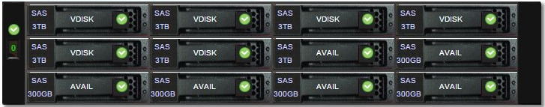
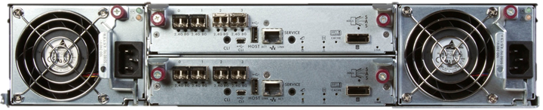
Storage selection – Storage
CDS4004 with 120TB (or 108TB) iSCSI RAID6 4U storage server
20D+2P+2H x 6TB NLSAS HDD, or 2x(9D+2P)+2H NLSAS HDD
8x SFP(+) ports for data, 2x 1Gbps metal for management
1Gbps metal SFP by iSCSI connection or FC (1,2,4,8Gbps)
Mixable
iSCSI ports are connected as device-multipath, but not bonded in network layer
Performance
100K Read IOPS, 650K IOPS from cache
6.4Gbps read, 5.3Gbps write
Host interface
2U12 3.5in as one host or JBOD, up to 3 JBODs (+ 1 host)
Using 1host + 1JBOD with fully populated disk (24 HDDs in total)
Could add another 2 JBOD, if necessary during operation
Two host controllers in redundant
No battery backed-up cache, write from memory to flash by capacitor backed-up
Max 8 SFP+, compatible with FC, iSCSI (hybrid) or SAS
Certifications
NEBS 3 compliant for telecommunication
ML-STD-810F/G

Slide 62
Configuration plan (I) network – Storage
Requirements and limitations:
Maximum 8 connections of iSCSI (1Gbps metal) or FC are avail
iSCSI ports are configured as device-multipath, no special configuration required at network switch
Considering possible configuration of VM nodes (for management?) with iSCSI mount, 2 or 4 iSCSI connection is required
Like system log archive node, or database server
Connection ports at PFS-LAN CB2F network switch could be freely assignable
Backplane (FlexStack connection between two switches) has enough bandwidth
For management point of view, connecting all metal (iSCSI) connections to one switch is better and easy
NFS server is required in PFS ICS to proxy/expose storage
1 NFS server could be enough, but better to separate operational one and image data storage
FTP for transferring data to Gen2 could be required
Implementation plans:
Configuration I : all by iSCSI plan (current default plan)
Simple configuration, iSCSI load will be balanced to all eight ports by device-multipath (depends on configuration)
NFS storage server will have the same load to both RX and TX, performance and load balancing method need to be well verified
Configuration II : hybrid of iSCSI and FC
Connect LUNs for detector image data storage by FC to NFS server
Need to care of hardware redundancy (or backup connection port)
From next slide, configuration of connections and data flow for detector image data are shown for both configurations.

Slide 63
Configuration I
Gen2 (storage)
Subaru core switch
1x 1Gbps metal
PFS core switch
2x C2960X w/flexstack
8x 1Gbps metal
4x 1Gbps metal
4x 1Gbps fiber, for SpS
1Gbps fiber
PFS iSCSI Storage
PFS NFS server
PFS SpS distribution switch
PFS MCS
PFS NCU
PFS [BR]CU

Slide 64
Configuration I – data flow during exposure
Gen2 (storage)
H4RG
CCD
Subaru core switch
PFS core switch
PFS iSCSI Storage
PFS NFS server
PFS SpS distribution switch
PFS MCS
PFS NCU
PFS [BR]CU

Slide 65
Configuration I – data flow on CCD readout
Gen2 (storage)
H4RG
CCD
Subaru core switch
Better to be tested
PFS core switch
PFS iSCSI Storage
PFS NFS server
PFS SpS distribution switch
PFS MCS
PFS NCU
PFS [BR]CU

Slide 66
Configuration I – data flow after CCD readout
Gen2 (storage)
H4RG
CCD
Subaru core switch
PFS core switch
PFS iSCSI Storage
PFS NFS server
PFS SpS distribution switch
PFS MCS
PFS NCU
PFS [BR]CU

Slide 67
Configuration I – data flow exposure + transfer
Gen2 (storage)
H4RG
CCD
Subaru core switch
Better to be tested
PFS core switch
PFS iSCSI Storage
PFS NFS server
PFS SpS distribution switch
PFS MCS
PFS NCU
PFS [BR]CU

Slide 68
Configuration II
Gen2 (storage)
Subaru core switch
PFS core switch
4x 1Gbps fiber, for SpS
1Gbps fiber
PFS iSCSI Storage
PFS NFS server
PFS SpS distribution switch
PFS MCS
iSCSI FC
PFS NCU
PFS [BR]CU

Slide 69
Configuration II – data flow during exposure
Gen2 (storage)
H4RG
CCD
Subaru core switch
PFS core switch
4x 1Gbps fiber, for SpS
1Gbps fiber
PFS iSCSI Storage
PFS NFS server
PFS SpS distribution switch
PFS MCS
iSCSI FC
PFS NCU
PFS [BR]CU

Slide 70
Configuration II – data flow on CCD readout
Gen2 (storage)
H4RG
CCD
Subaru core switch
PFS core switch
4x 1Gbps fiber, for SpS
1Gbps fiber
PFS iSCSI Storage
PFS NFS server
PFS SpS distribution switch
PFS MCS
iSCSI FC
PFS NCU
PFS [BR]CU

Slide 71
Configuration II – data flow after CCD readout
Gen2 (storage)
H4RG
CCD
Subaru core switch
PFS core switch
4x 1Gbps fiber, for SpS
1Gbps fiber
PFS iSCSI Storage
PFS NFS server
PFS SpS distribution switch
PFS MCS
iSCSI FC
PFS NCU
PFS [BR]CU

Slide 72
Configuration II – data flow exposure + transfer
Gen2 (storage)
H4RG
CCD
Subaru core switch
PFS core switch
4x 1Gbps fiber, for SpS
1Gbps fiber
PFS iSCSI Storage
PFS NFS server
PFS SpS distribution switch
PFS MCS
iSCSI FC
PFS NCU
PFS [BR]CU

Slide 73
Configuration plan (II) LUN – Storage
108TB storage (if we choose 2x(9D+2P)+2H configuration)
4LUNs or 8LUNs is planned
1LUN or 5LUNs for detector storage, 80TB in total
1LUN: one for all storage – CCD/IR detector, AG, etc.
5LUNs: 4 for 4 IR detector controller, 1 for others
This will make IR detector data handling complex (e.g. transfer to Gen2), and is an option when seriously required, like directly mounted from IR detector controller.
1LUN for VM image storage and its backup, 3TB in total
Including revision history
VM image could be in qcow2 for incremental host backup, but default plan is raw image
1LUN for operational NFS storage and backup, rest of all
1LUN for PostgreSQL database, 3TB
Directly mounted from host or VM of database server
This could be better for file IO on filesystem side (really?)

Slide 74
Configuration plan (III) NFS – Storage
Basic plan for NFS are:
Export configuration: async, wdelay, no_subtree_check
Async could have some issue on system failure, but it should be safe since our backend is redundant storage server.
Pre defined accounts for system and operational
Some system accounts need to be defined (pair of name and id), such as libvirt, postgres
Operational account (e.g. to run actors) is united as pfs/id=1000
User accounts could be defined, LDAP or some account database are desired
Need to verify configuration and performance for NFSv4 and LDAP if we want to go NFSv4
Storage format need to be defined considering its performance in combination with NFS server.
Currently assuming jfs for small file regions where file stat access is large, xfs for large data file regions.
Refer notes in performance verification section.
But still TBD.
Mount positions are managed in ‘datamodel’
Not yet fixed for the name of directory, but full path shall be in ‘datamodel’ definition.

Slide 75
Performance verification – Storage
Planned performance verification is in two stages:
To check maximum bandwidth with simple configuration
Configuration: Use the similar network topology and the NFS storage server
Aim: List possible drawbacks to configurations and/or performance optimization on storage and data flow
To check capability for real operation and level of slack with semi-real configuration
Configuration: Use configuration similar to the real one as much as possible, including detector simulator and other storage dependent devices
Need to estimate possible load to the database system
Also add some dummy module to generate random storage load for measurement of slack
Aim: To verify the entire system works well, and to check how much slack the system has (needless to say; its ratio is quite important for stable operation)
Also to check effects from random IO to the entire system, such as VM disk image, database system
PFS did the first stage successfully with the real storage server and computer device for NFS server.

Slide 76
1. Background – Performance verification – Storage
In PFS instrument at summit, we have several detectors which output large volume data: IR detectors and CCDs at spectrograph (SpS - spectrograph system at TUE-IR or so-called IR4), metrology camera (MCS) at Cs, and cameras in PFI (AG is connected through dedicated optical link of USB and controlled at CB2F; fiber viewing camera and central camera is small and will not be used in normal situation). For spectrograph, we have four 4k sq. IR detectors in ~3-4sec per frame readout speed, which is ~360Mbps for 3sec per frame, ~270Mbps for 4sec per frame in total (if 300kHz with 32port, readout time taks ~1.7sec and data rate will be ~615Mbps in total of four cameras), and one order smaller data rate from CCDs. Metrology camera is 50M pixel detector which output one frame per 0.8sec and ~1Gbps (100MB/frame in 0.8sec) in video streaming mode (TBC) is assumed, but normally data will be written only to local storage and final shot per each configuration stage will flow from Cs to CB2F. AG is controlled at CB2F and data rate for other devices are small. Network and storage configuration is required to match with these requirements.
Network configuration of PFS-LAN is to have two switches at CB2F as core switch (calling as "core" even its switch is not a level in standard definition, but as a terminology of three layered switch configuration), to have one switch at each focus (PFI, Cs, SpS) as distribution switch. Between CB2F and SpS, four 1Gbps SM links are used as LACP. To PFI and Cs, only one fiber links per switch is connected. Two core switches at CB2F are in a stack connected by flexstack dual link and are almost considerable as one big network switch.
PFS storage has eight 1Gbps metal links to the core switch and requires iSCSI device multipath configuration for load balancing over links at initiator.
Originally, PFS assumed to have detector control computer(s) for IR detectors at CB2F with network connection to detector control electronics, and FITS files were assumed to be written by these detector control computer(s) at CB2F. That keeps data connection between CB2F and SpS for IR detector readout as four single peer to peer connection, and all data generation and transfer after detector control computer(s) within CB2F where we can have more free options on network and computing resource configuration.
After some technical evaluations and discussions, PFS now have IR detector control computers at each camera (so-called "BEE" computer; small card typed PC/104), and these computers write FITS files to iSCSI storage (direct or via NFS). If we configure as these detector control computers (BEE) to mount iSCSI storage (LUN) directly, one LUN is possible to be mounted from one initiator, we need another connection to NFS server on these detector control computers. So, having NFS host server(s) at CB2F and have connection to the server(s) from these detector control computers is the only possible way.

Slide 77
1. Configuration – Performance verification – Storage
For first stage, we only evaluated storage performance by block/stream IO from multiple data generator hosts. Host computers are:
Data generator (4 PCs): 4C8T Corei7 with 16GB memory, one 1Gbps metal interface
Host server (1 server): 4C4T Xeon (E5310) with 9GB memory, four 1Gbps metal ports
These hosts and a storage server are connected to network switches in the similar configuration as at the summit:
CB2F.cisco 1/0/25-28 - SpS.cisco 1/0/25-28, connected with four SM fibers (1000BASE-LX) in LACP
CB2F.cisco 1/0/1-4 - host server eth2-5 (as bonding; configuration on Linux side varies for measurement)
CB2F.cisco 2/0/1-8 - iSCSI storage eight ports
SpS.cisco 1/0/9,11,12,13 - four data generator(s) in 1Gbps metal each
Monitoring of system performance is done by both host performance counters and also network switch monitors via SNMP.
FlexStack
(dual)
1000B-LX
(4 in LACP)
Data generator
CB2F 2/
CB2F 1/
SpS
Data generator
1Gbps metal x8
1Gbps metal (x4 in LACP)
Data generator
Storage
NFS server
Data generator

Slide 78
1. Results (I) – Performance verification – Storage
Before testing storage performance, we checked network performance with several possible configurations. Test was performed as the same way as one we did at the summit for fiber link, by “nc IP port < /dev/zero” with data flow from data generator computers to the NFSv3 server, and performance monitoring by SNMP status monitoring.
Points to be configured is bonding configuration on NFS server (Linux), and LACP operational configuration on LACP link between CB2F-1 and SpS switch is kept as
port-channel load-balance src-ip
channel-protocol lacp
First one can have other value, but these will not work or will be the same as “src-ip” in this configuration with small number of devices connected, so we have not tested.
Results are:
802.3ad for bonding: data rate was at 3.94Gbps in total for optimized IP address assignment
balance_rr for bonding: data rate drops to 1.1Gbps (switch configured port as stand-alone)
This could be overhead of round robin routine.
balance_alb for bonding: ~30% degradation happened from 4Gbps (in 802.3ad right before) to ~2.9Gbps
Note:
balance-rr: transmit in round robin, receive is decided by switch in connection, but normally switch will set ports as standalone and receive will be similar to transmit.
balance-xor: transmit in xor based balancing, receive is decided by switch in connection
802.3ad: LACP, in xor based balancing policy
balance-tlb: transmit in balancing based on current load of network link in bonding (or configurable to xor based hash policy), receive is decided by switch in connection but normally the current network link (used in transmit) will take.
balance-alb: similar to -tlb with receive in round robin based on ARP negotiation. This mode uses ARP replies for selection of network link to be used in receive, and will take some time delay on load balancing (re-)configuration, Calculation on load balancing (xor) is selectable from MAC address or both MAC and IP address.
calculation is done in: (<source_MAC_address> XOR <destination_MAC>) MODULO <slave_count> (((<source_IP> XOR <dest_IP>) AND 0xffff) XOR (<source_MAC> XOR <destination_MAC>)) MODULO <slave_count>

Slide 79
1. Results (I-b) – Performance verification – Storage
Notes for real operation from trials and results with this configuration:
We had several trial to have good load balancing over LACP, to assign four data flows to four fiber links in one per one. We can test load balancing parameter on terminal as:
cb2f#test etherchannel load-balance interface po1 ip 0.0.0.0 10.100.200.241
Would select Gi1/0/28 of Po1
(note: port-channel 1 has gigabitEthernet1/0/25-28), and I got following selections for 0.0.0.0-0.0.0.15 (in sequential)
28, 27, 25, 26, 25, 26, 28, 27, 25, 26, 28, 27, 28, 27, 25, 26
Results for other port channel or another switch with the same IOS version were the same. This could have some impact on the real IP configuration, and also need to be kept in mind.
Especially, we cannot control MAC address of PC104 devices, and also we assume to exchange PC104 board to spare on device failure with keeping assigned IP address (IP address is issued against service but not to device), LACP load balancing by IP address is safer option to keep things well under our control.
Since output of calculation for load balancing was the same over two switches and three port channel configurations, I suppose it is fine to assume the same balancing configuration over more than two LACP connections from IR detector control computer at SpS to NFS server at CB2F. Data flow in large volume from SpS to CB2F is only one direction for all switches in between, so load balancing on cisco switches are fine with configuration to refer src IP addresses (or dst-src-ip if we need).
For iSCSI storage and NFS server, we do not need load balancing configuration on network layer (switch or network interface of Linux) since our iSCSI storage has eight network links and can balance well on device multipath layer. Also resource is not limited at CB2F, that we can increase number if in emergency for normal operation, we may not encounter such difficult situation on load balance configuration.
Connections of CB2F-SpS and CB2F-NFS server are only possible ones with LACP (or some option of Linux bonding), so we do not need to put destination IP address for load balancing calculation, which may make our situation simpler for selection of pair of src-dst.
Also this will make some difficulty on data flow between PFS and Gen2 for large FITS files transfer, we need to check and evaluate in simulating the configurations.

Slide 80
1. Results (II) – Performance verification – Storage
Storage performance was measured with two configurations for bonding interface of NFSv3 server, using simple data writing of 1TB continuous file by dd from /dev/zero not to introduce any performance degradation at data generation side.
NFS configuration was rw, async, wdelay, no_subtree_check, sec=sys, no_root_squash, no_all_squash
Configuration I: round-robin
path_selector=“round-robin 0”
rr_weight=priorities
Total bandwidth was 1.72Gbps, and almost uniform distribution (within ~5%) over eight iSCSI connection from NFS server to storage was observed
Configuration II: layer3+4
2.33Gbps from 4 data generators, almost in uniform distribution
One data generator occupies one connection in 4 LACP bonded connection between switches
Notes:
We already have found some issue with NFS over xfs region for performance degradation on file node (and metadata) manipulation, compared to NFS over jfs. We may not use xfs for the real configuration.
We already have found performance degradation with jfs storage when we write a file more than 1TB in sequential append mode, which does not happen with xfs storage in the same hardware and operating system (Debian Jessie) configuration. PFS does not plan to use large files more than 1TB, we do not have any plan to find any mitigation on this issue.

Slide 81
1. Results (II-b) – Performance verification – Storage
Also we have measured basic storage performance over NFS server from data generator computer. Results were followings:
bonnie++ @ /mnt/iscsi/bonnie from is0
Version 1.97 ------Sequential Output------ --Sequential Input- --Random-
Concurrency 1 -Per Chr- --Block-- -Rewrite- -Per Chr- --Block-- --Seeks--
Machine Size K/sec %CP K/sec %CP K/sec %CP K/sec %CP K/sec %CP /sec %CP
is0 31920M 2119 97 111498 4 47356 5 5500 90 105527 4 1411 24
Latency 8188us 200ms 15121ms 24703us 341ms 1113ms
Version 1.97 ------Sequential Create------ --------Random Create--------
is0 -Create-- --Read--- -Delete-- -Create-- --Read--- -Delete--
files /sec %CP /sec %CP /sec %CP /sec %CP /sec %CP /sec %CP
16 2355 15 +++++ +++ 4221 13 2412 14 7834 15 4425 14
Latency 1282us 17292us 19694us 1718us 572us 665us

Slide 82
Monitoring and recovery plan – Storage
The target storage server can issue alerts on system events by:
SNMP trap (target port is fixed)
Email (SMTP server is required)
Syslog
PFS plans to cover all three notifications, and to use SNMP trap (via a proxy to MHS) as real time notifications at panels for operators and email for maintenance operations.
All components in the storage server are redundant, that CPU module and power (per single 2U unit) are dual and HDDs are in RAID6 with one hot spare per each unit. This makes recovery operation not to be an emergency, and later maintenance work is enough (including lead time for getting spare parts from vender – all devices including HDDs or SFPs are vender locked).

Slide 83
VM infrastructure
PFS ICS plans to use virtual machine for some of hardware control part and most of non-hardware part, such as status archiver or MHS. Their control and monitoring is quite important for the instrument operation and maintenance, and also their performance need to be secured at required level for operation of each client.
In this section, following items are presented:
System design and trade studies
VM host configuration
Storage configuration
Client configuration
Operation
Access and monitoring
Remote control
Recovery plan

Slide 84
System design and trade studies – VM
PFS plans to host most of functions running at CB2F on virtual machines (VMs), such as the message hub system (MHS), g2t host, and also some instrument component control modules. Although functions or hosts which require computing performance are not planned to be on VMs, like MPS (Cobra control host; planning to use GPGPU) or database, overhead will cost on instrument performances and is better to be reduced by design or by operation.
Communication of PFS ICS relies on its custom protocol (“tron”; its communication server is called as the message hub system at PFS), it should be better to have some integration between VM management and “tron”. There are several advanced management system like Proxmox or OpenStack, but considering simplicity and possible human load on operation and maintenance, PFS selected to just use libvirt (virsh) interface with set of simple scripts.
Planned number of host computers are multiple to cover loads and number of VM clients for instrument operation. Load balancing/offloading is possible following observed load during real operation, and recovery on failure of host computers could be done just with starting VMs (but not live migration – assuming recovery from a dead VM host) on other host computers. Instrument will not run 24/365 (even on periods of observation, instrument will not be operated at noon time), so we can shutdown/startup VM clients on host maintenance and possibility of live migration is not a requirement. But redundancy in each host computer is important for continuous and safe operation of the instrument, and needs to be considered in designs and selections of host computers – this makes host computers to be simple configuration without exposing local storage to clients (but all over network) except for connected devices via USB etc.

Slide 85
VM host configuration I – System design
Requirements on VM hosts are:
Normal level of redundancy
Possibility to expose host devices (e.g. USB, serial) to VM client
Configurations and trades are:
Management of VM host
Host storage on RAID1 configuration, and have small swap region on storage (like 4-8GB).
Considering redundancy, redundant RAID is required but no large capacity nor access speed is required – No local storage resource is required for VM client operation, nor we don’t use network cluster filesystem. So, RAID1 with small SAS disk is fine.
Host storage is just for running host operating system with small capacity, having swap region on host storage does not cost on host configuration.
Not to run other service than VM host, like NFS server.
Device expose to VM clients
USB is exposed using USB passthrough, specified by vendor/product.
Exposure of PCI(e) device will not be used.
Network redirect interface will not be used. Use bridge interface to subsystem. Not use NIC driver specific options (no client custom offload configuration).
Redirecting network interface will make dependency to host-client pair configuration.
Serial port (physical) by normal host device proxy of serial port
No serial console for VM client.

Slide 86
VM host configuration II – System design
Configurations and trades are: (cont.)
Resource assignment to VM client
No overcommit to VM clients except for host resource. Take 2 HT cores for host operation.
Host operation does not require 2 HT cores, but keeping spare resource is better for VM client operation like running additional VM clients on demand or connecting to client via SPICE especially for GUI enabled hosts.
No overcommit policy is except for emergency situation, such as periods of multiple hosts down.
PFS will enable HT, but assign by pair(s) of HT cores to clients by default
So CPU assignments are multiple of 2 cores.
Quite light load VM clients like periodic status acquisition actor could be configured with 1 core, but just optional.
Most of processing in PFS ICS will not gain much by HT for their type of load, so there is almost no or quite small advantage by HT. Disabling HT could be an option, but enable with paired assignment for just in case of performance gain.
Memory assignment is based on 4GB per 1 HT core, no exception is assumed.
8GB with 2 HT cores are enough to run normal actors.
There is a trade between keeping client configuration unite (rate of memory size per CPU core) and flexible allocation of memory per CPU core, keeping client configuration has advantage of simplicity on operation that moving VM clients among host computers can be done with considering only one parameter (number of CPU cores). Also VM clients require more memory like image processing are special cases, it might be better to consider allocating more CPU cores for its load.

Slide 87
Storage configuration – System design
Performance and operability need to be considered in storage configuration of VM hosts. On these two points, configurations and trades are:
Storage pool is by NFS mounted storage from NFS server mounting one iSCSI LUN for VM clients. And file based storage for VM client storage.
For multiple VM hosts, storage for VM clients need to be network filesystem, such as NFS, iSCSI, or Gluster etc.
Having multiple iSCSI LUNs is alternative option, which could be backed up by simple disk copy (dd) on offline, but storage server configuration is more complex especially when adding or removing VM client.
Volume configuration in “raw”
“qcow2” has advantage of live backup on VM client storage, but PFS can have maintenance downtime and there is quite small advantage of live backup possibility.
On performance point of view, overhead by filesystem operation need to be reduced. On demand file size extension for qcow2 is nightmare for NFS server and this option was rejected. Comparing to FITS image data, size for data of VM clients are quite small. Even if one has 10GB, it is just 300 files of 4k sq. image or several raw up-the-ramp image.
Filesystem at NFS server could also be a point for performance. For disaster recovery point of view, this part is better to be configured as high availability filesystem.
PFS will not use large volume for client storage. Also file stat access are quite small number. So, NFS server file system is fine for both xfs or jfs.

Slide 88
Client configuration – System design
VM clients configurations are:
GUI access via SPICE of VM host, no serial console access.
Serial console access via telnet is possible, but operation is mostly done via ssh access. SPICE is enough if used just for emergency operation.
SPICE is lighter and advanced protocol than VNC, so no reason to use VNC on virt. Also it is easier to configure SPICE of VM host, which is just a several lines at XML configuration, than VNC at VM client, which requires server software installation and its configuration.
Mount NFS storage for operational data, rather than having at local.
Both VM client local storage and NFS storage are provided via NFS server, it would not change much for performance point of view.
For recovery point of view, periodic (incremental) backup configuration is preferred, it is easier to configure at NFS server at once rather than making configuration at each VM client operating system. Periodical VM disk image backup is an option for data inside, but recovery from disk image requires additional operation like mounting filesystem inside each disk image.

Slide 89
Host cluster at CB2F – System design
Current VM host computers’ configuration are as follows (still in development):
Dell R710 Xeon E5506x2 (2xAC, 2U) x2, 8C8T
One system might be used for NFS server but not VM host.
One is upgraded to E5540x2 (8C16T) but not tested yet.
Dell R410 Xeon E5640x2 (1xAC, 1U) x3, 8C16T
Using these four or five VM host computers, up to 32 or 40 sets of HT-CPU is assignable. Required number of resources (CPU, memory) for the entire VM clients is not yet fixed, such as possibility of hosting PFI software modules on VM infrastructure, but PFS ICS assumes VM clients (well?) less than 20 clients. Adding VM host computer is not complex operation and also will not cause any operation on existing VM hosts, PFS ICS plan to add VM host computing resource on demand if required.

Slide 90
Operation – VM
PFS VM infrastructure is based on pure libvirt without extensive management software. Taking remote access security into account, remote access for operation is better to be over TLS or ssh. Having local PKI is not complex for this kind of closed site, and authentication of client is easier than ssh (like adding to key chain at each host or having directory of key chain), PFS ICS will use TLS (virt qemu+tls) for its connection.
Remote access using libvirt has capability of configuration and status monitoring of VM host including statistics of client, monitoring of VM host (like which clients are running on each host) and client is planned to be performed using XML output from libvirt remote access.
Remote control like start or shutdown of VM client is also to be performed via libvirt remote access. For normal operation, VM client shutdown shall be done by client local command, but remote shutdown (or turning into S3/S4 state, if client is configured) is an option for emergency operation, such as shutting down entire system on power failure.
VM client storage is from NFS, and entire configurations of VM client are able to be dumped as XML, recovery for VM host down is possible just by defining from XML (or all clients could be configured into all hosts) and starting them from remote. On an event of VM client issue, such as VM client crashed, recovery from saved image file could be possible. Since instrument code and configuration are managed at git repository, also most of client data shall be saved into NFS storage, it would be better to build new VM client from scratch not to keep issues at operating system into recovered one.

Slide 91
ICS infrastructure support hardware
PFS ICS is required to present how to provide servability and/or maintainability from remote especially at Hilo (and also from outside Subaru), and it is a key to provide functionality to operate (not just monitor) from outside the Summit. Also, PFS need to get/prepare some hardware to host these components.
In this section, following items are presented:
Space condition, registration, and assignment at CB2F
Resource management components and configurations

Slide 92
Space condition at CB2F – Support hardware
19” racks at CB2F are managed by Subaru (CDM) and PFS plans to use one. Also cables and supplies in CB2F are required to follow standards by Subaru. Requirements and conditions from both Subaru and PFS are as follows:
Functional requirement from PFS
Can mount 30” (~760mm) depth computer
PFI/MPS control computer (Dell Precision R5500) is ~30” depth 2U
PFS plans not to use CMA, so no additional space is required at rear
Can mount 0U PDU at rear side
Want to have 42U
Power input by NEMA L5-30P
Subaru standard
External cabling will be from floor access panel (power, Ethernet, fiber)
(TBC) No forced cooling
No redundant power supply, no DG backedup

Slide 93
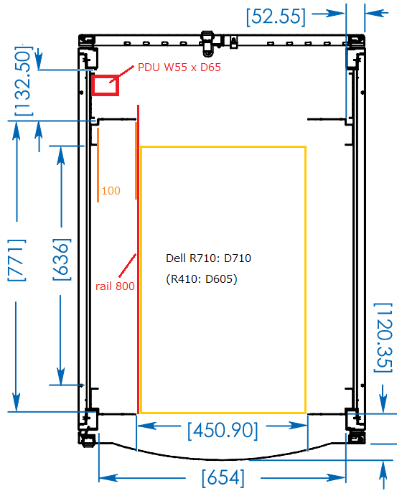
Unit registration – Space condition at CB2F
Unit registration of CB2F rack is tracked at SSN-00022. Current assumptions are as follows, which has ~20U in total, and we assume only one rack at CB2F:
Management and service resources
0U PDU (1 or 2)
1U KVM
System wide infrastructure
2x 1U Cisco network switch (rear side??)
(TBC) 1U patch panel
IIC computing resource
2x 2U iSCSI storage
3x 1U computers (Dell R410) for VM
2x 2U computers (Dell R710) for VM and NFS server
(TBC) 1x 1U computers (Dell R310) for database server
PFI control
(TBC) 1U AGCC host computer (extender fiber connection to PFI)
This is planned to be changed as VM client, but still under discussion.
2U MPS host computer (with GPGPU)
SpS control
Originally assumed to have 2-4U computer for IR readout, but nothing for now
IR detector is planned to be controlled from BEE, could use tiered storage but hosted at NFS server
No need for Cs (MCS)

Slide 94
Resource management – Support hardware
Direct access at CB2F (Subaru summit) is quite difficult as human resource management point of view, servability and/or maintainability from remote are highly recommended. For computing resources, operating system is remotely accessible if ssh is up, and hardware can be remotely manageable via Dell iDRAC, but it is also better to have redundant access (e.g. console access) to computing resources and remote monitoring and control on supplies to computing resources.
Conditions:
All of PFS resources are on PFS dedicated network (so-called PFS-LAN), which is routed at network switch by CDM.
Better to reduce SPOF, and having plans to monitor and/or control hardware failure by another route at minimum.
Power supply
(Controllers @ dome)
Facility UPS
PDU
Computers @ CB2F
Summit network
CB2F switch
Subaru summit facility
PFS

Slide 95
Trade (I) – Resource management
Control computers
Aim to enables maintenance operators to access terminals and also to shutdown power supply to computers.
Power: PFS plans to attach PDU to all control computers at CB2F
Power on by power recovery will be off, but WoL will be enabled for remote power on via PFS-LAN (or via iDARC could be possible).
Console: PFS plans to attach KVM (VGA+USB) to all control computers at CB2F
No serial console is assumed, uniform service is not possible since one (or some) of control computers is required to connect MLP1.
Also we need serial console server to connect these serial lines from remote, but it makes additional failure point as SPOF.
If some serial issue occurs on VGA output, we may have another option via iDARC as secondary operation.
Plan to have shared NIC for iDRAC port. Some computers have network port on iDARC, which could be connected for redundancy.
Network switch
Management VLAN (by CDM) will be fed to all PFS network switches via trunk port through switch at CB2F
telnet or ssh remote access will be enabled, but no serial connection.
The same as control computer, additional serial console server could be a SPOF.
Accessibility would be the same for all these connection.
Although serial console can have outputs during boot up, almost nothing could be gained from simply replacement
KVM
Plan to use 1U 16port KVM, one local console and two Ethernet ports / ATEN KN2116A (procured)
Vendor manual : https://pfs.ipmu.jp/docsrv/doc/Software/ICS/ATEN%20KN2116A%20KVM%20user%20manual
This KVM can send Ctrl+Alt+Del from remote console or client (Windows or Java).
One Ethernet will be connected to PFS-LAN network switch in the same rack, another could be connected to Subaru network for remote access.
To deal with PFS network switch failure, additional connection to Subaru network could be desired.

Slide 96
Trade (II) – Resource management
PDU
Plan to use 0U vertical mount type, 20 port outlet, 2 line breakers, and one Ethernet connection / ATEN PN7320 (procured)
2 sensors (1 temperature, 1 temperature + humidity) are attached from option, which can monitor environment in the rack.
Vendor manual : https://pfs.ipmu.jp/docsrv/doc/Software/ICS/ATEN%20PN7212-7320%20PDU%20user%20manual
Patch panels
PFS has instrument exchange at PF and Cs, and also may have reconnection to deal with hardware failure
Connection for Cs is just one fiber Ethernet link, which is reconnected only at auto connecter of Cs (others are permanent)
It is better not to access connectors on computers directly for cabling
Both connector safety (by making number of reconnections as less as possible) and not to access crowded cabling routes
Possible targets
Ethernet and PCIe bus extender fiber connection to PF
Fibers between OCB21 and PF top-ring are shared with HSC+ (MM only??), between OCB21 and TUE-Opt are dedicated? (TBC)
Reconnection is required at OCB21 on PF instrument exchange, no reconnection is assumed for works at TUE-Opt
No plan has been developed for when we bring PFI to the control building, but fiber cables are changed
To make points of exchange as less as possible, reconnection only at OCB21 is preferred??
Serial communication to MLP1
AG communication actor is assumed to run on VM client, and reconnection of serial line could happen
Host computer for this VM could be limited (e.g. only R410), so just small number of ports are required.
Cables could be managed to be easily accessible, and no extensive patch panel is not in need??
Or just pig-tail is fine?
AUX metal Ethernet connection for maintenance
Mostly not used, but better to have some for emergency?
SpS has AUX ports as its room design, and no need on AUX metal Ethernet patch panel within SCR rack
Number of required ports are not large, can be implemented in 1U
Like http://www.delock.com/service/document/463_industriemodule.html

Slide 97
Implementation plan – Resource management
power
Metal eth
Fiber
KVM
(others)
Facility UPS
reconnection
Control
computers
PDU
Summit network
serial
OCB21 panel
switch
PCIe ext
Fiber eth = TBC
MLP1 serial
Patch panel
Subaru summit facility
PFS

Slide 98
PFS ICS operation part
In this part:
This is a main body of software support part of PFS ICS infrastructure, which includes operational configuration, system operation and monitoring.
Requirements on performance are not yet fixed nor evaluated yet, PFS will show possibility to expand to cover evolving requirement and possible verification plans as ICS infrastructure part.
And is organized as:
Review items:
Database server and its replication/backup
ICS infrastructure status monitoring and defect detection
Procedure on instrument exchange
Discussion (open issue):
System alert handling (items to STS)

Slide 99
Database server and its replication/backup
PFS ICS plans to use database for both its internal operation and archive of non-image outputs especially for status and logs. Also on-site quick quality assurance and data reduction will put all statistics and results into database, whose SSP part are requested by science team to transfer directly (in schema-ed data format) to external SSP processing site(s).
In parallel to database definitions and their schema design, performance of database server is a key for instrument operation especially for data of internal operation.
This section is organized as follows:
Requirements and usage of database
Operational data
Status and log archive
On-site operation, backup, and replication
Performance requirement and verification
Optimization for database contents
Coordination for database server and replication

Slide 100
Requirements and Usage – Database
PFS database is planned to be on PostgreSQL and to be used for following three types of data:
Operational data, which are actively INSERTed, UPDATEed, and SELECTed during both instrument operation and maintenance
Database optimization is a key for this operation, especially for actively used tables for instrument operations like Cobra operation.
On-site data reduction is operated at Hilo, if we select one database for all of this operational data, we need to have bi-direction replication appliance to PostgreSQL server cluster.
Connection between summit and hilo is defined as unstable, by means of possible sudden disconnection, but operational activities are only at the summit and Hilo just do data reduction over FITS images transferred from the summit, there could be no need of standalone operation on both side at connection trouble.
We may divide operational database into two, which has master at a single side, and keep replication to be one direction. This causes lack of JOINability, PFS shall have detailed and extensive study on database scheme when we seriously consider this option.
Operational log and status from instrument operation, archived from ics_archiver connected to MHS and logger interface used in each actor, which are mostly INSERTed but also SELECTed for status monitoring over all time
Even instrument is standby, MHS and some actors are online and will generate status, such as continuous monitoring of camera system.
For system defect monitoring and trouble analysis, SELECTing with advanced WHERE conditions or full text searchability, especially for operational log, is a key, so PFS may need to think about switching to other database drivers for operational log (but not for status?), such as elasticsearch or Kibana.
System log from instrument such as syslog outputs, which are mostly INSERTed over all time, but are SELECTed for status monitoring on maintenance
Several web application exist using PostgreSQL on syslog typed database, but also we may be better to think about another database system with full text search integrated. Of course, there is several implementation of full text index based database store for PostgreSQL, and also several implementations to perform pre-analysis of syslog messages, and we may select these for simplicity of the entire system.

Slide 101
On-site operation, backup, and replication – Database
Database operation including INDEXing, WAL, storage or logging largely depends on its design (esp. individual database scheme), and need to be well defined following definitions of detailed database scheme. PFS plans to define with semi-real performance simulation on these optimizations, and also to test hardware implementations to achieve required performance, such as WAL on PCIe SSD, tiered storage, or design of index between overhead on INSERT/UPDATE and performance gain on SELECT with conditions. We already have extended simulation hardware with PCIe SSD at IPMU independent from ones planned to be delivered to Subaru, and have several simulations using multiple configurations.
PFS has only one storage server (RAID6) at the summit, to make backup of database effectively, PFS need to have another one to store backup data, such as local storage at database server computer (if we really have), or backup to Hilo by periodic data transfer or by replication. Data on the PFS storage server except for database have redundant data source, such as git repository for instrument control modules including their configurations, FITS archive for acquired data, but no redundant source is defined for contents of PFS onsite database. So (on-site) backup of database is a key for continuous operation, and need to be secured in at least one way. On this point of view, PFS plans/wants to have backup in following ways:
on-site backup to local storage of independent host (, or rsync backup from backup made to storage server)
Better to be done at both summit and Hilo
At summit, we may have small dedicated RAID1 storage on some host for database or service host.
Bi-direction replication (BDR) between summit and Hilo
This is also for operation of on-site QA, which are performed at Hilo following data transfer from summit.
If we plan to provide external view for maintenance or operation, this replicated database at Hilo will be an end point of access.

Slide 102
On-site operation, backup, and replication – Database
PFS plans to have two types of database backup as:
Daily binary backup (custom archive format of pg_dump) of database at noon time.
Used for operational data.
Number of tables which are UPDATEd might be small from the entire number of tables in operational data, so full daily backup only for selected tables could be an option, but gain will be small considering total volume of operational data.
PFS plans to have several (or up to ~ten) histories without any sampled old history.
PITR (and its backup)
Used for operational log and status log archive.
These are almost INSERT only operation, and their volume could increase to huge amount over ~10 year’s operation. Periodic full backup in short time span seems not a good option.
Basebackup could be performed when PFS is not in observation period. Its performance degradation is not an issue even with ~100GB of data volume.
Plan to use simple command for archive_command.
Target of this can point different storage server, and also can copy to multiple points. These are also an option for backup of PITR.
Planned replication and backup are shown in diagram next slide.

Slide 103
off-summit backup storage
summit
DB
backup
Status archive
MHS
Daily backup
(ICS)
db server
replication
db server
hilo
Daily backup
operation
DB
backup
hilo outside-DMZ
External access
Summit master iSCSI storage

Slide 104
Performance – Database
PFS plan to optimize database performance mainly by their design such as normalization and INDEX, especially for tables used during observation between two exposures, such as target statistics (TBC) or Cobra operation.
Required computing resource largely depends on results of optimization, at this point PFS plans with capability of upgrade when it found required. Current plan of replacement, which are also used as staged delivery on a phase of instrument subsystem delivery, are:
Run as VM client, starting from 2 cores up to 8 cores
If we need 8 core VM, we will think about migration to physical host.
Storage for database are mounted via iSCSI, local modification is just configuration files and scripts for operation/backup, and it is easy to reconstruct on hardware issue.
Even if this could work for semi-real operation, PFS need to do trade study between options including storage flow and redundancy level of VM operation.
Run as computer, starting from R310 (originally planned as database server), to other computers planned as VM host

Slide 105
Status monitoring and defect detection
PFS ICS plans to have a status archive via the MHS from instrument components, which contains operational or environmental statistics such as temperatures of cryostats, and to perform online analysis to detect hardware failure or fault. PFS ICS infrastructure plans to rely on these archive and analysis, but most of these are not connected to the MHS, and need to have another way to do.
In this section, status monitoring and defect detection on infrastructure are presented as following:
Status monitoring of computing resources
Syslog archive and periodic data collection
Alert acquisition and handling
Status monitoring of infrastructure
Status monitoring (e.g. SNMP)
Alert acquisition and handling
Defect detection
Status analysis
Push alert handling

Slide 106
Status monitoring of computing resources (I)
PFS runs many operating system on both virtual and physical computers, such as 12 detector control board computers at spectrograph modules, and mechanisms to monitor these operating systems are a key for smooth maintenance and troubleshooting. On this point, PFS plans to have logging infrastructure for both syslog type text message and periodic status acquisition. Logging of syslog type text message could be also used from the instrument control software, which use python logger modules and can output to syslog if configured.
Based on these requirement, PFS plan to have followings for syslog archive and periodic data collection:
Syslog archive is currently planned as postgresql in simple schema, but something specific like Elasticsearch or Kafka could be an option.
rsyslog has output modules for them (e.g. omelasticsearch), and there are several implementations of python logging output handler for these servers.
We may be better to have advanced viewer application for stored data in database selected from widely existing ones. Also configured Jupyter notebook could be an option for frequently used analysis, monitoring, and troubleshooting.
Periodic data collection is planned as munin, but prometheus is an alternate option.
Configuration could be a bit complex for Prometheus including making custom data acquisition module, but functionality especially for data analysis is quite extended.
Periodic data from instrument operation (telemetry monitoring) are recorded in MHS archiver database in its custom table format, and could be difficult to cross analysis between two data store. But operational data are mostly archived into MHS archiver, and only statistics of computing resources are logged to this data store, so possibility of cross analysis could be small.

Slide 107
Status monitoring of computing resources (II)
Except for “alert” (or “warning”) flagged status from syslog format, alert acquisition and handling is analysis based event.
For periodic status acquisition, PFS plans to use similar error detection system as one planned for instrument operational status to arise warnings or alerts on irregular trends or pre-defined thresholds, such as vacuum pressure and temperature of camera cryostats, flags of valve operations.
For syslog based text messages, PFS does not have plan to analysis (semi-)realtime for alerting, but plans to archive just for further reference of troubleshooting or maintenance. One possible (easy and low load) implementation is just to check level of flags attached on pushed messages with periodic monitoring over archived data into log database, and to arise alerts as messages to the MHS.

Slide 108
Status monitoring of infrastructure
Status monitoring of infrastructure is based on the same logging infrastructure for computers, but we need to have converter from SNMP (reading status) to periodic data collection. PFS already have ones for munin plugins, with identification of OIDs to be monitored, so it is easy to convert these plugins to other platform or to configure a platform with capability of SNMP communication.
Several network connected supply hardware provide SNMP trap for arising alerts, PFS plans to run a module which accepts SNMP trap and proxy to the MHS as status or as defined command to sequencer(s) or modules, such as event of failure of UPS which PFS need to take some action to keep functionality or security.
These modules are planned to run in a VM client at CB2F, but we need to have special care on power failure mode for SpS. After CB2F ICS infrastructure turned down, SpS turns into standalone mode, and any monitoring or alerting need to be handled locally at SpS. For these, we will plan to have backup handler (or just a copy instance at SpS for standalone mode, like backup MHS) for SNMP trap to check notifications from PFS SpS UPS, or to find another way such that frequent periodic status check via SNMP or something.

Slide 109
Defect detection
Planned defect detection in PFS ICS for instrument status archive via the MHS are:
Threshold based alert
Trend based alert, using running mean (or MACD) with deviation rate or difference
and alerts are to be decided by pre-defined value from each hardware component. Pre-defined values could be added during operation and/or maintenance.
In ICS status/statistics monitoring, we plan to use the same mechanism, so these thresholds need to be defined during instrument performance verification and also ICS hardware integration/commissioning at Subaru.

Slide 110
Procedure on instrument exchange
PFS has subsystems at telescope focus (PF, Cs) where instrument exchange works happen, and needs to have plans for shutdown and startup procedure with connection/disconnection. In this section, items to be defined are listed for each type of subsystems’ exchange. For each of Cs and PF, plans are presented as following:
Cs – instrument exchange between Cs and stand-by
PF
Installation/Removal to/from top ring and TUE-Opt standby
Maintenance at TUE-Opt or control building (PFI removal)

Slide 111
Cs – Instrument exchange
There is no hardware reconfiguration on instrument exchange works at Cs, since fiber connections are permanent at both side – two fibers are permanently connected to CB2F PFS network switch and reconnected by instrument frange at Cs. So, only thing to be performed on instrument exchange works are:
To shutdown Cs control computer
Remote shutdown is possible via the MHS
ssh access is also an option
To startup computer and subsystem control module.
PFS shall plan to enable autostart for S1, or WoL
WoL could be invoked via the MHS from control panel
Need to have a capability to check MCS (Cs) is working (connected to the MHS) easily at console for Cs instrument exchange work (or at control room?).
PFS does not plan to remove components within Cs container, and external interface (e.g. power, network) is fixed as a set at Cs instrument frange. But one possibility is to test Cs container at the dome floor, where PFS need to get temporary fiber connection between CB2F and Cs container.

Slide 112
PF – Instrument exchange
For ICS infrastructure, we need to switch following connections at instrument exchange between TUE-Opt standby and PF:
Network MM fibers (2 pairs): reconnection at OCB21 is assumed
PCIe bus extender SM fibers (2 pairs): reconnection at OCB21 is assumed, also reset on PCIe bus extender board at host computer could be required (TBC)
For control computing resource, most of components at PF are fine to plug-in/-out power without operation of components (except for CalLamp control board computer, but design is still TBD), only thing to do is to check connection and control of hardware components in PFI from instrument control modules. Connection for these are over network or by USB, and are not require complexed hardware communication like PCI bus (one exception is PCIe bus extender for USB devices), so we don’t assume hardware operation on instrument exchange work even for CB2F infrastructure.
For maintenance at control building (assumed place is a lab at CB3F), we need to have all four fiber connections between the lab and CB2F to run instrument control software. Another possibility is to have required number of VM hosts, host computer with PCIe bus extender, and PFS-LAN connection. If we can have a spare, or bring one (or two) computers from CB2F to the lab, to have one connection of PFS-LAN at the lab could be easier for wiring point of view.

Slide 113
Discussions III – System alert handling

Slide 114
Maintenance part
In this part:
Emergency handling and recovery plans on power failure are presented.
And is organized as:
Review items:
Procedures for power failure detection and handling
Discussion (Open issues):
Redundant power supply with DG backedup at CB2F

Slide 115
Procedures for power failure detection and handling
PFS has distributed subsystems over four places at the summit, communications and system activities are required to be controlled following events of power failure. PFS ICS infrastructure itself does not need to consider of subsystems, but most of operation depend on the infrastructure, power failure handling over the entire instrument is required to be developed in close connection with PFS ICS infrastructure.
In this section, both detection and handling by PFS of power failure are presented as following:
Power failure detection at each subsystem
CB2F computing resource
SpS including PFS-UPS
Power failure classification and handling
Mode I to IV
Subsystem shutdown and recovery procedure

Slide 116
Power failure detection (I)
Subsystems of PFS are distributed to several places over telescope and dome, and are controlled by instrument sequencer hosted at CB2F. For long term power outage at a supply to Subaru from commercial line, diesel generator (DG) backup is placed but most of these subsystems are not on the DG. Only PFS SpS (spectrograph system at TUR-IR) is on the DG (but without facility UPS) and has its own UPS to backup critical components including cryocoolers of dewars. Others need to be turned down on events of power failure or on when PFS decided to turn into shutdown mode.
Subsystems at PF and Cs are backed up by facility UPS, but operation can (or need to) be stopped right after an event of power failure since telescope operation (tracking) will stop on power failure. This shall be done from PFS instrument sequencer but not by self detection.
PFS has following possible power failure detection points:
Notification from Subaru to OBCP
At the point of power failure, Subaru will notify PFS OBCP for power failure.
PFS CB2F computers do not have its own UPS, but rely on facility UPS. There is no information of remaining time of facility UPS, but can just assume.
PFS SpS UPS
Supply line of SpS UPS is connected to DG backedup commercial line (via facility power distribution panel), which can detect power outage of its supply, but cannot determine whether source was from commercial line or the DG.

Slide 117
Power failure detection (II)
Following these considerations, power failure detection plans of PFS are:
Commercial power outage, by notification from Subaru to OBCP
At this point, full PFS ICS are working (for normal operation, especially on observation), and message distribution from PFS ICS sequencer via MHS is possible to the entire instrument.
Subaru DG drain, by power outage detection at PFS SpS UPS
Power outage event detected by PFS SpS UPS has two means, commercial power outage (before DG starts) and DG outage, we can determine these two using several way:
Check Ethernet connectability (link up) between network switches of SpS and CB2F
CB2F network switch is a next hop from SpS switch, will up on power recovery at CB2F from commercial power supply, and can be an identification of power status.
Rise/Down a flag of power outage status from CB2F to SpS control computer
This needs a reset of flag on recovery of commercial power supply, which could cause side effects on unstable commercial power supply, like severe weather at the summit.
From these events and considering instrument operation, PFS defined several levels of power failure modes:
Mode I: glitch
Mode II: commercial power supply outage for several minutes
Mode III: DG running
Model IV: shutdown mode of spectrograph cameras

Slide 118
Power failure mode I - glitch
“glitch” is actually not a power failure, voltage will not fall down to 0V, but will be effectively low voltage (normally to 80% level in Japan) for short time up to ten cycles.
This mode will not happen UPS-ed power line, like PF (POpt2) and Cs
TUE-Opt stand-by backed up by UPS-2 (+DG)
PFS SpS (TUR-IR) is mostly backed up by PFS UPS
PFS cillers and rough pumps for cameras are not on PFS UPS, could stop on this mode
Ctrl. Bldg. 2F is backed up by UPS-3 (w/o DG) (or we also bring our own, as others)
Situations / fatal events will be happen
No impact on observation – telescope will continue working
Need to continue instrument operation – regardless modes (exposure, configuration)
Actions / considerations required
Develop procedure to check statuses of SpS modules (chiller etc.) and to recover if any issue happened.

Slide 119
Power failure mode II – several minutes
As for telescope operation, power failure of several minutes level will be covered by dome-UPS (UPS-1 and UPS-2; CVCF), but dome rotation and tracking will stop. Instrument need to be operated without failure, but “active” operation like exposure or moving parts need to be finished or suspended as soon as possible after power failure detected.
Situations / fatal events will be happen
Dome co-rotation and telescope tracking will stop
Dome-chiller will down until diesel come up
Actions / considerations required
When to give up this mode, and to switch mode III – Time based or event based
Operations to be taken
Stop exposure – close shutter, read detector
Turn off illuminators – fiber back illuminator (science, fiducial), calib. lamp etc.
Stop fiber configuration procedure (not to issue next command to MPS)
Keep PFS backend (infrastructure) functionality until FITS finalized if under exposure
Stop AG camera for thermal protection (no glycol flow to HEX)

Slide 120
Power failure mode III – ten-odd min to several tens of hours
After diesel generator (DG) came up and stabilized, MDB-2 will run with DG power. Dome chillers (in operation after DG supplied) and some part of telescope (drives on) will remain in operation, others like dome air compressor will be off to reduce load on DG.
Situations / fatal events will be happen
Instrument control computers (CB2F) had gone
No control on PFI
Dome chillers return on diesel came up (hopefully)
Operations to be taken
PFS ICS infrastructure at ctrl. bldg. 2F need to be down before this mode
PFS-LAN, shared storage, database server, heartbeat system will down
MHS VM (+ e.g. telemetry archive) need to start running on SpS infrastructure
Subsystems (SpS modules) are operated in stand-alone mode
shutdown non-emergency items
Turn off outlets of PDU – for required by control box, e.g. ENU control box
Monitor dome chiller glycol supply temperature at SpS chiller

Slide 121
Power failure mode IV – more than several tens of hours
Diesel backup will go away after several tens of hours from power failure. PFS need to shutdown all subsystems before it.
Situations / fatal events will be happen
All power will down
No monitoring will run at SpS, PCM will take programmed operation following command by PC104
Even if we run PC104 by battery, no connection between PCM and PC104 is active
Actions / considerations required
Who (system) to decide to shutdown? – need control at SpS floor
No way to get diesel status? e.g. remaining time. DG down will be detected w/power.
PFS-UPS at IR3 will be for shutdown, batteries in racks for keep heaters and PC108 on.
Operations to be taken
Shutdown control computing resources
Stop cryo-cooler, warm-up detectors by heater (TBC)

Slide 122
Summary – Operational flow on each power failure mode
Power failure detection
Will follow “official” procedure of Subaru, also we have some mechanism via UPS etc.
Immediately after power failure detected
Stop operational commands in execution
Close shutter and readout detectors, finalize data (CCD/IR)
Decision to switch to subsystem-level stand-alone mode
After operational commands finished
CB2F controllers need to be successfully shutdown before UPS out
Staged switch could be possible – depends on timeline
First, shutdown subsystem controllers , whose start-up time is short
Telescope may not be recovered immediately after power recovered, we have time
Subsystem-level stand-alone mode
PFI have no controller, Cs/MCS could be down right after stand-alone mode
SpS need to change operational mode (shutdown un-emergency items)
System shutdown (final)
SpS subsystems will be the one

Slide 123
Operational flow on each power failure mode - timeline
Power outage
Event + 5-10min
Event + 1-3days
UPS-3 active
UPS active @ CB2F (UPS-3 or PFS-UPS)
UPS-1,2 active
diesel active
dome chiller down
Stop AG
PFS-LAN down
Finish COBRA operation
Finish detector operation
Stop illuminators
Shutdown MCS computers
Shutdown subsystem controllers @ CB2F
Shutdown system modules
Shutdown CB2F physical servers
SpS-chiller non-backup by dome-chiller
SpS cooling active
Stop turbo pumps
Detectors warm up
Stop exposure, exec readout
Shutdown ENU, FMS
Shutdown cryocooler
Start SpS emm heartbeat?
Shutdown SCR
Standalone xCU PC108
Decide to standalone
Subsystem @ standalone
Decide to shutdown (SpS)

Slide 124
Subsystem shutdown procedures and remarks I
Control computers for PF (PFI) are hosted at CB2F, although are hosted locally for Cs and SpS. Subsystem shutdown procedure need to be developed with power down of components and their control computers considered.
Requirements on instrument hardware components are:
PF
AG camera need to be idol on facility glycol down (internal operation)
No remote power down procedure is required, including Cobra FPGA, USB controller and extender, . Can unplug power when not running.
Cs
Control computer need to be shutdown locally, no remote power down operation is required for other components.
SpS
SpS itself develops a procedure on power failure.
Shutdown procedure for PF and Cs will be:
PF
Stop cameras (both AG, FFIS camera) and illuminators
Wait to finish executed queue to COBRA system (MPS)
and shutdown (or wait for power to disappear)
Cs
Shutdown control computer at Cs container

Slide 125
Subsystem shutdown procedures and remarks II
Control building 2F (CB2F) is backed up by UPS-3 but without diesel. PFS will bring PDU, UPS of PFS dedicated need to be considered depending on timing, since we will have key infrastructural modules for operation at CB2F and need to care on procedure.
Key modules
Network switch : if down, we cannot reach to any subsystem
Storage server, database server, heartbeat system, VM server, MHS server
Operational modules
Subsystem controllers : AGC, PFICS, MPS
System modules : IIC (master sequencer), logging system, Gen2 connection system
Possible procedure
(decided to move mode-III, and to start shutdown procedure)
Wait to finish subsystem commands – FITS finalization, COBRA operation, lights off
Shutdown operational subsystem modules AND send “standalone” signal to subsystems
(after hardware operation finished; but shall be finished within “decision” period)
IR SAM / CCD-BEE control : readout, finalize up-ramp to FITS files + sending to Gen2
PFICS, MPS : stop by commanded COBRA move finished
Shutdown system modules : IIC, logging system, Gen2 connection system, MHS server
For VM clients, check via virt remote interface, and execute shutdown (or even destroy) on virt for ones remaining up
Start backup MHS and logging system at SpS
Logging target need to be considered and prepared, since PFS database server is down at this phase.
Shutdown infrastructural computing resources (servers) : VM, database, storage
Make network switch remain operation, until UPS power down
From previous events, DG will up at all events, so PFS assumes no deadlock of event detection between DG and UPS.

Slide 126
Subsystem startup/recovery procedures
Once PFS started sequences for power failure, control systems will be in an irregular state than normal power on/off procedure. Also power supply may be back suddenly before instrument checked by operator, we need to be care of hardware safety conditions with disabling power supply before power cut procedure and so on. Also for the same reason, PFS does not plan to recover automatically without any inspection by operator after sequences for power failure run.
Detailed analysis and procedure developments are required for each subsystem, especially for SpS. In this part, just show current plan for computers at CB2F.
Items need to be checked or considered on recovery procedures are:
Check SpS operation condition, backup MHS etc. are working or not
Replace backup system to normal system, and migrate data logged at backup system to normal system.
Start support software modules, including PFS ICS sequencer, before starting instrument control modules

Slide 127
Discussions IV – Power supply at CB2F

Slide 128
Hardware delivery to Subaru
PFS will bring hardware for ICS infrastructure to the summit and mostly installed to the CB2F (note1: except for SpS so-called “distribution” switch at TUE-IR; note2: computing resources at Hilo for on-site DRP and some remote access components are not included in this design). These hardware delivery are planned in staged delivery to the summit, but are required to be prepared at point of delivery of each instrument component.
In this section, staged hardware delivery plans are described.

Slide 129
Items to be delivered
Followings are hardware items which the project (or Subaru) need to prepare or deliver to the summit, and subsystems use these items.
Requirements and plans for preparations per each point of preparation/delivery are listed from next slide.
CB2F (Control Building 2F)
Rack to host items (Subaru): before all of followings
Assumed deepest unit is ~760mm (MPS) – note: ~650mm (DB host), ~700mm (VM host)
Network switch (IPMU; already in hand): (at least) 1st at SCR, 2nd at MCS
ICS RAID6 storage (IPMU; already in hand): SM1
MCS data store could be done with small network storage or even at local?
VM host computers (IPMU; some already in hand)
(at least) 1 at MCS (any subsystem delivered to summit) – to run MHS
Others depends on system load
Serial communication (MLP1; IPMU) host: PFI
KVM, PDU etc. (IPMU; some already in hand): SCR – on point of first host delivery
DB host (IPMU): SM1??
SpS (both IR3 and TUE-IR)
5th rack (from JHU): SCR
Network switch to connect CB2F (IPMU; already in hand): SCR
UPS and power supply (Subaru): SCR
1U host computer @ 5th rack (IPMU; spec TBD): SCR
Telemetry devices/system (TBD): SCR (or SM1)

Slide 130
Points of preparation and requirements
Following are assumed instrument subsystem delivery to Subaru and items required to run each subsystem.
Preparation for SpS/SCR (2017/Q2)
PFS need to have connectability to SpS (TUE-IR) through CB2F, need to bring minimum set of infrastructure at CB2F
We will not need full set of control system at SpS for SCR commissioning, we just bring minimum set of computing hardware and will increase items for commissioning when something is found to be required for testing or real operation.
Preparation for MCS delivery (2017/Q4)
MCS will be tested locally at observation floor or at standby port, but we may need core of CB2F ICS servers, such as MHS and support modules, for system verification of MCS.
Preparation for SpS SM1 (early 2018)
To accept SM1, we need VM hosts with storage server at CB2F and full set of computing hardware at TUE-IR including control of support hardware such as UPS, telemetry on supply lines, and control of chillers.
Preparation for PFI (late 2018 – early 2019)
PFI delivery is assumed to be the last one of delivery, except for remaining SMs.
At this point, all hardware need to be delivered.

Slide 131
Setup to accept SCR
In parallel to build SCR (Spectrograph Clean Room) at TUE-IR (IR4), we need to have control hardware for SCR.
19” rack at CB2F to host CB2F control hardware
1st network switch at CB2F (IPMU; already in hand)
might only need 1 SFP to SpS, but better to have all four connections and check working at this moment
SCR control host computer is planned as static IP configuration, we may not need DHCP server at CB2F
Network switch at SpS (IPMU; already in hand)
5th rack (from JHU)
UPS at IR3, with power distribution/panel (Subaru)
1U host computer (also for SCR control) (IPMU)
Attached PCIe extender for mounting control boards for SCR facility equipments.
Telemetry devices (TBD)
e.g. Lakeshore temperature monitor and sensors (ref. tiered monitoring system on SCR environment)
At this point, we need full power distribution system to supply spectrograph, both UPS and power panel w/ cables, since it is quite difficult to add power lines to SCR. Environment active control subsystem for SCR shall be considered as a part of SCR, such as HEX or , so not listed here.
For network and storage, we only need “connected” at this point, so performance evaluation on network in parallel to SCR preparation (or validation) is fine. But to run MHS and support modules, we rely on VM infrastructure, we may have options like building minimum set of CB2F infrastructure or temporary system for VM host/client.

Slide 132
Setup to accept MCS
MCS will be installed as Cs instrument, although we plan to test at observation floor for initial moment which may not be connected to PFS ICS infrastructure. So, for point of delivery of MCS, we assume to have minimum operation hardware at CB2F, including PFS network.
PFS network switch (at least 1; IPMU; already in hand)
Also connection to subaru’s core switch
VM host (IPMU; 1 already in hand)
Hosting administrative VM, e.g. dnsmasq
KVM, PDU (IPMU; already in hand)
At this stage, no special care for power distribution is required, only like connecting things to PDU at CB2F. Also network is simple, we need two fiber connection to Cs and its standby (one active, one backup), one connection to subaru core switch with routing.

Slide 133
Setup to accept SM1
Before we have SM1 at summit, we need almost all of hardware.
ICS RAID6 storage (IPMU)
VM host computers at CB2F (IPMU)
To run full of MHS and support modules, and also FITS data transfer system.
DB host (IPMU)
Not as full operation (e.g. interaction with ETS or survey coordination), but to store MHS status archive or telemetry etc.
Before this point, PFS network and storage need to be fully prepared and validated on performance point of view (for NCU1 operation).

Slide 134
Setup to accept PFI
Most of computing and power resources need to be active well before delivery of PFI to the summit.
Full set of VM host computers at CB2F (IPMU)
If we will run PFI control software modules as VM client, we need to bring full set at this point.
Serial communication (IPMU)
This communication will be validated at factory of melco (Mitsubishi; at Amagasaki) in test setup.

Slide 135
General Discussions
General discussion over the entire review.
Discussion items in this presentation (again):
Network connection to Subaru (data flow, V-LAN)
Access control to/from PFS network
System alert handling (items to STS)
Redundant power supply with DG backedup at CB2F
Closed subnet in SpS/ENU for subcomponent control

Slide 136
Backup or copied materials to be used

Slide 137
Updates/Progresses – shared infrastructure
Communication fibers at Subaru have tested and passed
Mostly by real data flow, except for 1Gbps SM fibers (OTDR)
ICS storage performance have verified with simulated 4 H4RG data streams
Simulation configuration: Storage – NFS server – 4x data generator
Achieved ~2.3Gbps file write, enough for 4 H4RG data streams
ToDo
Need some consideration on network configuration
More realistic test (e.g. having both read/write) could be better
PFS-LAN network host stage for configuration and stability passed
Using real hardware to be used on-site
Some management configuration will be modified by Subaru (CDM) after delivery
ToDo
Connection between PFS-LAN and Subaru network is not fixed yet
Data backup procedures (e.g. DB) are in production at pfs servers
Virtual machine servers for ICS components are under host stage at IPMU
Dell R710 (2U Xeon E5506) x2, R410 (1U Xeon E5640x2) x3, R310 x1+ backup (2U x2)
4 port Gbps NIC

Slide 138
Host cluster ToDo
Verify iSCSI storage performance with more realistic configuration
Currently only write from 4xH4RG simulator – NFS server – iSCSI storage.
Better to verify with running VMs, DB connections, with some data read/write (incl. sending up-the-ramp to Gen2)
IR data handling
Original plan was host control computer at CB2F with large memory, which will do all for data management
Read directly from SAM over 1Gbps network
Save up-the-ramp FITS (single 2D HDU) to storage, and on memory
Build final FITS file from data on memory (no read stream from storage for this)
Currently, BEE reads data from SAM via USB, and saves to storage
Something other need to care of building final FITS file etc.
Verify VM operation performance
Mostly tested using PFS server cluster at IPMU for pfs.ipmu.jp
Integration of PFI control into VM cluster
Need to check PCI passthrough performance and capability for PCIe extender.
Or USB mount could work?
Check network bandwidth requirement (for shared interface)
Host maintenance operation
Health check with iDRAC etc.

