Slide 1
SpS SCR cabling and Cutouts
PFS SysEng study note – PFS-SE-IPMU-00016-002+
PFS Project Office
2016/09/15
Updated per discussion at JHU @ 2016/09/07
Added cutout ICD and size of cutouts for cable

Slide 2
Introduction
Backgrounds: Subaru has placed contracts with a vendor (signed on Aug 2016) to build SCR for PFS SpS, and the design studies of SCR panels are supposed to finish under this contract in Oct 2016.
Even after the installation of SCR (expected around Mar 2017), minor modifications such as tapping mount holes will be possible by ourselves, but we need to implement major features such as cutouts for cables in the design by Oct/2016. Then we also need to finalize cabling details by the end of 2016, for the actual installation process expected mid 2017.
Outline of the following slides:
Overview of the structures of SCR
Cutout for SM control cables (electric, vacuum, dry air, glycol)
Cutout for SCR control cables (electric, dry air, glycol)
Manifolds and telemetry sensors for vacuum, dry air, and glycol
Fiber cable B (FCB) to SM from IR3
ICD of cutouts on SCR panels (wall, floor, and ceiling)
Size of cutouts for cable to SMs on 2nd layer of floor

Slide 3
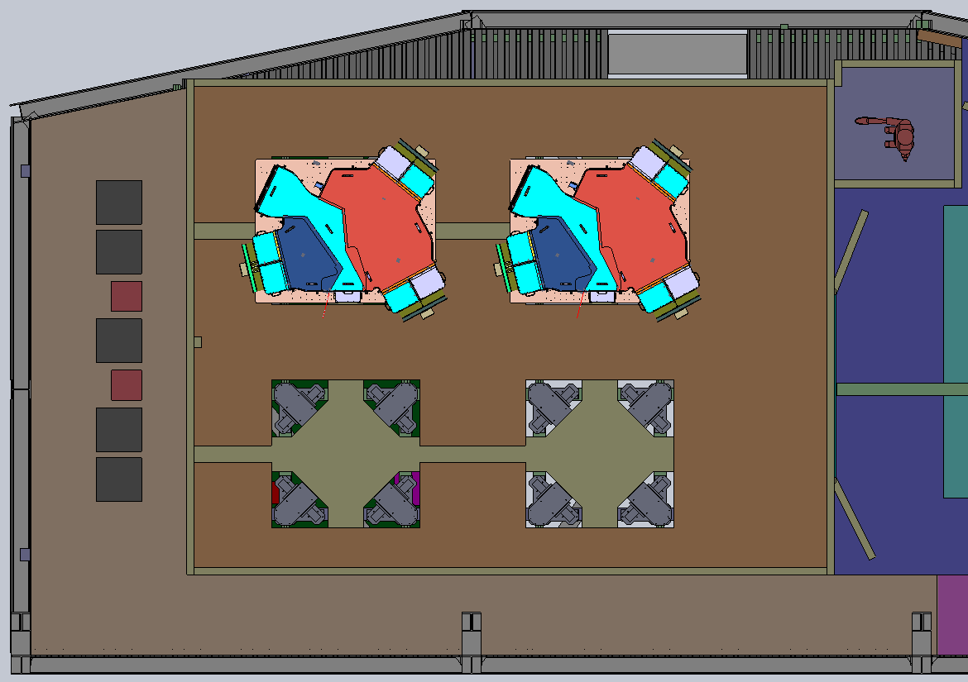
Overview of SpS/SCR – top view
SpS SM
Rotated by 180degree for lower two
SpS racks
(4 ENU+1)
xCU Rough
pumps (2)
SCR wall
SM bench support + ERS

Slide 4
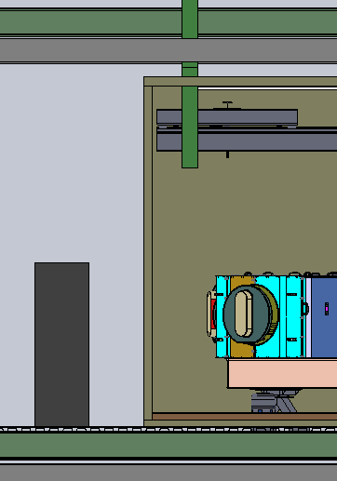
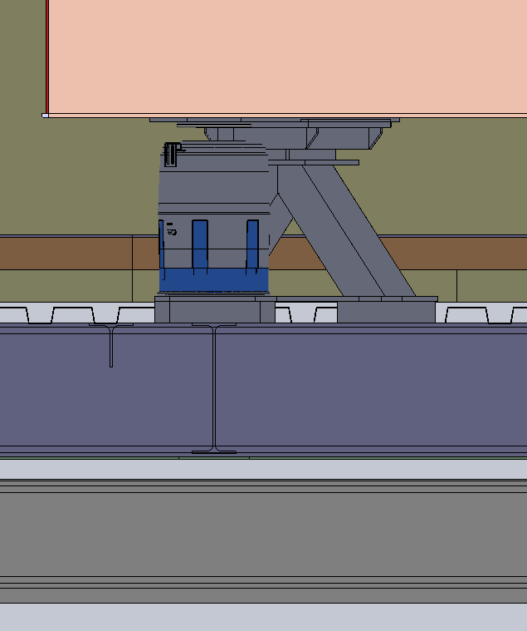
Overview of SpS/SCR – side view
Al plate, t6
2nd layer floor panel, t75
1st layer floor panel, t75
Corrugated flooring
t38.1
IR4 floor existing beam
Dome frame beam
Each panel (floor, wall, ceiling) is consisted of foam covered with thin metal plate (~t1) on both side.

Slide 5
Cutout for SM control cables (I)
Current designs/assumptions and restrictions are:
Two cutouts in total are implemented on the 2nd floor panel
Cables for two SMs share one cutout.
Cables from ENU racks (1st-4th) do not branch toward each hardware mounted on SM.
Some ENU cables can be no longer than 10m.
Other cables branch below SMs
Vacuum lines to rough pump are permanent.
The clearance from the top of Al plate to the bottom of SM bench is ~260mm (branches, manifolds, etc need to be fit within this).
Aux cables (power, ethernet) come from the 5th rack but not to cutouts for SMs
Terminals of connectors are on wall, but not under bench.
Working area to wall is close and could have extension cable to connectors at wall.
No cable cover are assumed between the bench and the floor
Just hanged and be tighten on bench and/or floor.
Cable management structures are installed under the bench on 1st floor or al plate
Within the tickness of 2nd floor (below Al plate over cutout? – do we have?)
Floor cutouts
The 1st layer panel has windows for SMs (including ERSs).
The 2nd layer panel has the same windows as the 1st layer and rectangular cutouts (channels) for cables in addition.

Slide 6
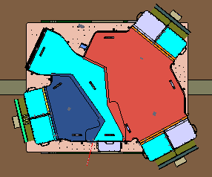
Cutout for SM control cables (II)
Destinations of cables at SM:
Red: FCA
Light blue: ENU (2 ports)
Orange: xCU (3 cameras)
Electricity
Vacuum for turbo pump
Compressed air for vacuum valve
Compressed or dry (or N2?)
Glycol for piepan, ion pump
Below SM
Compressed air for anti-vibe system on the cameras
Note: The “lower” two SMs (see the figure on the left) are 180 degree flipped in orientation with the same port positions as the other SMs. This is to make cable length of FCAs as the same as possible from SRB-II below floor at the center.
“Lower” two SMs

Slide 7
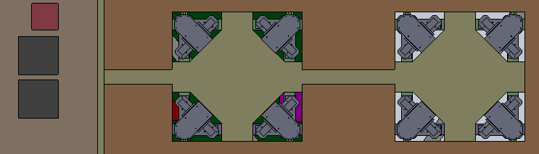
Cutout for SM control cables (III)
Red lines indicate the proposed cabling routes:
Going around the support structures of the SM bench (ERS, legs, etc)
Routing and cable wrappers on the 1st layer panel (i.e. in the cutouts of 2nd layer)
Need to check the length of cables for ENU (blue connector panel)
Red dashed lines indicate cable wrapper on Al floor
SM benches are wider than cutouts on 2nd floor, wrappers are not protruded
Light purple boxes: Manifolds (one for glycol, one for vacuum), valves are TBD
No ports assumed around SM benches.

Slide 8
Cutout for SCR control cables (I)
Current designs/assumptions are:
Items
Room light / ceiling / power, remotely controlled
HEX and circulation fan / a mid height on the side wall / power, glycol, dry air?
Telemetry (temperature, humidity) sensors / on the side wall / power, remotely control/monitored
Safety sensors (CO2, light detection) / on the side wall / remotely controlled/monitored
Remote sensing camera / on the side wall / power, remotely controlled
Make one window on the side wall to feed the cables in.
Route the cables from the ceiling down to the components (at the center of room)
40mm for cabling with cover/tray on ceiling.
Route glycol and dry air lines to HEX on the floor (since the pipes are heavy)
Have a patch panel to plug power and ethernet cables on the side wall.
At 4 corners and middle of side wall, at lower side.
These will be routed on the floor (as same as glycol/dry air lines) but not at ceiling?
So, we will route the cables mostly on the side wall panels just with small cable cover or cable tie, but we will not need any cutouts except for the window to feed the cables into SCR.

Slide 9
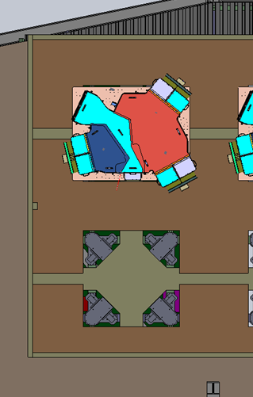
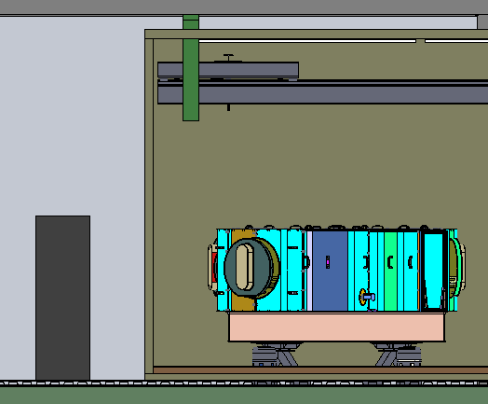
Cutout for SCR control cables (II)
Cutout on the wall
(nothing at 2nd floor?)
Cable wrappers on floor
Terminal panels at wall

Slide 10
Proposals of manifolds and telemetry sensors for vacuum, dry air, and glycol (I)
Vacuum
Emergency closing valve at power failure nearby roughing pump (outside SCR)
No external control/monitoring, just connecting AC power supply for power failure monitoring by this system
e.g. https://www.mksinst.com/product/product.aspx?ProductID=439
No valve near any ports under the bench: direct connection to turbo pumps.
Air
Compressed air for SM bench support
Breakout without any valve or sensor under SM, to 4 legs of each SM
Breakout to two at outside SCR (into 2 cutouts) from supply
Dry air (air, not N2; TBC) for xCU vacuum valve and SCR humidity control
For SCR humidity control
TBD: just feed at somewhere in SCR or feed at HEX? Also breakout to all HEX if we have multiple HEX in SCR?
TBD: Do we need a remotely controlled flow regulator (open/close) for humidity control of SCR?
For xCU vacuum valve
dry air need to be regulated to specified pressure (TBC psi)
No remote control required to xCU vacuum valve lines (controlled by valve itself)

Slide 11
Proposals of manifolds and telemetry sensors for vacuum, dry air, and glycol (II)
Glycol
Two chillers at IR3: one for SCR HEX (temperature control), one for SM heat removal
Have manifold nearby HEX at IR3, into 2 (or 4?) lines for SCR HEX, 4 lines for SM heat removal
To SM
One manifold with ~8(-10) ports per each SM (both supply and return)
Connection to xCU ports by connector having a valve that is automatically closed when disconnected.
Flow meter on glycol pipe at both supply and return right before manifold
Temperature monitoring sensors at both supply and return after manifold to components
Valve to cut glycol supply by hand on emergency before manifold to components under bench
To SCR/HEX
Control of HEX by changing fan speed (and glycol temperature?), but not by glycol flow rate
Manifold to multiple HEX at outside SCR
Flow meter on glycol pipe right after the breakout outside SCR to supply and return
TBD: Do we want to have temperature monitor also?
General
Manifolds and sensors under SM benches are mounted on 1st layer floor panel.

Slide 12
Manifolds and telemetry sensors for vacuum, dry air, and glycol (schematic diagram)
Subaru
IR3
Flow meter
Valve
Temperature monitor
HEX
SCR
HEX
HEX
HEX
Next SM
Racks
cryocooler
Emergency close at power failure
Piepan
Rough
pump
Turbo pumps
Air
xCU
SM
Bench legs
IR4

Slide 13
Fiber cable B from IR3
We will have SRB-II for FCB on IR3 (in fact, a mezzanine near the ceiling of IR3), and route the cables into SCR (and to gang connectors on SpS/SM bench) through some cutout/hole of SCR floor.
We may have two options:
Have a dedicated through hole on 1st/2nd floor, around red circle below
Have a dent at corner near gang connector, around blue circle below
Having a dedicated through hole could cost both manufacture and operation (hitting by cart etc.), but since gap between IR4 floor structure and edge of 1st/2nd floor holes is around 50-70mm, we need a dent to make gap wider. We need to have a guidance on required minimum space.
What if we make such a through hole inside the large window (see the blue oval below) that is more or less matched with the location of FIA at the bench?

Slide 14
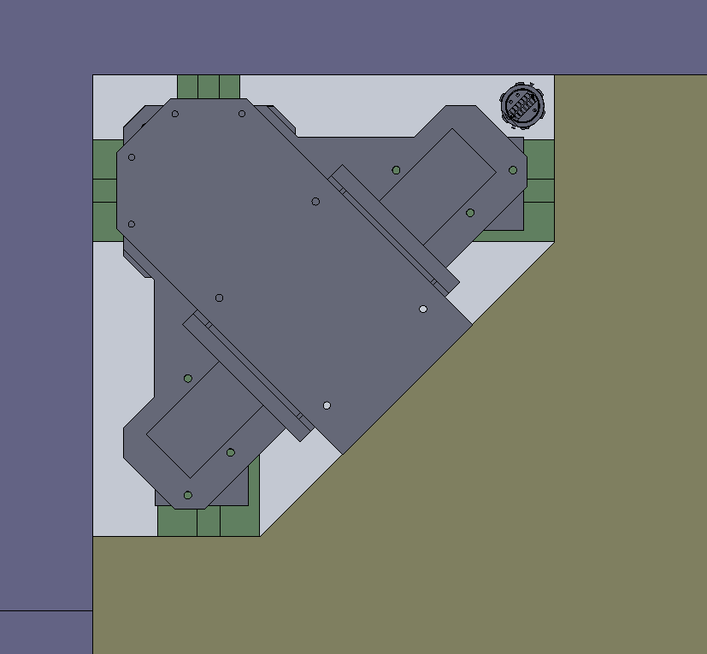
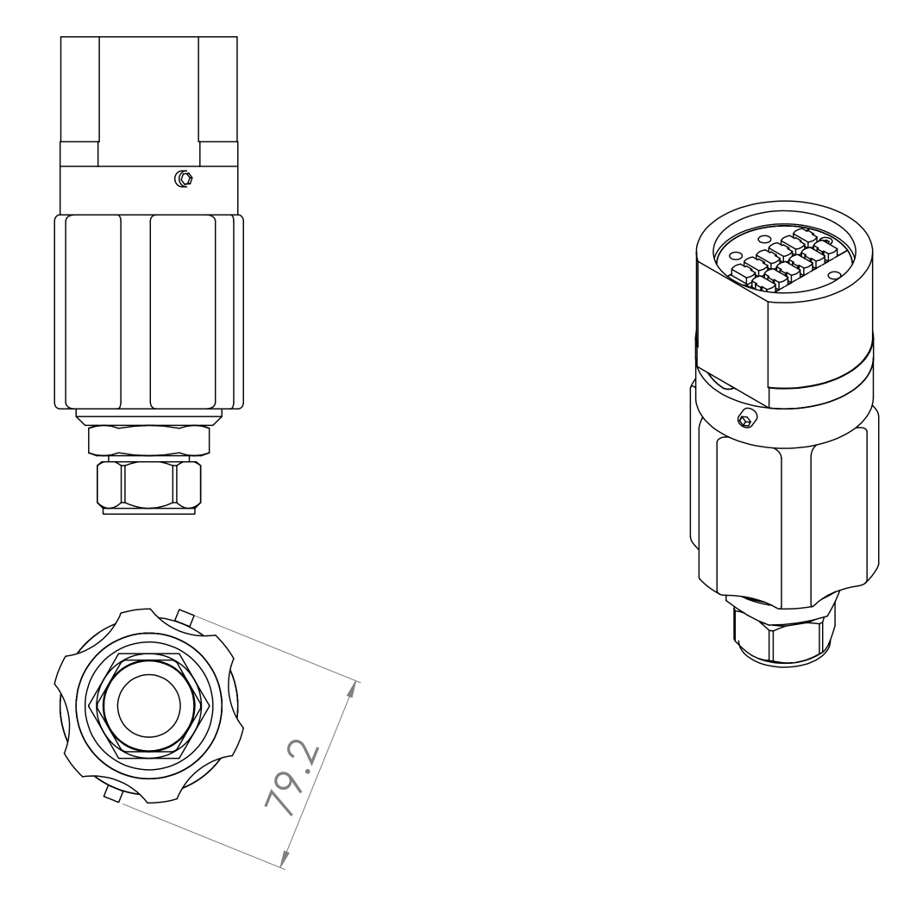
(Note: size of ERS cutout and FCB gang connector)
128
101

Slide 15
ICD of cutouts and cable managements on SCR panels

Slide 16
List of cutouts
Wall
Wall door, entrance
Cable outlet (two for 4 SMs, one for 5th rack)
Ceiling
Crane mountings
Floor
1st floor (bottom)
Cutout for 4 supports per SM, 16 in total
Cutout for 4 FCA outlets
2nd floor (upper)
Cutout for 4 square area under SM benches
Cutout for cable tray for 4SMs
Cutout for 4 FCA outlets

Slide 17
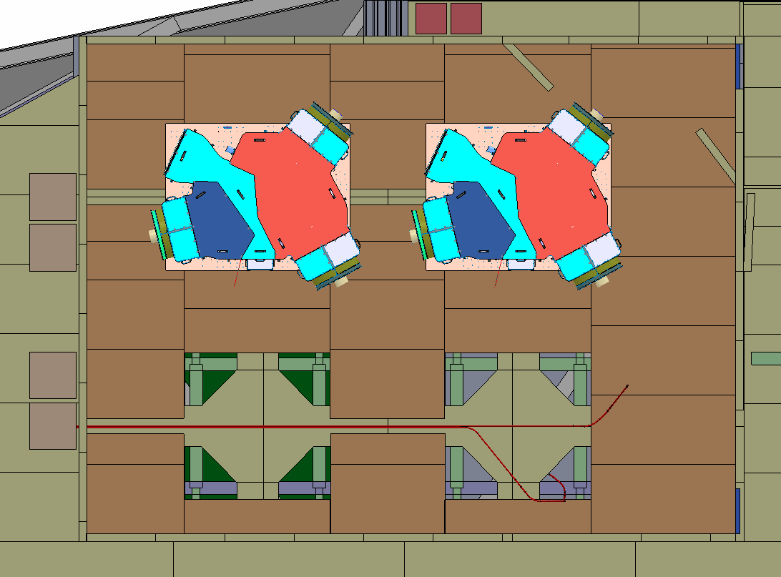
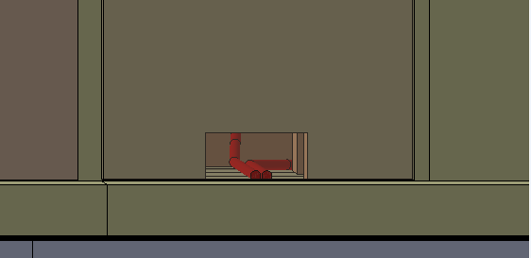
Cutouts on floors (drawing)
Cable route between the rack and the spectrograph
Cutout for FCA
Square hole with longer to up direction for 5th rack
square hole for the cables route
One hole per two racks
1st floor of SCR (4 cutouts at corner)
2nd floor (brown)
Square cutouts below bench of SMs on 2nd floor.

Slide 18
Size of cutouts for cable to SMs on 2nd layer of floor

Slide 19
references
This part is for width of cutouts at 2nd layer of floor for cables to SMs, from SCR wall to each SM.
PFS-SE-IPMU-00010 (-1) for design study
SpS-SCR-cabling-budget (20160201) for list of cables (especially for electrical cables)

Slide 20
External conditions
Cutouts are 75mm height
Height is the same as thickness of 2nd floor
Cutouts are covered by steel plate at the same level of floor Al plate
Cutouts are not thermally insulated (to inside SCR)
Similar thermal condition between inside SCR and cutout, since division is steel plate.
Cable management panel is inserted at wall
Maximum width for cutout is ~200mm, per mechanical strength of cover
We may have partition in cutout, if required

Slide 21
List of cables
Electrical cables – 50mm width (at minimum) with 70mm height per one SM
2400mm sq. for sum of circular cross section
Assuming 70% stacking efficiency (nearly maximum for round cable), 50mm width for 70mm height
If we have cable covers for some group, dimension gets larger
Will have some additional cables for monitoring gas/liquid lines
Gas/liquid cables
dia. 50mm vacuum, one per two SMs (one per one lane)
Flexible, bellows, straight is TBD.
dia. 10mm dry air, one per two SMs
dia. 10mm compressed air, one per two SMs
dia. ~20mm glycol pipe, two per one SM without insulator
Fibers – 20mm sq. per one SM (SpS/ENU IIS)
In total for two SMs (cutout at wall side), 70mm height 190mm width is minimum.

