Slide 1
Exposure time control per camera (arm)
PFS SysEng study note – PFS-SE-IPMU-00017-001+
PFS Project Office

Slide 2
Outline
This memo is to show the hardware configuration and operational constraints on exposure time control per camera (= “arm”), and exemplify how (in)flexibly it can be controlled per arm according to them.

Slide 3
The shutter configuration
PFS spectrograph module has two shutters: “Blue” shutter and “red” shutter (see next slide):
The “blue” shutter is dedicated to the blue arm. Namely, exposures of red and NIR arms are independent of the blue shutter status.
Meanwhile, since the red shutter is in front of the blue dichroic, when it closes, it then shuts the light to ALL the cameras.

Slide 4
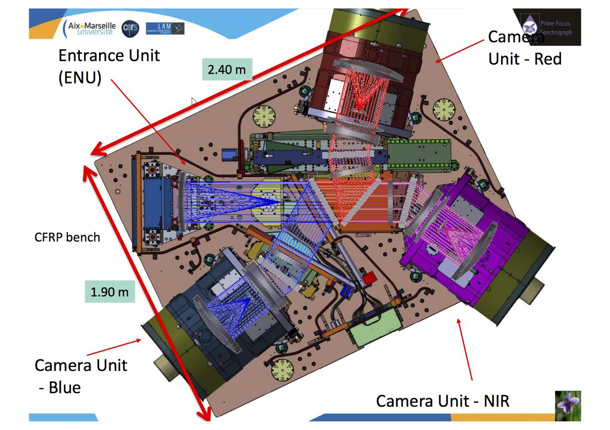
Hardware layout vs. optical path
Blue Dichroic
Red Dichroic
“Red” shutter
“Blue” shutter

Slide 5
Exposure time control under constraints
Constraints from the shutter configuration:
Exposure of blue arm can be shorter than those of red and NIR by using the blue shutter.
Exposure of NIR arm can be controlled by reset and up-the-ramp reads without operating any shutters.
To finish the exposure of red arm, the red shutter should be closed. Then exposures of blue and NIR arms should also be terminated (so the blue shutter should be closed to minimize stray light).
Constraints from operation (specifically, fiber configuration)
For fiber reconfiguration, both of the shutters have to be closed and the science fibers need to be back-illuminated from the spectrograph, where the shutters are illuminated by LEDs, the diffuse reflection goes to the collimator, and then the focusing beam goes to the fiber slit.
Once the fibers are configured, exposure is ready to start. Many exposures as wanted can be taken with keeping this fiber configuration, but when the fibers start being reconfigured, the shutters have to be closed for the back illumination and therefore exposures need to be terminated.
The interval between two adjacent fiber configurations are most likely defined by the allowed drift of the fibers away from science targets due to differential atmospheric refraction. Typically it is expected to be ~30min considering the PFS’s large field of view, but this depends on the observed sky position and the tolerance of science case against such a fiber offset.

Slide 6
Possible sequence (I)
This section is to show possible operational exposure sequence among three channels (arms) of PFS spectrograph, and it may include non realistic ones. Start and end of each sequence mean points of Cobra position reconfiguration, when PFS needs to close both shutters of all four spectrograph modules.
In this note, 15min is used for shutter-open time in one exposure sequence (or for one Cobra position configuration) which starts from left line and ends at right line with 15min between two lines, total integration times in one exposure sequence for each arm are shown with exposure time. Note that multiple exposure sequences could be assigned to one target assignment configuration between fibers and objects after Cobra position reconfiguration on focal plane, total integration time for each target assignment configuration could be longer than shown.
An exposure time of NIR could be a bit (~second) shorter than others, due to timing of reset and up-the-ramp readout, which defines an exposure time of NIR detector and runs over all pixels in ~3 seconds, while exposure time of other (blue and red) optical arms are controlled by shutter operation. This is not taken into account in exposure time nor integration time shown in each sequence.
Simple operation, without any intermediate readout nor reset
blue
red
NIR
No intermediate operation is taken in this case. Exposure time and integration time are the same for all arms, and are 15min.

Slide 7
Possible sequence (II)
One intermediate reset on NIR arm
blue
red
NIR
reset time
NIR arm has one reset in between two fiber reconfiguration, but no shutter operation. A reset operation on H4RG will take a few seconds (~3 sec; and some additional time for data finalized from up-the-ramp in parallel to next up-the-ramp readout), and it makes exposure times of NIR shorter than exact 7min 30sec like 7min 28sec.
Integration times differ between blue/red and NIR in such a way as 15min for blue/red and 14min 57sec for NIR.
One intermediate shutter operation on blue arm
Blue shutter closed (readout)
blue
red
NIR
Blue shutter is possible to be operated independently to make intermediate readout on blue CCDs, but will cost ~20-40sec(TBC) for its readout operation, and it makes two exposures of blue arm shorter than 7min 30sec like 7min 10sec.
Integration time differs between blue and red/NIR, such as 14min 20sec for blue, 15min for red/NIR.

Slide 8
Possible sequence (III)
One intermediate shutter operation on both shutters, two intermediate reset on NIR
blue
shutter closed (readout)
red
shutter closed (readout)
NIR
dead time
reset time
reset time
Even when both shutters are closed, NIR arm can have dead time and can continue up-the-ramp operation with no light from object. Also NIR arm can have resets while shutters are open. Integration times differ among the arms, like in the above two example cases. While NIR arm is in dead time, dark and thermal (from the back of the shutter) will be charged on the NIR images.
Integration times from 15min exposure sequence are: 14min 20sec (as one previous example) for blue/red arms, 14min 14sec for NIR arm (cost of both one CCD readout operation and two NIR detector reset).
One intermediate shutter operation on red shutter, two intermediate reset on NIR
blue
dead time
red
shutter closed (readout)
NIR
dead time
reset time
reset time
Similar to one previous example, but blue arm continues integration without light from sky. The blue shutter could be closed to make blue camera not affected from scattered light from the reset of the optics in the spectrograph module. This could make signal to noise ratio better than summing two exposures for blue arm, with only one readout noise to blue arm.
Integration time of the blue and red arms is the same, as 14min 20sec.

Slide 9
Possible sequence (IV)
One intermediate shutter operation on red shutter, one intermediate reset on NIR
blue
dead time
red
shutter closed (readout)
NIR
The same operation for shutters as one previous example, but NIR arm reset/readout are set as the same as red arm.
The total integration time will be the same for all the arms, as 14min 20sec.

