Slide 1
Global Nutrition Paradox Analysis
Obesity & Malnutrition Trends (2012–2022)
This project analyzes global obesity and malnutrition patterns using WHO data to understand trends, disparities, and public health implications.

Slide 2
Problem Statement
Obesity and malnutrition are major global health challenges
Some regions suffer from Malnutrition while others face rising obesity
Goal: Use data to guide public health decisions
  We wanted to understand where the world is struggling with nutrition and how data can help guide interventions.

Slide 3
Data Source & Scope
Source: WHO Global Health Observatory
Indicators:
  Adult & child obesity
  Adult & child malnutrition
Coverage:
  Countries & regions worldwide
  Genders and age groups
Time period: 2012–2022
We used official WHO data, which ensures credibility and global coverage.

Slide 4
Data Cleaning & Preparation
  Data Cleaning Steps
  Converted country codes to readable names
  Standardized gender values (Male, Female, Both)
  Handled missing region values
  Filtered data for consistent years (2012–2022)
  Cleaning ensured the data was consistent and ready for analysis.

Slide 5
Feature Engineering
New Features Created
CI Width = Upper Bound − Lower Bound
→ Used to measure data reliability
Obesity levels: Low | Moderate | High
Malnutrition levels: Low | Moderate | High
Age groups: Adult | Child/Adolescent
These features helped us measure severity and confidence in the data

Slide 6
Exploratory Data Analysis (EDA)
EDA Techniques Used
Histograms & KDE plots
Boxplots for group comparison
Line plots for trend analysis
EDA helped us understand the data before drawing conclusions.

Slide 7
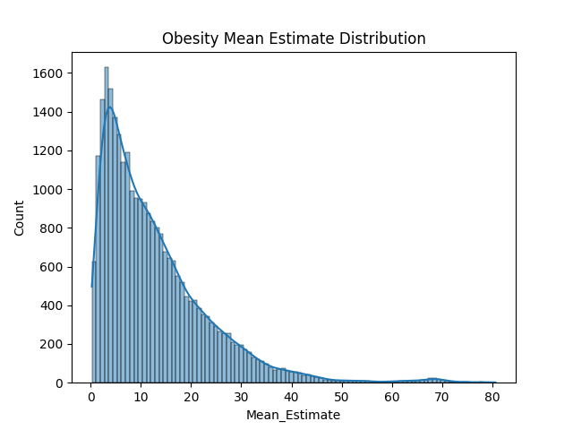
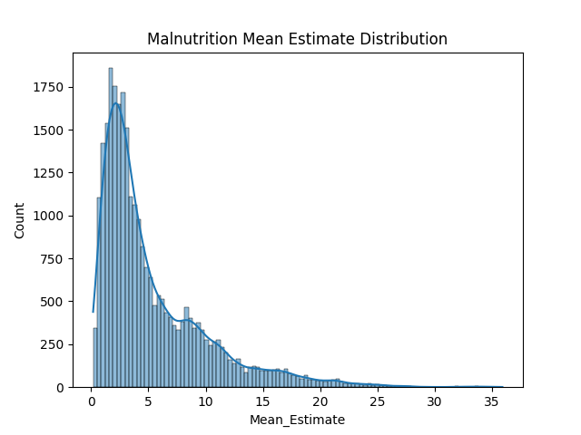
Distribution Insights
Obesity data is right-skewed
Most countries have low to moderate obesity
Few countries have extremely high obesity rates
Malnutrition shows wide variance across countries

Slide 8
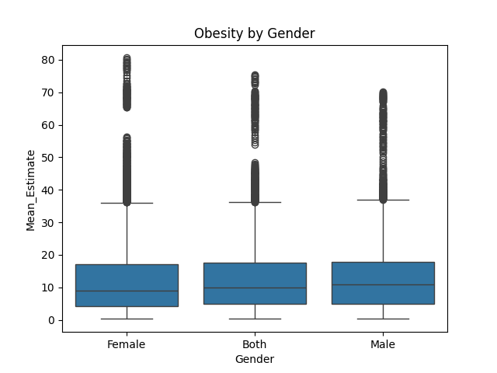
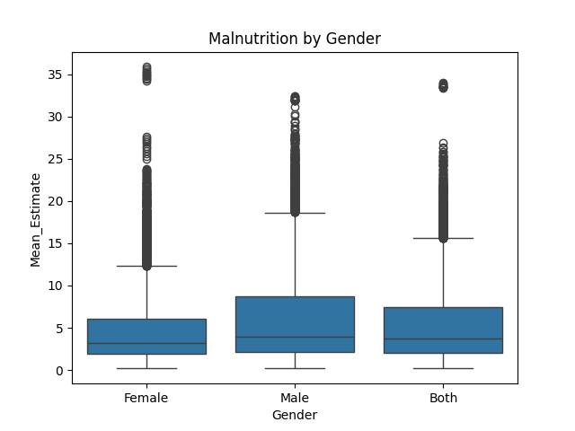
Demographic Insights
Female obesity higher than male in many countries
Children and adolescents more vulnerable to malnutrition
Presence of extreme outliers indicates crisis regions

Slide 9
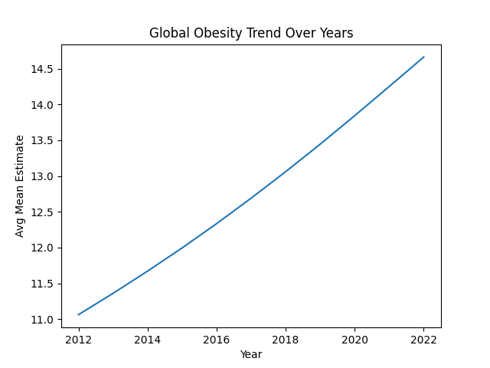
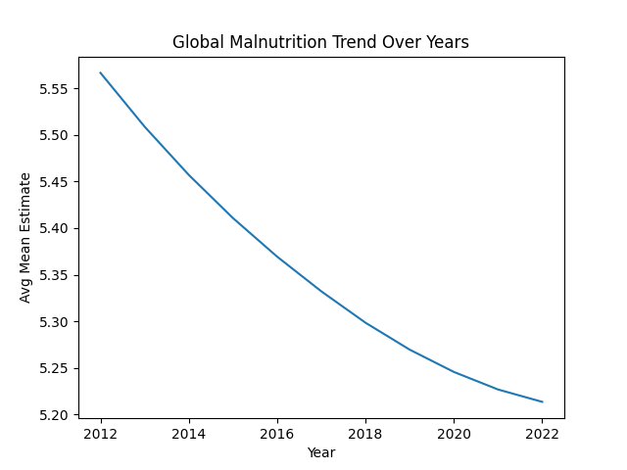
Trends Over Time (2012–2022)
Global obesity shows a steady increasing trend
Malnutrition declines slowly and unevenly
Progress varies significantly by region

Slide 10
SQL-Based Analysis
To validate visual findings numerically
To compare regions, countries, and demographics
To identify high-risk and low-reliability areas
SQL provided strong numerical evidence to support visual insights.

Slide 11
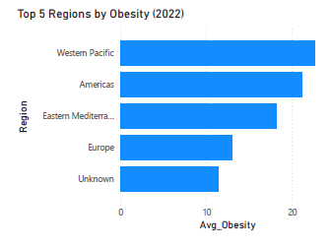
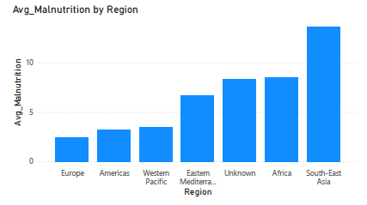
Regions Requiring Intervention
Africa and South-East Asia: High malnutrition
Western Pacific and Americas: Rising obesity
Need region-specific health strategies
Low-income regions face Malnutrition crises, while high-income and rapidly urbanizing regions struggle with obesity — demanding region-specific intervention strategies.

Slide 12
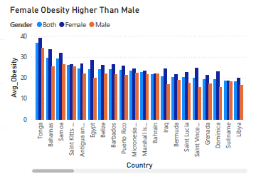
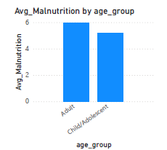
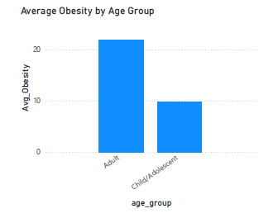
Most Vulnerable Groups
Adults → Higher malnutrition prevalence
Children & adolescents → Persistent nutritional vulnerability
Adult women → Highest obesity prevalence
Although children are traditionally viewed as the most vulnerable group, our WHO data analysis shows that adults currently exhibit a higher average malnutrition prevalence. This highlights a double burden of malnutrition, where adult Malnutrition coexists with rising obesity, particularly among women. Hence, nutrition policies must be age- and gender-specific.

Slide 13
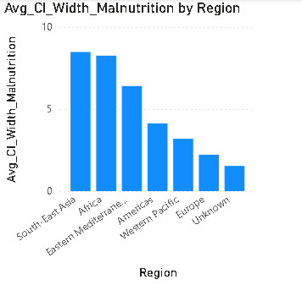
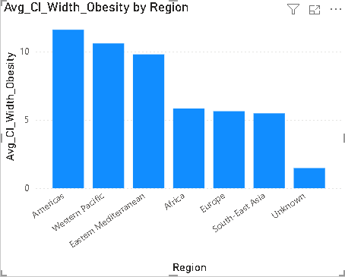
Data Reliability Across Regions (Average CI Width)
Confidence Interval (CI) width is used to assess data reliability
Higher CI width → Greater uncertainty → Lower reliability
Low-income regions show wider confidence intervals due to limited data coverage
Regions with lower CI width provide more reliable benchmarks for comparison

Slide 14
Public Health Recommendations
Strengthen nutrition programs for adults, addressing rising adult malnutrition
Implement gender-specific obesity interventions, especially for women
Prioritize high-risk regions (Africa & South-East Asia) for focused support
Improve data collection systems in regions with high CI width
Use reliable regions as benchmarks for best practices and policy design

Slide 15
Conclusion
Nutrition challenges show a dual burden: rising obesity alongside persistent malnutrition
Regional disparities are significant, with Africa and South-East Asia facing higher risk
Adults exhibit higher average malnutrition, while obesity is concentrated among adult women
Data reliability varies, requiring cautious interpretation in high-uncertainty regions
Targeted, data-driven policies are essential for effective nutrition interventions
This analysis highlights the complex nature of global nutrition challenges. The coexistence of malnutrition and obesity, regional inequality, and varying data reliability underscores the need for targeted, evidence-based policies supported by strong data systems.

Slide 16
Tools & Technologies Used
Python (Pandas, Matplotlib, Seaborn)
  SQL & SQLite
  Streamlit Dashboard
  WHO GHO API

Slide 17
Thank You
Questions?

