Slide 1
Tasks list
Pennywise solutions
Subash Chandra Bose.M
Employee Id : D03912

Slide 2
Task-01
To Create and work on Azure Entra, Create Users and group, manage Multifactor for the user account.
Azure Active Directory (Azure AD), "user" and "groups" are fundamental entities that play a crucial role in managing identity and access within Azure services.
User in Azure AD:
A user in Azure AD represents an individual who can sign in and access resources. This can include employees, customers, partners, or any other person who needs access to Azure services.
Users are typically associated with one or more identities, such as usernames and passwords, or they can use other authentication methods like multi-factor authentication (MFA), certificates, or federated identity providers.

Slide 3
Task-01
Groups in Azure AD:
Groups are collections of users, devices, or other groups. They are used to simplify the management of permissions and access to resources.
Azure AD supports several types of groups, including:
Security Groups: Used for granting access to resources. Permissions can be assigned to security groups, and users added to these groups inherit those permissions.
Microsoft 365 Groups: Used for collaboration within Microsoft 365 services. This includes email distribution groups, shared mailboxes, and more.
Mail-Enabled Security Groups: Similar to security groups but also have an associated email address.
Dynamic Groups: Membership is automatically managed based on rules defined by administrators.

Slide 4
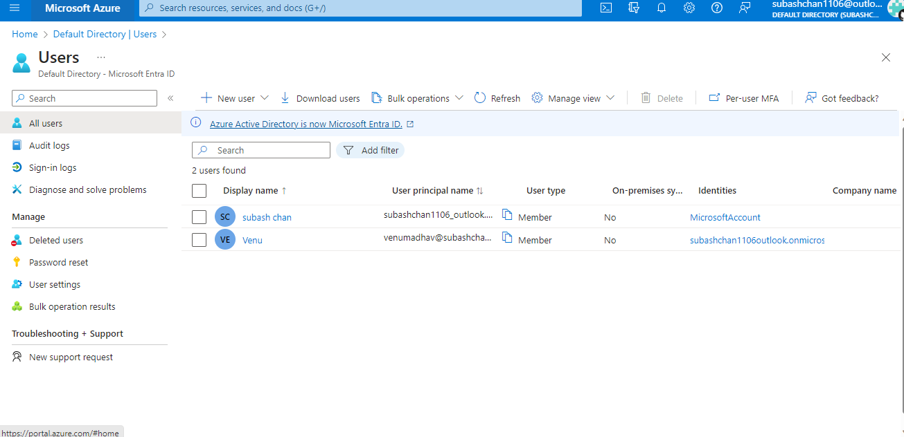
Task-01
WORK:

Slide 5
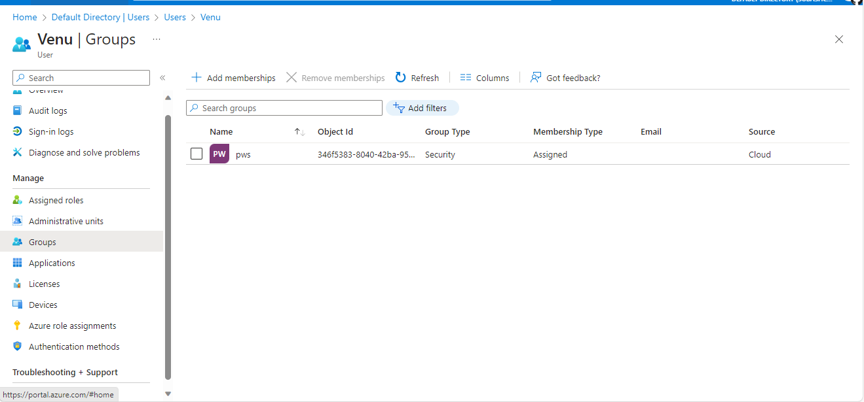
Task-01
WORK:

Slide 6
TASK-02
Create a storage account on Azure and create a blob storage upload some media and apply the retention period for the blob storage.
In Microsoft Azure, a Storage Account is a fundamental Azure resource that provides scalable and secure cloud-based storage. It serves as the foundation for storing and managing data used by various Azure services. Azure Storage supports different types of data services, including blob (object) storage, file storage, table storage, and queue storage

Slide 7
TASK-02
Types of Storage:
Blob Storage: Designed to store massive amounts of unstructured data, such as images, videos, documents, and backups. Blobs can be accessed over HTTP or HTTPS.
File Storage: Offers fully managed file shares that can be accessed using the Server Message Block (SMB) protocol. It is suitable for applications that require shared access to files.
Table Storage: A NoSQL data store that allows you to store and retrieve data using a key/attribute store. It is well-suited for semi-structured data.
Queue Storage: Provides a messaging solution for scalable and asynchronous communication between components of cloud services.

Slide 8
TASK-02
Replication:
Azure Storage Accounts support different replication options to ensure high availability and durability of data. These options include Locally Redundant Storage (LRS), Geo-Redundant Storage (GRS), Zone-Redundant Storage (ZRS), and Read-Access Geo-Redundant Storage (RA-GRS).
Access Control:
Access to data stored in Azure Storage is controlled using Shared Access Signatures (SAS) and Azure Active Directory (Azure AD) credentials.
Storage Account keys provide full control over the account and should be kept secure. Shared Access Signatures allow more fine-grained control over access to resources.

Slide 9
TASK-02
Scalability:
Azure Storage is designed to scale dynamically to meet the demands of applications. As your storage needs grow, you can seamlessly scale up the capacity of your storage account.
Integration with Azure Services:
Azure Storage is integrated with various Azure services, making it a central data repository for cloud-based applications. For example, virtual machines can use blob storage for OS disks and data disks.

Slide 10
TASK-03
Task: Use terraform script to build a virtual machine with NSG, 1 OS disk and 1 data disk.
STEPS:
Install terraform https://developer.hashicorp.com/terraform/tutorials/aws-get-started/install-cli

Slide 11
TASK-03
Automate infrastructure management
The Terraform template-based configuration file syntax enables you to configure Azure resources in a repeatable and predictable manner. Automating infrastructure includes the following benefits:
Lowers the potential for human errors while deploying and managing infrastructure.
Deploys the same template multiple times to create identical development, test, and production environments.
Reduces the cost of development and test environments by creating them on-demand.

Slide 12
TASK-03
What is Terraform?
Open-source infrastructure as Code
Developed by HashiCorp.
Used to define and provision the complete infrastructure
Declarative language.
Infrastructure provisioning tool
Cloud infrastructure setup as codes.
Similar to tools like CloudFormation
However provider independent.

Slide 13
TASK-03
The core Terraform workflow has three steps:
Write - Author infrastructure as code.
Plan - Preview changes before applying.
Apply - Provision reproducible infrastructure.

Slide 14
TASK-03
init
Initialize a working directory
First command in workflow
Downloads plugins specific to the provider
validate
Verifies the syntax consistency of the configuration.
plan
Creates execution plan
Performs a refresh and determines what action to performance
Compare .tfstate to current state
compare your changes with current state and above state
create the plan (order of execution)
display all the delta to us.
apply
Again executes the plan (unless we have persisted)
CRUD of infrastructure
destroy
Destroy infrastructure.

Slide 15
Also for today’s task i have created one separate terraform directory in my ubuntu vm.
Installed terraform in my machine and have created needed files like main.tf ,variable.tf and output.tf for my task
And have applied terraform init ,terraform validate,plan and apply.
And after all those steps my virtual machine have created in my azure portal using terraform successfully.

Slide 16
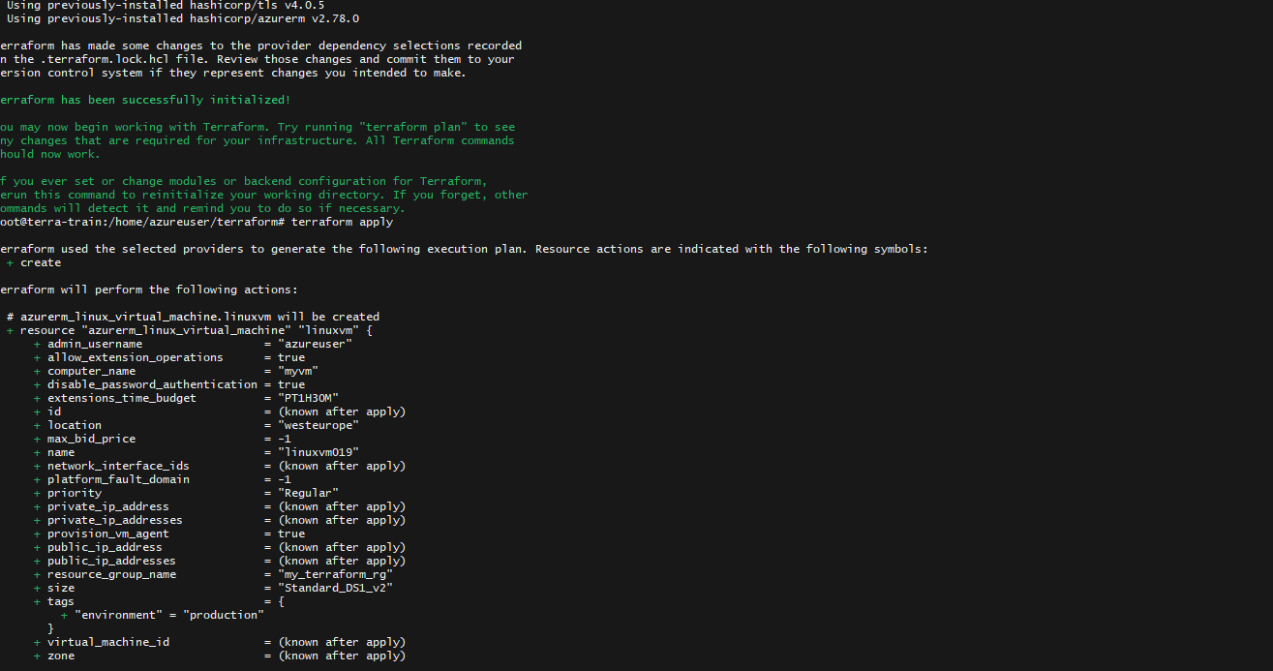

Slide 17
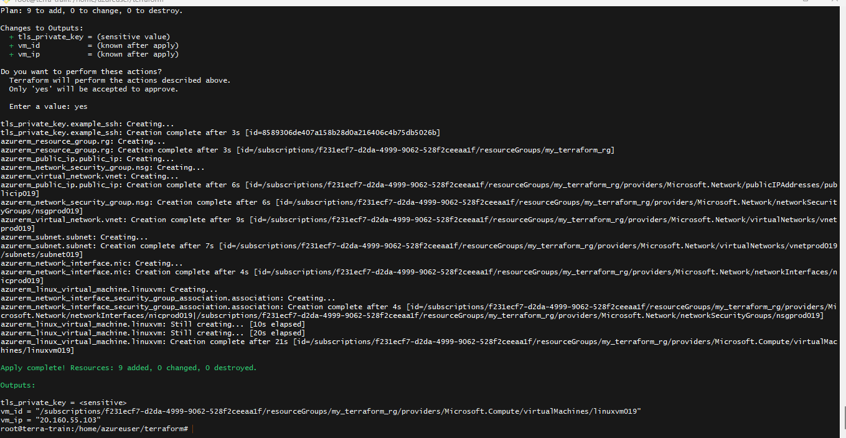

Slide 18
