Slide 1
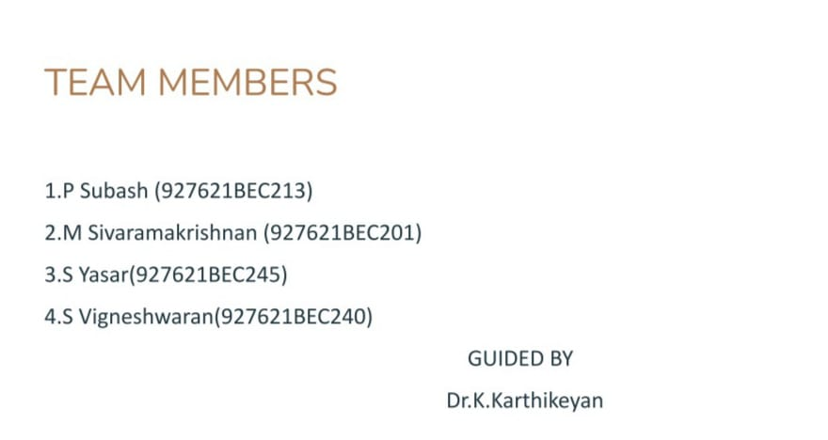

Slide 3
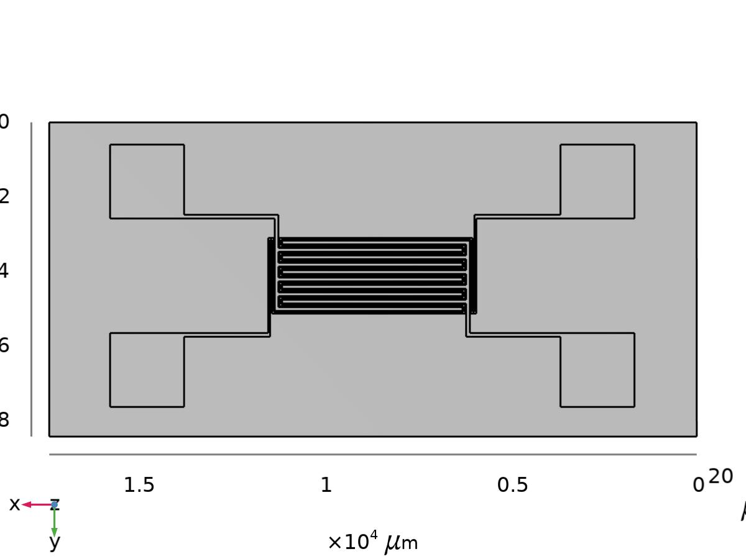
GEOMENTRY

Slide 4
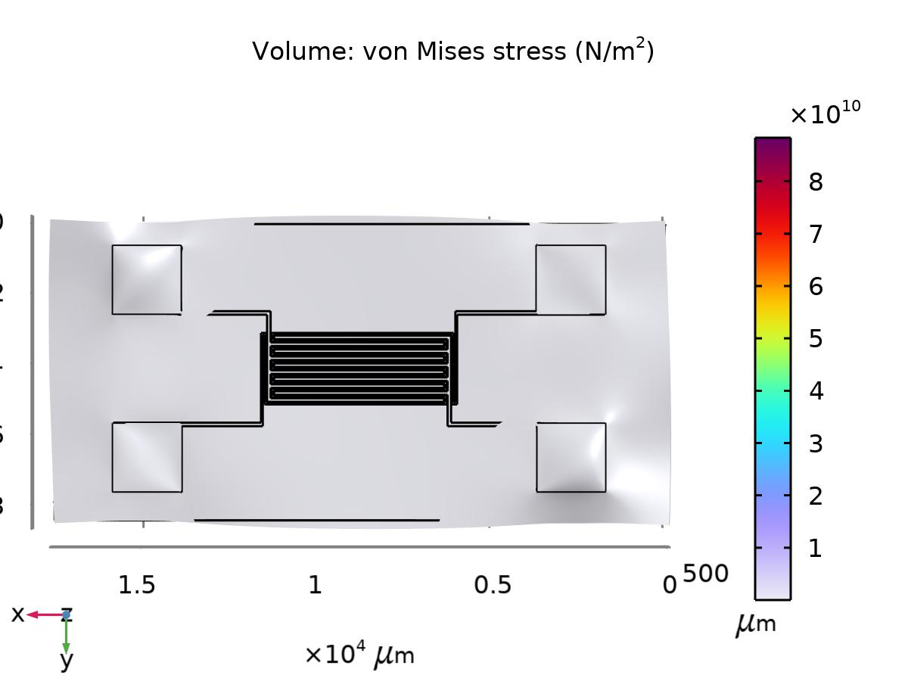
Stress (solid)

Slide 5
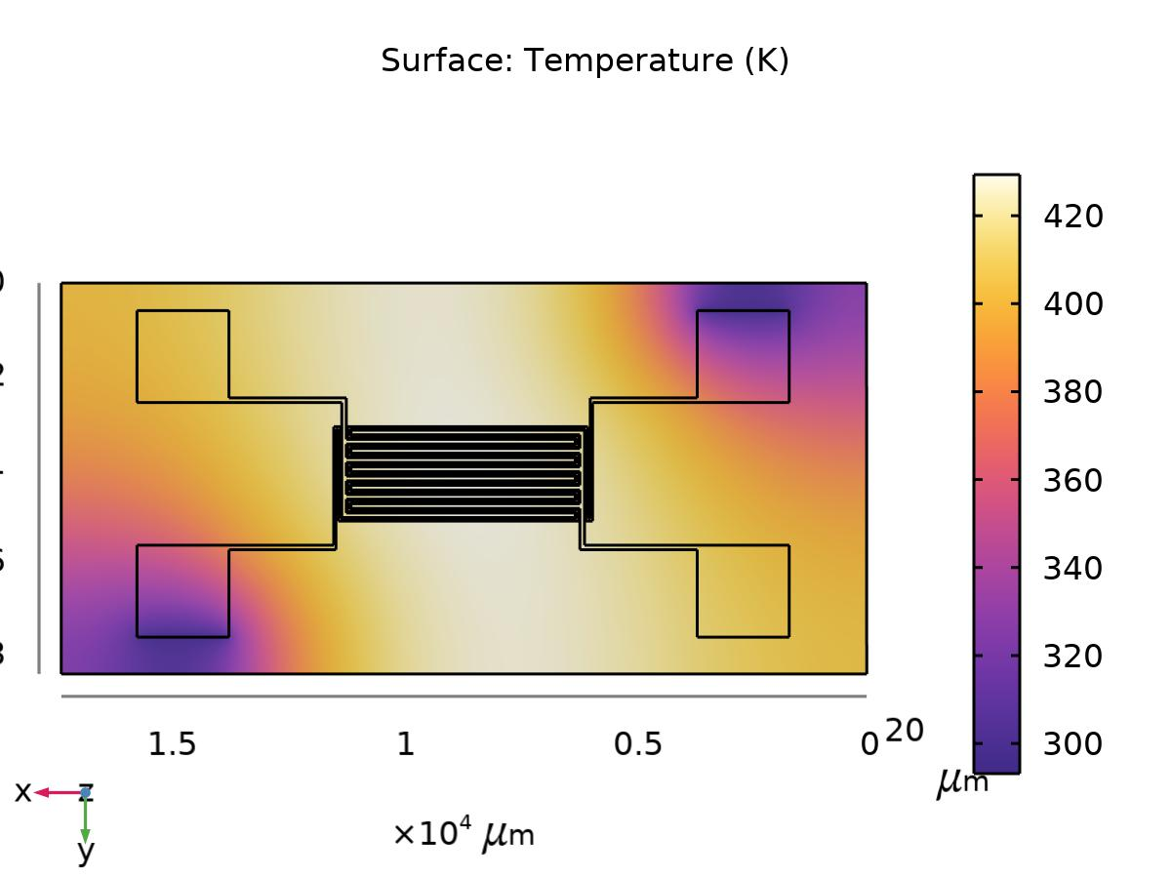
Temperature (ht)

Slide 6
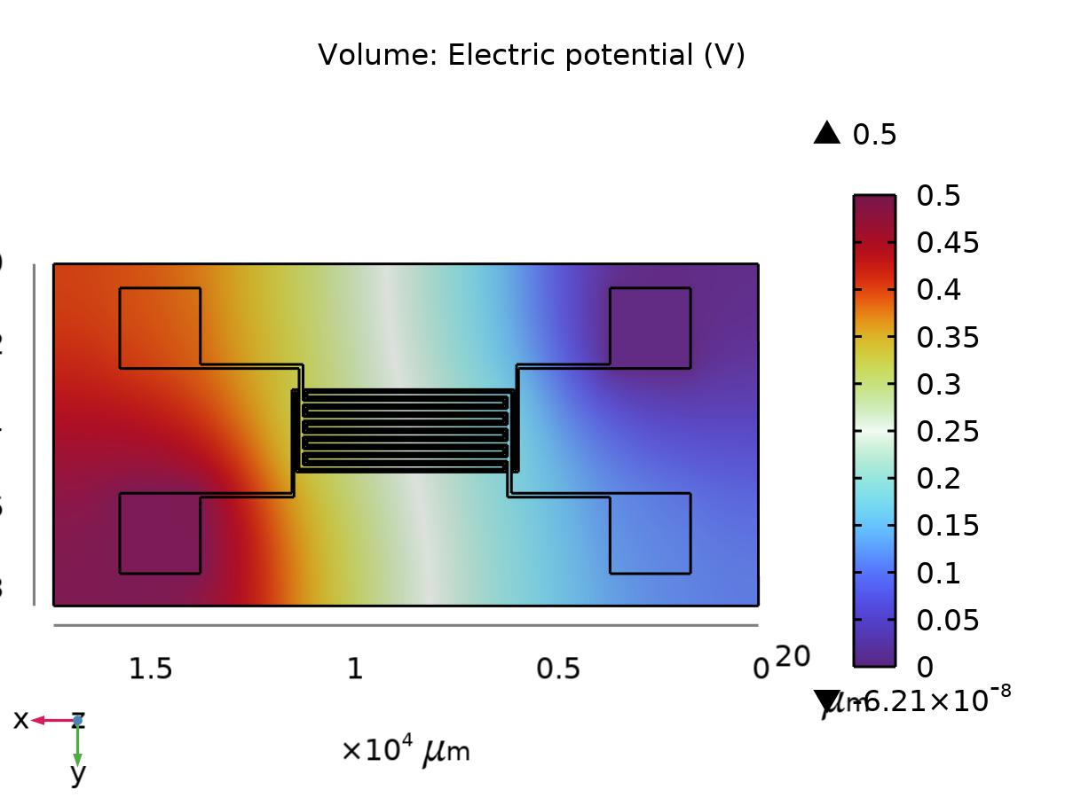
Electric Potential (ec)

Slide 7
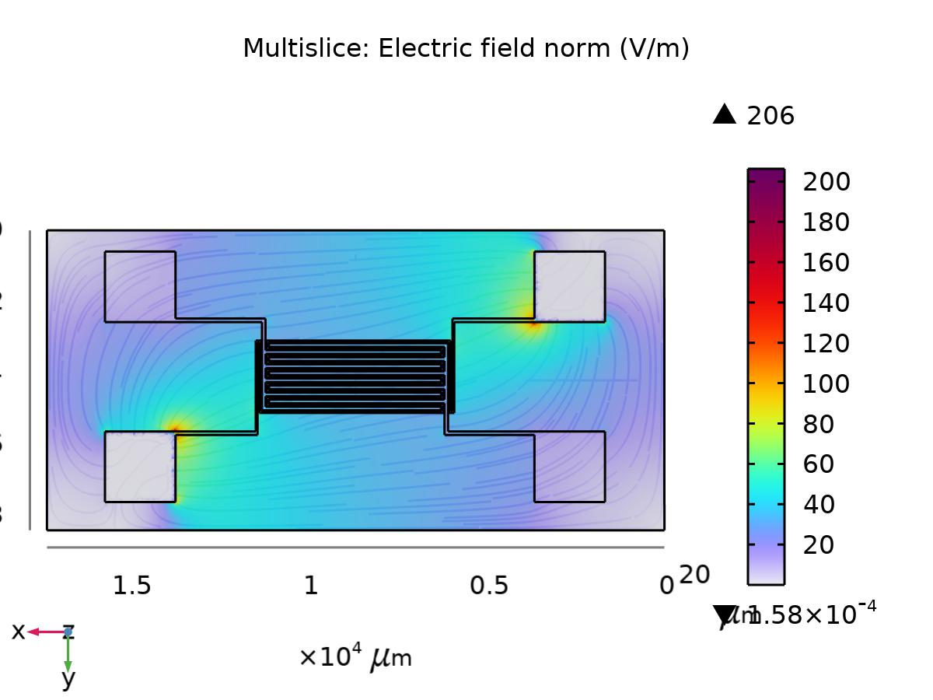
Electric Field Norm (ec)

Slide 8
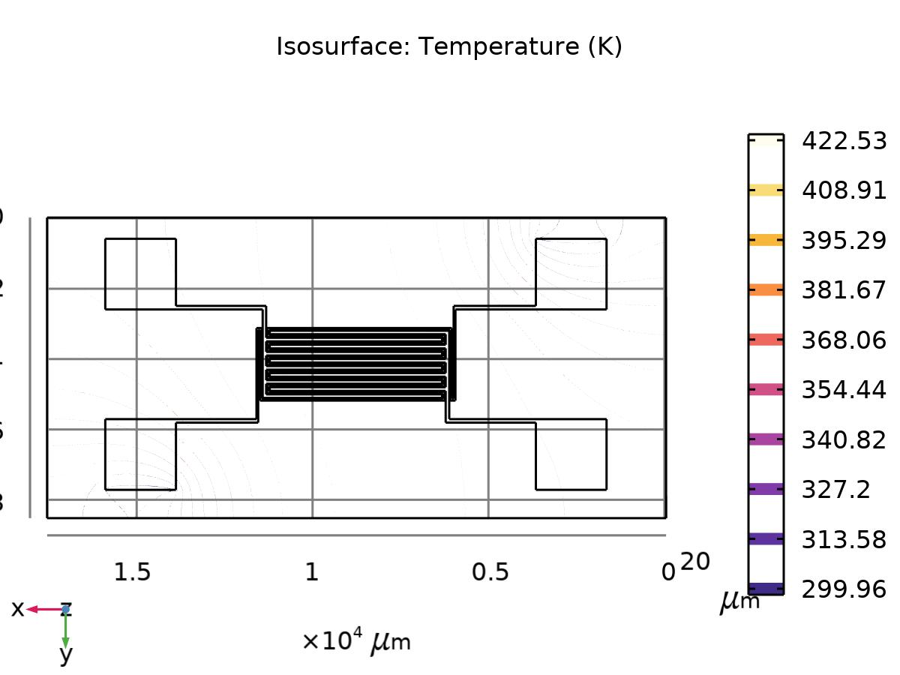
Isothermal Contours (ht)

