Slide 1


CASE STUDY- 3
ENERGY EFFICIENCEY IN SMART BUILDINGS

Slide 2
TEAM
SUBASH. S TEAM LEADER S4F_CP_Team_12291
SURIYA. R TEAM MEMBER S4F_CP_Team_12291
HARIHARAN. A.S. TEAM MEMBER S4F_CP_Team_12291
PRADEEP. D TEAM MEMBER S4F_CP_Team_12291
PRASANNA S TEAM MEMBER S4F_CP_Team_12291

Slide 3
Content
Abstract
Problem Statement
Objective
Data Collection and Preparation
Proposed Solution (Methodology)
Model Performance Evaluation
Screenshots / Demonstration (video)
Future Scope
Conclusion
Notes:
Abstract
Problem Statement (Clearly define the challenge)
Objective (State your project's goal)
Background and Research (Discuss existing solutions, trends, and gaps)
Data Collection and Preparation (Focus on data sources, cleaning, and augmentation)
Proposed Solution (Methodology)
Model Architecture (e.g., CNN, U-Net, YOLOv5)
Key Techniques (e.g., Transfer Learning, Image Augmentation)
Model Performance Evaluation
Metrics (Accuracy, Precision, Recall, IoU, etc.)
Graphs (Confusion Matrix, ROC Curve, etc.)
Screenshots / Demonstration (Visual proof of system functionality)
Future Scope (Improvements, scalability, and integration ideas)
Conclusion (Summarize results and impact)
Q&A Session

Slide 4
Abstract
Energy consumption in buildings contributes to nearly 40% of global energy use.
Improving energy efficiency is essential for achieving sustainability goals and reducing operational costs.
This case study focuses on how AI-based systems were utilized in a smart office building in Singapore.
The AI system used real-time data like occupancy, weather conditions, and historical energy use to optimize the HVAC system, resulting in a 20% reduction in energy consumption and a 10% cost decrease.

Slide 5
Problem Statement
Traditional buildings lack intelligent systems to adapt to changing occupancy and environmental conditions.
This results in high energy usage and operational inefficiencies. Commercial buildings, in particular, face challenges in managing HVAC systems effectively.
The absence of real-time data processing and control leads to unnecessary energy wastage.
The goal is to address this problem using AI-powered energy optimization solutions.

Slide 6
Objective
The main objective of this case study is to design a predictive AI model capable of estimating and optimizing energy usage in commercial buildings.
The model should utilize historical energy consumption, occupancy data, and weather patterns to make accurate predictions.
Based on these insights, actionable steps can be taken to minimize energy usage and move towards net-zero building operations.

Slide 7
Data Collection and Preparation
Data Sources: Energy usage, occupancy levels, and weather data over two years.
Features Used: Temperature, humidity, occupancy, and weather condition.
Preprocessing Steps:
Handled missing values
One-hot encoded categorical data
Normalized numerical features
Split into training (80%) and testing (20%) sets

Slide 8
Proposed Solution (Methodology)
Algorithm Used: Random Forest Regressor (supervised ML)
Input Features: Occupancy, temperature, humidity, weather condition
Target Variable: Energy consumption
Process:
Preprocessed and encoded data
Trained model on 80% of data
Tested on 20% for accuracy
Evaluated using MAE and R² Score

Slide 9
Model Performance Evaluation
Model Used: Random Forest Regressor
Evaluation Metrics:
Mean Absolute Error (MAE)
R² Score
Results:
Low MAE indicating accurate predictions
High R² Score showing good model fit
Visualization:
Scatter plot of actual vs predicted values
Points close to the diagonal line → high accuracy

Slide 10
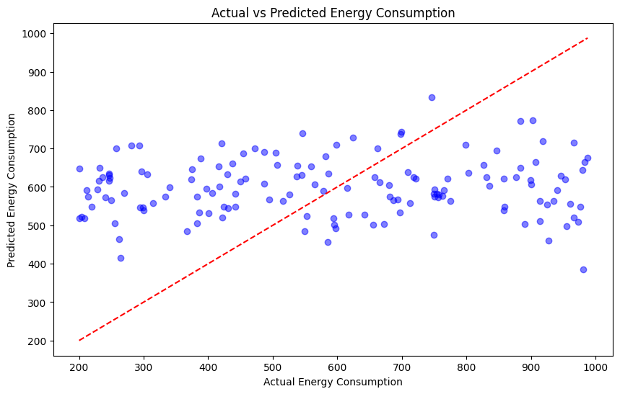
Screenshots / Demonstration (video)
GitHub Link: https://github.com/Subash028/AI_and_GREEN_SKILLS_CASE_STUDY-3

Slide 11
Future Scope
Real-time Optimization: Integrate IoT sensors to enable real-time energy monitoring and control.
Reinforcement Learning: Use adaptive AI models that learn and improve HVAC efficiency over time.
Renewable Integration: Balance energy consumption with solar or wind energy sources.
Predictive Maintenance: Use AI to forecast equipment failures and reduce downtime.
Scalability: Apply the solution across multiple buildings or entire smart cities.
User Feedback Loop: Include occupant feedback to adjust comfort levels dynamically.

Slide 12
CASE STUDY-3
QUESTIONS & ANSWER

Slide 13
How can Al be used to identify inefficiencies in energy consumption in smart buildings?
AI can analyze real-time and historical energy usage data to detect abnormal patterns or excessive consumption.
It identifies underperforming systems (like HVAC running during low occupancy).
AI systems can benchmark performance against similar buildings to flag inefficiencies.
Predictive analytics help forecast high-consumption periods and optimize equipment use accordingly.
2. Build a model to predict the energy consumption of the building based on occupancy and weather data?
A Random Forest Regressor was used as the prediction model.
Input features: Occupancy, temperature, humidity, and weather condition.
Target: Energy consumption (in kWh).
The model was trained on 80% of the dataset and tested on the remaining 20%.
It showed a high R² score and low MAE, indicating strong performance.

Slide 14
3. Suggest additional features that could be incorporated into the model to improve its accuracy?
Time-related features: Day of week, hour of day, holidays
Building usage: Meeting schedules, floor-wise activity
Equipment status: HVAC runtime, lighting usage
External data: Real-time energy prices, air quality index
Renewable input: Solar panel energy generation
4. What steps can building managers take based on the model's predictions to reduce energy consumption?
Adjust HVAC and lighting schedules based on occupancy forecasts
Implement predictive maintenance for inefficient equipment
Optimize energy usage during non-peak hours
Enable zone-based temperature control
Provide energy-saving recommendations to occupants

Slide 15
5. How can Al-driven solutions contribute to achieving net-zero energy buildings?
AI ensures energy demand matches supply, especially with renewable sources.
It optimizes the use of solar, wind, or battery storage systems.
Enables automated, intelligent controls that adapt to real-time needs.
Reduces carbon footprint by minimizing waste and forecasting needs accurately.
Promotes long-term sustainability and cost savings.

Slide 16
Conclusion
AI technologies play a crucial role in transforming traditional buildings into smart, energy-efficient systems.
The machine learning model successfully predicted energy usage patterns, enabling proactive decision-making.
Insights from occupancy and weather data helped optimize HVAC operations and reduce unnecessary energy use.
Significant improvements were achieved:
20% reduction in energy consumption
10% decrease in operating costs
The solution is scalable and adaptable for different types of commercial buildings.
By integrating AI, building managers gain greater control, visibility, and automation in energy systems.
AI contributes directly to achieving sustainability targets and supports the global movement toward net-zero energy buildings.

