Slide 1



DROWINESS DETECTION AND PREVENTING
ACCIDENT USING
K-NEAREST NEIGHBOR [KNN] ALGORITHM
Dr.L.Rahunathan¹ Associate Professor Department of Computer Applications Kongu Engineering College Perundurai-638060, Tamilnadu, India. lrahunathan@gmail.com, | Miss. Pandieswari M² PG Final Year Department of Computer Applications Kongu Engineering College Perundurai-638060, Tamilnadu, India. pandieswariponnuthai@gmail.com..
Miss. Priyadharshini S³ PG Final Year Department of Computer Applications Kongu Engineering College Perundurai-638060, Tamilnadu, India. priyaasuresh3110@gmail.com.. | Mr. Sownthar K⁴ PG Final Year Department of Computer Application Kongu Engineering College Perundurai-638060, Tamilnadu, India. sowndharkrishna@gmail.com..

Slide 2
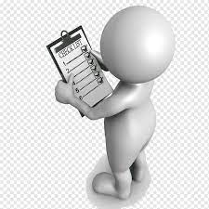
AGENDA
Abstract
Introduction
Problem Statement
Literature Review
System Flow
Mathematical Calculation
Classified Algorithm
Tools Used
Conclusion
Future Work

Slide 3
ABSTRACT
To prevent accidents, it is possible to determine a driver's level of intoxication by utilizing a distinct algorithm to calculate their eye and mouth aspect ratios
Using the precise formula for determining the MOE value to average them
Therefore, establishing mouth ratio aspect value over eye ratio aspect of MOE can be used in diagnose tiredness
In this paper, we propose and evaluate a K-Nearest Neighbor [KNN] algorithm designed for classifying the drowiness

Slide 4
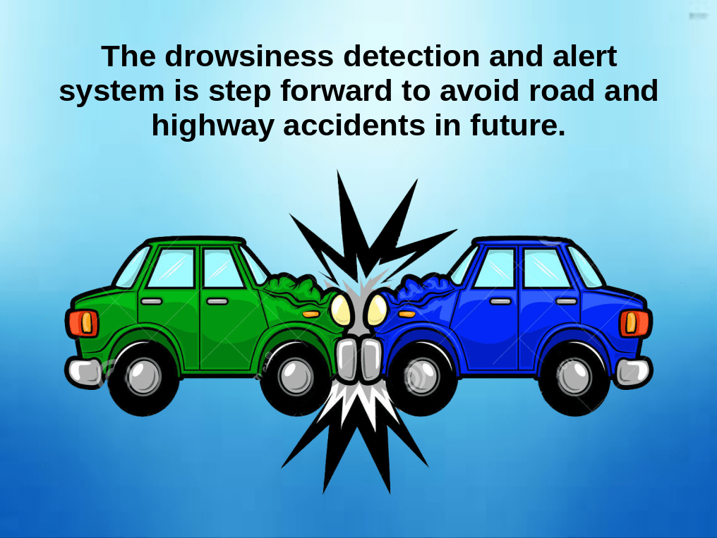
INTRODUCTION
No one can survive without transport now a days. Transportation causes accident not at all time but often
Road accident are very frequent now a days and it is most probably occurs because of sleepy drivers
We cannot avoid transportation but can reduce the count of accident level
Aim to avoid those accidents by detecting the drowsiness of a person who drives a vehicle by various features

Slide 5
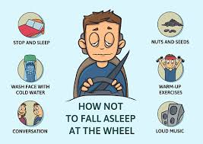
PROBLEM STATEMENT
Long travel
Lack of sleep
Night time journey
No conversation

Slide 6
LITERATURE REVIEW
S.NO | TITLE | YEAR & AUTHOR | OBSERVATION | DATASET/ ALGORITHM | ACCURACY
1 | Real-time classification for autonomous drowsiness detection using eye aspect ratio | 2020 & Caio Bezerra Souto Maior Márcio José das Chagas Moura , João Mateus Marques Santana , Isis Didier Lins | Here by they identified the early symptoms of sleeping state and trained by using the different dataset of images and videos for drowsiness detection. | Support Vector Machine | 94.44 %
2 | Drowsiness Detection System using Eye Aspect Ratio Technique | 2020 & Saravanaraj, Sathasivam, Abd Kadir, Mahamad Sharifah Saon | It is done by using the EAR technique. Here by for future development can be done by detecting the state of yawning and distraction of the driver. | electrocardiogram (ECG), electroencephalogram (EEG), electrooculogram (EOG) and electromyogram (EMG) | 90 %
3 | Using Eye Aspect Ratio to Enhance Fast and Objective Assessment of Facial Paralysis. | 2020 & Jialing Feng , 1 Zhexiao Guo , 1,2 Jun Wang , 3 and Guo Dan 1,2 | Paper is about detecting drowsiness in paralysis patients by calculating their EAR value.87 paralilysis patients are detected in this paper. | Ensemble of regression tree (ERT) algorithm, gradient boosting decision tree (GBDT) algorithm | 85.2 %

Slide 7
S.NO | TITLE | YEAR & AUTHOR | OBSERVATION | DATASET/ ALGORITHM | ACCURACY
4 | Real-Time Driver Drowiness Detection System Using Eye Aspect Ratio and Eye Closure Ratio | 2019 Sukrit Mehta, Sharad Dadhich, Sahil Gumber, Arpita Jadhav Bhatt | The drowsiness had detected by facial landmarks, Eye aspect ratio and eye Closure Ratio drowsiness based on adaptive thresholding. | Naïve Bayes, SVM, Random Forest | 80%, 80 %, 84 %
5 | State Of The Art Analysis Of Modern Drowiness Detection Algorithm Based On Computer Version | 2021, Fudail Hasan, Alexey Kashevnik | By detecting the yawning state of a person they themselves created a dataset and trained and also blinking state also calculated. | Deep Nerual Network, | 95.2%
6 | Drowsiness Detection According to the Number of Blinking Eyes Specified From Eye Aspect Ratio Value Modification | 2019, Novie Theresia Br. Pasaribu, Agus Prijono, Ratnadewi, Roy Pramono Adhie, Joseph Felix | Drowsiness detected by level of stages, Face detection and then eye detection, EAR value calculated and compared to the MEAR value. | Histogram of oriented gradient (HOG) ,and Convolutional Neural Network (CNN) | 90 %

Slide 8
S.NO | TITLE | YEAR & AUTHOR | OBSERVATION | DATASET/ ALGORITHM | ACCURACY
7 | Drowiness Detection Based on Eye Closure and Yawning Detection | 2019, B. Mohana, C. M. Sheela Rani | Haar basded classifier is used in extraction of facial features to detect the eye closure and yawning state. Alarm will be sounded when the eye closure and yawing detected. | Haar – Based Classifier, Support Vector Mechine (SVM), Convolutional Neural Network (CNN) | 85 %
8 | Driver Drowiness Detection Model Using Convolutional Nerual Networks Techniques for Android Application | 2020, Rateb Jabber, Mohammed Shinoy, Mohammed Kharbeche | EEG with Inertial Measurenebts Units(IMU) sensors are used to detect the 5 levels of drowsiness. Android Application is used to take the sleepy pictures of the driver. | Convolutional Neural Network (CNN) | 83.33 %
9 | Driver Drowsiness Detection using Machine Learning Approach | 2019, Novie Theresia Br. Pasaribu, Agus Prijono, Ratnadewi, Roy Pramono Adhie, Joseph Felix | Integral image is used for fast feature evaluation. AdaBoost is used to select the small number of features. Then face is detected. All these contributes in detection of drowsiness. | HAAR face detection algorithm, AdaBoost algorithm | 95 %

Slide 9
S.NO | TITLE | YEAR & AUTHOR | OBSERVATION | DATASET/ ALGORITHM | ACCURACY
10 | Driver Safety Development: Real Time Driver Drowsiness Detection System Based on Convolutional Neural Network | 2021, Maryam Hashemi , Alireza Mirrashid , Aliasghar Beheshti Shirazi | Eye detection and preprocessing done then collection process is used in detection of drowsiness. Time cost for eye closure detection in different methods. | Fully Designed Neural Network (FD-NN) | 98.15%
11 | Real Time Driver Drowsiness Detection Using a Logistic-Regression Based Machine Learning Algorithm | 2019, Mohsen Babaeian, Nitish Bhardwaj, Bianca Esquivel, and Mohammad Mozumdar | ECG sensor is used to detect the electrical signal from the heart.Due to irregular pattern of heart resamples the uniformity sampled signal. | Naïve Bayes Method, logistic regression | 85 %, 92%
12 | A Machine Learning Approach for Driver Drowsiness Detection Based on Eye State | 2019, Venkata Rami Reddy Chirra , Srinivasulu Reddy Uyyala , Venkata Krishna Kishore Kolli | Feature extraction is used to extract the images in the dataset and then face detection is done also eye is detected to confirm the drowsiness. | Convolutional Neural Network (CNN) | 96.42%

Slide 10
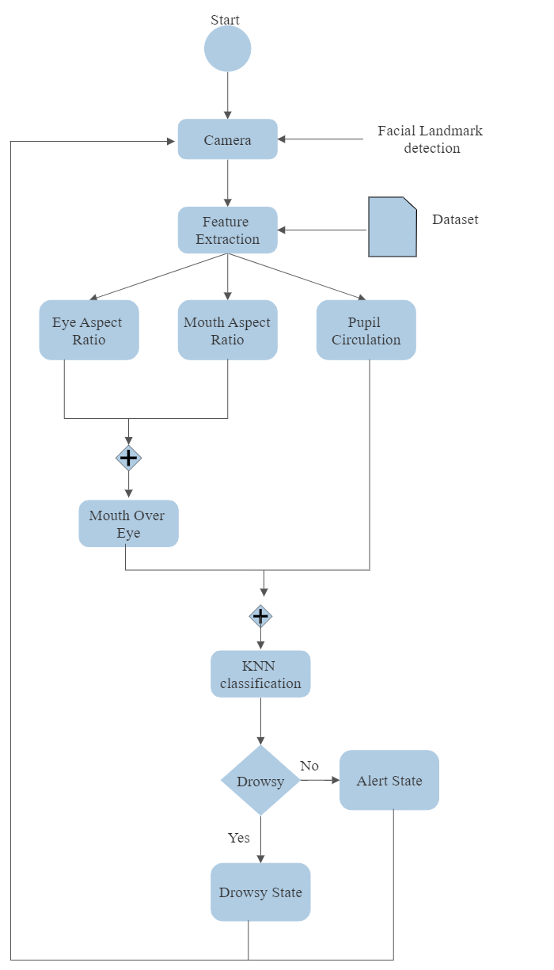
SYSTEM FLOW

Slide 11
MATHEMATICAL CALCULATION
There are several mathematical terms used to identify the drowsy of a person.
EYE ASPECT RATIO ( EAR )
MOUTH ASPECT RATIO ( MAR )
PUPIL CIRCULARITY ( PUC )
MOUTH OVER EYE ( MOE )
In face there are totally 68 landmarks per frame. It is a task which uses in prediction of points in facial regions includes eyes, nose, lips, mouth
We are going to focusing on eye and mouth which has the points in the range of 37-68

Slide 12
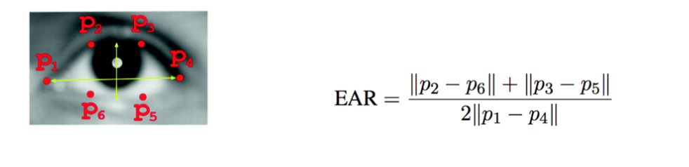
EAR is the ratio of the length of the eyes to the width of the eyes
During the drowsiness phase, eyes get smaller, and the person blinks them often, which reduces EAR
EAR decreases – Drowsiness increases
EYE ASPECT RATIO ( EAR )

Slide 13
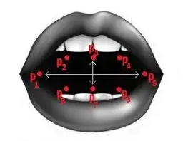
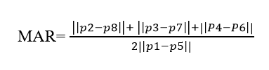
MOUTH ASPECT RATIO ( MAR )
MAR measures the ratio of the length of the mouth to the width of the mouth
When a person feels drowsy, they tend to yawn more, which increases MAR from the normal condition
MAR increases – Drowsiness increases

Slide 14
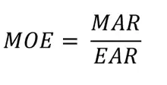
PUPIL CIRCULARITY ( PUC )
This PUC emphasis more on the pupil instead of the entire eye
People who feel drowsy will have their half eyes open which will reduce their Pupil Circularity
EAR and MAR are inversely proportional
MOE as a measure will be more responsive to these changes as it will capture the subtle changes in both EAR and MAR and will exaggerate the changes as the denominator and numerator move in opposite directions
MOE increases (MAR increases and EAR decreases) – Drowsiness increases
MOUTH OVER EYE ( MOE )

Slide 15
CLASSIFIER ALGORITHM
Supervised learning classifier of K- Nearest Neighbors algorithm is used to predict the accuracy in high level
Where KNN is non- parametric classifier it can use for all supervised problems
It is used by grouping up of data point individually. Here we have taken average prediction value of K is 9
Using this K value the highest accuracy is going to be predicted

Slide 16
TOOLS USED
Jupyter notebook is an open-source software
It is allows users to create and share documents that contain interactive calculations, code, images, etc
Users can combine data, code, and visualizations into a single notebook, and create interactive “stories” that they can edit and share
It is a browser-based tool

Slide 17
CONCLUSION
We have proposed by using facial landmarks the calculations of EAR, MAR, MOE and PUC
Based on these range of calculation drowsy has been detected in a person who drives a car
By using KNN we predicted the accuracy in range of 90.74%
The state of drowsiness is detected effectively

Slide 18
FUTURE WORK
The detection can done by calculating the head pose, chin pose of a person
In this cases it has a chance of getting higher accuracy
They are several types of supervised algorithms are there it can also implemented for future work to get better result

Slide 19
THANK YOU

