Slide 1
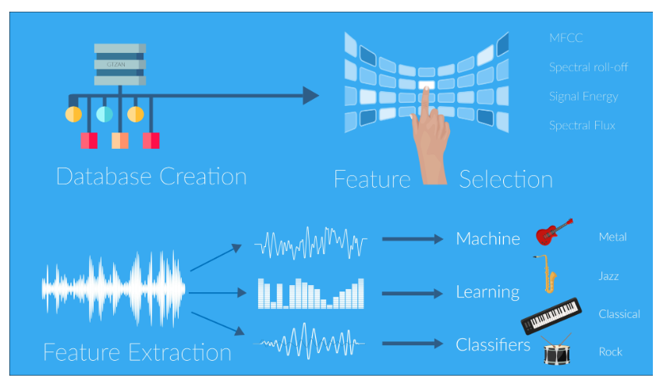
Music Genre Classification using DNNs
Introduction
In our project, we aim to classify music based on its genre using feature extraction followed by machine learning classifiers.
Our main focus is to study and analyze how different categories of audio signals consist of varying information in both the time and the frequency domain and thus exploit them to build features for accurate classification.
Methodology
Dataset acquisition and pre-processing
Extraction of Features
Building and Training a DNN Model on extracted features
Classification

Slide 2
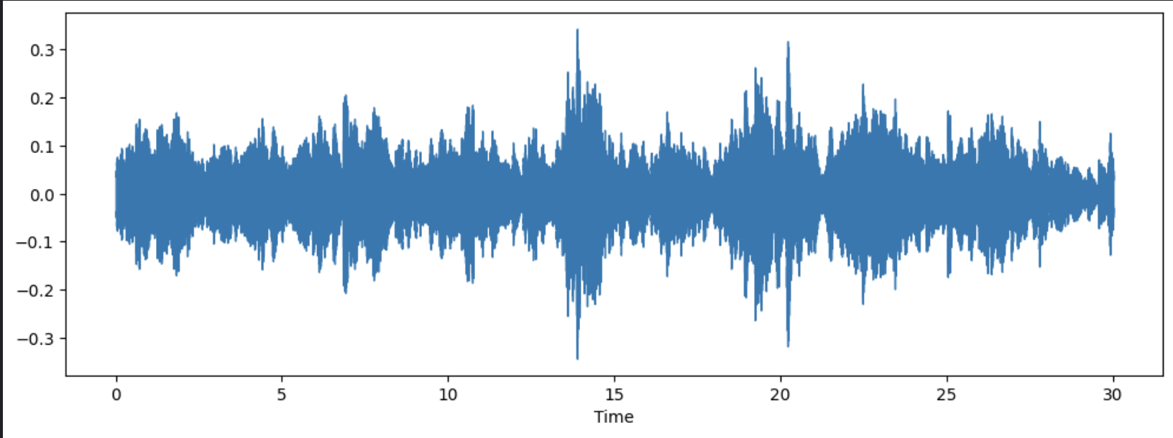
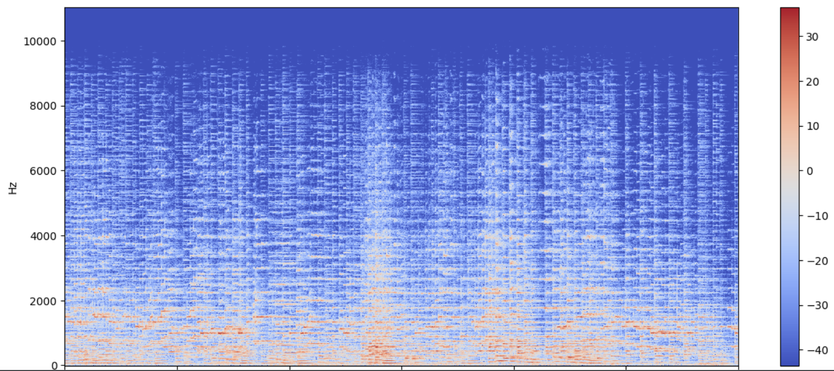
Dataset Description
We have used the GTZAN dataset. It contains 10 music genres, each genre has 100 audio clips in .wav format. Each audio clip is 30 seconds long, 22050 Hz Mono 16-bit file.
2 CSV files — Containing features of the audio files.
Visualization of an audio sample
Raw audio file of a Classical genre audio sample in Time domain
Spectrogram of same sample: Visualization in Frequency domain

Slide 3
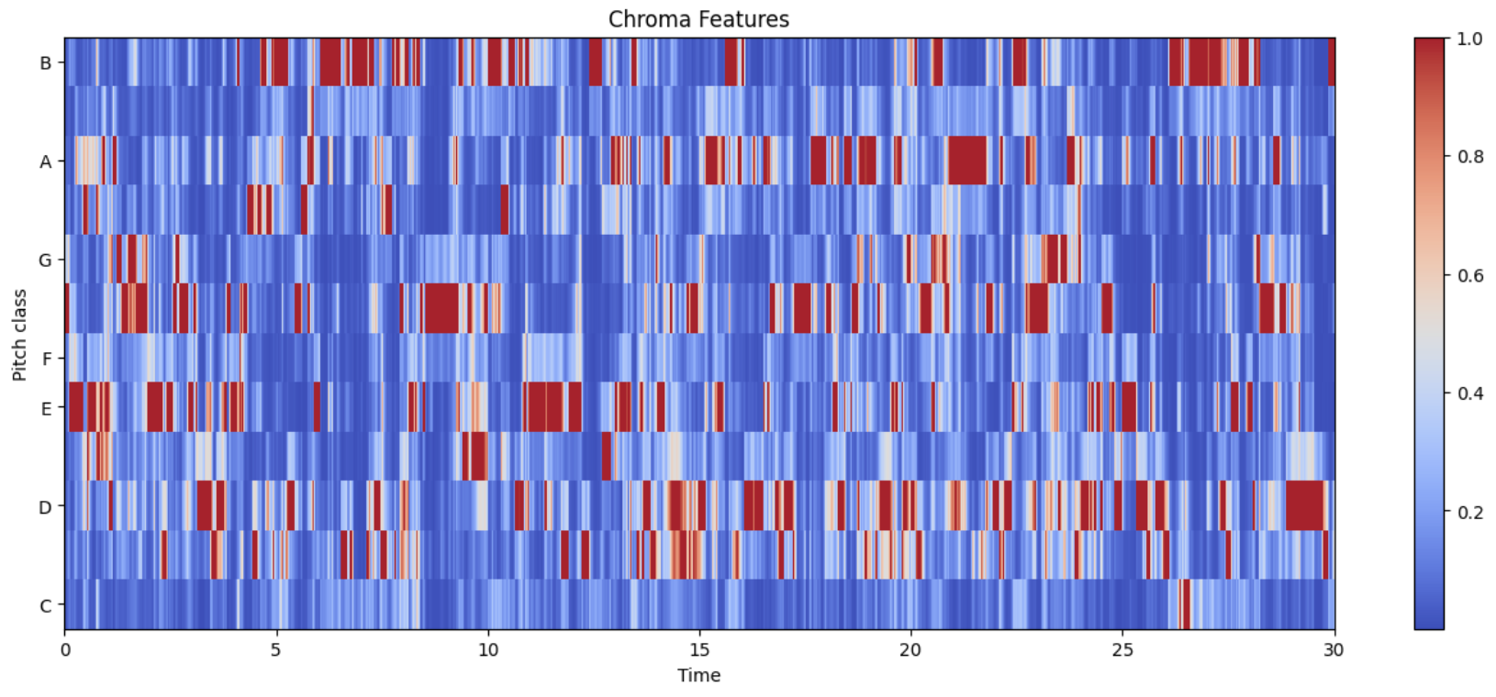
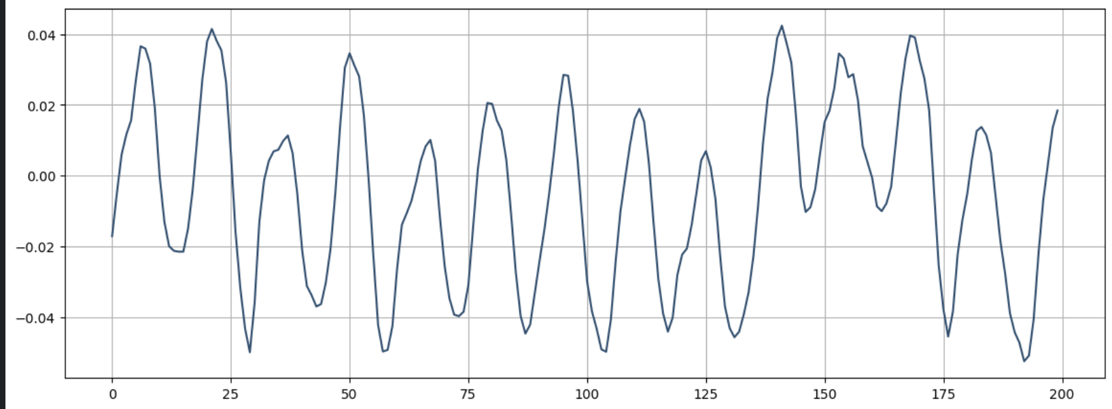
Extraction of Features of audio sample
Chroma Features
It is a powerful tool for analyzing music features whose pitches can be meaningfully categorized and whose tuning approximates to the equal-tempered scale.
Zero Crossing Rate
Zero-crossing rate is a measure of the number of times in a given time interval/frame that the amplitude of the speech signals passes through a value of zero.
The rate at which zero-crossings occur is a simple measure of the frequency content of a signal.

Slide 4
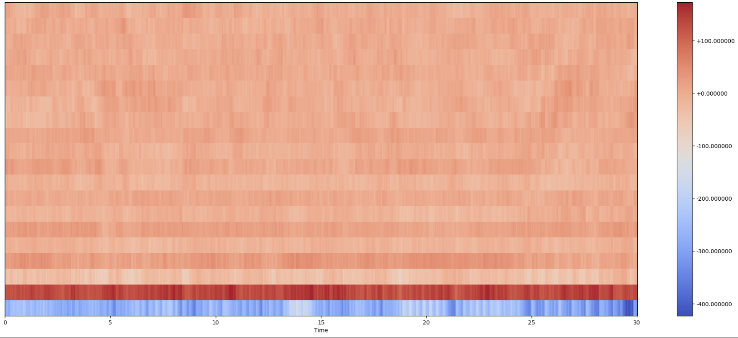

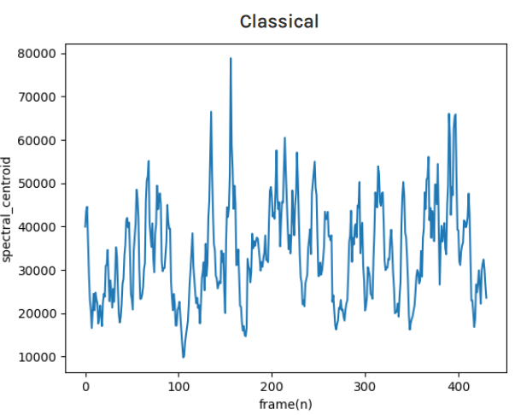
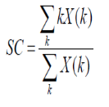

Mel-Frequency Cepstral Coefficients
MFCC represents a set of short term power spectrum characteristics of the sound and have been used in the state-of-the-art recognition and sound categorization techniques.
Spectral Centroid
It describes where the "center of mass" for sound is.
This feature describes the center of frequency at which most of the power in the signal is found.
Spectral Roll off
Spectral Rolloff is the frequency below which a specified 85%percentage of the total spectral energy lies.

Slide 5
Building a DNN model for Classification
Model Description
Model Training
DNN Inference
A DNN model with 4 dense layers and 1 FC layer with different no. of neurons per layer is implemented with Tensorflow framework.
All of the hidden layers are using the ReLU activation function and the output layer uses the softmax function.
Dropout is used to prevent overfitting.
The described NN architecture model is trained on the above extracted features of input samples in GTZAN Dataset.
We used the Adam optimizer for training the model. The epoch that was chosen for the training model is 500.
The loss is calculated using the Sparse Categorical Cross entropy function.
An inference pipeline to extract the above said features from the input sample is implemented.
The output of the model is a vector of probability scores of genres with the highest probability score sample being the Genre of the input audio

Slide 6
Results
Test set accuracy is : 93.29%, Validation accuracy : 94.99% , with a Test loss : 0.529
The model can classify the given audio into any one of 10 genres mentioned in the dataset.
Our code can extract and visually depict the features of a given audio sample
Kaggle Notebook Link
Summary
Our main focus was to examine how different generical audios differ in their spectral contents.
So, we extracted the basic relevant spectral features for different audios and compared the differences first analyzing manually and then feeding the data into the machine learning classifier.
In the end the features extracted were Chroma features, Zero Crossing Rate, MFCC, spectral centroid and spectral roll off.
References
http://ismir2001.ismir.net/pdf/tzanetakis.pdf
https://farranaanjum05.medium.com/music-genre-classification-with-python-51bff77adfd6
https://cse.iitk.ac.in/users/cs365/2015/_submissions/archit/report.pdf
Thank You

