Slide 1
Capstone Project
- Cab booking Application
Subash .B
Java J2ee Batch-2

Slide 2
ROAD MAP:
Application will be developed in following
1. Spring Boot + Rest Controller + Spring Data JPA
INTRODUCTION:
This application's goal is to help customers reserve a cab for a trip.
This application was developed by using Microservices which includes Eureka server, Admin service, Customer service, Driver service, Cab Service and Booking service.

Slide 3
PROBLEM STATEMENT
To Create an Application for Online Cab Booking
Customer should be able to view the list of available cabs.
Customer should be able to book cab for desired location from a certain location.
Admin should be able to perform below operations:
- admin can add/update/delete/view the cabs
- admin can add/update/delete/view the driver
– admin can view and cancel the bookings
- admin can add/update/delete/view the customer
Customer should be able to perform below operations:
- Customer can register
- Customer can update their profile
- Customer can view all the available cabs
- Customer can book and cancel the booking
- Customer can view the booking history.
Driver should be able to perform below operations:
- Driver can view the booking details
- Driver can view the booking history

Slide 4
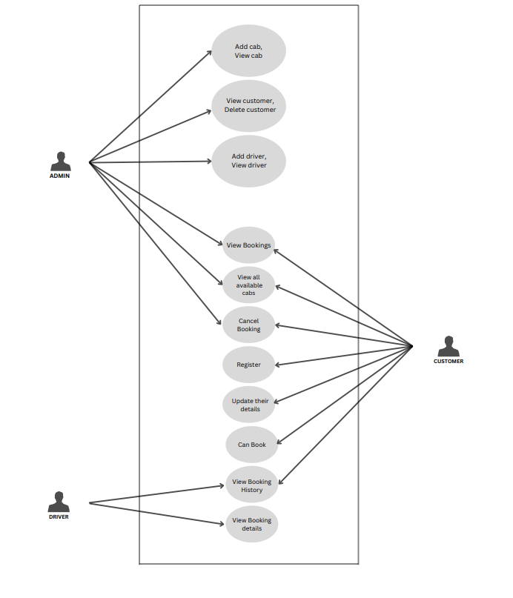
USE CASE:

Slide 5
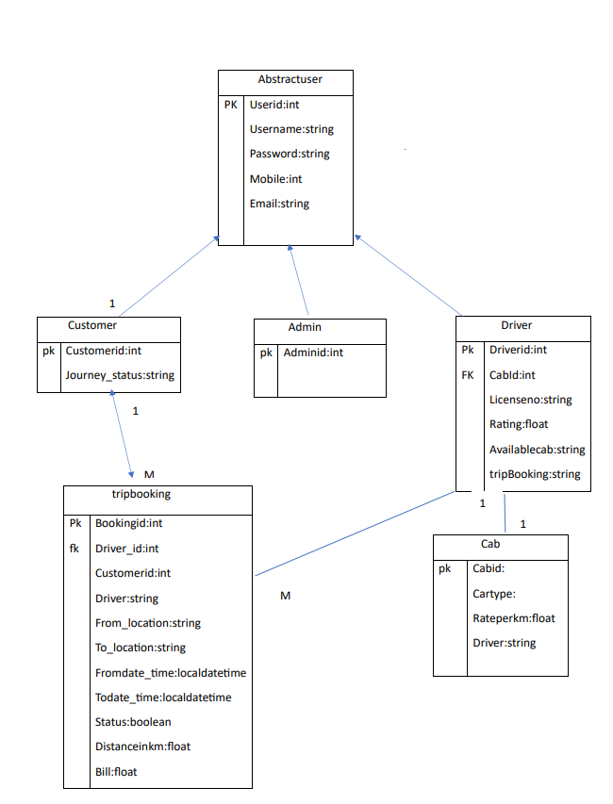
CLASS DESIGN:

Slide 6
USER STORIES:
ADMIN | Use Case | Description
 | Add Cab | Admin can add the Cab. On successful adding return Cab details with http status code 201(Created)
 |  | Admin can add the Cab. If cab not added successfully then return "Cab is not added" with error details
 | Update Cab | Admin can update the cab. On Successful updation return Cab details and message "cab updated successfully"
 |  | Admin can update the Cab. If cab not updated successfully then return "Cab not found with id: ??"
 | Delete Cab | Admin can delete the cab. On Successful deletion return "cab deleted successfully"
 |  | Admin can delete the Cab. If cab not deleted successfully then return "Cab not found with id: ??"
 | View Cab | Admin Can view all cabs using GET method.
 | View Available Cabs | Admin can view all available cabs. On successful request Return All available cabs list.
 |  | If No cabs available then Return "No cabs available for boking"
 | Add Driver | Admin can add the Driver. On successful adding return Driver details with http status code 201(Created)
 |  | Admin can add the Driver. If Driver not added successfully then return "Driver is not added" with error details
 | Update Driver | Admin can update the Driver. On Successful updation return Driver details and message "Driver updated successfully"
 |  | Admin can update the Driver. If Driver not updated successfully then return "Driver not found with id: ??"
 | Delete Driver | Admin can delete the Driver. On Successful deletion return "Driver deleted successfully"
 |  | Admin can delete the Driver. If Driver not deleted successfully then return "Driver not found with id: ??"
 | View Driver | Admin can view all drivers list using GET method.
 | Delete Customer | Admin can delete the Customer. On Successful deletion return "Customer deleted successfully" with status 200(OK)
 |  | Admin can delete the Customer. If Customer not deleted successfully then return "Customer not found with id: ??"(404)
 | View Customer | Admin can view all Customers list using GET method .
 | View Bookings | Admin can view all bookings.
 | Cancel Booking | Admin can cancel booking. On successful cancellation return "booking canceled" (200- OK)
 |  | If booking not canceled . Return "booking not found with bookingId: ??" (404- NOT FOUND)

Slide 7
CUSTOMER | Use Case | Description
 | Register | Customer can register. On successful registration return "Successfully Registered" (201- CREATED)
 |  | If any error occurs Return "Registration Unsuccessfull" (500-Internal serrver error)
 | Update | Customer can update their details. On successful updation return Customer details and "Details Updated successfully"
 |  | On Unsuccessful updation Return "Customer not found with customerID: ??"
 | View Available Cabs | Customer can view all available cabs. On successful request Return All available cabs list. (200-OK)
 | Book Cab | Customer can book cab. On successful booking Return Booking Details and a message "Cab Booked Successfully"
 |  | If any failure Return "Try agin after some time later"
 | Cancel Booking | Customer Can cancel booking. On successful cancelation Return "Booking canceled Sucessfully"
 |  | If any failure then Return " Booking not canceled"
 | View Booking History | Customer can view booking history.
DRIVER | Use Case | Description
 | View Booking Details | Driver can view booking details. On successful GET request Return Details of Booking.
 | View Booking History | Driver can view Booking History. On successful GET request Return List of all Bookings.

Slide 8
SERVICES:
Cab Service
Driver Service
Customer Service
TripBooking Service
Admin Service
SERVER:
Tomcat Server

Slide 9
REQUIREMENTS:
Dependency:
SpringBoot-dev-tools
Spring Data JPA
Spring Web
Eureka Server
Eureka Discovery Client
Oracle Driver
Lombok
Actuator
Swagger

Slide 10
CONCLUSION:
Flexible:
-It is flexible for people to book a cab from their places to wherever they want to go.
User-Friendly:
-We have included technologies like Spring Boot, Rest Controller which will helps the customers to give user friendly experience while using.
Easy Usage:
-Customers can easily access for booking tickets and it can be used by every age group people and its flexible.

Slide 11
THANK YOU…!

