Slide 1
CSE 3020 DATA VISUALIZATION
J COMPONENT
REVIEW 2
ROHITH SAI G 18BCE0451
K SAI KOUSHIK 18BCE0561

Slide 2
TOPIC:
CHURN PREDICTION OF TELCO CUSTOMERS USING VISUALIZATION TECHNIQUES AND MACHINE LEARNING ALGORITHMS
About Topic:
The telecommunications sector has become one of the main industries in developed countries. The technical progress and the increasing number of operators raised the level of competition. Companies are working hard to survive in this competitive market depending on multiple strategies.
As such, the higher the customer churn rate, the lower the companies chances of growing its business. Even if a company have some of the best marketing campaigns in the industry, the company’s bottom line suffers if its losing customers at a high rate, as the cost of acquiring new customers is so high. Customer churn is a critical metric because it is much less expensive to retain existing customers than it is to acquire new customers

Slide 3
Objective:
This project aims to build a predictive model to identify the Churn of the customer using the service of a Telecom company. The idea is to find out the factors in the service which is influencing the customers most. So that it would be helpful to the companies to improve their services and retain the original customers and attract the original customers. Using this we are trying to understand which factors are mainly useful to decrease the churn rate of customers.
We used various plots to visualize the data for better understanding.
Algorithms we are using are:
1. Logistic Regression
2. Decision Tree
3. Random Forest

Slide 4
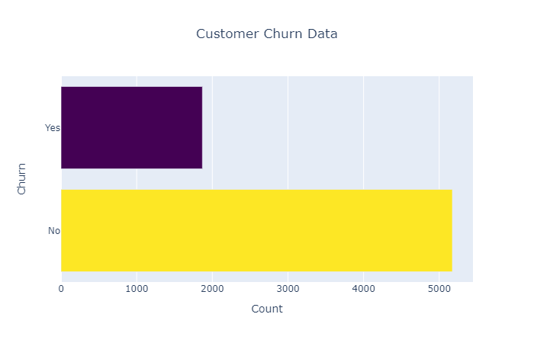
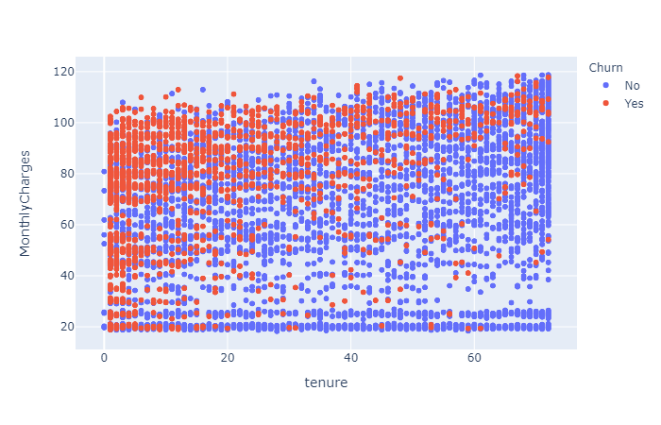
Techniques Used: Data Visualization
We have used countplots, boxplots, histograms, scatterplots, barplots, violinplots etc to visualize the data.

Slide 5
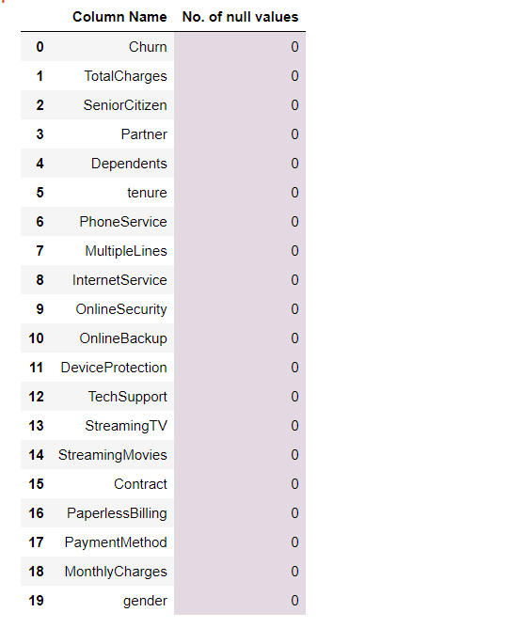
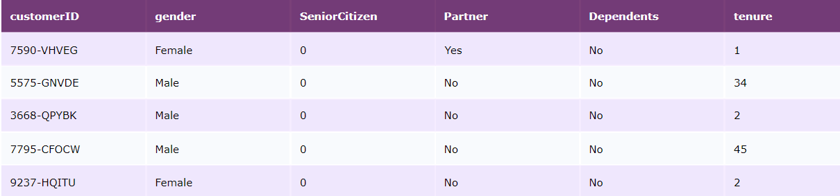
Data Preprocessing
Converting Data types of columns
Handling NULL values in the Dataset
Creating Dummy variables for categorical data

Slide 6
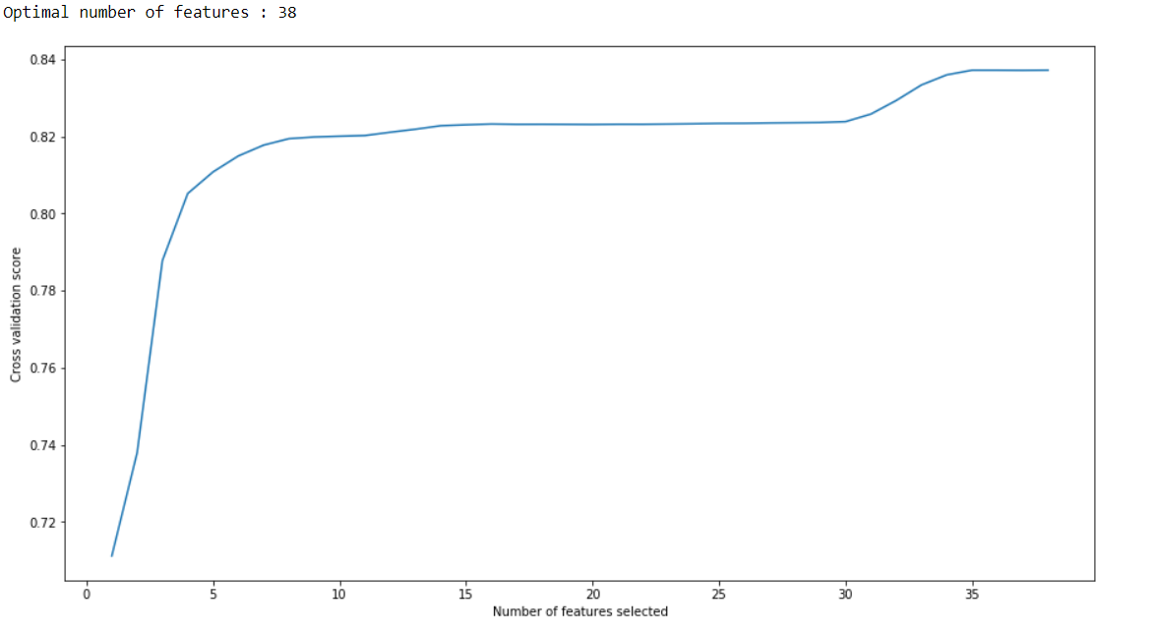
Feature Engineering
Feature Engineering one of the most important part of Model Building
The features in your data will directly influence the models you use and the results you can achieve.
If you have better features the better results we can achieve.
In this project we have used Random Forest Classifier to know how importance each feature is and also used Recursive Feature elimination technique to eliminate redundant attributes and choose the best number of features so that the model performance is good.

Slide 7
Dataset Balancing
In some cases the dataset used for training machine learning model is not balanced. The percentage of labels that need to be predicted is biased towards one value.
In our project we have used some data balancing techniques like
Random Over-Sampling
SMOTE
ADASYN
Each of these techniques uses different methodology to balance the class values of predictive variable.

Slide 8
Random Over-Sampling
Random Over-Sampling simply replicates randomly the minority classes.
Examples from the training dataset are selected randomly with replacement. This means that examples from the minority class can be chosen and added to the new more balanced training dataset multiple times; they are selected from the original training dataset, added to the new training dataset, and then returned or “replaced” in the original dataset, allowing them to be selected again.
SMOTE(Synthetic Minority Over-Sampling Technique)
SMOTE synthesis new minority instances between existing minority instances.
For each minority classes smote calculates K-Nearest Neighbours from a selected point and depending upon the resampling size it chooses a number n under k and creates n samples between selected point and n choosen points.

Slide 9
Model Training
After balancing the dataset machine learning models are trained
Models Used:
1. Logistic Regression
2. Decision Tree
3. Random Forest
4. Bagging Classifier
5. Gradient Boosting Classifier
6. AdaBoost Classifier
7. XGboost Classifier

Slide 10
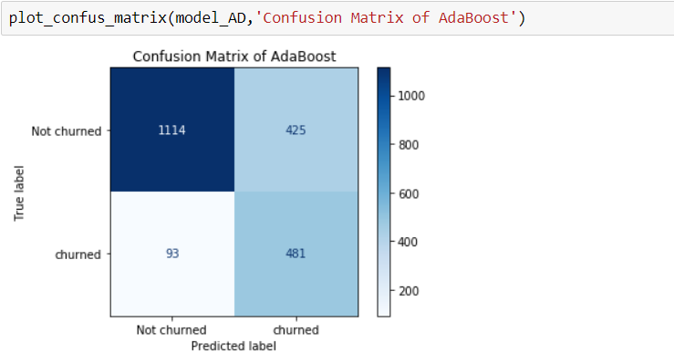
Model Testing
After the completion of model training. The trained model is tested on testing dataset
Metrics used comparing relative performances of models
1. Accuracy
2. Precision
3. Recall (imp)
4. Confusion Matrix
5. f1-score

Slide 11
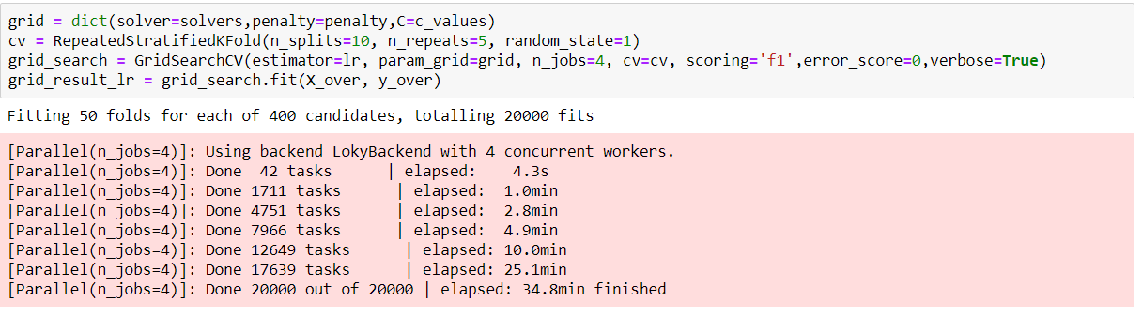
Hyperparameter Tuning
After testing the models on test datasets and selecting the best performing model. We tune the hyperparameters of best performing model
Different machine learning algorithms have different parameters to tune

Slide 12
PACKAGES/LIBRARIES USED
Sklearn
Seaborn
Matplotlib
Plotly
Pandas
Numpy
Imblearn
Xgboost

