Slide 1
A WALKTHROUGH
Introducing
A Practical Walkthrough
SonarQube
Code quality and security, enforced from the IDE to the merge gate.
Subash Krishnan
April 2026

Slide 2
Agenda
1
2
3
4
The Basics
Walkthrough
Governance
Takeaways
What SonarQube is
Why it matters
Three points of enforcement
Dashboard & ratings
Pull-request gate
Inline review experience
IDE shift-left
Quality Profiles
Quality Gate
Rules catalog
Clean-as-You-Code
What we gain
Where to start
Open discussion
Introducing SonarQube — A Practical Walkthrough
2 / 16

Slide 3
What is SonarQube?
SonarQube is a static analysis platform that continuously inspects source code for quality and security problems. It runs as part of the development workflow — in the IDE, in CI, and on a central dashboard — and flags issues long before they reach production.
BUGS & RELIABILITY
Logic errors the compiler accepts
VULNERABILITIES
SAST including taint analysis
It inspects code at three levels:
Correctness — bugs, null-dereference, async mistakes, dead code
Security — injection, hardcoded secrets, weak crypto, TLS misuse
Maintainability — complexity, duplication, code smells, coverage
SECURITY HOTSPOTS
Sensitive code patterns to review
CODE SMELLS
Maintainability debt and complexity
Introducing SonarQube — A Practical Walkthrough
3 / 16

Slide 4
Why it matters
Compilers and code reviews are necessary but not sufficient. These are the gaps SonarQube closes:
Injection vulnerabilities
Hardcoded secrets
Weak cryptography
SQL, XSS, command injection through concatenated strings — found by inter-procedural taint analysis.
AWS keys, JWT keys, DB passwords committed to the repository — caught by 355 secret rules.
MD5 / SHA-1, TLS certificate bypass, insecure random — flagged as Security Hotspots with reviewer workflow.
Complexity drift
Coverage regression
Reliability slips
Cognitive complexity, god-methods, duplication and dead code erode maintainability over time.
Test coverage silently drops without a gate condition on new code.
async void, floating-point equality, potential null dereference — real bugs the compiler accepts.
Introducing SonarQube — A Practical Walkthrough
4 / 16

Slide 5
Three points of enforcement
The same rule set is applied at three stages — each catches issues before the next one has to.
1
2
3
SHIFT LEFT
THE GATE
VISIBILITY
IDE
CI / PR
Dashboard
SonarQube for VS Code
GitHub Actions + PR check
SonarQube Cloud
Connected Mode syncs the server rule set and findings locally. Issues appear inline while you type — before commit.
Every pull request is scanned. Inline annotations on the diff. A failing Quality Gate blocks the merge.
Central view for leads and architects — ratings, trends, hotspots, coverage, and per-folder attribution.
Same rule set · Clean-as-You-Code policy · Same Quality Gate
Introducing SonarQube — A Practical Walkthrough
5 / 16

Slide 6
PART 02
Walkthrough
What Sonar actually shows us — on a clean main branch, on a bad PR, and in the editor.

Slide 7
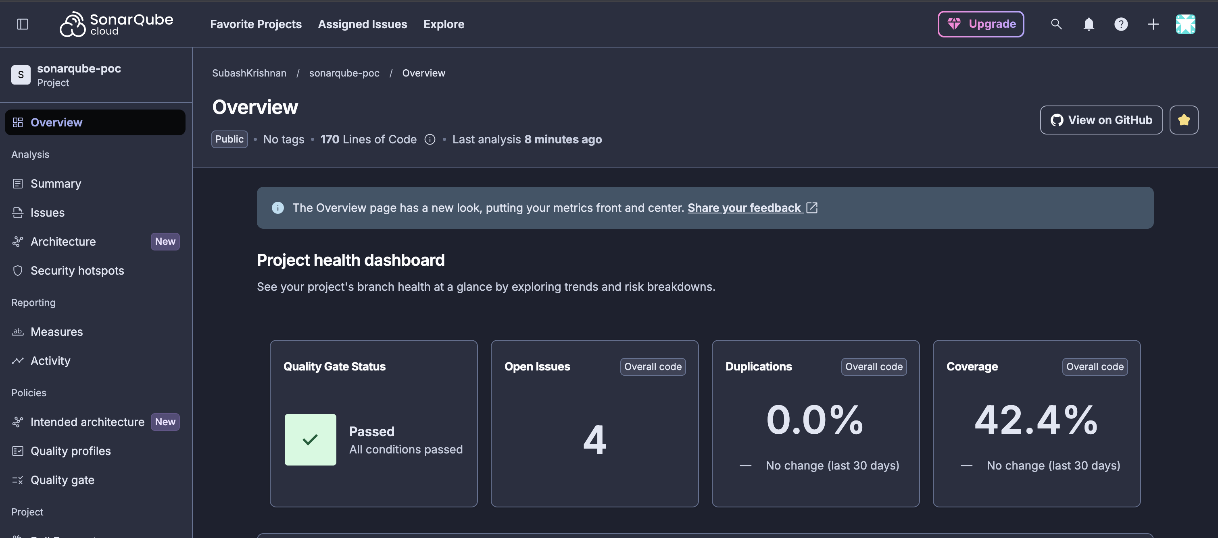
Dashboard — a clean project
Project Overview: the single pane that answers "what is the state of this code?"
LINES OF CODE
170
OPEN ISSUES
4
all medium smells
COVERAGE
42.4%
QUALITY GATE
PASSED
Introducing SonarQube — A Practical Walkthrough
7 / 16

Slide 8
Per-domain ratings
Every project is scored A through E across four domains. A rating of A means no critical issue; E means at least one.
Security
A
Reliability
A
HOW TO READ THE RATINGS
A clean — no critical or high-severity issues
B at least one medium-severity issue
C at least one high-severity issue
D multiple high-severity issues
E at least one critical-severity issue
0 issues
2 medium
Maintainability
A
Security Hotspots
A
2 medium
0 hotspots
These roll up to a single Quality Gate result — the pass/fail value used by the merge check.
Introducing SonarQube — A Practical Walkthrough
8 / 16

Slide 9
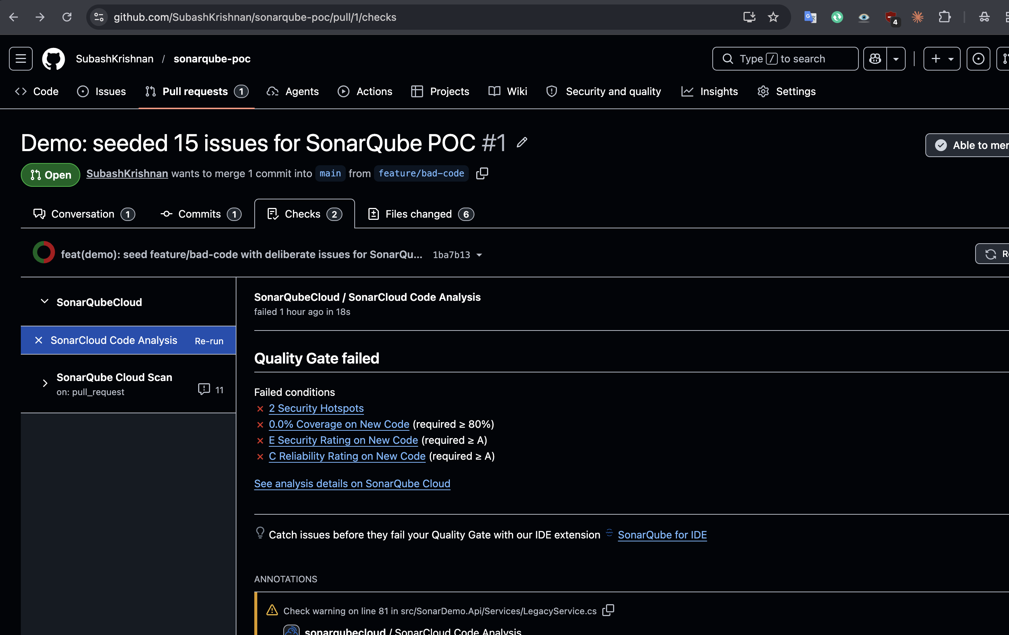
When a PR breaks the rules, the merge is blocked
A required status check from SonarQube Cloud fails and the merge button is disabled until it's fixed.
QUALITY GATE: FAILED
4 failed conditions
2 Security Hotspots on new code
0% coverage on 92 new lines
Security rating E on new code
Reliability rating C on new code
24 new issues flagged — including 2 taint-analyzed vulnerabilities that only SAST can find.
Introducing SonarQube — A Practical Walkthrough
9 / 16

Slide 10
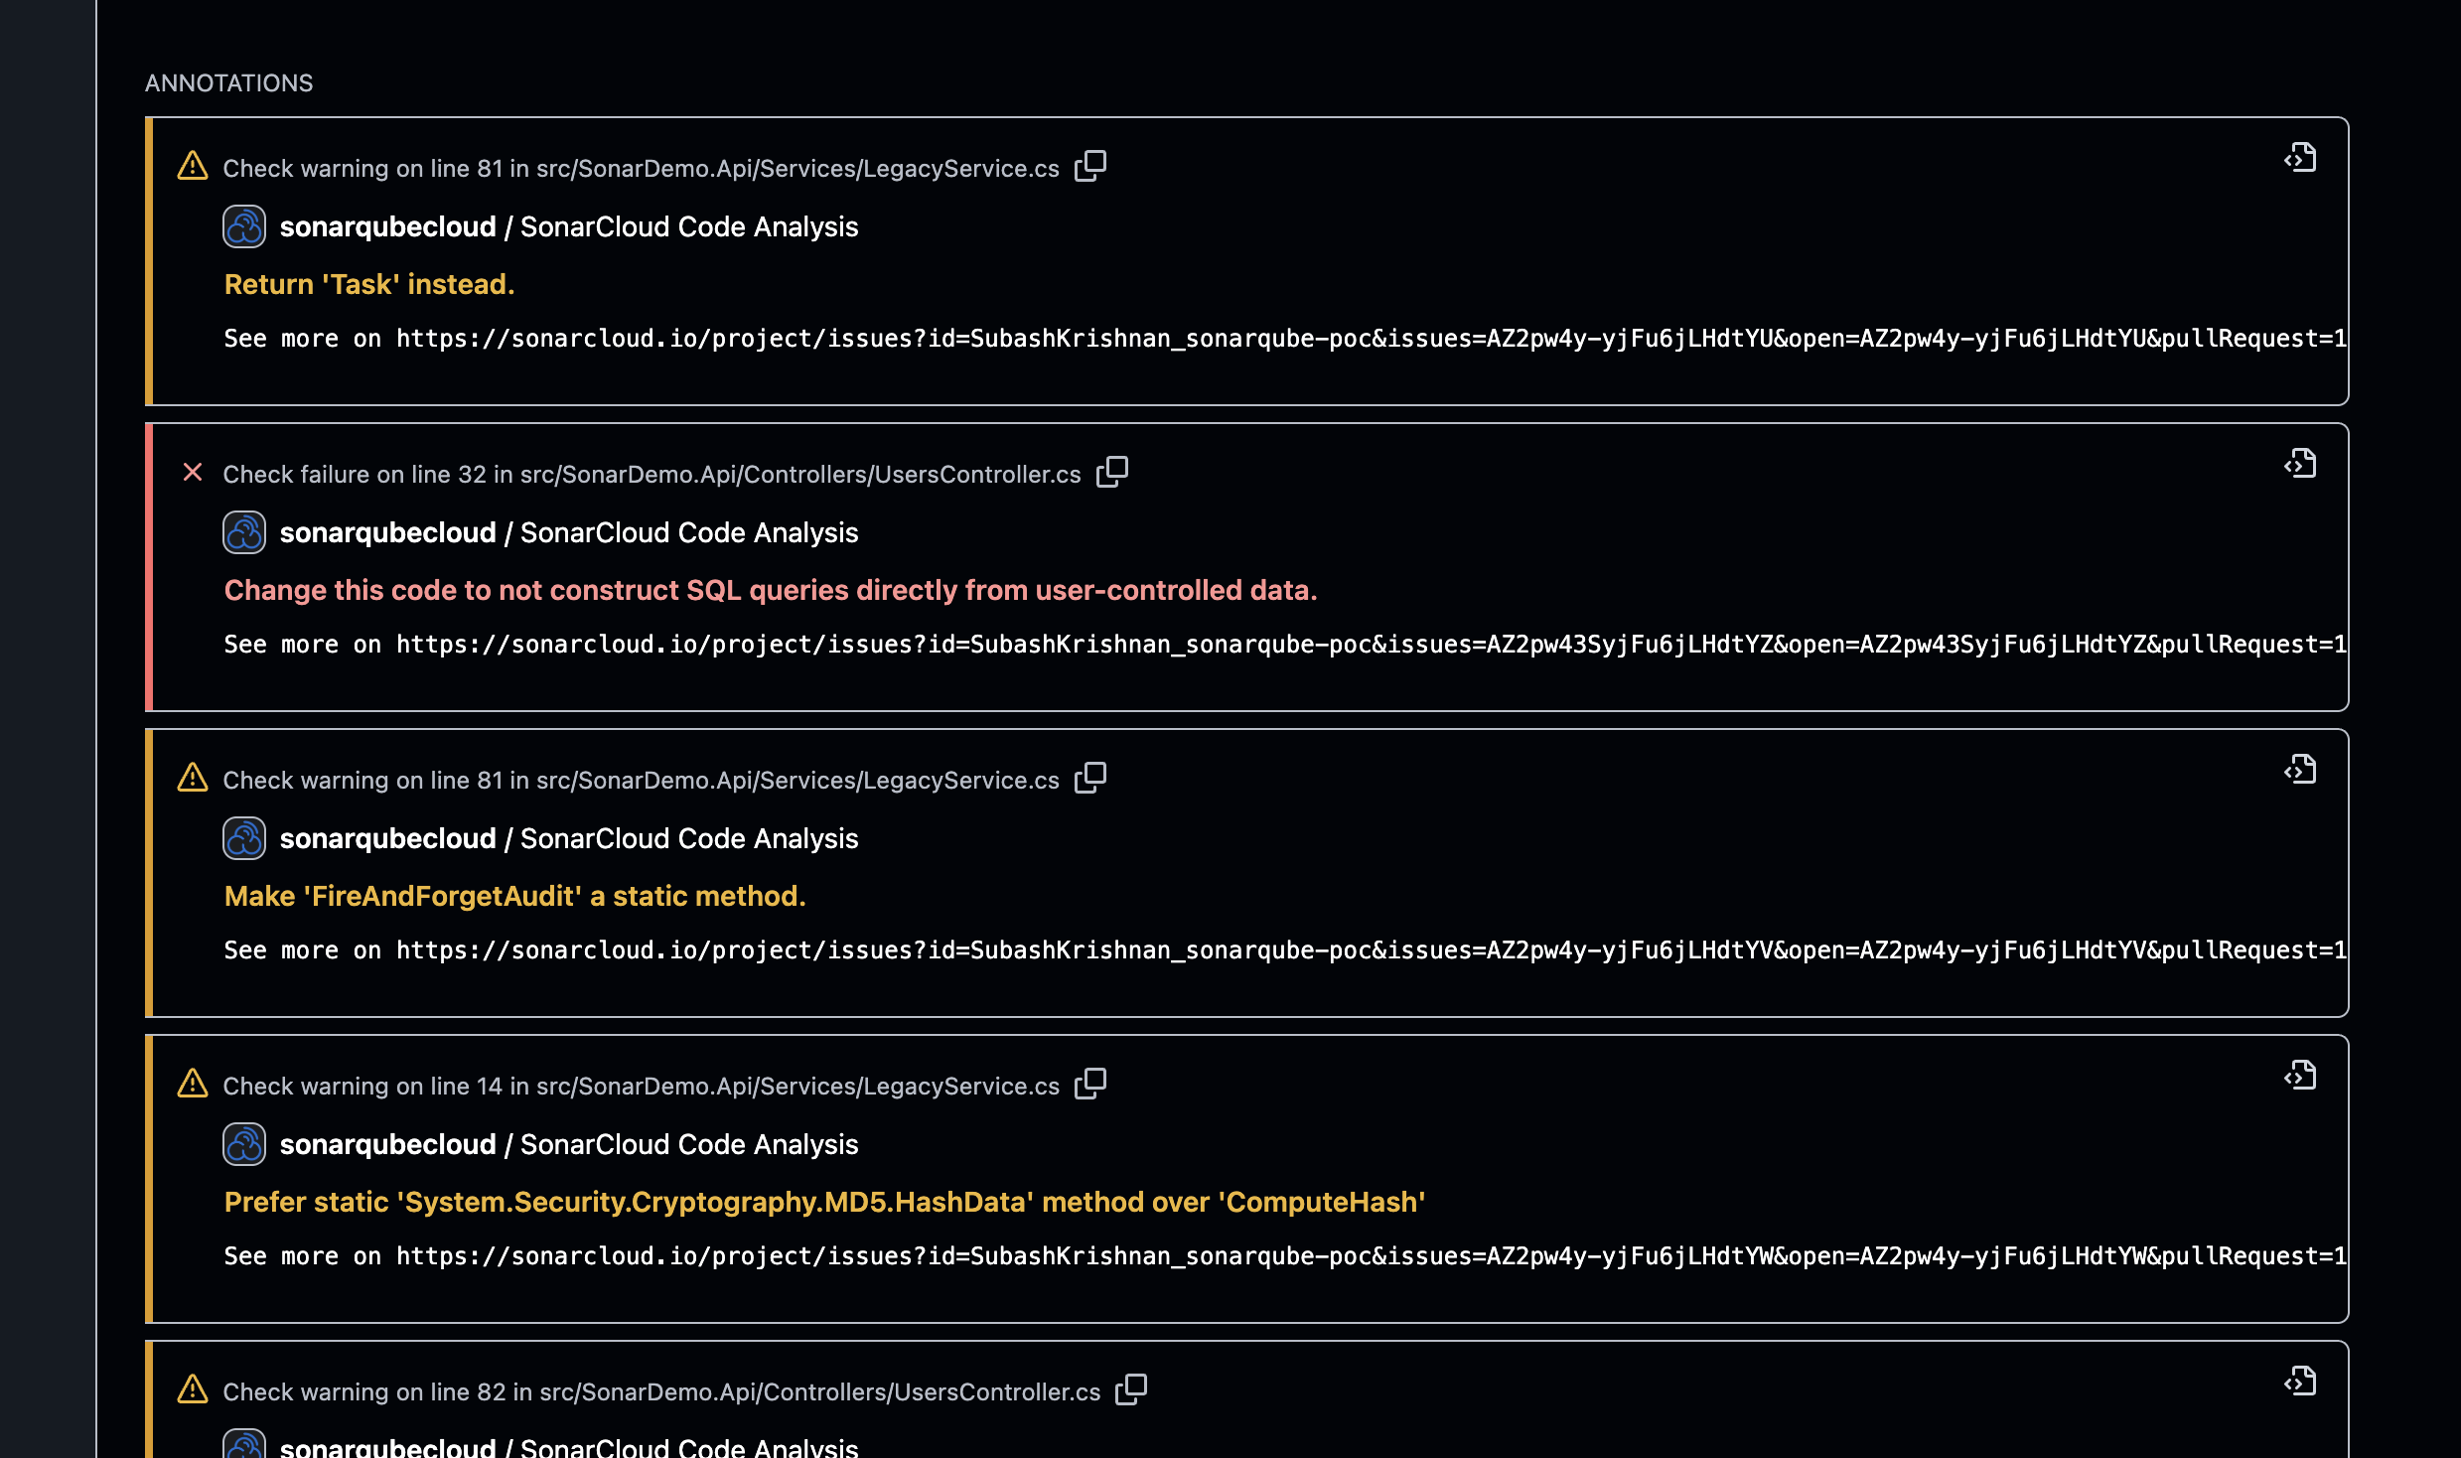
Inline review — findings posted on the diff
The reviewer never leaves GitHub. Sonar posts each finding as an inline comment on the exact line.
WHAT THE REVIEWER SEES
SQL injection
UsersController.cs:32
MD5 weak crypto
LegacyService.cs:14
async void misuse
LegacyService.cs:81
“make static” suggestion
“return Task instead”
Introducing SonarQube — A Practical Walkthrough
10 / 16

Slide 11
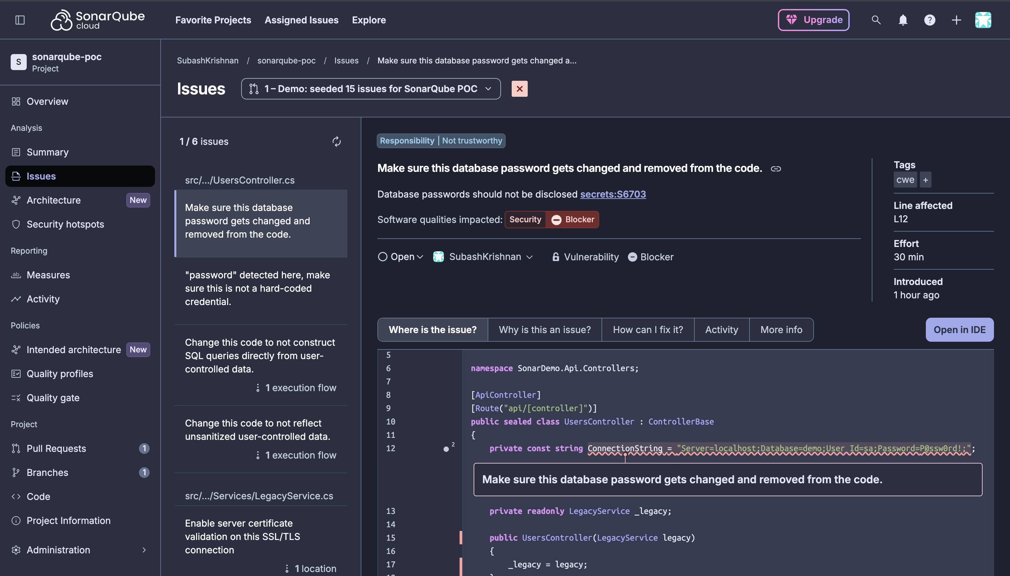
Taint analysis — the SAST differentiator
Following data from an untrusted source all the way to a dangerous sink — the piece compilers and unit tests cannot do.
DATA FLOW
SOURCE
HTTP request parameter
PROPAGATES
Passed into service call
PROPAGATES
Concatenated into SQL string
SINK
Executed as raw query
Introducing SonarQube — A Practical Walkthrough
11 / 16

Slide 12
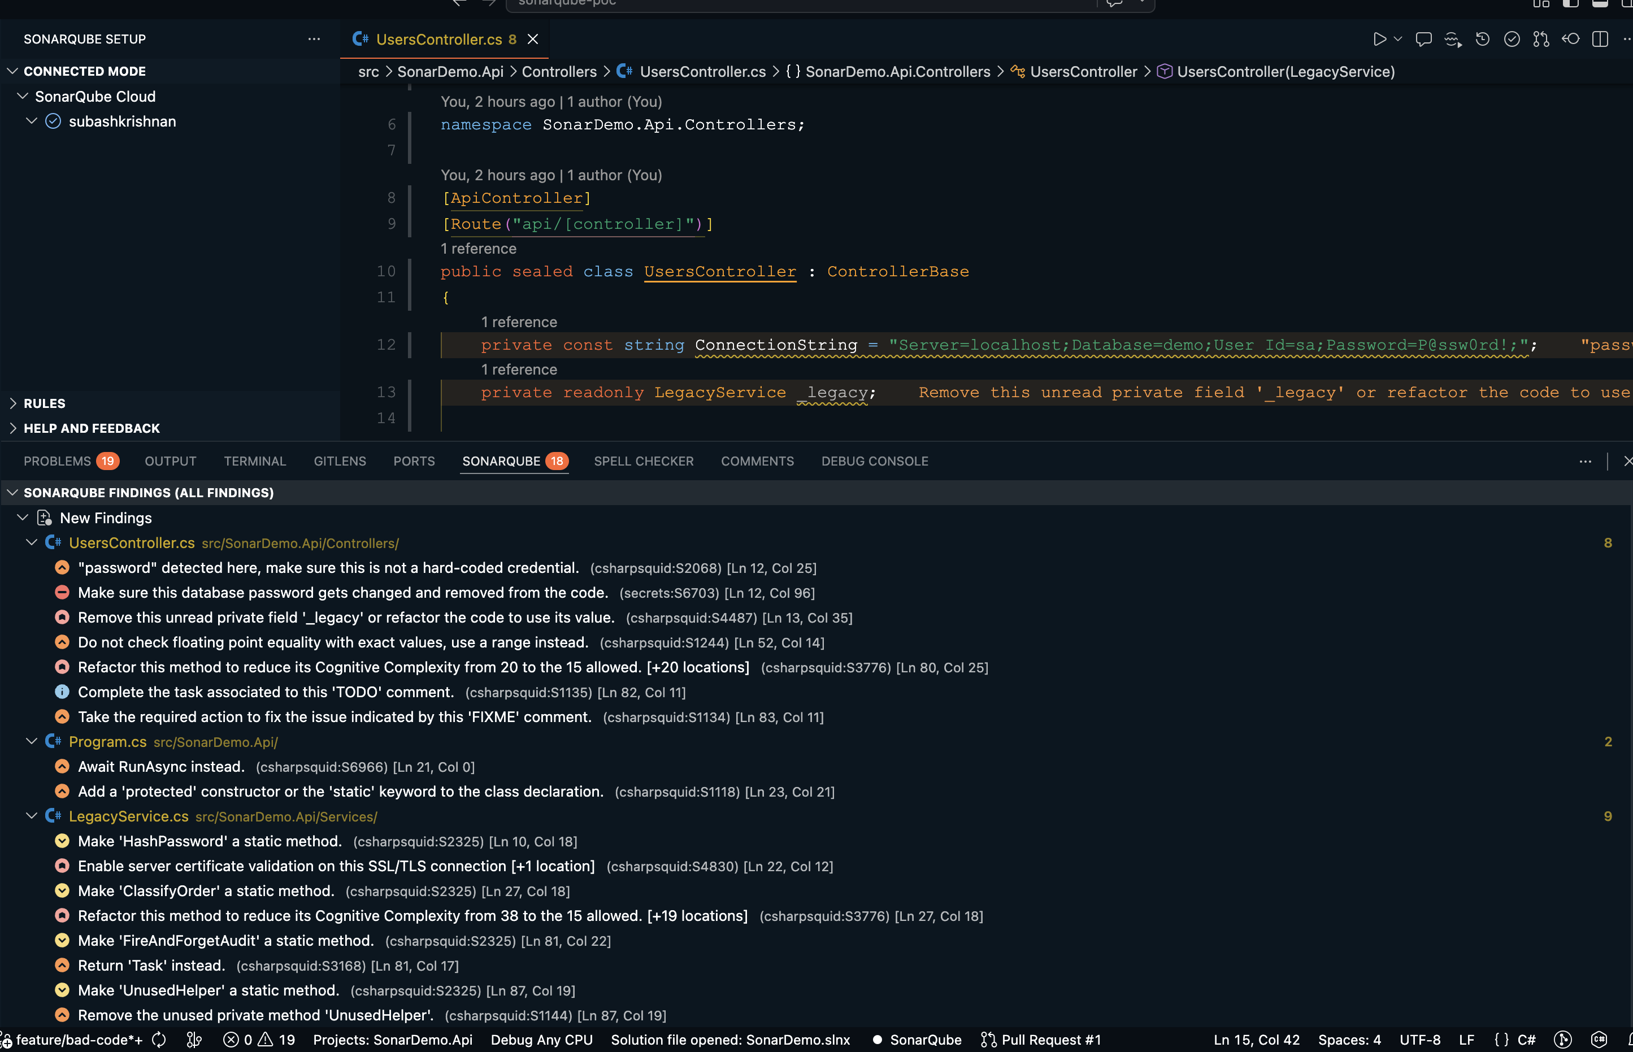
Shift-left — the same findings inside VS Code
Connected Mode binds the editor to the server rule set. 18 findings sync locally — including server-side taint findings.
Live while typing
Issues appear as inline squigglies — no commit required.
Server rules locally
Connected Mode uses the same profile as CI, not a local subset.
Taint findings synced
Whole-program analysis that only the server can compute is mirrored into the panel.
On-demand analyze
Re-scan any file from the command palette.
Introducing SonarQube — A Practical Walkthrough
12 / 16

Slide 13
PART 03
How it's governed
The three levers an architect controls — rules, gates, and profiles.

Slide 14
Rules, profiles, and the Quality Gate
Three configuration surfaces — each solves a different governance question.
01
02
03
Quality Profiles
Quality Gate
Rules Catalog
Which rules are active
Pass / fail conditions
What the platform can detect
A named set of rules per language. The built-in Sonar way profile enables 500+ C# rules out of the box. Clone and customise in paid tiers.
A set of threshold conditions — applied only to new code under the Clean-as-You-Code model. Built-in gate enforces no new bugs, no new vulnerabilities, ≥80% coverage, ≤3% duplication.
7,616 rules across 30+ languages — tagged to OWASP Top 10, CWE, PCI-DSS, STIG. The compliance evidence a regulator will ask for.
500+
6
7,616
C# rules
conditions
rules · 30+ langs
Introducing SonarQube — A Practical Walkthrough
14 / 16

Slide 15
Clean-as-You-Code — gate on new code only
You do not have to fix the entire legacy codebase to adopt Sonar. The gate applies only to lines you changed.
BUILT-IN GATE CONDITIONS
LEGACY CODE
Reliability on new code
A
Rated informationally · not gated
Security on new code
A
Legacy coverage and ratings stay visible so you can track the slope of improvement, but they do not block merges.
Maintainability on new code
A
Security Hotspots reviewed
100%
Coverage on new code
≥ 80%
NEW CODE
Gated — must meet Quality Gate conditions
Duplication on new code
≤ 3%
Introducing SonarQube — A Practical Walkthrough
15 / 16

Slide 16
Takeaways
01
02
Catches what reviewers miss
Enforces at the right moment
SQL injection, hardcoded secrets, weak crypto, async misuse, coverage regression — evidence-backed on the walkthrough.
Live in the IDE, posted inline on the PR, blocking at the merge gate. No pre-commit hooks, no friction.
03
04
Adopts without a legacy cleanup
Compliance-ready out of the box
Clean-as-You-Code gates on new code only — legacy ratings stay informational until refactored.
Rules tagged to OWASP, CWE, PCI-DSS, STIG — the evidence regulators ask for, without a separate scanner.
Thank you · Questions?
Introducing SonarQube — A Practical Walkthrough
16 / 16

