Slide 1
Document Object Model & EventHandling
Subash EN12021072126

Slide 2
What is Document Object Model ?
Document Object Model (DOM) is a platform and language-neutral interface that allows programs and scripts to dynamically access and update the content, structure, and style of a document.

Slide 3
What is Event Handling?
Event Handling is the mechanism that controls the event and decides what should happen if an event occurs. This mechanism have the code which is known as event handler that is executed when an event occurs

Slide 4
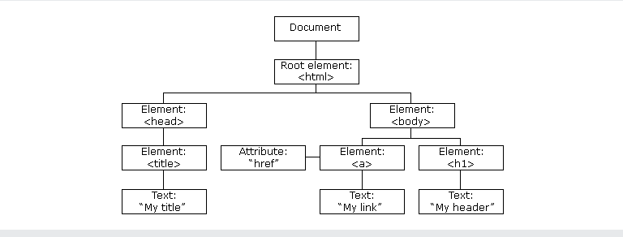
The HTML DOM Tree of Objects

Slide 5
Example1:-
<!DOCTYPE html>
<html>
<head>
<style>
.democlass {
color: red;
}
</style>
</head>
<body>
<p id="p1" class="p2" >HeLLo EveRyOne</p>
<p id="p3"></p>
<button onclick="myFunction()">Click</button>
<script>
function myFunction() {
document.getElementById("p1").innerHTML = "GoodMorning all";
document.getElementsByClassName("p2")[0].style.color = "blue";
document.getElementById("p3").innerHTML = "Thanq";
document.getElementsByTagName("P")[1].setAttribute("class", "democlass");
}
</script>
</body>
</html>

Slide 6

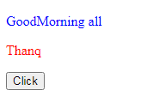
OutPut:-
Before :-
After:-

Slide 7
Example2:-
<!DOCTYPE html>
<html>
<body>
<h1 id="demo"> 2nd Example</h1>
<h2 class="xyz" onmousemove="myFunction1()" onmouseleave="myFunction2()">The Method Too :</h2><button id="myBtn">-!Create and Delete!-</button>
</body>
</html>
<script>
document.getElementById("myBtn").addEventListener("click", myFunction);
function myFunction() {
var ob1 = document.createElement("h1");
ob1.innerText = "This is a paragraph.";
document.body.appendChild(ob1);
var ob2 = document.getElementById("demo");
ob2.remove();
}
</script>

Slide 8
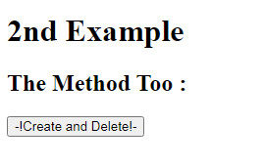
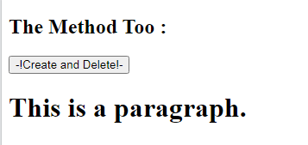
OutPut:-
Before:-
After:-

Slide 9
Thank You
EveryOne

