Slide 1

Jukebox
A Music App
By Subash

Slide 2

What is
Why
Jukebox?

Slide 3

Objective The objective of this project is to develop an console based application called Jukebox. Which enables users to listen to Songs or PodCast , and add their favorites to the playlists, and search it by , applying various filters to filter the music based on categories like Artist , CelebrityName, etc.

Slide 4
Software’s used
IntelliJ IDEA
MySQL
Programming Language’s Used
Java for ( Frontend )
SQL for ( Backend )

Slide 5
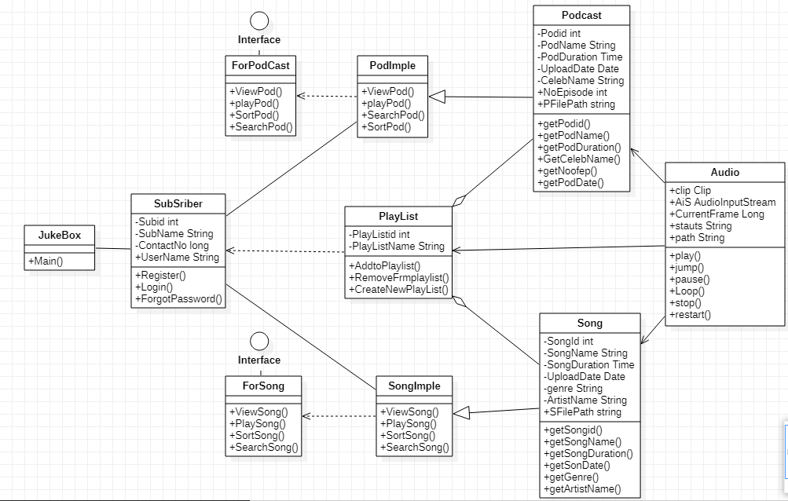
Class Diagram

Slide 6

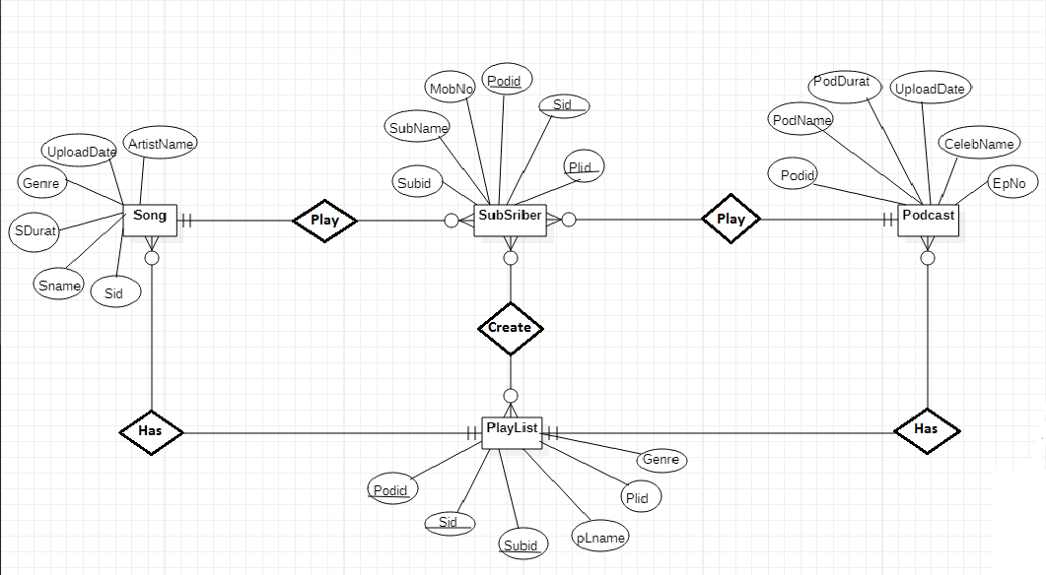
ER Diagram

Slide 7
Thank You

