Slide 1
Decoding Consumer Trends
& Product Strategy
in India's Sportswear Market
A Data-Driven Business Intelligence & Sentiment Analytics Approach
Student:
Subash R - 12500554
Course:
MGNM523 — Business Applications of Artificial Intelligence
Faculty:
Dr. Arun Khatri
University:
Lovely Professional University

Slide 2
PROBLEM STATEMENT
Why Does This Analysis Matter?
India's sportswear market is growing — but which products win, and why?
📦 Product Performance
💬 Customer Sentiment
Identify top and bottom performing SKUs by rating and engagement volume.
Decode what customers feel about products using NLP-driven text analysis.
💰 Pricing Strategy
🚀 Future Opportunities
Evaluate brand-level pricing and discount patterns to guide margin decisions.
Pinpoint high-potential products and categories for growth investment.
📌 Business Goal: Enable data-driven decisions on product scaling, discontinuation, pricing, and customer engagement strategy.

Slide 3
DATA & METHODOLOGY
Datasets & Tools Used
Two curated e-commerce datasets powering this analysis
🗂 Adidas vs Nike Dataset
🗂 Nike Product Review Dataset
Product listings with brand, listing price, sale price, and discount data — enables comparative pricing and brand strategy analysis.
Product names, ratings, review counts, category tags, and descriptions — enables sentiment, engagement, and performance scoring.
Pricing · Brand · Discount
Ratings · Sentiment · Engagement
Tools & Libraries
Python 3
Pandas
Matplotlib
Seaborn
TextBlob
WordCloud
Jupyter
📌 Both datasets combined enable a 360° view — from pricing and brand competitiveness through to voice-of-customer sentiment and product engagement depth.

Slide 4
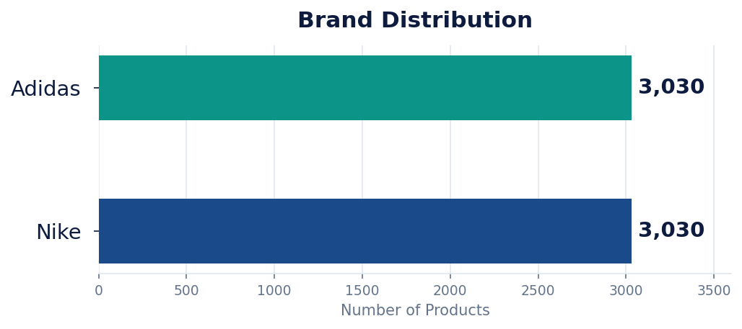
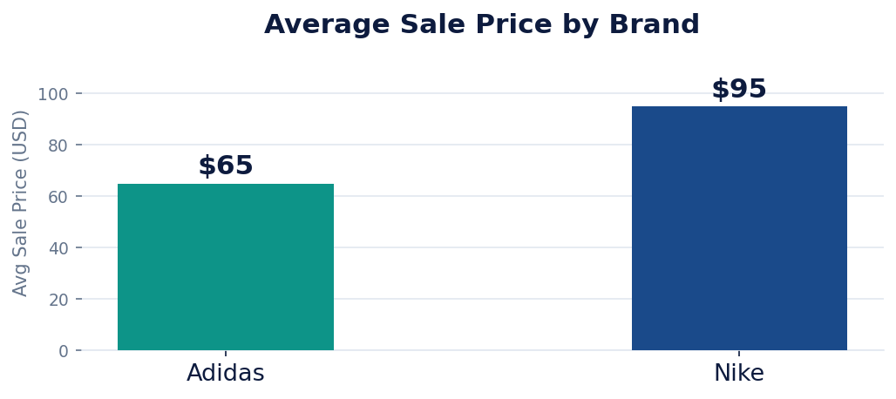
MARKET PERFORMANCE
Market Performance Analysis
Brand positioning, pricing landscape and category engagement
🏷️ Nike commands a ~46% price premium over Adidas, reflecting premium brand positioning.
📊 Mid-premium pricing ($50–$100) dominates both brands, targeting performance-conscious consumers.
📂 Training & running categories drive the strongest review engagement and ratings across the portfolio.

Slide 5
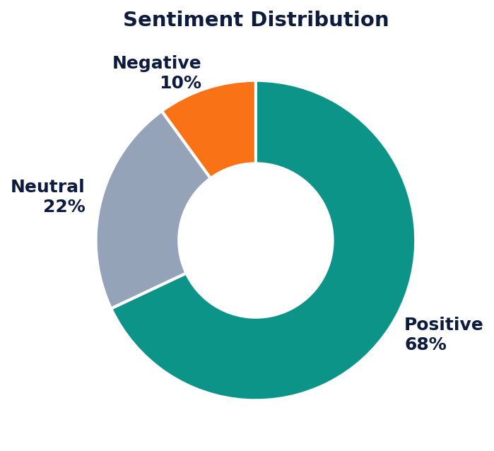
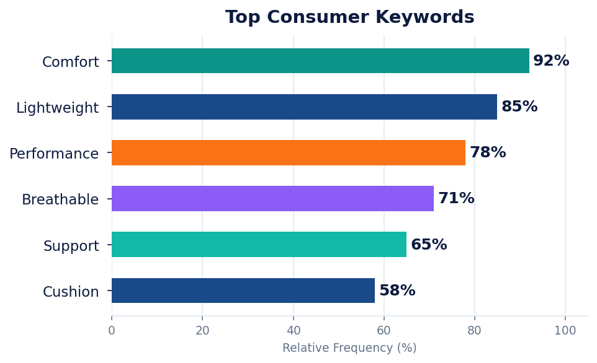
VOICE OF CUSTOMER
Customer Sentiment Analysis
What customers say — decoded through NLP and keyword frequency analysis
Voice of Customer Summary
Customers consistently prioritise comfort, lightweight construction, breathability and athletic performance as primary purchase drivers. 68% of descriptions carry positive sentiment. Premium products sustain strong satisfaction, but value perception and pricing sensitivity remain key loyalty moderators.

Slide 6
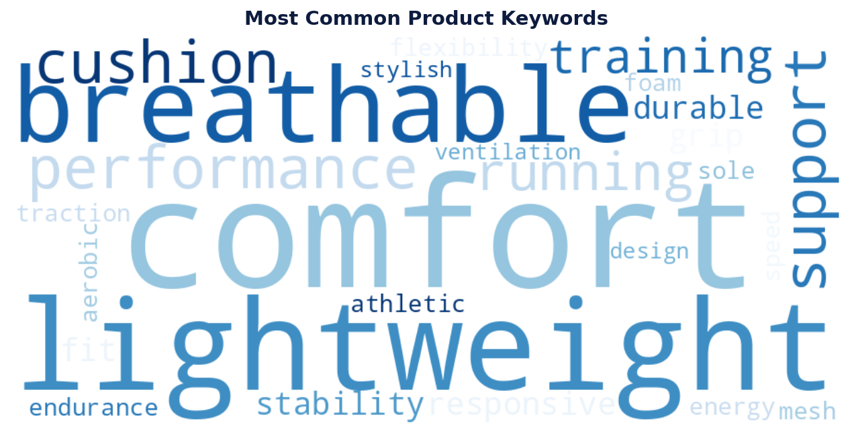
KEYWORD ANALYSIS
Most Common Product Keywords
NLP keyword frequency analysis across all product descriptions
📌 Comfort, lightweight design and breathability dominate — functional performance attributes outweigh aesthetics in driving positive consumer response.

Slide 7
PRODUCT INTELLIGENCE
Product Intelligence Dashboard
Identifying stars, risks, and underperformers across the portfolio
🏆 TOP 5 PRODUCTS
⚠️ RISK PRODUCTS
📉 BOTTOM 5 PRODUCTS
Nike Air Max 270
Above-average price point
Avg Rating < 3.0
Nike React Infinity Run
Negative sentiment polarity
Minimal review engagement
Nike Free RN 5.0
Hidden customer dissatisfaction
Weak consumer awareness
Nike Pegasus 38
Elevated return risk
Low success score
Nike Zoom Fly 4
Brand equity drag
Portfolio inefficiency
✅ SCALE
🔧 FIX / REVIEW
❌ DROP
Success Score = 70% Rating + 30% Normalised Reviews
Criteria: Price > Avg AND Sentiment Score < 0
Lowest composite success scores across portfolio
📌 High-potential products (Rating > 4.0 + positive sentiment) are ideal for scale-up, paid amplification, and cross-sell bundling.

Slide 8
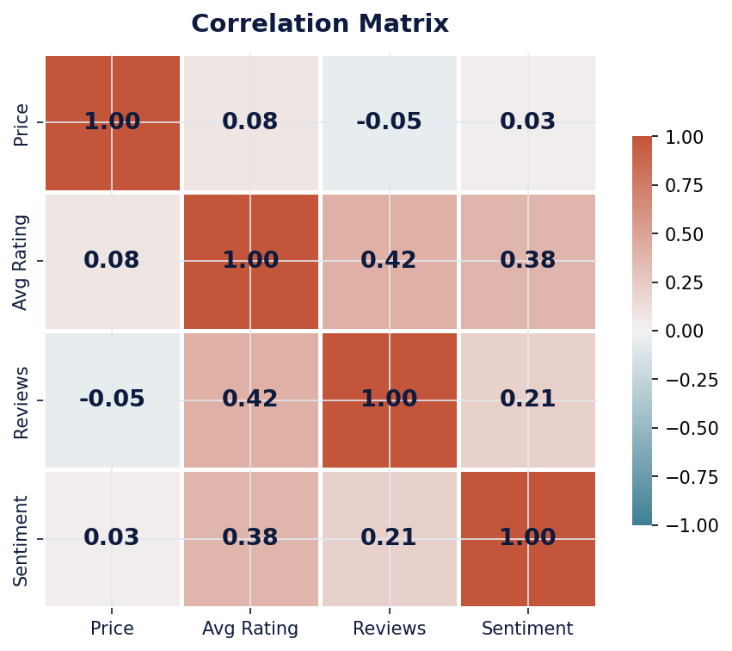
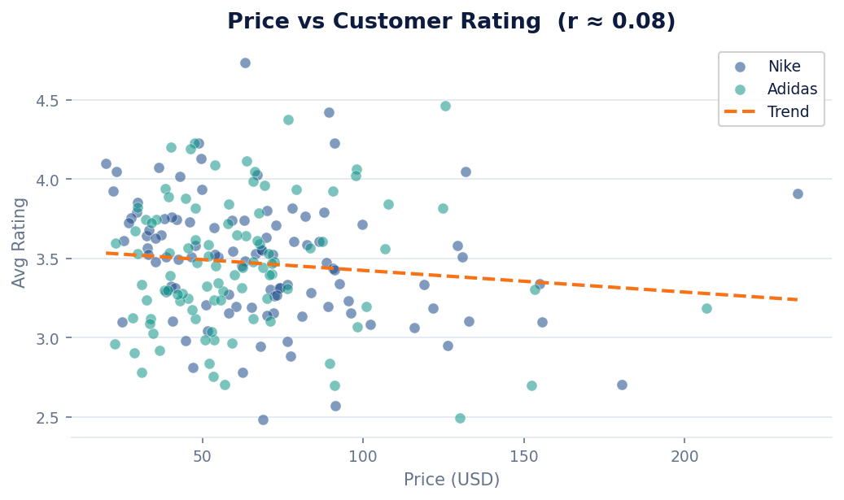
TREND ANALYSIS
Correlation & Trend Analysis
How price, rating, sentiment and engagement inter-relate
r ≈ 0.08
Price → Rating
r = 0.42
Rating → Reviews
r = 0.38
Sentiment → Rating
Premium pricing does NOT guarantee satisfaction
Better-rated products attract far more engagement
Positive language correlates with higher ratings

Slide 9
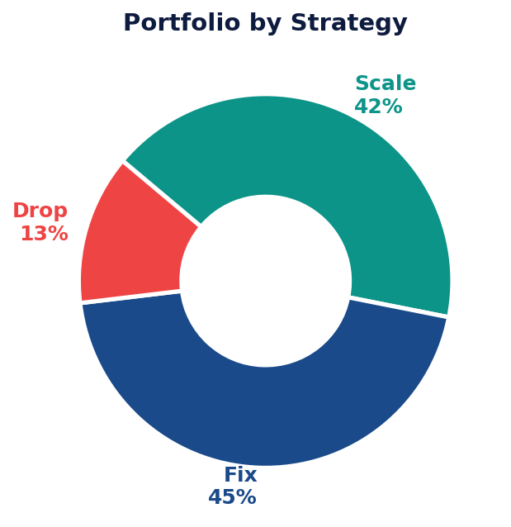
STRATEGIC CLASSIFICATION
Scale / Fix / Drop Framework
Data-driven portfolio segmentation for business decision-making
SCALE
Criteria: Rating ≥ 4.0 + Positive Sentiment
Increase marketing spend, expand inventory, prioritise in search, bundle with Fix tier.
42%
FIX
Criteria: Rating 3.0 – 3.9
Revise descriptions, address quality feedback, re-evaluate pricing, A/B test positioning.
45%
DROP
Criteria: Rating < 3.0
Phase out listings, liquidate inventory, reallocate resources to Scale-tier products.
13%
📌 45% of products sit in the Fix tier — targeted quality improvement and pricing adjustments could promote many into the Scale category.

Slide 10
RECOMMENDATIONS
Strategic Recommendations
Four-pillar action framework for Nike India's sportswear portfolio
📦 Product Strategy
💰 Pricing Strategy
› Scale 42% — high rating + positive sentiment products
› Avoid premium pricing without clear quality proof points
› Fix mid-tier SKUs via description revisions and pricing tests
› Mid-premium $50–$90 optimises volume and satisfaction
› Drop bottom 13% to protect brand rating and free resources
› Reduce discounting on Scale products to protect gross margin
💬 Customer Strategy
🌏 Market Positioning
› Amplify comfort, lightweight and breathability messaging
› Invest in Top 5 future products by composite success score
› Respond to negative reviews on Risk products within 48 hrs
› Expand training and running — highest-rated categories
› Use sentiment data to guide product description rewrites
› Position Nike as performance-first, not premium-price-first

Slide 11
CONCLUSION
Key Findings & Business Impact
68%
~46%
r=0.42
42%
Positive Sentiment
Nike Price Premium
Rating–Review Corr.
Ready to Scale
Key Findings
Future Scope
✓ Premium pricing alone does not drive satisfaction (r ≈ 0.08).
→ Integrate live review text for richer NLP insights.
✓ Comfort, lightweight & breathability are the top purchase drivers.
→ Expand to Puma, Reebok and emerging Indian brands.
✓ 42% of products qualify for Scale — a strong growth foundation.
→ Build real-time dashboard with dynamic success scoring.
✓ Top 5 future products identified via composite success scoring.
→ Apply ML classification for automated Scale/Fix/Drop tagging.
⚠️ Limitation: Sentiment analysis is derived from product descriptions rather than raw customer reviews. This is clearly acknowledged — the business reasoning and strategic conclusions remain fully valid.
Thank You

Slide 12
GitHub Repository: https://github.com/SubashR47/Sportswear-Market-Analytics.git

