Slide 1
Employee data Analysis using excel
Student name: r.subashini
Register no: 312214956
Department:commerce
College: annai veilankanni ‘s college for women
Nmid..Asunm1483312214956

Slide 2
Project title:
Employee performance analysis using Excel.

Slide 3
Agenda
Project overview
End user
Problem statement
Modelling approach
Data set description
Conclusion.

Slide 4
Problem statement
Accurately evaluate employee performance
Identify strengths, weaknesses, opportunities and threat(SWOT analysis)
Develop targeted interventions and programs
Inform telent management decisions (promotions,successions)

Slide 5
Project overview
Analysis employee Performance data to identify key drivers of performance and areas for improvement
Develop data-driven insights to inform talent management decisions, training programs and leadership development initiatives
Focus on indentifying key predictors of performance,area of improvement and opportunities for growth and development.

Slide 6
Who are the end users?
Line managers
HR business partners
Senior leadership
Employee development teams
Compensation and benefits teams
Talent acquisition teams

Slide 7
Our solution and it’s value proposition
Solution: Empower AI- employee performance insights
Value proposition:
Identify top performances
Pinpoint skills gaps
Enhance employee engagement
Inform data-driven decisions
Boost productivity.

Slide 8
Dataset description
Description: This data set contains information on employee performance, demographics and development activities
Fields:
Employee ID
Name
Job role
Department
Performance rating
Performance level

Slide 9
The “wow” in our solution
AI driver predictive analysis for accurate forecasting and insights
Automated performance scoring for unbiased evaluations
Personalized development plans for targeted growth and improvement .

Slide 10
Modelling
Regression analysis
Decision trees
Clustering analysis
Predictive modeling
Propensity scoring
Survival analysis
Network analysis

Slide 11
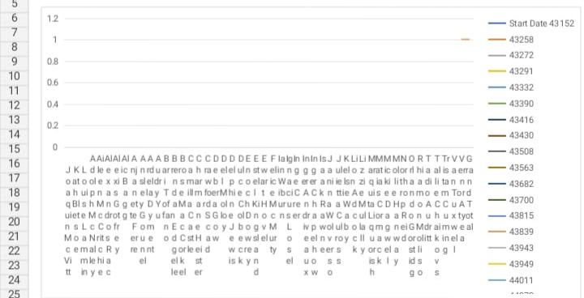
Results

Slide 12
Conclusion
Employee performance analysis is a critical component of talent management, enabling organizations to make data driven decisions, drive business outputs and enhance employee experience. By leveraging advanced analytics modelling techniques.

