Slide 1

Department of Computer Science and Engineering
PROJECT NAME: NOISE POLLUTION MONITORING
TEAM NAME: Proj_224788_Team_1
TEAM MEMBERS:
Sijayini M (113321104093)
Siva Nandhini V (113321104094)
Sneka K (113321104096)
Subashree S (113321104098)

Slide 2
Phase 2 - Innovation
OUTLINE
Project Objectives
Virtualization Diagram on IOT
Raspberry PI Integration
Code Implementation
Conclusion

Slide 3
Project Objectives
The Primary Objective of this project is:
To design and implement a low-cost, portable, and reliable sound sensor module that can detect and measure the sound level in decibels (dB).
To connect the sound sensor module to an Arduino board and an ESP8266 module that can transmit the data to the cloud using Wi-Fi.
To analyze the data for noise pollution levels and display the results on a mobile app using Blynk platform.
To raise awareness and alertness about the harmful effects of noise pollution on human health and the environment.

Slide 4
Steps Involved
IOT Sensors Setup:
Sensor Selection
Data Collection
Data Processing and Visualization
App Development
Raspberry Pi Integration
Code Implementation
Conclusion

Slide 5
IOT Sensors Setup

Slide 6
1. Sensor Selection
The sound sensor module was selected because it is cheap, easy to use, and compatible with Arduino and Raspberry Pi.
The sound sensor module can measure the sound level in dB, which is a standard unit for noise pollution assessment.
The sound sensor module can also detect the frequency and duration of the sound, which are important factors for noise pollution analysis.
The sound sensor module has a wide range of detection, from 30 dB to 130 dB, which covers most of the noise sources in public areas.

Slide 7
2. Data Collection
The data collection process involves the following steps:
The sound sensor module is deployed in a public area, such as a park, a street, or a school.
The sound sensor module detects the sound level in dB and sends it to the Arduino board via an Analog pin.
The Arduino board converts the analog value to a digital value and sends it to the Raspberry Pi via a USB cable.
The Raspberry Pi reads the data from the Arduino serial port and sends it to the cloud broker using MQTT protocol.
The cloud broker receives the data and stores it in a database for further processing and analysis.

Slide 8
3. Data Processing and Visualization
The data processing and visualization process involves the following steps:
The cloud service subscribes to the MQTT topic that receives the data from the Raspberry Pi.
The cloud service performs some statistical analysis on the data, such as calculating the average, minimum, maximum, and standard deviation of the dB values.
The cloud service also applies some filters and thresholds to the data, such as removing outliers, smoothing the data, and classifying the noise levels into categories (low, moderate, high, very high).
The cloud service generates some charts and graphs to visualize the data, such as line charts, bar charts, pie charts, and heat maps.
The cloud service sends the processed and visualized data to the mobile app using Blynk platform.

Slide 9
4. App Development
As the app was created by using Android Studio, the app will display the data taken from the sound sensor. Android Studio is a software to create app use JAVA language to design an Android development. The app has four features which are the reading of sound level in dBA, the level of warning based on the reading of sound intensity, the possible sound that contributes to the sound level and the suitability for students to study. The app gives different level of warning such as “low”, “normal”, “high” and “very high”.
The mobile app displays the data on a user-friendly interface that shows the current noise level.

Slide 10
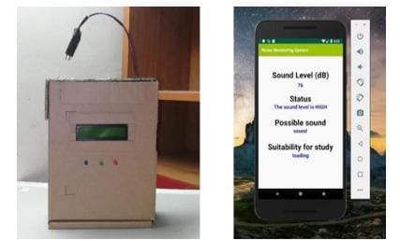
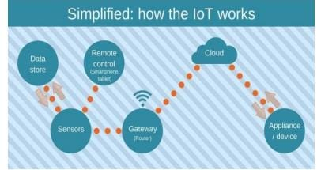
Diagram
Working Principles of IOT
Interface of the app on mobile phone

Slide 11
Raspberry Pi Integration
The Arduino board is connected to a Raspberry Pi via a USB cable.
The Raspberry Pi acts as a gateway between the sensor module and the cloud service.
The Raspberry Pi runs a Python script that reads the data from the Arduino serial port and sends it to the cloud using MQTT protocol.
The Raspberry Pi also hosts a web server that displays the data on a web page.

Slide 12
Code Implementation
The Arduino code uses the Serial library to communicate with the Raspberry Pi and the Blynk library to communicate with the mobile app.
The Arduino code reads the Analog value from the sound sensor module and converts it to dB using a formula.
The Arduino code also sends the dB value to the Blynk app using a virtual pin.
The Python code uses the Paho MQTT library to publish and subscribe to MQTT topics on the cloud broker.
The Python code also uses the Flask library to create a web server that serves a web page with a chart of the dB values.

Slide 13
Conclusion
The project demonstrates how IoT can be used to monitor noise pollution in public areas and provide real-time feedback to the users.
The project uses low-cost and easy-to-use components that can be replicated and deployed in various locations.
The project also shows how noise pollution can be visualized and analyzed using cloud services and mobile apps.
The project aims to create awareness and alertness about noise pollution and its impact on human health and the environment.

Slide 14
Thank You

