Slide 1
NOISE POLLUTION MONITORING
SUBMITTED BY:
SIJAYINI.M(113321104093)
SIVA NANDHINI(113321104094)
SNEKA(113321104096)
SUBASHREE S (113321104098)

Slide 2
ABSTRACT:
Now a days in metropolitan cities air and noise pollution becomes serious issues. due to high decibels and toxic gases present in the environment which directly effect on human’s health and thus needs a special attention. Therefore, it has now become necessary to control the pollution (air and noise)to ensure healthy livelihood and better future. To overcome with these issues, Here we implement the system. Where it detects the harmful gases and noise present in the environment

Slide 3
PROBLEM STATEMENT:
An effective natural observing framework is essential to screen and estimate the conditions in the event of surpassing endorsed level of parameter (for example, commotion, COand radiation levels). At the point whenthe items like condition furnished with sensor gadgets, smaller scale controller and different programming application turn into a self-securing and self-observing condition.

Slide 4
EXISTING SYSTEM:
Some of the research work made for monitoring the pollution parameters in a particular location in order to make the environment safe and that area smart. Different methods were used in the past and are described in this section. First is Smart Environment Monitoring using Wireless sensor networks in which the main focus was on the developing an environment free of pollution by making it smart. Wireless sensors are fitted all over the city and in public transports. By monitoring all the sensor networks, all the environmental happenings can be gathered as a streaming database to analyse the environmental position.

Slide 5
PROPOSED SYSTEM:
The noise pollution monitoring system consists of ARM7 microcontroller [5] and sensors. Microcontroller is also known as the mind of the device. Initially, the microcontroller is provided with a 5V supply. Sensors provide the data to the microcontroller that is displayed on the LCD display continuously, LCD Display is connected to the microcontroller board and if the air pollution exceeds the set limit (defined by the programmer) then the output is shown in the analog form i.e. if the air pollution is raised it will be displayed on the output pane, Buzzer simultaneously buzz and similarly when the sound pollution exceeds the set limit (90dB in this case) the buzzer will be displayed as output on the output panel. Now the data which is retrieved from sound sensor will be provided to the WiFi module which is connected to the 3.3 V pin on the microcontroller board. This WiFi module (nRF24L01 module) will then provide this data to the android application accessible to all the android phone users and accordingly the local people can take actions on their part.

Slide 6
SOFTWARE REQUIREMENT:
Aurdino compiler
MC programming language :C
IOTGecKo

Slide 7
HARDWARE REQUIREMENTS:
ArduinoUNO
MQ135 (Gassensor)
LM393 (Noisesensor)
ESP8266 WIFIModule
16*2 LCDDisplay
LED
Buzzer • Arduino UN

Slide 8
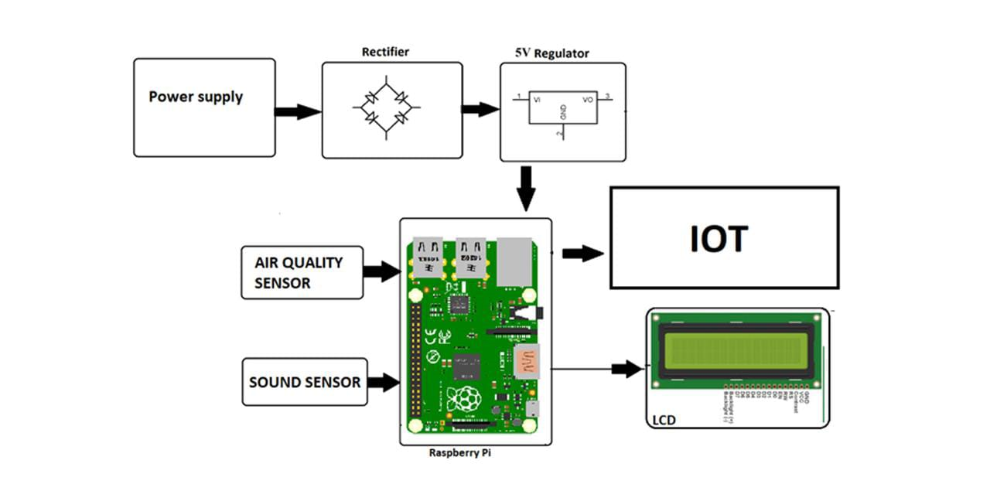
ARCHITECTURE:

Slide 9
CONCLUSION:
By using this project each and every variation we can analyze and inform nearby people in time. We can also analyze data form home using thingspeak. The most important factor of this system is that it is small, cost efficient and portable. Sensors are available easily anywhere. This system fully helpful to save the lives and overcome all the problem related to environment.

Slide 10
THANK YOU

