Slide 1

Department of Computer Science and Engineering
PROJECT NAME: NOISE POLLUTION MONITORING
TEAM NAME: Proj_224788_Team_1
TEAM MEMBERS:
Sijayini M (113321104093)
Siva Nandhini V (113321104094)
Sneka K (113321104096)
Subashree S (113321104098)

Slide 2
Innovation:
Revolutionize noise pollution monitoring by integrating cutting-edge technologies.
Employ a decentralized network of sensors, leveraging machine learning for real-time data analysis.
This innovative approach not only identifies noise sources promptly but also prioritizes interventions effectively.
Foster community engagement through user-friendly interfaces, enabling residents to access and contribute data.
Implementing this comprehensive system encourages a collective effort in managing and mitigating noise pollution.
It not only enhances urban living quality but also provides valuable insights for urban planning, promoting a harmonious balance between technology, community, and environmental sustainability.

Slide 3
Project objective:
*Real-time Monitoring:* Develop a system capable of continuously monitoring noise levels through distributed sensors.
*Source Identification:* Implement machine learning algorithms to analyze data and identify specific sources of noise pollution.
*Early Warning System:* Establish protocols for immediate alerts and notifications to relevant authorities and communities for proactive noise management.
*Community Engagement:* Create user-friendly interfaces and apps to involve residents in contributing data, fostering community awareness and participation in noise reduction efforts.
*Data Analysis and Reporting:* Develop robust analytical tools to generate reports, providing valuable insights for policymakers and urban planners.
*Scalability:* Design the project with scalability in mind, allowing for expansion and adaptation to different urban environments.
*Integration with Urban Planning:* Collaborate with city planners to integrate noise pollution data into urban development strategies, contributing to more sustainable and livable cities.

Slide 4
Project requirements:
1. *IoT Sensors:* Acquire and deploy a network of high-quality IoT noise sensors for accurate and real-time data collection.
2. *Data Storage and Processing:* Implement a secure and scalable data storage solution, paired with robust processing capabilities for efficient analysis.
3. *Machine Learning Algorithms:* Develop or integrate machine learning algorithms capable of identifying and categorizing different sources of noise pollution.
4. *Communication Infrastructure:* Establish a reliable communication infrastructure to facilitate seamless data transfer between sensors, processing units, and end-users.
5. *User Interfaces:* Design user-friendly interfaces for both authorities and residents, allowing easy access to noise data, alerts, and community engagement features.

Slide 5
Project requirements:
6. *Security Measures:* Implement stringent security protocols to safeguard collected data, ensuring privacy and preventing unauthorized access.
7. *Scalability and Flexibility:* Ensure that the system is scalable to accommodate the addition of new sensors and flexible enough to adapt to different urban landscapes and technological advancements.
8. *Integration Protocols:* Develop protocols for integrating noise pollution data with existing urban planning systems, promoting collaboration with city authorities.
9. *Community Outreach:* Plan and execute community outreach programs to educate and involve residents in the project, encouraging their active participation and support.
10. *Regulatory Compliance:* Adhere to local regulations and standards related to data privacy, environmental monitoring, and other relevant aspects.

Slide 6
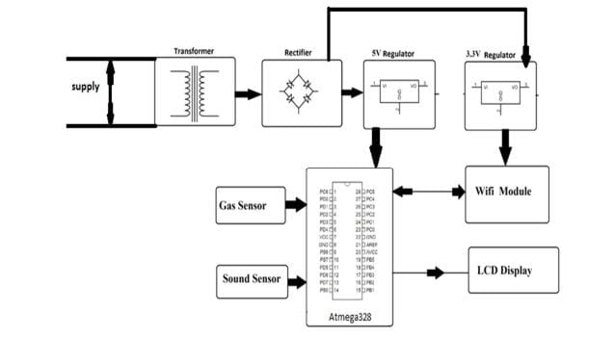
Implementation:

Slide 7
Code implementation:
1. *Programming Language:* - Python libraries and frameworks.
2. *IoT Sensor Libraries:* - Libraries ,SDKs provided by the manufacturers of IoT noise sensors.
3. *Machine Learning Libraries:* - scikit-learn, TensorFlow, PyTorch for machine learning tasks.
4. *Data Processing Libraries:* - Pandas for data manipulation and analysis. - NumPy for numerical operations.
5. *Web Framework (Optional):* - Flask,Django to create a web-based user interface.
6. *Database :* - SQLite, MySQL, MongoDB for storing historical noise data.
7. *Communication Protocols:* - MQTT, HTTP protocol for communication between IoT devices and data processing modules.
8. *Development Environment:* - An integrated development environment (IDE) such as VSCode.
9. *Version Control:* - Git for version control.
10. *Containerization :* - Docker for containerization if plan to deploy your system in containers.
11. *Machine Learning Model Deployment (Optional):* - Tools TensorFlow Serving for deploying machine learning models.
12. *Alert Mechanism:* - Libraries or services for sending alerts, such as SMTP for email or Twilio for SMS.
13. *Documentation Tools:* - Markdown, reStructuredText tools for documenting your code and project.
14. *Testing Frameworks:* - Pytest testing framework for automated testing.
15. *Security Tools (Optional):* - SSL/TLS for secure communication. - Security auditing tools for code review.

Slide 8
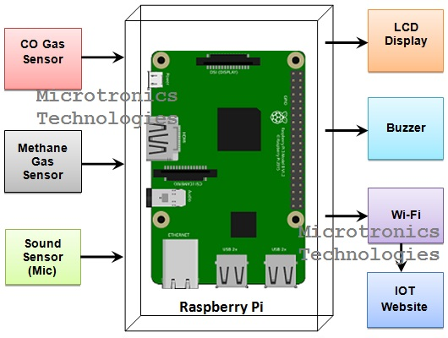
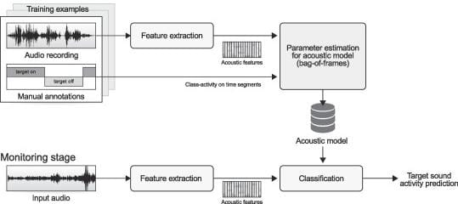
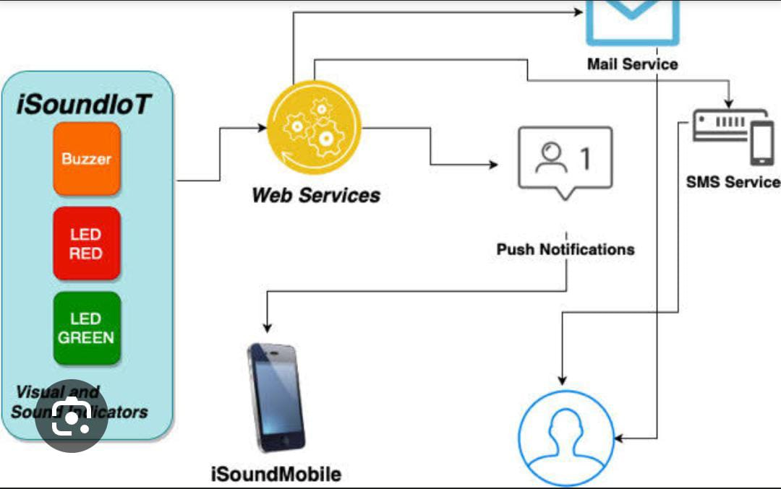
Implementation and simulation:

Slide 9
Thank You

