Slide 1
Project Part 2 • 13–15 min
PPO for Continuous-Control Robotics
Robot Joint Reaching with Proximal Policy Optimization
Subash Kambala • Student ID 005059675
Applied Machine Intelligence and Reinforcement Learning (PhDAI-830-A02)
University of the Cumberlands • October 2026
continuous torque
state → action → reward → update
Notes:
Hello, my name is Subash Kambala. This presentation is the second part of my reinforcement learning project. I implemented Proximal Policy Optimization, or PPO, for a continuous-control robot-joint reaching task. I will explain the problem, the environment and reward design, the actor-critic implementation, the training results, a short demonstration, and the main limitations and future improvements.

Slide 2
Problem and Project Goals
Learning real-valued torque decisions over time
Observe
Act
Dynamics
Reward
Learn
angle • velocity • angle error
continuous motor torque
joint moves + slows
accuracy • stability • effort
update PPO policy
Goal 1
Goal 2
Goal 3
Create a reproducible continuous-control environment with randomized start and target conditions.
Implement PPO with actor-critic learning, clipped updates, GAE, and stochastic Gaussian actions.
Measure learning with held-out evaluation, baselines, diagnostics, a 3-seed ablation, and a demo.
Notes:
The problem is continuous robotic control. At every time step, the agent must choose a real-valued motor torque, and each torque changes the joint's angle and velocity, so every decision affects the ones that follow. This connects directly to my Part 1 objective: use reinforcement learning to move a rotary joint to a target and hold it there. I set three goals: build a reproducible continuous-control environment, implement PPO with an actor-critic network and Generalized Advantage Estimation, and measure learning rigorously, with held-out evaluation, baselines, diagnostics, an ablation study, and a demonstration.

Slide 3
Background and Project Context
Why PPO is a reasonable fit for continuous robot control
RL in Robotics
Actor–Critic
PPO + GAE
Robotic behavior is sequential: each action changes the physical state that the next action must control. RL can learn behaviors that are difficult to hand-code.
The actor learns the control policy; the critic estimates state value and provides a lower-variance learning signal for the policy update.
PPO limits overly large policy updates. GAE smooths advantage estimates by combining multi-step reward and value information.
Design principle: stable policy improvement is more important than aggressive one-step optimization.
Sources: Schulman et al. (2017); Schulman et al. (2015); Kober, Bagnell, & Peters (2013).
Notes:
Reinforcement learning is useful in robotics because many control behaviors are difficult to specify as fixed rules. The agent can instead learn from repeated interaction with a simulated environment. PPO was selected because it is a policy-gradient method designed to make policy updates more stable by limiting excessively large changes. The original PPO paper also evaluated the method on simulated robotic locomotion. I also used Generalized Advantage Estimation, which combines reward and value information to reduce variance in policy-gradient estimates. These ideas fit a continuous torque-control problem where both stability and smooth learning are important.

Slide 4
Continuous Robot-Joint Environment
A lightweight Gym-style simulator with bounded torque
Episode setup
target
Random initial angle, angular velocity, and target angle. Maximum length: 200 steps.
Dynamics
Inertia + damping + small gravity term update angular acceleration, velocity, and angle.
current joint
Interface
reset() and step(action) follow the common Gym/Gymnasium interaction pattern.
torque ∈ [−2, +2]
Project implementation: CustomContinuousRobotJointEnv in ppo_robotics_project.py.
Notes:
The completed environment is a lightweight simulation of one rotary robot joint. At the start of every episode, the joint angle, angular velocity, and target angle are randomized. The agent applies torque between minus two and plus two. The joint dynamics include inertia, damping, and a small gravity term, and each episode lasts at most two hundred steps. This environment follows the Gym-style reset and step interface. The main advantage of this design is that it keeps the continuous-control behavior while making the project easy to reproduce without a large external simulator.

Slide 5
State, Action, and Reward Design
The reward balances reaching accuracy, stability, and control effort
STATE
ACTION
REWARD
[ sin θ, cos θ, ω / ω_max, sin e, cos e ], e = θ − target
Target is given relative to the joint; sin/cos avoid the ±π jump.
One Gaussian-sampled torque command, clipped to [−2, +2].
Continuous action space matches motor-control behavior.
Higher near the target; penalties for angle error, angular velocity, and torque. Bonus for precise + stable reaching.
r = 1 − 1.4(error/π)² − 0.04·velocity² − 0.002·torque² + stabilization bonus
Notes:
The observation has five values: the sine and cosine of the joint angle, the normalized angular velocity, and the sine and cosine of the angle error, which is the difference between the joint and the target. This relative encoding was one of the most important design decisions in the project. In my early version, I gave the target as a raw angle, so the network had to learn wrapped angle subtraction on its own, and it barely beat a random policy. The action is one continuous torque value. The reward is highest near the target, penalizes angle error, velocity, and torque, and adds a bonus for precise, stable reaching, because arriving fast is not the same as stabilizing.

Slide 6
PPO Methodology
Collect → estimate advantage → optimize clipped objective → repeat
1
2
3
4
5
Collect rollout
Compute GAE
Normalize
PPO update
Repeat
obs • action • reward • logπ • V(s)
TD residuals; bootstrap V(s) at time limit
stabilize the advantage scale
ratio × advantage with clipping
new policy collects the next rollout
PPO clip range = 0.20 → probability ratio is limited around 1.0 during the surrogate update
PPO: Schulman et al. (2017). GAE: Schulman et al. (2015). Time limits: Pardo et al. (2018).
Notes:
Training follows the standard PPO cycle. The policy collects a rollout of 512 steps, storing observations, actions, rewards, log probabilities, and value estimates. Generalized Advantage Estimation then combines temporal-difference residuals into advantages. One detail matters here: episodes end only because of a 200-step time limit, not because the task failed, so I bootstrap the value of the final state instead of treating it as zero, as Pardo and colleagues recommend. I normalize the advantages, and the PPO update clips the probability ratio to plus or minus zero point two, which keeps each policy change small.

Slide 7
Actor–Critic Architecture
Separate policy and value networks share the same 5-D observation
ACTOR
Linear 5→64 → Tanh → 64 → Tanh → action mean
Learnable log σ controls Gaussian exploration
Gaussian policy
→ torque action
5-D state
CRITIC
Linear 5→64 → Tanh → 64 → Tanh → scalar value
V(s) estimates expected discounted return
Value estimate
→ GAE baseline
Notes:
The model uses separate actor and critic networks in PyTorch. Both take the same five-dimensional state through two hidden layers of sixty-four tanh units. The actor outputs the mean of a Gaussian distribution, and a learnable log standard deviation controls exploration. During training, actions are sampled and then clipped to the torque range. The critic outputs a single value estimate, which serves as the baseline for computing advantages.

Slide 8
Implementation and Training Configuration
Python + PyTorch + NumPy + Matplotlib + Gym-style API
PyTorch
Total steps
204,800
Actor, critic, Gaussian distribution, Adam optimizer
Rollout steps
512
Learning rate
3e−4
NumPy
γ / GAE λ
0.99 / 0.95
Environment math, buffers, advantages, shuffling
PPO clip
0.20
Matplotlib
Batch / epochs
64 / 5
Reward, diagnostics, ablation, and demo video
Entropy coef.
0.0
Max grad norm
0.5
Notes:
The project uses Python, PyTorch, NumPy, Matplotlib, and the Gymnasium interface. The final run trained for 204,800 environment steps, which is exactly 400 updates of 512 steps. The learning rate was three times ten to the minus four, gamma was 0.99, and GAE lambda was 0.95. Each update ran five epochs of 64-sample mini-batches, with gradient clipping at 0.5. I set the entropy coefficient to zero, because the learnable standard deviation already provided enough exploration.

Slide 9
How the Project Evolved
Fixes were made and reported in Part 1; Part 2 keeps the method and makes it demonstrable
Early version → Part 1 report
Part 1 → Part 2 (this project)
Raw target angle → relative error
fixed
PPO, GAE, environment, results
kept
Time limit as failure → bootstrapped
fixed
No demo → 4-episode held-out demo
added
32-step final batch → removed
fixed
Code + outputs → documented repo
added
20k steps → 204,800 + evaluation
fixed
Report → recorded walkthrough
added
Why: the early run barely beat random (p = 0.54). Part 2 makes the verified final results reproducible and visible.
Notes:
This slide explains how the project evolved. My early version trained for only twenty thousand steps and improved from about 120 to 129, which a t-test showed was not statistically significant. Diagnosing that result led to the fixes on the left, which I made and reported in Part 1: expressing the target relative to the joint, bootstrapping episodes at the time limit, removing a misleading 32-step final batch, and training ten times longer with held-out evaluation. For Part 2, the method and results stayed the same as in my Part 1 report. What Part 2 adds is a reproducible demonstration on held-out episodes, a documented code repository, and this recorded walkthrough, so the results can be verified and seen, not just read.

Slide 10
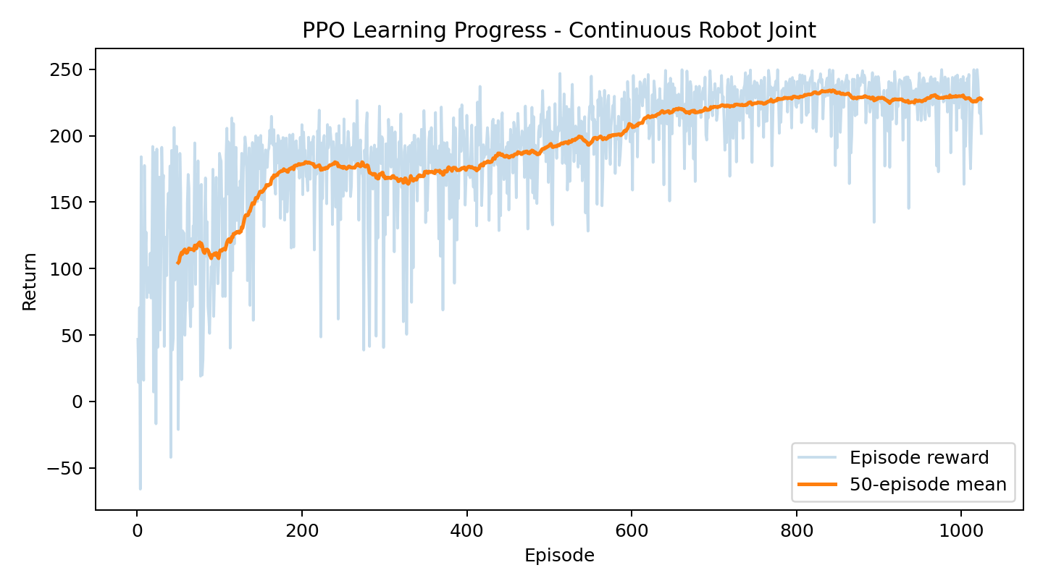
Training Results: Reward
1,024 completed episodes over 204,800 environment steps
104.5
First 50 mean return
227.7
Last 50 mean return
0.029 rad
Last 50 mean final error
Interpretation
clear learning • plateau near episode 800
Seed 42. Values from outputs/training_summary.txt in the repository.
Notes:
This curve shows return across 1,024 training episodes. The pale line is each episode, which varies because targets and starting angles are random, and the orange line is the 50-episode average. Return rose quickly over the first 200 episodes, improved more slowly afterward, and plateaued around episode 800. Mean return grew from 104.5 in the first 50 episodes to 227.7 in the last 50, and the final angle error dropped from about 1.54 radians to 0.029 radians. These are the same verified results reported in Part 1, and they show the clear convergence that my early version lacked.

Slide 11
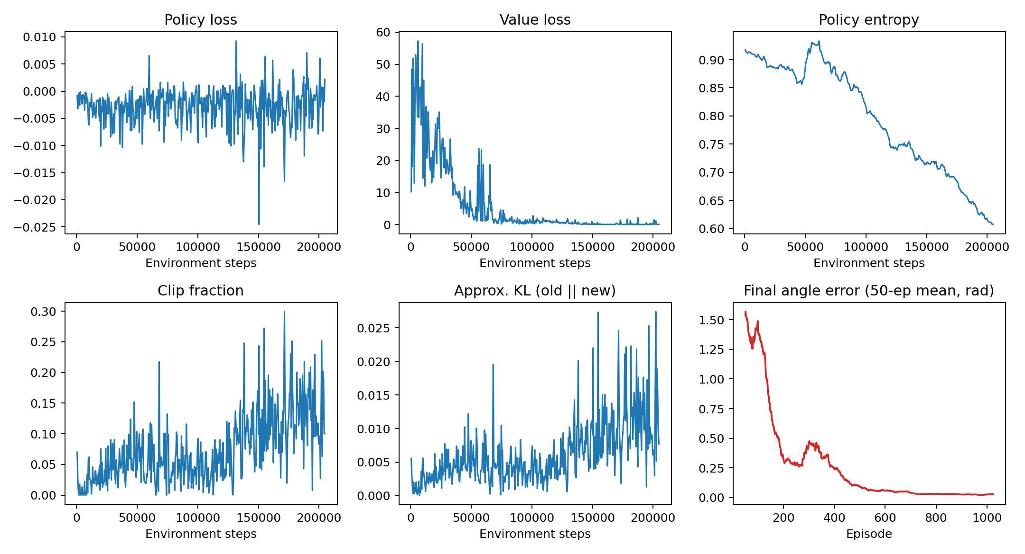
Diagnostics and Interpretation
The critic converged and every policy update stayed bounded
Value loss
Fell from ≈50 to 0.06: the critic learned accurate values. An early-version spike was a 32-step-batch bug.
Entropy
Declined from 0.92 to 0.61 as the Gaussian policy became more confident.
Clip fraction and KL
KL stayed below 0.03 on every update; clip fraction mostly 0.02–0.15, so updates were bounded.
Notes:
The diagnostics confirm that training was stable. Value loss fell from about fifty to 0.06, so the critic learned accurate value estimates. The spike from my early version is gone, because it was caused by a 32-step final batch. Entropy decreased steadily from 0.92 to 0.61 as the policy became more confident. The approximate KL divergence stayed below 0.03 on every update, and the clip fraction stayed mostly between two and fifteen percent. That means clipping was active on a small share of samples, keeping updates bounded without stopping learning.

Slide 12
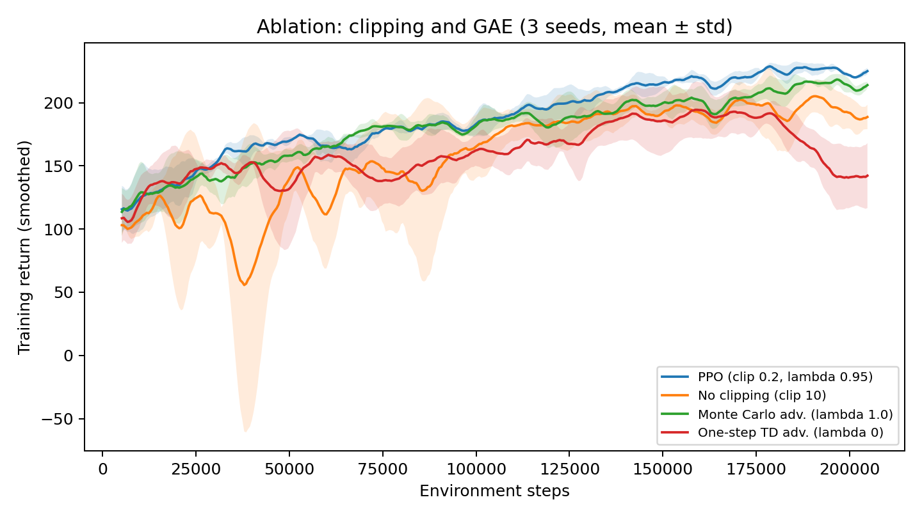
Evaluation and Ablation
Held-out performance vs. baselines, and what clipping and GAE contribute
100%
PPO success, 50 held-out episodes
4% / 2%
Random / zero-torque success
52.7%
Success without clipping
GAE λ = 0.95 → 98.7%
λ = 0 → 0% success
Success = final error < 0.1 rad. Ablation: mean of 3 seeds per variant (outputs/ablation_results.csv).
Notes:
To test performance properly, I evaluated the deterministic policy on fifty held-out episodes with seeds never used in training. PPO reached the target in all fifty, compared with four percent for random torque and two percent for applying no torque. The ablation, run with three seeds per variant, shows how PPO's components contribute. Removing clipping made updates about thirty times larger, one seed collapsed early, and success fell to about fifty-three percent. For GAE, lambda equal to zero relied on the early, inaccurate critic and never learned reliable reaching, while lambda 0.95 gave the best combination of return and stability.

Slide 13
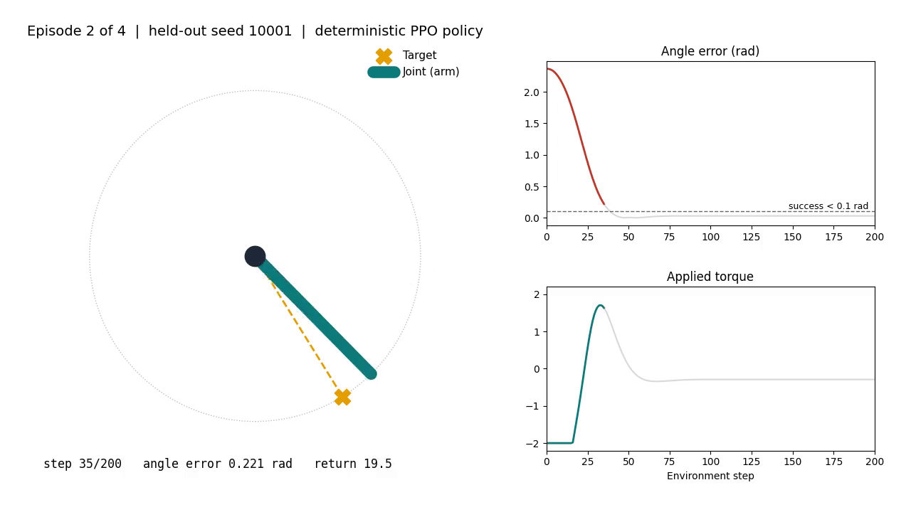
Demonstration of the Learned Policy
First four held-out episodes, deterministic policy, saved final model
4 / 4
Episodes reached the target
≤ 0.031 rad
Final angle error
2.37 rad
Largest starting error
Not hand-picked: held-out seeds 10000–10003
Notes:
Here is the demonstration. I load the saved final model and use the actor's mean action, with no sampling. These are the first four held-out evaluation episodes, so they are not hand-picked. The orange marker is the target, and the teal bar is the joint. Watch episode two: the joint starts about 2.4 radians away, more than 135 degrees. The policy applies maximum torque, brakes before the target, and settles within about fifty steps, while the plots show the error falling below the success line. All four episodes finish within 0.031 radians. One limitation is visible: a small steady-state offset of about 0.02 radians, because the policy holds a constant torque against gravity.

Slide 14
Strengths and Limitations
What the project demonstrates — and what it does not
STRENGTHS
LIMITATIONS
✓ End-to-end PPO pipeline with diagnostics
• Simplified single-joint physics
✓ 100% held-out success vs. 4% random
• Small steady-state offset (≈0.02 rad)
✓ 3-seed ablation of clipping and GAE
• Main run uses one seed (ablation uses 3)
✓ Reproducible: seeds, saved model, demo script
• No PPO vs. SAC/DDPG baseline
✓ Small dependency footprint
• No sensor noise or disturbances tested
Notes:
The main strengths are a complete PPO pipeline with diagnostics, one hundred percent held-out success against a four percent random baseline, an ablation that isolates clipping and GAE, and reproducibility through fixed seeds, a saved model, and a demo script anyone can rerun. The limitations matter just as much: the physics are a simplified single joint, there is a small steady-state offset, the main run uses one seed, there is no SAC or DDPG comparison, and I did not test sensor noise or disturbances. So the project validates PPO for this task, but it does not show that PPO is the best algorithm or that it is ready for hardware.

Slide 15
Ethical and Practical Considerations
Safe deployment matters more than maximizing a simulated reward
Safety
Reward specification
Reliability
Oversight
Simulation success does not guarantee safe behavior on hardware. Use constraints, staged tests, and emergency-stop controls.
Poorly chosen rewards can create unintended behavior. Safety limits should be hard constraints, not optional bonuses.
Evaluate disturbances, sensor noise, failure cases, and multiple random seeds—not only best-case trajectories.
A human should remain able to monitor, interrupt, audit, and understand the controller before real-world use.
Practical rule: validate robustness before increasing autonomy.
Notes:
Reinforcement learning for physical robots raises safety and accountability concerns. A policy that behaves acceptably in simulation can fail when sensors, friction, loads, or timing differ in the real world. For that reason, a learned controller should not be transferred directly to safety-critical hardware without constraints, staged testing, emergency-stop mechanisms, and human oversight. Reward design also matters because an agent can optimize the numeric objective in an unintended way. In a real deployment, safety limits should have priority over reward maximization, and evaluation should include failure cases rather than only successful trajectories.

Slide 16
Conclusion and Future Work
PPO learned accurate, stable reaching once the problem was framed correctly
KEY FINDINGS
NEXT STEPS
• 0.021 rad error; 100% held-out success
→ Multi-seed main runs with confidence intervals
• State representation mattered most
→ Add sensor noise and disturbance tests
→ Compare with SAC or DDPG
• Clipping and GAE (λ = 0.95) stabilized learning
→ Use vectorized/parallel environments
• Fixing bugs made diagnostics trustworthy
→ Move to MuJoCo/PyBullet multi-joint arms
Notes:
In conclusion, PPO learned accurate and stable reaching, with 0.021 radians of final error and one hundred percent success on held-out episodes. My biggest lesson was that state representation mattered more than any hyperparameter: the same algorithm went from near-random to reliable once the target was expressed relative to the joint. The ablation confirmed that clipping and GAE both contributed to stability, and fixing the truncation and batch issues made the diagnostics trustworthy. Next, I would run multiple seeds with confidence intervals, test noise and disturbances, compare PPO with SAC or DDPG, and move to multi-joint arms in MuJoCo or PyBullet.

Slide 17
References and AI Use Disclosure
Selected References
Schulman, J., Wolski, F., Dhariwal, P., Radford, A., & Klimov, O. (2017). Proximal Policy Optimization Algorithms. arXiv:1707.06347.
AI Use Disclosure
ChatGPT helped organize the project, review PPO/GAE concepts, and improve clarity. Claude (Anthropic) reviewed the code and results, identified the representation, truncation, and batch issues, helped build the evaluation, ablation, and demo scripts, and helped update these slides.
I reviewed all code, reran training, and verified every number shown in this presentation.
Schulman, J., Moritz, P., Levine, S., Jordan, M. I., & Abbeel, P. (2015). High-Dimensional Continuous Control Using Generalized Advantage Estimation. arXiv:1506.02438.
Kober, J., Bagnell, J. A., & Peters, J. (2013). Reinforcement learning in robotics: A survey. The International Journal of Robotics Research, 32(11), 1238–1274.
Pardo, F., Tavakoli, A., Levdik, V., & Kormushev, P. (2018). Time limits in reinforcement learning. Proceedings of the 35th International Conference on Machine Learning, 80, 4045–4054.
Thank you
Notes:
My main references are the PPO and GAE papers by Schulman and colleagues, the robotics survey by Kober, Bagnell, and Peters, and Pardo and colleagues on time limits. For AI disclosure, I used ChatGPT to help organize the project and review concepts, and Claude to review my code and results, which helped identify the issues I fixed, and to help build the evaluation, ablation, and demo scripts and update these slides. I reviewed all of the code, reran the training, and verified every number in this presentation. Thank you.

