Slide 1


A/B Test Globox
Subasini Ravindran
Data Analyst

Slide 2

Overview
Groups
Group A
No banner
Total Users – 24,343
Group B
Displays Banner
Total Users – 24,600
Key Metrics
Spending Average
Revenue
Conversion rate
New customers

Slide 3
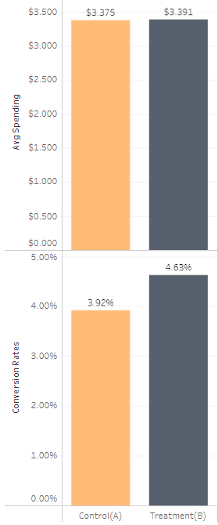


Comparison of Key Metrics
Spending Average
Group B
No strong Evidence of Change
Conversion Rate
Group B
Strong Evidence of Change

Slide 4
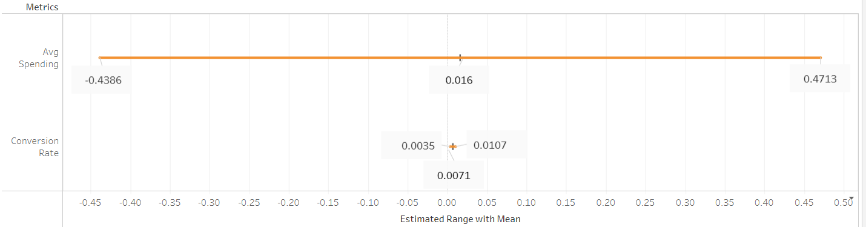
Estimated Range
Estimation of difference in the average amount spent between the groups is in the range of -0.439 to 0.471
Estimation of difference in the conversion rate between the groups is in the range of 0.35% to 1.07%

Slide 5
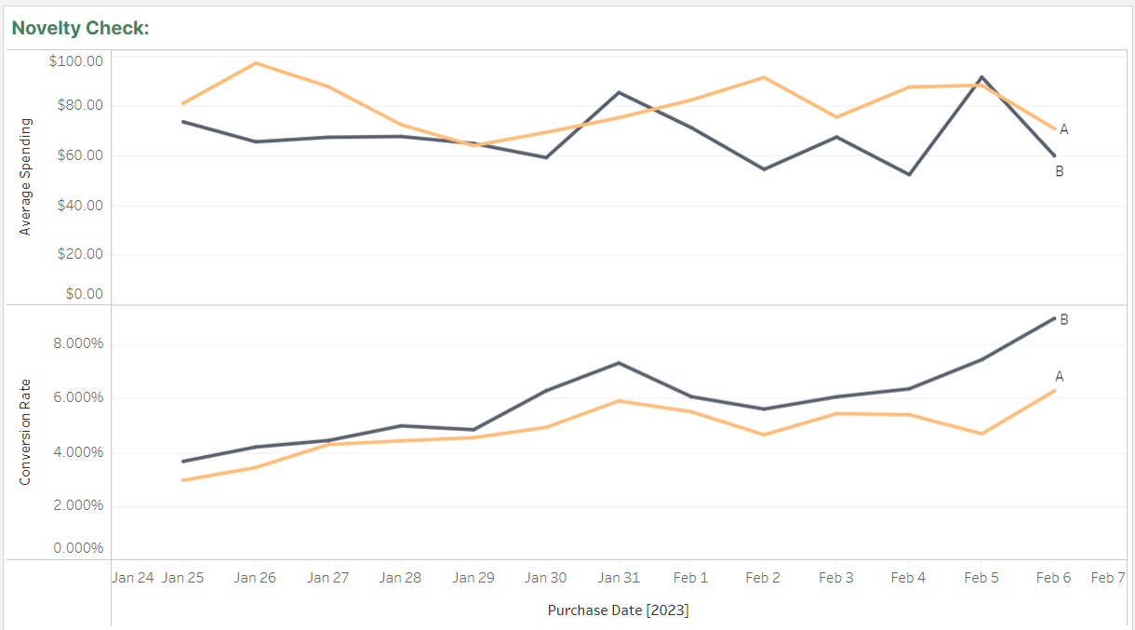
Novelty Check
Period of Testing
Jan 25th, 2023 – Feb 6th, 2023
13 days
Total Users – 48,943
Spending Average
Group A
Conversion Rate
Group B

Slide 6





Power Analysis
24343
Group A
38400
24600
Group B
38400

Slide 7


RECOMMENDATIONS
Do not launch the banner.
Potential for Improvement.
Re-run with a larger sample.

