Slide 1
Pregafit
A goto place for all pregatastic women!
Made By:
She who must BOT be named
Aarushi Singh
Subasree Arvind
Surmayi Sharma
Nimisha Gupta

Slide 2
INTRODUCTION
An all in one portal for pregnant Women where they can clear all their doubts and misconceptions about pregnancy.
It’s a platform where they can ask the simplest of questions anonymously.

Slide 3
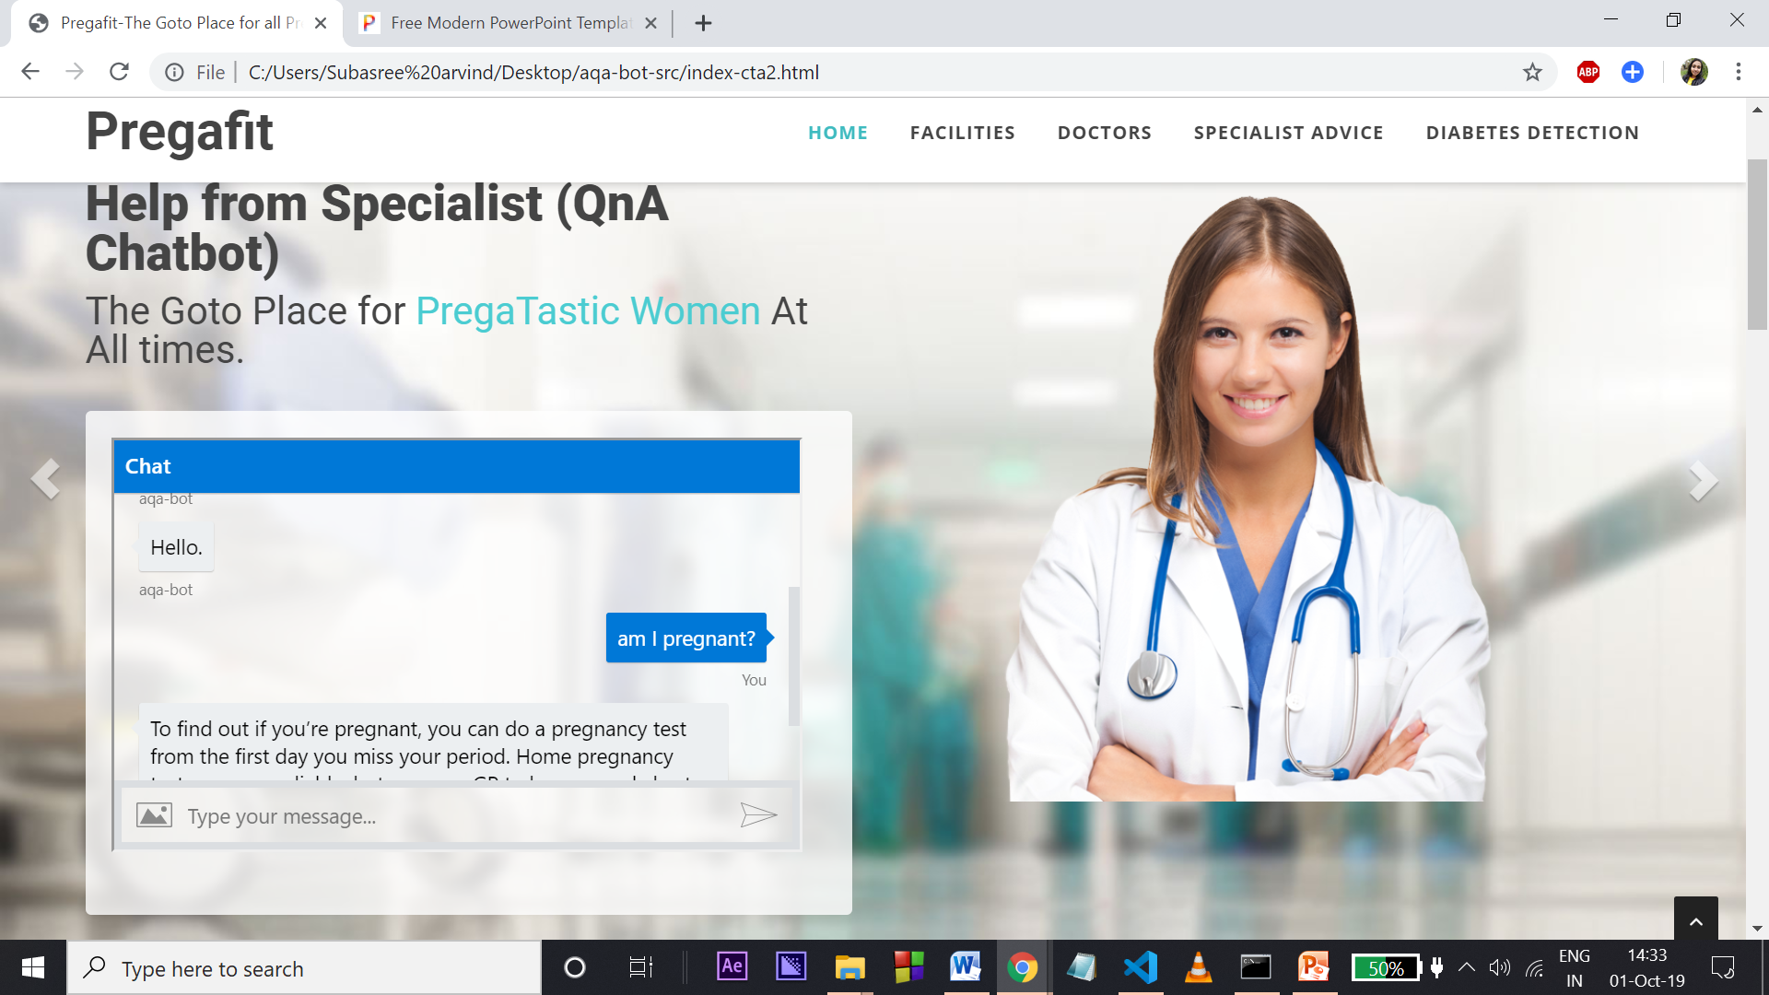
Chatbot 1

Slide 4
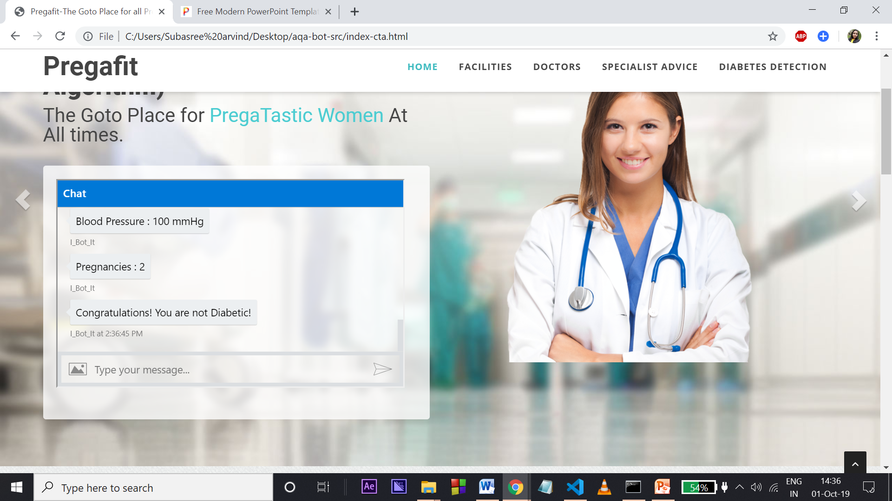
CHATBOT 2

Slide 5
Future scope
Due date calculator
Bots for prediction of other congenital diseases
Appointment booking via bot
Widen our data set for improved analysis
Improved ML algorithms

