Slide 1

SceneSeek: A Semantic Video Dialogue Search Engine
Submitted by:
Subasri B
B.Tech. Electronics and Communication
SASTRA University, Thanjavur

Slide 2
Introduction
SceneSeek is an AI-powered system designed to help users quickly find the exact moment they are looking for inside any video. Instead of manually scrolling or guessing timestamps, the system listens to the video’s audio, converts it into clear text, understands the meaning of every line, and lets the user search for any word or idea directly. This makes long videos easier to explore and saves a lot of time for students, professionals, and anyone working with information-heavy content.

Slide 3
Problem Statement
Most long videos do not offer any way to search through the spoken content, so users often waste time jumping from minute to minute trying to find one specific sentence or explanation. Traditional keyword search does not work for videos because the spoken words are not available as text. This project solves that frustration by converting the video’s audio into a searchable transcript and allowing direct navigation to the exact timestamp.

Slide 4
Objectives
To convert video audio into accurate, time-aligned text using an advanced
speech-to-text model.
To represent each dialogue line using sentence embeddings so the system can
understand meaning, not just words.
To allow users to instantly jump to the correct timestamp in the video using generated
scene links.
To enable question–answering over the video by retrieving and summarizing the
most relevant parts of the transcript.
To build a clean, minimal, and easy-to-use interface for smooth user interaction.
To implement both exact and semantic search for fast, accurate retrieval of r
elevant scenes.
4

Slide 5
Methodology
1. Audio Extraction
The system extracts the audio from the input video and prepares it for speech processing.
2. Speech-to-Text Conversion (ASR – Distil-Whisper)
The audio is sent to the Whisper model, which converts the speech into accurate text along with start and end timestamps for every spoken segment.
3. Transcript Cleaning & Segmentation
The generated text is cleaned, organized and divided into small time-aligned pieces so the system can process them efficiently.
4. Semantic Embedding Generation (SBERT)
Each dialogue line is converted into a numeric vector that captures its meaning. This allows the computer to understand similarity between sentences.
5. Semantic Search Indexing (FAISS)
All vectors are stored in the FAISS search engine, enabling fast and efficient similarity matching across thousands of dialogue lines.

Slide 6
Methodology
6. Query Processing & Retrieval
When the user enters a search query, it is also converted into a vector. FAISS finds the closest matching lines instantly.
7. Exact Search + Semantic Search Combination
Both exact word matching and meaning-based matching are applied to ensure accurate retrieval, even if the user’s wording is different from the video.
8. Display of Results & Timestamps
Finally, the UI shows the matching dialogue lines with timestamps and jump links that allow the user to directly view the moment in the video.

Slide 7
Results
The system successfully converted the full video audio into accurate text with
proper timestamps using the Whisper ASR model.
All dialogue lines were transformed into meaningful sentence embeddings, allowing the system
to understand similar ideas even when the words were different.
The hybrid search method delivered correct matches for both exact keyword queries and
semantic (meaning-based) queries.
The FAISS search engine retrieved matching lines instantly, even for long videos with hundreds of
dialogue segments.
The system correctly generated jump links, allowing users to directly open the exact scene in the
YouTube video.
The Q&A feature provided relevant answers by identifying important parts of the transcript related
to the user’s question.
The minimal liquid-glass interface displayed all results clearly and made navigation simple for the user.

Slide 8
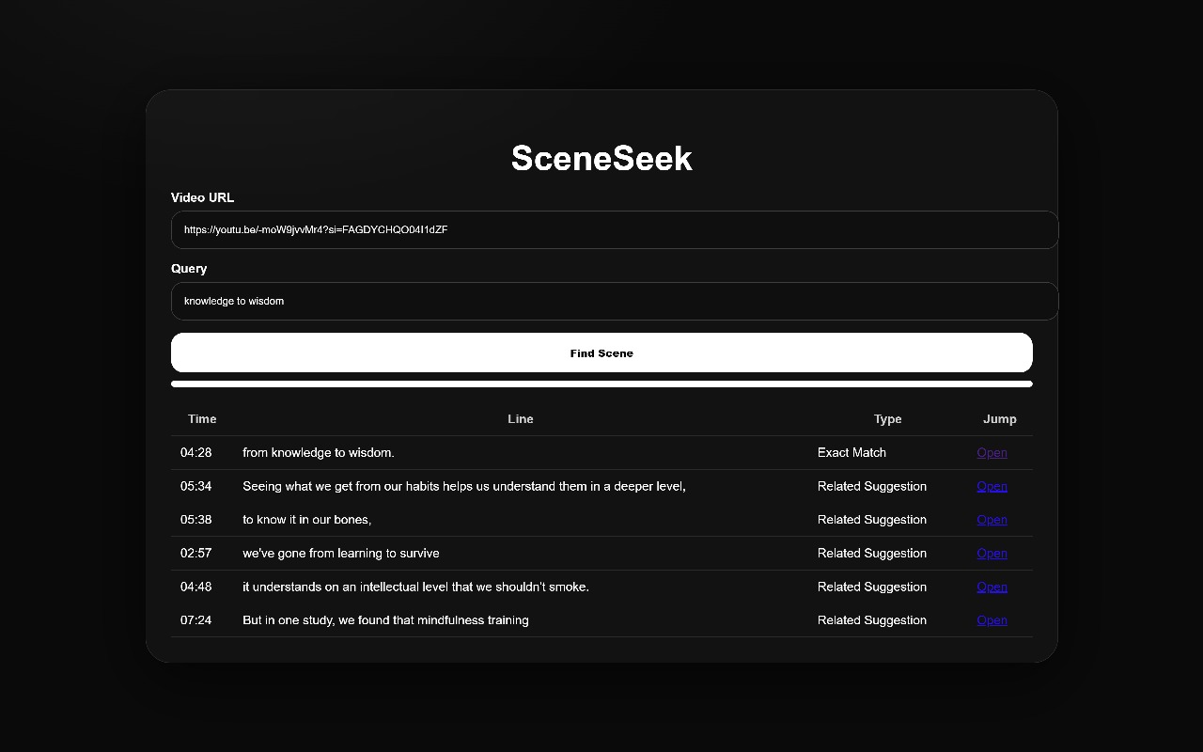
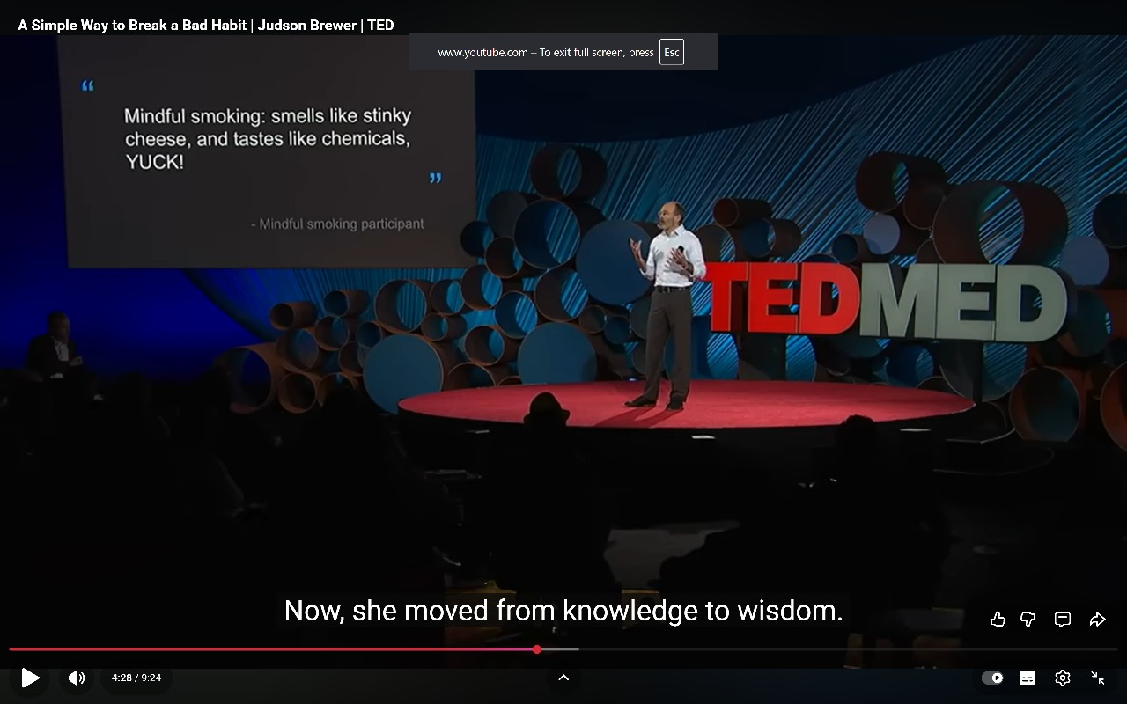
Output

Slide 9
Thank You!

