Slide 1

GANESH COLLEGE OF ENGINEERING
Y. ESTHER (Team leader )
K. ANUSHA
G. SUBASRI
T. GOPIKA

Slide 2

An Artificial Intelligence of toilet(AI-toilet)based on a triboelectric pressure sensor array.
Low cost and easily deployable software.
The sensor array attached on the toilet seat is composed of 10 textile-based tribolelectric sensons.
6 user can be correctly identified with more than 90% accuracy using deep learning.
The system integrates a camera sensor to analyze the simulated urine by comparing with urine chart and classify the types and quantities of objects using deep learning.

Slide 3
All information including two-factor user identification and entire seating time using pressure sensor array ,and data from the with more then 90% accuracy using deep learning.
The signals from pressure sensor also can be used for recording the seating time on the toilet.
The data from the urinalysis and stool analysis were automatically transferred to a cloud system and were further shown in user’s mobile devices for better tracking their health status.

Slide 4

It is uses integrated technology and data to interact and connect with the user

Slide 5
For elderly people more prone to arthritis or mobility issues ,removing the need to grab cumber some handles or flush buttons can make for a much smoother toilet trip.

Slide 6
Uses of smart toilet
A smart toilet cleaner will automatically flush when the user moves away.
Heated seat ,automatic dryer ,automatic toilet tank cleaners and deodorizer.

Slide 7
Invented the smart toilet
History of the development of smart toilets.
The most people think that the smart toilet originated.
American Aronld Cohen invented the world’s first smart toilet in 1964.

Slide 8
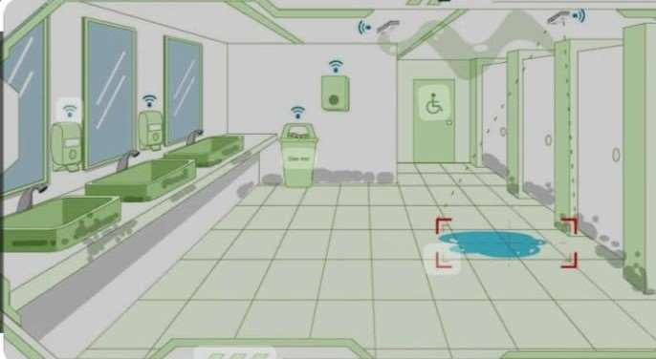

Slide 9
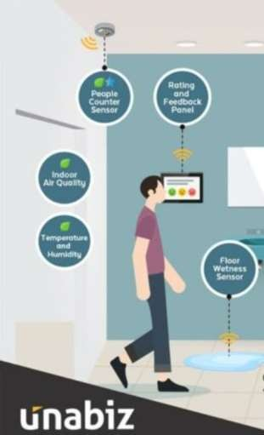

Slide 10
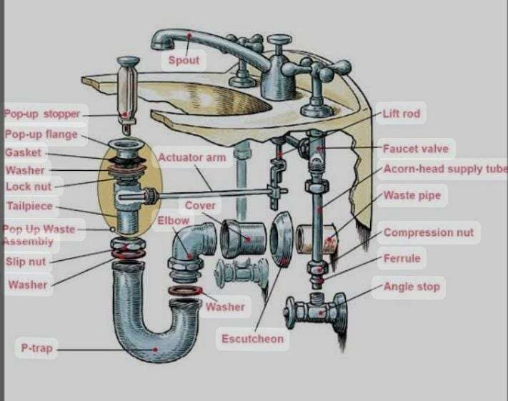

Slide 11
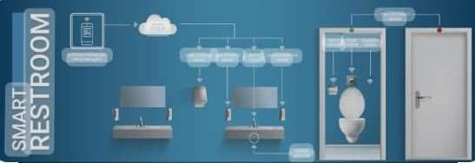

Slide 12
Future
Scientists are working on toilet that use bioprocessing and heat treatment to kill pathogens and make solids safe for the environment.
Older toilets typically use3.5 gallons or more per flush while morden toilets use just 1.28 gallons or less per
flush.

Slide 13
Working of every item used in our system
Platform working
Cistern working
Lever working

Slide 14
Different postions of lever
Following fig illustrate different load condition and their respective position of lever

Slide 15
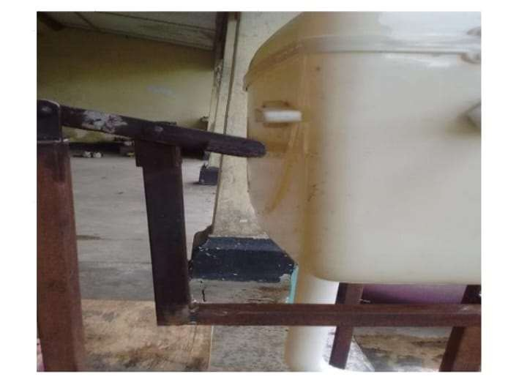
Position of lever when load is not applied

Slide 16
Lever working
There are total two levers attached on our system.
Motion transmitting lever.
Lever with synthetic rubber at the end.

Slide 17
Motion transmitting lever which pushes the second lever attached on it in upward direction and net effect is converted into downward direction.

Slide 18
Lever with synthetic rubber
The end this lever is grooved and synthetic rubber is attached which touches the handle of the cisterm

Slide 19

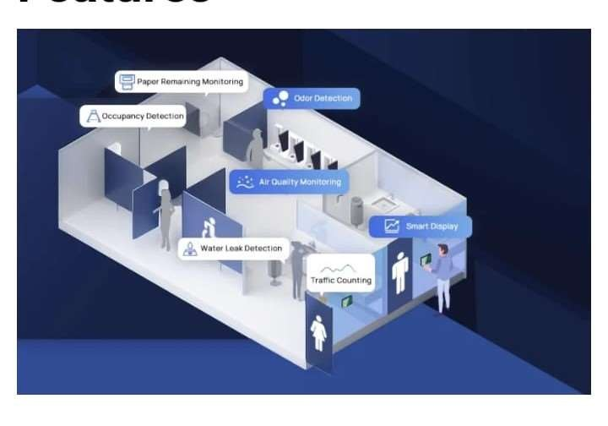

Slide 20
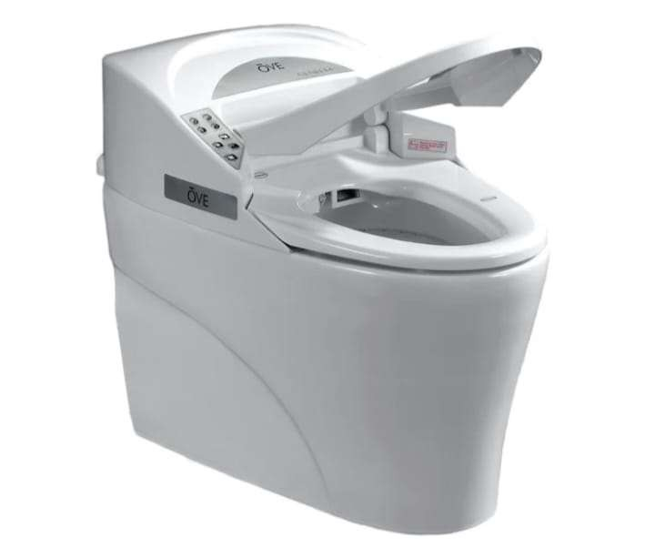
Iever

