Slide 1
Multi-Environment Trial (MET) Analysis
Quantitative Genetics (PS 756) Group 3:
Mandeep Singh
Guilherme Oliveira
Subash Thapa
(Instructor: Ravi Mural, Ph.D.)
South Dakota State University , Brookings, SD
November 14, 2024

Slide 2
Presentation Outline
Introduction
Hands on training
Conclusions
References

Slide 3
Multi-Environment Trial
What ?
Multi-Environment Trial (MET) refers to refers to the process of growing different genotypes (G) in multiple environments (J) over time to evaluate and improve a specific trait, such as yield, across varying conditions.
Why ?
Year 1
……………….
Year n
E1
G1 | G2 | … | … | Gn
G1 | G2 | … | … | Gn
G1 | G2 | … | … | Gn
G1 | G2 | … | … | Gn
G1 | G2 | … | … | Gn
E1
G1 | G2 | … | … | Gn
G1 | G2 | … | … | Gn
G1 | G2 | … | … | Gn
G1 | G2 | … | … | Gn
G1 | G2 | … | … | Gn
Essential part of plant breeding programs to evaluate crop productivity and adaptability in diverse environments
E2
E2
……………….
……………….
EJ
EJ

Slide 4
Purposes of MET
Evaluate Genotype Performance Across Environments
Assess Genotype-by-Environment (G×E) Interactions
Improve Yield Stability
Optimize Breeding Decisions
Enhance Environmental Adaptability

Slide 5



Genotype x Environment Interactions
Differential response of genotypes to varying environmental conditions
Yield/performance stability has always been considered as an important aspect to distinguished those genotypes whose phenotypic performance remains constant across varying environmental conditions
Phenotype of an individual is the combination of genes, environment and their interactions
Phenotype (P) = Genotype (G) + Environment (E) + G * E

Slide 6
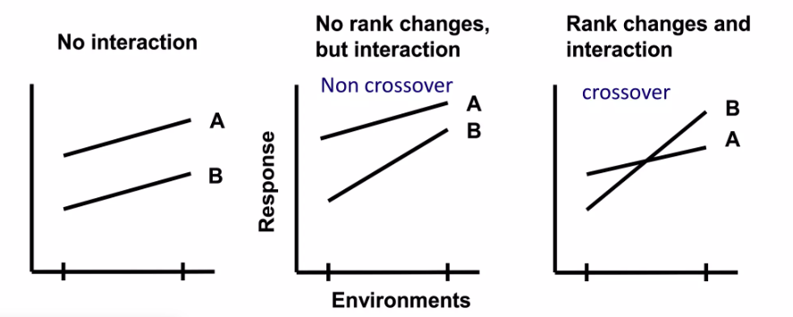
Types of G x E interactions

Slide 7
MET Analysis Steps
Analysis of Variance (ANOVA) Enables the effects, variance of effects and variances of differences among effects to be estimated
Stability Analysis (AMMI, FW, MTSI) Commonly associated with the use of joint linear regression methods, to measure similarity among genotypes
Ordination/Pattern Analysis & Cluster Analysis Joint use of cluster analysis of ordination methods Compare multiple genotypes in multiple environments for several traits Provide essential information for selecting and recommending crop cultivars Repeatable interactions are target to be determined

Slide 8
Strategies for Coping with G x E
Broad adaptation: develop a variety that performs consistently well across a range of environments (high mean mean environments) will not necessarily identify the best genotype for a specific environment
Specific adaptation: subdivide environments into groups so that there is little GEI within each group. Breed varieties that perform consistently well in each environment have to carry out multiple breeding programs, which means that you will have fewer resources for each, and hence reduced progress from selection

Slide 9
Models for estimating G x E
Genotype main effect and G X E interactions (GGE) 1) Decomposes the variation in multi-environmental trial data into genotypes main effects (overall performance) and G X E interaction (how genotypes respond differently to environments) 2) helps to identify stable genotypes and discriminating environments, typically visualize using GGE biplots, where PCA is applied to understand G X E interactions
Additive main effects and multiplicative interactions (AMMI) 1) Combines additive effects (main effect of genotypes and environments) with multiplicative interactions (G X E) using PCA 2) often visualized with AMMI biplots to identify stable genotypes and environments

Slide 10

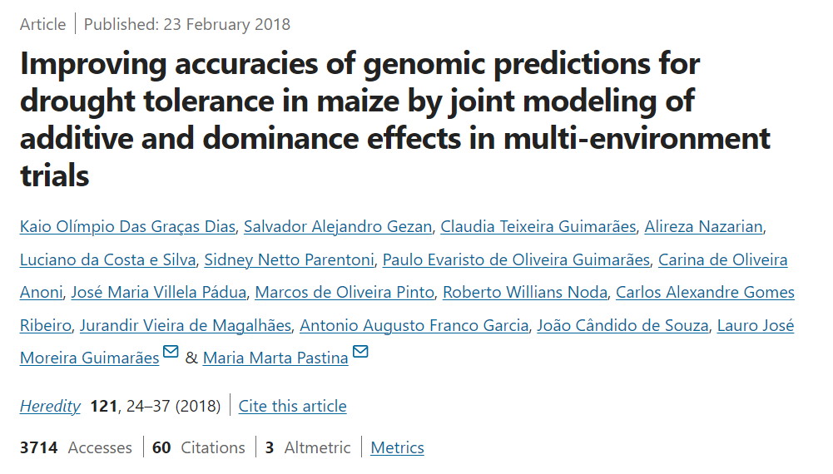
Dataset 1
202 corn hybrids
Yield
EPP (ears per plot)
FFT (female flowering time)
MFT (male flowering time)
ASI (anthesis-silking time)
8 environments
(3 reps by E)
Differences in the water availability

Slide 11
Exploratory Data Analysis
Install the required packages and run the libraries
Set your working directory (make sure you have all the necessary input files in that directory)
Data preparation and exploration (descriptive statistics)
Data cleaning and normalization
Get the graphical summary of your data

Slide 12
GGE Analysis
Step 1:
ANOVA : Check for the significance of G X E interaction. A significant G X E interaction indicates that the genotypes perform differently across environments, which justify the need of G X E analysis
Step 2: Conduct GGE Biplot Analysis: A graphical method that help visualize the G X E interaction.
Standardize the data
Principle component analysis (PCA)
Generate GGE Biplot
Interpret the GGE Biplot
Identify the ideal genotype and environment
Step 3:
Use the GGE biplot to make the decision
Identify the stable genotypes
Recommend best performing genotypes for specific environments
Selection if environments

Slide 13
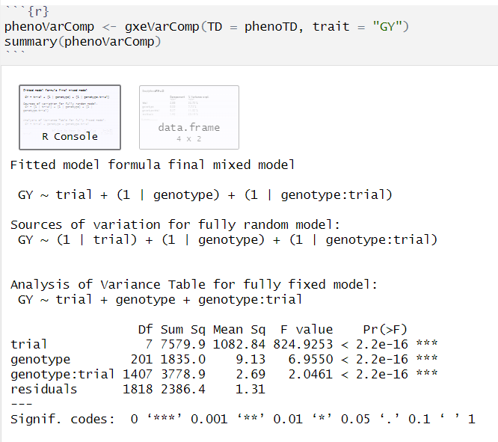
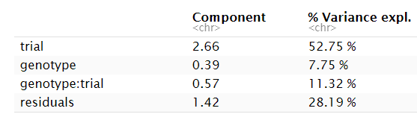
Step 1:
ANOVA
Since we obtained the variance components this information can be used to estimate the heritability of the traits.

Slide 14

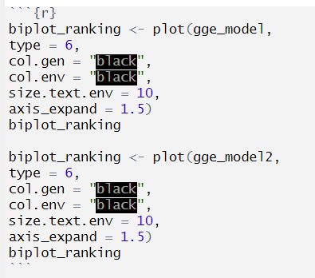
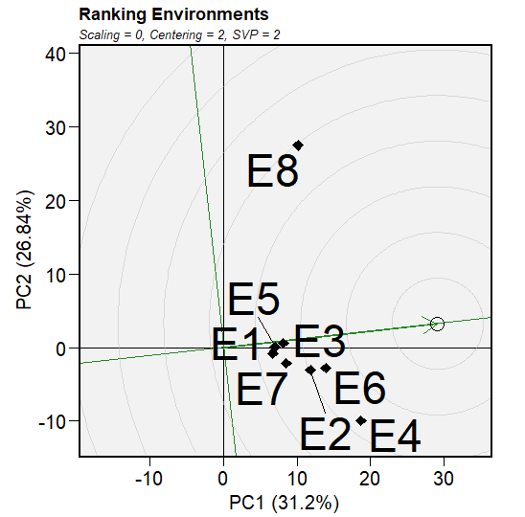
Step 2: Conduct GGE Biplot Analysis
Fit a gge model:
type | Plot
1 | GGE biplot
2 | Mean vs Stability
3 | Which Won Where
4 | Discriminative vs. Representative
5 | Examine an environment
6 | Ranking environments
7 | Examine a genotype
8 | Ranking genotypes
9 | Compare two genotypes
10 | Relationship among environments
Plot GGE Biplot For Ranking Environments:
Note: we have used the subset of the data for easy and more clear visualization with gge model labelled as “gge_model2”

Slide 15
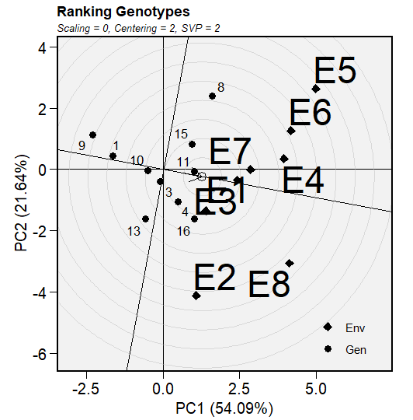
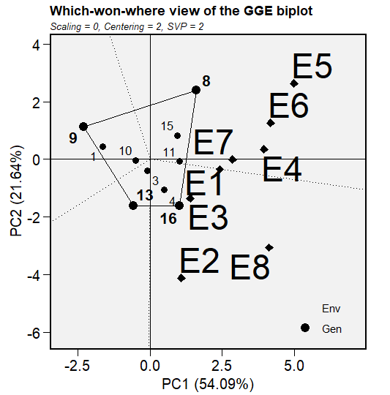
Step 3: Interpretation of GGE Biplot

Slide 16
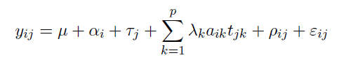
AMMI Analysis
Step 1:
Perform PCA on the G X E interactions matrix
Response Variable
yij: This represents the response of the genotype i in the environment j.
Fixed Effects:
μ: Overall mean effect.
αi: Effect of the ith genotype.
τj: Effect of the jth environment.
Interaction Effects:
λk: Singular value (eigenvalue) corresponding to the kth principal component (PC).
aik: Principal component score of the ith genotype on the kth PC.
tjk: Principal component score of the jth environment on the kth PC.
Random Effects:
ρij: Random effect for the interaction between the ith genotype and jth environment.
εij: Random error term associated with the observation yij.
Step 2: Combine main effects with interactions
Step 3:
Visualize results with AMMI Biplots
Step 4:
Identify stable genotypes and discriminating environments

Slide 17

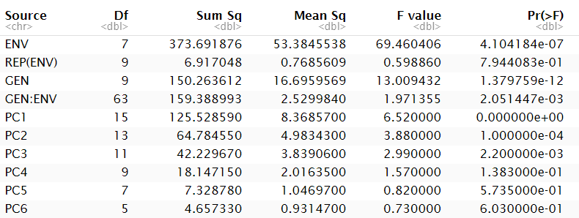
Step 1 & 2:
Fit AMMI Model

Slide 18
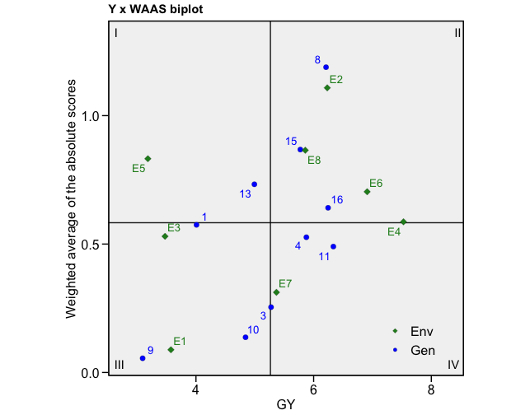
Step 3:
Visualize the results with AMMI Biplots
Quadrant | Interpretation
I | Unstable genotypes or environments & productivity below the grand mean
II | Unstable genotypes & productivity above the grand mean
III | Low productivity but stable genotypes
IV | High productivity with broad adaptability
Fig: Represent 4 classifications regarding the joint interpretation of the mean performance
and stability

Slide 19
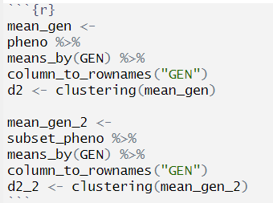
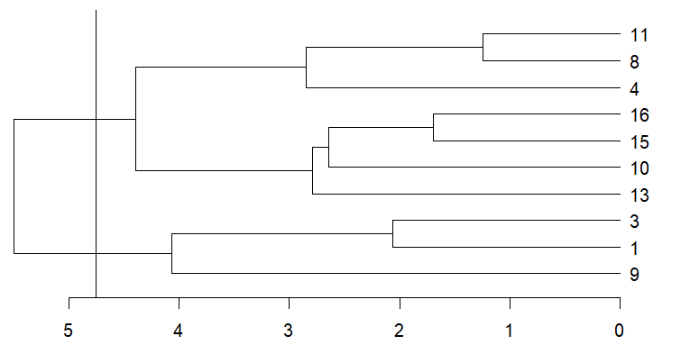
GGI Analysis
Grouping genotypes according to their similarities, considering all the traits, and estimating group-by-environment interactions

Slide 20

Finlay & Wilkinson (FW) Analysis
Helps plant breeders to estimate G X E interaction which is estimated heterogeneity of the slopes of a regression of individual genotypic performance on an environmental index
Step 1:
Fit the FW regression models
yij: The observed value of the trait for the i-th genotype in the j-th environment.
μ: The overall mean or intercept of the model.
Gi: The effect of the i-th genotype on the trait, averaged across all environments.
βi: The slope of the regression line for the i-th genotype, representing its adaptability or responsiveness to changes in the environment.
Ej: The effect of the j-th environment on the trait, averaged across all genotypes.
εij: The residual error term, representing the unexplained variation in the model.
Step 2: Interpret the regression parameters
Step 3:
Test the significance of the slope
Step 4:
Visualize the regression results
Step 5:
Select genotypes based on the slope

Slide 21
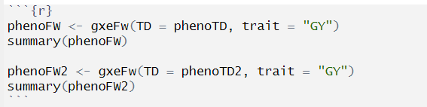
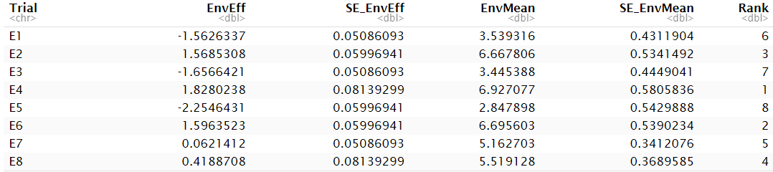
Step 1:
Fit the FW regression models

Slide 22
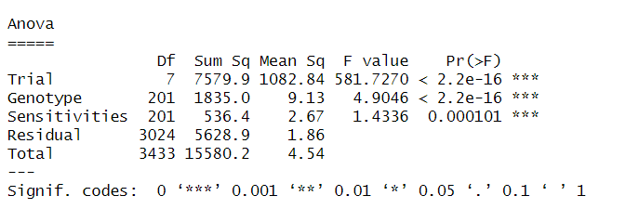
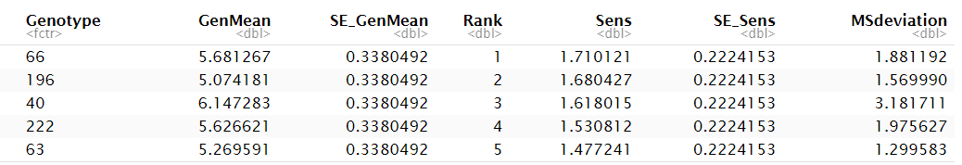
ANOVA & Genotype Sensitivity

Slide 23
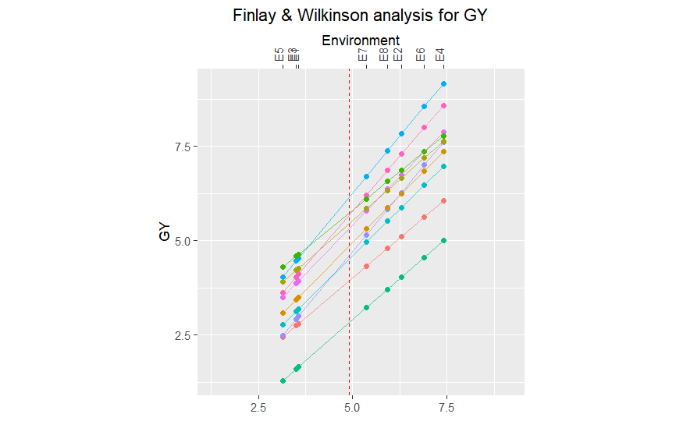
Visualization & Interpretation

Slide 24
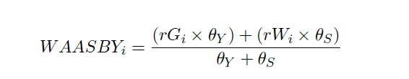
Multi-trait stability index (MTSI)
Helps plant breeders in their selection for multi traits at the same time, identifying the most stable ones according different environments.
Step 1:
Fit the MTSI mixed model
Step 2: Obtaining the indexes for all the traits (individually)
(rGi x θy) + (rWi x θs):
rGi: The correlation between the individual's genetic value and the mean phenotypic value.
θy: The weight assigned to the mean phenotypic value.
rWi: The correlation between the individual's environmental value and the mean environmental value.
θs: The weight assigned to the mean environmental value.
θy + θs:
The sum of the weights assigned to the mean phenotypic and environmental values.
Step 3:
Obtaining the MTSI values
Step 4:
Plotting the results and finding the most stable according the MTSI values

Slide 25
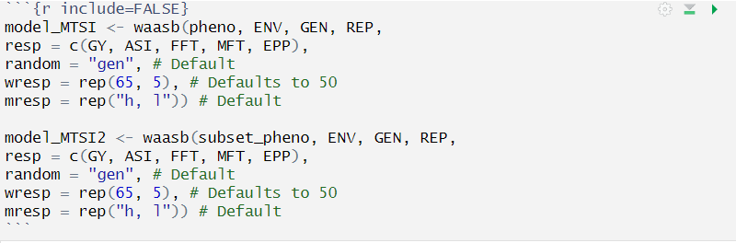
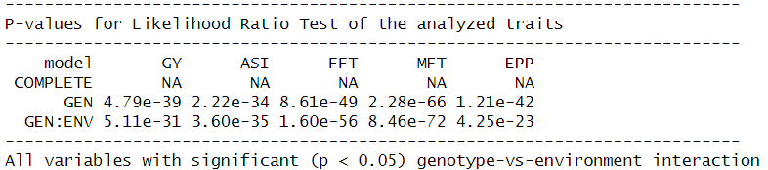
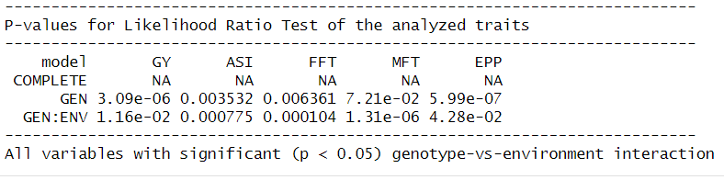
Step 1:
Fit the MTSI mixed model
Model: subset_pheno

Slide 26
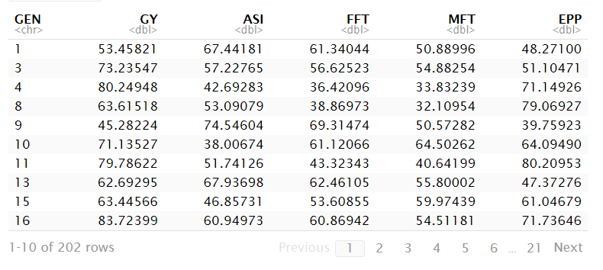
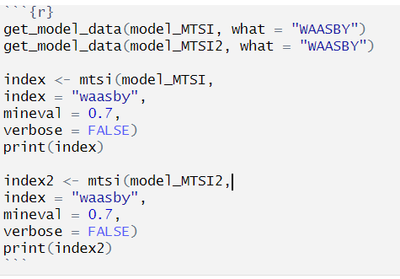
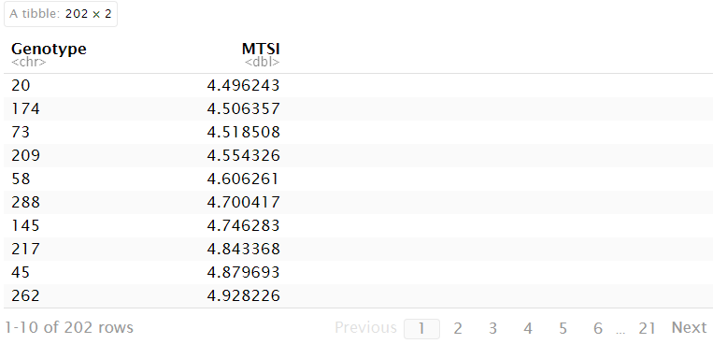
Step 2 & 3:
Obtaining the indexes

Slide 27
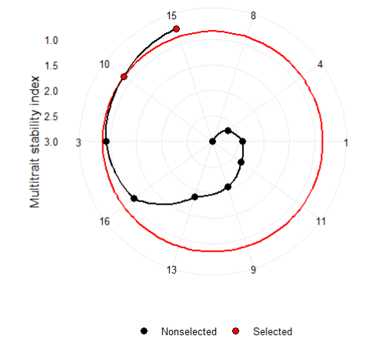
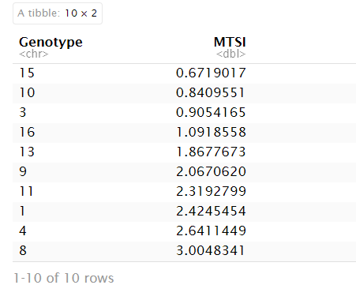

Step 4:
Plotting
Note: We have used the subset of the data for easy and more clear visualization of the MTSI plot

Slide 28

Genomic Selection (GS)
Plant breeders usually evaluate multi traits in multi-environments. In this step, we are exploring the BMTME R package for analyzing breeding data with multiple traits and multiple environments and trying to do some predictions.
Step 1:
Load the data and order the dataset
Step 5:
Observed and predicted values
Y: n x L, with L the number of traits and n = J x I, where J denotes the number of lines and I the number of environments
X: n x I
β: I x L
Z1: n x J
b1: b1 is of order J x L and contains the genotype x trait interaction
Z2: Z2 is of order n x IJ
in the model.
b2: IJ x L and contains the genotype x environment x trait interaction
Step 2: Design of matrices
Step 6: Cross validation strategy
Step 3:
Fitting the model
Step 7:
Average predictions
Step 4:
Extracting covariance between traits (+residual) and covariance between environments

Slide 29
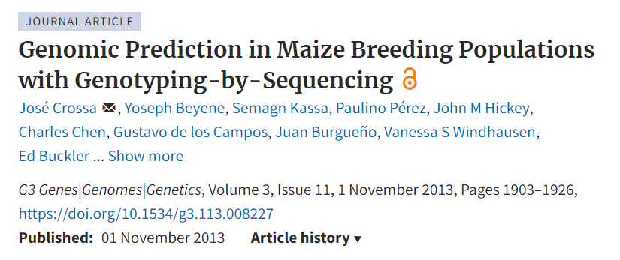
Dataset 2
309 corn hybrids
Yield
PH (plant height)
ASI (anthesis-silking time)
3 environments
(3 reps by E)

Slide 30
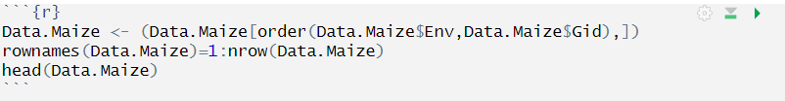
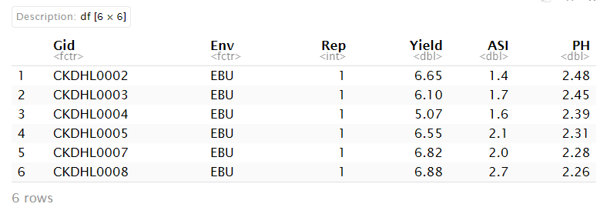
Step 1:
Load the data and order the dataset

Slide 31


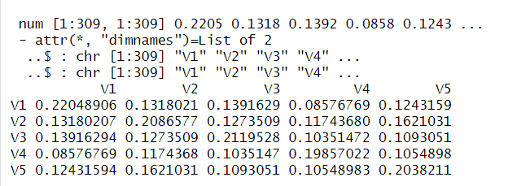
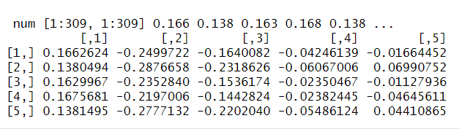
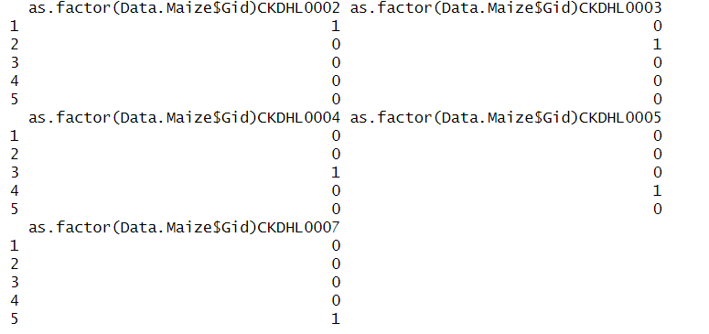
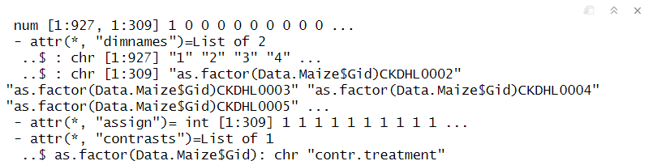
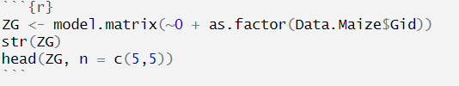
Step 2:
Note: The Cholesky factorization, is a process of breaking down of a Hermitian, positive-definite matrix into the product of a lower triangular matrix and its conjugate transpose, which is important for quick numerical solutions in linear algebra.
Design of matrices
Note: This is already the G matrix (kinship matrix)

Slide 32
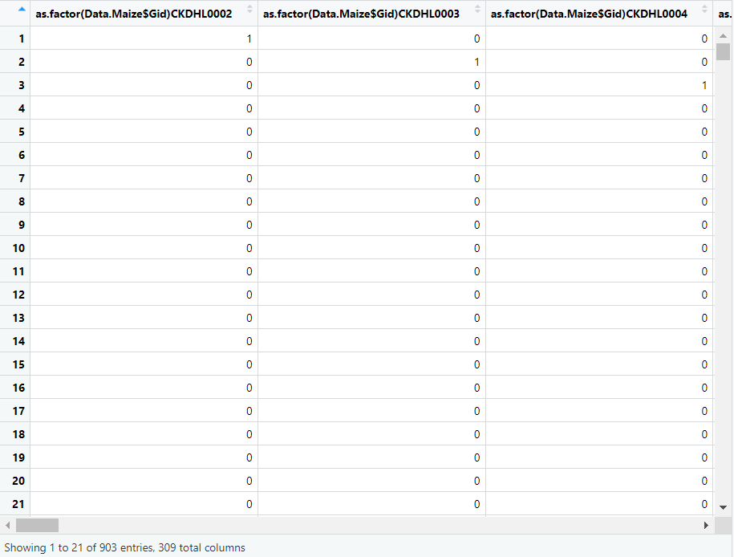
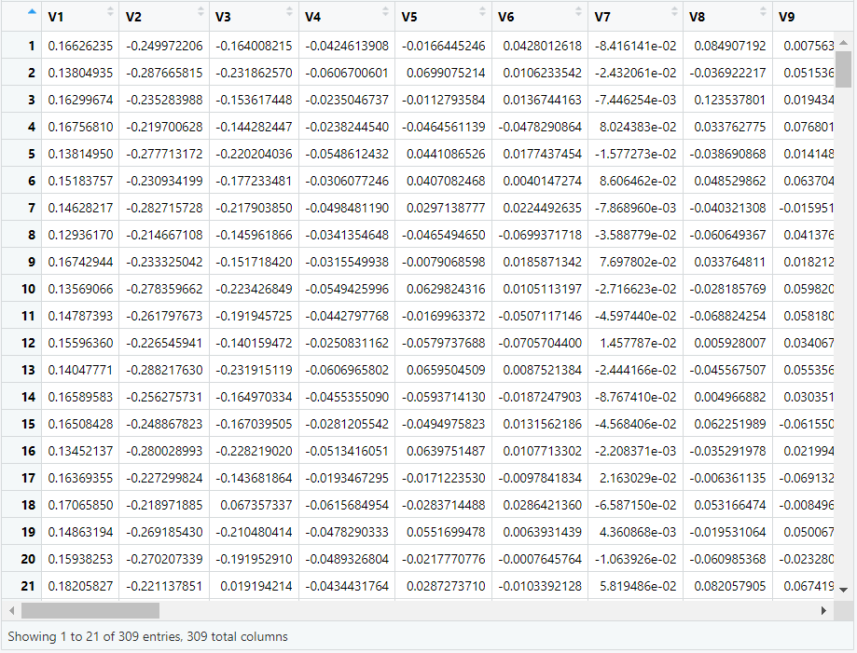

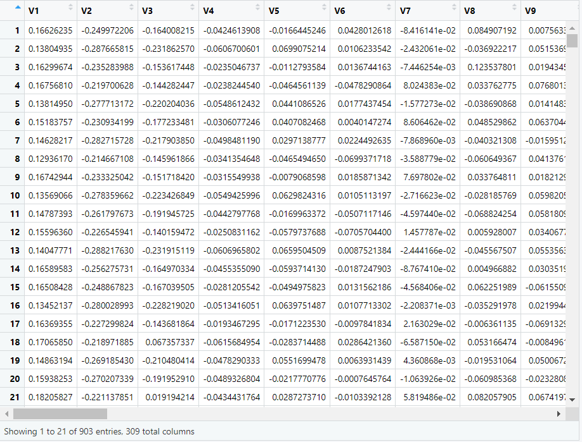
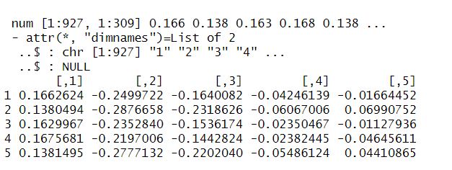
ZG
LG
Step 2:
Design of matrices
%*%
Note: Z.G is basically a LG multiplied by 3. Why? 3 environments
Z.G

Slide 33

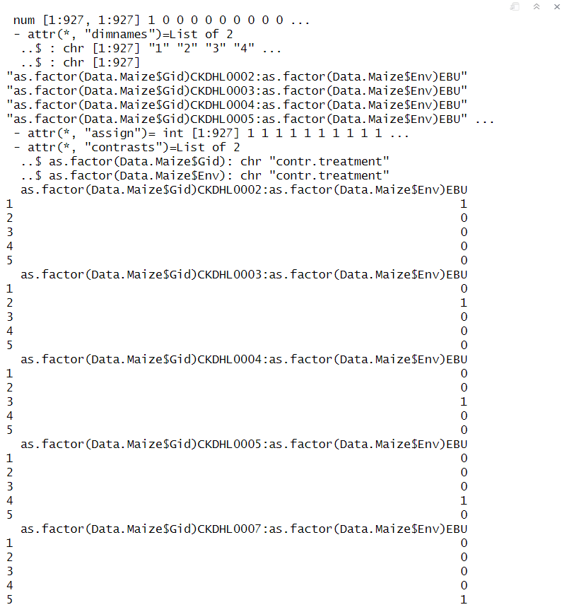
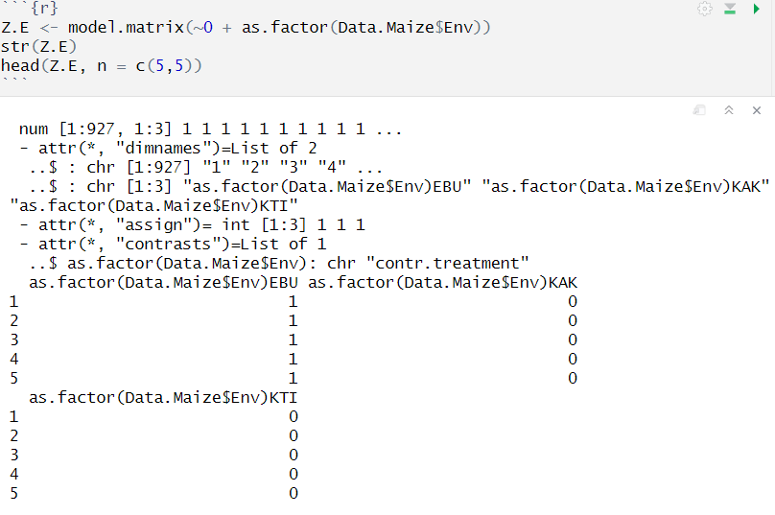
Step 2:
Design of matrices
Note: ZEG is basically is combining basically all the hybrids and environments.
(genotype x environment interaction matrix)
Note: The purpose of this matrix is very similar to the Z.G, but here is to code the hybrids observation to a respective environment.

Slide 34
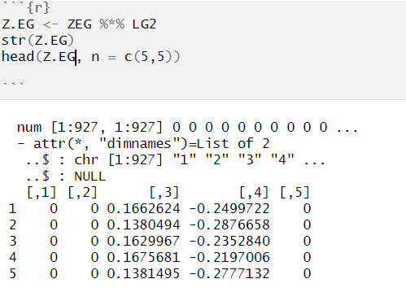
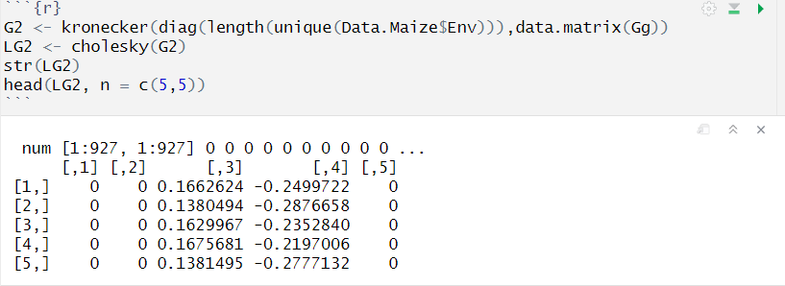
Step 2:
Design of matrices
Note: In summary, now we are creating a multi-environment genomic relationship
Note: We are transforming the genotype-environment interaction matrix according to the multi-environment genomic relationships.

Slide 35
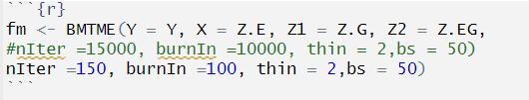
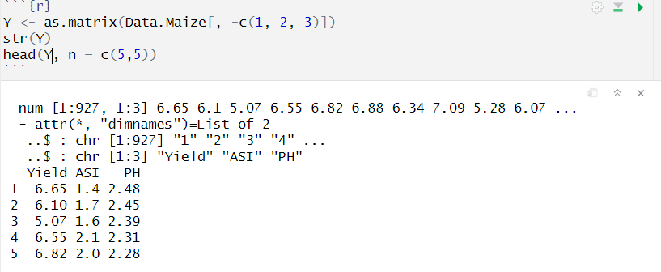
Step 3:
Fit the model
Model interpretation:
Y = Phenotypic trait data for each genotype-environment combination.
X (Z.E) = Environment effects in the model
Z1 (Z.G.) = Genetic effects, combining genotype information with genetic relationships
Z2 (Z.EG) = Genotype-by-environment (GxE) interaction effects
nIter = Total number of Markov Chain Monte Carlo iterations for sampling posterior distribution. High number is required to ensure model convergence
burnIn = Number of initial iterations that will be discarded (chain stabilization and avoiding bias)
Thin = Determines that every second iteration will be kept (others discarded). Thinning reduces autocorrelation in the samples.
bs = Number of posterior samples to save.
Note: Because we change so much our genotypic matrix and created new ones to account for GxE interaction, we need to fix our phenotype.
*Note: Markov Chain Monte Carlo parameters (MCMC) = Control the computational aspects of the Bayesian sampling

Slide 36
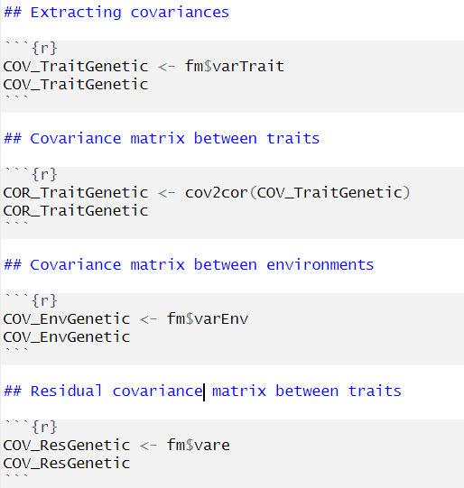
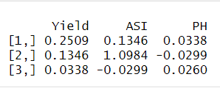
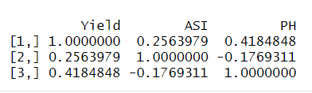
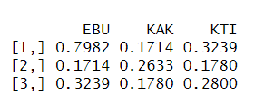
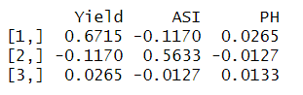
Step 4:
Extracting covariance between traits (+residual) and covariance between environments

Slide 37



Step 5 & 6:
Observed and predicted values and cross validation strategy
Model interpretation:
Like our first model built (fm), however, now we are adding a testingSet = CrossV. This is our Cross-validation scheme being account in the moment to build the new model. The package support different CrossV (LOOCV, training in a set of environments and testing in another subset, etc.). For practical purposes, we are showing the 5-fold.
Note: Here we are not doing any prediction, just looking (correlation) between predicted and observed. However, in GS, we want to do predictions, so we need some CV strategies to check if our model is reliable!

Slide 38



Step 7:
Average predictions

Slide 39
Take home message
Phenotypes are made by genotype, environment, and the genotype x environment interaction. It means that the same individual in different environments can look completely different! Therefore, MET analyses are fundamental in the biological areas, mainly in plant breeding.
By using tools like GGE, AMMI, FW, and other stability analysis (MTSI etc), researchers and breeders can better understand the complex interaction between genotypes and environments.
The main aspects that we can take from the MET analysis are identify stable genotypes, make informed breeding decisions for consistent yield, performance under diverse conditions etc.
Genomic selection in environmental trials (and exploring this type of information) is a powerful tool that enhances the ability to select elite genotypes.

Slide 40
References
Crossa, J., Y. Beyene, S. Kassa, P. Pérez-Rodríguez, J. M. Hickey, et al., 2013 Genomic prediction in maize breeding populations with genotyping-by-sequencing. G3: Genes|Genomes|Genetics (Bethesda) 3, 1903–1926. https://doi.org/10.1534/g3.113.008227
Dias, K.O.D.G., Gezan, S.A., Guimarães, C.T. et al. Improving accuracies of genomic predictions for drought tolerance in maize by joint modeling of additive and dominance effects in multi-environment trials. Heredity 121, 24–37 (2018). https://doi.org/10.1038/s41437-018-0053-6
Montesinos-López, O. A., A. Montesinos-López, J. Crossa, F. Toledo, O. Pérez-Hernández et al., 2016 A Genomic Bayesian Multi-trait and Multi-environment model. G3: Genes|Genomes|Genetics (Bethesda),6:2725–2744. https://doi.org/10.1534/g3.116.032359
Montesinos-López, O. A., A. Montesinos-López, J. Crossa, J. C. Montesinos-López, F. J. Luna-Vázquez et al., 2017 A Variational Bayes Genomic-Enabled Prediction Method with Genotype · Environment Interaction. G3: Genes, Genomes. Genetics 7: 1833–1853
Osval A Montesinos-López, Abelardo Montesinos-López, Francisco Javier Luna-Vázquez, Fernando H Toledo, Paulino Pérez-Rodríguez, Morten Lillemo, José Crossa, An R Package for Bayesian Analysis of Multi-environment and Multi-trait Multi-environment Data for Genome-Based Prediction, G3 Genes|Genomes|Genetics, Volume 9, Issue 5, 1 May 2019, Pages 1355–1369, https://doi.org/10.1534/g3.119.400126
Olivoto T, Lúcio AD. metan: An R package for multi-environment trial analysis. Methods Ecol Evol. 2020; 11: 783–789. https://doi.org/10.1111/2041-210X.13384*

